Slide 1
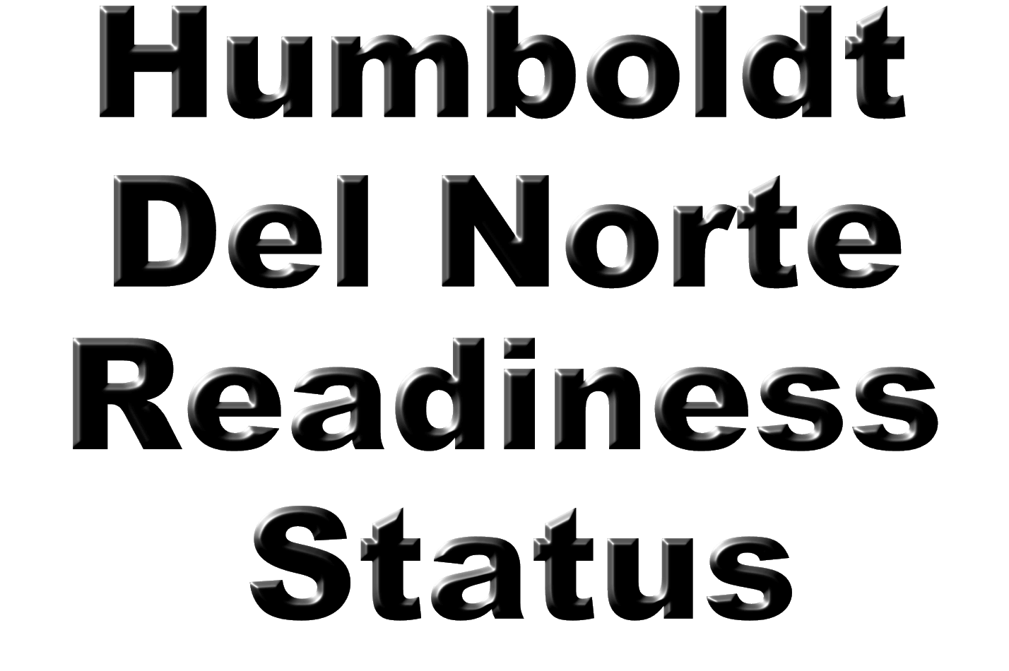

Slide 2




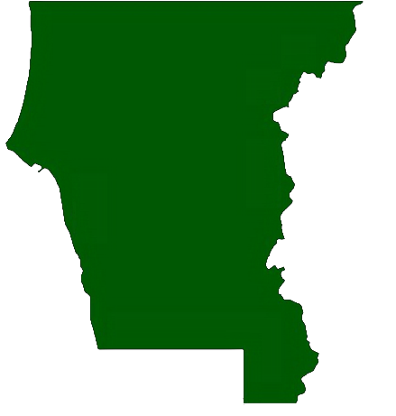
2000 Square Miles
45 Miles of Coast Line
Population 27,482
Tourism based Economy

Slide 3

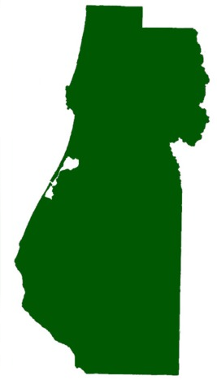

3573 Square Miles
110 Miles of Coast Line
Population 129,000
Tourism, Lumber, and Fishing based Economy

Slide 4
Del Norte Preparation Prior to June 14th
Installed second Tsunami Warning siren
Assisted Crescent City in Gaining Tsunami Ready Status
Tsunami Information page in the local phone book
Hotel / Motel Tsunami Page
RV Park Tsunami Information Flyer
How to Survive a Tsunami in Crescent City flyer
Tsunami Preparation Presentation for Local Schools and Community Groups
Tsunami & Earthquake Information Booth at the Del Norte County Fair

Slide 5
Humboldt Preparation Prior to June 14th
How to Survive a Tsunami in Humboldt County flyer
Tsunami Preparation Presentation for Local Schools and Community Groups
Tsunami & Earthquake Information Booth at the Humboldt County Fair
Tsunami Contingency Plan / Coordination

Slide 6
Del Norte June 14th What Happened
A local Earthquake is felt by Del Norte County Residents
Numerous Businesses and private citizens begin self evacuation
Tsunami Siren / Evacuation started based on NOAA tsunami Warning
Both Wireless and land line Phone systems become overloaded
Partial EAS system failure
No ability to communicate with local Radio / Media
Self Evacuation far exceeded the immediate needs of the public
An “All Clear” was issued over a local radio station by Non County Personnel

Slide 7
Humboldt June 14th What Happened
A local Earthquake is felt by Del Norte County Residents
Numerous Businesses and private citizens begin self evacuation
EAS activated within 10 minutes of event
Level 1 EOC activated within 10 minutes of event and operating with two plus persons within 20 minutes of event
Both Wireless and land line Phone systems become overloaded
Partial EAS system failure
Observers dispatched to ocean overlooks within 25 minutes of event
Active planning measures with local NWS office to cancel TWB once verification received from WCATWC
All Clear issued by County EOC and broadcast by EAS within minutes of WCATWC cancellation notice

Slide 8
Del Norte Future Needs / Plans
Continue public Tsunami preparation presentations
Coordinate with local Camber of Commerce to increase presence of Tsunami Flyers
Purchase and install 7 additional sirens and install evacuation route signs
Create and install public information kiosks at beach access points
Create a comprehensive public awareness campaign
Coordinate Tsunami efforts with all local agencies (State, Federal, County…)
Gain Tsunami Ready status for Del Norte County

Slide 9
Humboldt Future Needs / Plans
Continue public Tsunami preparation presentations
Coordinate with local Camber of Commerce to increase presence of Tsunami Flyers
Create and install public information kiosks at beach access points
Create a comprehensive public awareness campaign
Coordinate Tsunami efforts with all local agencies (State, Federal, County…)

