Slide 1
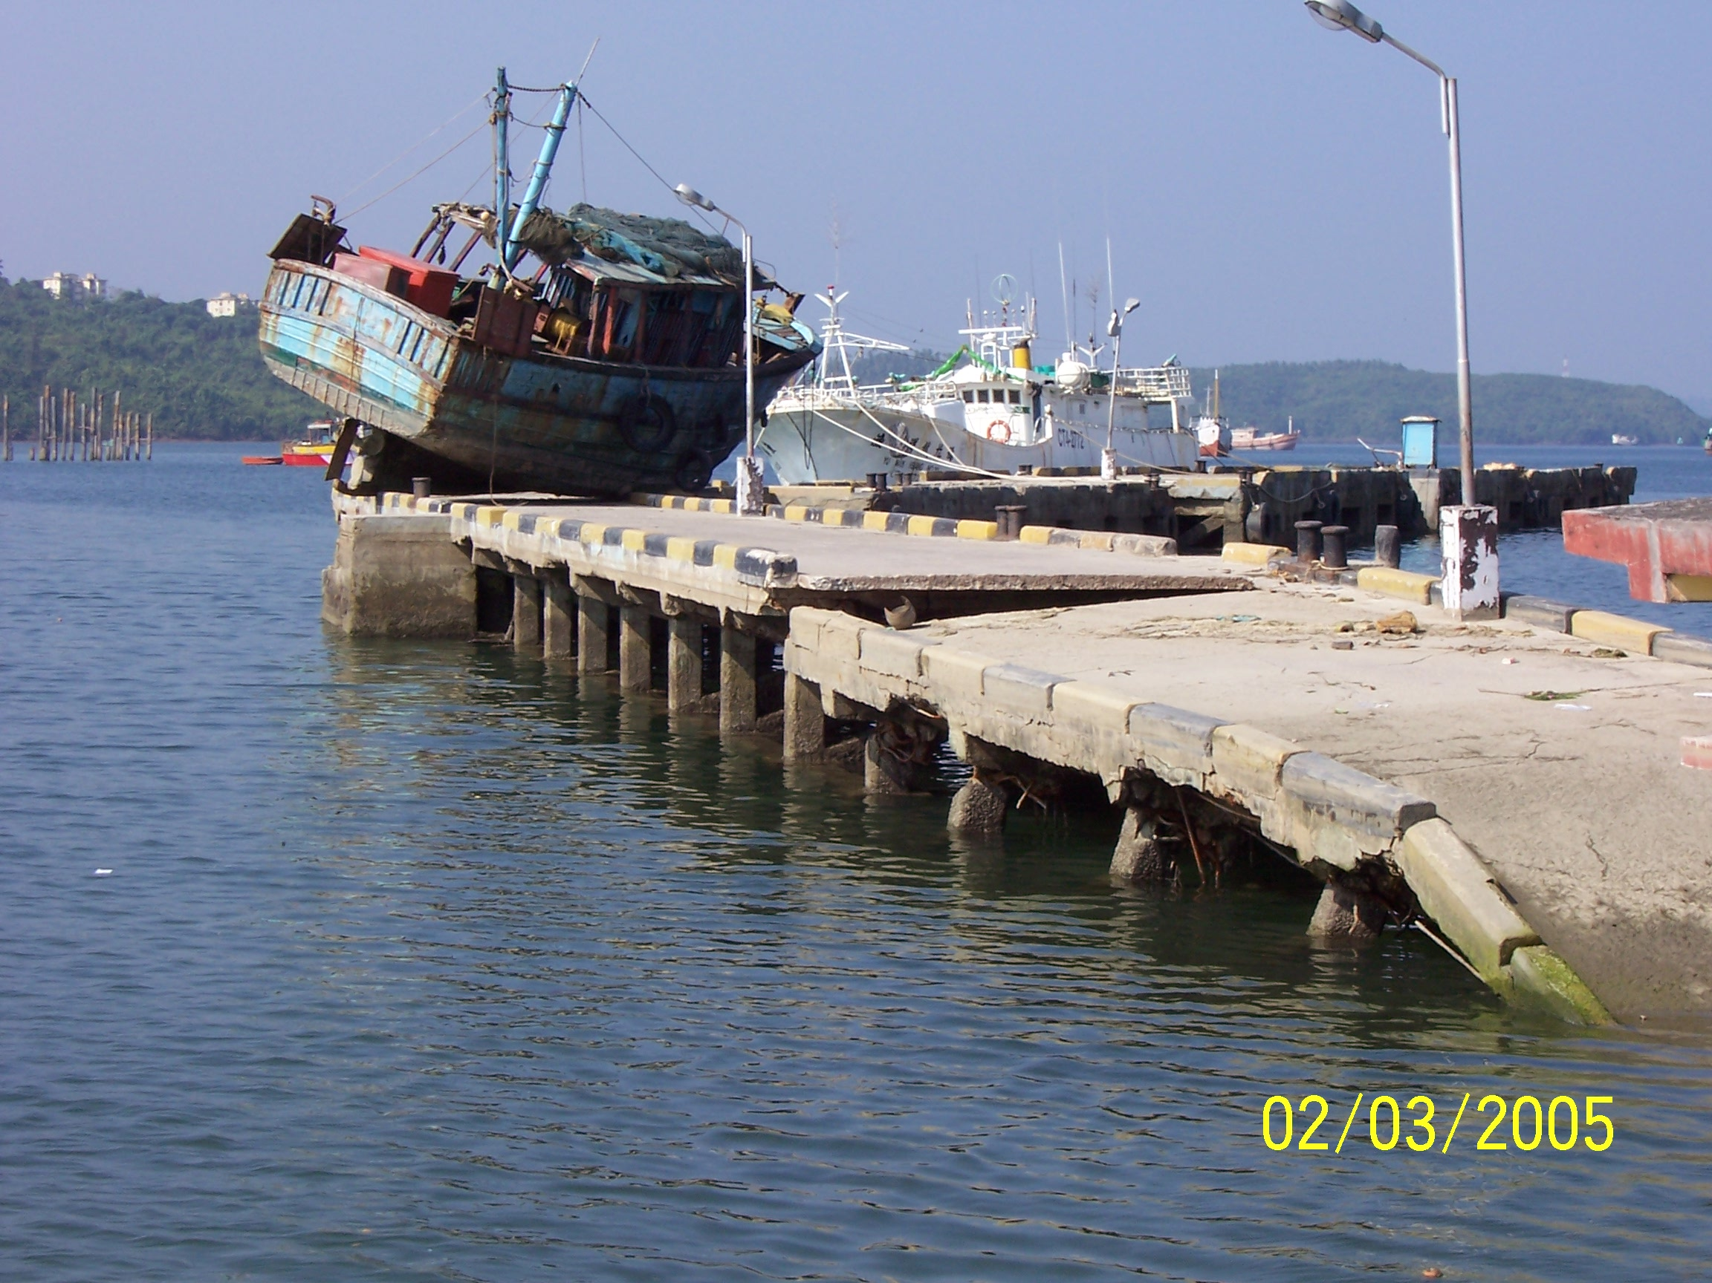
MOTEMS
Marine Oil Terminal Engineering and Maintenance Standards
California Seismic Safety Commission
Martin Eskijian, P.E.
Supervisor, Engineering Branch
Marine Facilities Division
California State Lands Commission
March 2005

Slide 2
MARINE OIL TERMINAL ENGINEERING AND MAINTENANCE STANDARDS (MOTEMS)
MANDATED:
LEMPERT-KEENE-SEASTRAND OIL SPILL PREVENTION AND RESPONSE ACT OF 1990
CURRENT CONDITIONS OF 39 TERMINALS:
Grandfathering – vessel size
Structural degradation
Inadequate fire detection/suppression
Build dates 1901 to 1984 (Average age is 50)
Seismic standards (Were there any?)

Slide 3
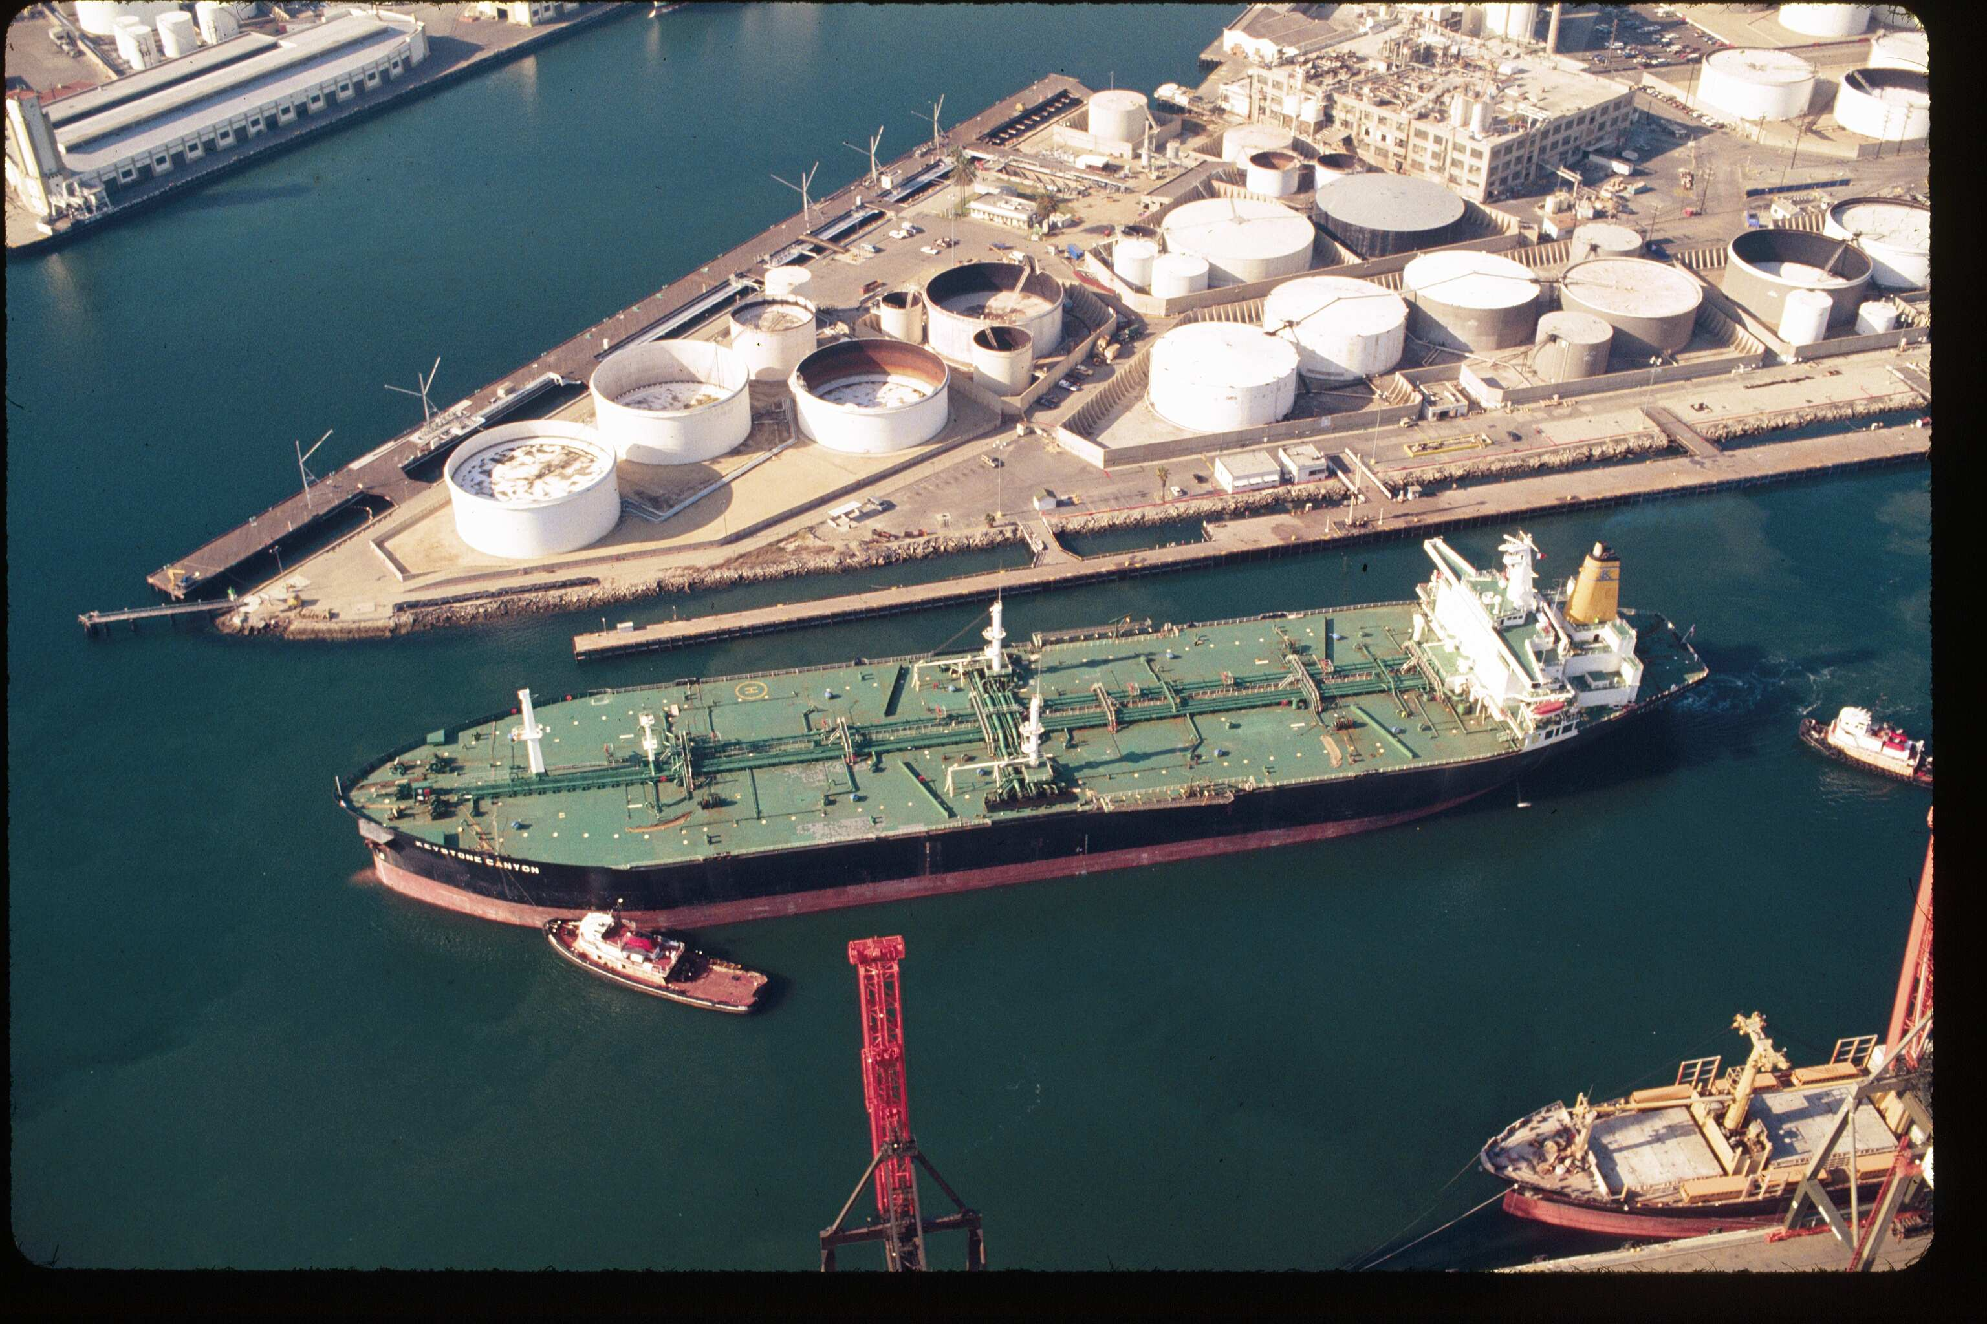
Examples of Current Practice
Large Tanker Berthing at an Old, Deteriorated Timber Wharf
Notes:
Large tank vessel, being moored to a very undersized, geriatric timber wharf.

Slide 4
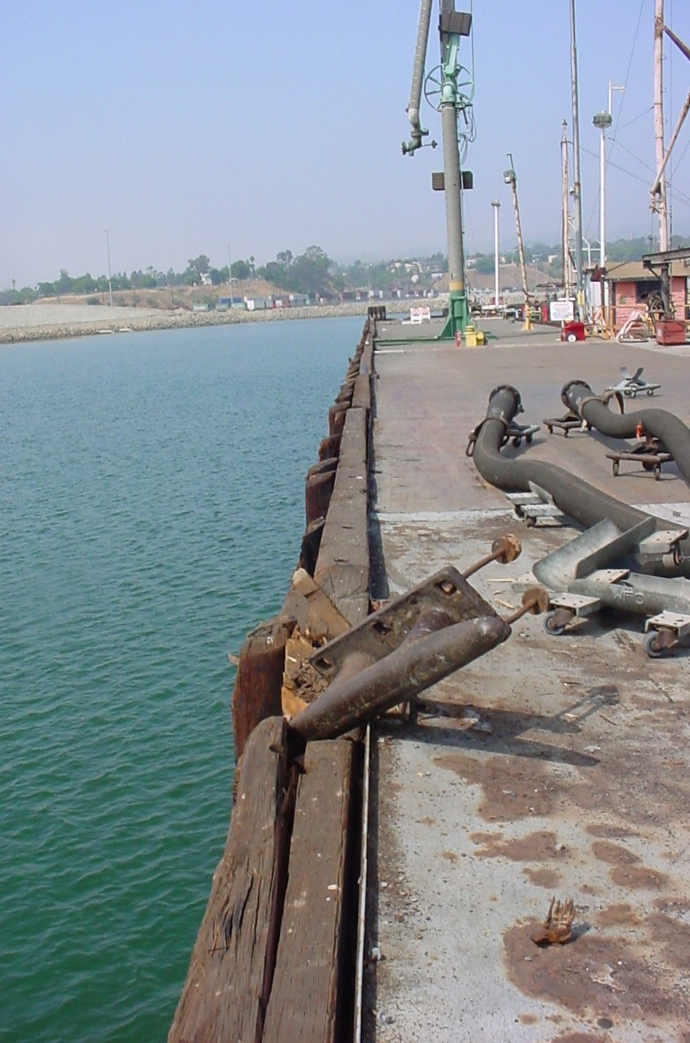
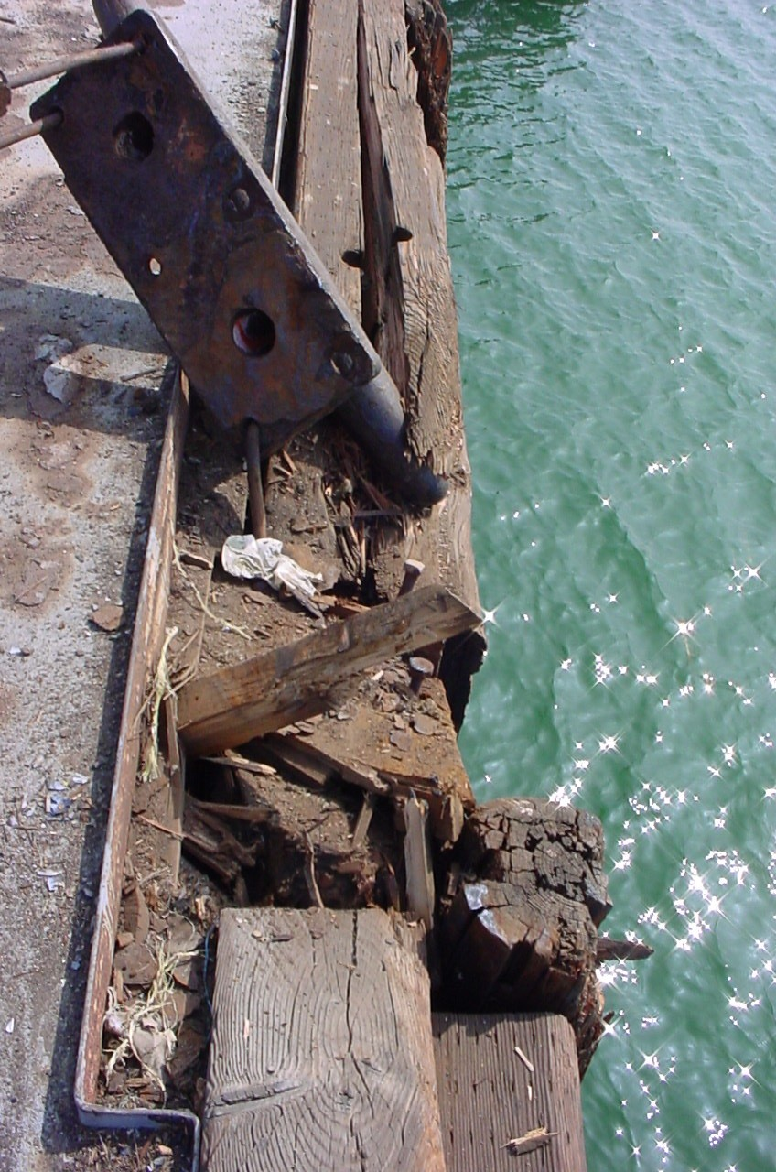
What Can Happen?
Port of Los Angeles, June 2004

Slide 5
MOTEMS REGULATORY PROCESS
APPROVAL OBTAINED BY THE STATE LANDS COMMISSION – AUGUST 17, 2004
ADOPTION OBTAINED BY THE CALIFORNIA BUILDING STANDARDS COMMISSION, JANUARY 19, 2005
PUBLISHED - CALIFORNIA BUILDING STANDARDS CODE (TITLE 24, PART 2, VOL 1, CHAPTER 31F)
IN PRINT, APRIL OR MAY 2005, EFFECTIVE 6 MONTHS LATER.
Notes:
The cost to rehabilitate was based on one terminal, possible rehab costs could reach $10M, but could be spread out over a number of years. Note that the benefit could be up to $1024 million.

Slide 6
MOTEMS Scope of the Standards
Audit and Inspection Criteria
Structural Loading Criteria
Seismic Analysis and Design Criteria
Mooring and Berthing Analysis and Design Criteria
Geotechnical Hazards Criteria
Structural Analysis and Design of Components
Piping and Pipeline Criteria
Mechanical, Fire and Electrical Criteria
Notes:
Overview of the 11 sections of the MOTEMS.

Slide 7
MOTEMS SEISMIC/TSUNAMI HAZARD ASSESSMENT
Probabilistic Seismic Hazard Analysis (PSHA) for Southern California Coastal Facilities, J. Savy & W. Foxall, LLNL, 2002.
Tsunami assessment, based on PSHA – performed by Drs. Costas Synolakis and Jose Borrero, University of Southern California
TSUNAMI RUN-UP HEIGHTS (FT):
100 Yr. Return Period 500 Yr. Return Period
Ports of LA and LB 8 ft. 15 ft.
Notes:
Based on 41 terminals, this is a preliminary estimate of how many terminals fall into each category. If MOTEMS becomes regulatory in January 2004, the first audits wouldn’t be due until mid 2006.

Slide 8
MOTEMS SEISMIC/TSUNAMI HAZARD ASSESSMENT
Section 3103F.5.7 of the MOTEMS):
“A tsunami generated by a distant source may allow operators to have an adequate warning for mitigating the risk by departing the marine oil terminal and going into deep water. For near-field events, with sources less than 500 miles away, the vessel may not have adequate time to depart.”
Section 3103F.3.4
“Run-up and current velocity shall be considered in the tsunami assessment…”
Notes:
Based on 41 terminals, this is a preliminary estimate of how many terminals fall into each category. If MOTEMS becomes regulatory in January 2004, the first audits wouldn’t be due until mid 2006.

Slide 9
MOTEMS Seismic Performance Criteria
Performance Criteria:
Level 1 Earthquake: No or minor structural damage without interruption in service or with minor temporary interruption in service (72 Year Return Period).
Level 2 Earthquake: Controlled inelastic behavior with repairable damage resulting in temporary closure in service restorable within months. Prevention of major spill. Prevention of collapse (475 Year Return Period).

Slide 10
SUMATRA EARTHQUAKE/TSUNAMI OF DECEMBER 26, 2004
California Seismic Safety Commission
Martin Eskijian, P.E.
Supervisor, Engineering Branch
Marine Facilities Division
California State Lands Commission
March 2005

Slide 11
EARTHQUAKE & TSUNAMI INVESTIGATION TEAM INDIA
INVESTIGATE DAMAGE RESULTING FROM THE MAGNITUDE 9 SUMATRA EARTHQUAKE OF DECEMBER 26, 2004
AMERICAN SOCIETY OF CIVIL ENGINEERS
COPRI: SPONSORED (COASTS, OCEANS, PORTS AND RIVERS INSTITUTE)
TCLEE: CO-SPONSORED (TECHNICAL COUNCIL ON LIFELINE EARTHQUAKE ENGINEERING)

Slide 12
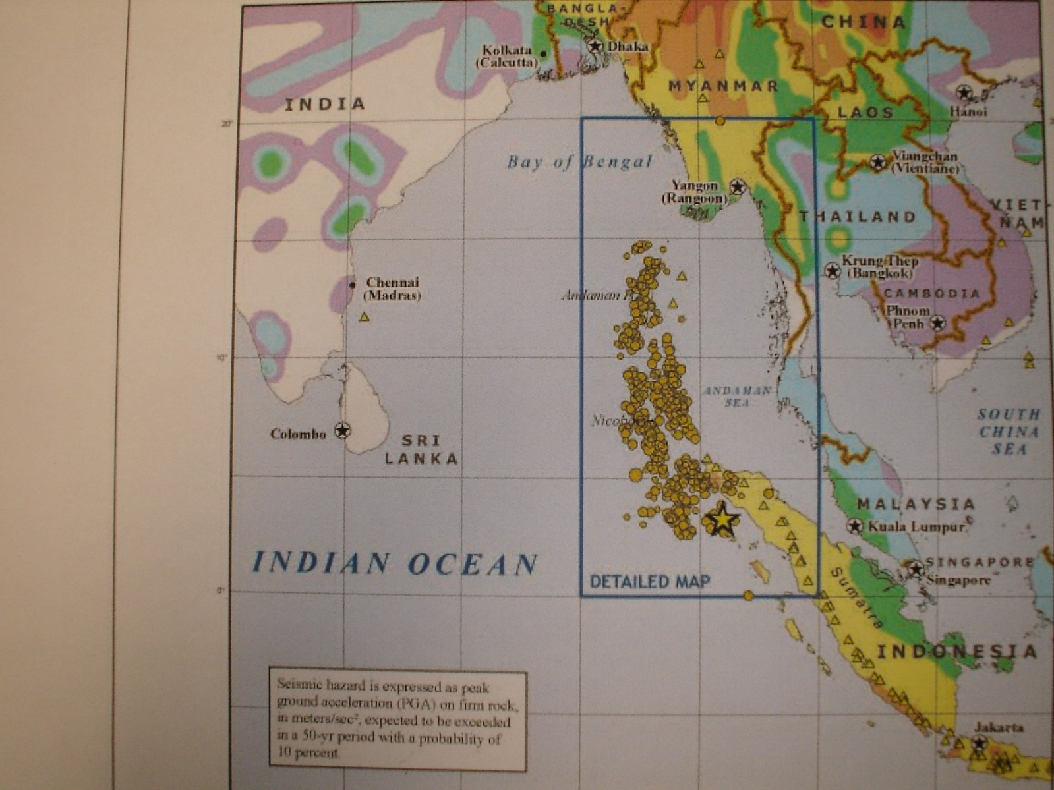
S. India and the Andaman Islands

Slide 13
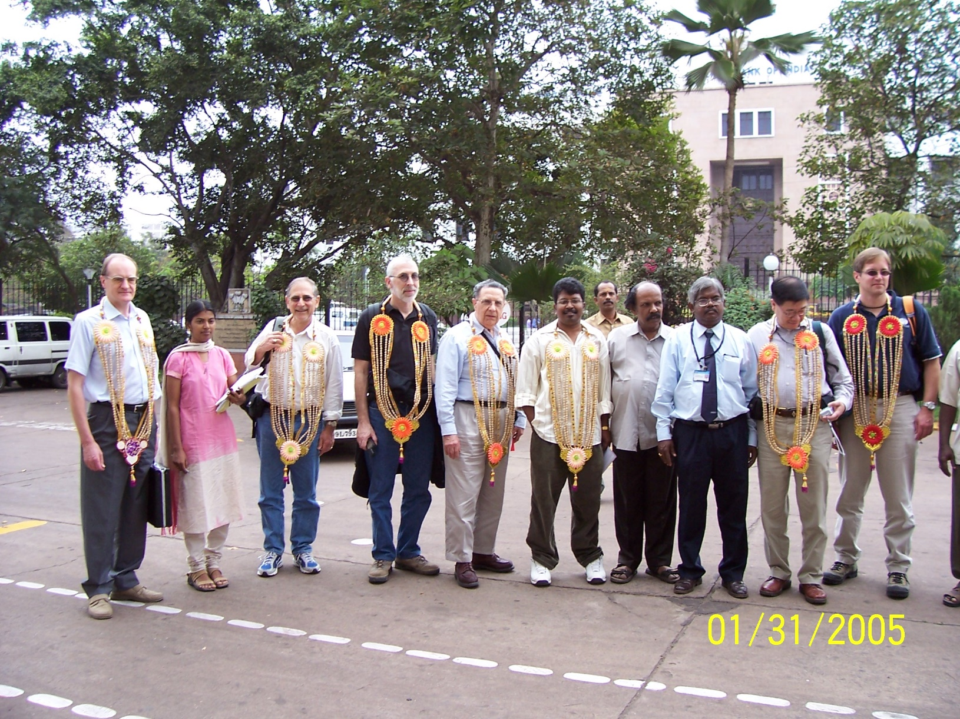
ASCE COPRI/TCLEE TEAM SOUTH INDIA - Port of Chennai

Slide 14
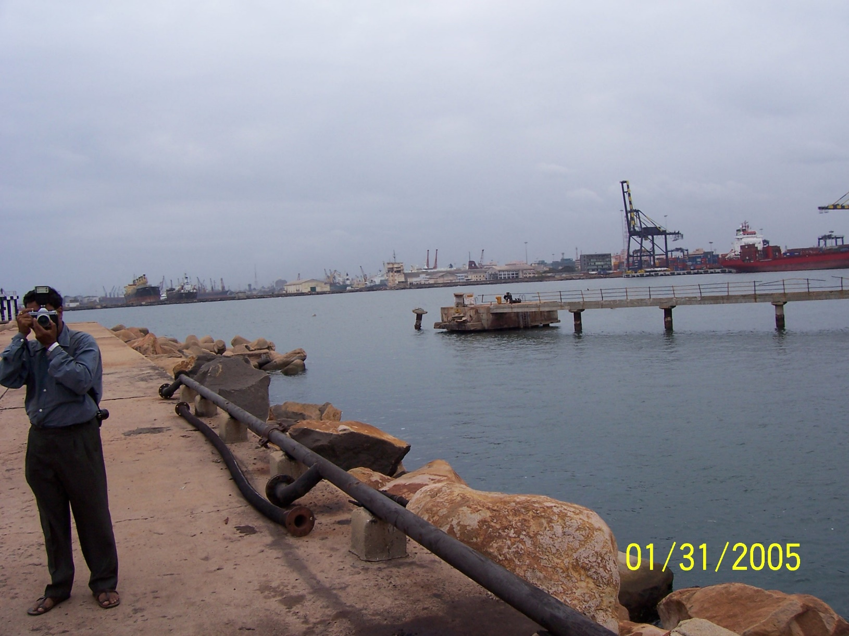
Port of Chennai – 2 Mooring Dolphins Missing

Slide 15
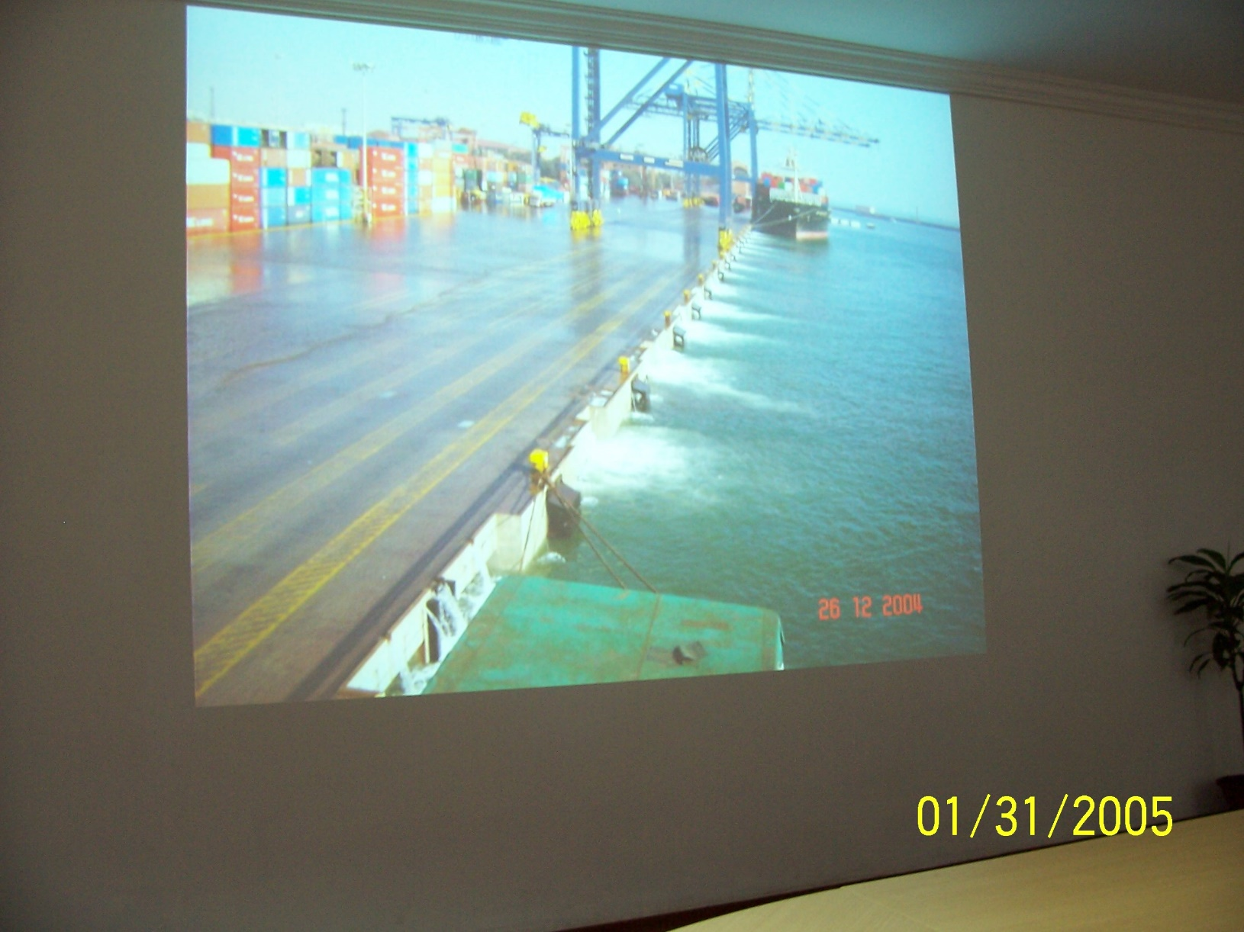
Container Wharf – Port of Chennai Ebb Current of Tsunami

Slide 16
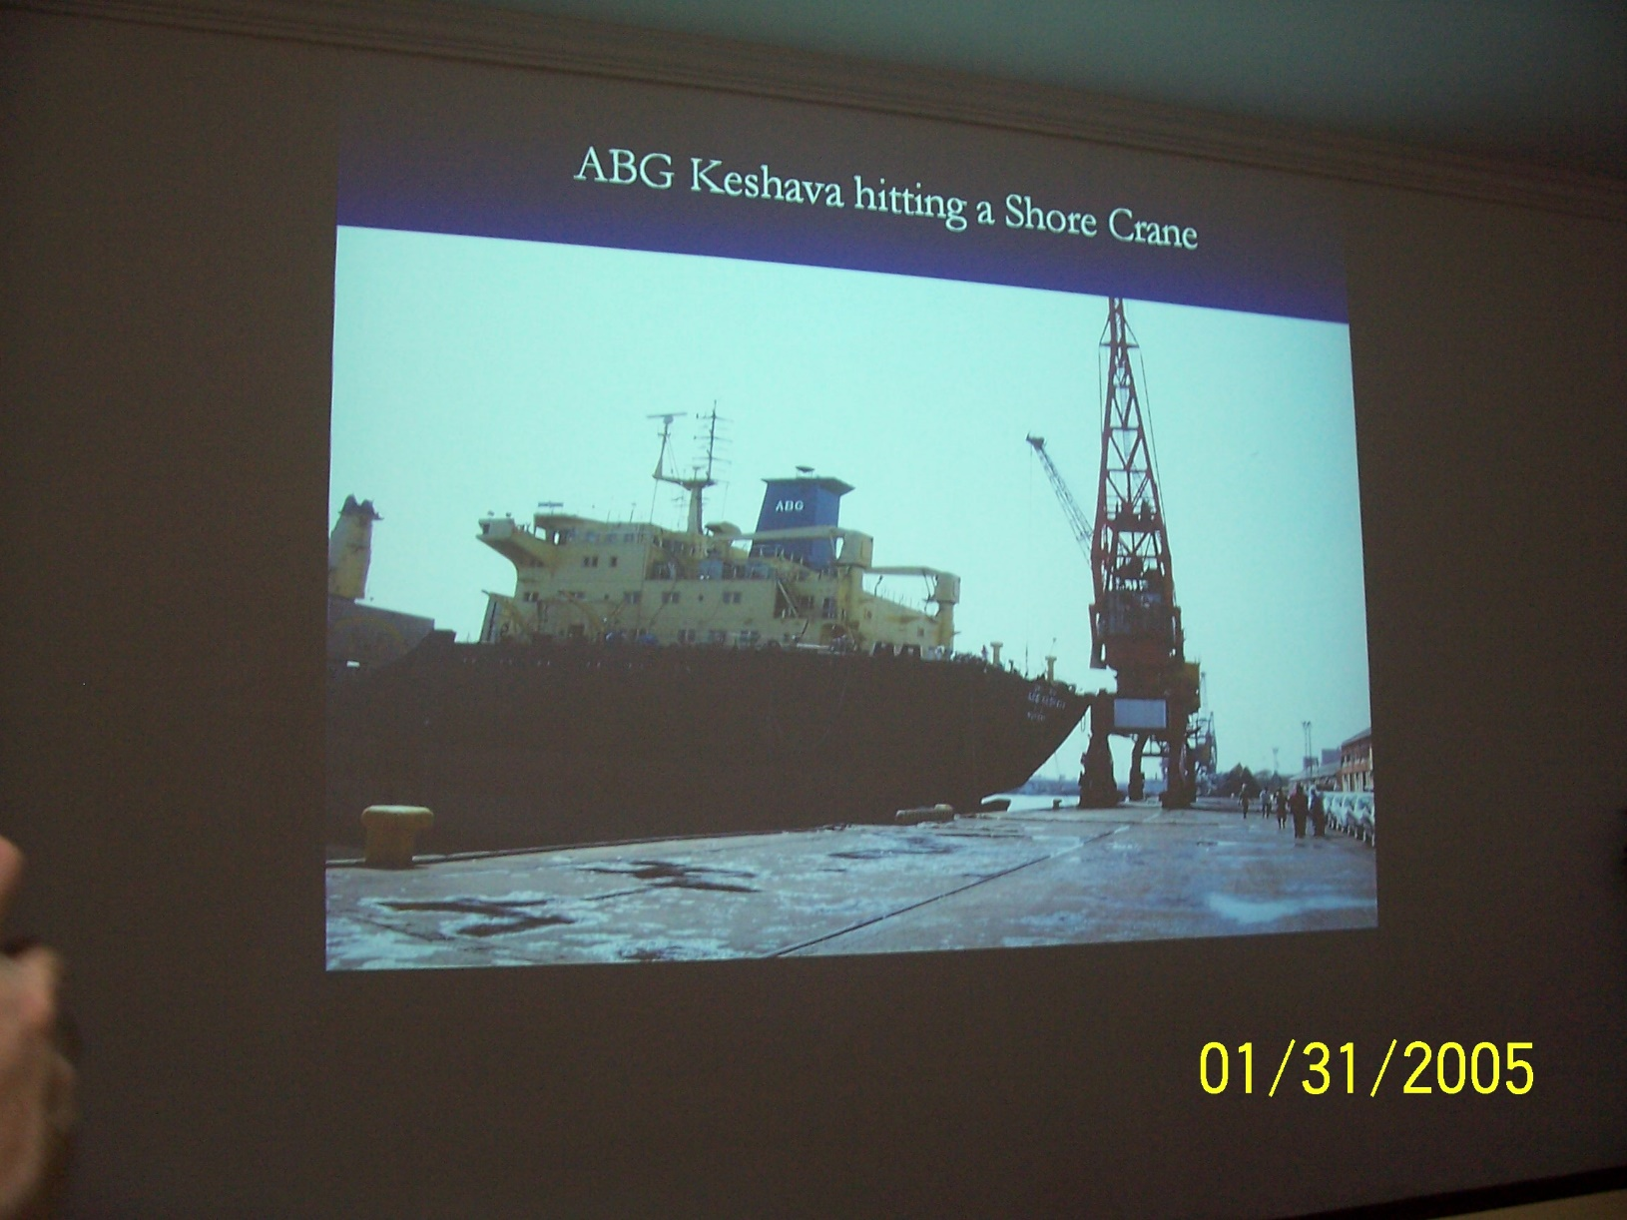
Vessel ABG Keshava Impacting Crane (Port of Chennai)

Slide 17
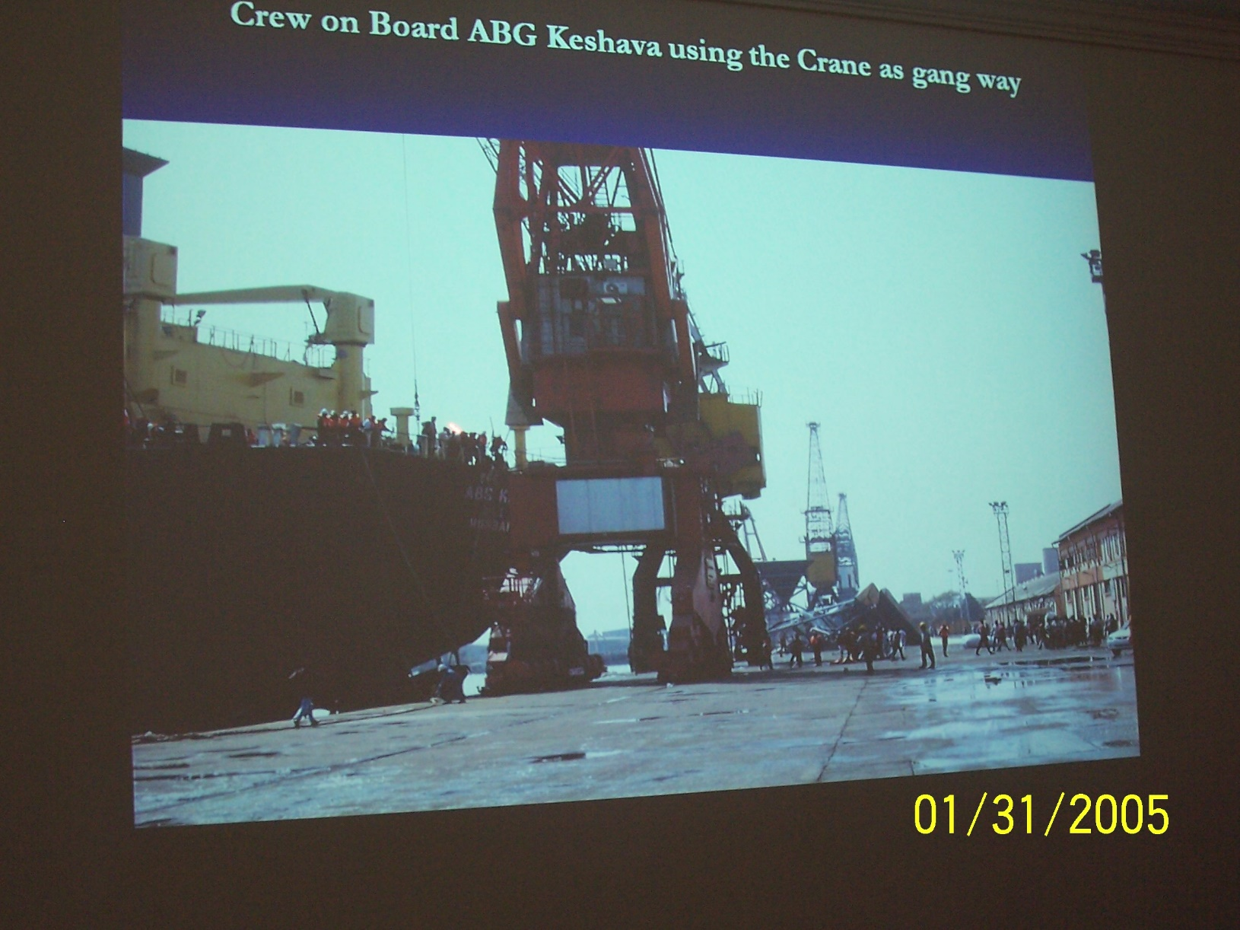
Crew Leaving Vessel – using Crane as a Gang Way (Port of Chennai)

Slide 18
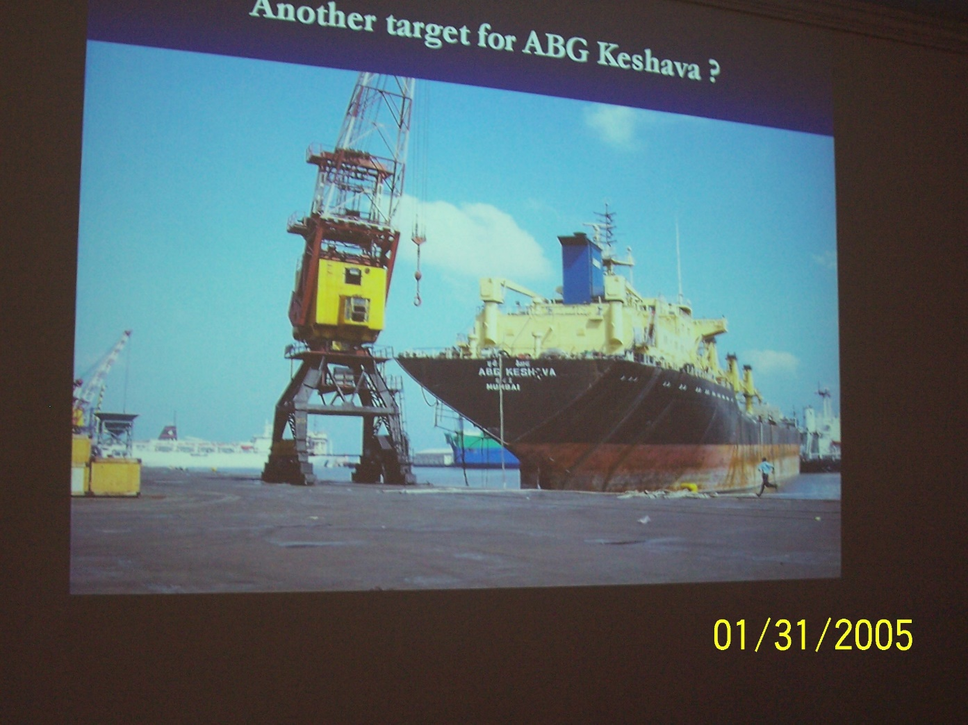
Vessel Impacting Wharf

Slide 19
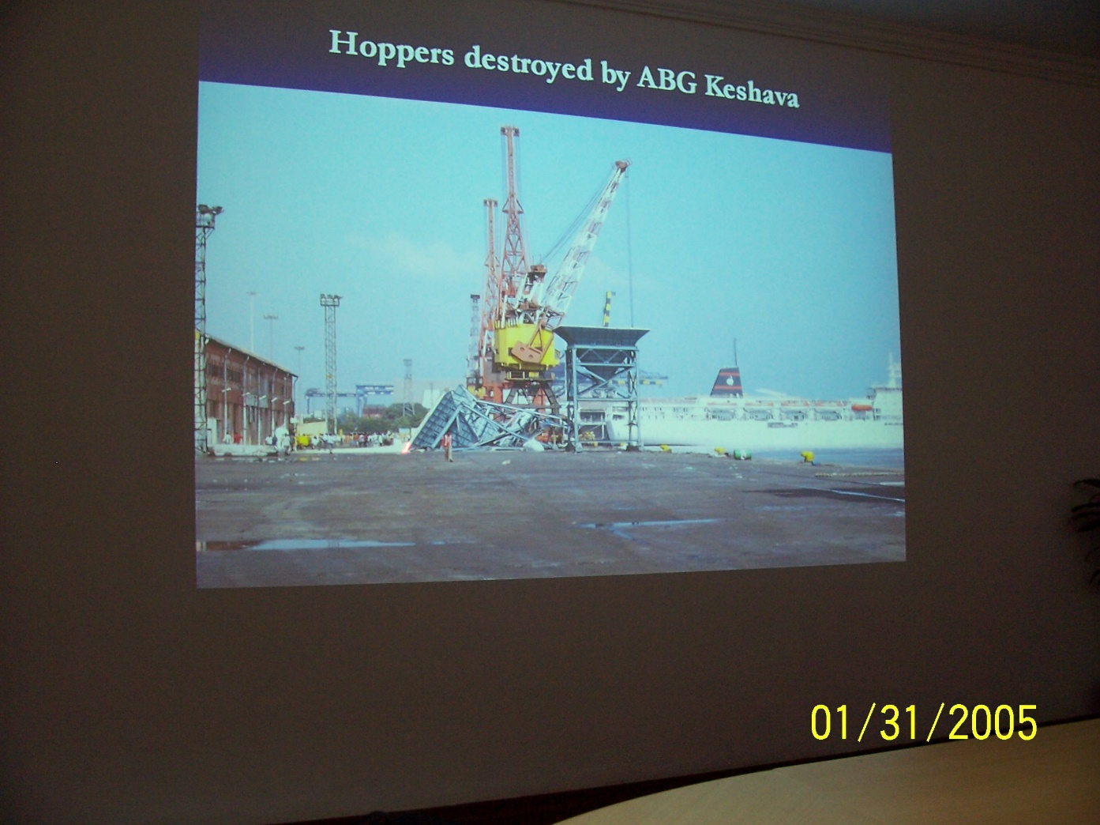
Vessel Impacting Hoppers on Wharf

Slide 20
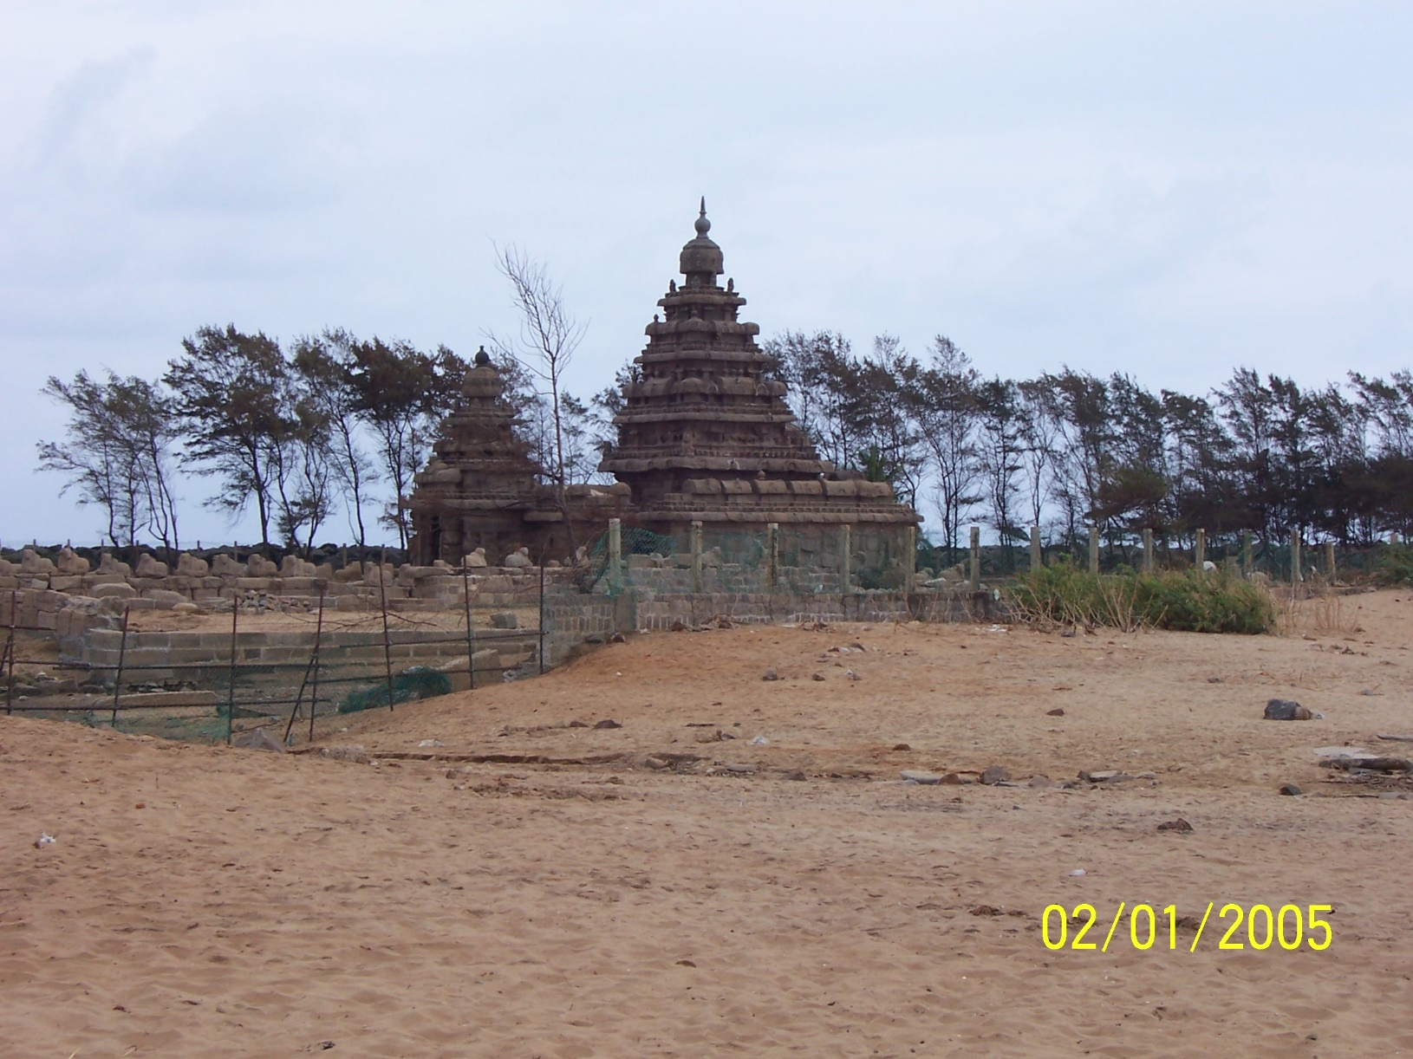
The Shore Temple at Mahabalipuram

Slide 21
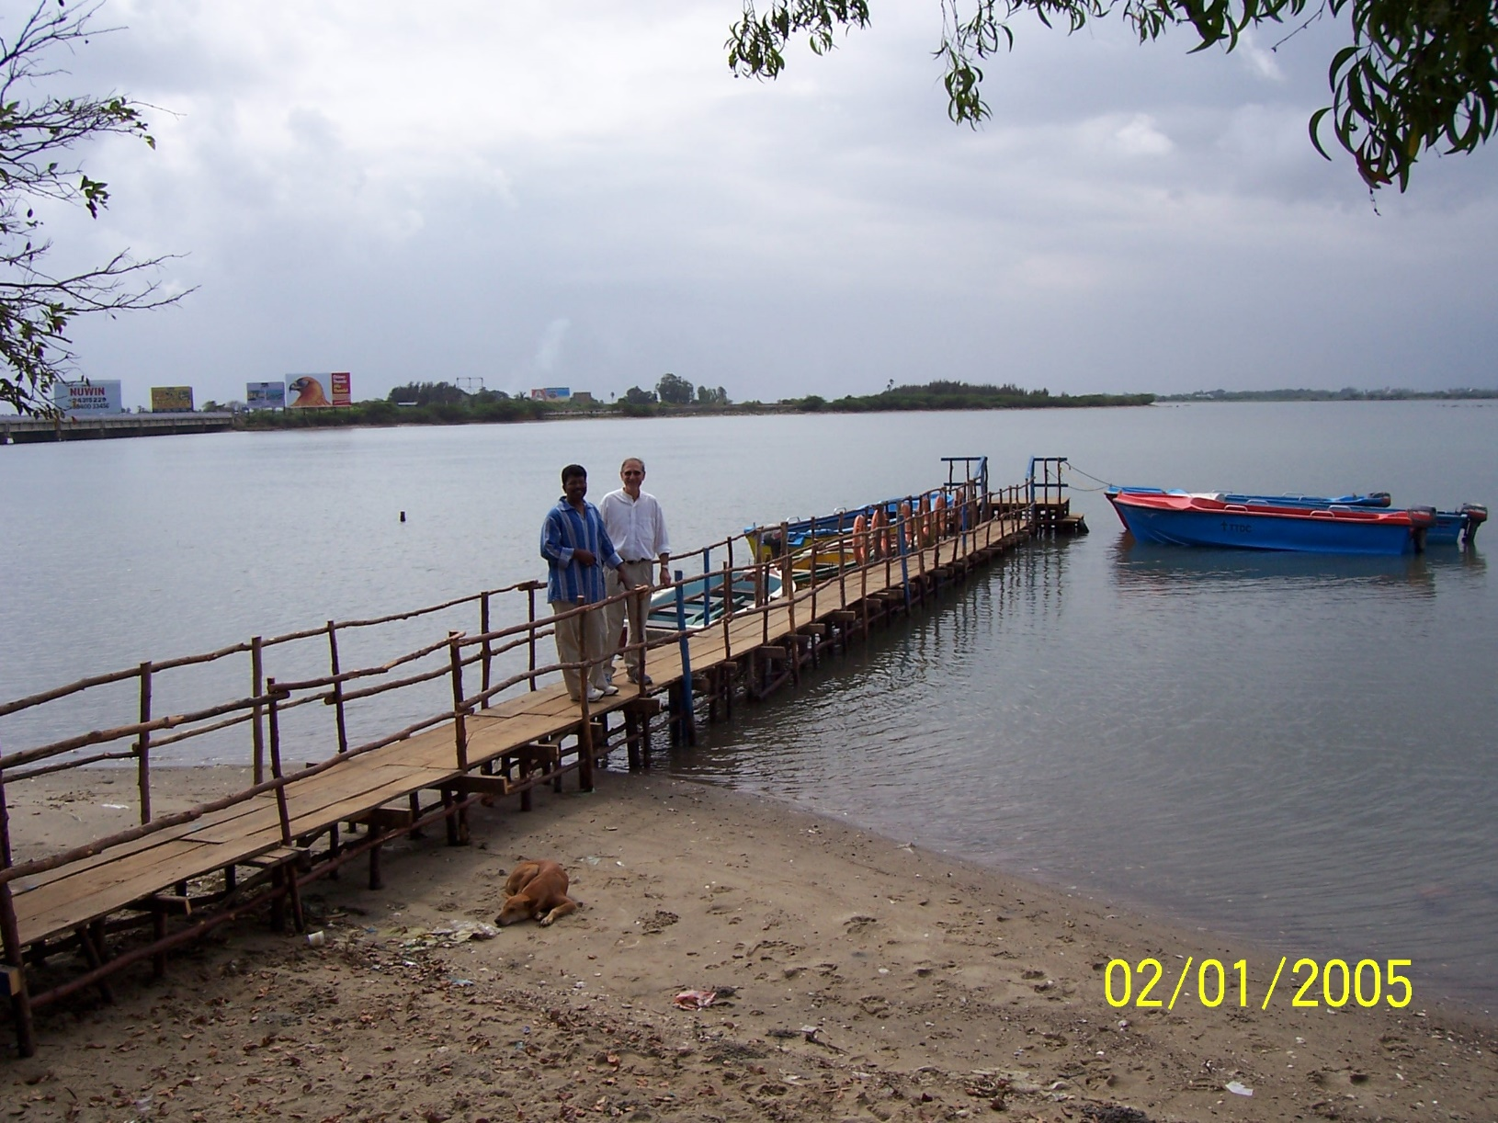
Small fishing/tourist pier (New Construction)

Slide 22
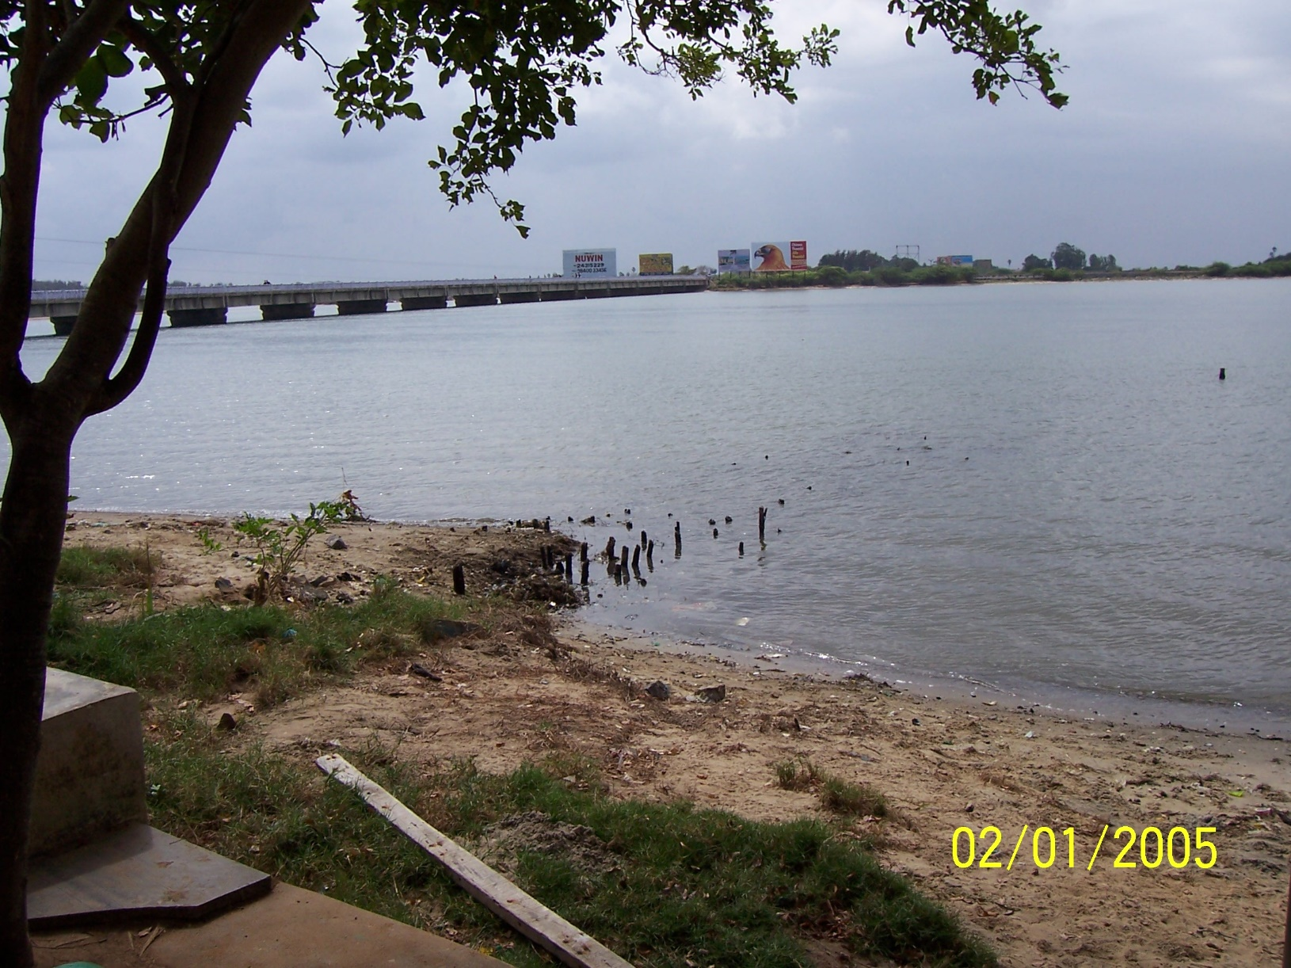
Small Fishing/tourist pier (post-tsunami)

Slide 23
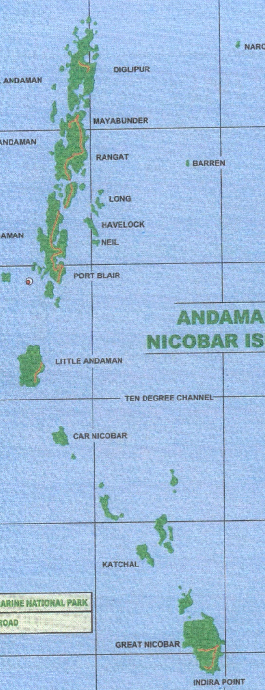
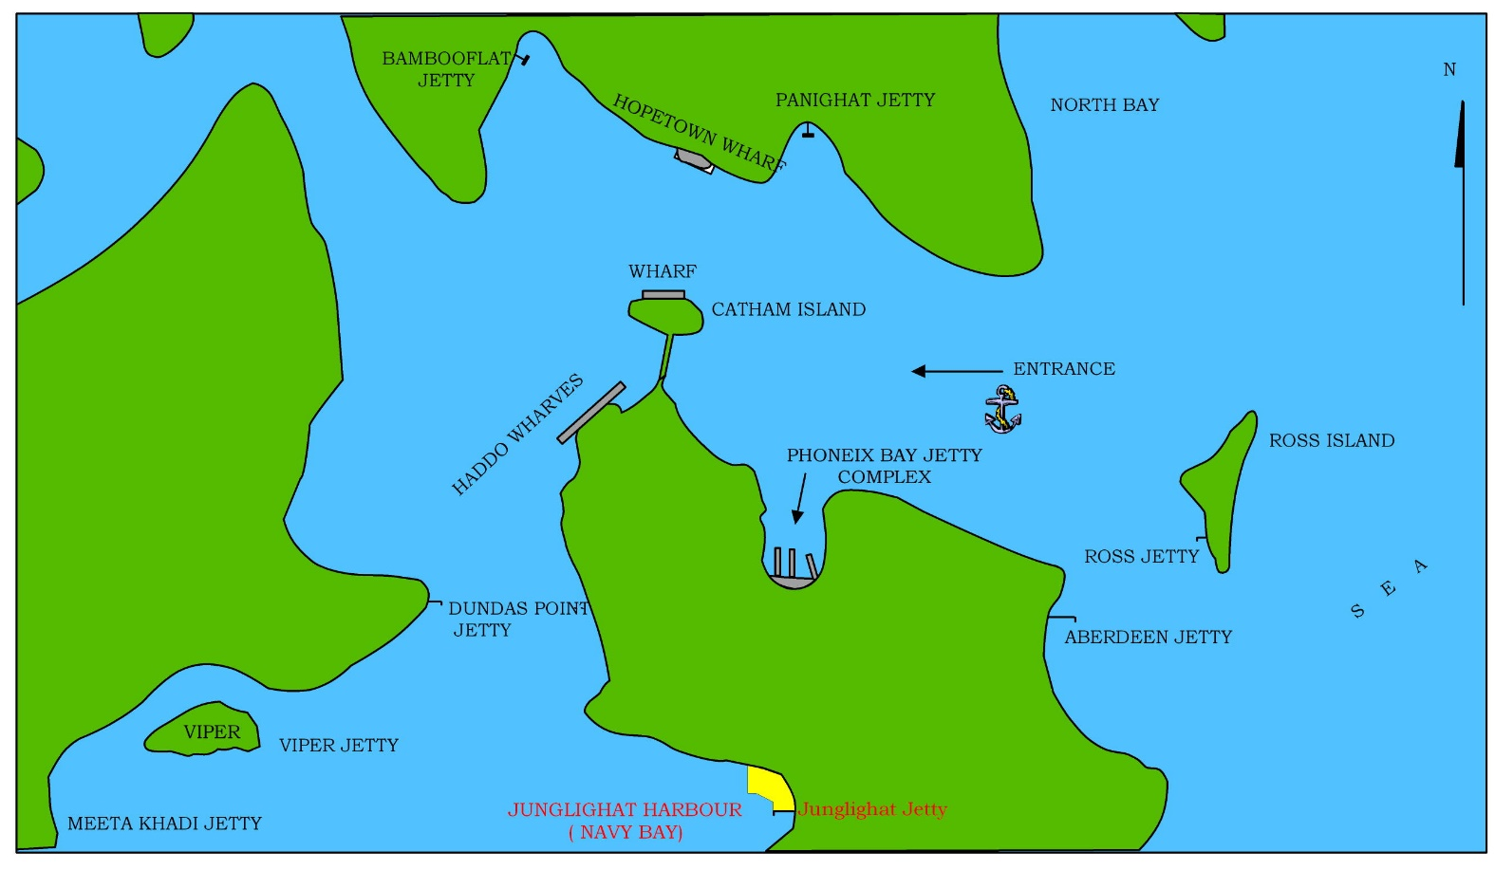
ALHW
PORT BLAIR HARBOUR
TIDAL DIFF + 1.0M

Slide 24
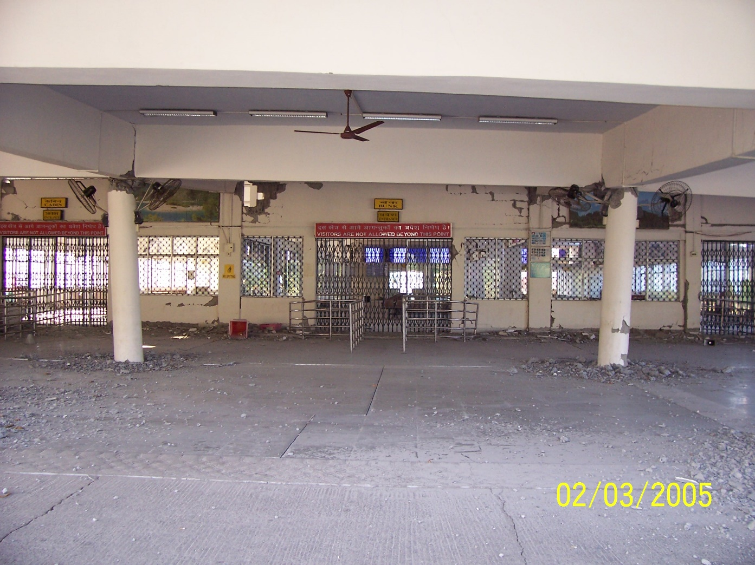
Ferry Terminal Building – Port Blair

Slide 25
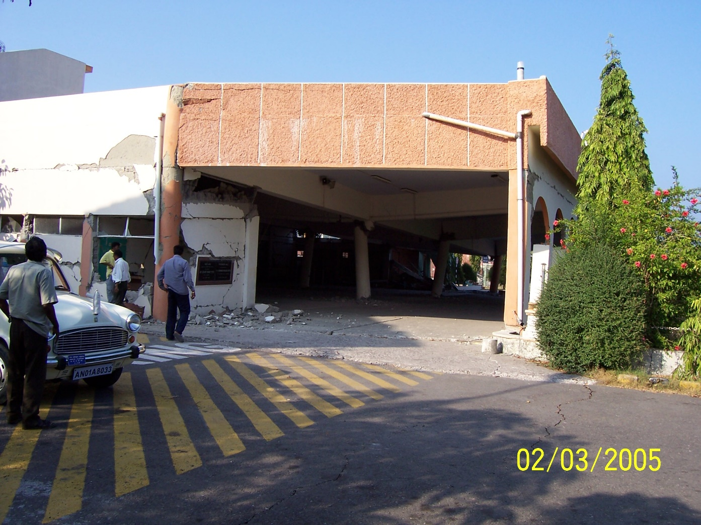
Ferry Terminal Building – Port Blair

Slide 26
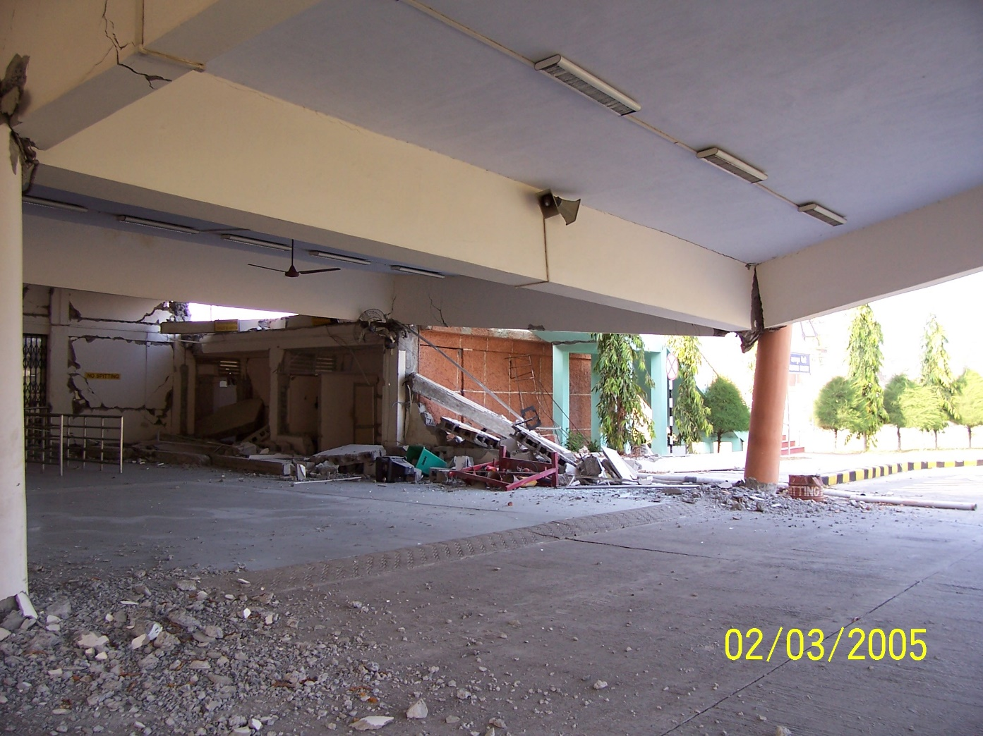
Ferry Terminal Building – Port Blair

Slide 27
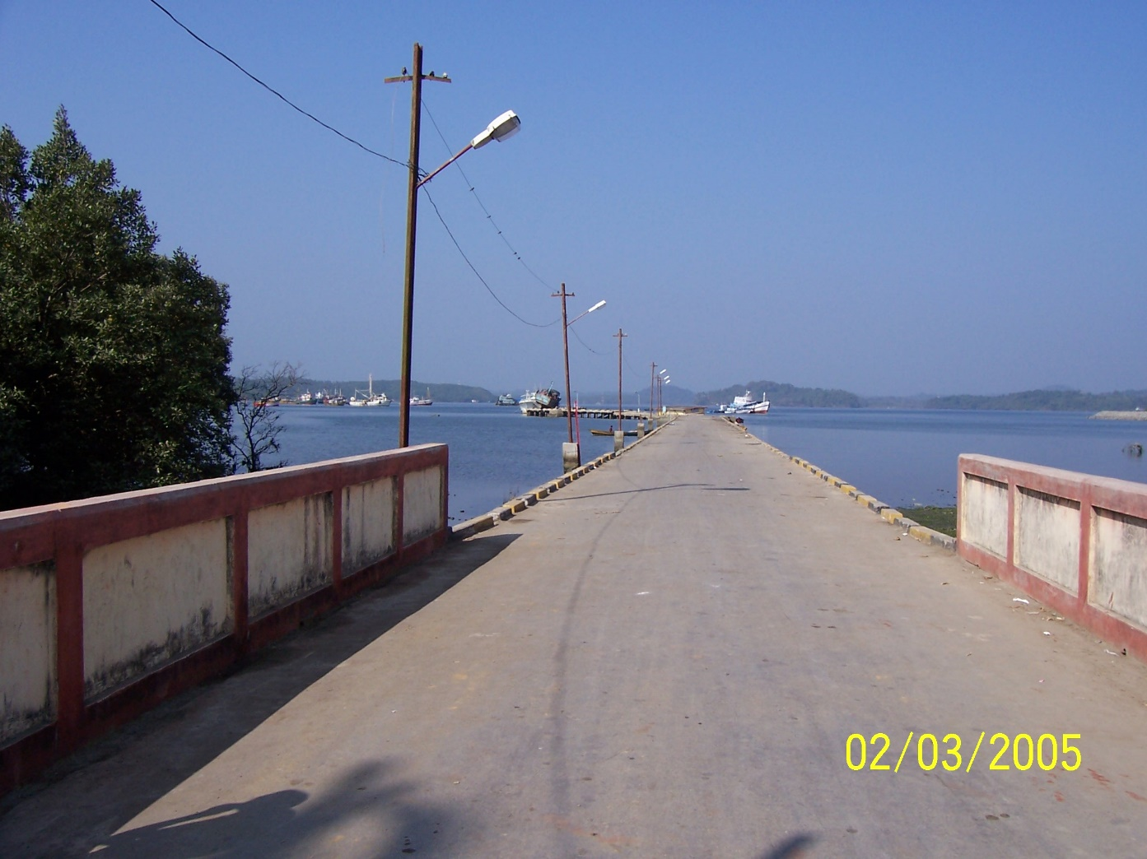
Junglighat Fishing Pier – rubble mount support

Slide 28
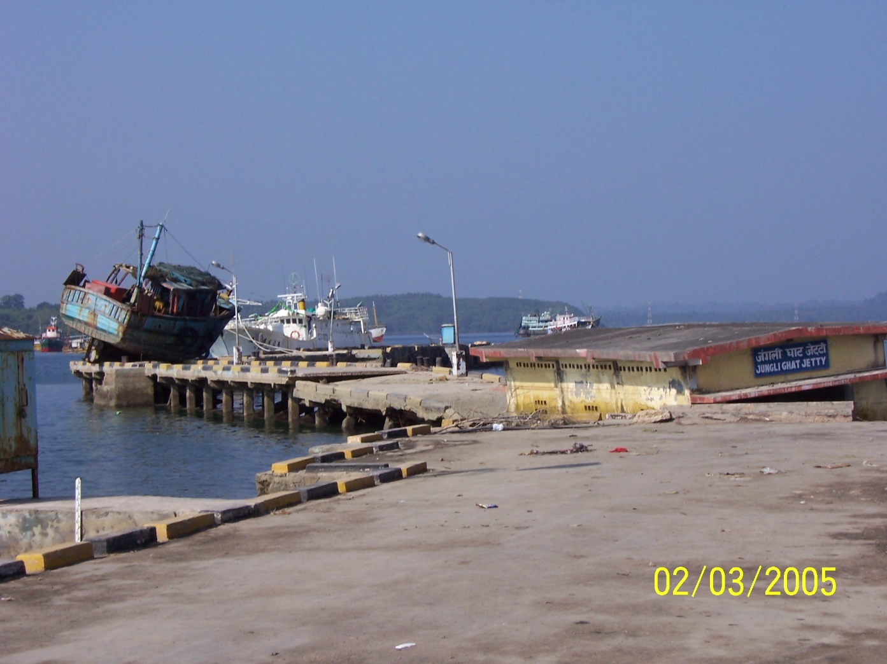
Junglighat Fishing Pier

Slide 29

Junglighat Fishing Pier

Slide 30
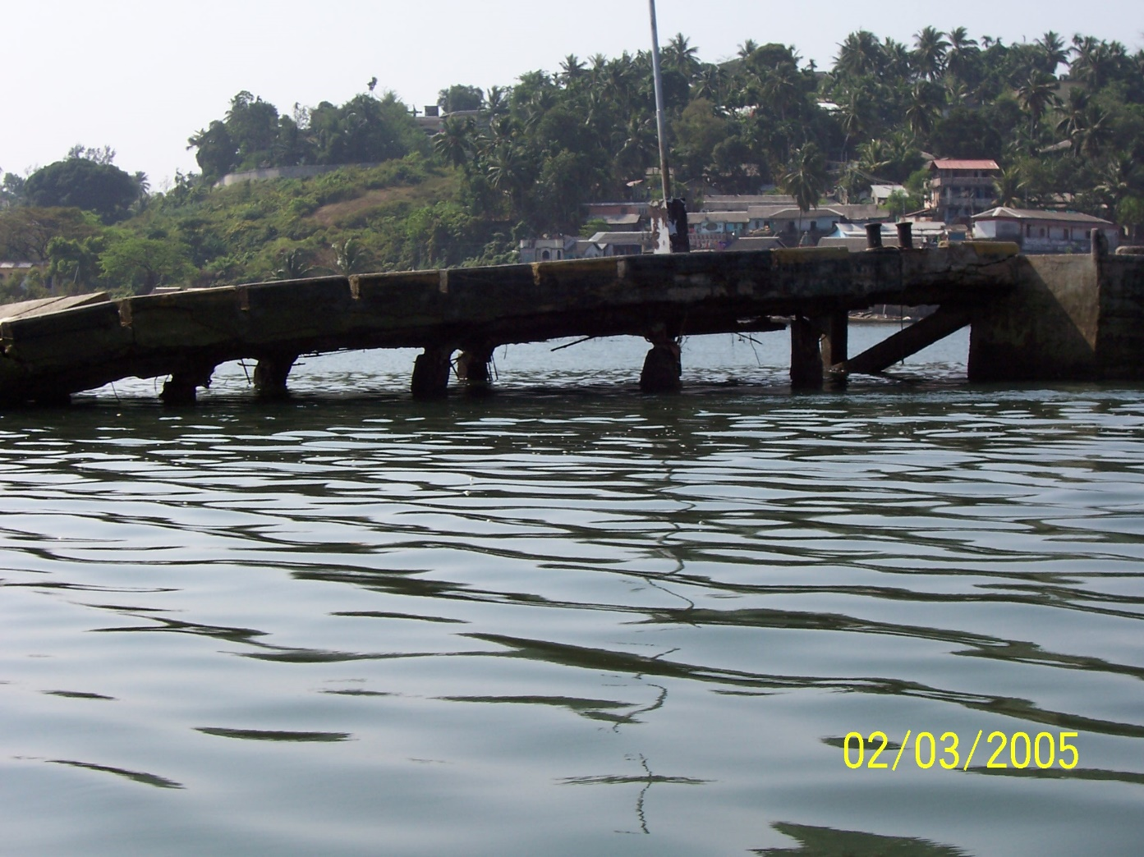
Junglighat Fishing Pier

Slide 31
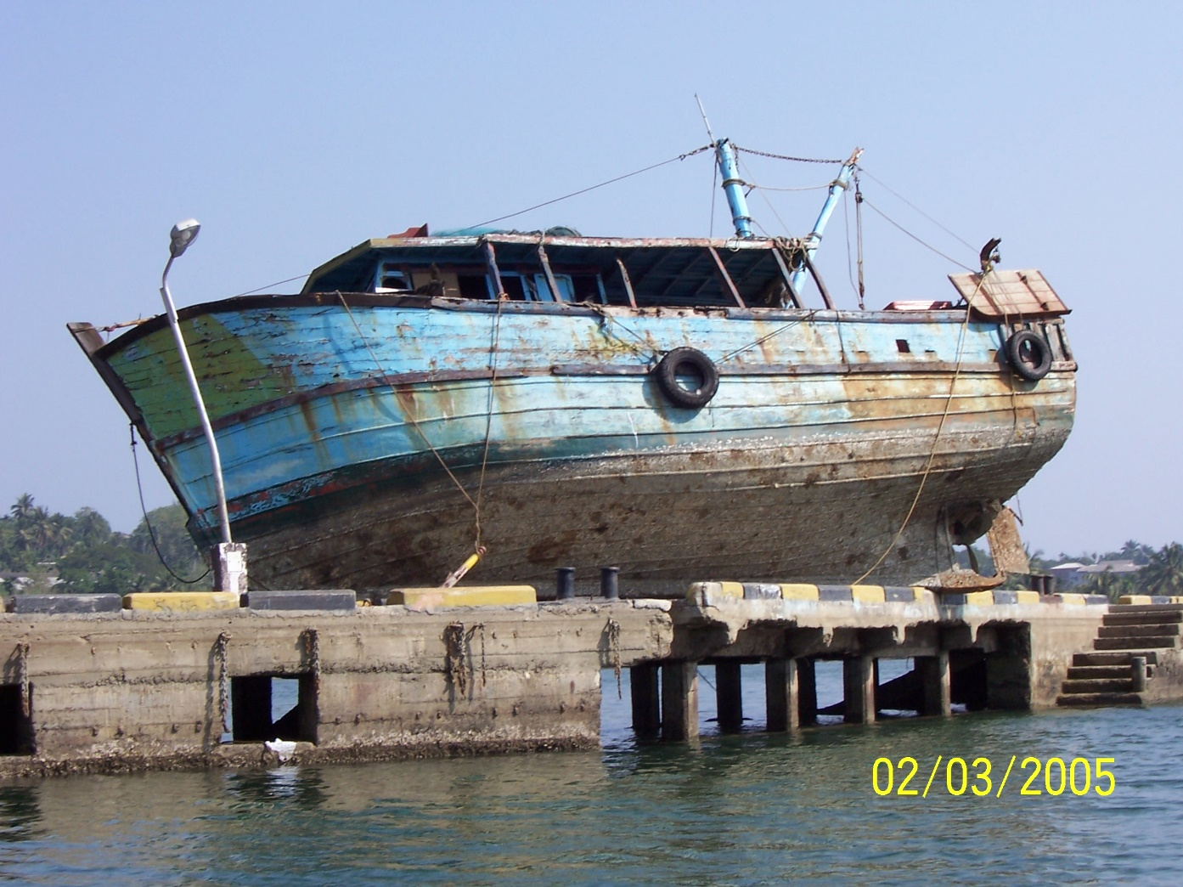
Junglighat Fishing Pier

Slide 32
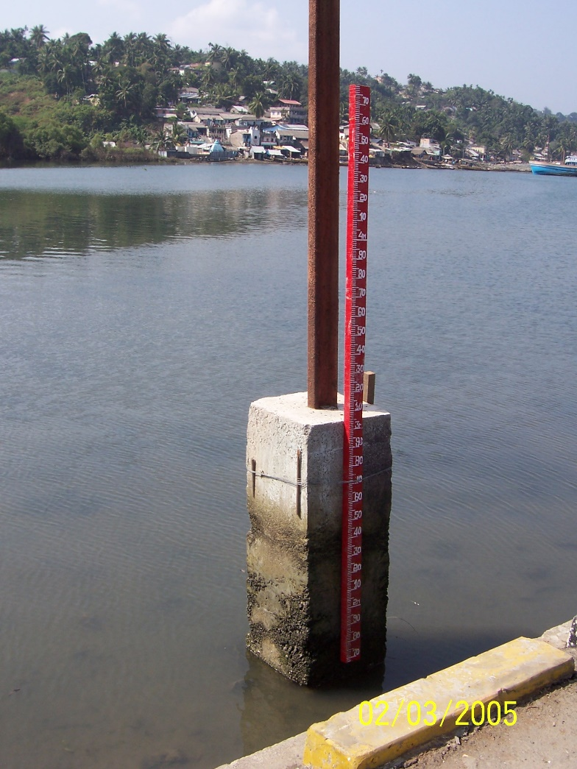
Water depth – 1 m more

Slide 33
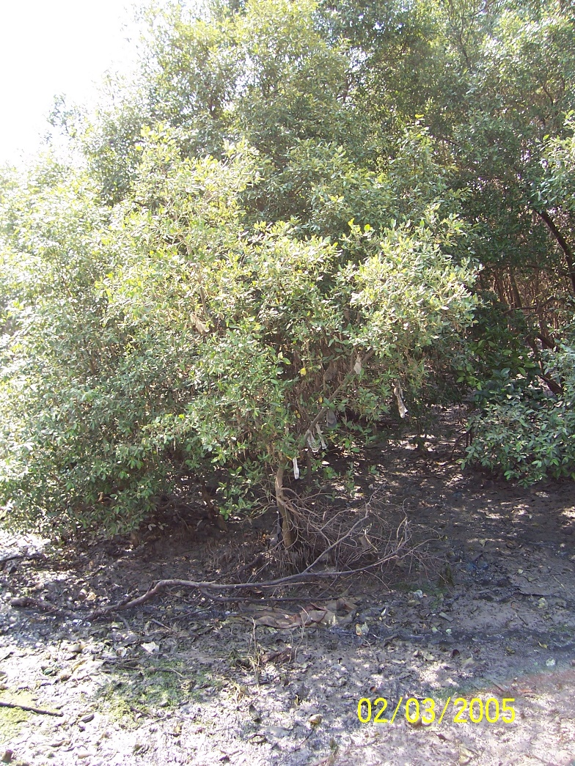
Note plastic bags in trees (level of tsunami)

Slide 34
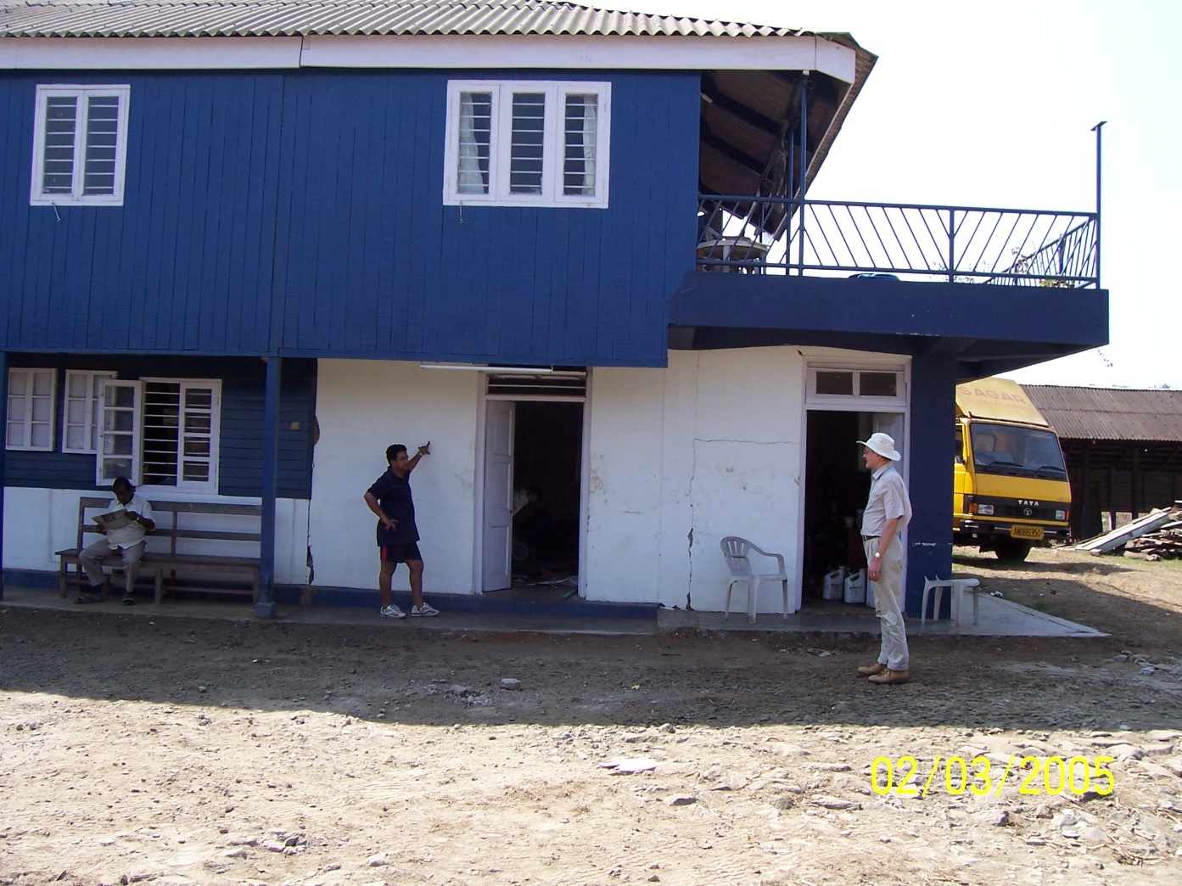
Tsunami Level almost 2m above floor

Slide 35
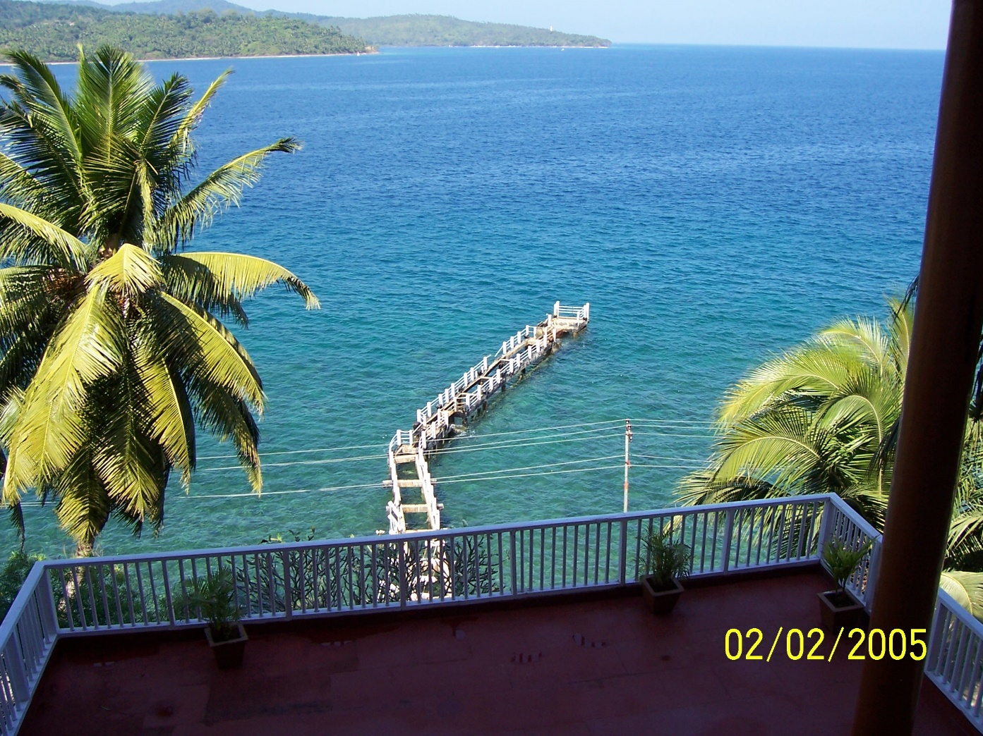
Small vessel pier – tsunami damage

Slide 36
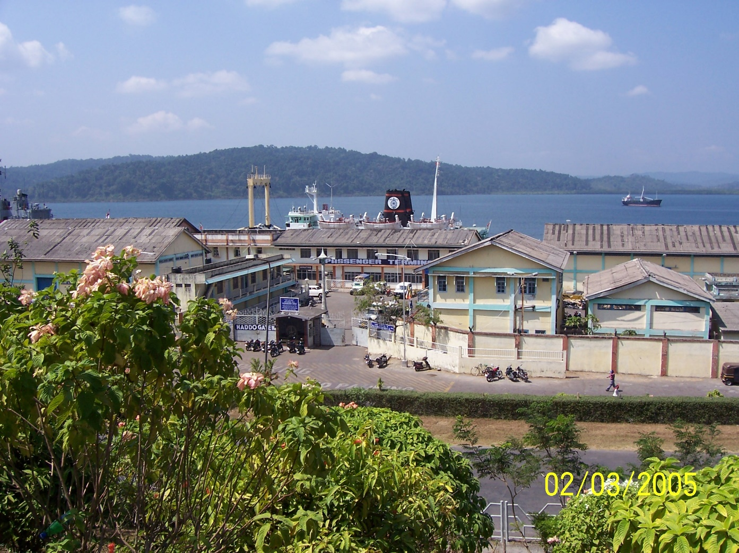
Port of Port Blair

Slide 37
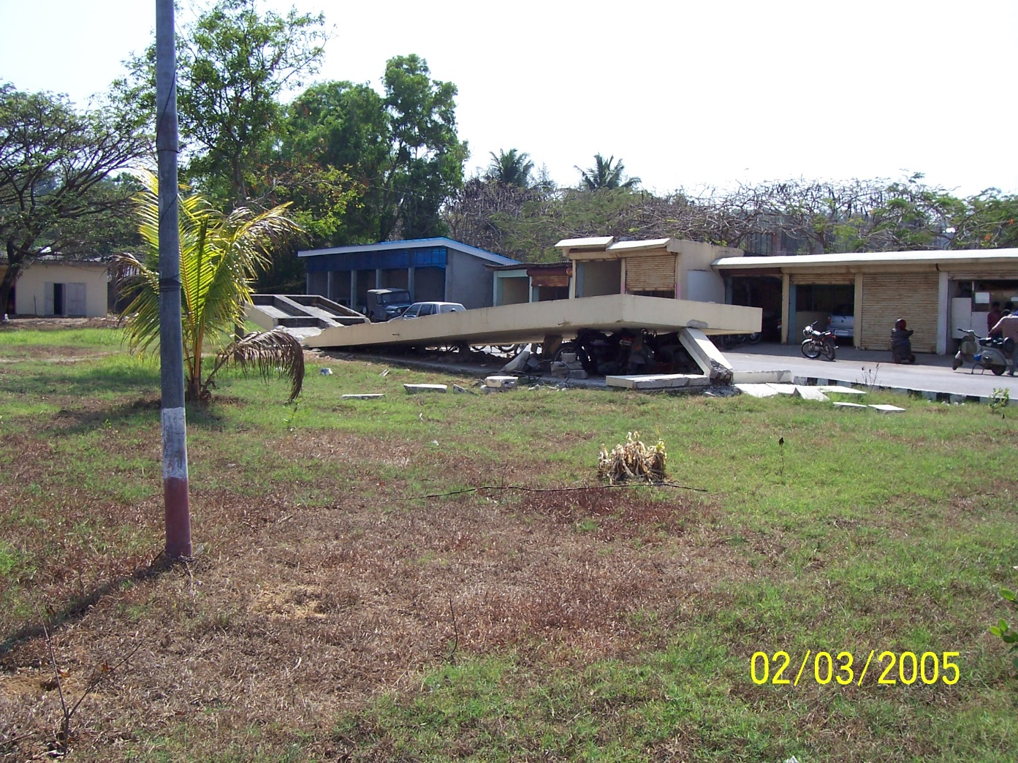
Motorcycle parking anyone?

Slide 38
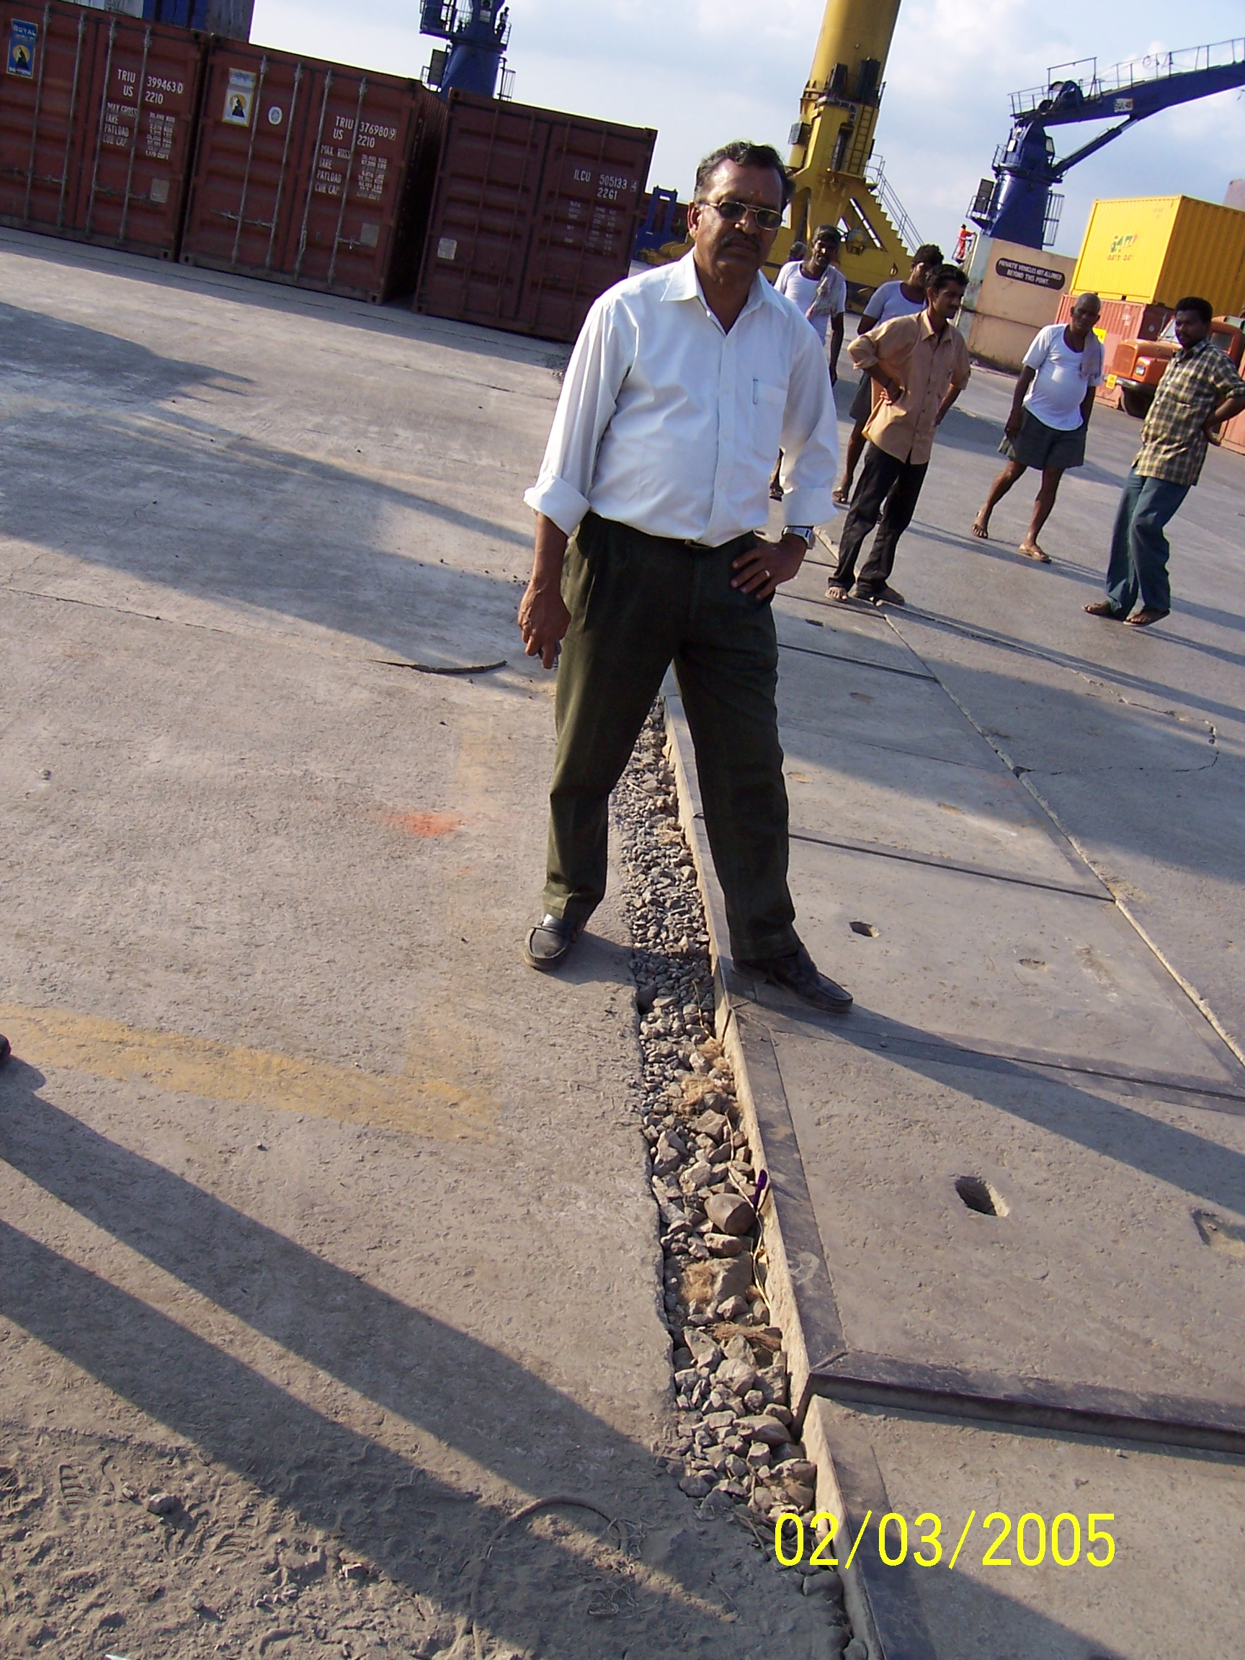
Left – Pile Supported Wharf Right – backfill area (container wharf)

Slide 39
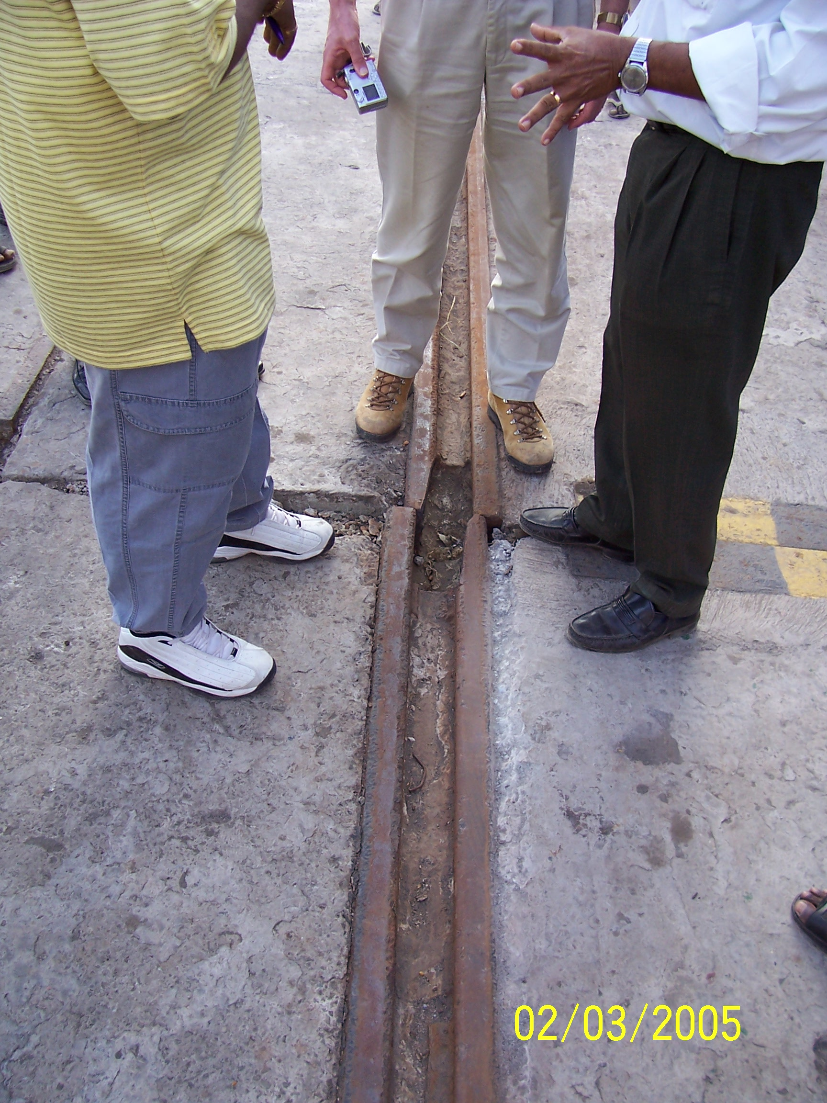
Crane Rail – Container Wharf

Slide 40
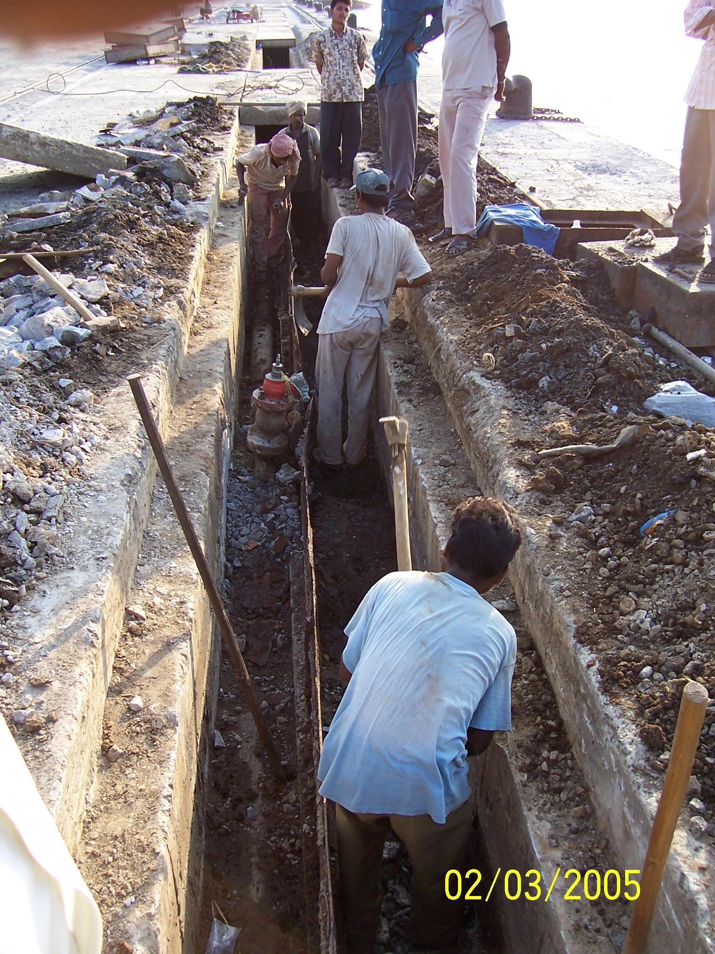
New Power/Utilities – Container wharf

Slide 41
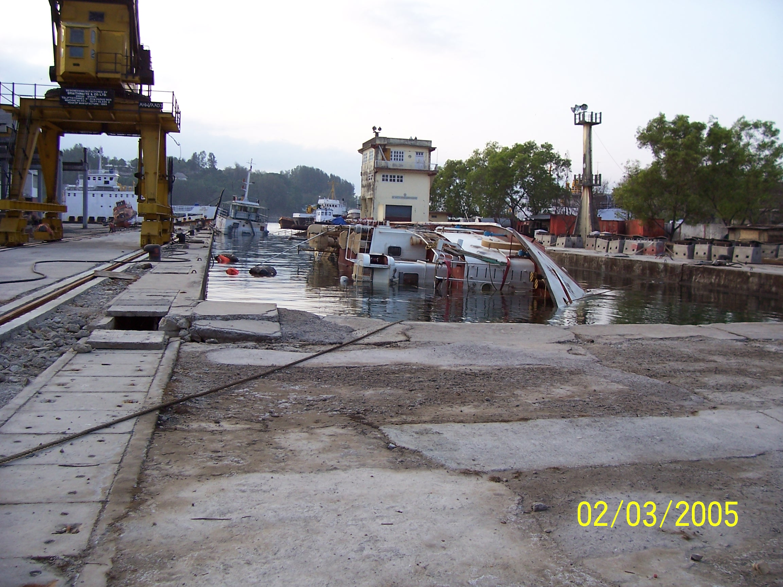
Dry Dock - Port Blair

Slide 42
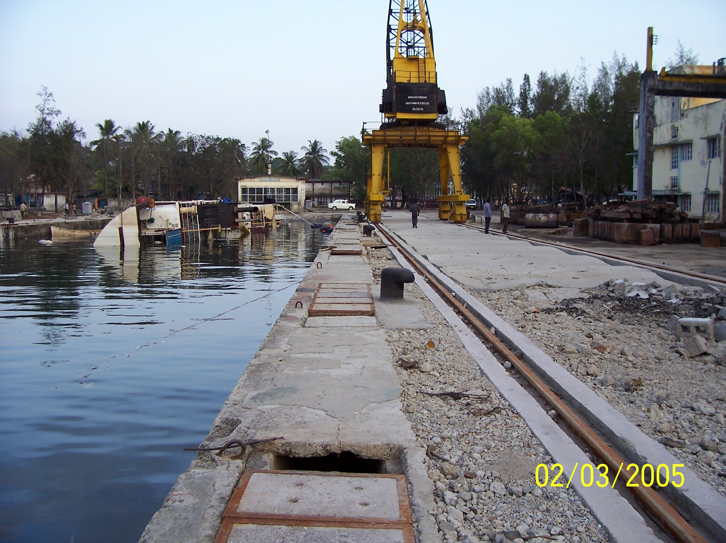
Dry Dock – Port Blair

Slide 43
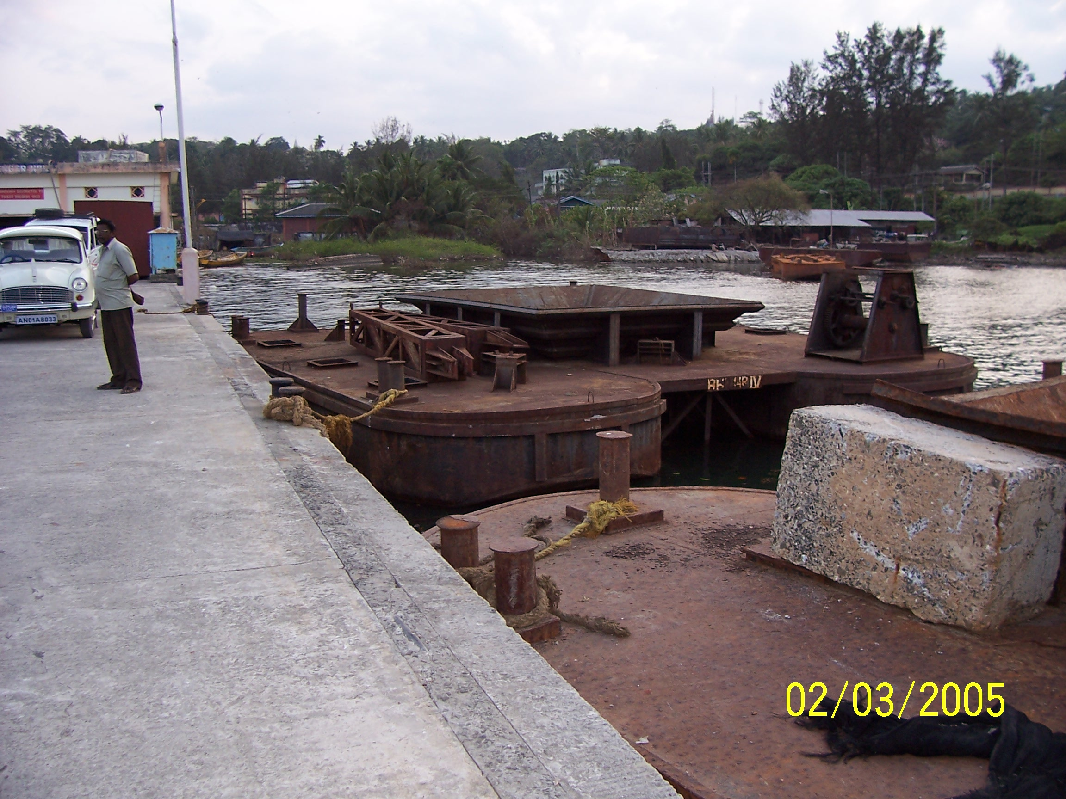
Barge was on top of wharf

Slide 44
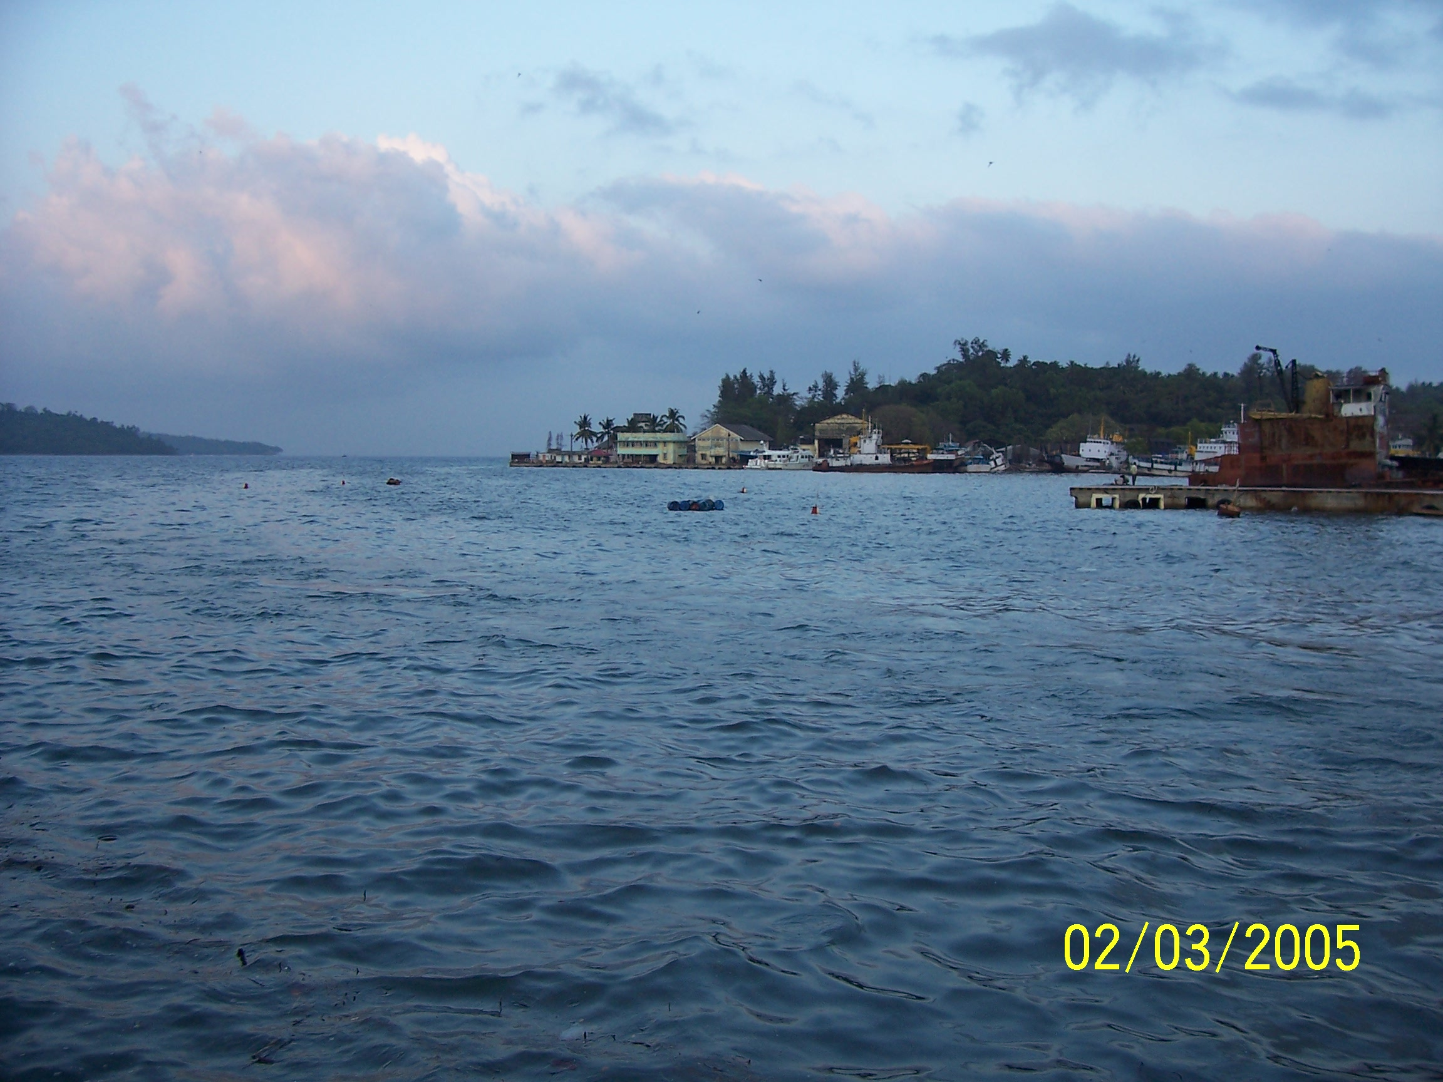
Pier collapse – Port Blair

Slide 45

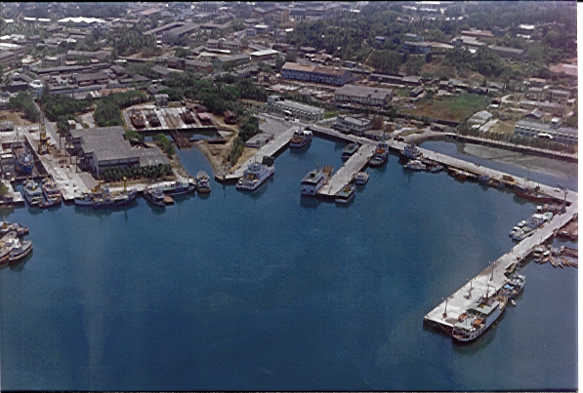
ALHW
PHOENIX BAY COMPLEX (BEFORE TSUNAMI)
COLLAPSED PORTION
TIDAL DIFF + 1.0M
FISHERIES JETTY

Slide 46
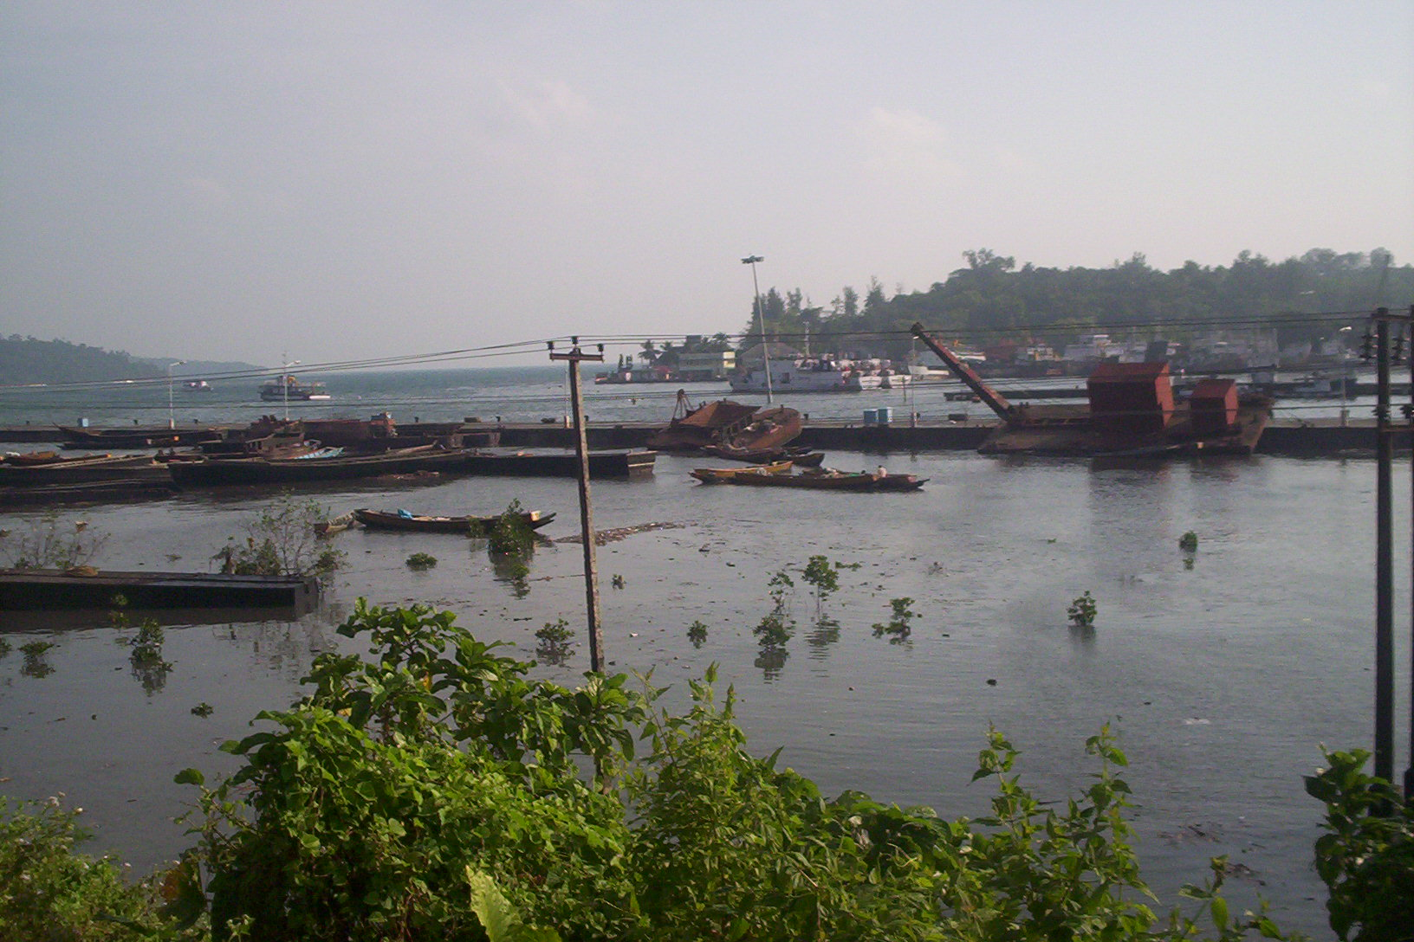
ALHW
COLLAPSED FISHERIES JETTY (AFTER TSUNAMI)
HIGH MAST LIGHT UNDER COLLAPSE
click for video

Slide 47
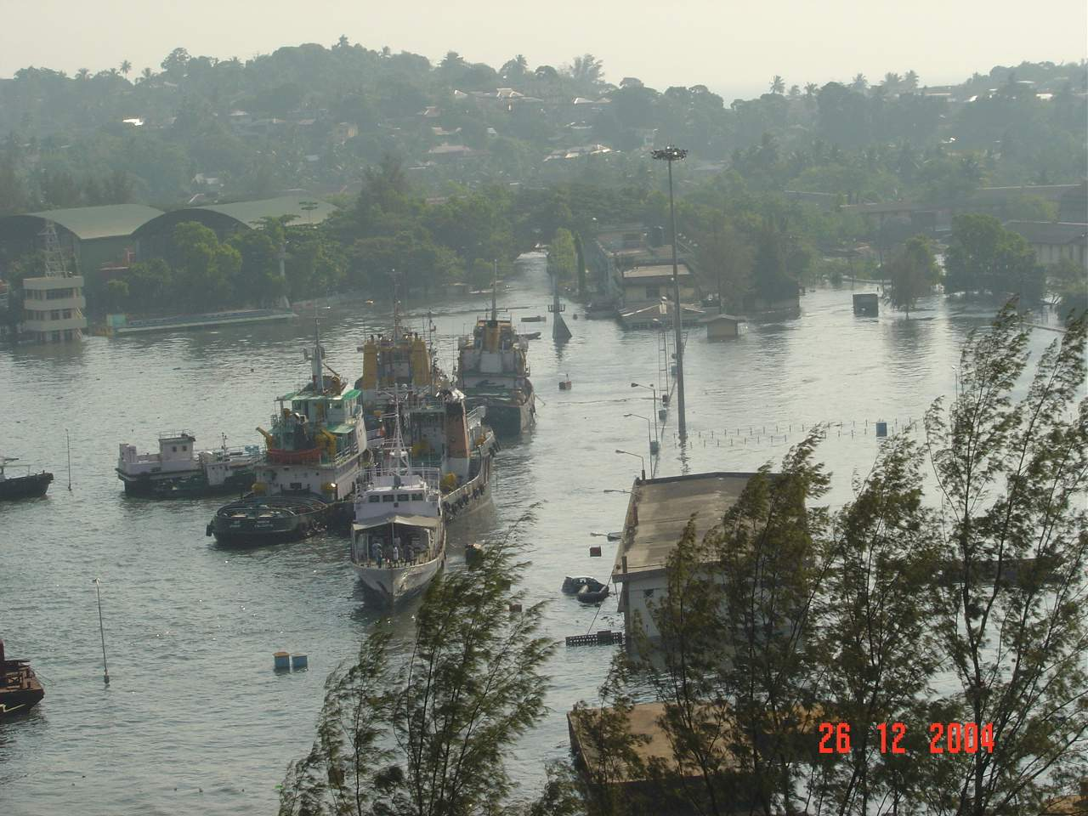
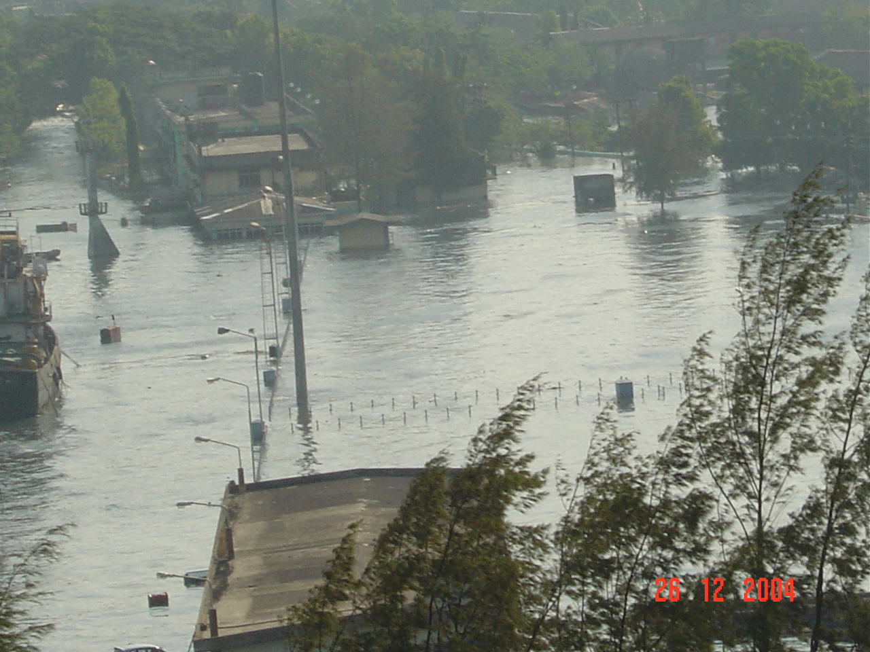
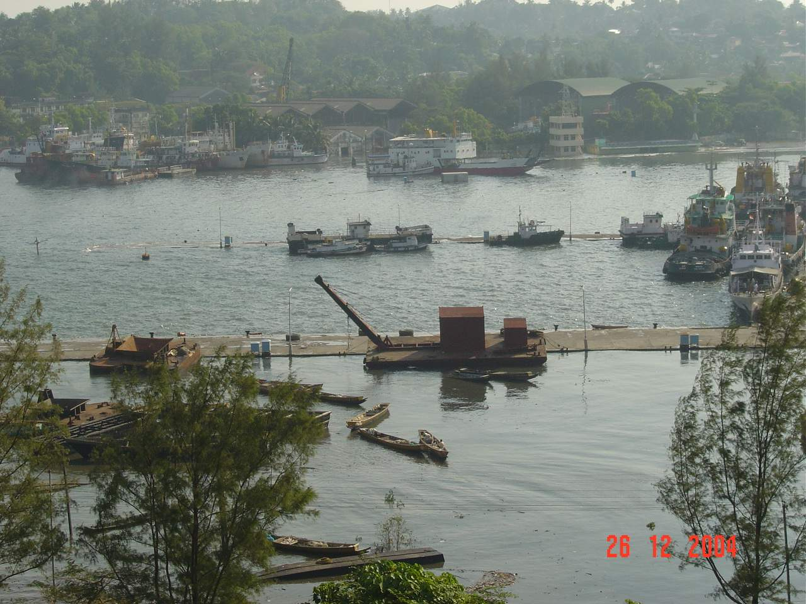
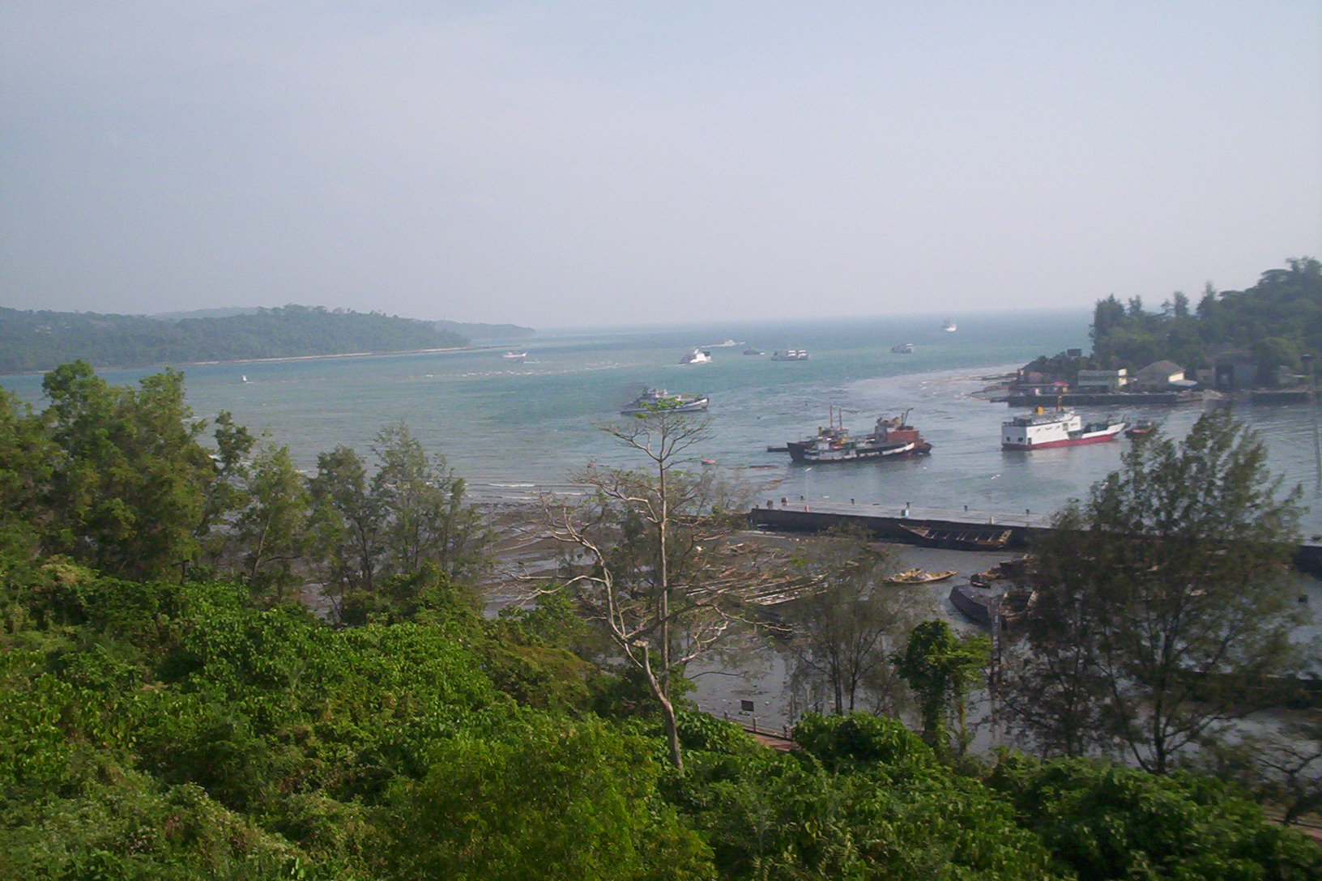
PHOENIX BAY COMPLEX (DURING TSUNAMI)

Slide 48
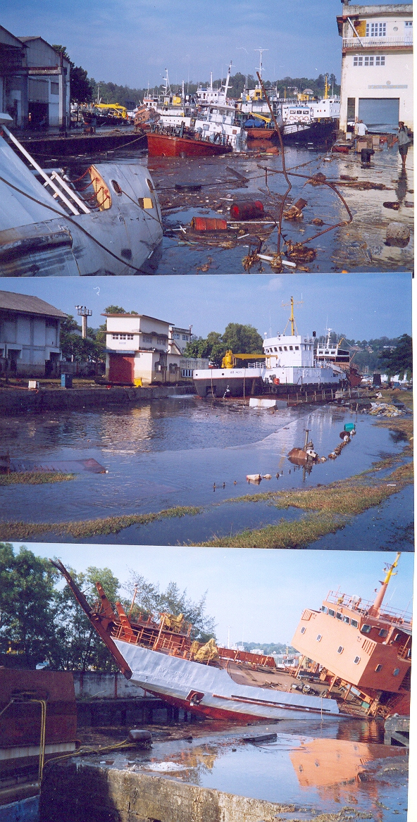
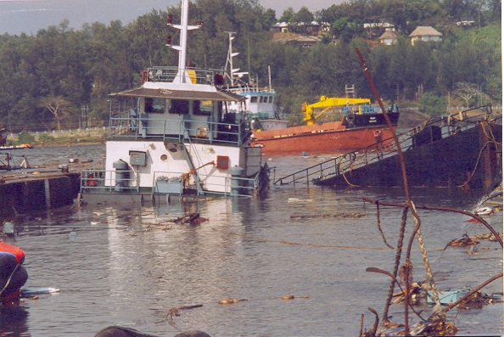
DAMAGE TO DRYDOCK COMPLEX
DAMAGED CAISSON GATE

Slide 49
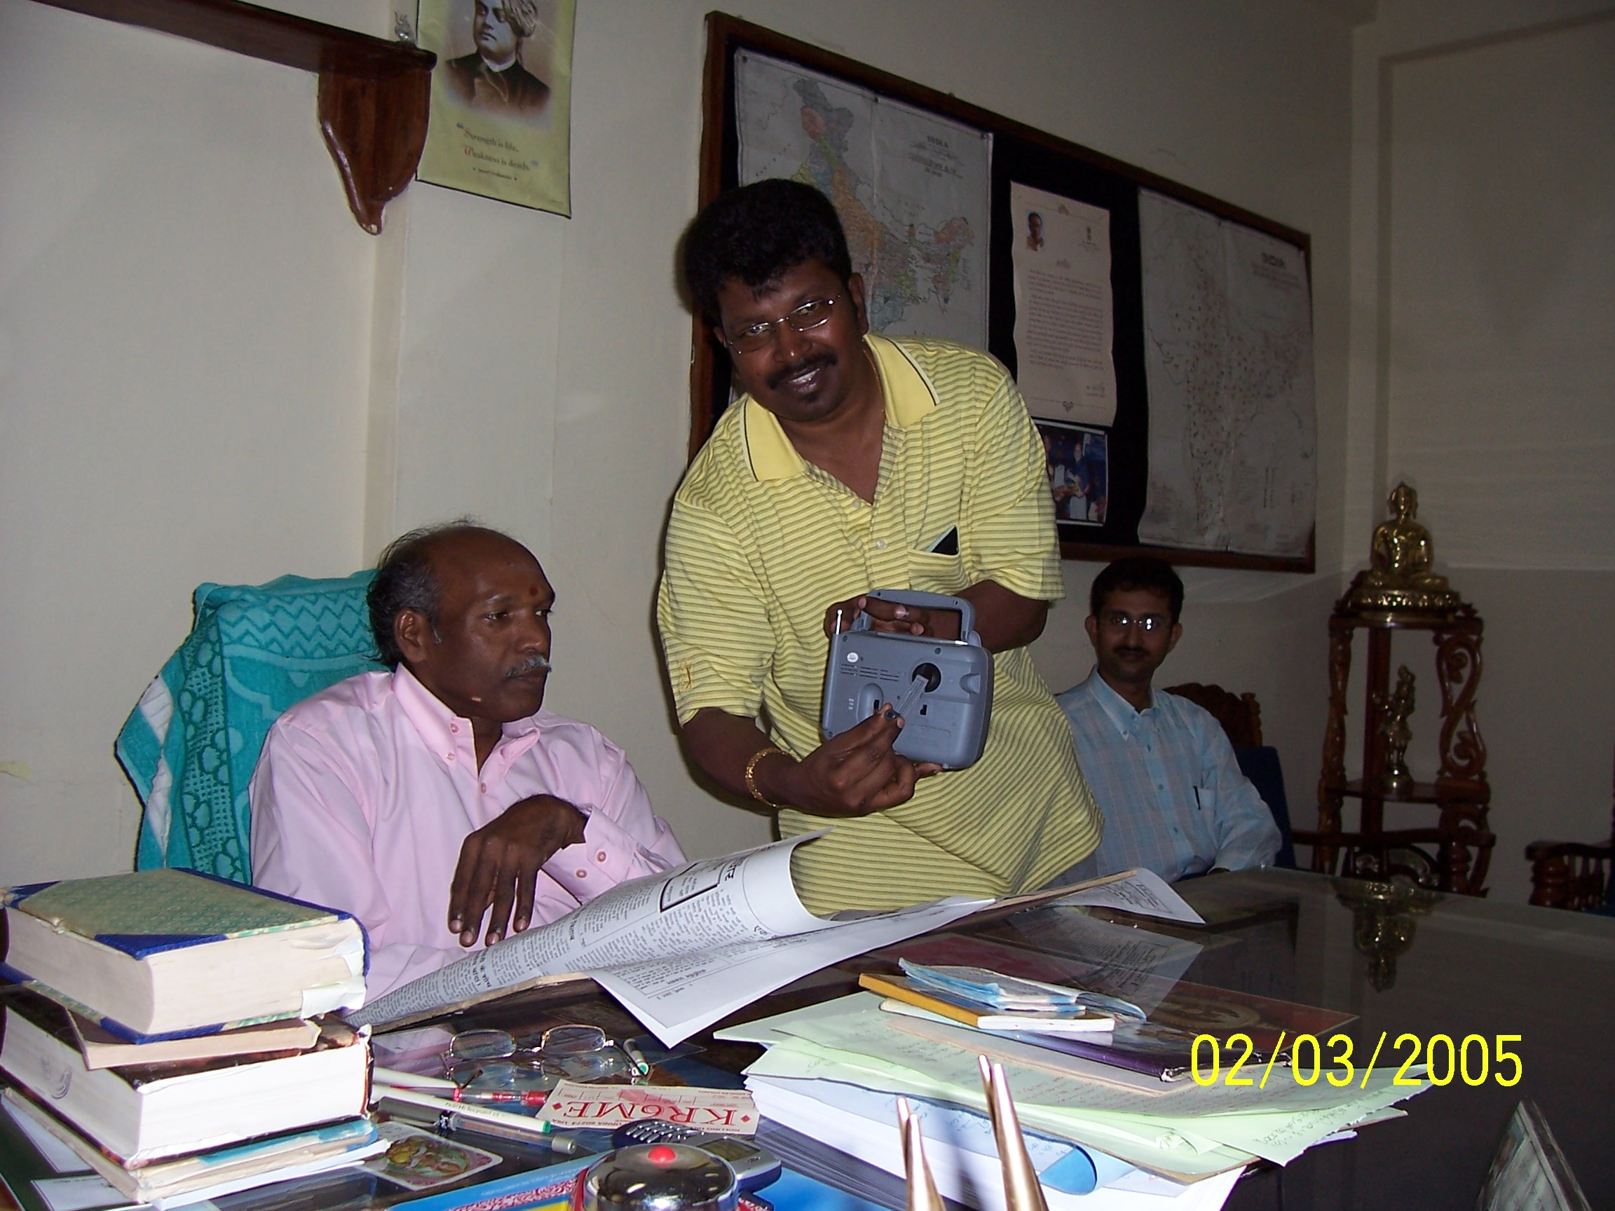
All India Radio – Federal government is providing hand crank transistor radios to neighboring islands

Slide 50
CONCLUSIONS AND OBSERVATIONS
MOORING LINES WILL “PART” IF SUBJECTED TO 4-5 METERS OF RUN-UP.
RECOMMENDED FAILURE MODE IS “PARTED” LINES, NOT BROKEN OFF BITTS, BOLLARDS OR HOOKS.
TSUNAMI CURRENTS DO NOT GENERALLY “PART” MOORING LINES.
CREWS WILL TRY TO LEAVE THE VESSEL WHEN IN PANIC CONDITIONS.

Slide 51
CONCLUSIONS AND OBSERVATIONS
LIGHT USE TIMBER WHARVES/PIERS WILL LOSE DECKING OR POSSIBLY COLLAPSE.
CONCRETE/STEEL PILE SUPPORTED MODERN WHARVES/PIERS WILL SURVIVE
TSUNAMI DAMAGE IN A PORT DUE PRIMARILY TO VESSEL IMPACT.
VESSELS UNDER POWER MAY NOT HAVE ENOUGH THRUST TO COUNTER HIGH VELOCITIES ASSOCIATED WITH A TSUNAMI.

Slide 52
RECOMMENDATIONS
MANDATE UNDERWATER INSPECTION PROGRAM.
PORT PROTOCOL – VESSELS TO LEAVE PORT FOLLOWING AN EARTHQUAKE
ACCELEROMETERS – ON PIERS/WHARVES
A QUICK EGRESS FOR SMALL VILLAGES AND COASTAL AREAS, SIGNS FOR HIGHER GROUND.

Slide 53
RECOMMENDATIONS
“HARDENED” COMMUNICATION SYSTEM BETWEEN VARIOUS PORTS/COASTAL AREAS.
EMERGENCY COMMUNICATIONS WITH OTHER COUNTRIES, STATES – AREAS CLOSER TO POSSIBLE TSUNAMI.
EDUCATION – MUST BE GENERATIONAL.

