Slide 1
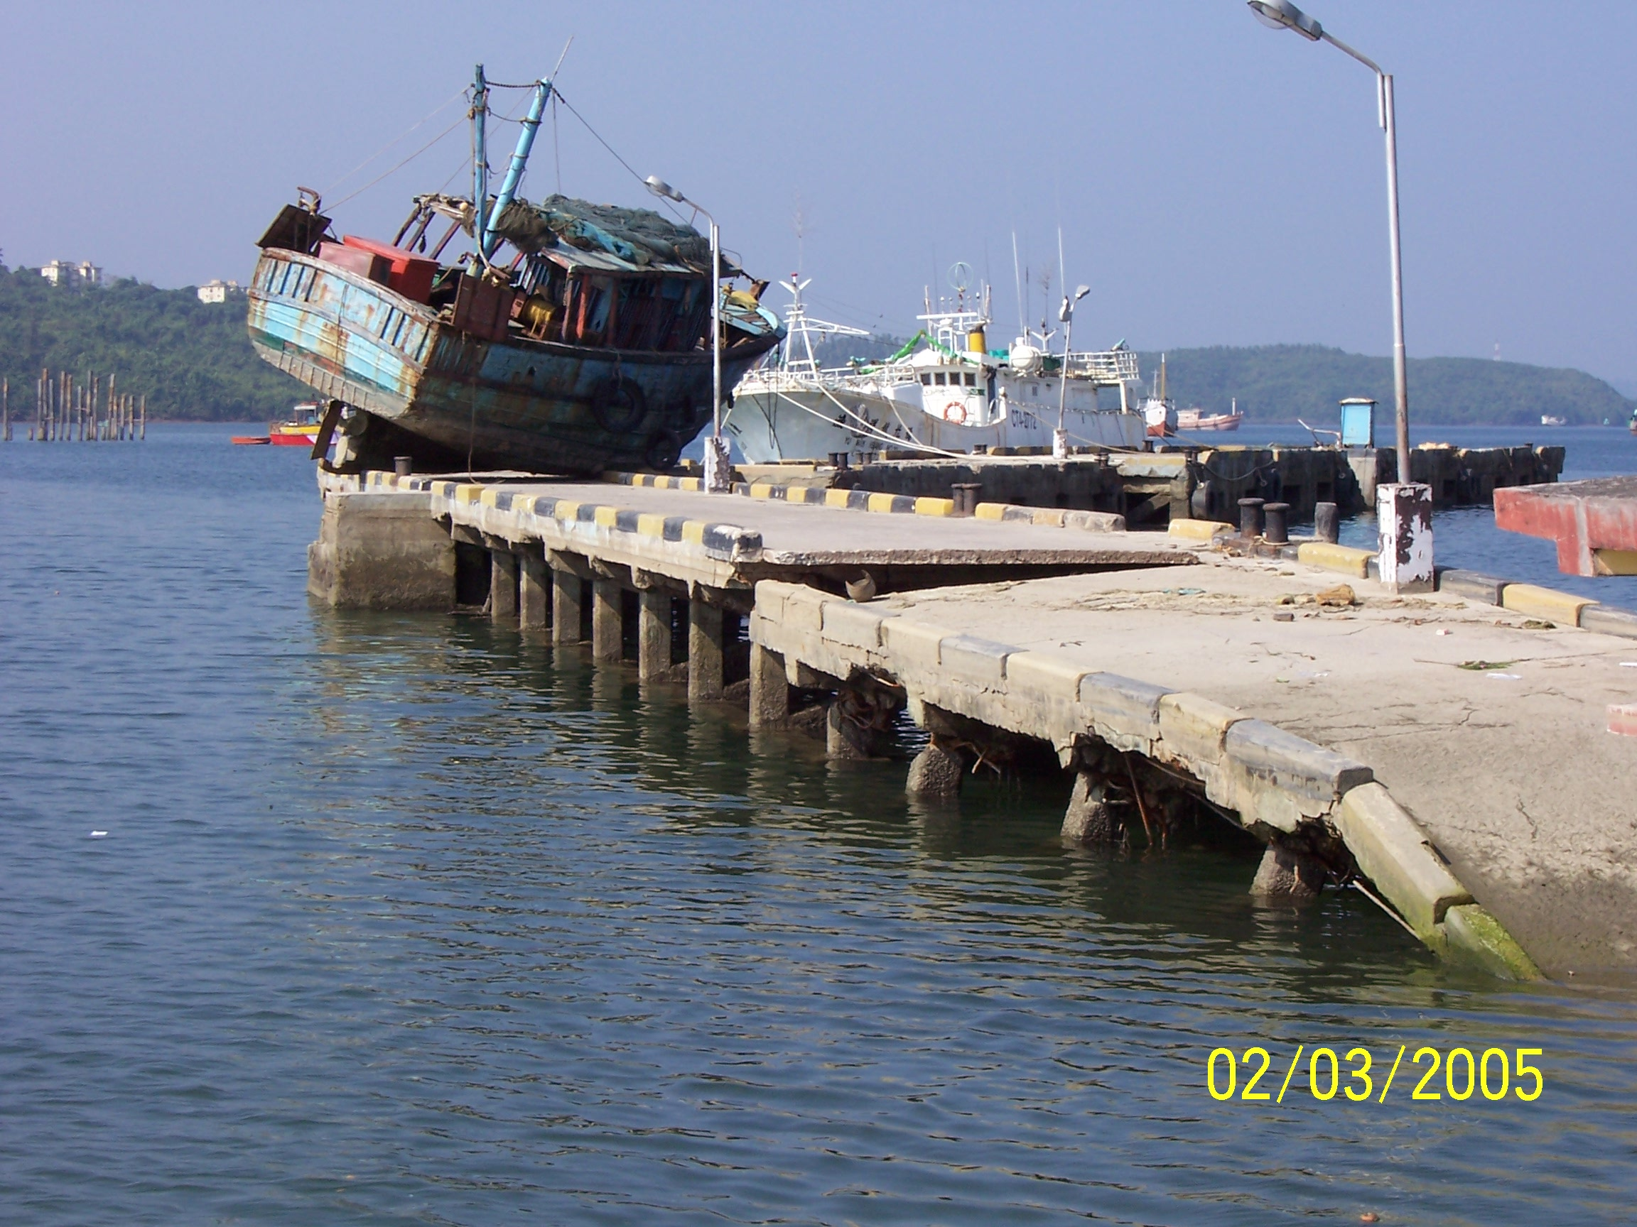
MOTEMS
Marine Oil Terminal Engineering and Maintenance Standards
& Tsunami Damage
California Seismic Safety Commission
Martin Eskijian, P.E. (eskijim@slc.ca.gov)
Supervisor, Engineering Branch
Marine Facilities Division
California State Lands Commission
July 2005

Slide 2
MARINE OIL TERMINAL ENGINEERING AND MAINTENANCE STANDARDS (MOTEMS)
MANDATED:
LEMPERT-KEENE-SEASTRAND OIL SPILL PREVENTION AND RESPONSE ACT OF 1990
CURRENT CONDITIONS OF 39 TERMINALS:
Grandfathering – vessel size
Structural degradation
Inadequate fire detection/suppression
Build dates 1901 to 1984 (Average age is 50)
Seismic standards (Were there any?)

Slide 3
MOTEMS
REGULATORY PROCESS
APPROVAL OBTAINED BY THE STATE LANDS COMMISSION – AUGUST 17, 2004
ADOPTION OBTAINED BY THE CALIFORNIA BUILDING STANDARDS COMMISSION - JANUARY 19, 2005
CALIFORNIA BUILDING STANDARDS CODE (TITLE 24, PART 2, VOL 1, CHAPTER 31F)
IN PRINT, LATE JULY 2005, EFFECTIVE 6 MONTHS LATER.
Notes:
The cost to rehabilitate was based on one terminal, possible rehab costs could reach $10M, but could be spread out over a number of years. Note that the benefit could be up to $1024 million.

Slide 4
MOTEMS
Scope of the Standards
Audit and Inspection Criteria
Structural Loading Criteria
Seismic Analysis and Design Criteria
Mooring and Berthing Analysis and Design Criteria
Geotechnical Hazards Criteria
Structural Analysis and Design of Components
Piping and Pipeline Criteria
Mechanical, Fire and Electrical Criteria
Notes:
Overview of the 11 sections of the MOTEMS.

Slide 5
MOTEMS
SEISMIC/TSUNAMI HAZARD ASSESSMENT
Probabilistic Seismic Hazard Analysis (PSHA) for Southern California Coastal Facilities, J. Savy & W. Foxall, LLNL, 2002.
Tsunami assessment, based on PSHA – performed by Drs. Costas Synolakis and Jose Borrero, University of Southern California
TSUNAMI RUN-UP HEIGHTS (FT):
100 Yr. Return Period 500 Yr. Return Period
Ports of LA and LB 8 ft. 15 ft.
Notes:
Based on 41 terminals, this is a preliminary estimate of how many terminals fall into each category. If MOTEMS becomes regulatory in January 2004, the first audits wouldn’t be due until mid 2006.

Slide 6
MOTEMS
SEISMIC/TSUNAMI HAZARD ASSESSMENT
Section 3103F.5.7 (MOTEMS):
“A tsunami generated by a distant source may allow operators to have an adequate warning for mitigating the risk by departing the marine oil terminal and going into deep water. For near-field events, with sources less than 500 miles away, the vessel may not have adequate time to depart.”
Section 3103F.3.4 (MOTEMS):
“Run-up and current velocity shall be considered in the tsunami assessment…”
Notes:
Based on 41 terminals, this is a preliminary estimate of how many terminals fall into each category. If MOTEMS becomes regulatory in January 2004, the first audits wouldn’t be due until mid 2006.

Slide 7
MOTEMS
Seismic Performance Criteria
Performance Criteria:
  Level 1 Earthquake: No or minor structural damage without interruption in service or with minor temporary interruption in service (72 Year Return Period).
  Level 2 Earthquake: Controlled inelastic behavior with repairable damage resulting in temporary closure in service restorable within months. Prevention of major spill. Prevention of collapse (475 Year Return Period).

Slide 8
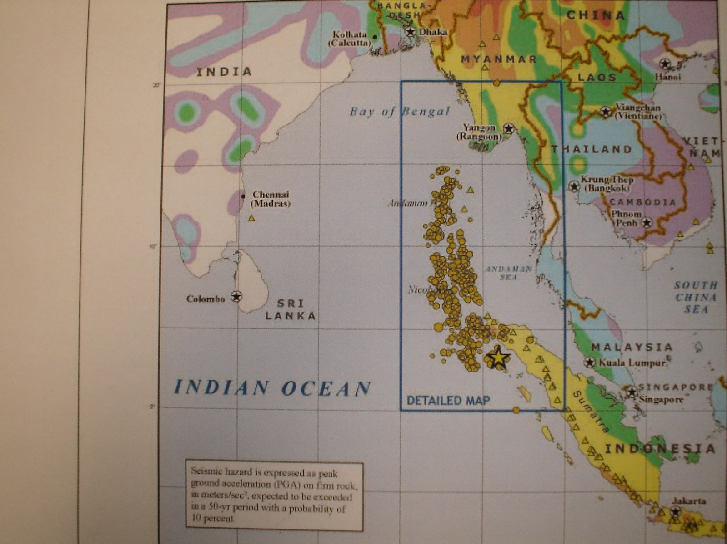
Earthquake & Tsunami (December 26, 2004) - S. India and the Andaman Islands

Slide 9
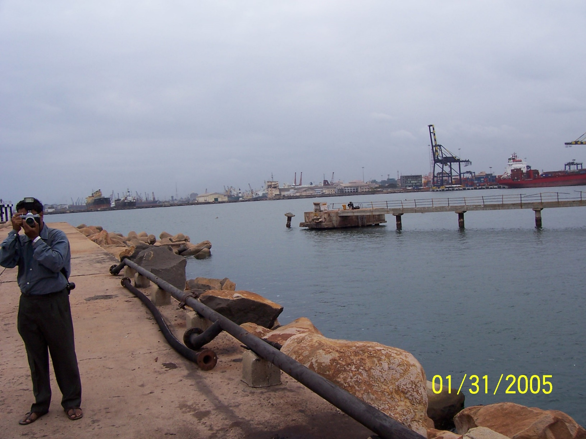
Port of Chennai – 2 Mooring Dolphins Missing

Slide 10
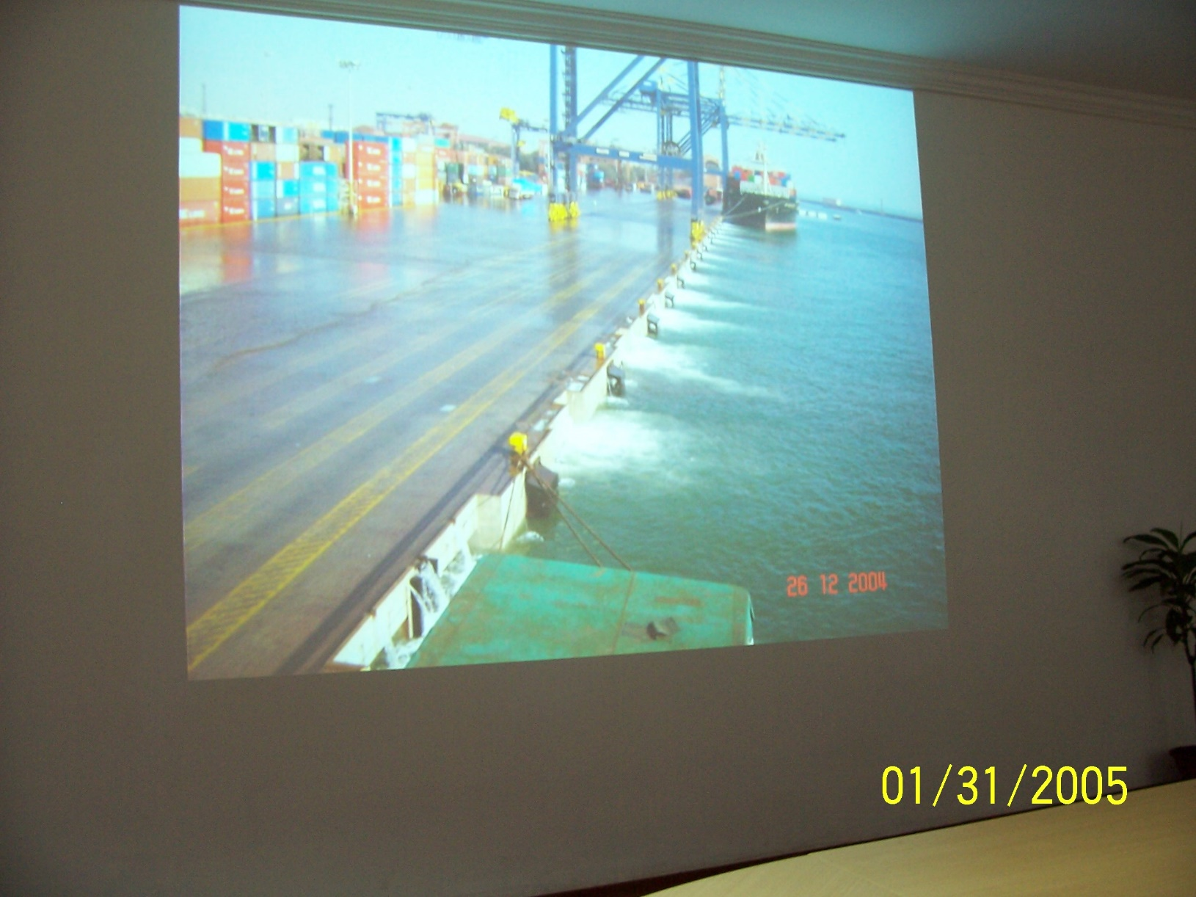
Container Wharf – Port of Chennai
Ebb Current of Tsunami

Slide 11
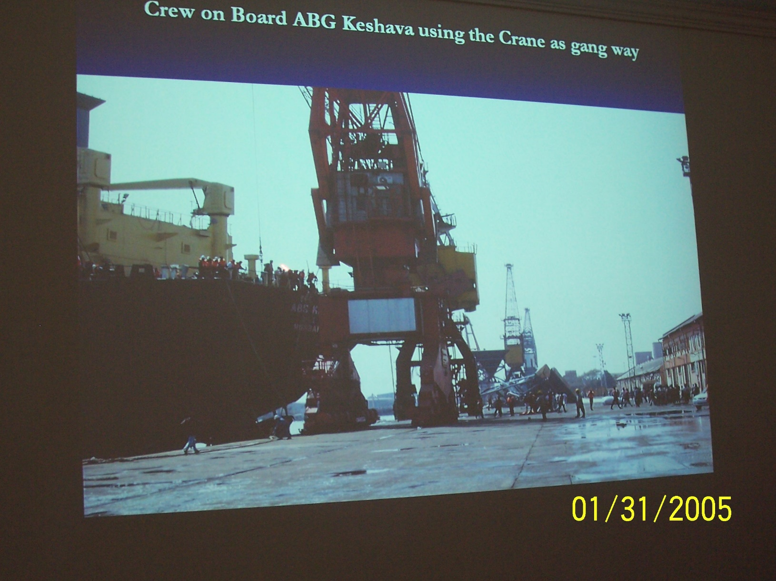
Crew Leaving Vessel – using Crane as a Gang Way (Port of Chennai)

Slide 12
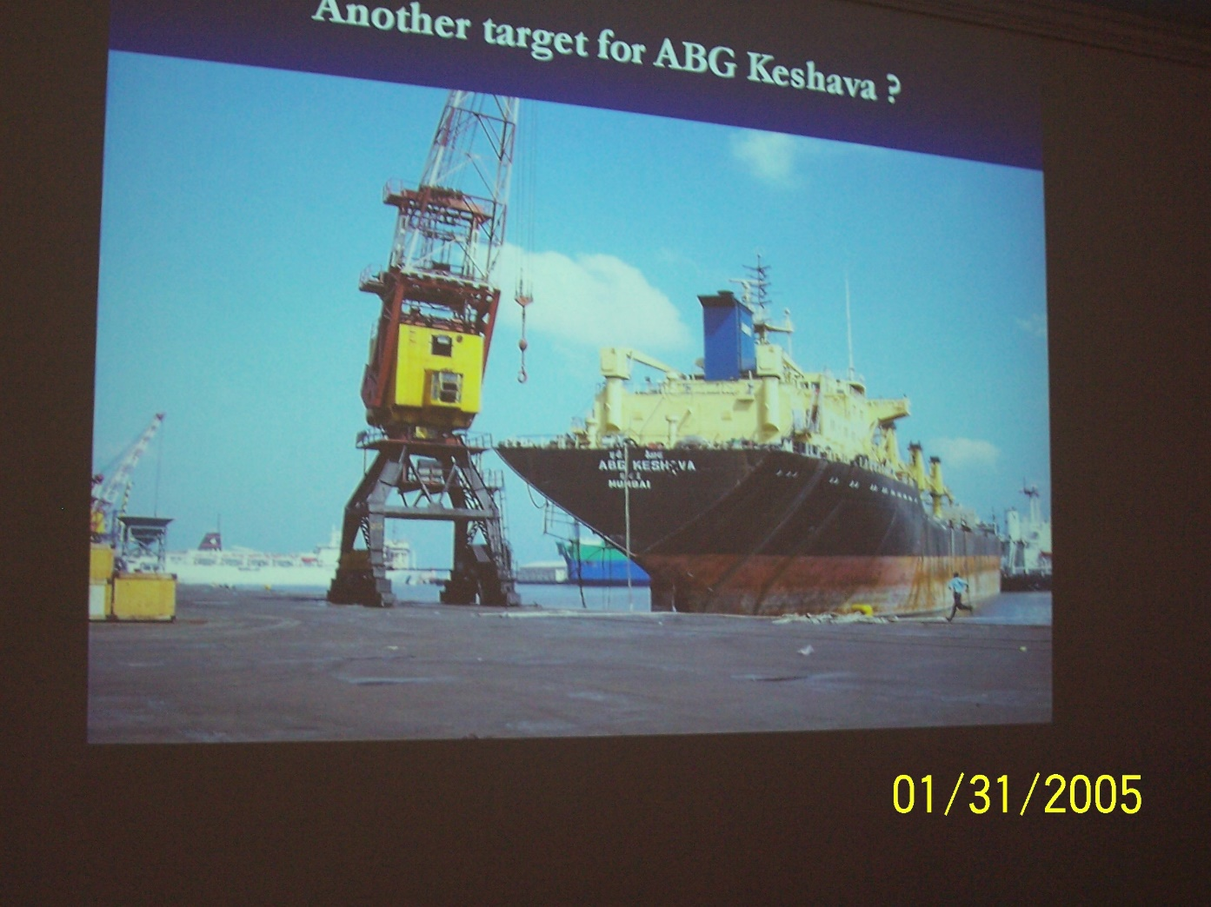
Vessel Impacting Wharf

Slide 13
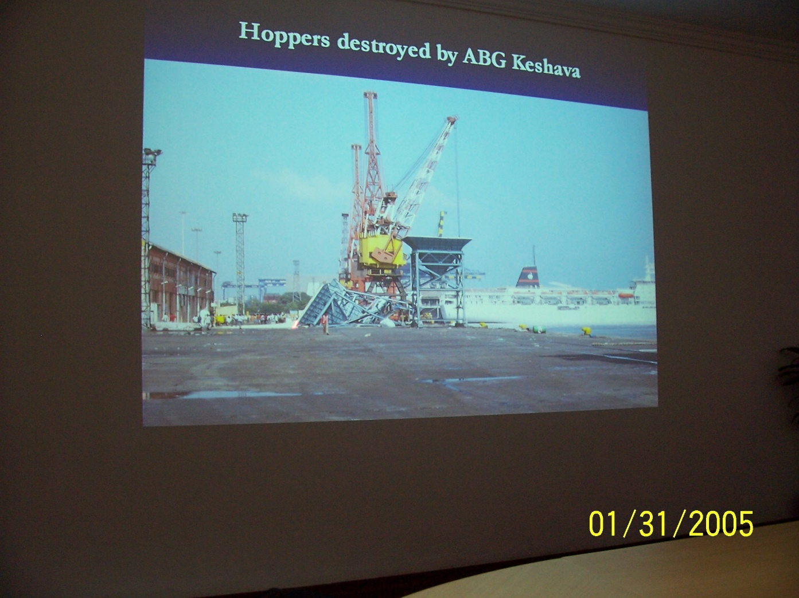
Vessel Impacting Hoppers on Wharf

Slide 14
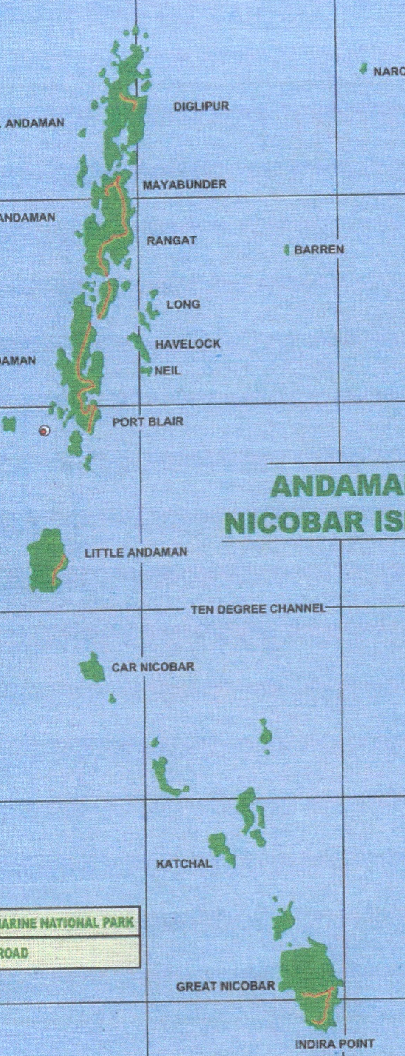
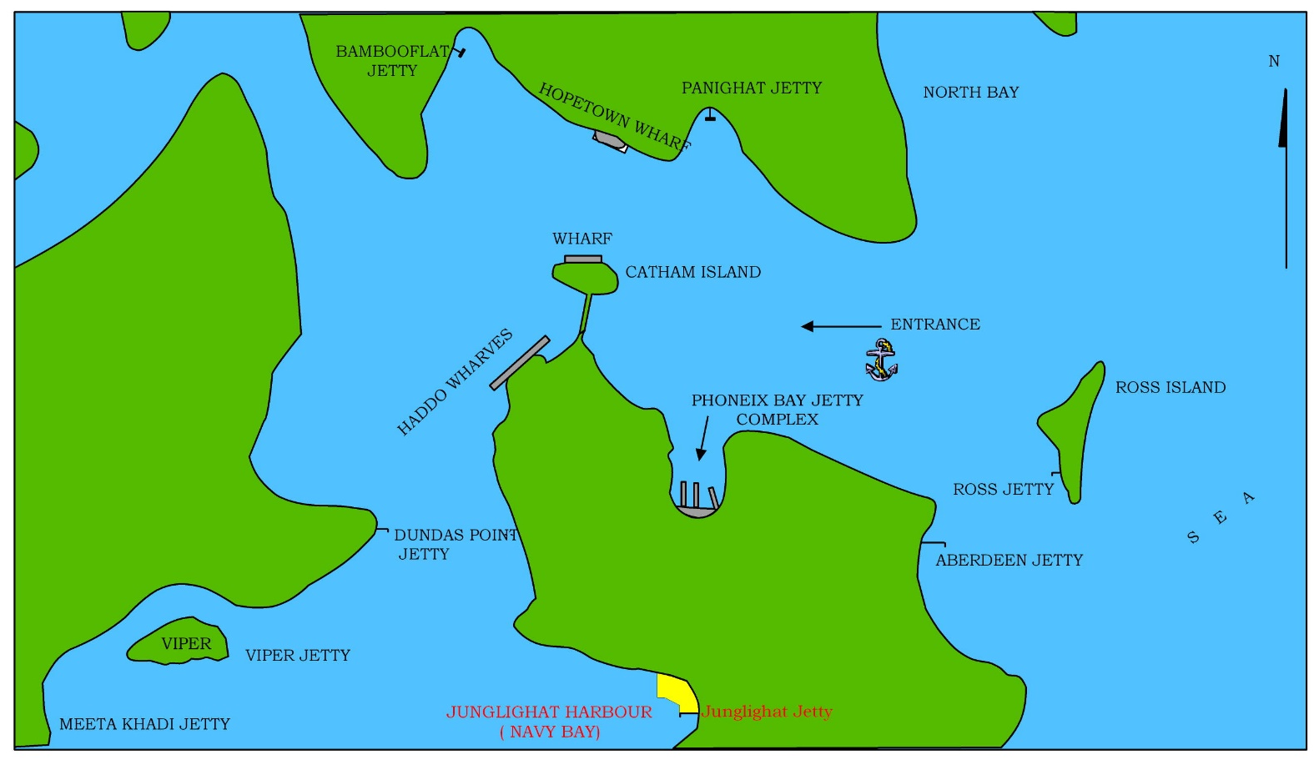
ALHW
PORT BLAIR HARBOUR
TIDAL DIFF + 1.0M

Slide 15
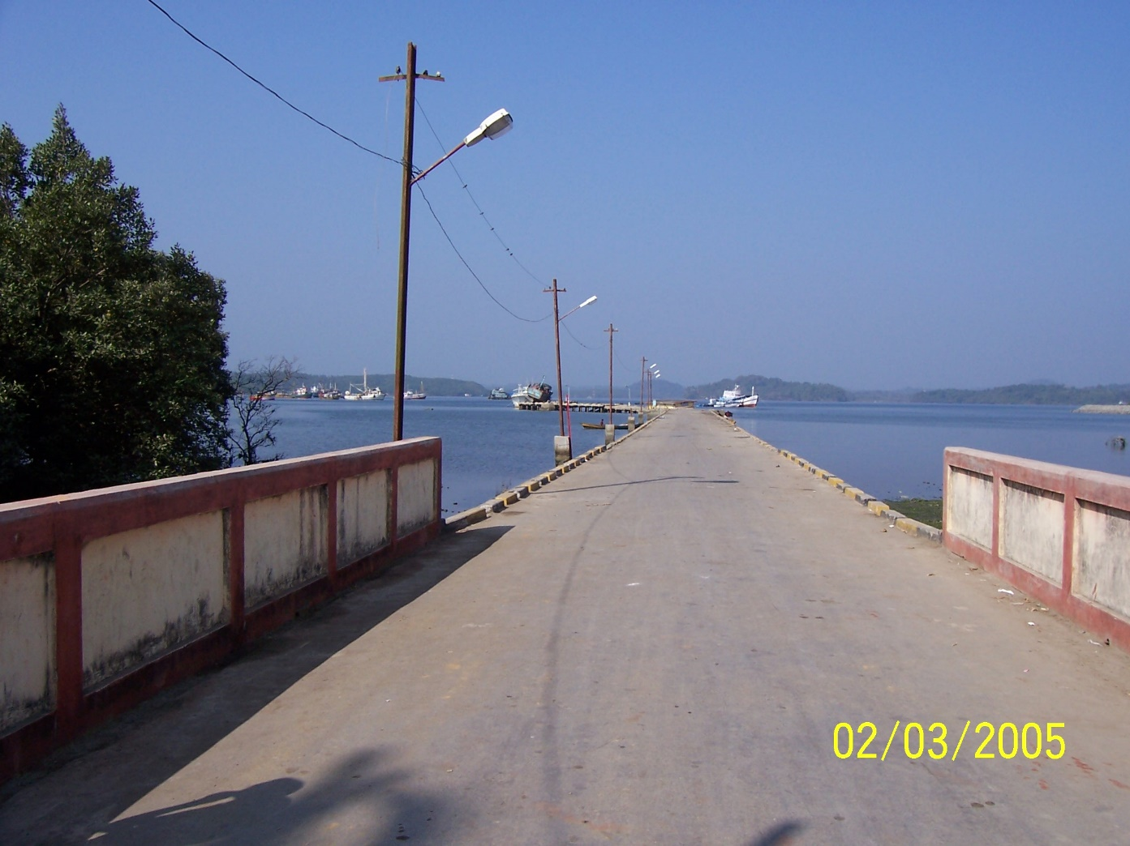
Junglighat Fishing Pier – rubble mount support

Slide 16
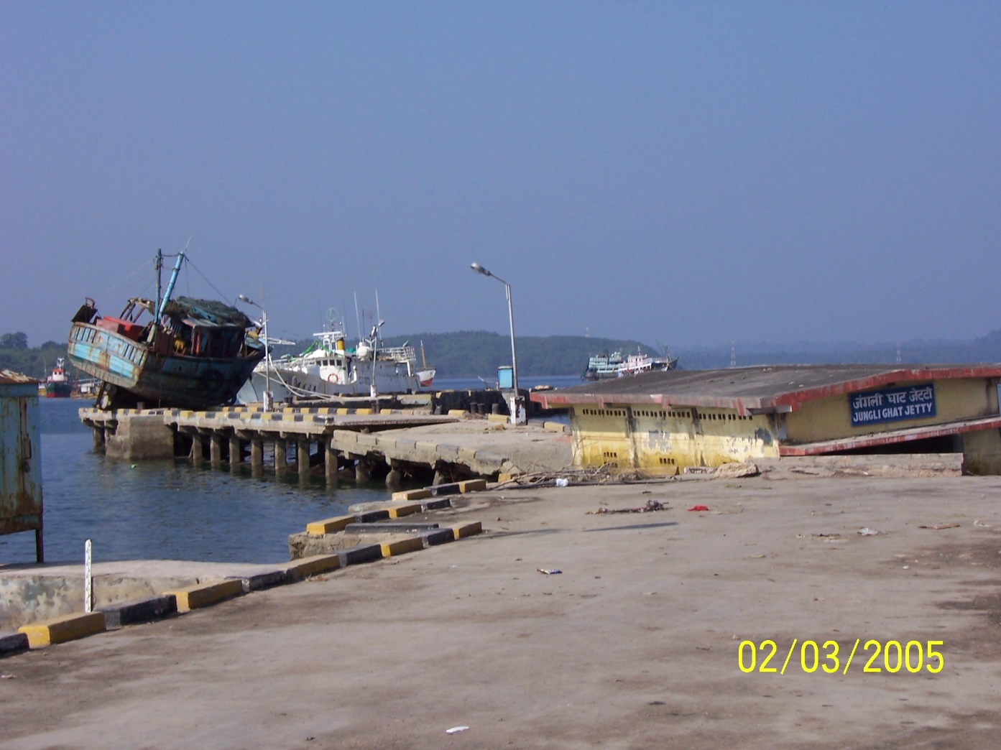
Junglighat Fishing Pier

Slide 17

Junglighat Fishing Pier

Slide 18
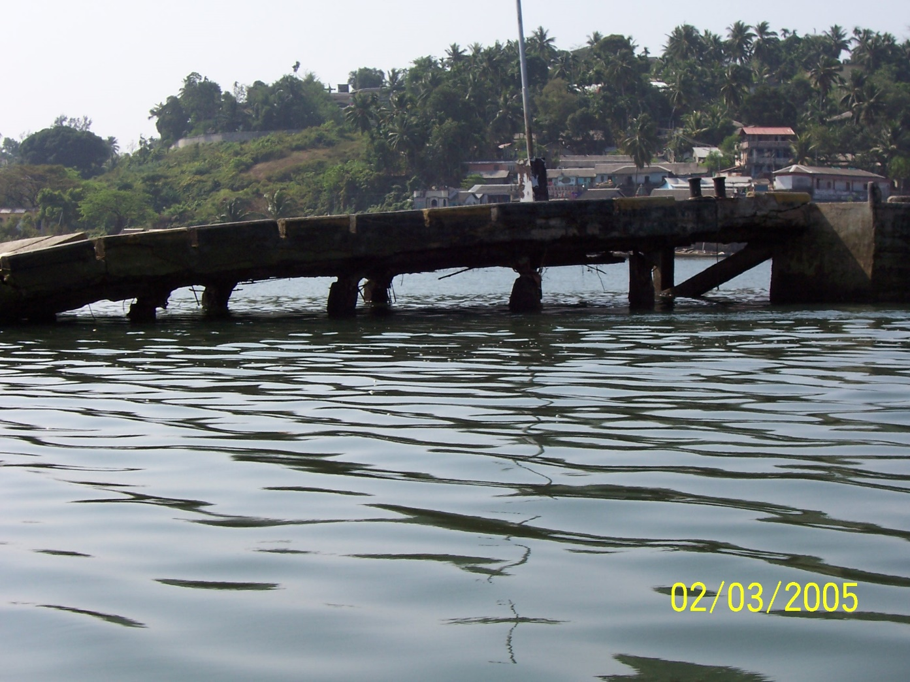
Junglighat Fishing Pier

Slide 19
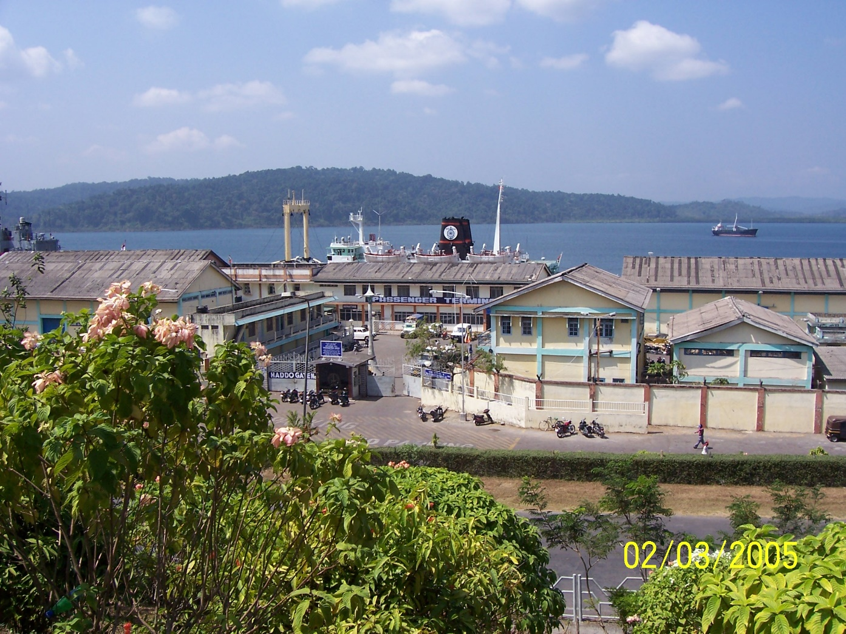
Port of Port Blair

Slide 20
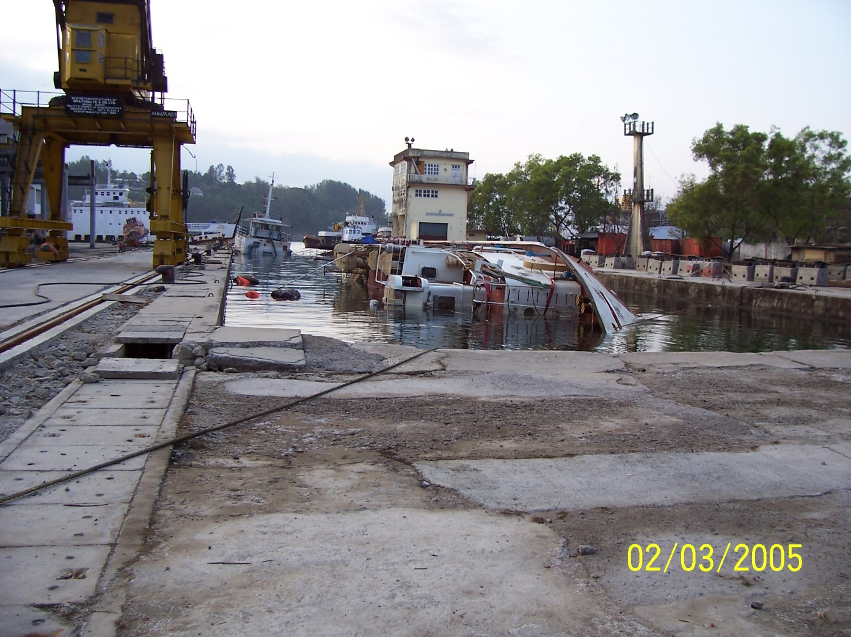
Dry Dock - Port Blair

Slide 21
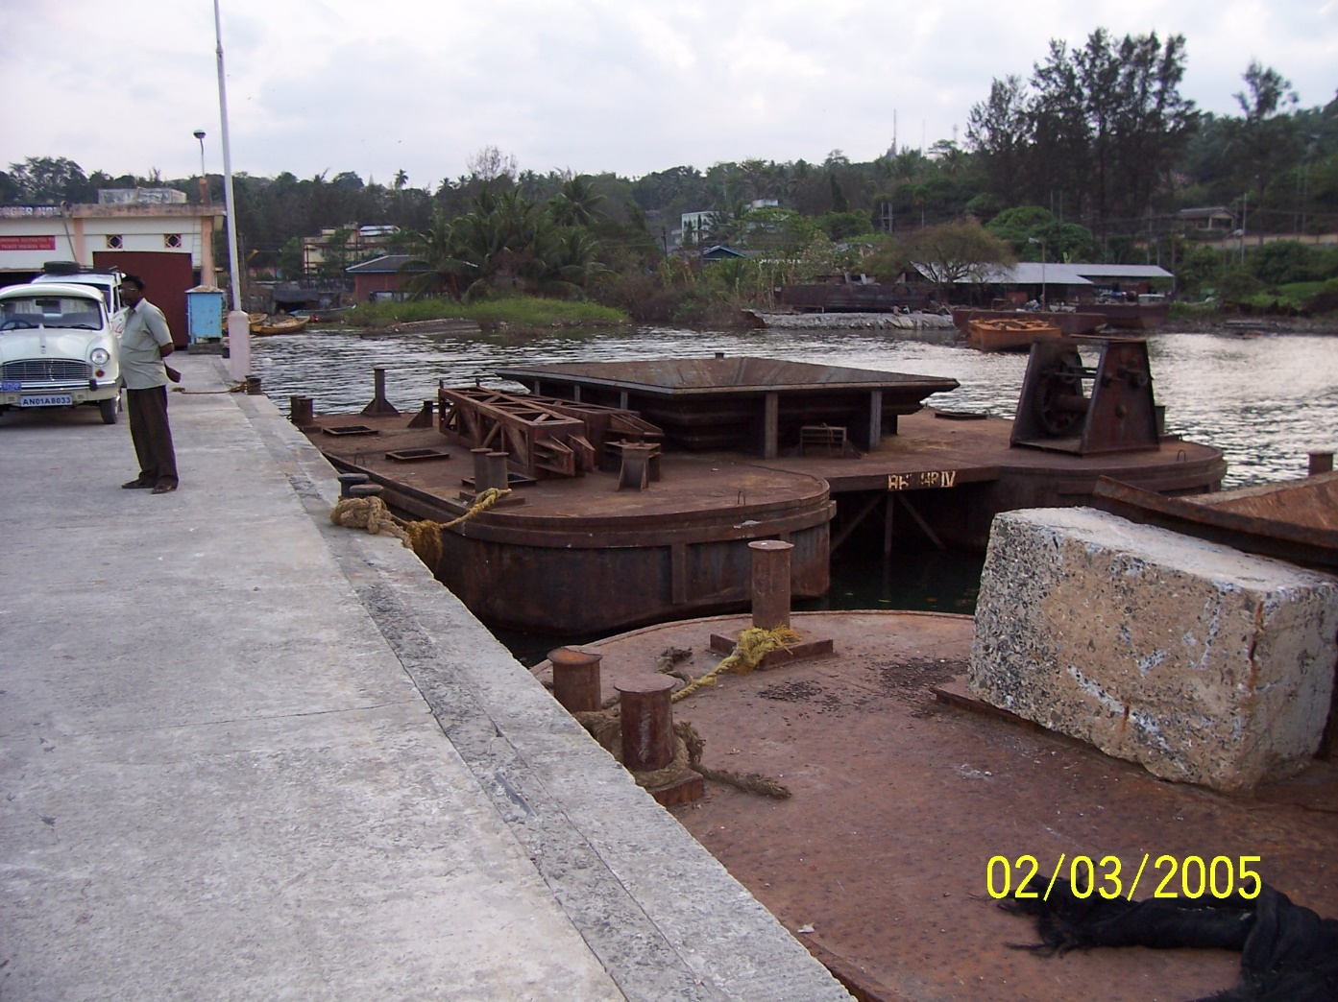
Barge was on top of wharf

Slide 22
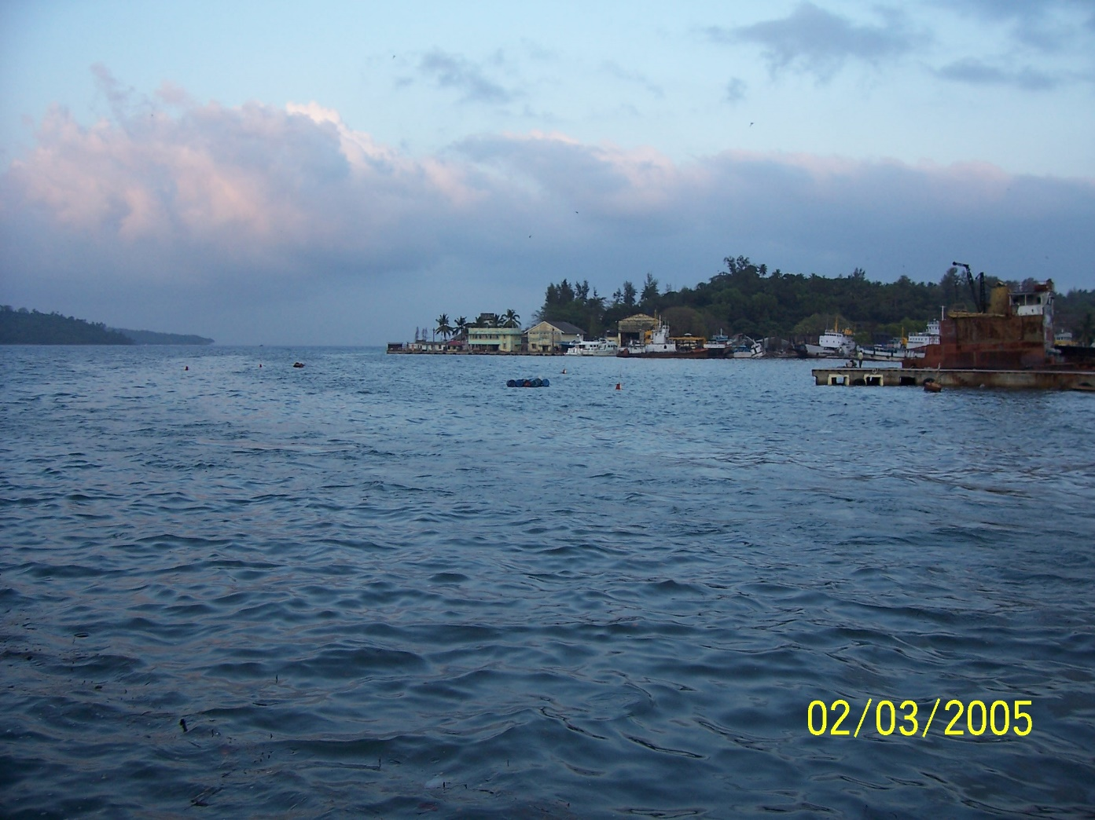
Pier collapse – Port Blair

Slide 23
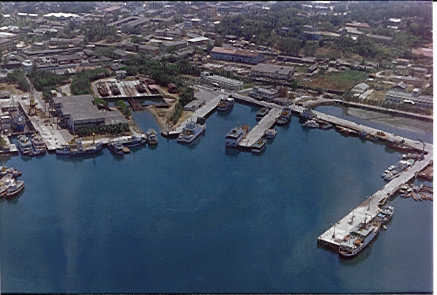
ALHW
PHOENIX BAY COMPLEX (BEFORE TSUNAMI)
COLLAPSED PORTION
TIDAL DIFF + 1.0M
FISHERIES JETTY

Slide 24
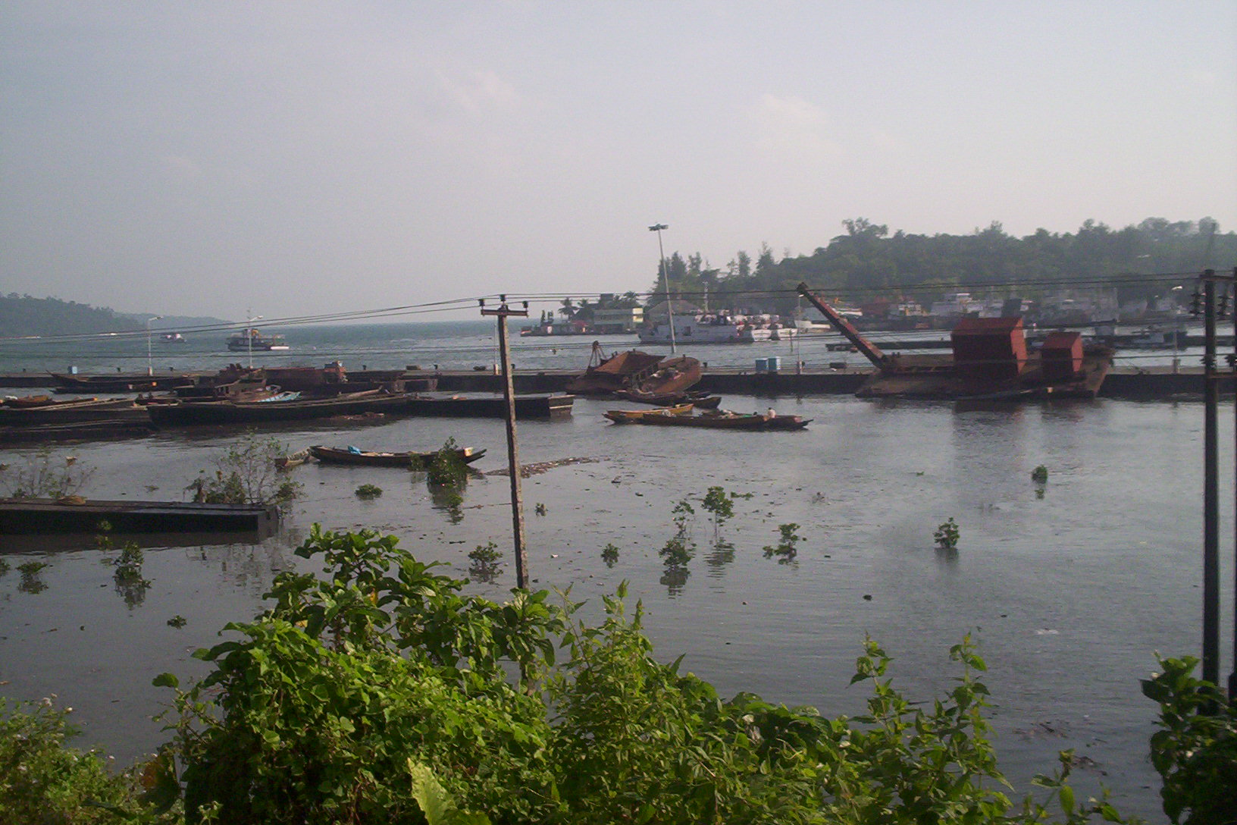
ALHW
COLLAPSED FISHERIES JETTY (AFTER TSUNAMI)
HIGH MAST LIGHT UNDER COLLAPSE
click for video

Slide 25
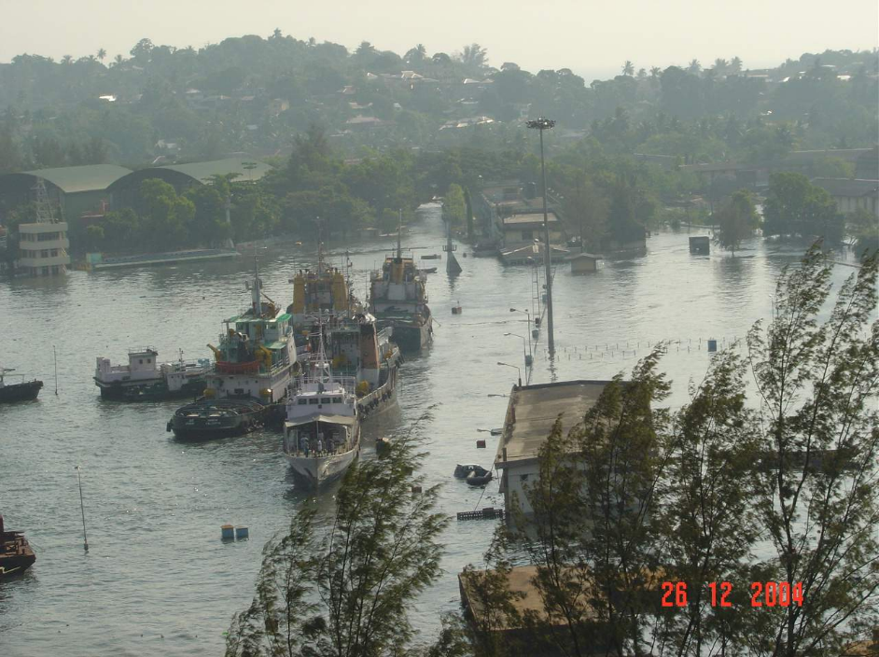
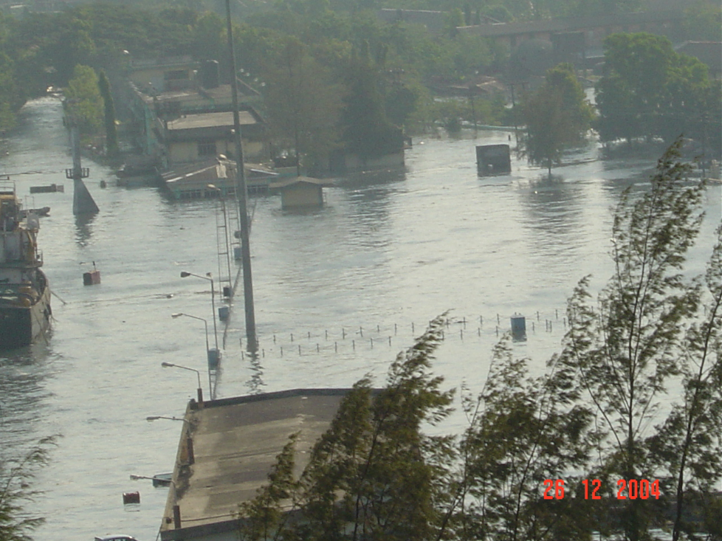
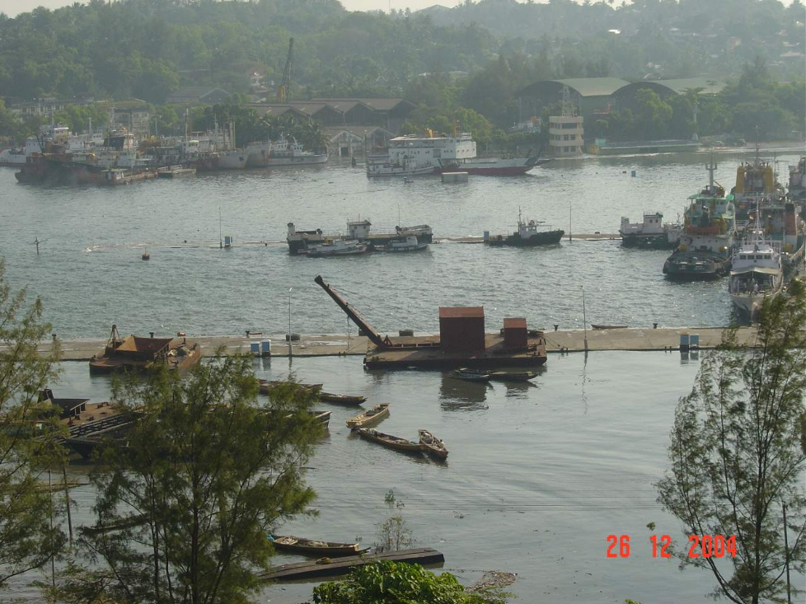
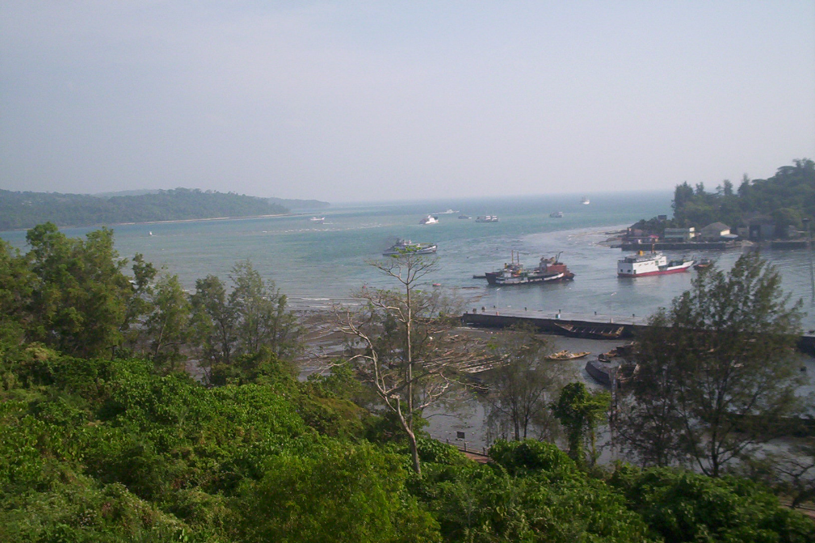
PHOENIX BAY COMPLEX (DURING TSUNAMI)

Slide 26
CONCLUSIONS AND OBSERVATIONS
MOORING LINES WILL “PART” IF SUBJECTED TO 4-5 METERS OF RUN-UP.
RECOMMENDED FAILURE MODE IS “PARTED” LINES, NOT BROKEN OFF BITTS, BOLLARDS OR HOOKS.
TSUNAMI CURRENTS DO NOT GENERALLY “PART” MOORING LINES.
CREWS WILL TRY TO LEAVE THE VESSEL WHEN IN PANIC CONDITIONS.

Slide 27
CONCLUSIONS AND OBSERVATIONS
LIGHT USE TIMBER WHARVES/PIERS WILL LOSE DECKING OR POSSIBLY COLLAPSE.
CONCRETE/STEEL PILE SUPPORTED MODERN WHARVES/PIERS WILL SURVIVE.
TSUNAMI DAMAGE IN A PORT DUE PRIMARILY TO VESSEL IMPACT.
VESSELS UNDER POWER MAY NOT HAVE ENOUGH THRUST TO COUNTER HIGH VELOCITIES ASSOCIATED WITH A TSUNAMI.

Slide 28
RECOMMENDATIONS
MANDATE UNDERWATER INSPECTION PROGRAM.
PORT PROTOCOL – VESSELS TO LEAVE PORT FOLLOWING AN EARTHQUAKE
ACCELEROMETERS – ON PIERS/WHARVES
A QUICK EGRESS TO HIGHER GROUND WITH SIGNS.

Slide 29
RECOMMENDATIONS
“HARDENED” COMMUNICATION SYSTEM BETWEEN VARIOUS PORTS/COASTAL AREAS.
EMERGENCY COMMUNICATIONS WITH OTHER COUNTRIES, STATES – AREAS CLOSER TO POSSIBLE TSUNAMI.
EDUCATION – MUST BE GENERATIONAL.

