Slide 1
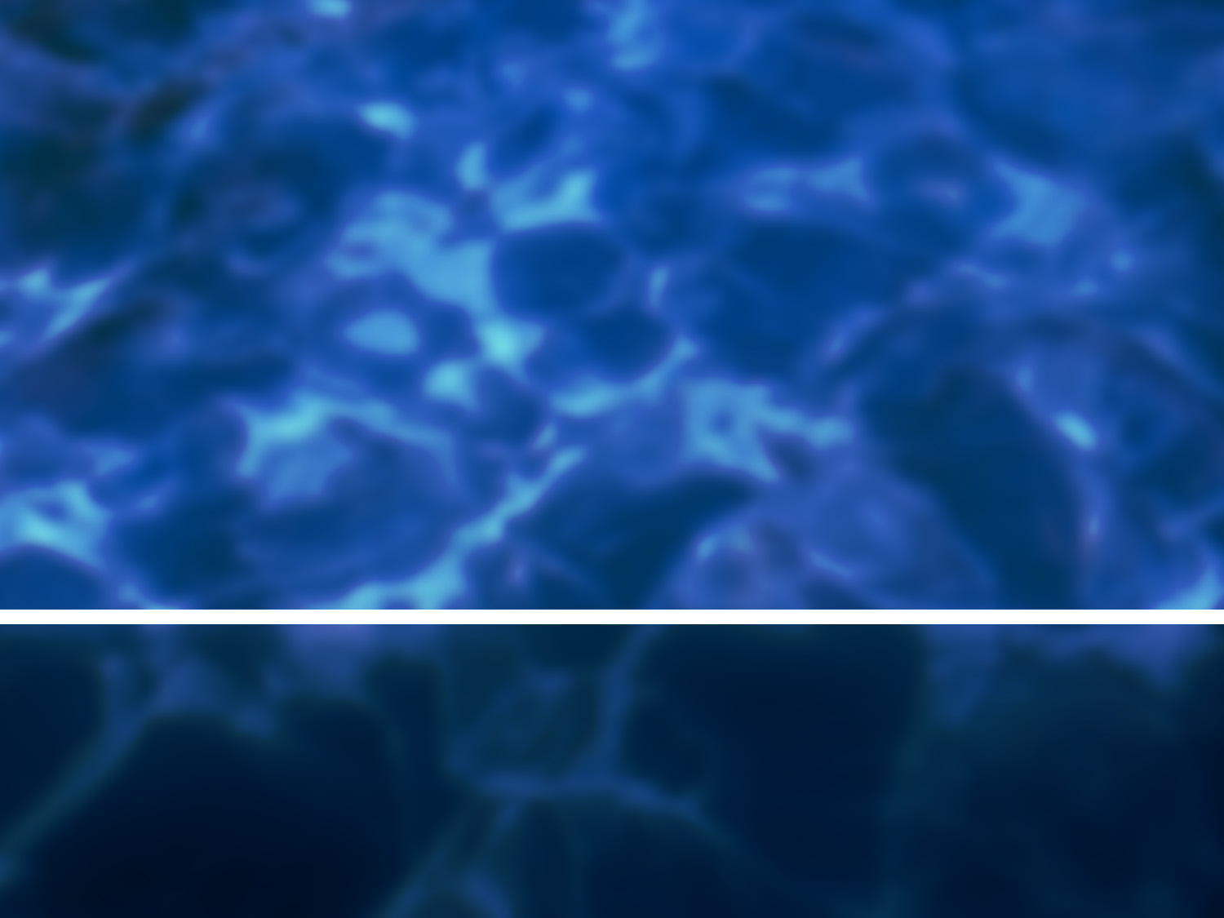
Wave Hydrodynamics In Ports of Los Angeles and Long Beach Tsunami Safety Committee July 25, 2005
By
David Dykstra
Moffatt & Nichol

Slide 2
Table of Contents
Coastal Wave Processes
Physical Modeling
Numerical Modeling of Wave Propagation
Ship Motion

Slide 3
Coastal Wave Processes

Slide 4
Coastal Wave Processes
Wave energy spectra
Wave refraction, diffraction, reflection, shoaling
Wave transmission through breakwaters
Harbor resonance
Deep water vs shallow water waves
Short period vs long period waves
Wave runup

Slide 5
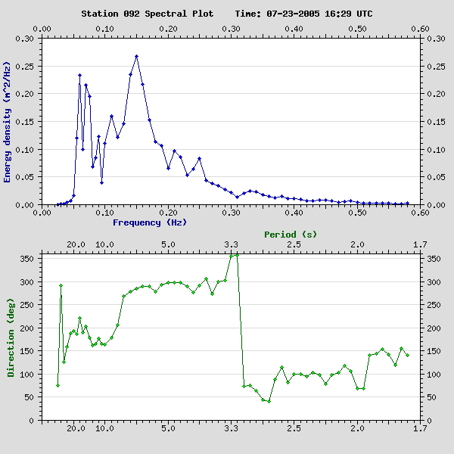
Example Deep Water Spectral Data
Courtesy of CDIP

Slide 6
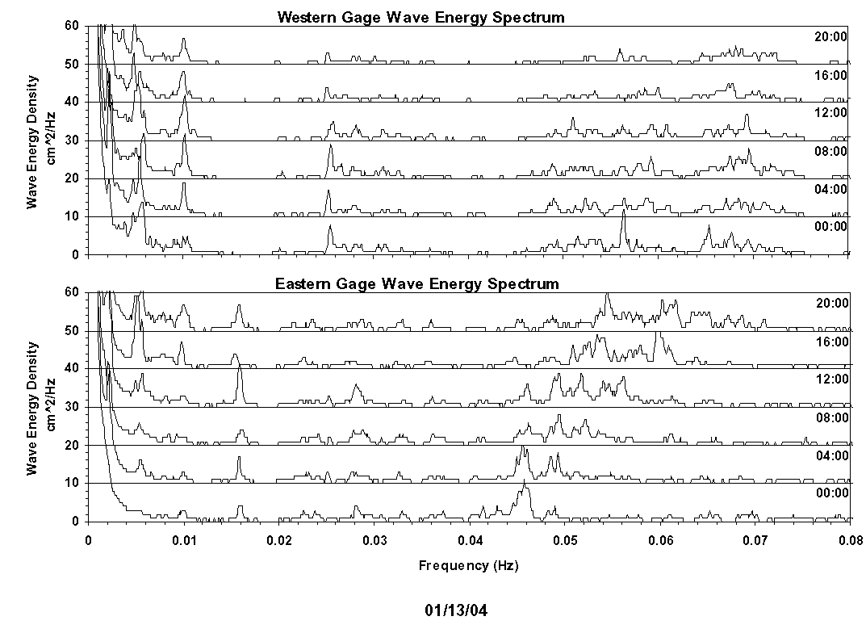
Example Port Spectral Data

Slide 7
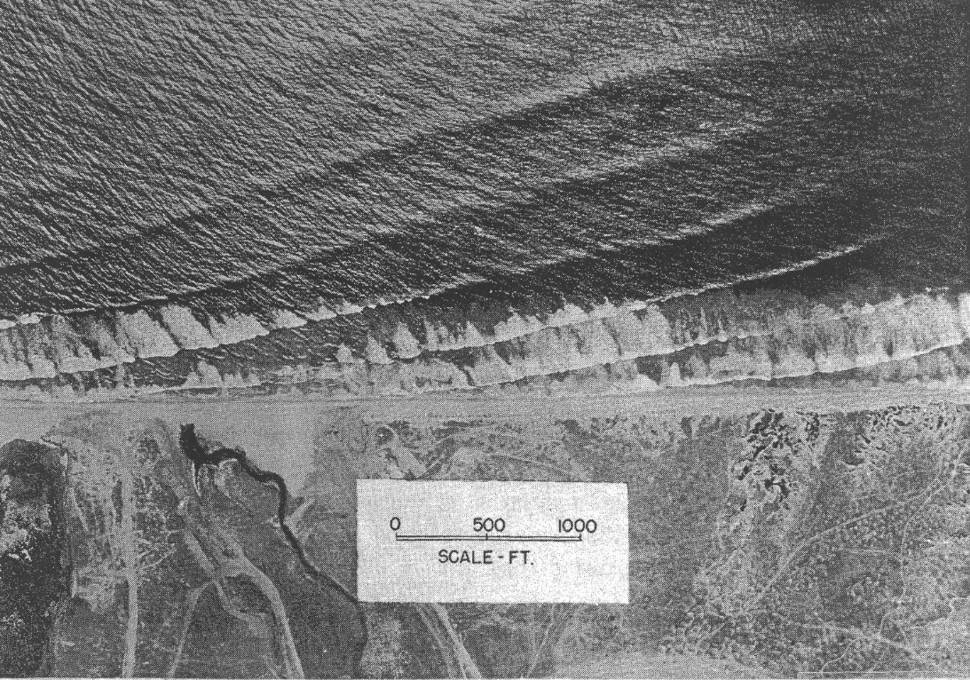
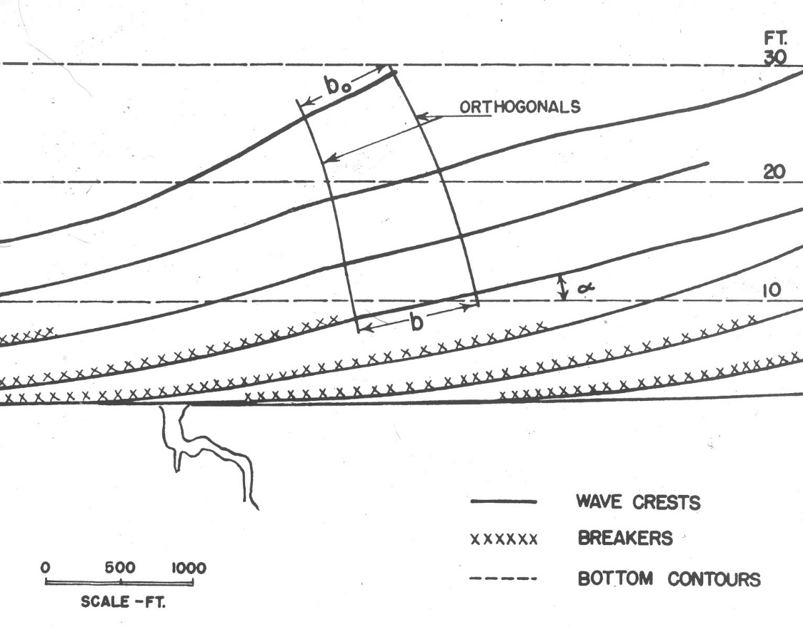
Wave Refraction
After Weigel, 1964

Slide 8
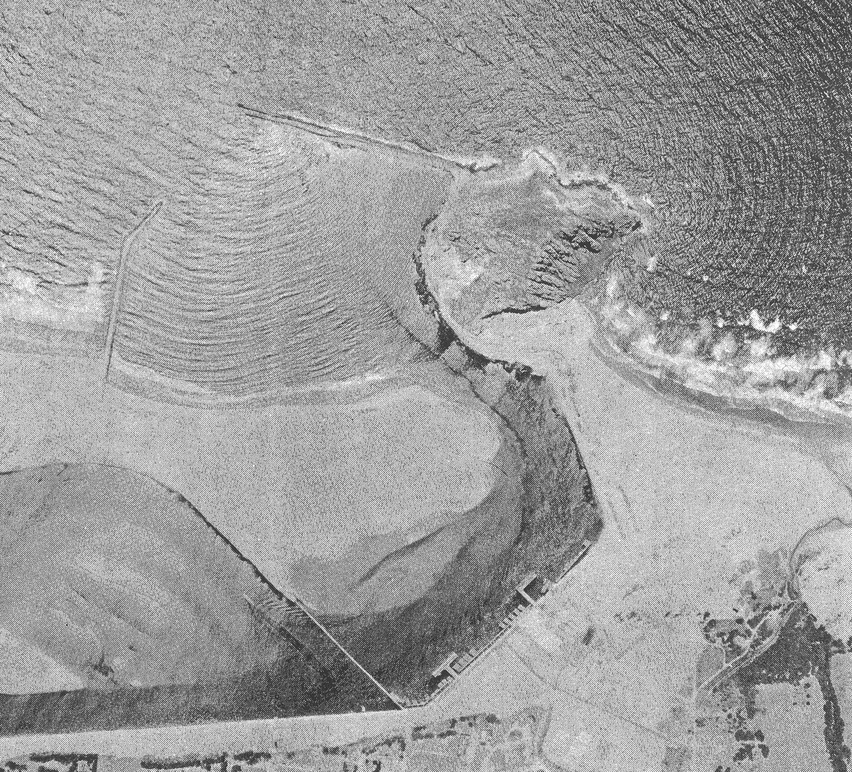
Wave Diffraction
After Weigel, 1964

Slide 9
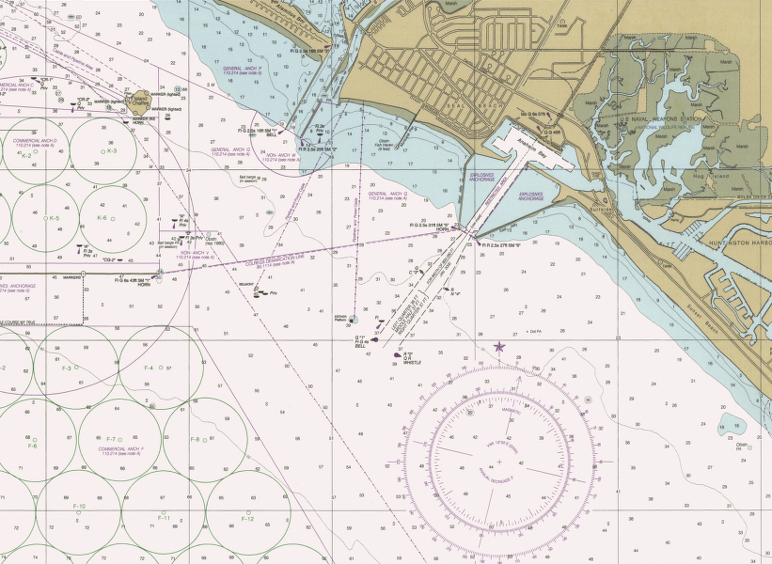
Wave Reflection

Slide 10
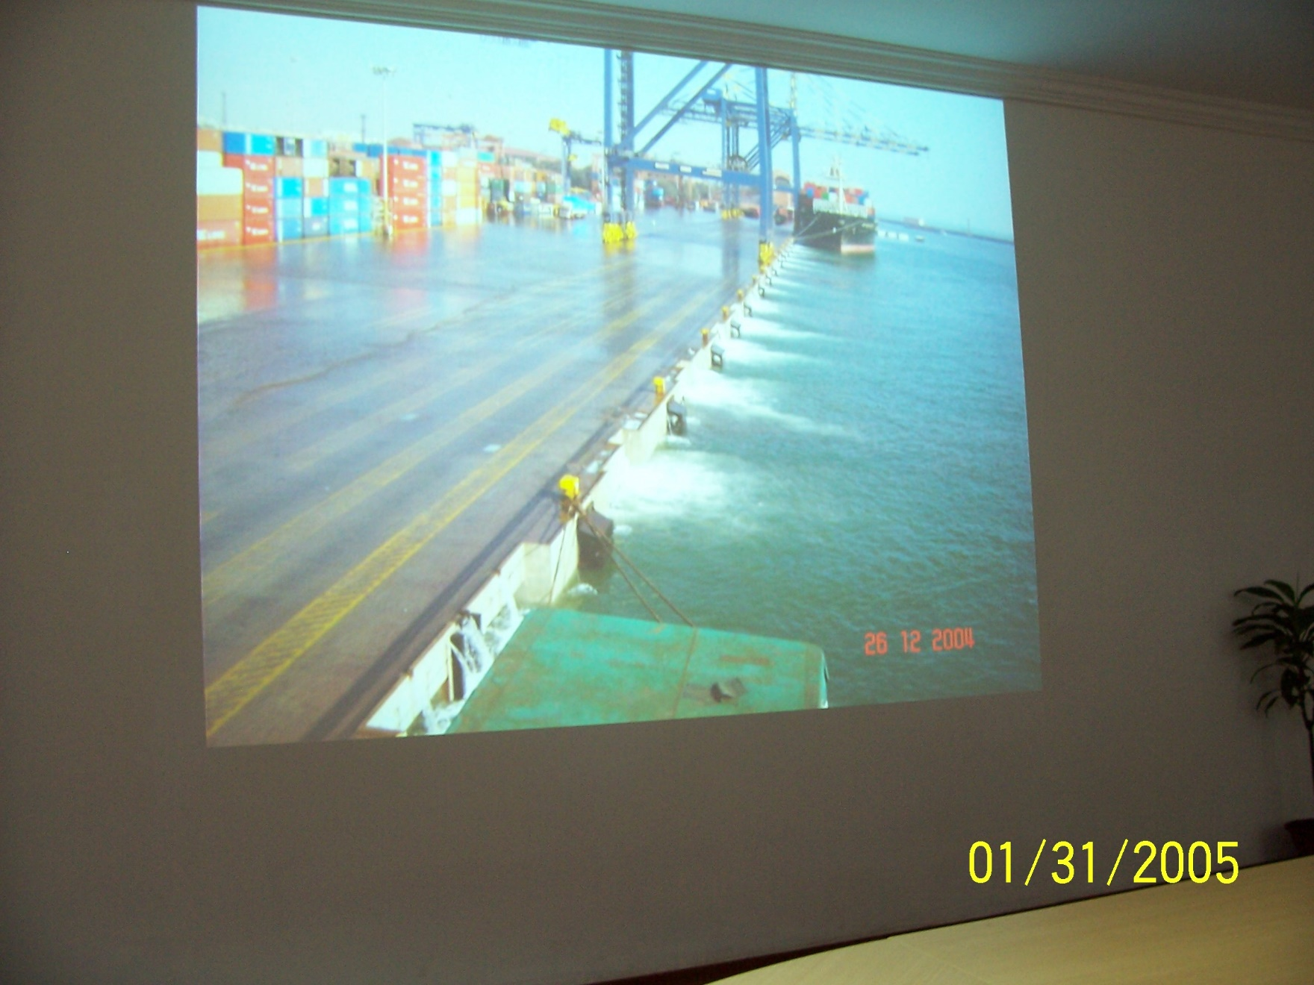
Container Wharf – Port of Chennai, India 4.1 m Tsunami

Slide 11
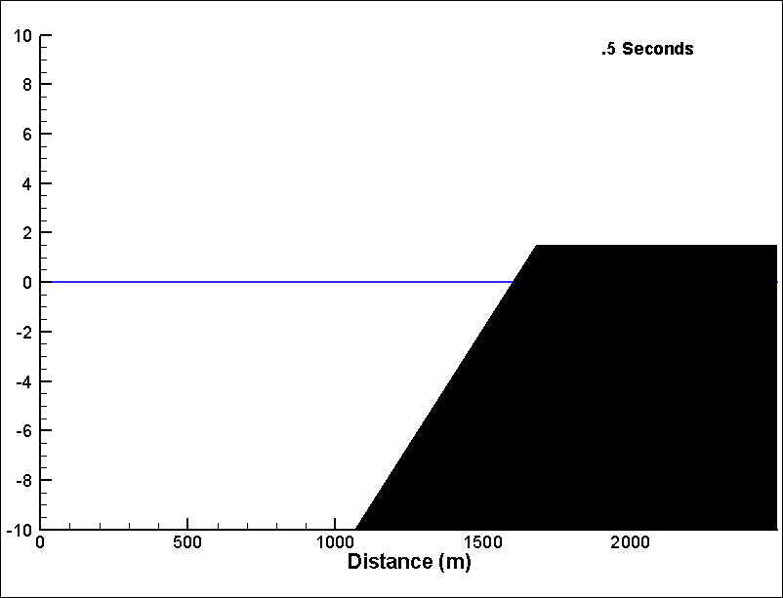
Wave Runup & Overtopping

Slide 12
Physical Modeling

Slide 13
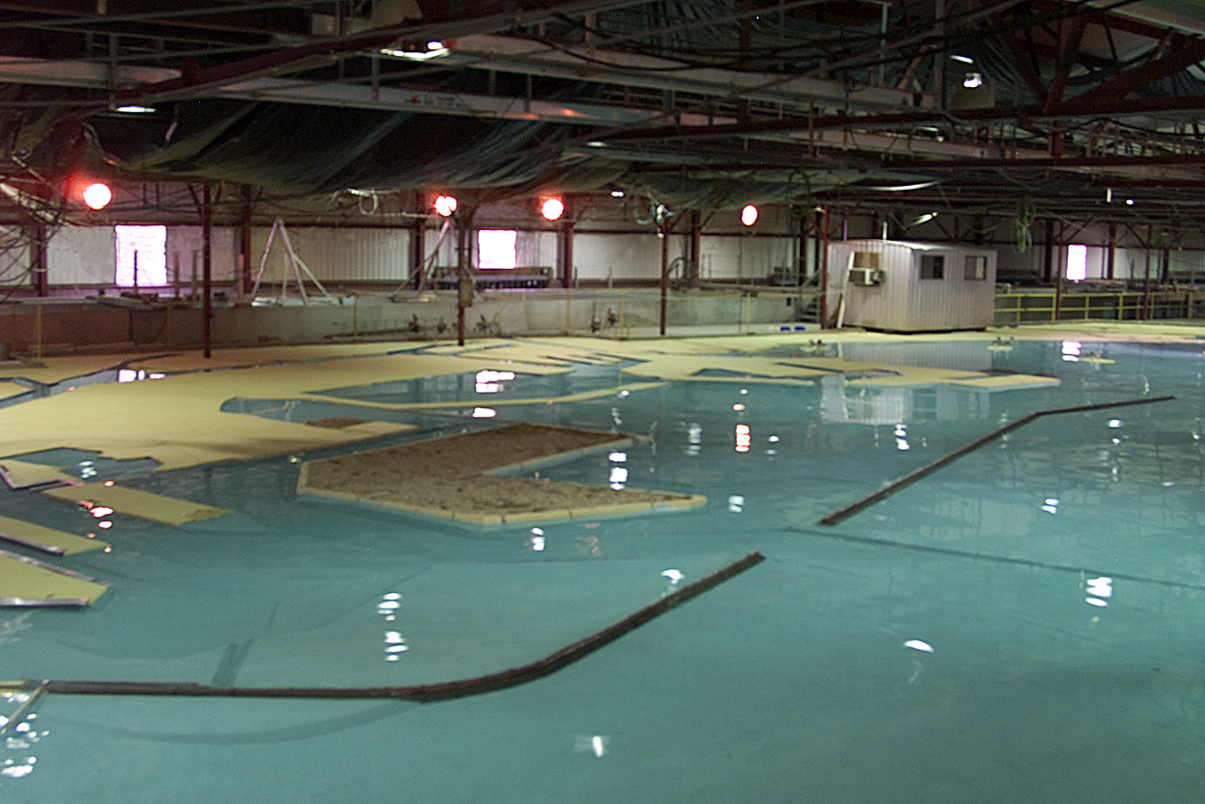
USACOE Physical Model
Located in Vicksburg, Mississippi
Constructed in 1973
Includes San Pedro Bay out to the 300 ft contour
Shoreline from 2 mi northwest of Point Fermin to Huntington Beach
The largest operating physical model in the world, covering an area of 253 sq mi in the prototype.
Continuously updated to match changes in prototype bathymetry and harbor modifications.

Slide 14
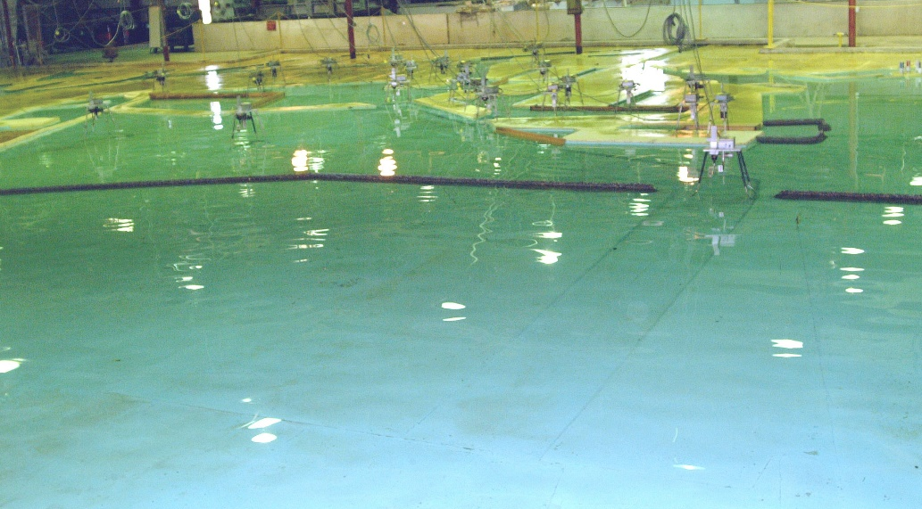
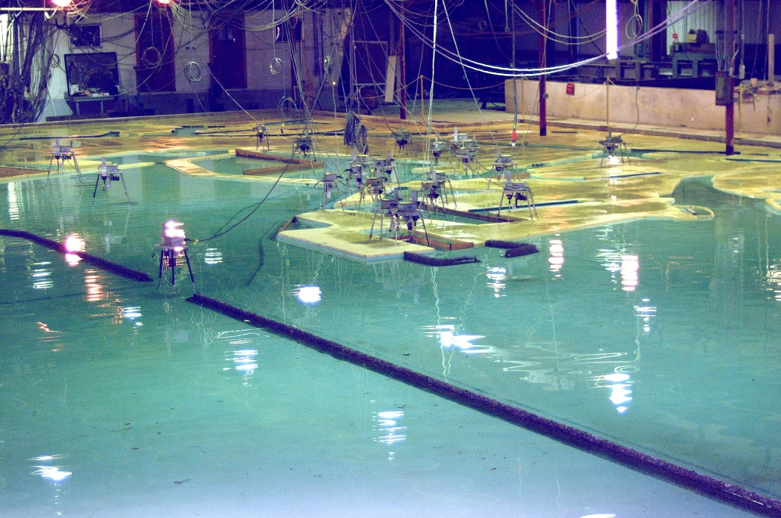
Physical Model
Distorted-Scale Model
1:100 Vertical
1:400 Horizontal
Time and frequency 1:40
Spectral and Monochromatic Waves

Slide 15
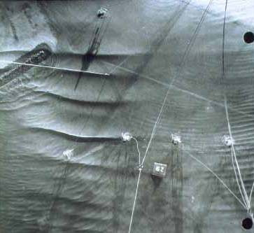

Slide 16
Performance Of J19 Breakwater - Gage 81
5
EXISTING PIER J
WITH J19 BREAKWATER
4
3
Amplification (H₈₁/h_{i})
2
1
0
0
20
40
60
80
100
120
140
160
180
Period (Sec)

Slide 17
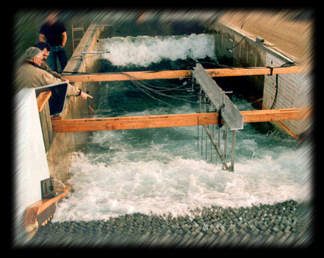


O. H. Hinsdale Wave Research Laboratory

Slide 18
Numerical Modeling

Slide 19
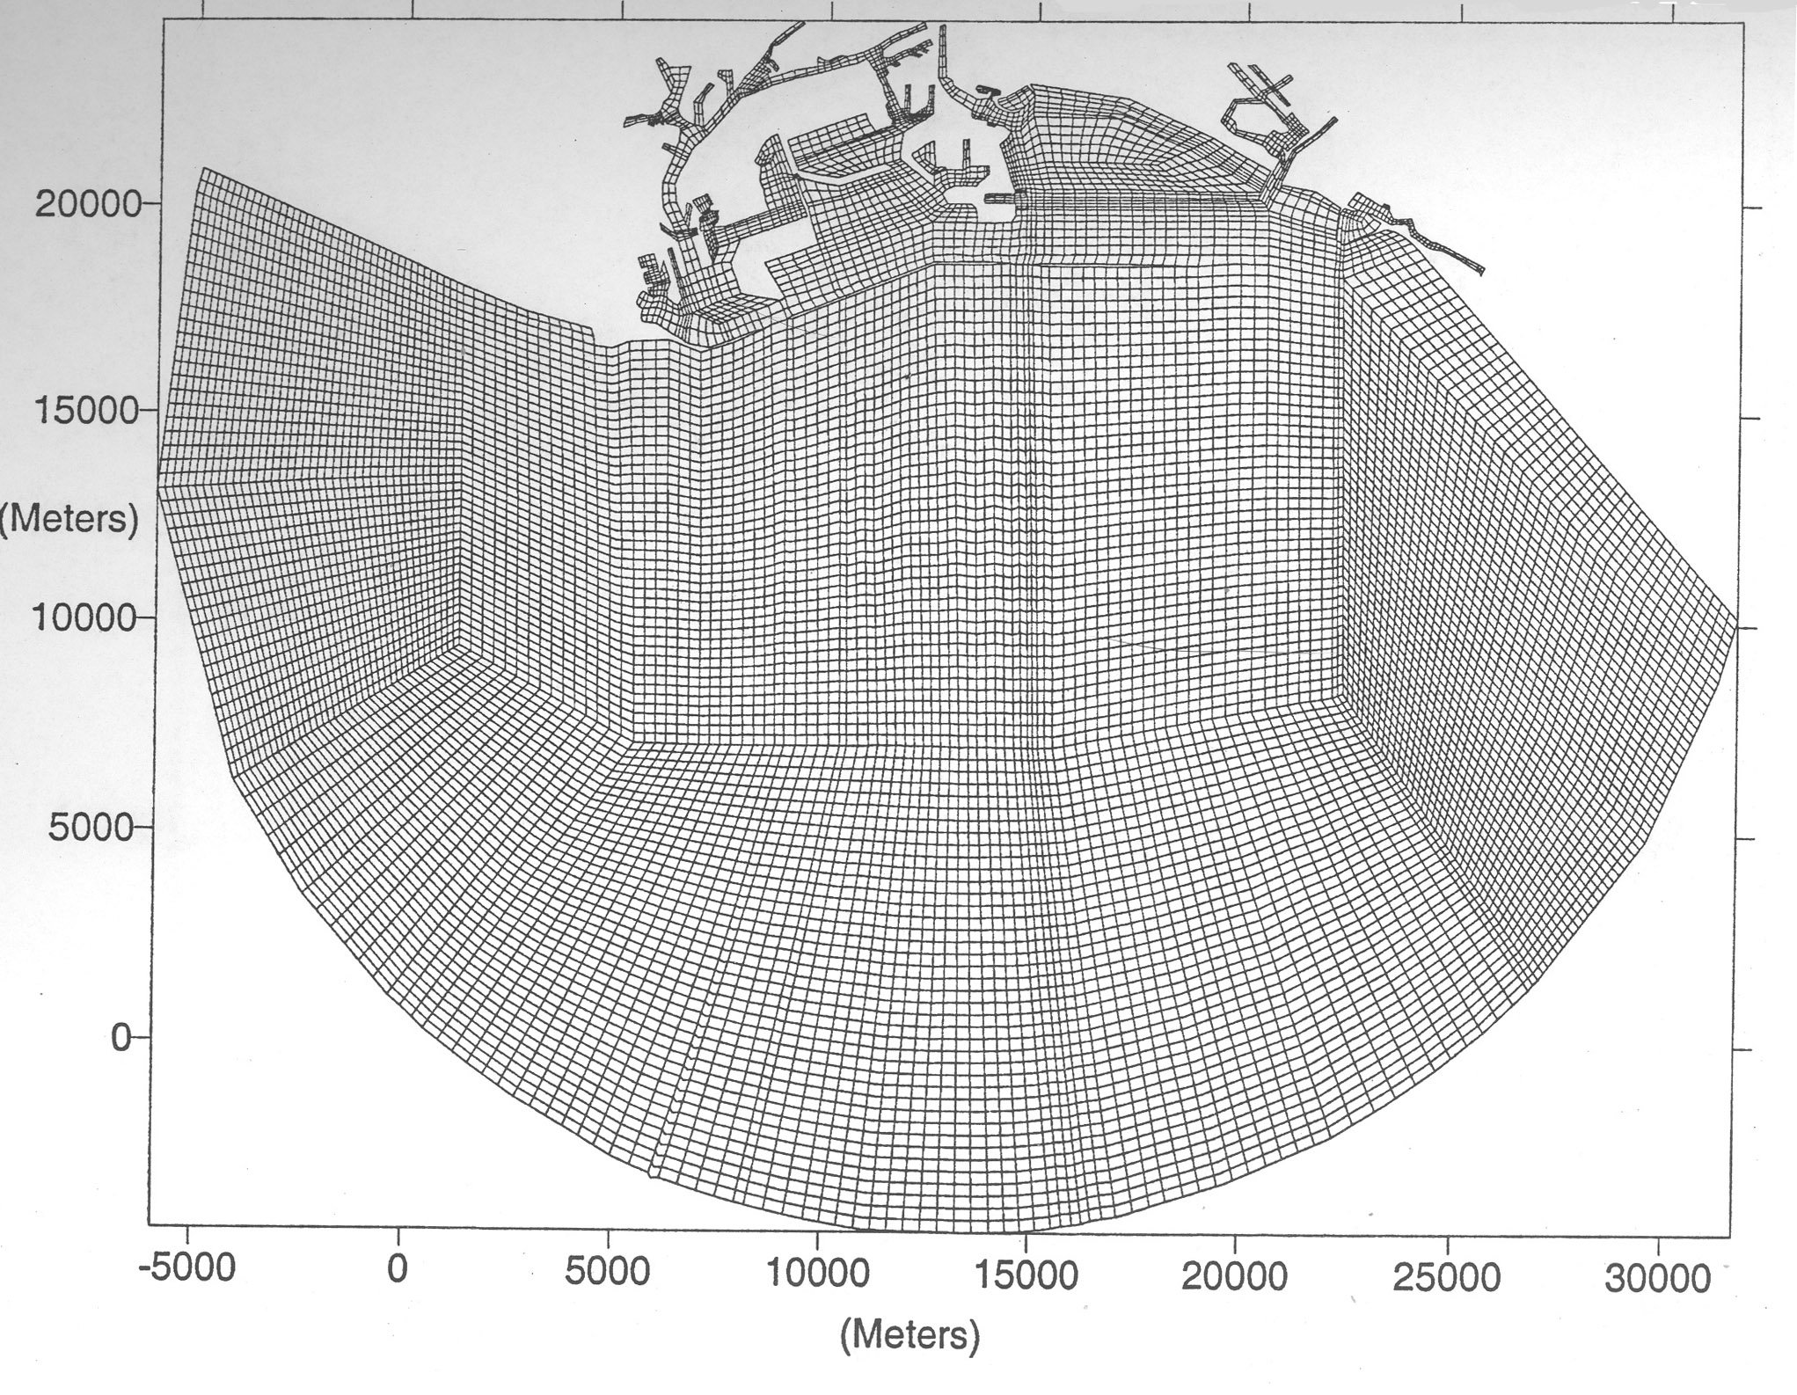
Harbor Resonance Numerical Model

Slide 20
Hydrodynamic Model Setup

Slide 21
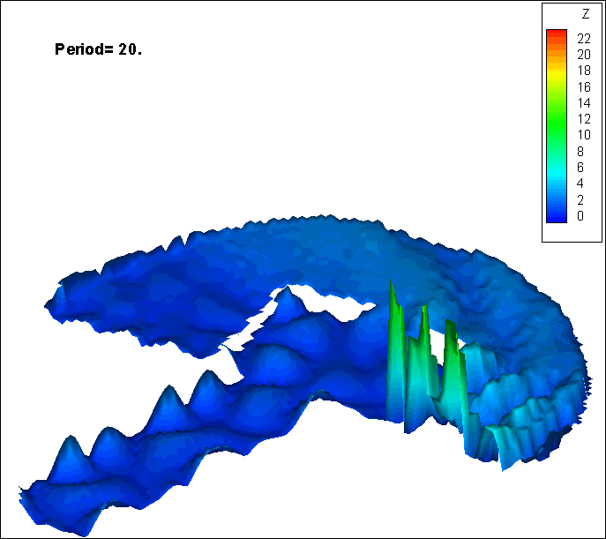
Computed Wave Amplification vs Wave Period

Slide 22
Example of Short Wave Propagation into the Ports

Slide 23
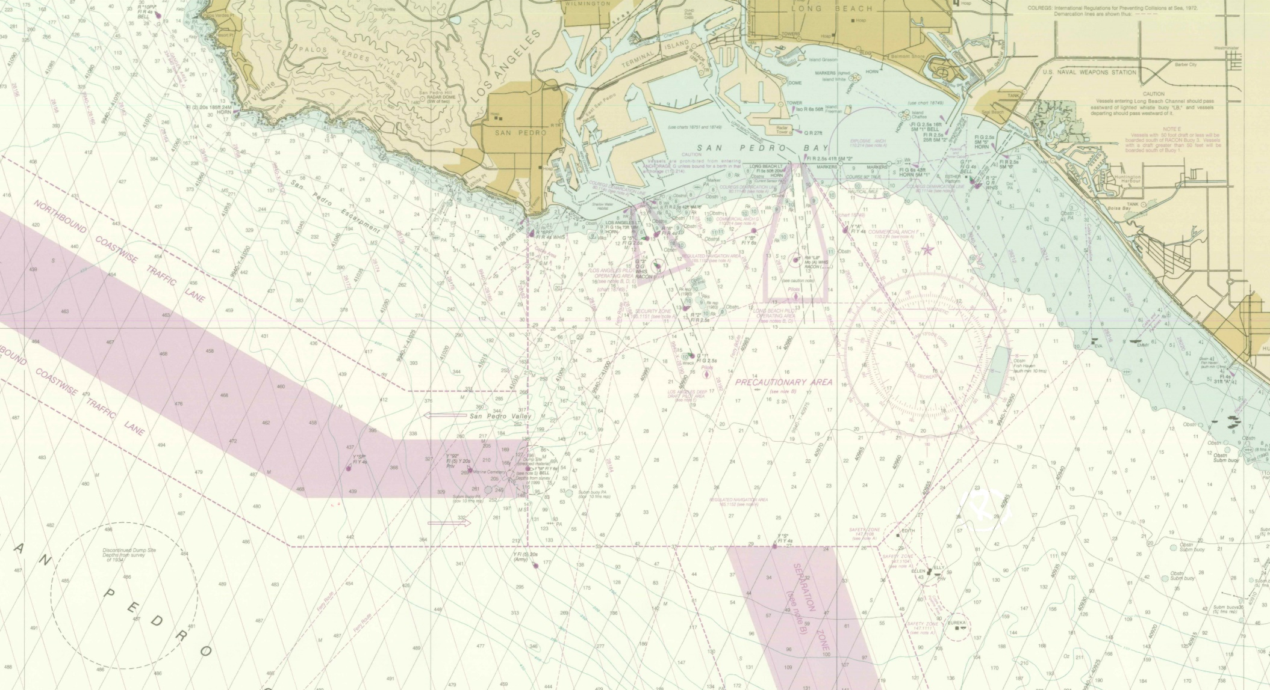
Palos Verdes Landslide Tsunami

Slide 24
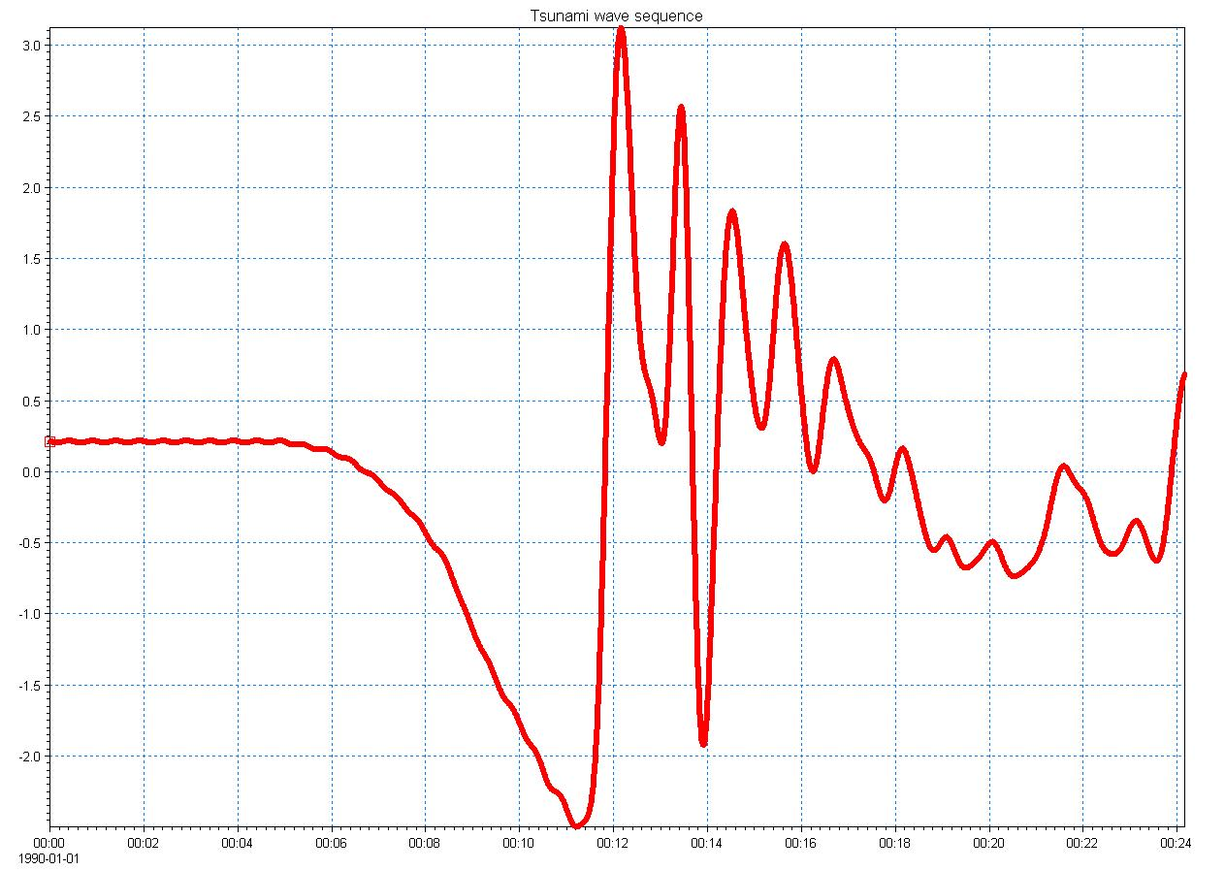
Water Level Time Series
After Borrero et al 2005

Slide 25
Preliminary Tsunami Propagation Results
With Federal Breakwater – 50% Transmission
Without Federal Breakwater

Slide 26
Ship Motion Modeling

Slide 27
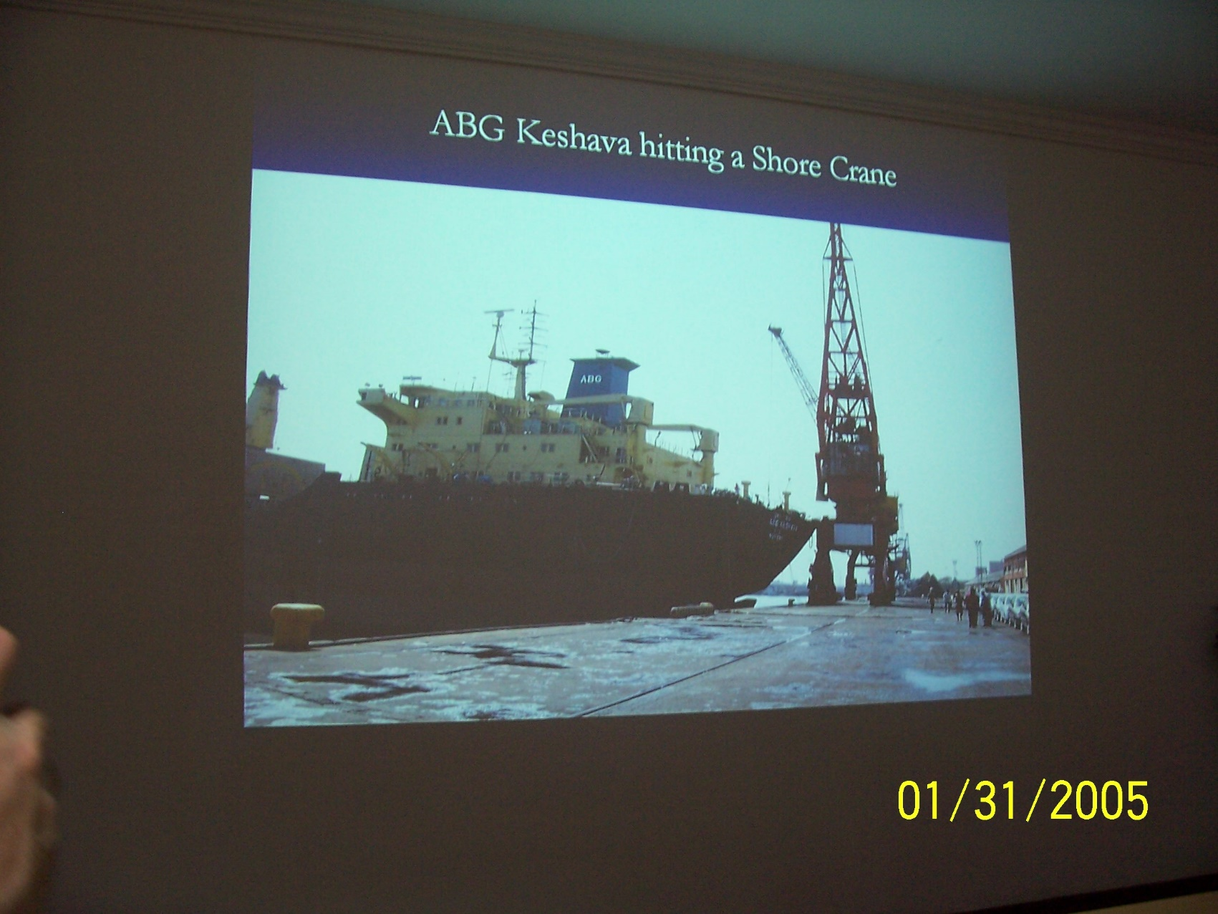
Port of Chennai, India

Slide 28
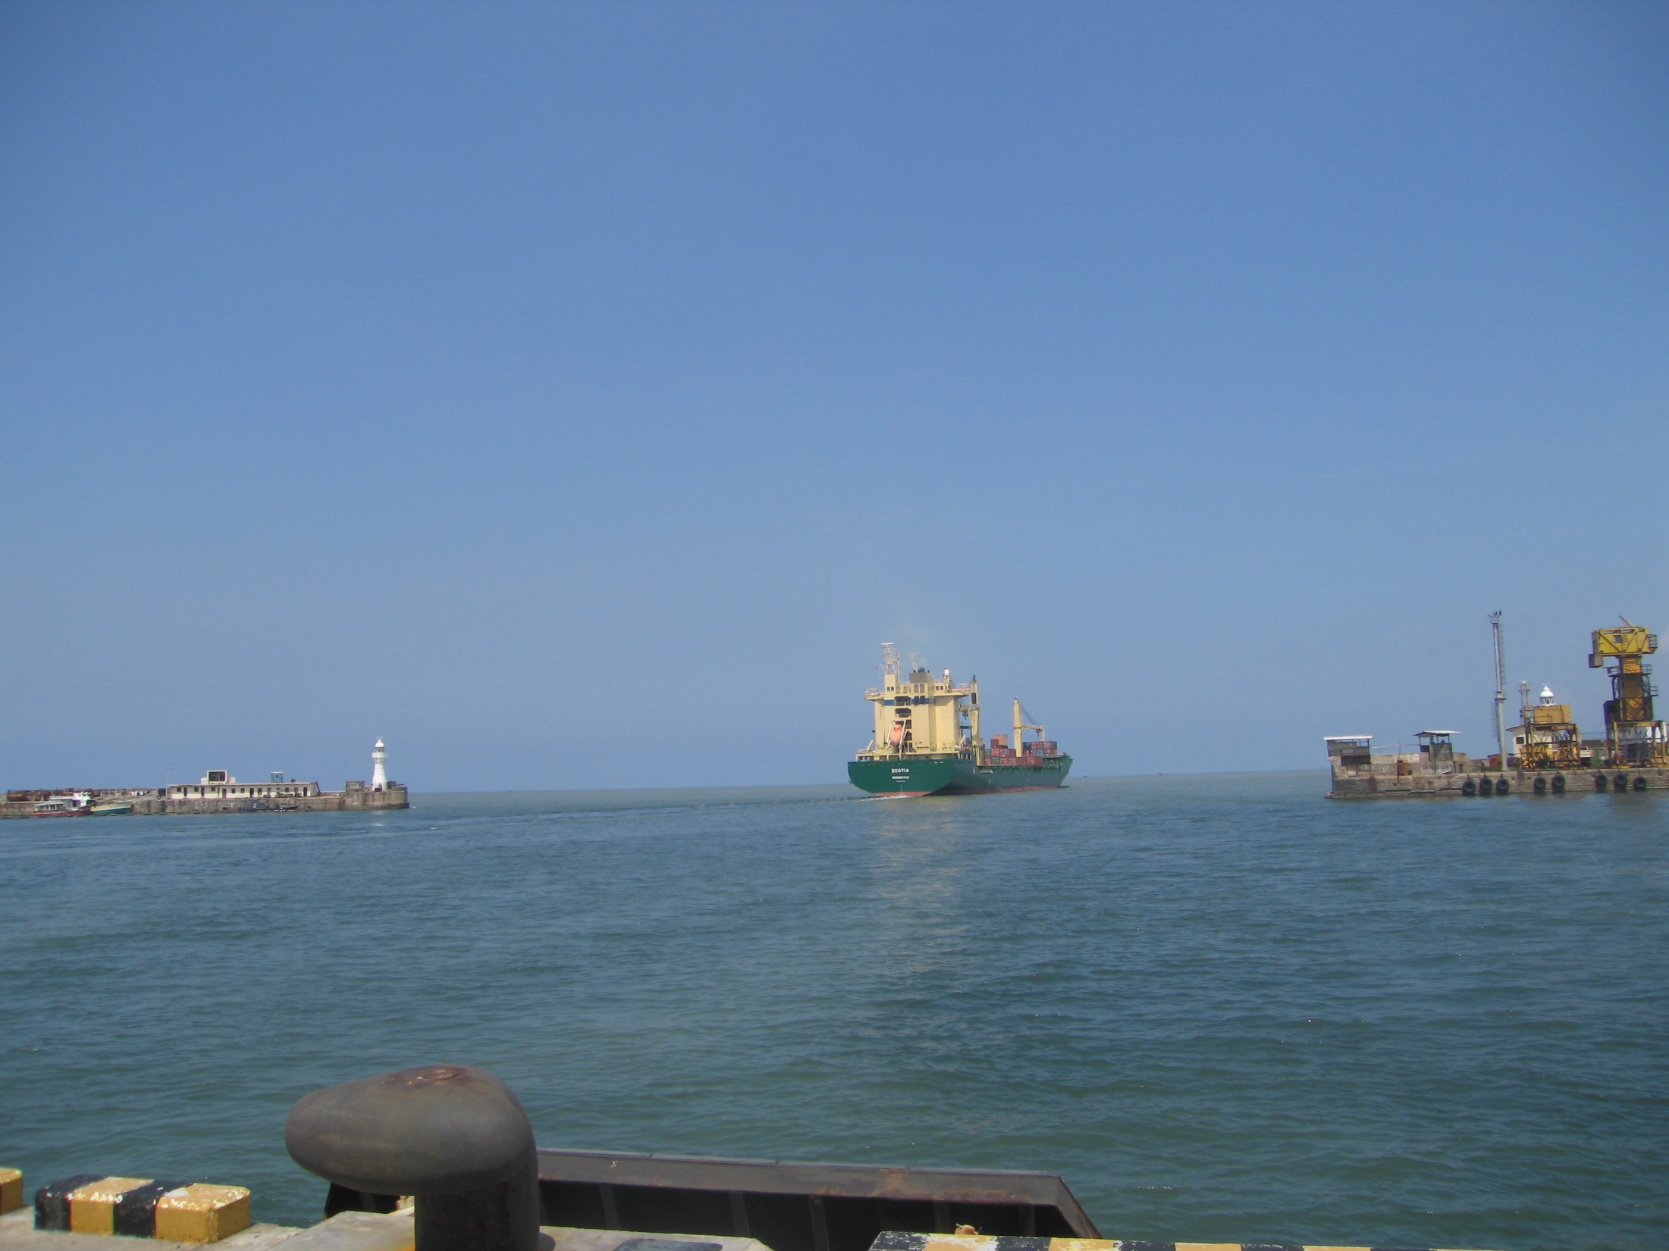
Port of Colombo
Sri Lanka
A Ship Lost Control In This Entrance During the December 26, 2004 Tsunami

Slide 29
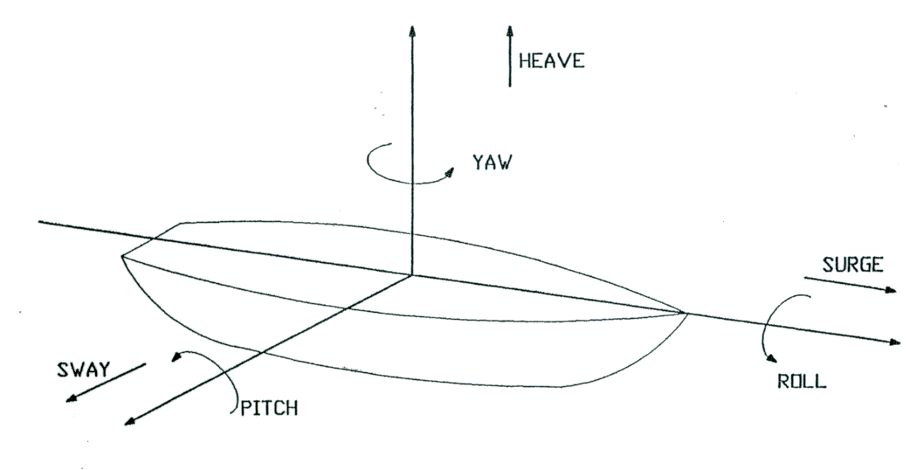
Definition of Six Degrees of Ship Motion

Slide 30
Mooring and Fender Arrangement for an M-Class Ship

Slide 31
Vessel Response Curve
Y
1.5
1.0
res/H
0.5
0.0
0
100
200
300
400
T_{i} (sec)

Slide 32
Ship Response Time Series

Slide 33
Q&A

Slide 34
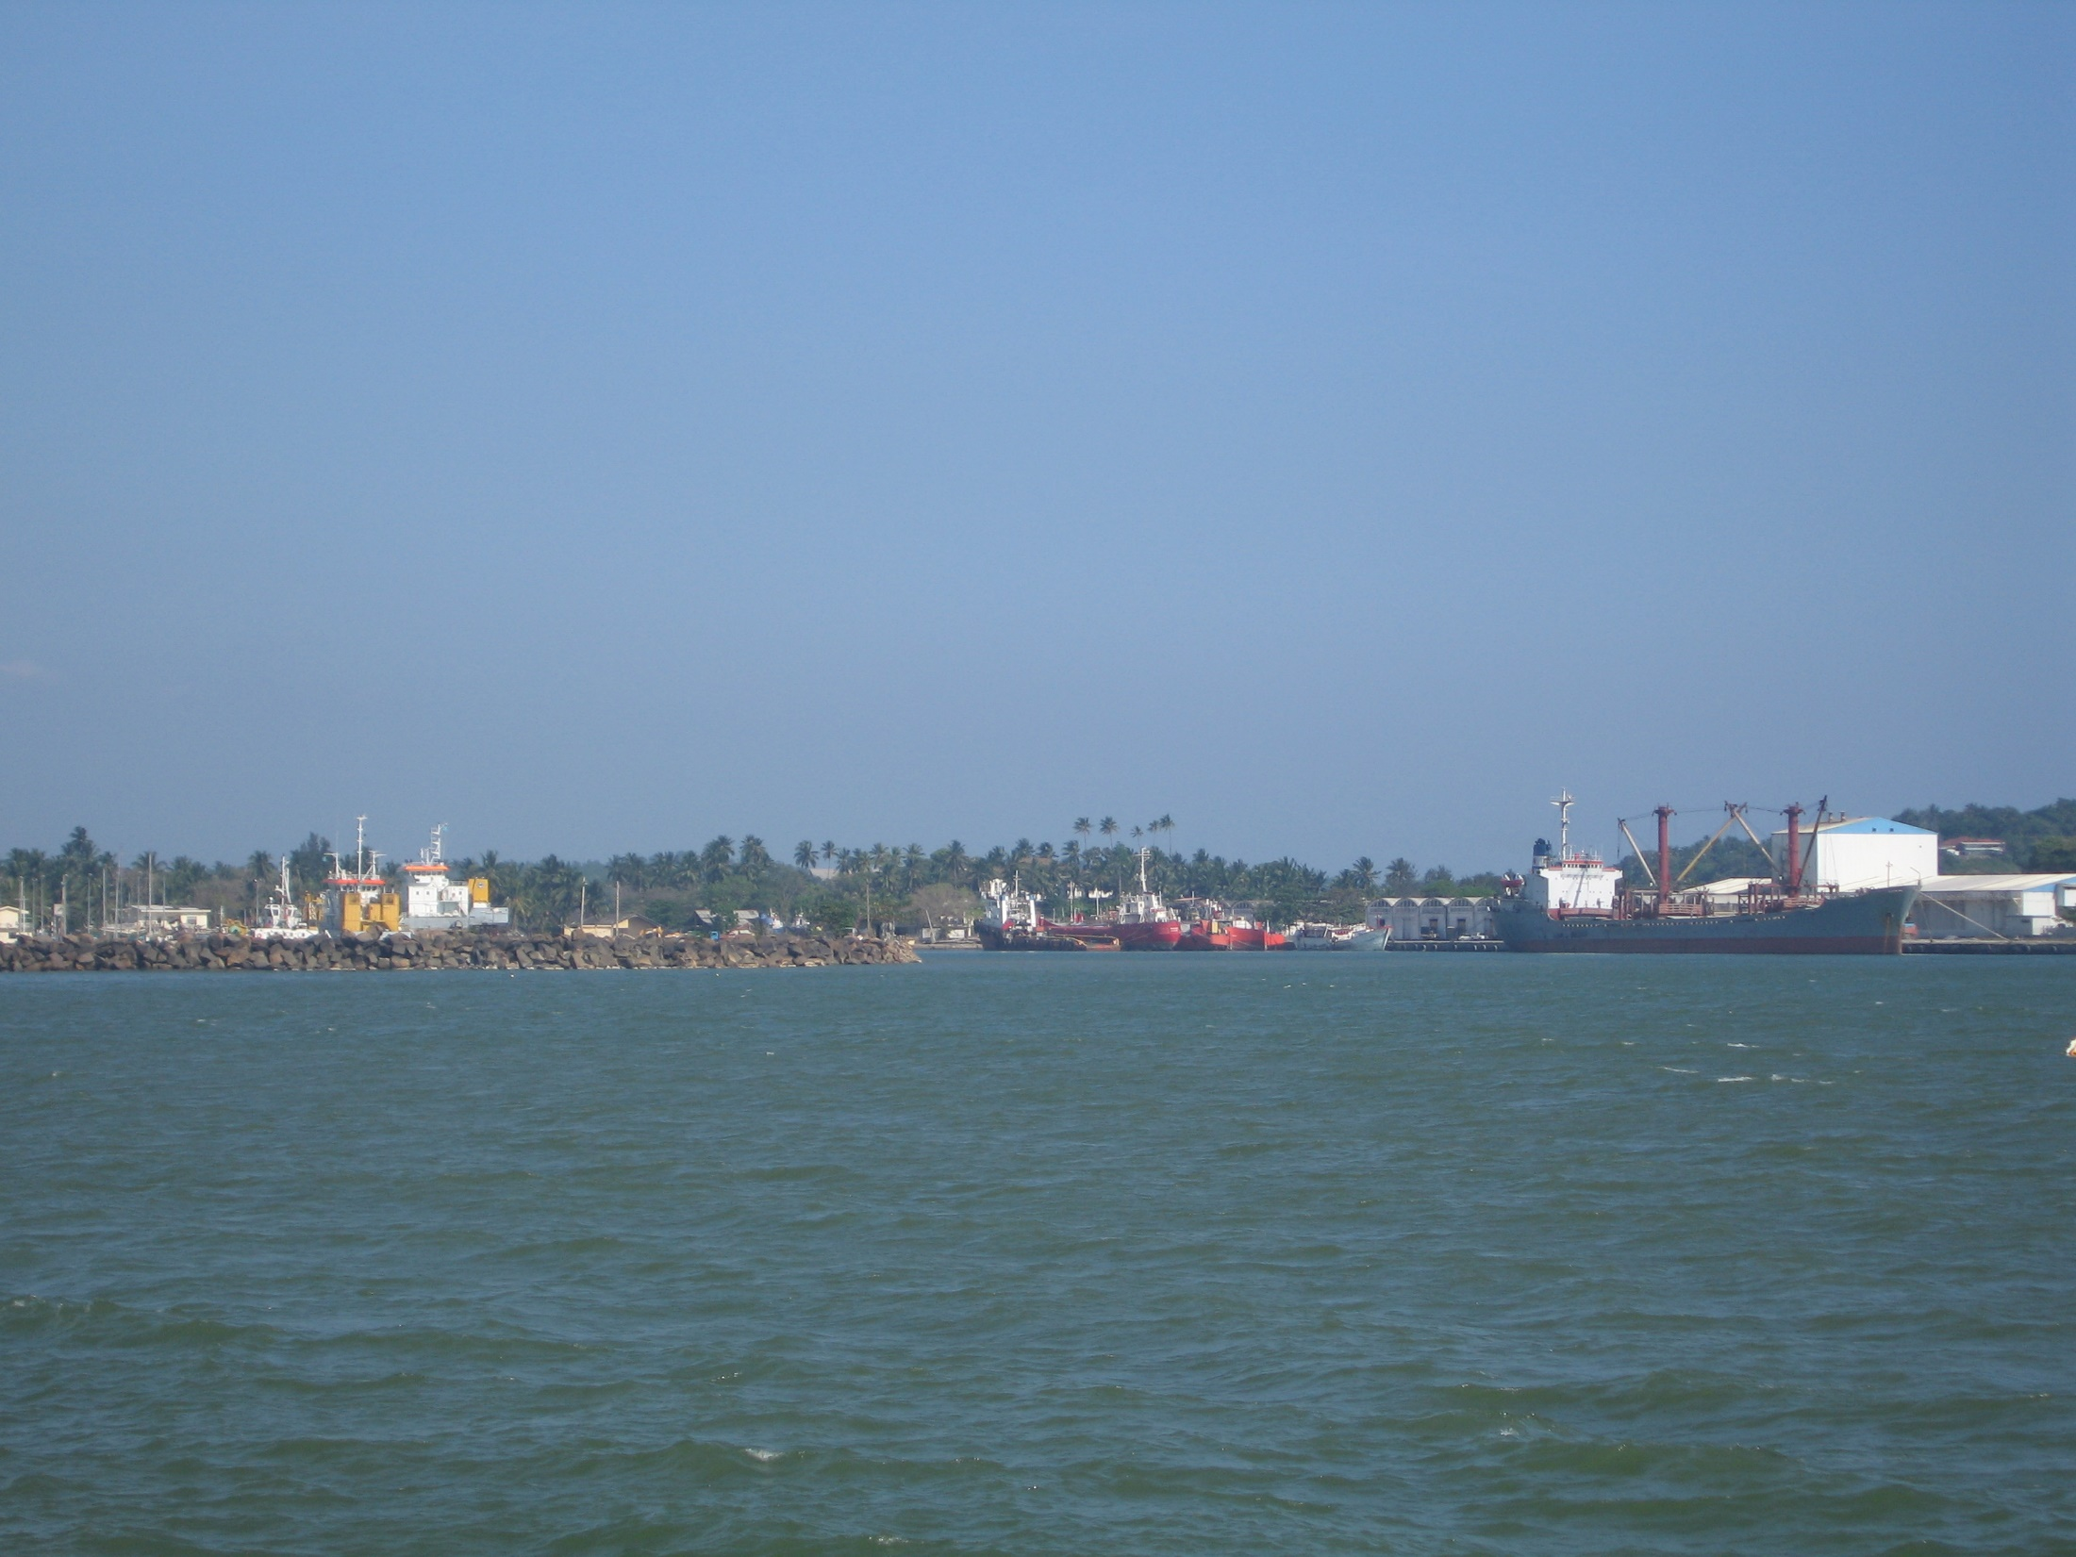
Sri Lanka Port of Galle
2m Sedimentation During December 26, 2004 Tsunami

Slide 35
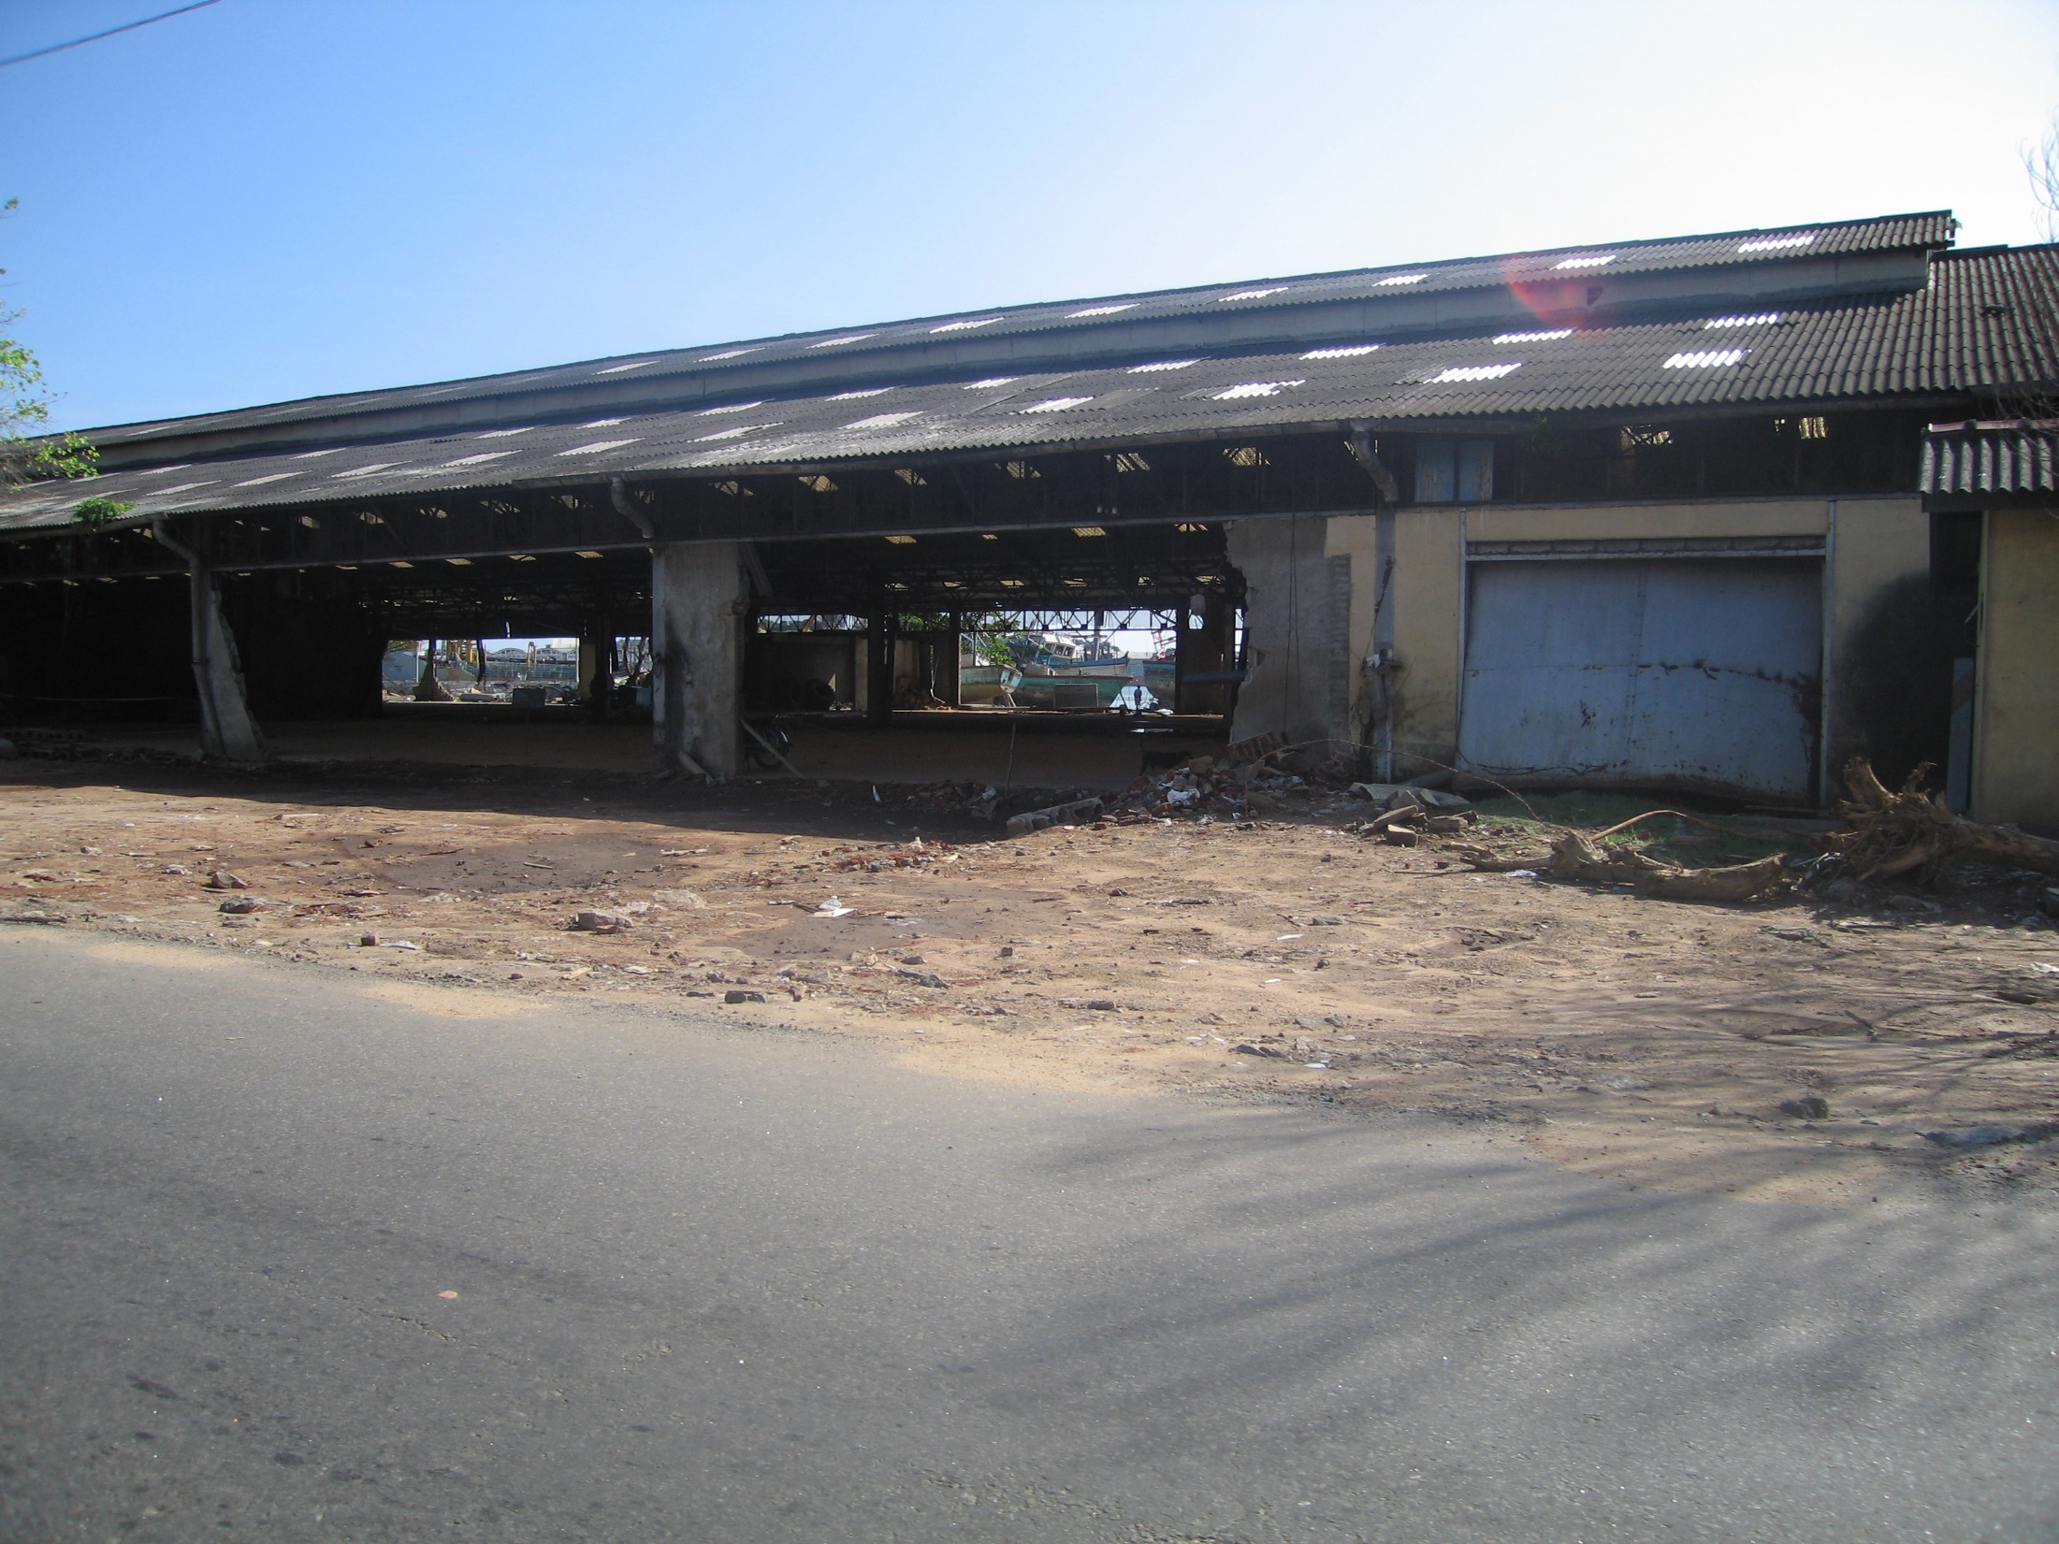
Day 1 #108
Sri Lanka Port of Galle
Warehouse Damage

Slide 36
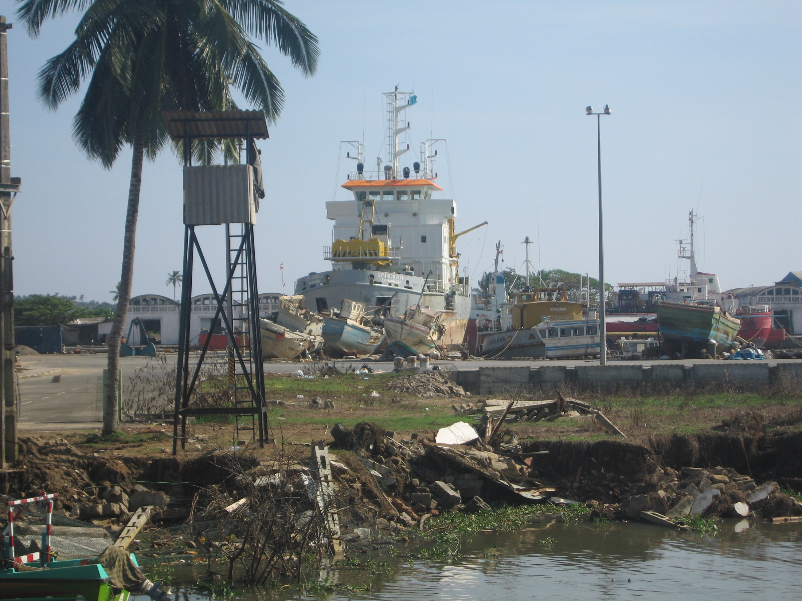
Day 1 # 115
Sri Lanka Port of Galle
Dredge Grounded On Wharf
Tsunami Height= 5.3 m

Slide 37
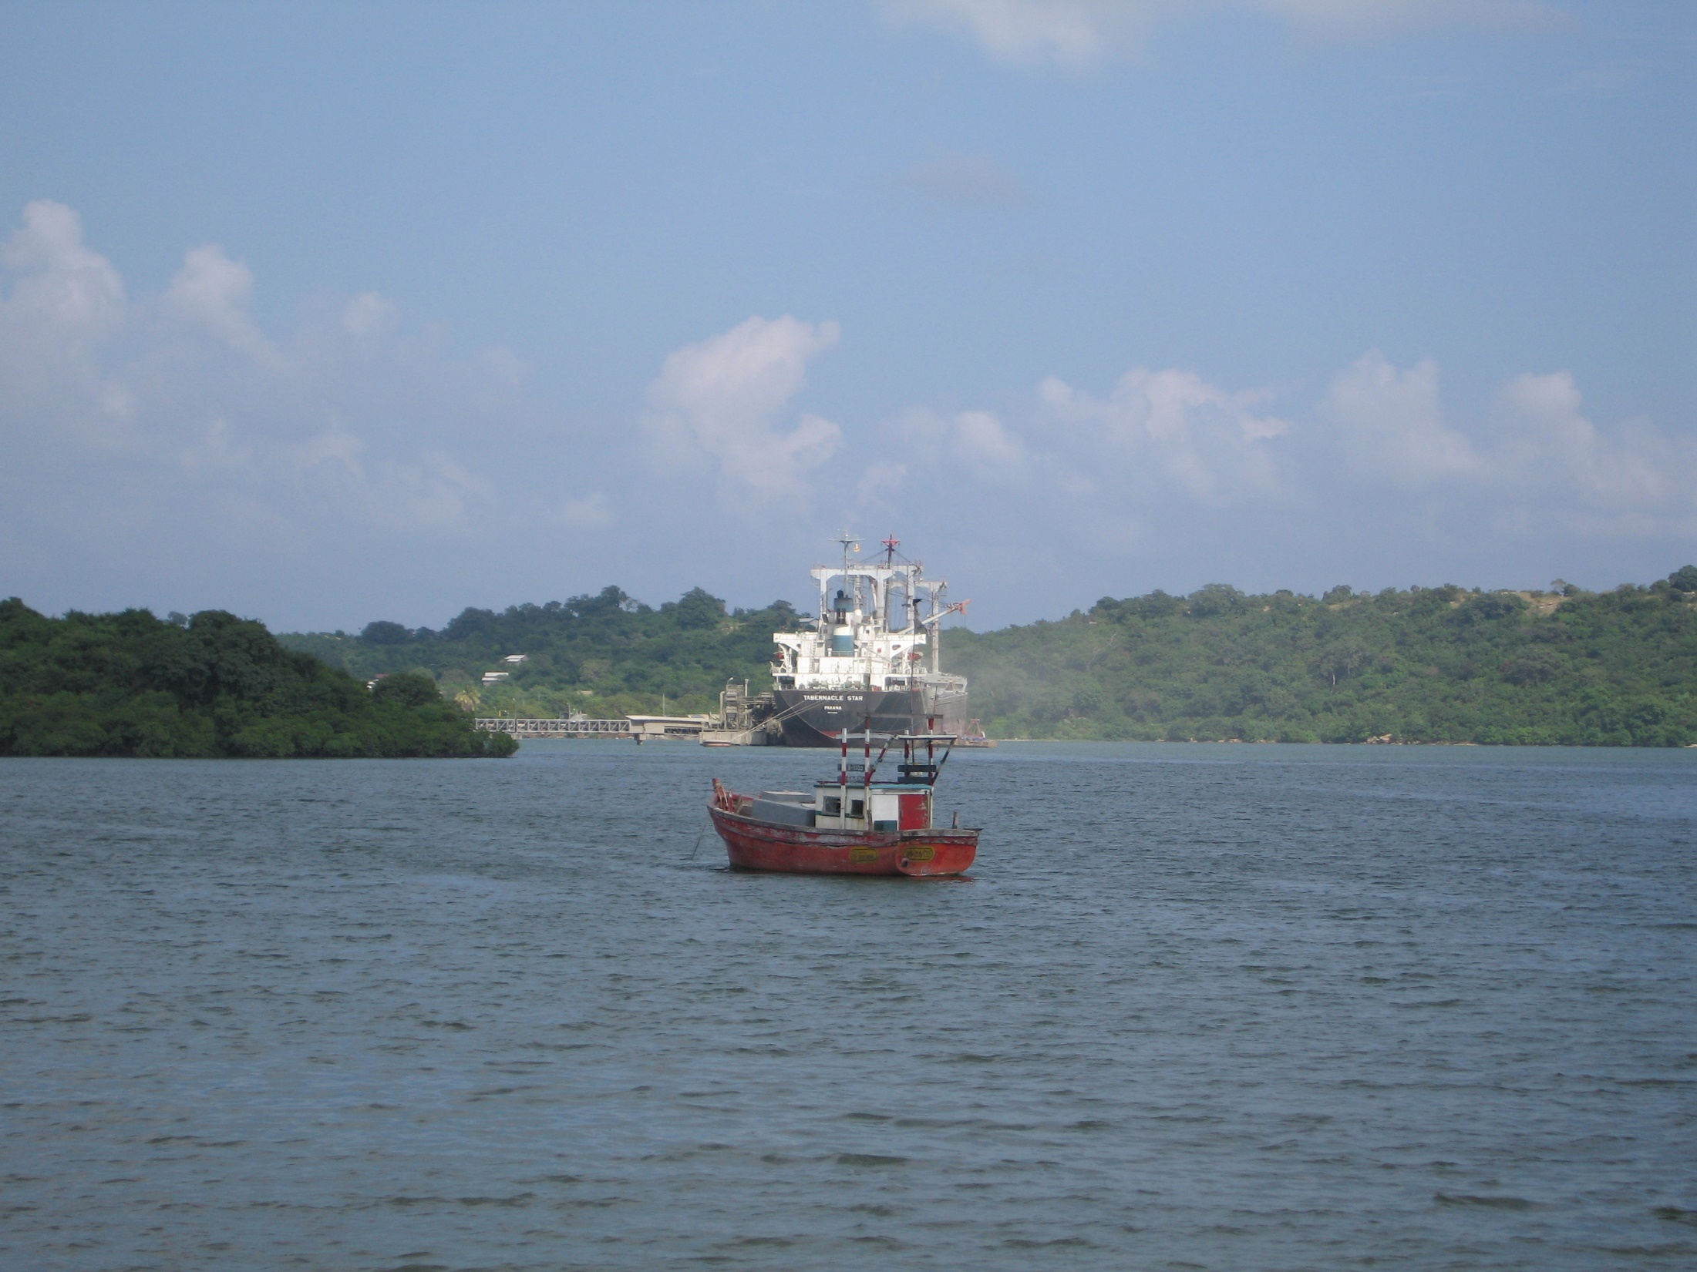
Sri Lanka
No Damage Trincomalee Bay

Slide 38
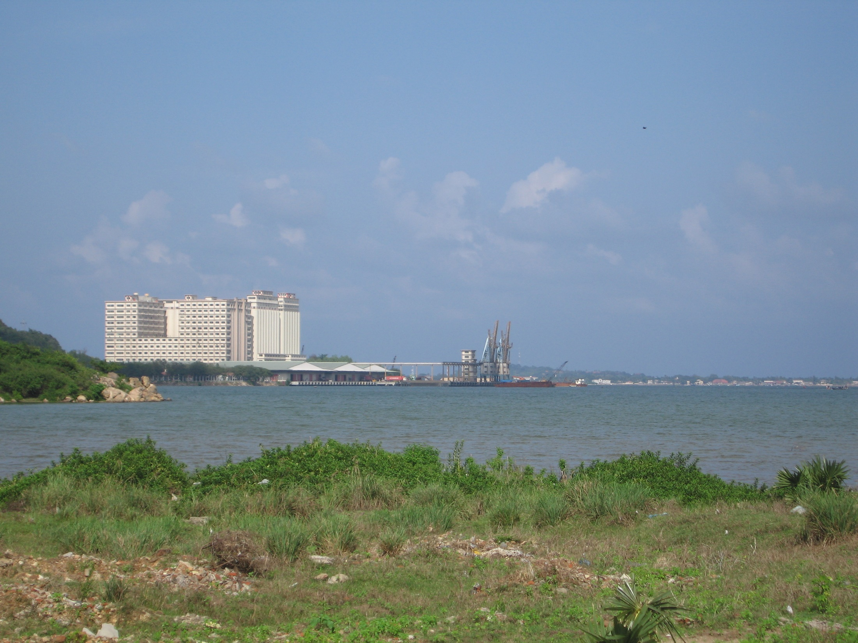
Sri Lanka
No Damage Trincomalee Bay

Slide 39
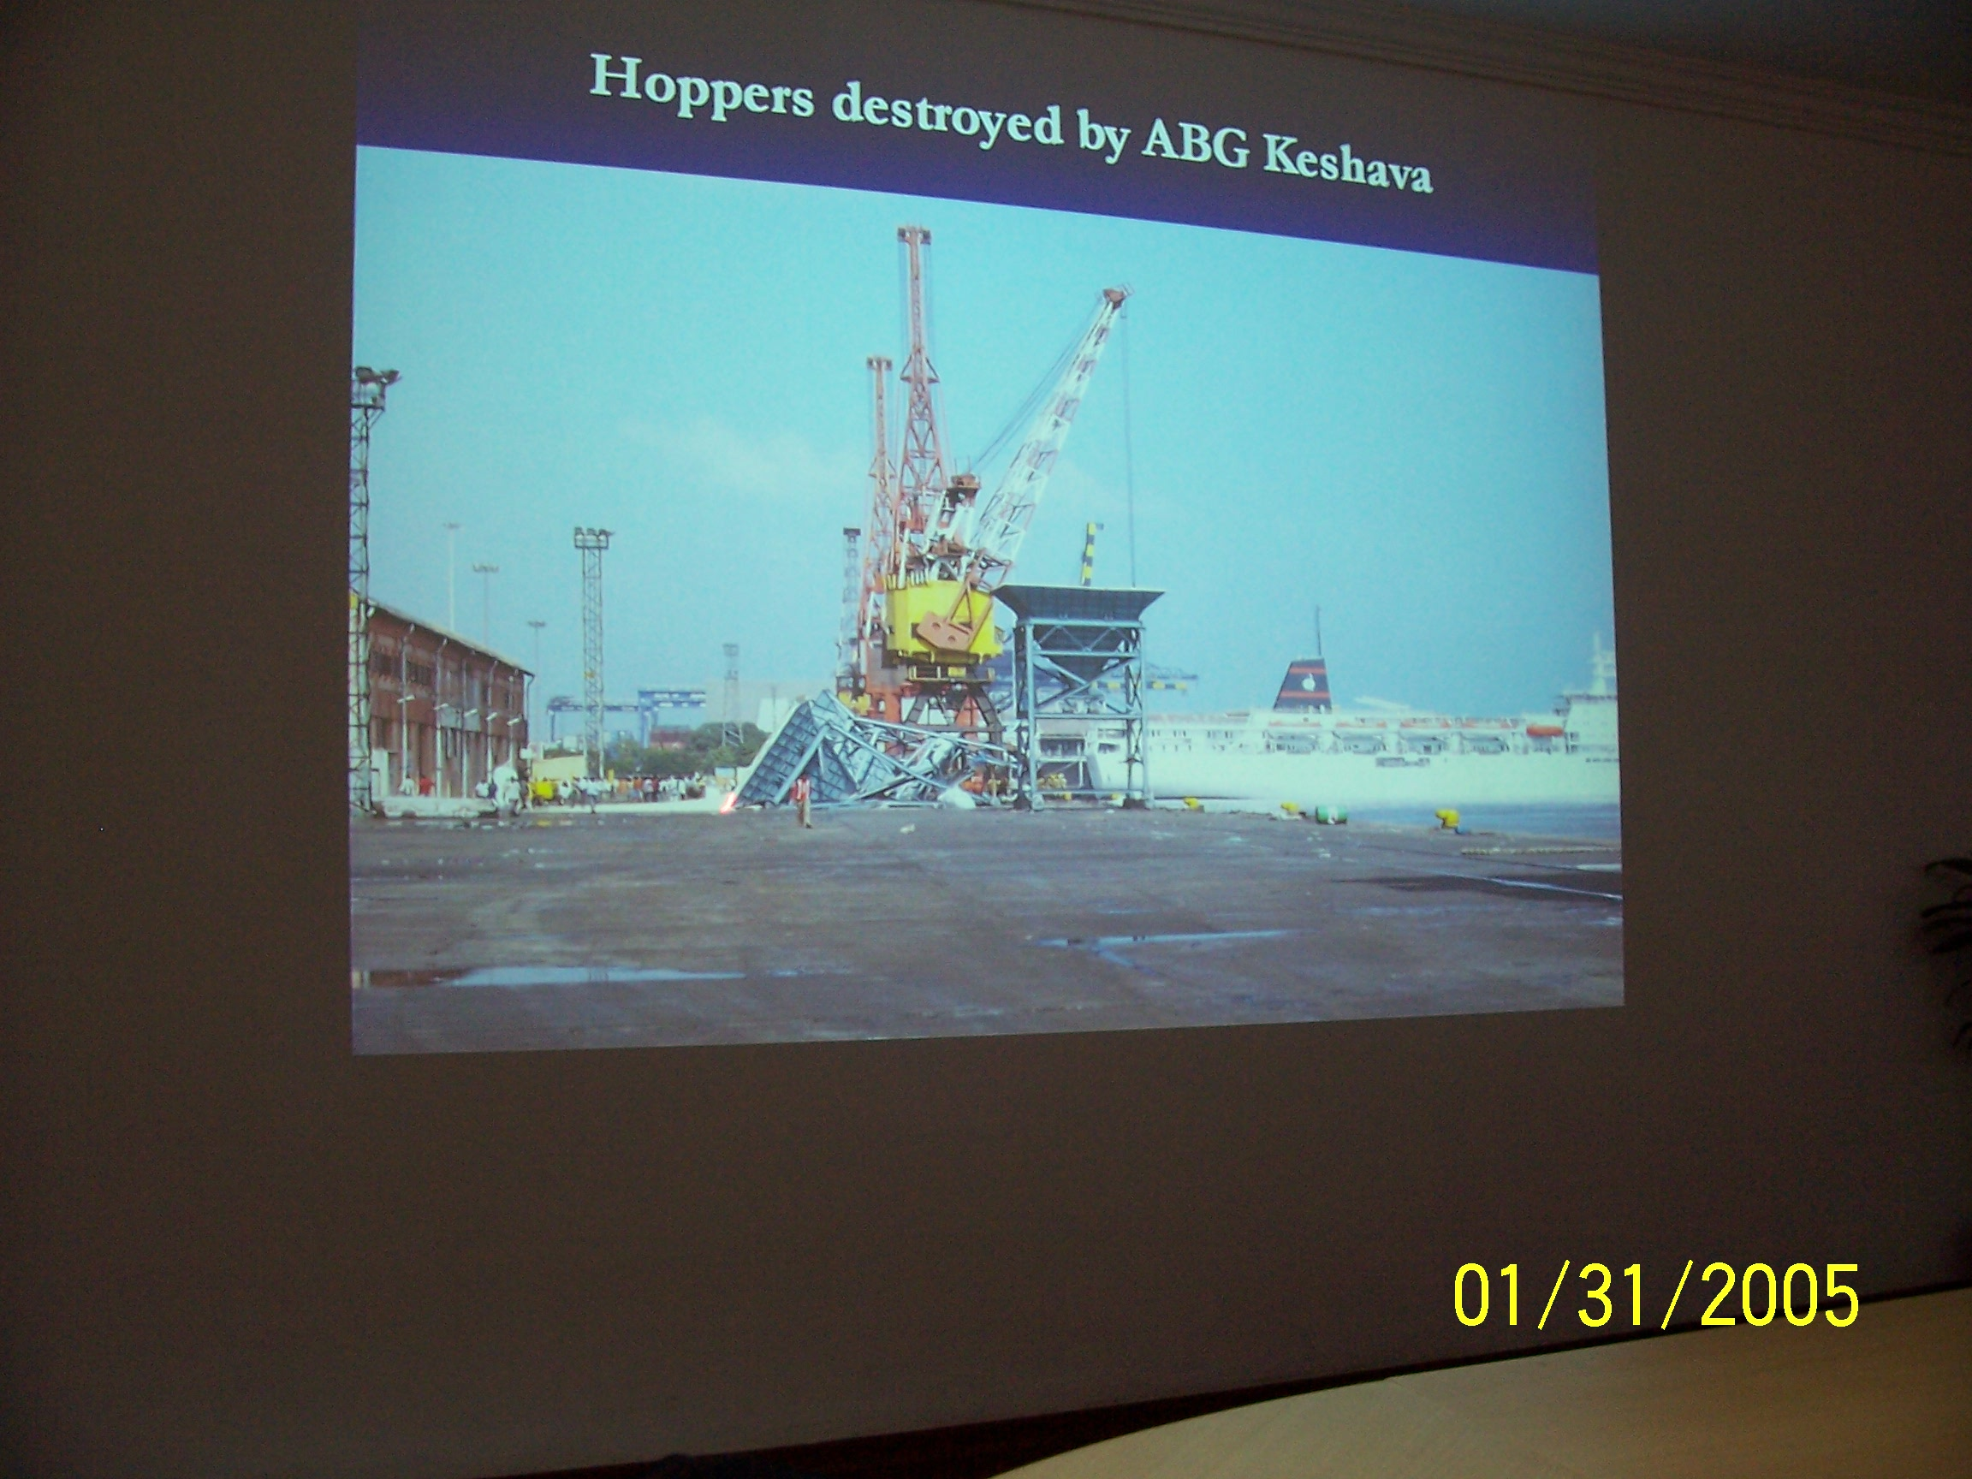
Port of Chennai, India

Slide 40
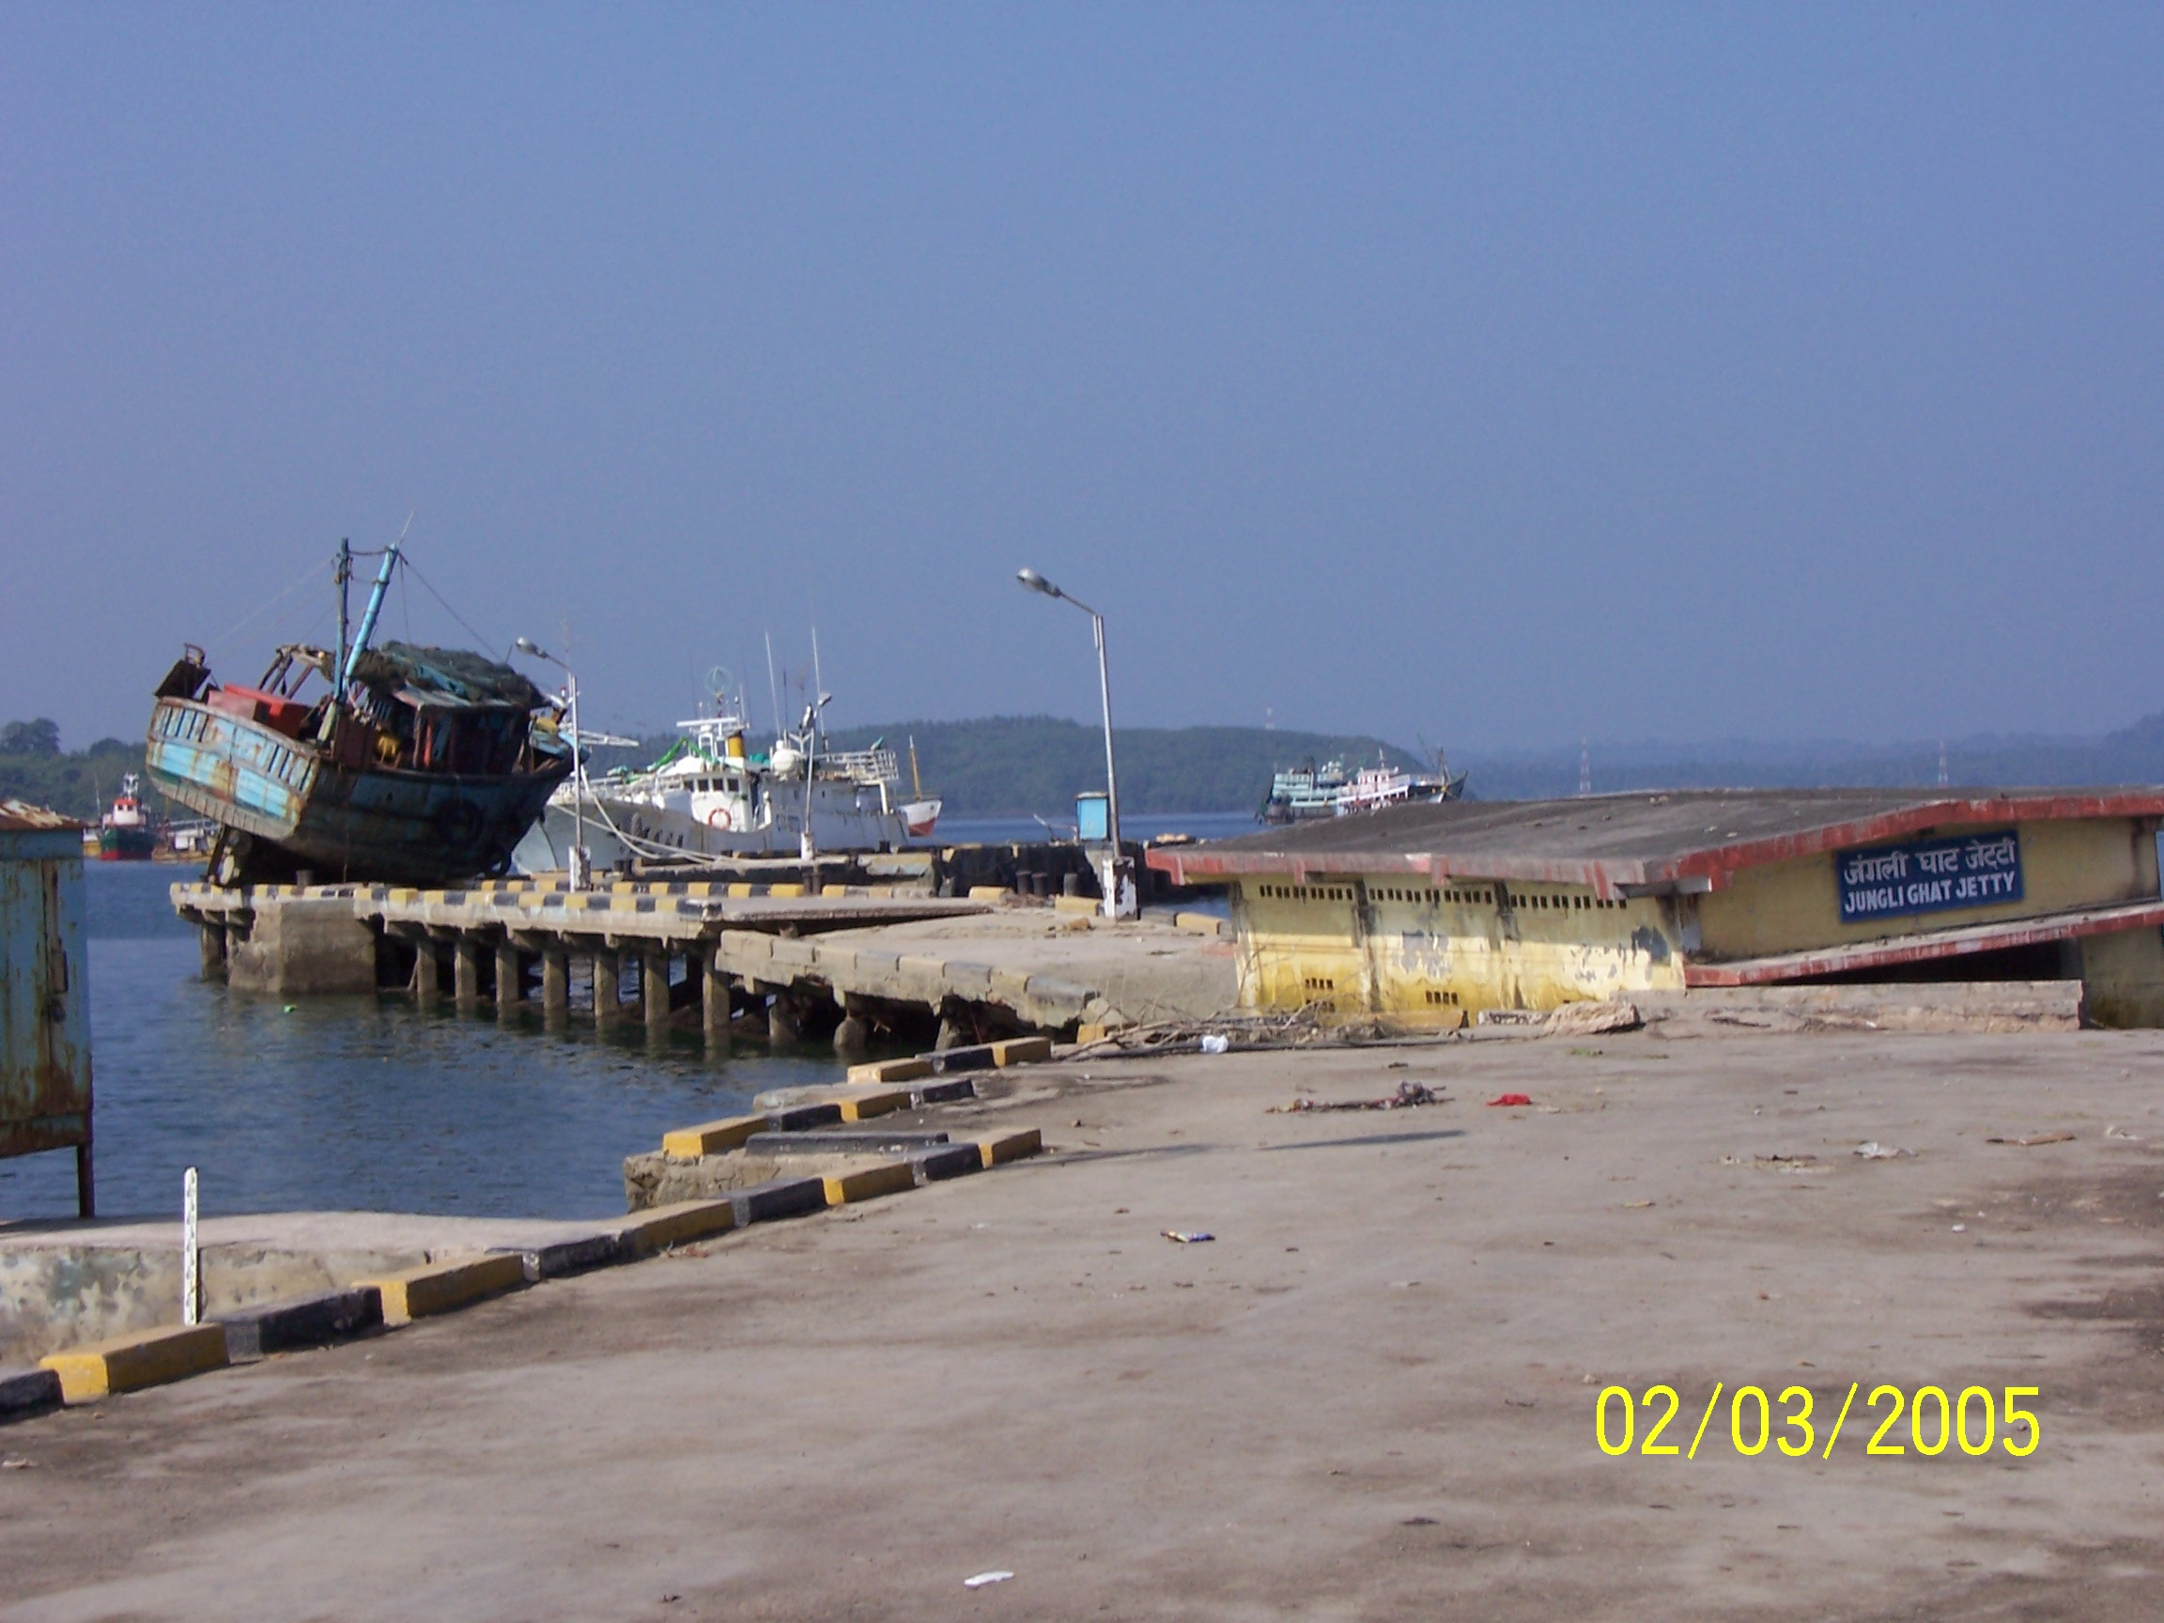
Junglighat Fishing Pier - Port Blair, India

Slide 41
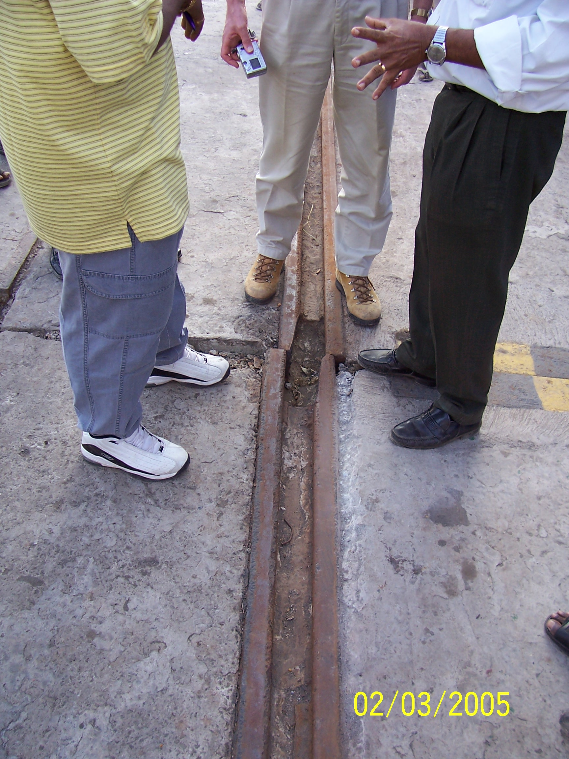
Crane Rail – Container Wharf - Port Blair, India

Slide 42
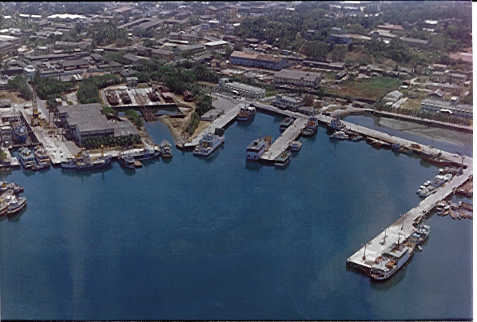
Phoenix Bay Complex (Before Tsunami)
FISHERIES JETTY

Slide 43
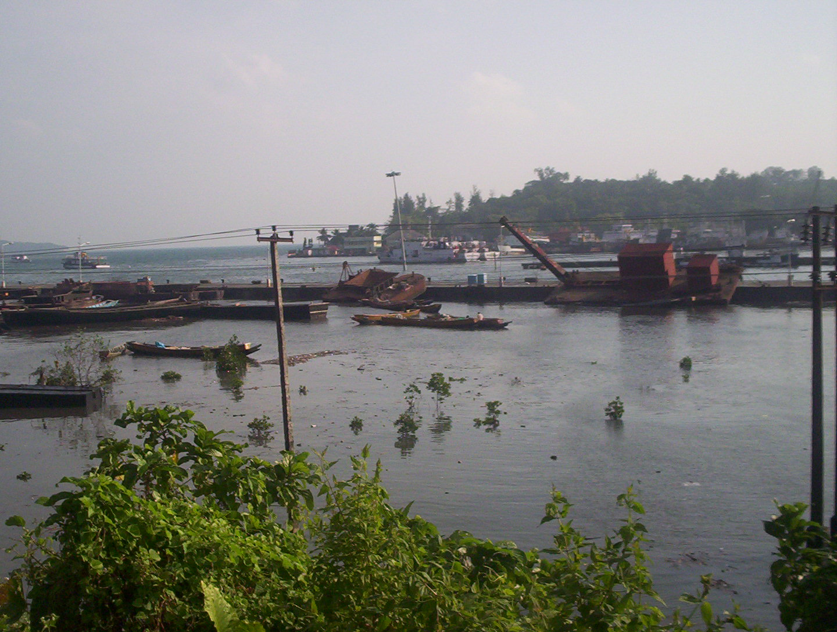
COLLAPSED FISHERIES JETTY (AFTER TSUNAMI)
HIGH MAST LIGHT COLLAPSE

Slide 44
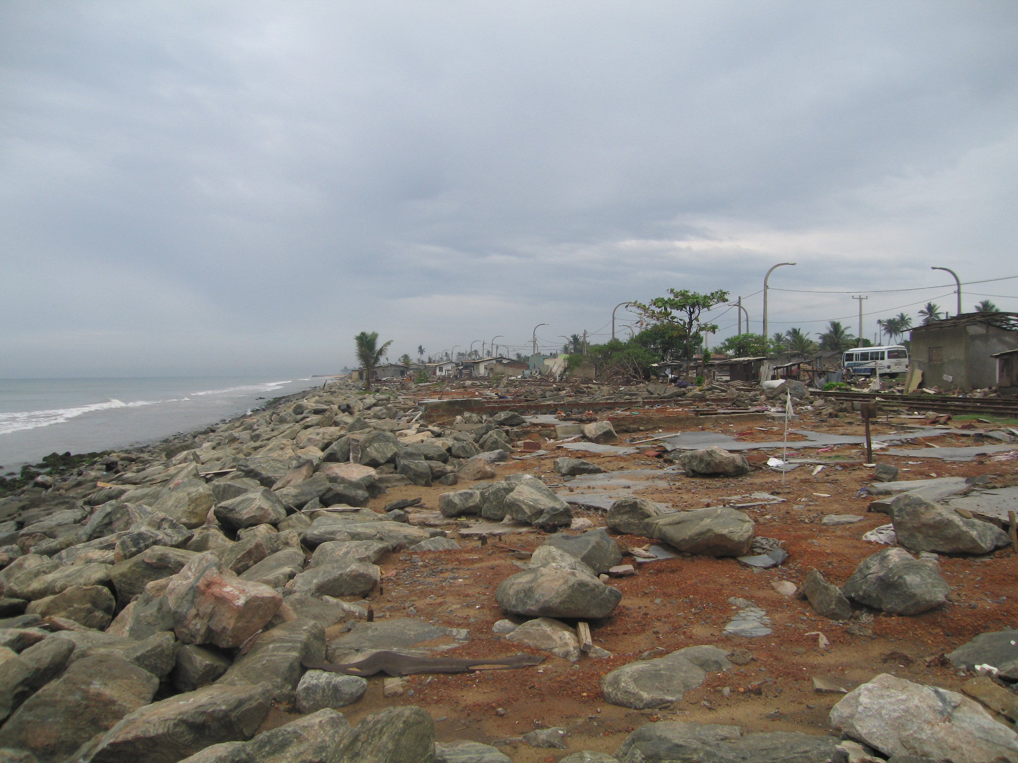
Day 3 # 11
Moratuwa
Sri Lanka
Runup= 4.4 m

Slide 45
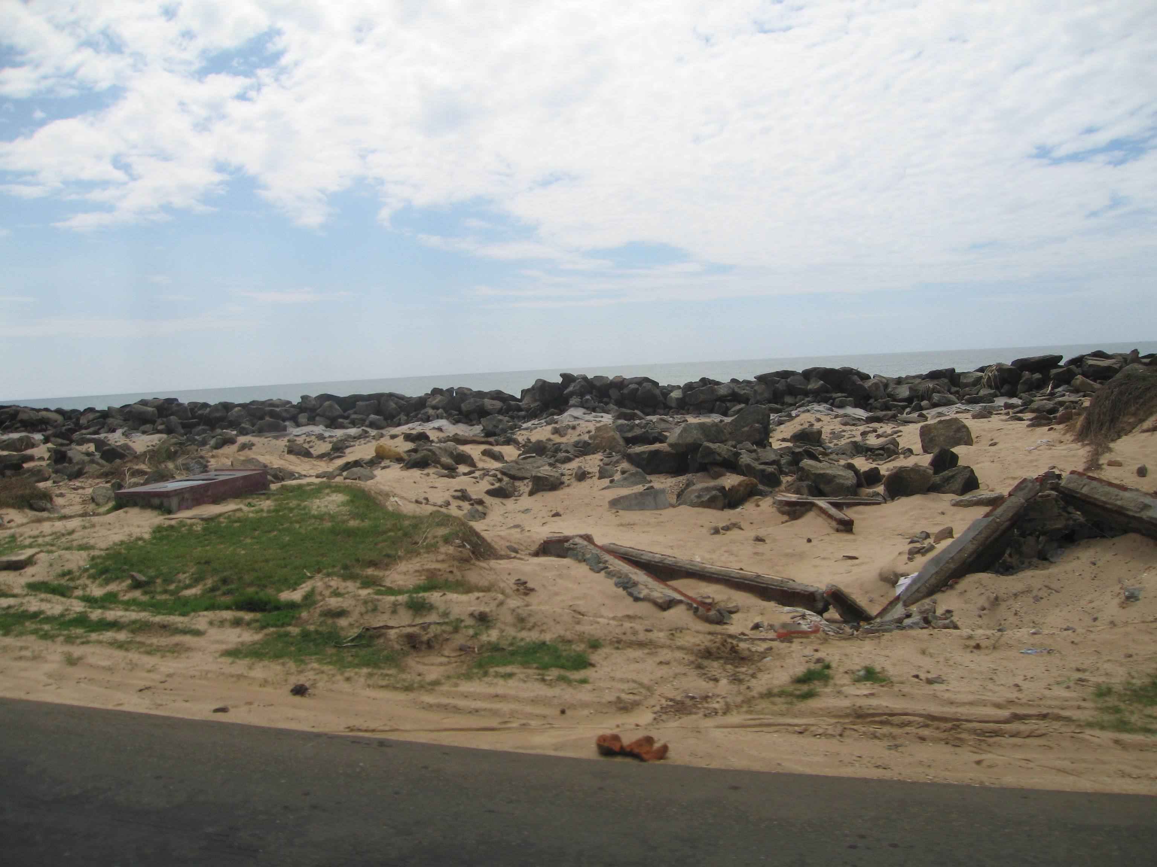
Day 3 # 99
Kahawa
Sri Lanka
Tsunami Runup= 4.1 m

Slide 46
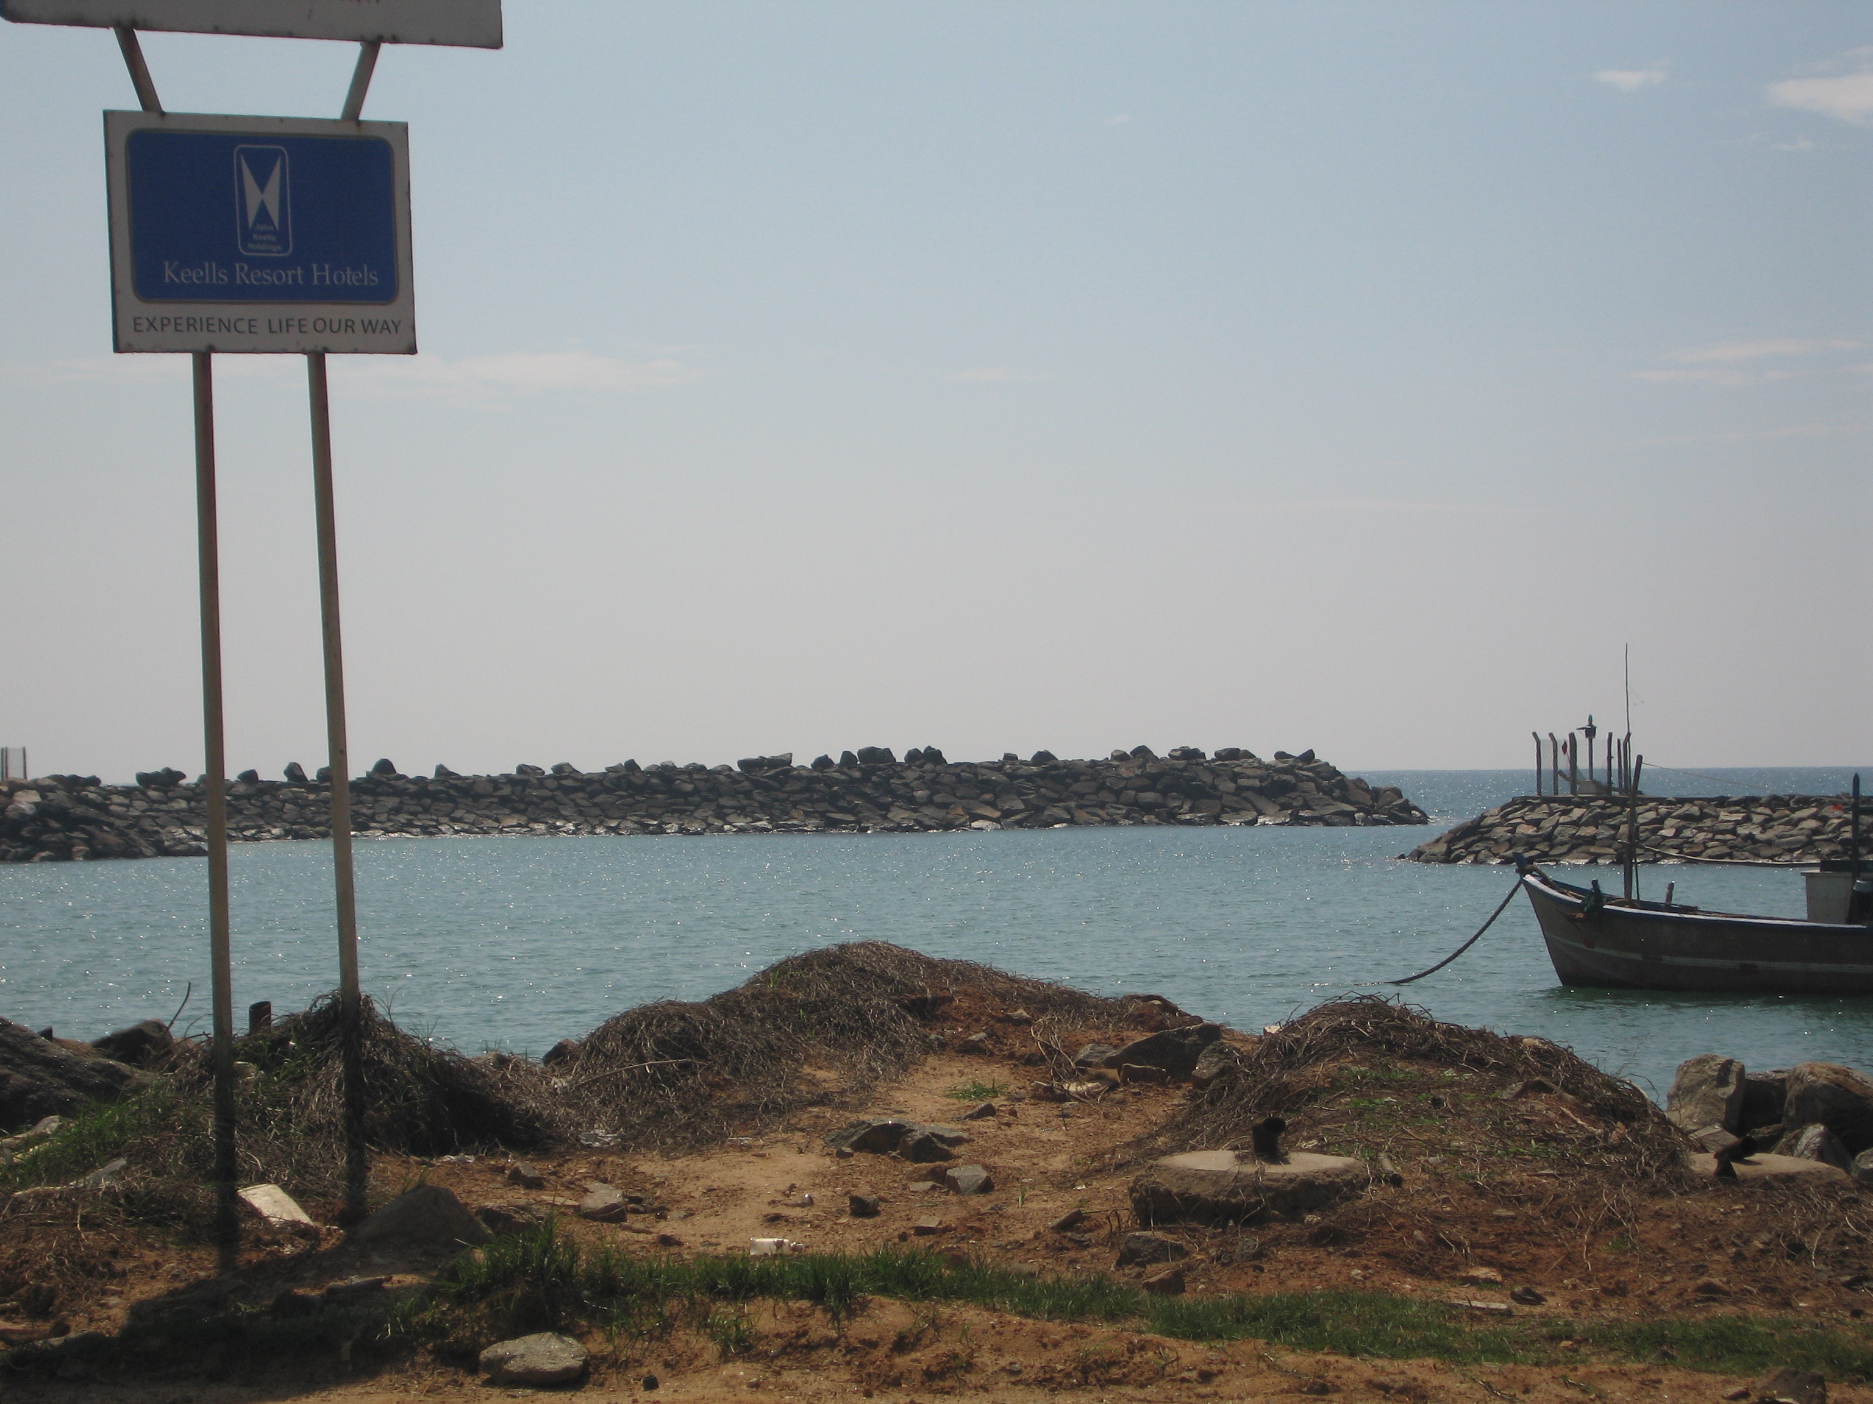
Day 3 # 141
Hikkaduwa Fishing Harbor - Sri Lanka
Backside Breakwater Damage
Tsunami Inundation = 4.73 m

Slide 47
