Slide 1
Outdoor Public Warning System

Slide 2
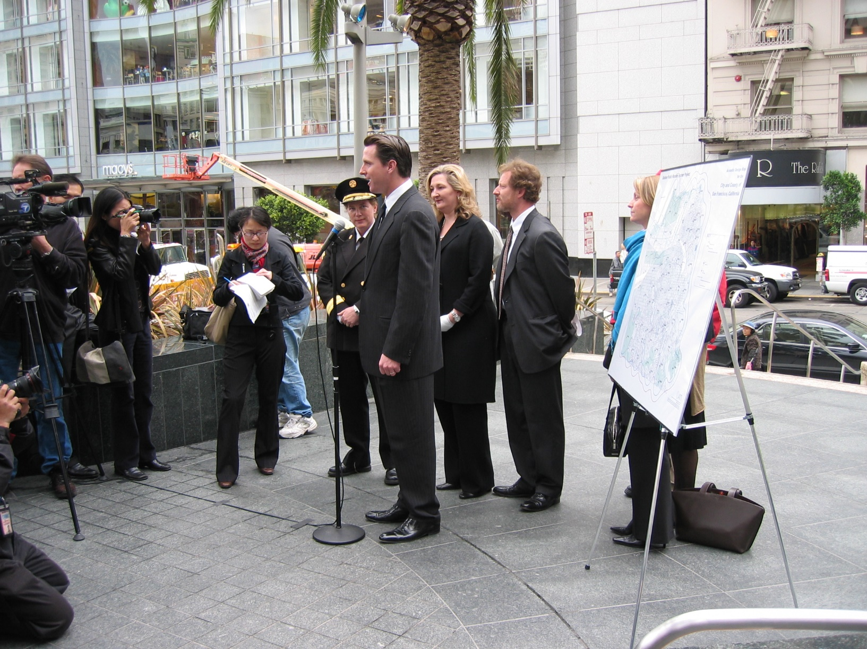
Project Announcement Conference: Nov. 9, 2004

Slide 3
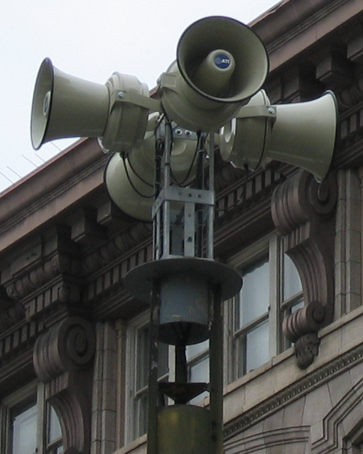

Outdoor Public Warning System
Project started Fall of 2004, will be completed in July
$ 2.1 M cost
Replacement for the old 1940’s mechanical system
65 sirens cover San Francisco, TI, YBI
Electronic, battery and/or solar powered
Public address (voice) capability
Click icon to play tone

Slide 4
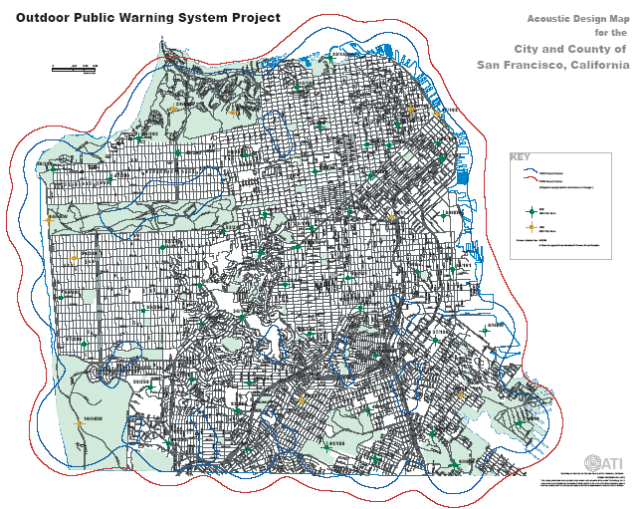

Slide 5
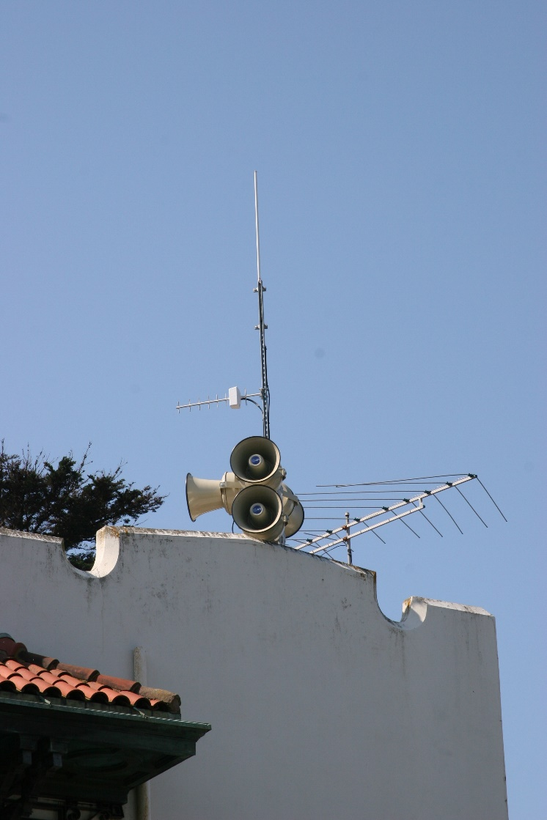
Customized Coverage
The siren system can be sub-divided into zones to customize coverage
Police and fire personnel can activate voice feature at one or more locations, based on situation
Two portable systems allow quick relocation of the control point

Slide 6
Community Education Program
Multiple strategies:
Advertising campaign using external and internal signs in buses and bus shelters
Brochure
Outreach to City/County employees & families
72 hours.org website
Presentations at community forums
Weekly test (noon on Tuesday)
Tri-Lingual educational material

Slide 7
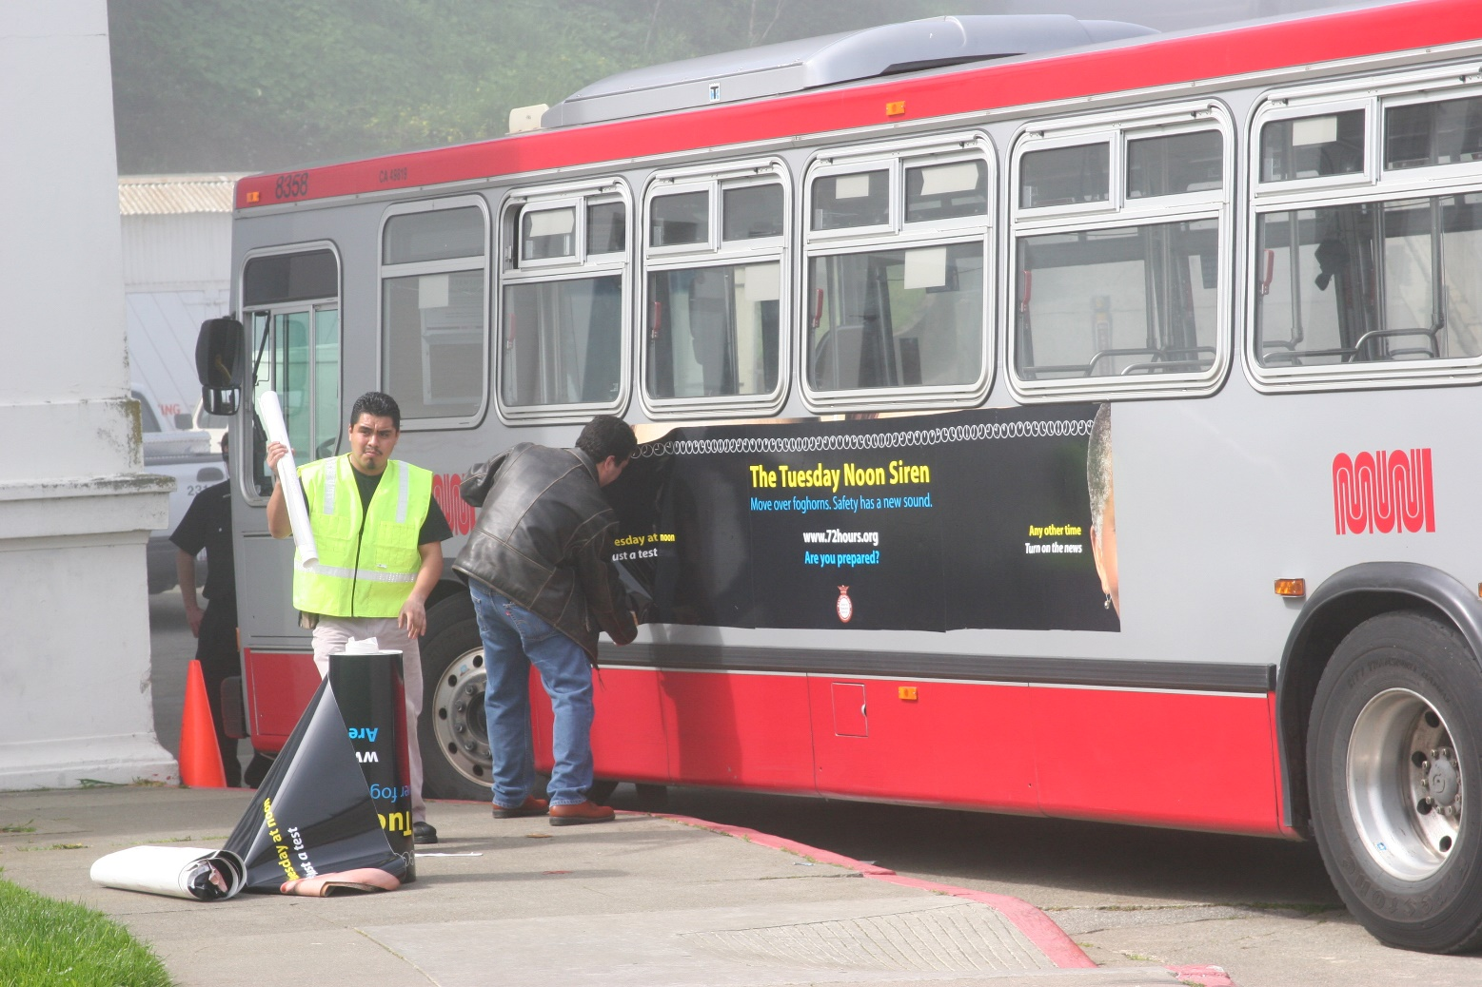
Bus Signage

Slide 8


English

Slide 9

Chinese

Slide 10

Spanish

Slide 11
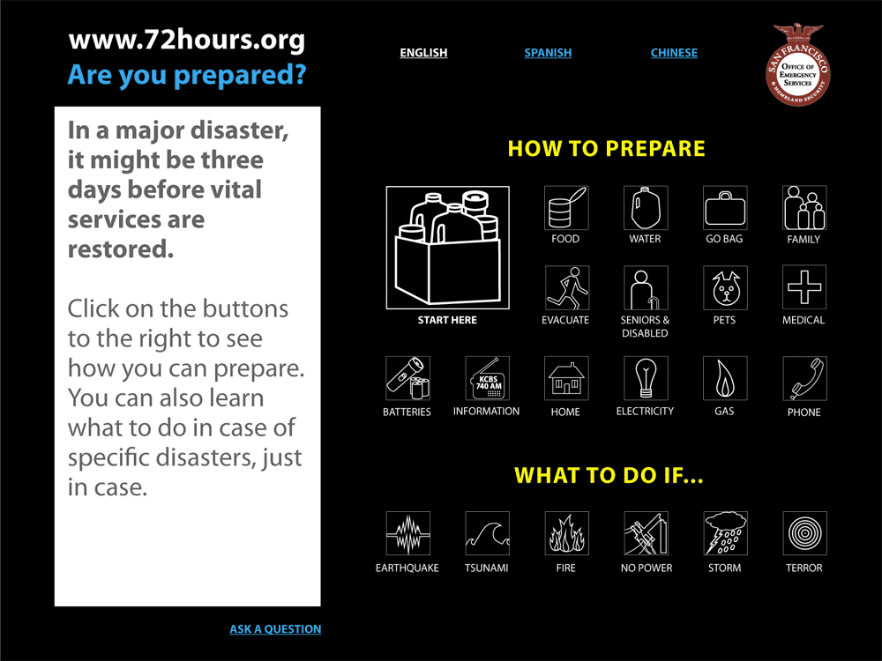

Slide 12
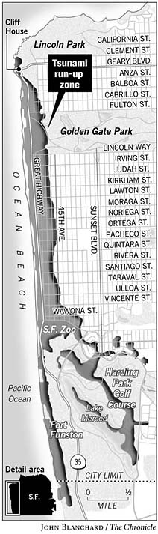
San Francisco’s Tsunami Run-up Zone
Map provided by State OES
For evacuation planning purposes only
Intended as a worst case scenario

Slide 13
San Francisco Tsunami Risk
Approximately 48 blocks could be impacted by a significant tsunami
A distant event may offer up to several hours of warning, a trigger event off the California Coast would provide very limited warning
Primary outdoor notification system controls located at the Emergency Communications Department - 911 Dispatch Center

Slide 14
Tsunami Warning/Watch Information
CLERS
Palmer
Center Issues
Watch/Warning
State OES
Issues
Warning
Disaster
Occurs
EDIS
Operational
Areas
CALWAS
NWS
OES Region
OES Op. Area
Call-down
NOAA Radio
Alert

Slide 15
System Activation Process (Internal)
EAS & EDIS
message
issued for CCSF
ECD receives:
CALWAS
EDIS
CLERS
NOAA
OES Duty
Officer Notified
(also by NOAA & EDIS)
OES Requests
ECD trigger system
Notification
begins
OES Director
Consulted
CCSF Policy
Group advised

