Slide 1

Overview of Kalifornia Coastal Processes and Tsunami Inundation
California Seismic Safety Commission
15 March 2005
Reinhard E. Flick, Ph.D.
California Department of Boating and Waterways &
Scripps Institution of Oceanography
M. Hany S. Elwany, Ph.D.
Coastal Environments &
Scripps Institution of Oceanography

Slide 2
California Coastal Processes Tsunami Origins
Earthquakes
Volcanoes
Landslides
Meteors
… and Sources
Remote versus Local

Slide 3
California Coastal Processes and Tsunami Inundation
Tectonics and Geological Setting
Tides and Sea Level
Waves
Climate
Sand Budgets
Human Intervention

Slide 4
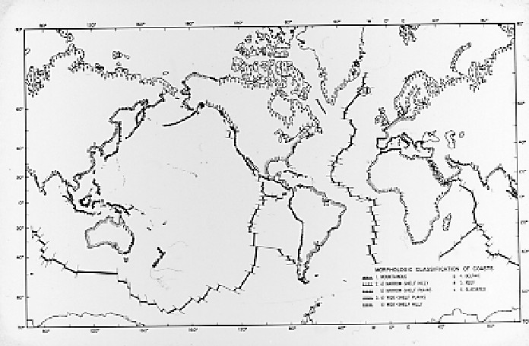
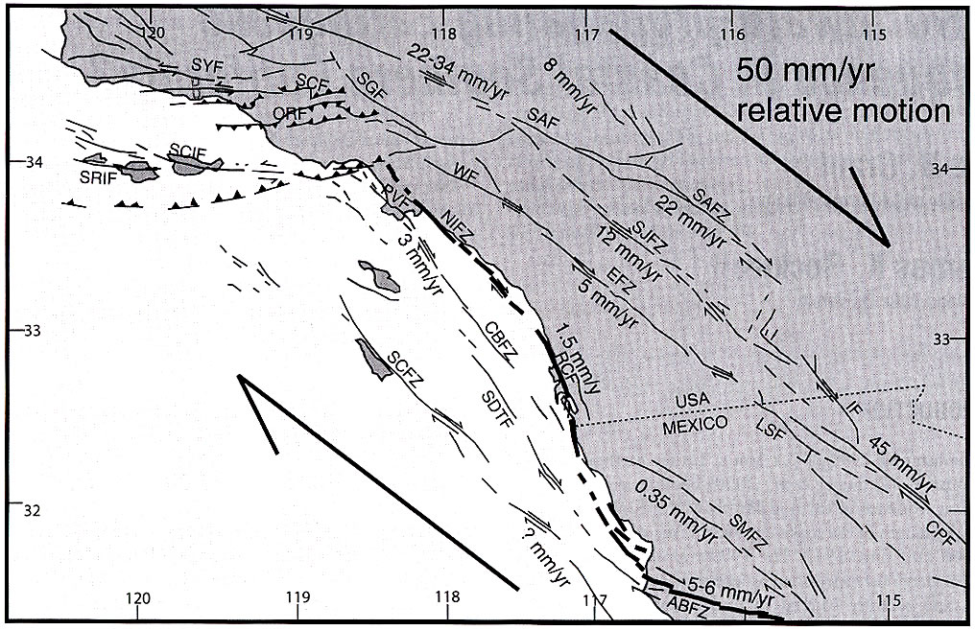
Tectonic Classification of Coasts
Inman and Nordstrom, 1971
Faults produce
beauty and hazard
Remote
Local
Pacific Ring of Fire
Remote
Grant & Rockwell, 2002

Slide 5
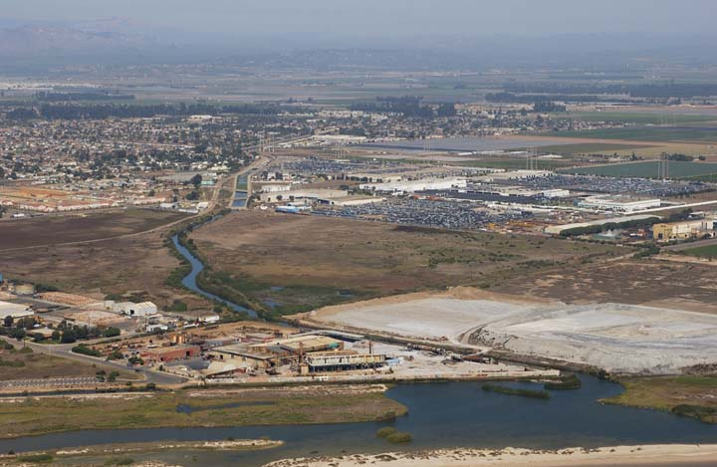
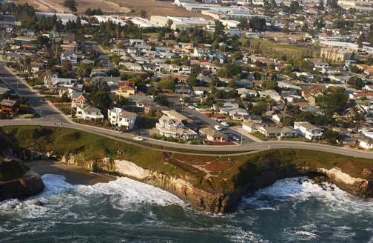
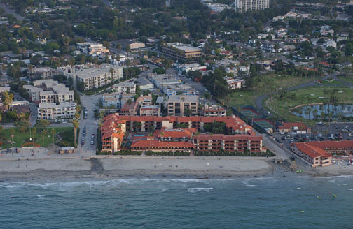
Geological Setting
Tectonic uplift
Sea level rise
TerraCosta Consulting Group
California Coastal Records Project

Slide 6
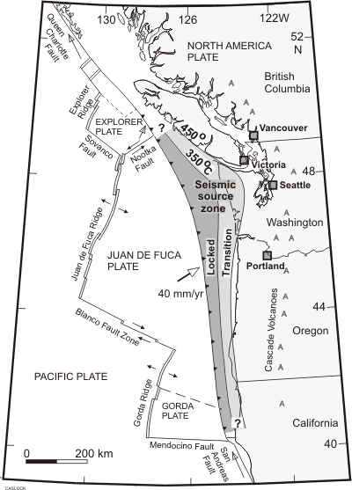
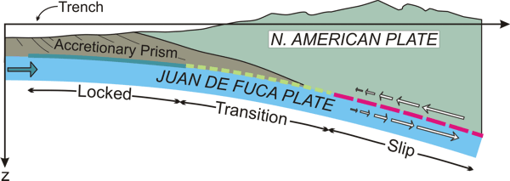
Cascadia Subduction Zone
One historic earthquake since 1700 (1992)
Large pre-historic earthquakes

Slide 7
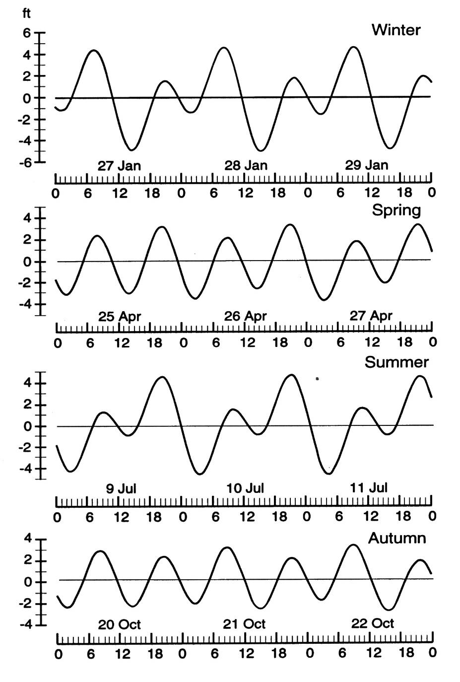
Mixed Tides are Important in California
San Diego 1983
Mean Range 3.5 - 6 ft (S - N)
Extreme Range 9 - 12 ft
Extreme Tides
Winter AM, Summer PM

Slide 8
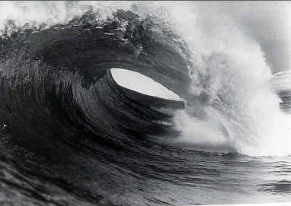
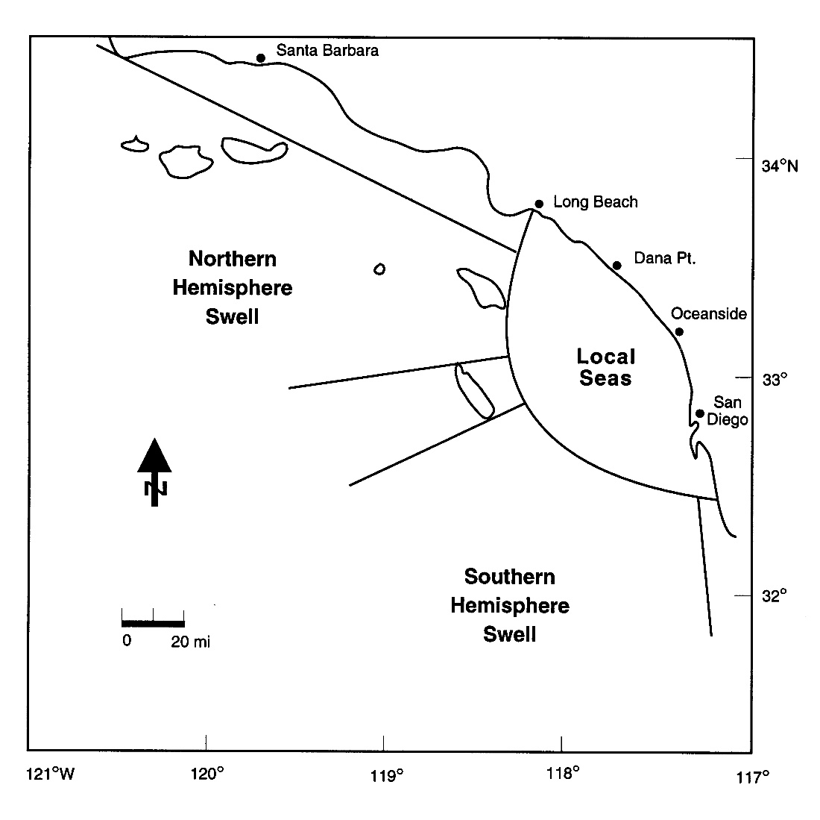
Wind Waves are Biggest Source of Coastal Energy
• Flooding
Sand Motion
Surfing

Slide 9
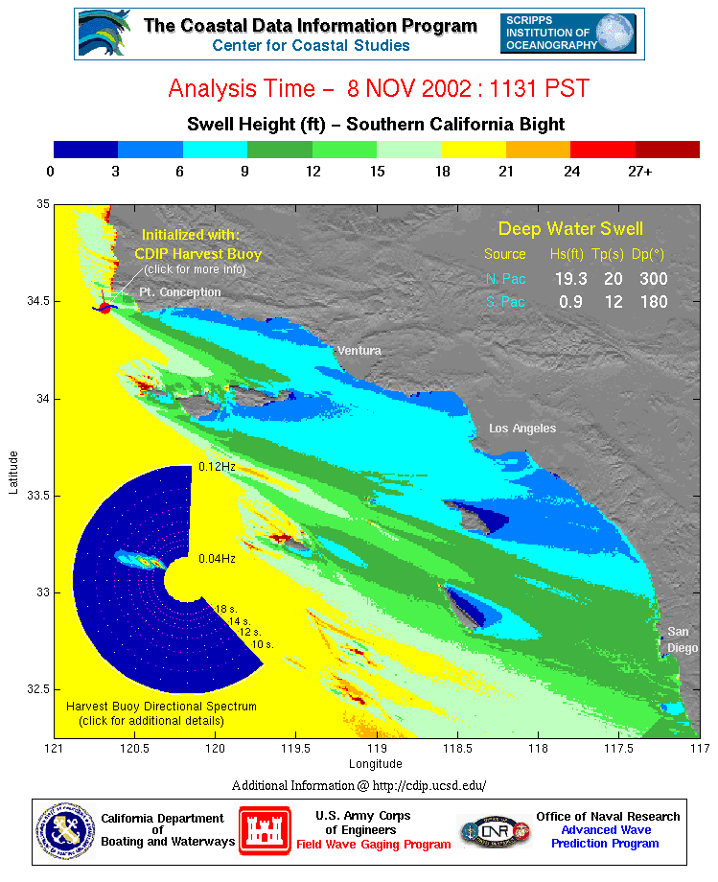
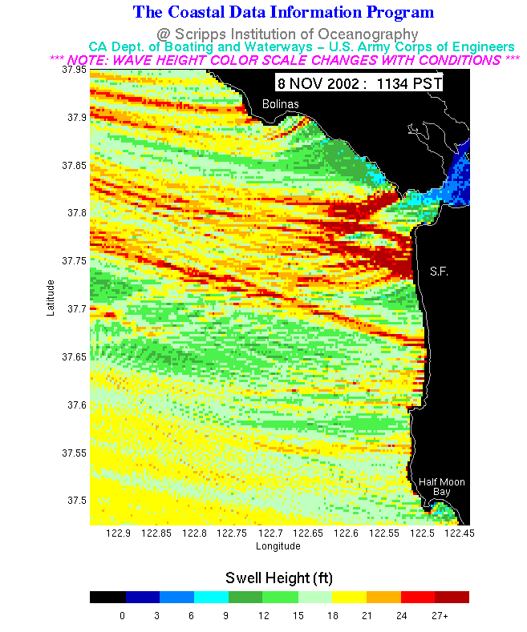
Wind Wave Modeling
• Refraction - Bathymetry
Sheltering

Slide 10
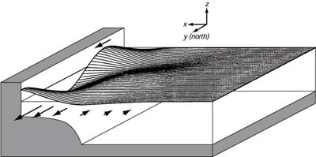
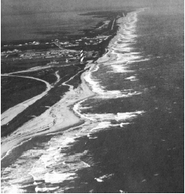
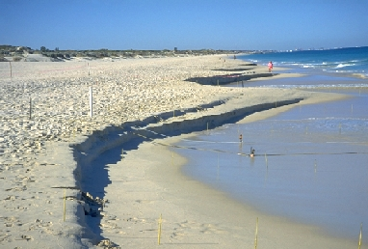
Edge Waves
Trapped nearshore by refraction
Travel alongshore
Common at all scales
Gonzalez, et al., Mendocino 1992
Cutchin & Smith, 1973

Slide 11
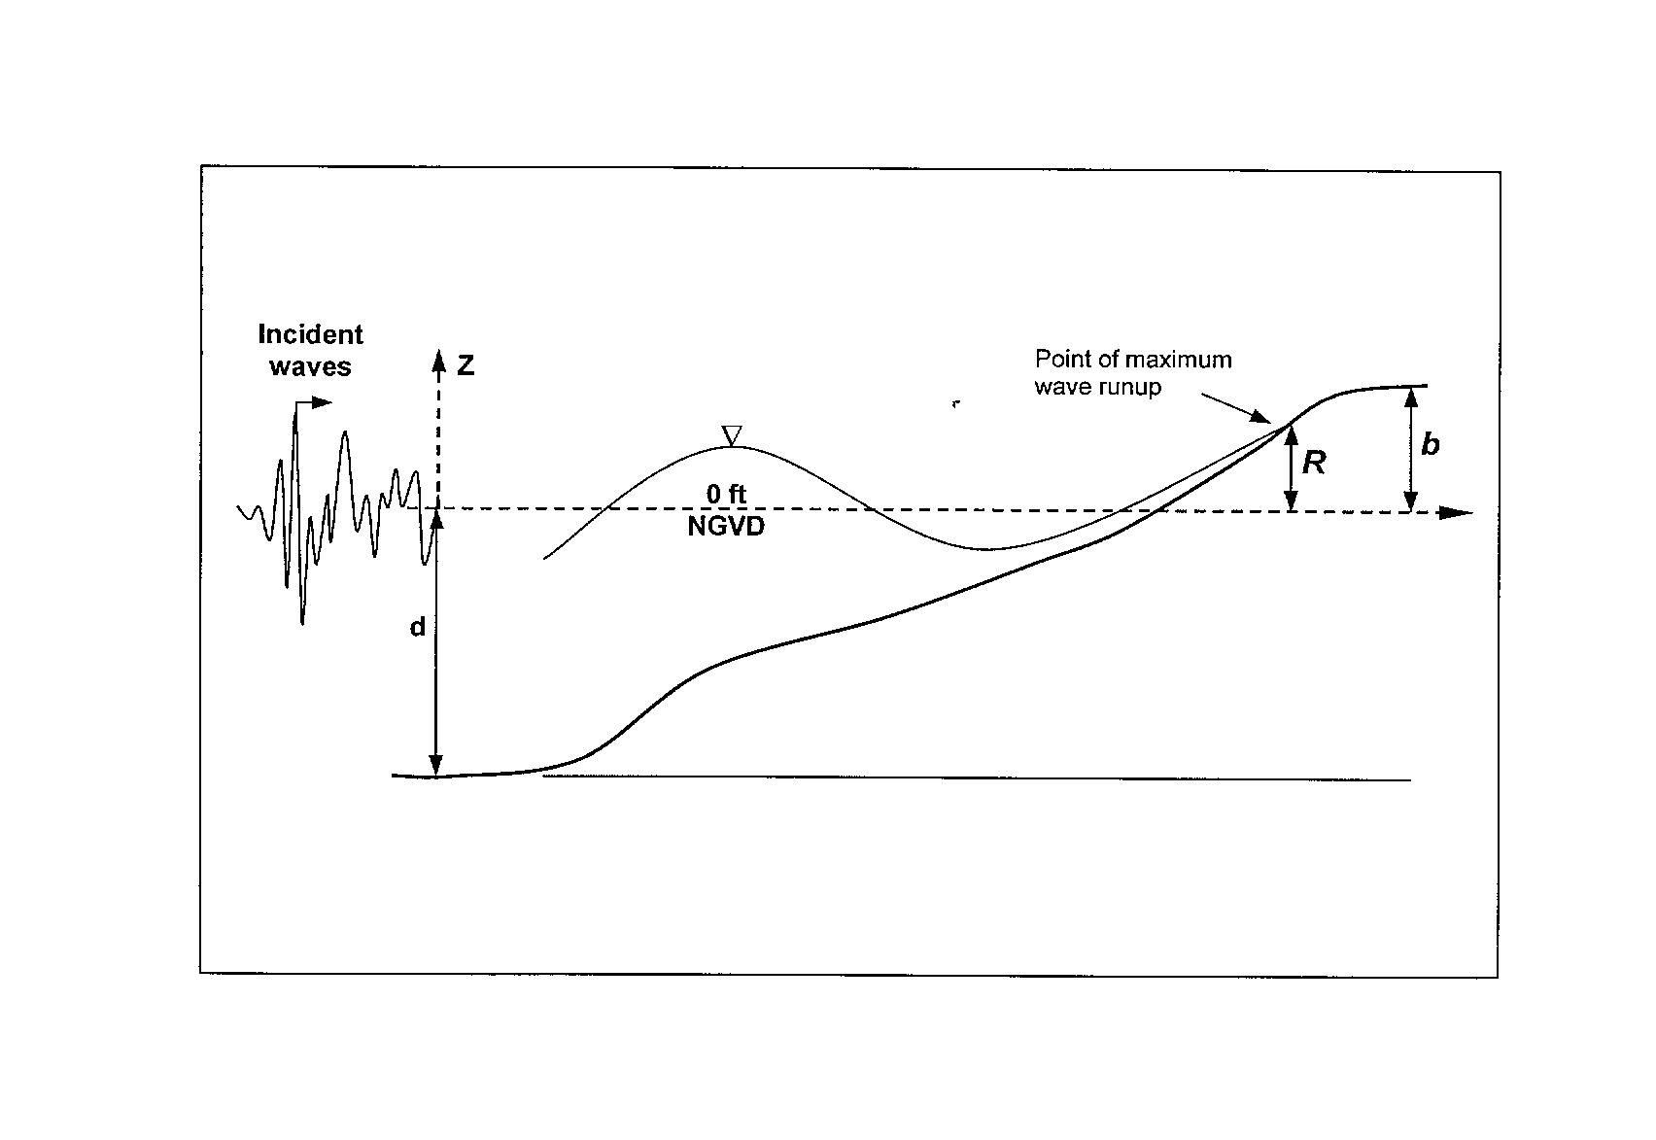
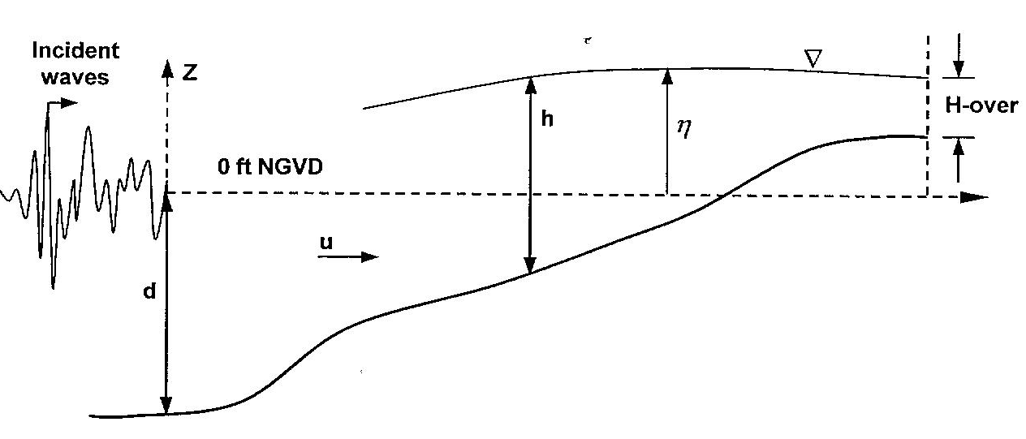
Wave and Tsunami Runup
Empirical formulas
Lab tests (COE – SPM)
Non-linear shallow water waves
Analytical approaches (Carrier & Greenspan)
Synolakis, Kobayashi numerical methods

Slide 12
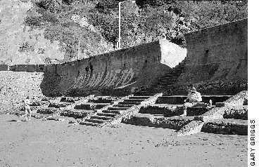
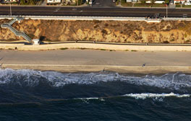
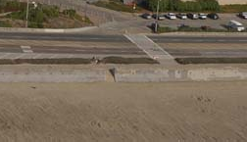
Seawalls
Offer protection under some circumstances
California Coastal Records Project
California Coastal Records Project

Slide 13
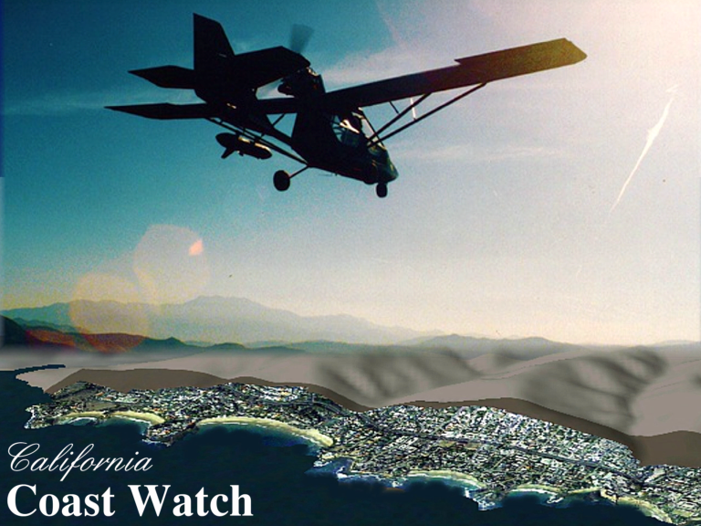
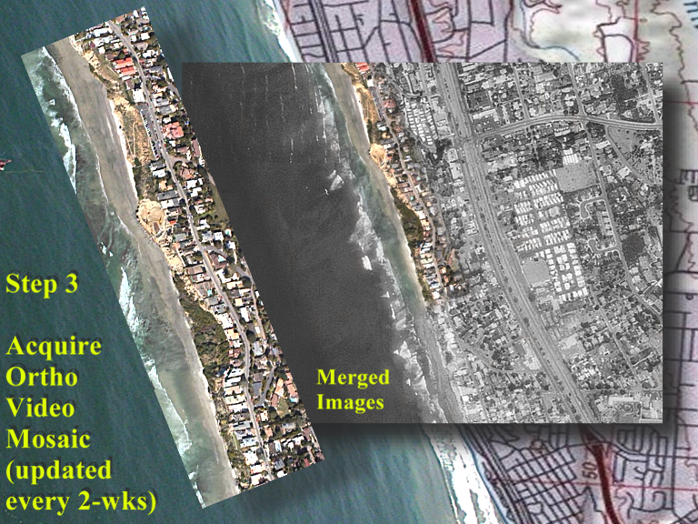
Low-Cost Rapid Assessment or Rescue
Real-time ground link
• Damage location surveys
Offshore rescue

Slide 14
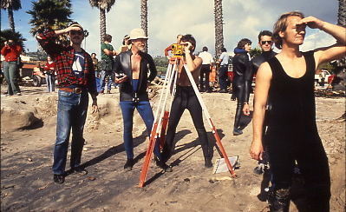
Summary and Looking to the Future…
Processes causing local tsunami hazard also mitigate
Coastal study has advanced understanding
Technology and communication ready to apply

