Slide 1
TSUNAMI BULLETIN NUMBER 001
PACIFIC TSUNAMI WARNING CENTER/NOAA/NWS
ISSUED AT 0114Z 26 DEC 2004
THIS BULLETIN IS FOR ALL AREAS OF THE PACIFIC BASIN EXCEPT ALASKA - BRITISH COLUMBIA - WASHINGTON - OREGON - CALIFORNIA. ..................
TSUNAMI INFORMATION BULLETIN ..................
THIS MESSAGE IS FOR INFORMATION ONLY.
THERE IS NO TSUNAMI WARNING OR WATCH IN EFFECT.
AN EARTHQUAKE HAS OCCURRED WITH THESE PRELIMINARY PARAMETERS ORIGIN TIME - 0059Z 26 DEC 2004
COORDINATES - 3.4 NORTH 95.7 EAST
LOCATION - OFF W COAST OF NORTHERN SUMATERA
MAGNITUDE - 8.0
EVALUATION THIS EARTHQUAKE IS LOCATED OUTSIDE THE PACIFIC.
NO DESTRUCTIVE TSUNAMI THREAT EXISTS BASED ON HISTORICAL EARTHQUAKE AND TSUNAMI DATA.
THIS WILL BE THE ONLY BULLETIN ISSUED FOR THIS EVENT UNLESS ADDITIONAL INFORMATION BECOMES AVAILABLE. THE WEST COAST/ALASKA TSUNAMI WARNING CENTER WILL ISSUE BULLETINS FOR ALASKA - BRITISH COLUMBIA - WASHINGTON - OREGON - CALIFORNIA.
**************************************************************

Slide 2
TSUNAMI BULLETIN NUMBER 002
PACIFIC TSUNAMI WARNING CENTER/NOAA/NWS
ISSUED AT 0204Z 26 DEC 2004
THIS BULLETIN IS FOR ALL AREAS OF THE PACIFIC BASIN EXCEPT ALASKA - BRITISH COLUMBIA - WASHINGTON - OREGON - CALIFORNIA. ..................
TSUNAMI INFORMATION BULLETIN ..................
ATTENTION: NOTE REVISED MAGNITUDE. THIS MESSAGE IS FOR INFORMATION ONLY.
THERE IS NO TSUNAMI WARNING OR WATCH IN EFFECT.
AN EARTHQUAKE HAS OCCURRED WITH THESE PRELIMINARY PARAMETERS
ORIGIN TIME - 0059Z 26 DEC 2004
COORDINATES - 3.4 NORTH 95.7 EAST
LOCATION - OFF W COAST OF NORTHERN SUMATERA
MAGNITUDE - 8.5
EVALUATION REVISED MAGNITUDE BASED ON ANALYSIS OF MANTLE WAVES.
THIS EARTHQUAKE IS LOCATED OUTSIDE THE PACIFIC.
NO DESTRUCTIVE TSUNAMI THREAT EXISTS FOR THE PACIFIC BASIN BASED ON HISTORICAL EARTHQUAKE AND TSUNAMI DATA.
THERE IS THE POSSIBILITY OF A TSUNAMI NEAR THE EPICENTER.
THIS WILL BE THE ONLY BULLETIN ISSUED FOR THIS EVENT UNLESS ADDITIONAL INFORMATION BECOMES AVAILABLE. THE WEST COAST/ALASKA TSUNAMI WARNING CENTER WILL ISSUE BULLETINS FOR ALASKA - BRITISH COLUMBIA - WASHINGTON - OREGON - CALIFORNIA. **************************************************************

Slide 3
Notification Process
WC/A TWC, Palmer, Alaska
  NAWAS
  WeatherWire, NOAA Alert Radio, EMWIN
  CISN/Tsunami Display
  E-Mail Notification
  EDIS, Pagers
California State Warning Center
  CALWAS
  CLETS
  Emergency Manager Call Down

Slide 4
Notification at the Local Level
Public Safety Access Point (PSAP)
  Fire, Law, EMT Dispatch
Emergency Managers
  EAS, CISN/Tsunami Display
  “George Crawford’s AHAB”
  Local Siren & PA Systems
Broadcast Media

Slide 5
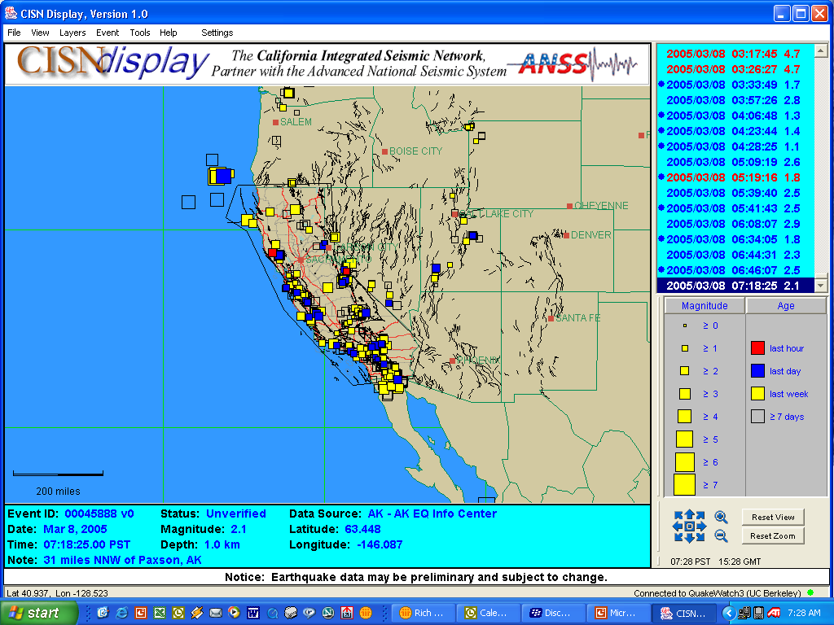

Slide 6
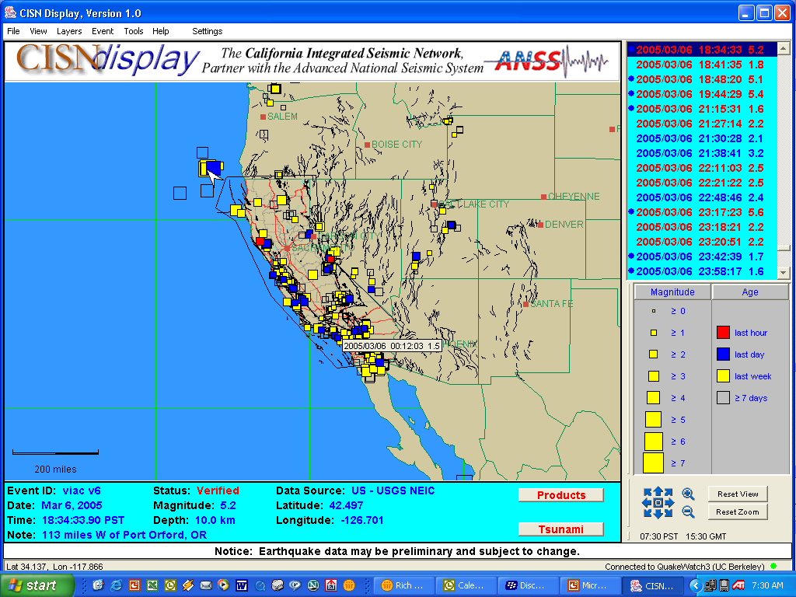

Slide 7
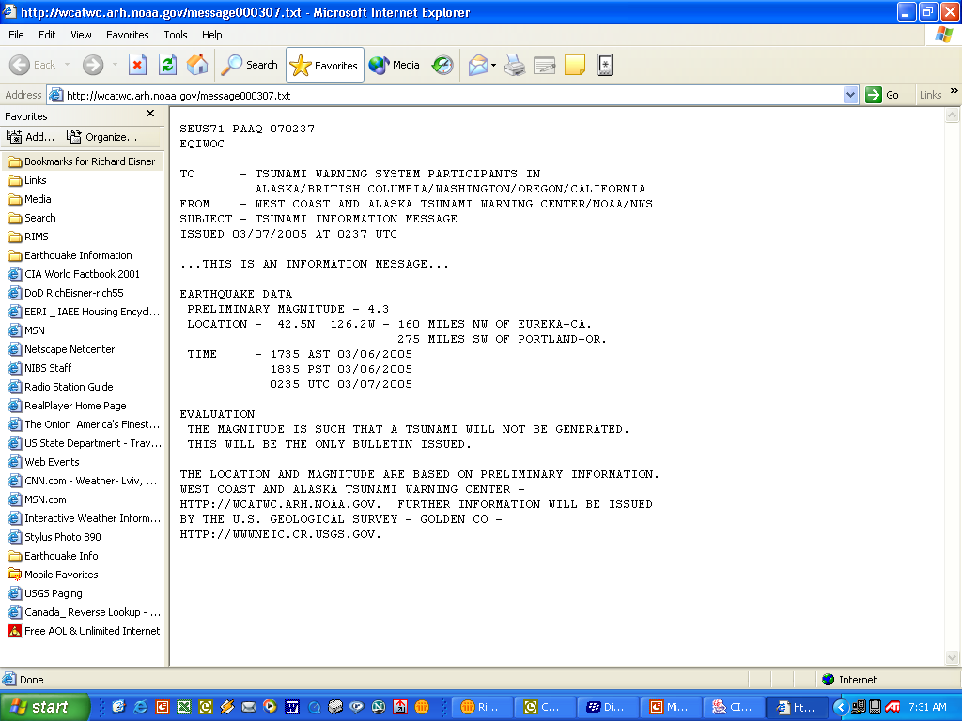

Slide 9
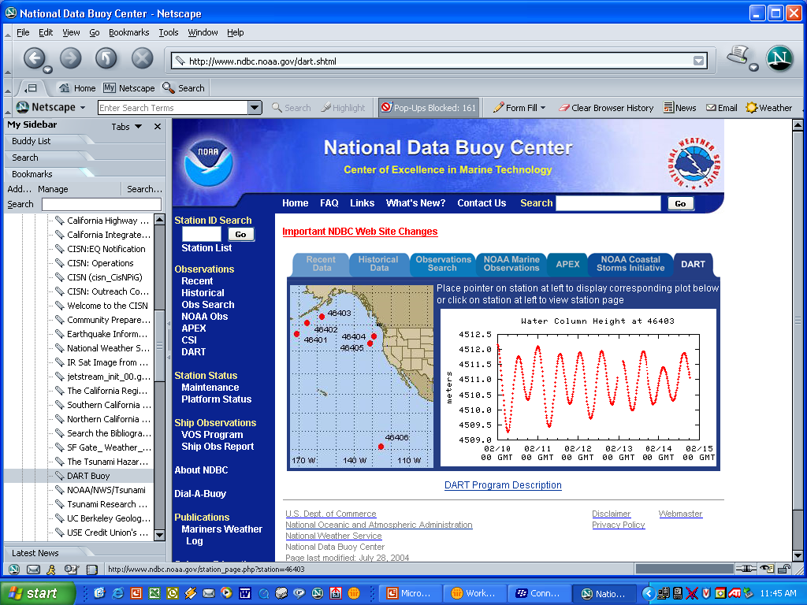

Slide 10
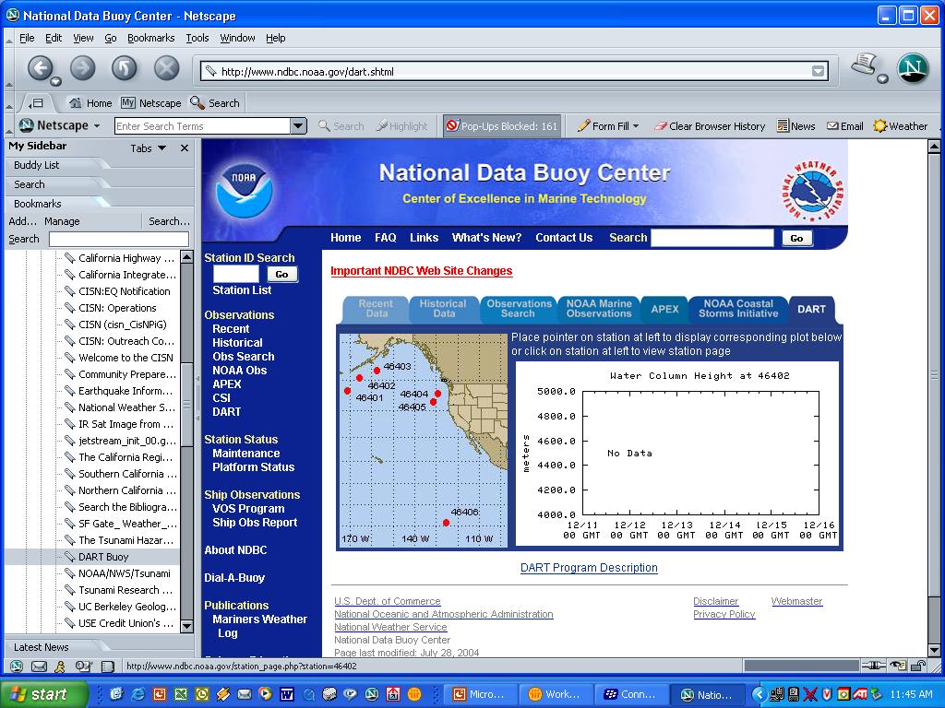

Slide 11
Mitigation
Land Use and Development Controls in Built Out Areas
Construction Standards for Existing Structures
Difficulty in Establishing and Maintaining Interest -- The Maps!
Given the Uncertainty, Let El Nino or Darwin Do the Mitigation?

Slide 12
Structure of the State Program
Guided by a State Steering Committee
  Coastal Counties
  State Agencies
State Strategic Plan and Priorities
  Mapping
Funding from NOAA
Progress and Success Dependent on Local Governments

Slide 13
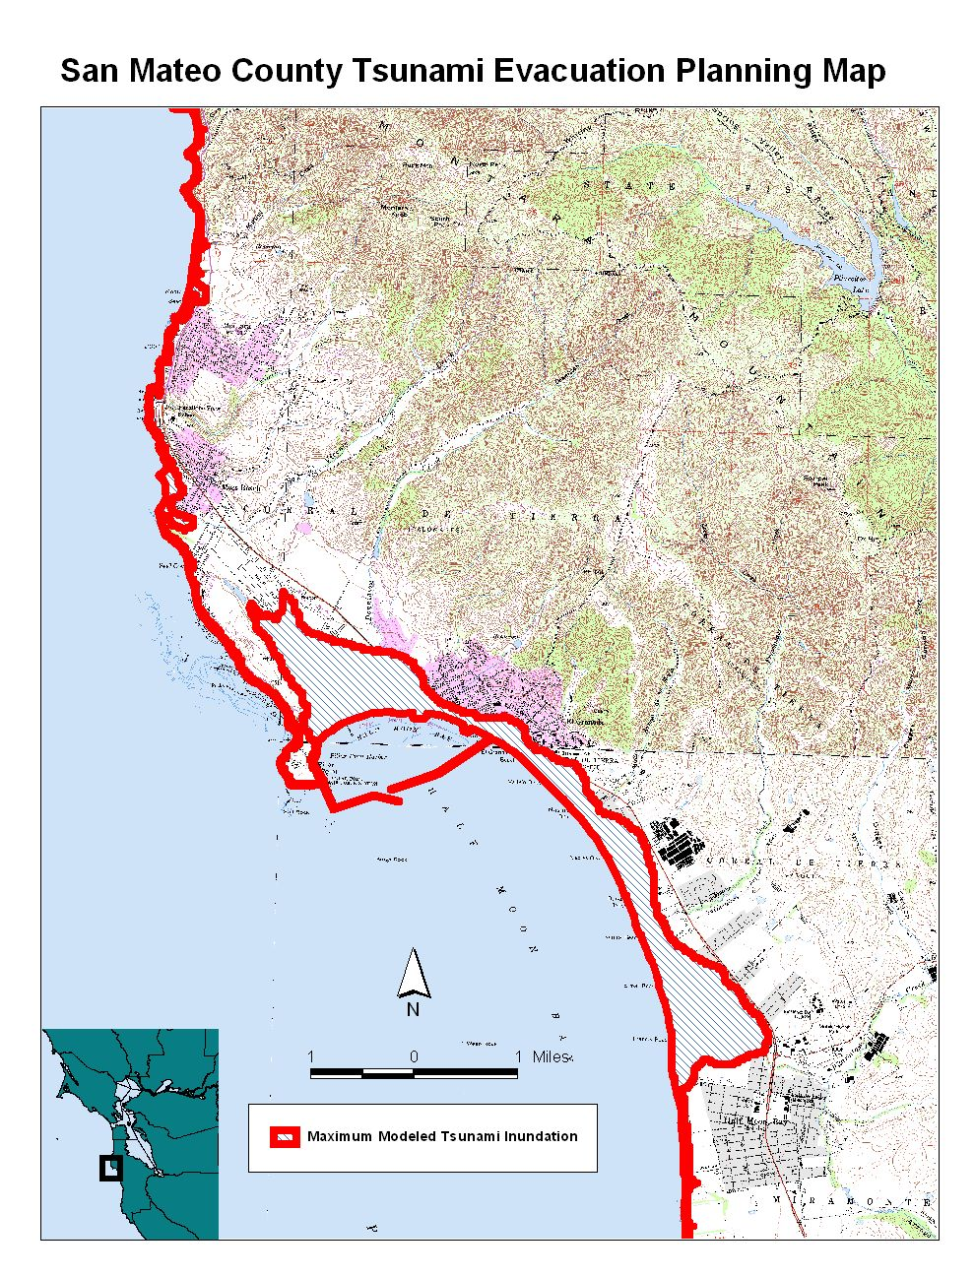
Inundation Projection
From MOST Model

Slide 14
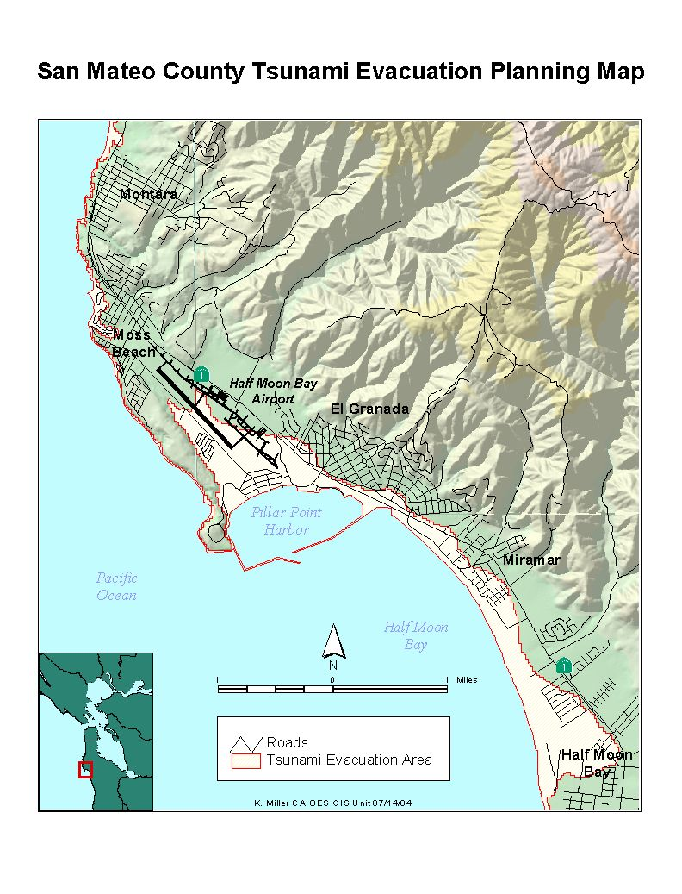
Inundation Projection
Superimposed
On County Map

Slide 15
Next Steps
Identify “Landmark” Defined Evacuation Zone
Identify Areas of Refuge and Shelter Structures
Identify Special Uses and Populations
Identify Evacuation Routes
Sign and Educate

Slide 16
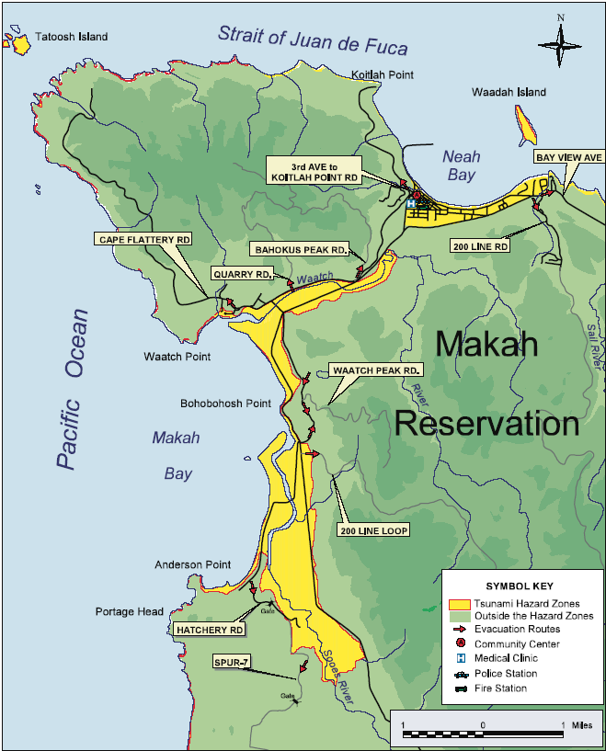
Sample Community
Evacuation Map

Slide 17
Progress To Date
Inundation Projections for 9 of 15 Counties Since 2000
Published Emergency Planning Guidance
Published Land Use Planning Guidance
Developed Standard Brochure
Acceptance of Oregon Signage and Washington Publications by National Program
Incorporation of Tsunami into FEMA CDRP
Development of CISN Display Technology
FEMA/NOAA/ATC Coastal/Tsunami Construction Guidance

Slide 19
Next Steps for California
Quantifying Tsunami Sources and Probabilities
Development of Evacuation Plans by Local Governments
Develop Standard Public Information Materials
Developing New Warning System Technologies
  CISN Display 2
  Enhanced Notification
  Improve World Wide Reliability

Slide 20
Unknown Factors
Impact on Public and Governments of Indian Ocean Earthquake and Tsunami
New Funding Options
  NOAA Enhanced Budget for FY 2005
  OSTP and Congressionally Initiated New Funding (S-50)
  State Funding
State Program = $ 88,000 to $ 274,000 or ………..
National Program = $ 2.3 to $4.2 Million ………..

Slide 21
Issues Critical to Success
Local Initiatives to Develop Evacuation Plans and Maps
Continued Cooperation Among State and Local Agencies
Adequate Funding to Local Governments
Long Term Commitment to Maintenance
  Technology
  Public Awareness and Education

Slide 22
But, Most Importantly
Communicate: When, How and To Whom
Communicate: What Do You Say
Communicate: What We’ve Learned From the Social Sciences
Communicate: What We’ve Learned About Other Tsunami Disasters

Slide 23
And Response
“In order to prepare for WMD/T we need to be preparing to respond to catastrophic earthquakes: for mass casualties, loss of communications and transportation infrastructure, hazardous material releases, collapsed structures, flooding……”
SA John Lightfoot, FBI

Slide 26
