Slide 1
California Tsunami Program
Richard Eisner, FAIA, Administrator
OES Coastal Region & Tsunami Program

Slide 2
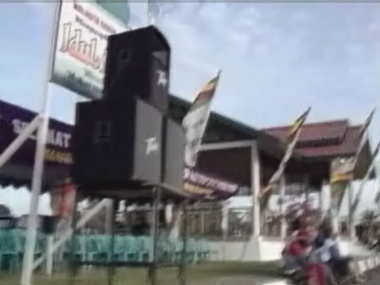
Tsunami-Hits-Pantong-Beach-and-Banda-Ache

Slide 3


Slide 4
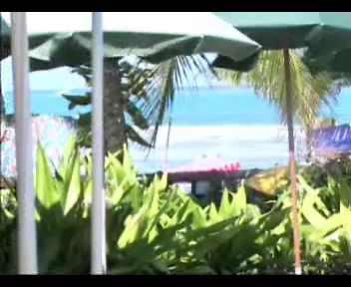

Slide 5
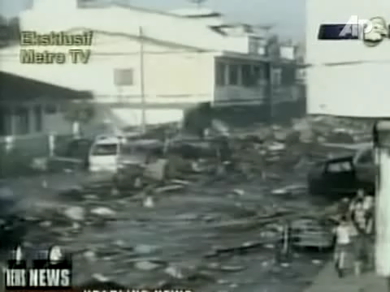

Slide 6
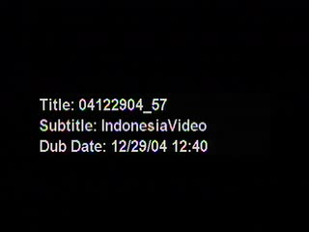

Slide 7
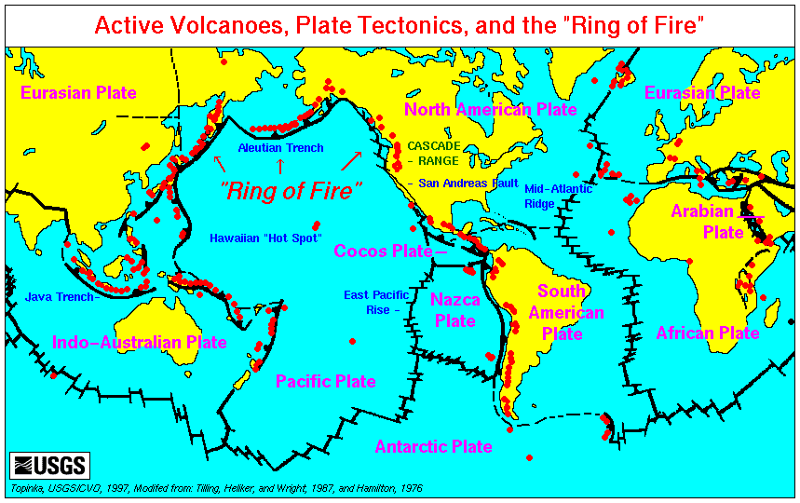
Plate Boundary Earthquakes

Slide 8
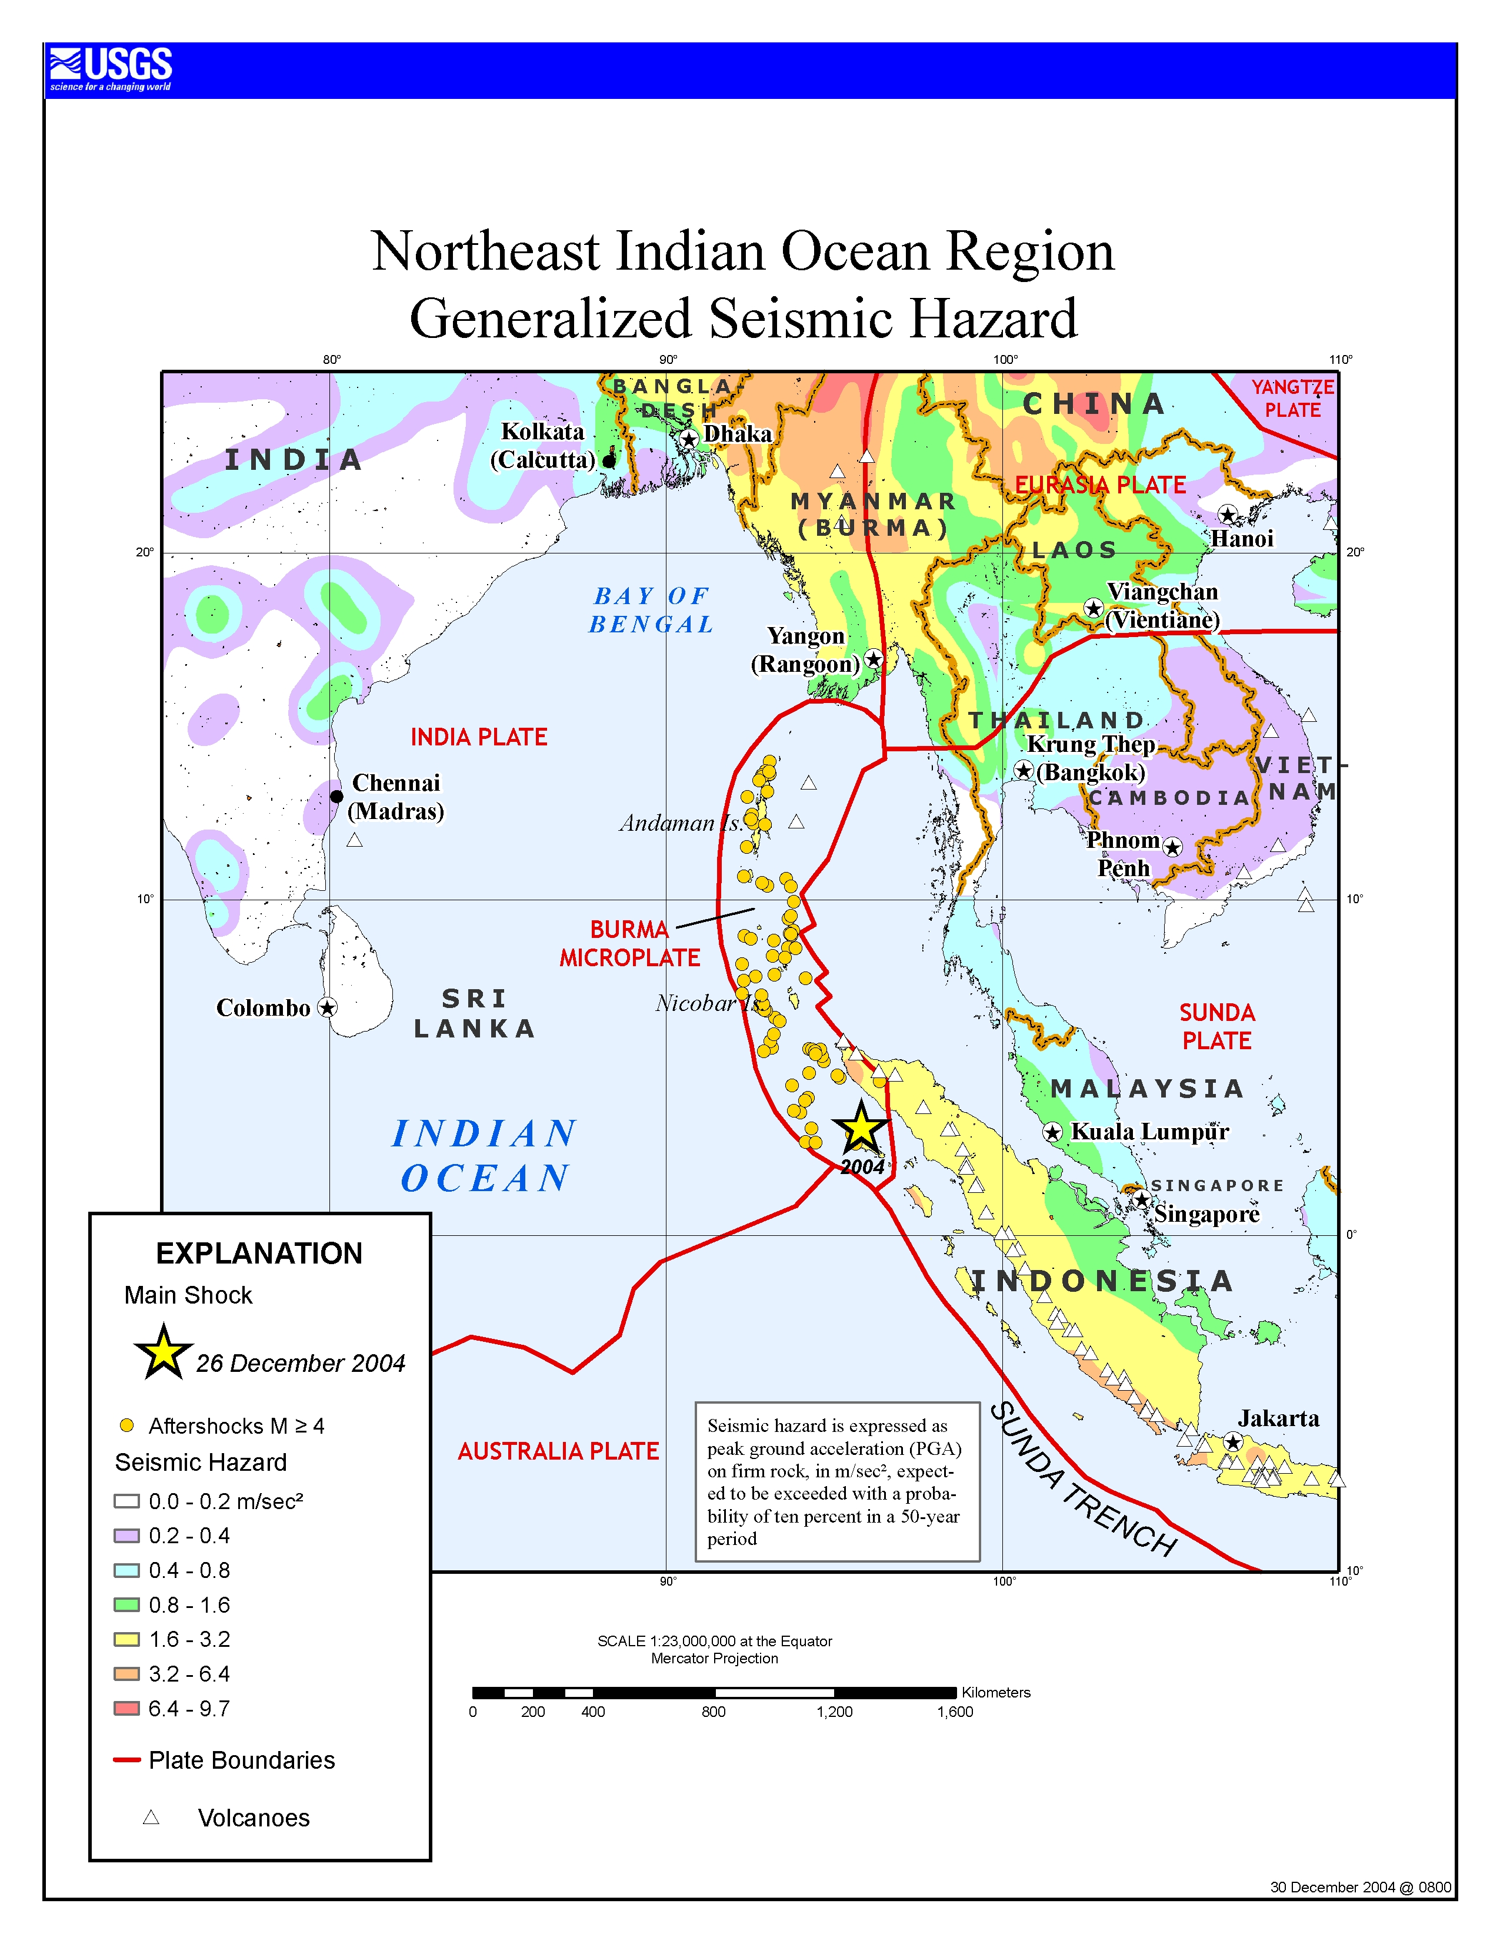
M9.3 Earthquake
in Sumatra

Slide 9
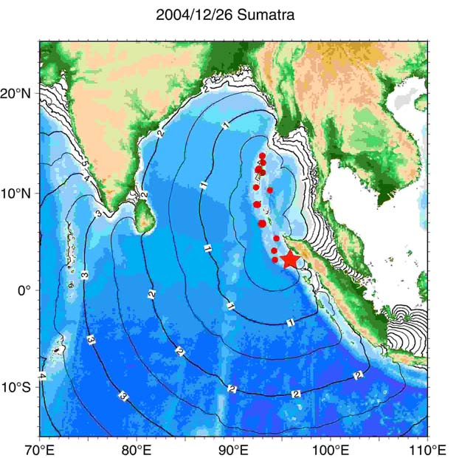
Travel
Times

Slide 10
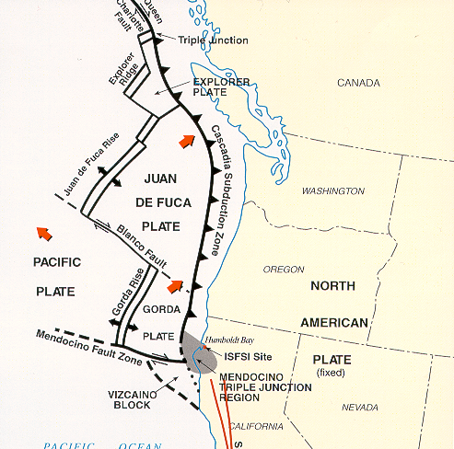
Tectonic Context

Slide 11
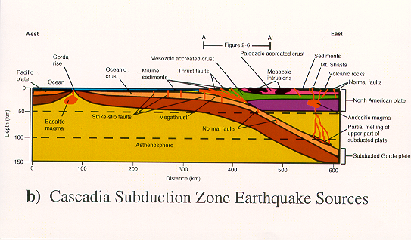
Tectonic Cross Section

Slide 12
How Do Earthquakes Create Tsunamis?
Rapid Sea Floor Deformation and Vertical Displacement
Ocean Above Deformation is Displaced
Waves Form As Displaced Water Levels
Waves Propagate Across Ocean

Slide 13
Non-Tectonic Tsunamis
Landslides
Monterey Bay
Palos Verdes
Santa Barbara
Catalina Island
Undersea Volcanoes
Meteors

Slide 14
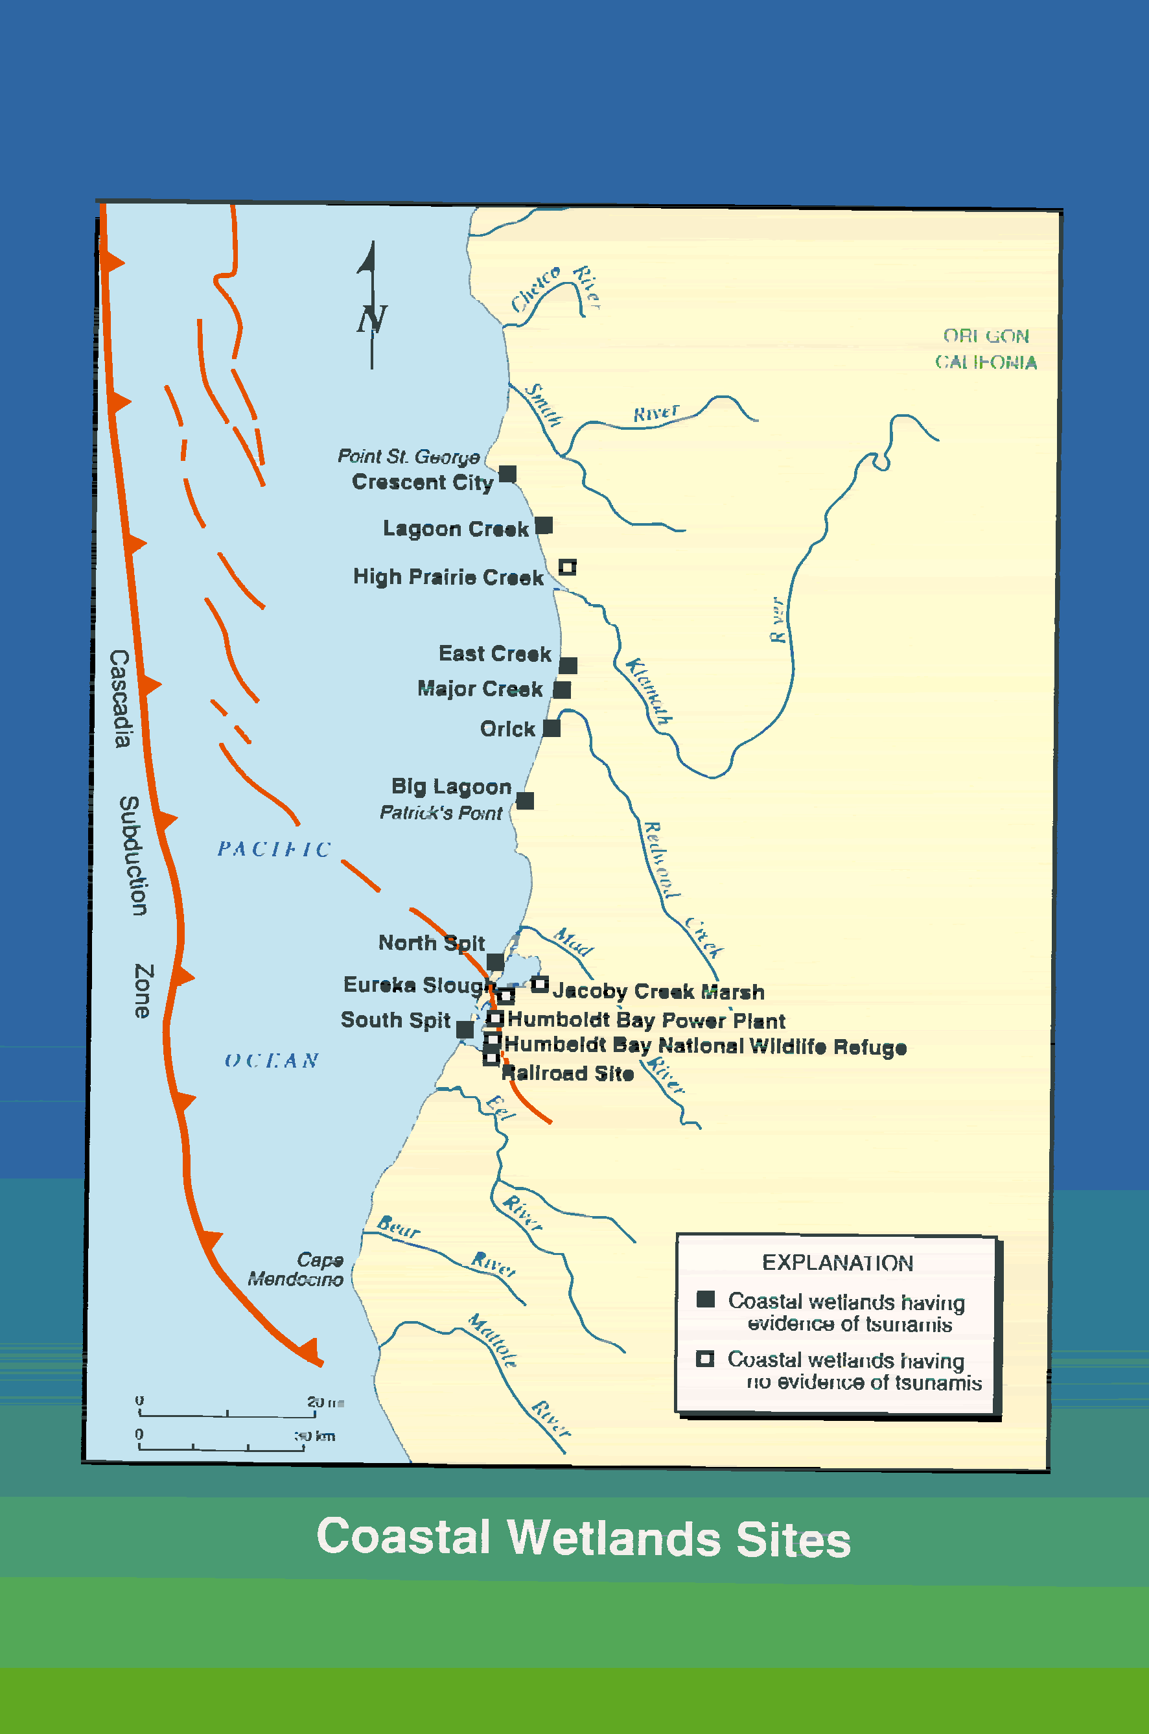

Slide 15
What is a Tsunami Wave?
Long Wave Length (>100km)
Long Period (>1 hour)
High Speed (>700 km/hour)
Little Energy Loss Over Great Distance
Grows in Shallow Water

Slide 16
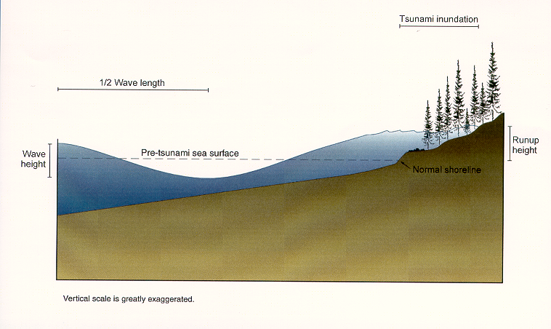
Tsunami Inundation

Slide 17
Challenges
Uncertainty
Unpredictability
Possible Warning?
Limited Mitigation Options to Reduce Risk
Systems Depend on State and Federal Support BUT Local Lead
Infrequency -- Recurrence (?)

Slide 18
Prediction and Warning
How Do You Describe The Threat
A Physical Model for Phenomenon by NOAA
Scientific Review by NOAA
Where?
How Big?
Probability of Occurrence?
When?
Impact and Protective Measures?

Slide 19
Will There Be A Tsunami?
Tsunami-genesis Inferred From Earthquake
Magnitude
Location
Mechanism
Historic Record
Tsunami Confirmed by Tide Gages
Distant
In Harbors
And Mid-Ocean NOAA Buoys (DART)

Slide 20
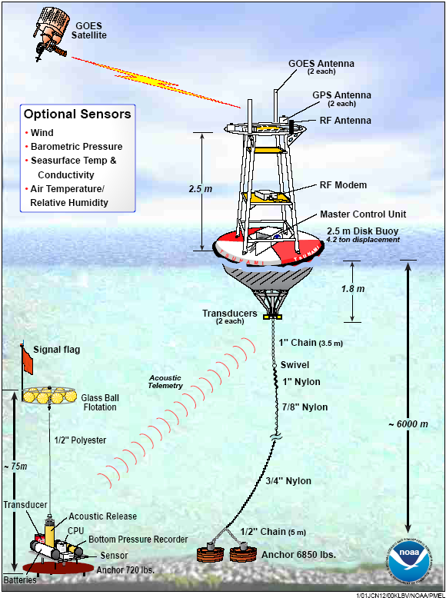
Deep Ocean Assessment
and Reporting of
Tsunamis (DART)
Or
“Tsunamometers”

