Slide 1
A Nearshore Tsunami Detection Network Richard Seymour Scripps Institution of Oceanography
Tsunami Safety Committee Meeting
25 July, 2005

Slide 2
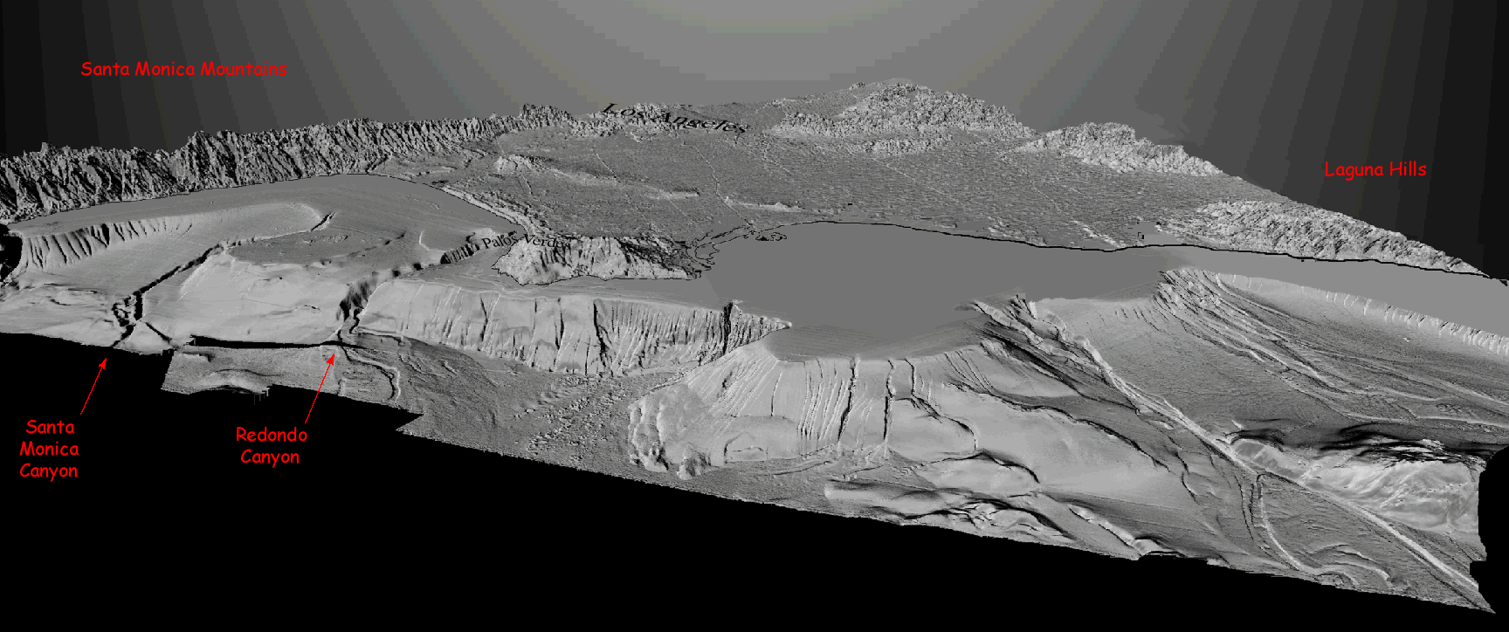
Why Nearshore Detection?
Massive slumps
Tsunamis can be generated very close to shore

Slide 3
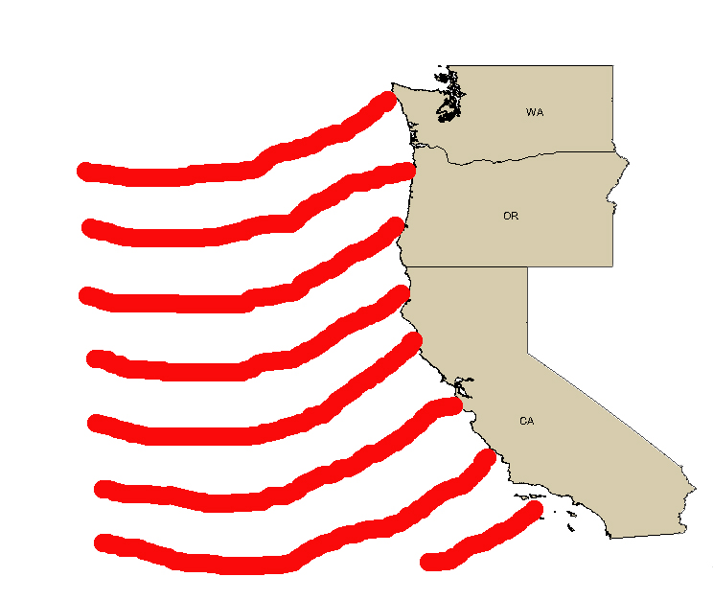
Tracking Distant-Source Tsunamis
Detection at
critical sites,
networked
through the
Internet,
provides advance
warning to
distant locations

Slide 4

Detecting Tsunamis Close to Shore
What you might see

Slide 5
Detecting Tsunamis Close to Shore
Or you might see

Slide 6
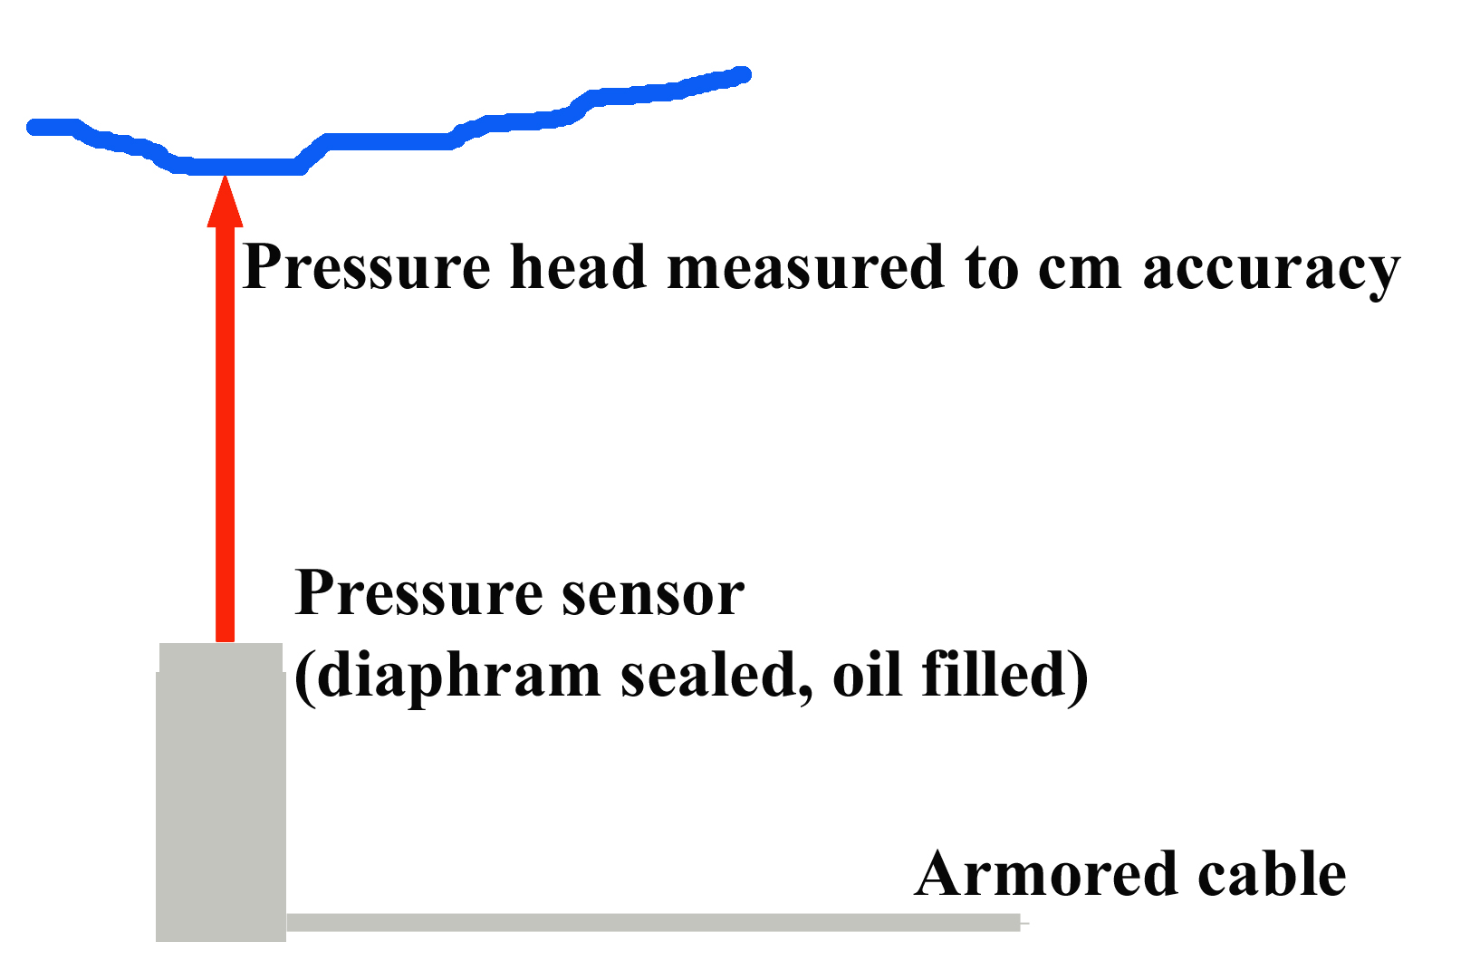
How to Detect

Slide 7
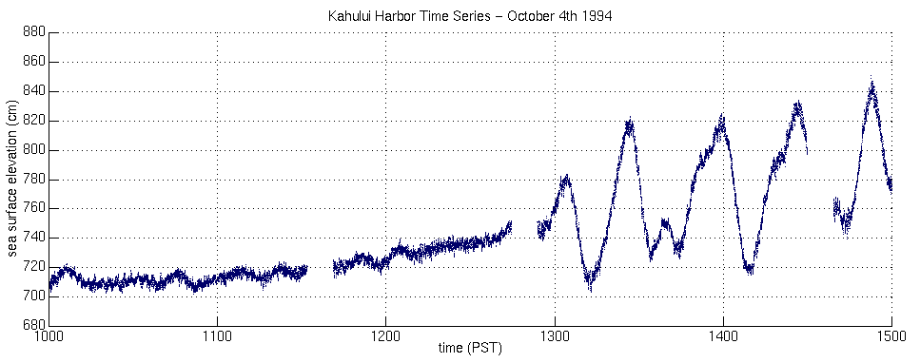
Tsunami recorded in Hawaii from 8.5 Earthquake NE of Hokkaido, Japan

Slide 8
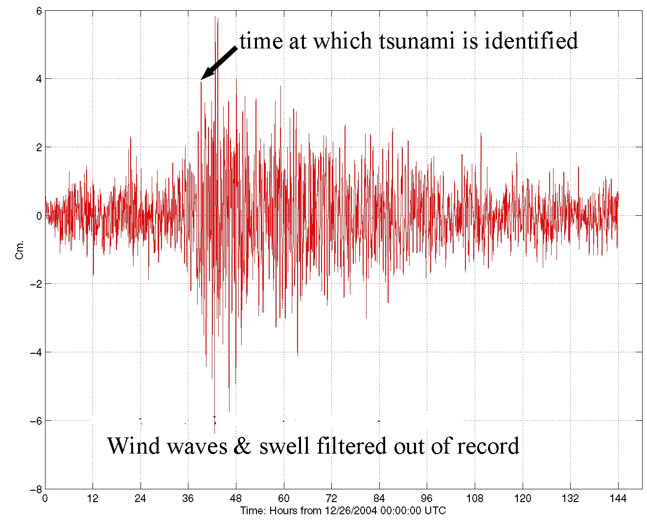
Sumatra Tsunami Recorded at Scripps Pier

Slide 9
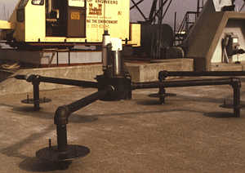
Typical Instrument Mount

Slide 10
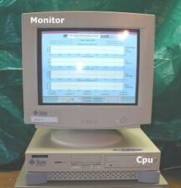
Typical Local Station

Slide 11
Proven Technology
Rugged, reliable pressure sensors
Armored cable for power and signals
Uninterruptible power supplies
Fast, accurate sensing of tsunamis
Local displays
Automatic initiation of warning devices
Real time displays remotely over the Internet

Slide 12
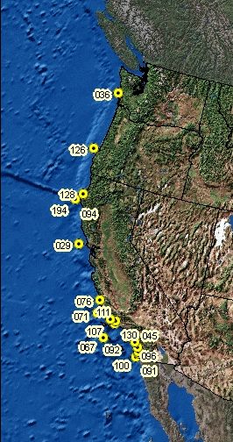
Can Be Part of CDIP Network
29 years of experience in wave measurement, recording and data dissemination
Solid financial support for the existing network of 24 stations
Expertise in design, installation and maintenance of wave sensors
Experience in real time systems for communication of hazards

Slide 13
Big Plus
Between tsunamis, system is a CDIP wave gage
Provides lifeguards, boaters and surfers with accurate local wave conditions
Data are archived to provide downloadable historical records to establish a local wave climate or assist in accident investigations

Slide 14
Cost of a Node
Order of $100k-$120k – first year dependent on cable length, shore facilities, etc.
Order $30k-$50k – annual maintenance and operation costs
Service life --- 10-15 years

