Slide 1
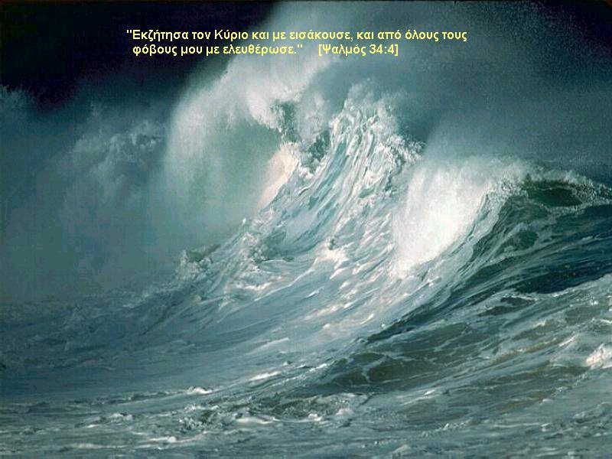
Overview of Performance of Ports, Harbors, Infrastructures and Buildings in Sri Lanka and India
By Peter Yin, Port of Los Angeles
ASCE-COPRI Reconnaissance Team Member
January 31- February11, 2005

Slide 2
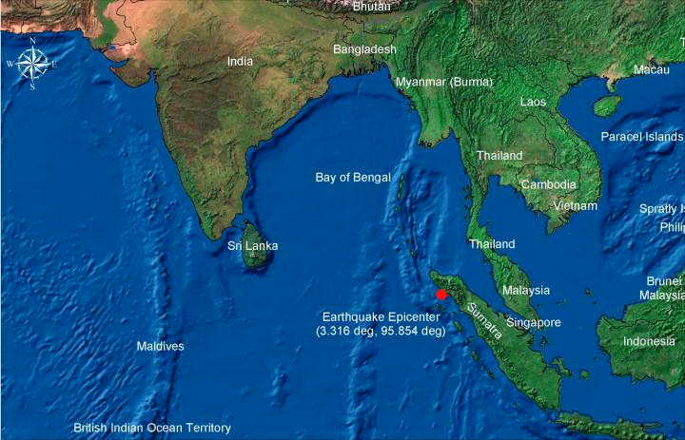
Following the Sumatra Earthquake and Tsunami
ASCE sent Reconnaissance Teams to
Thailand, India and Sri Lanka.
Area visited in this report

Slide 3
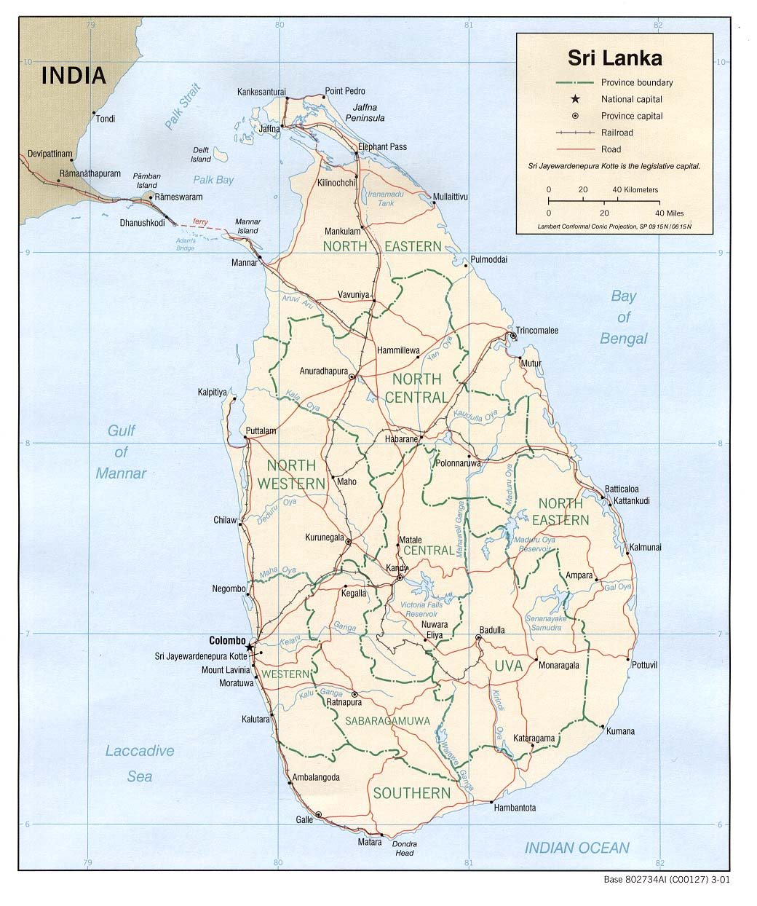
ASCE Sri Lanka Reconnaissance Team visited the island from 1/31/05 to 2/4/05
Major ports visited:
Trincomalee
Colombo
Galle
Buildings, bridges, Ports, and fishing harbors were observed and evaluated

Slide 4
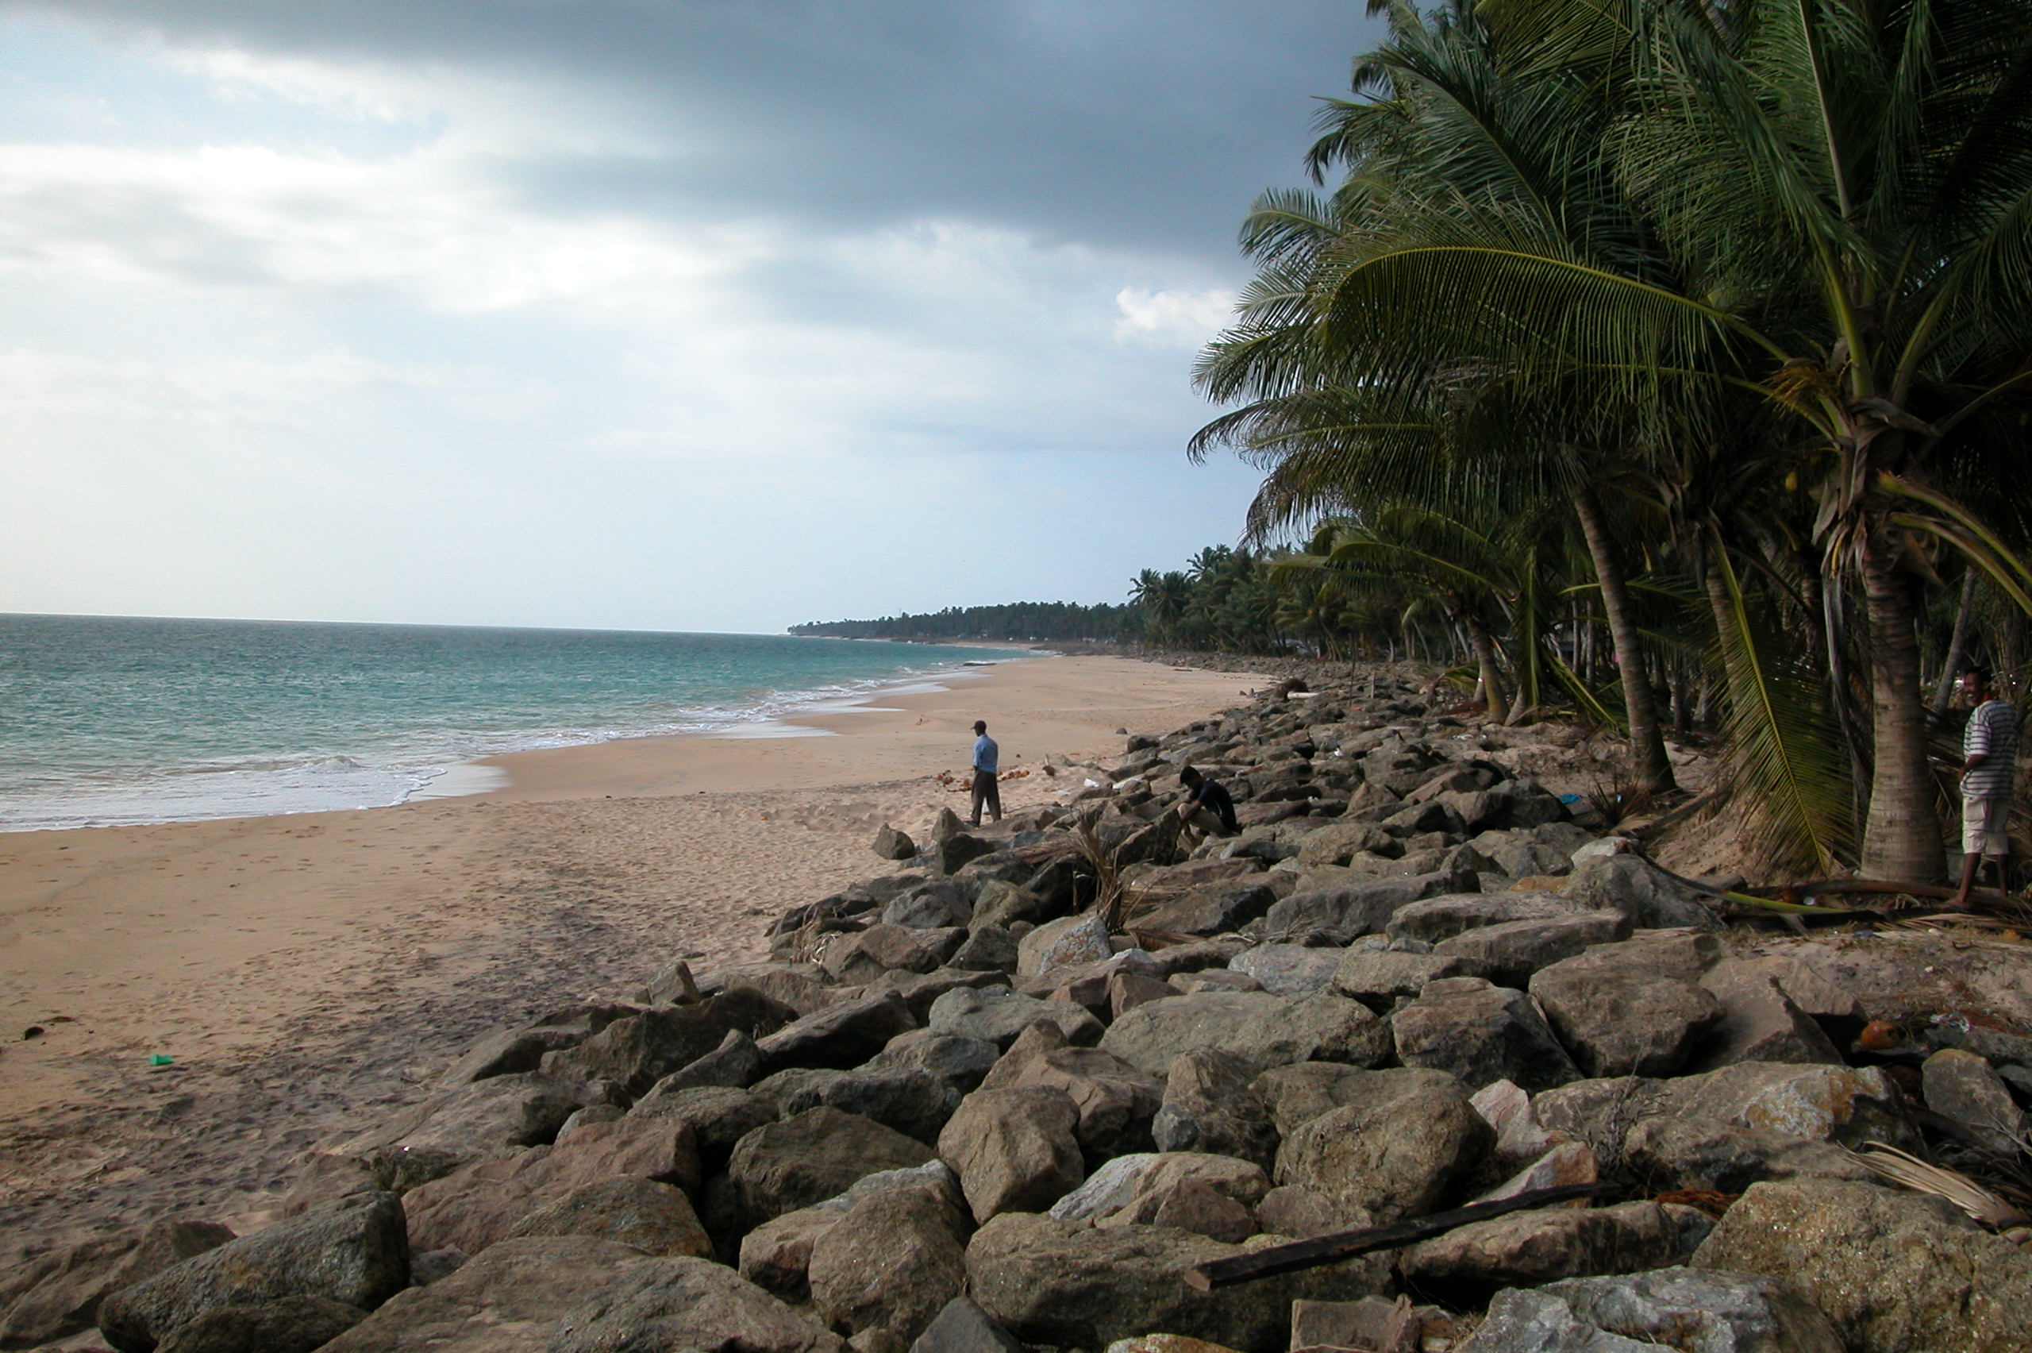
Southwest Sri Lanka Coast
Part I : Building Performance

Slide 5
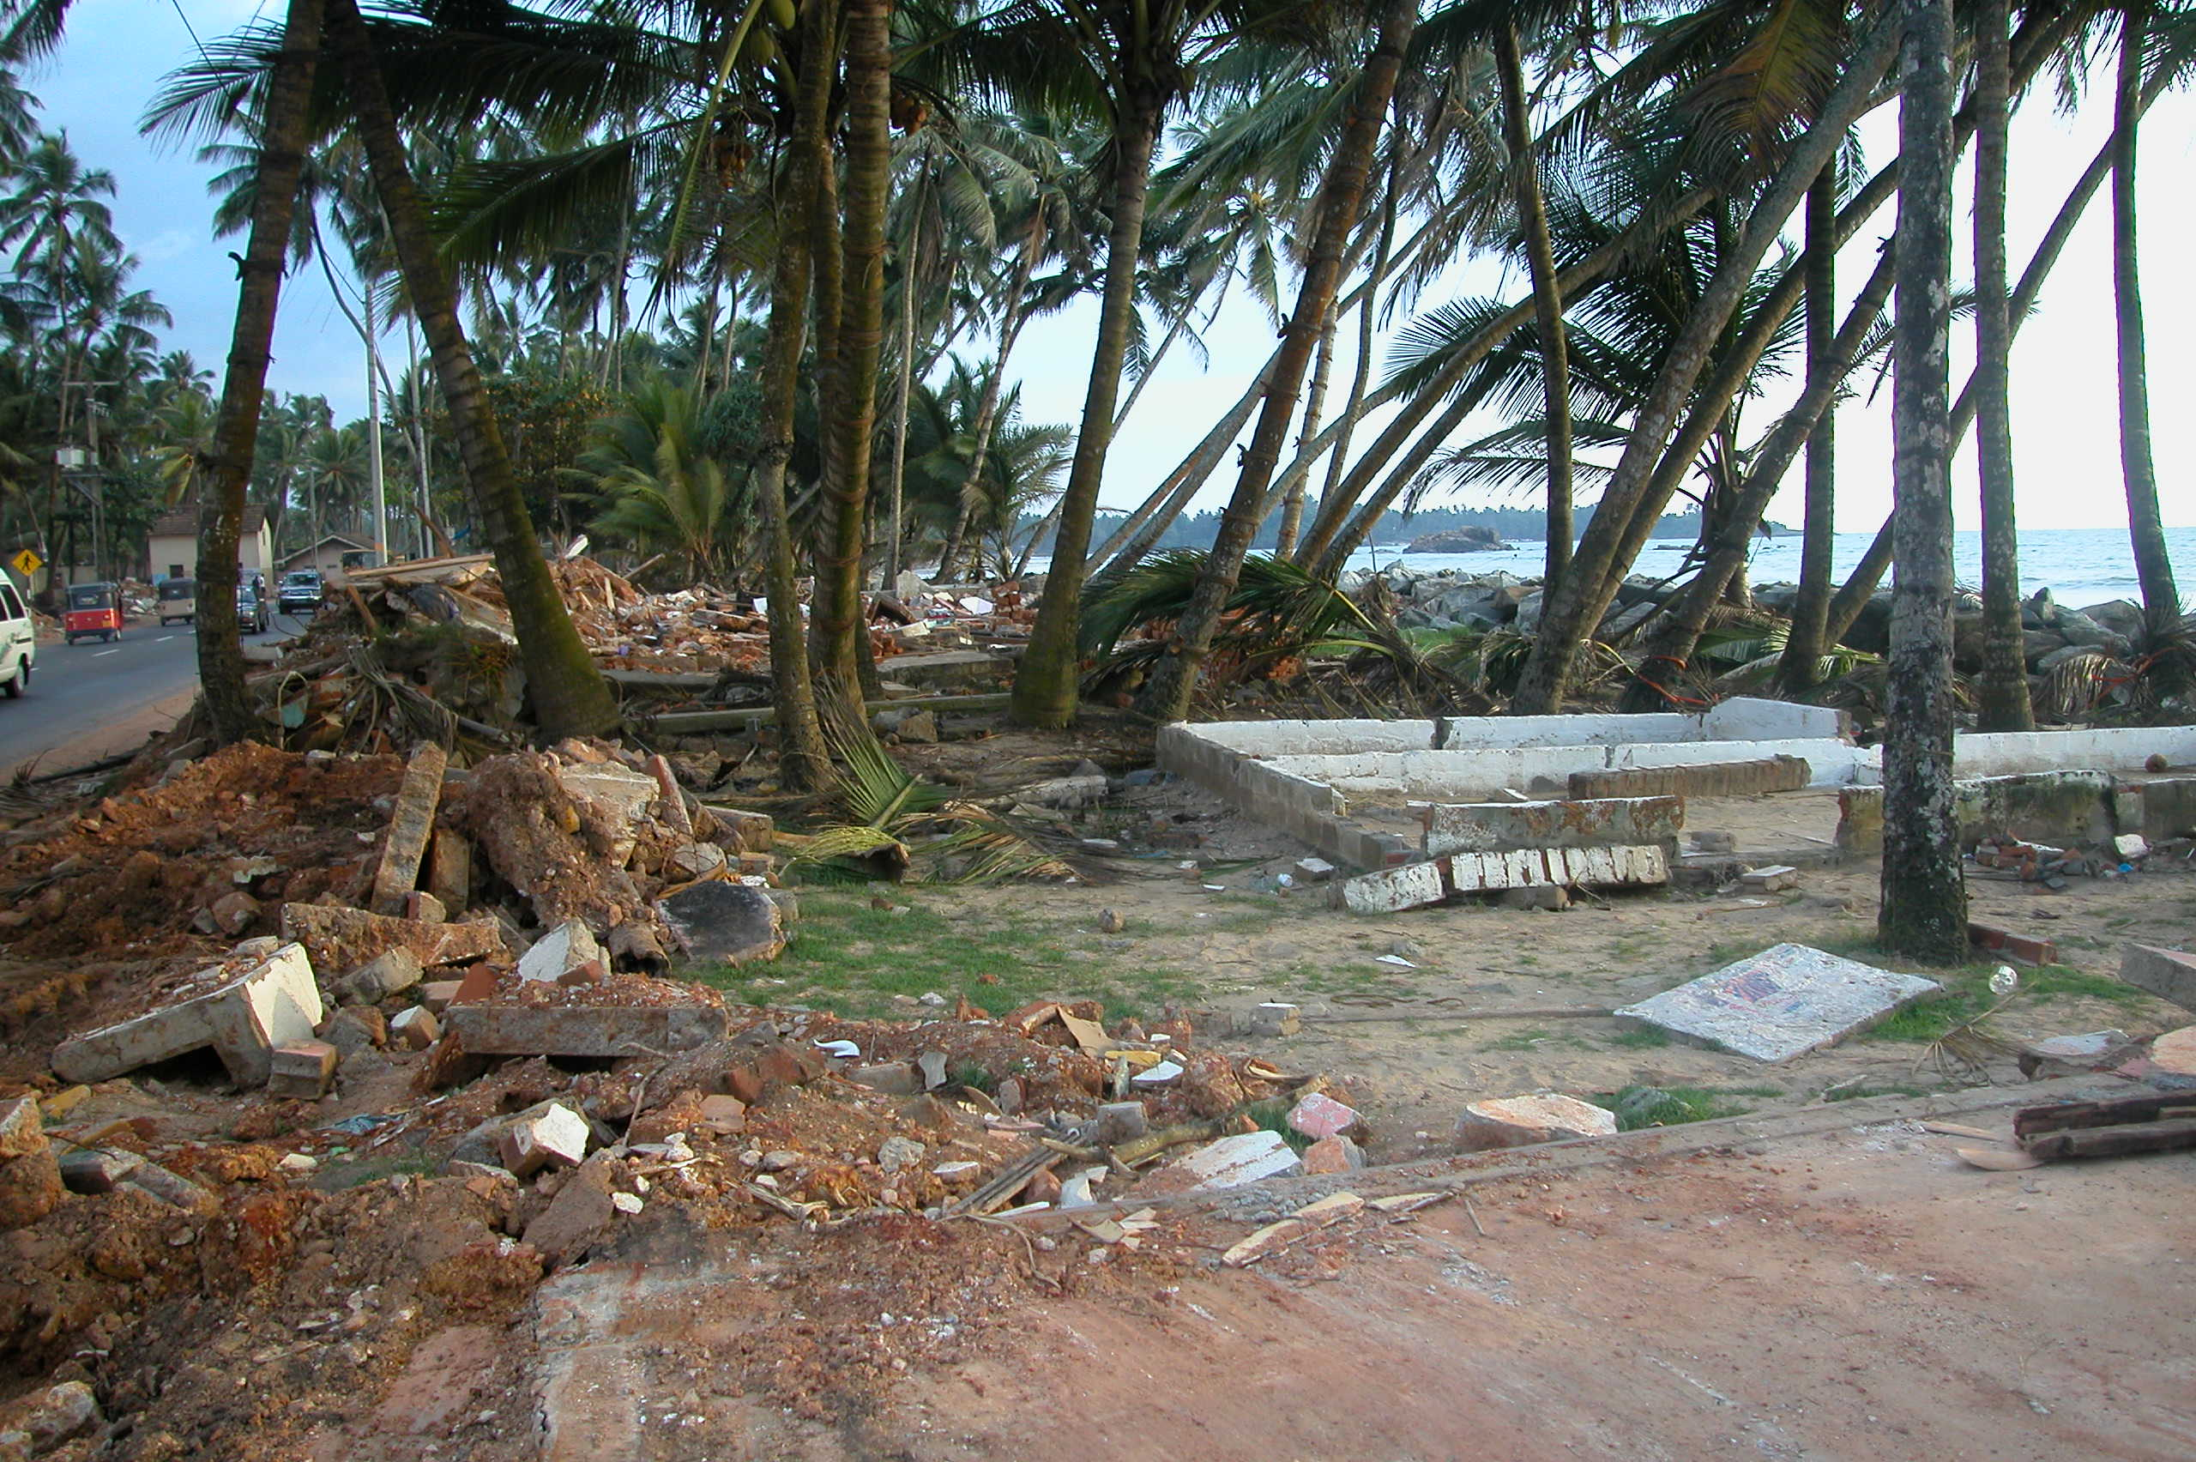
Heavy losses occurred at west coastline of Sri Lanka, area does not face the origin of tsunami.

Slide 6
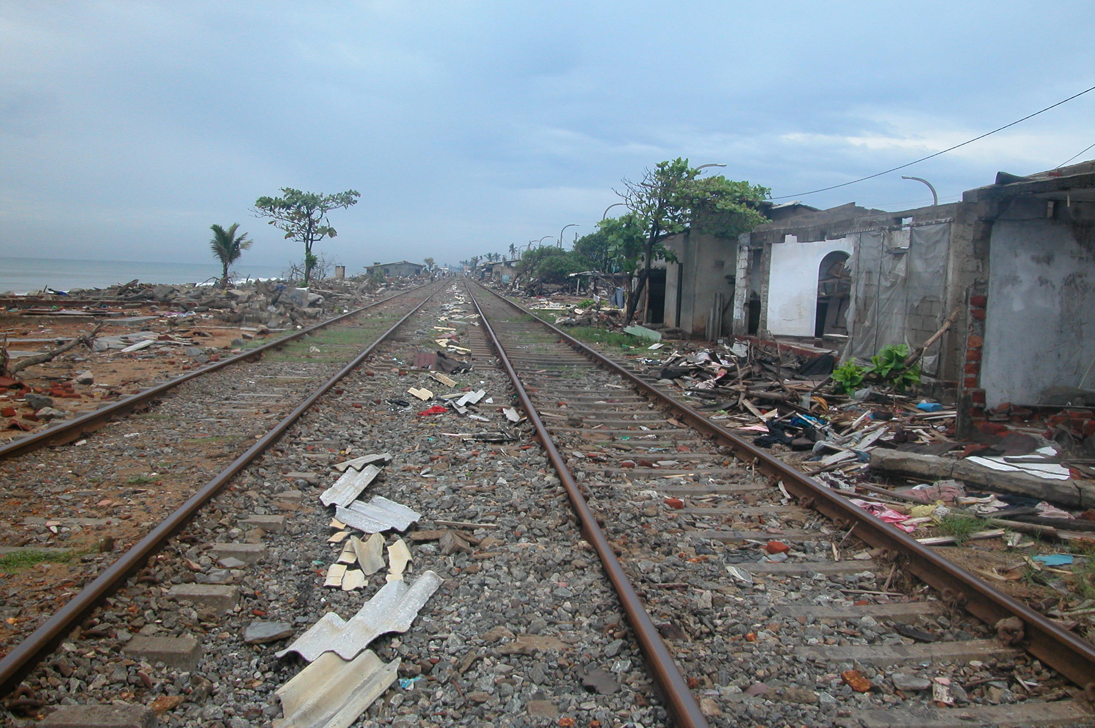
Panadura, 25 km South of Colombo
Nearly all houses along this west coast line were destroyed.

Slide 7
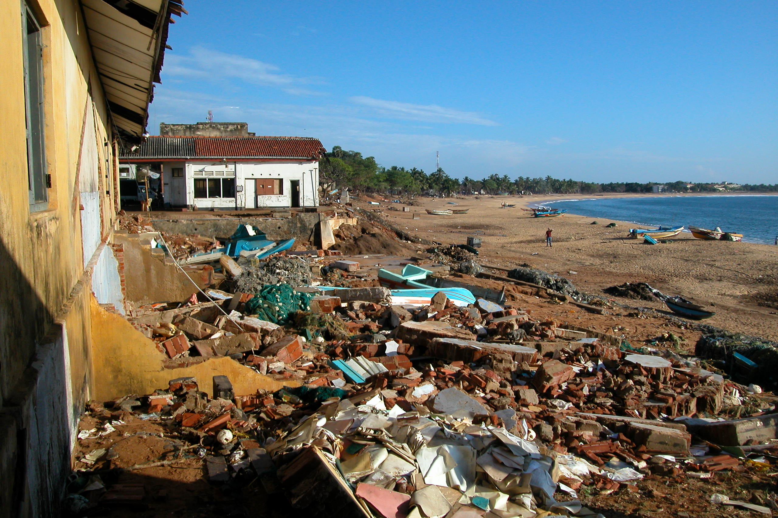
Hambantota, S.E. Lanka:
11 m (33 ft) water level was the highest.

Slide 8
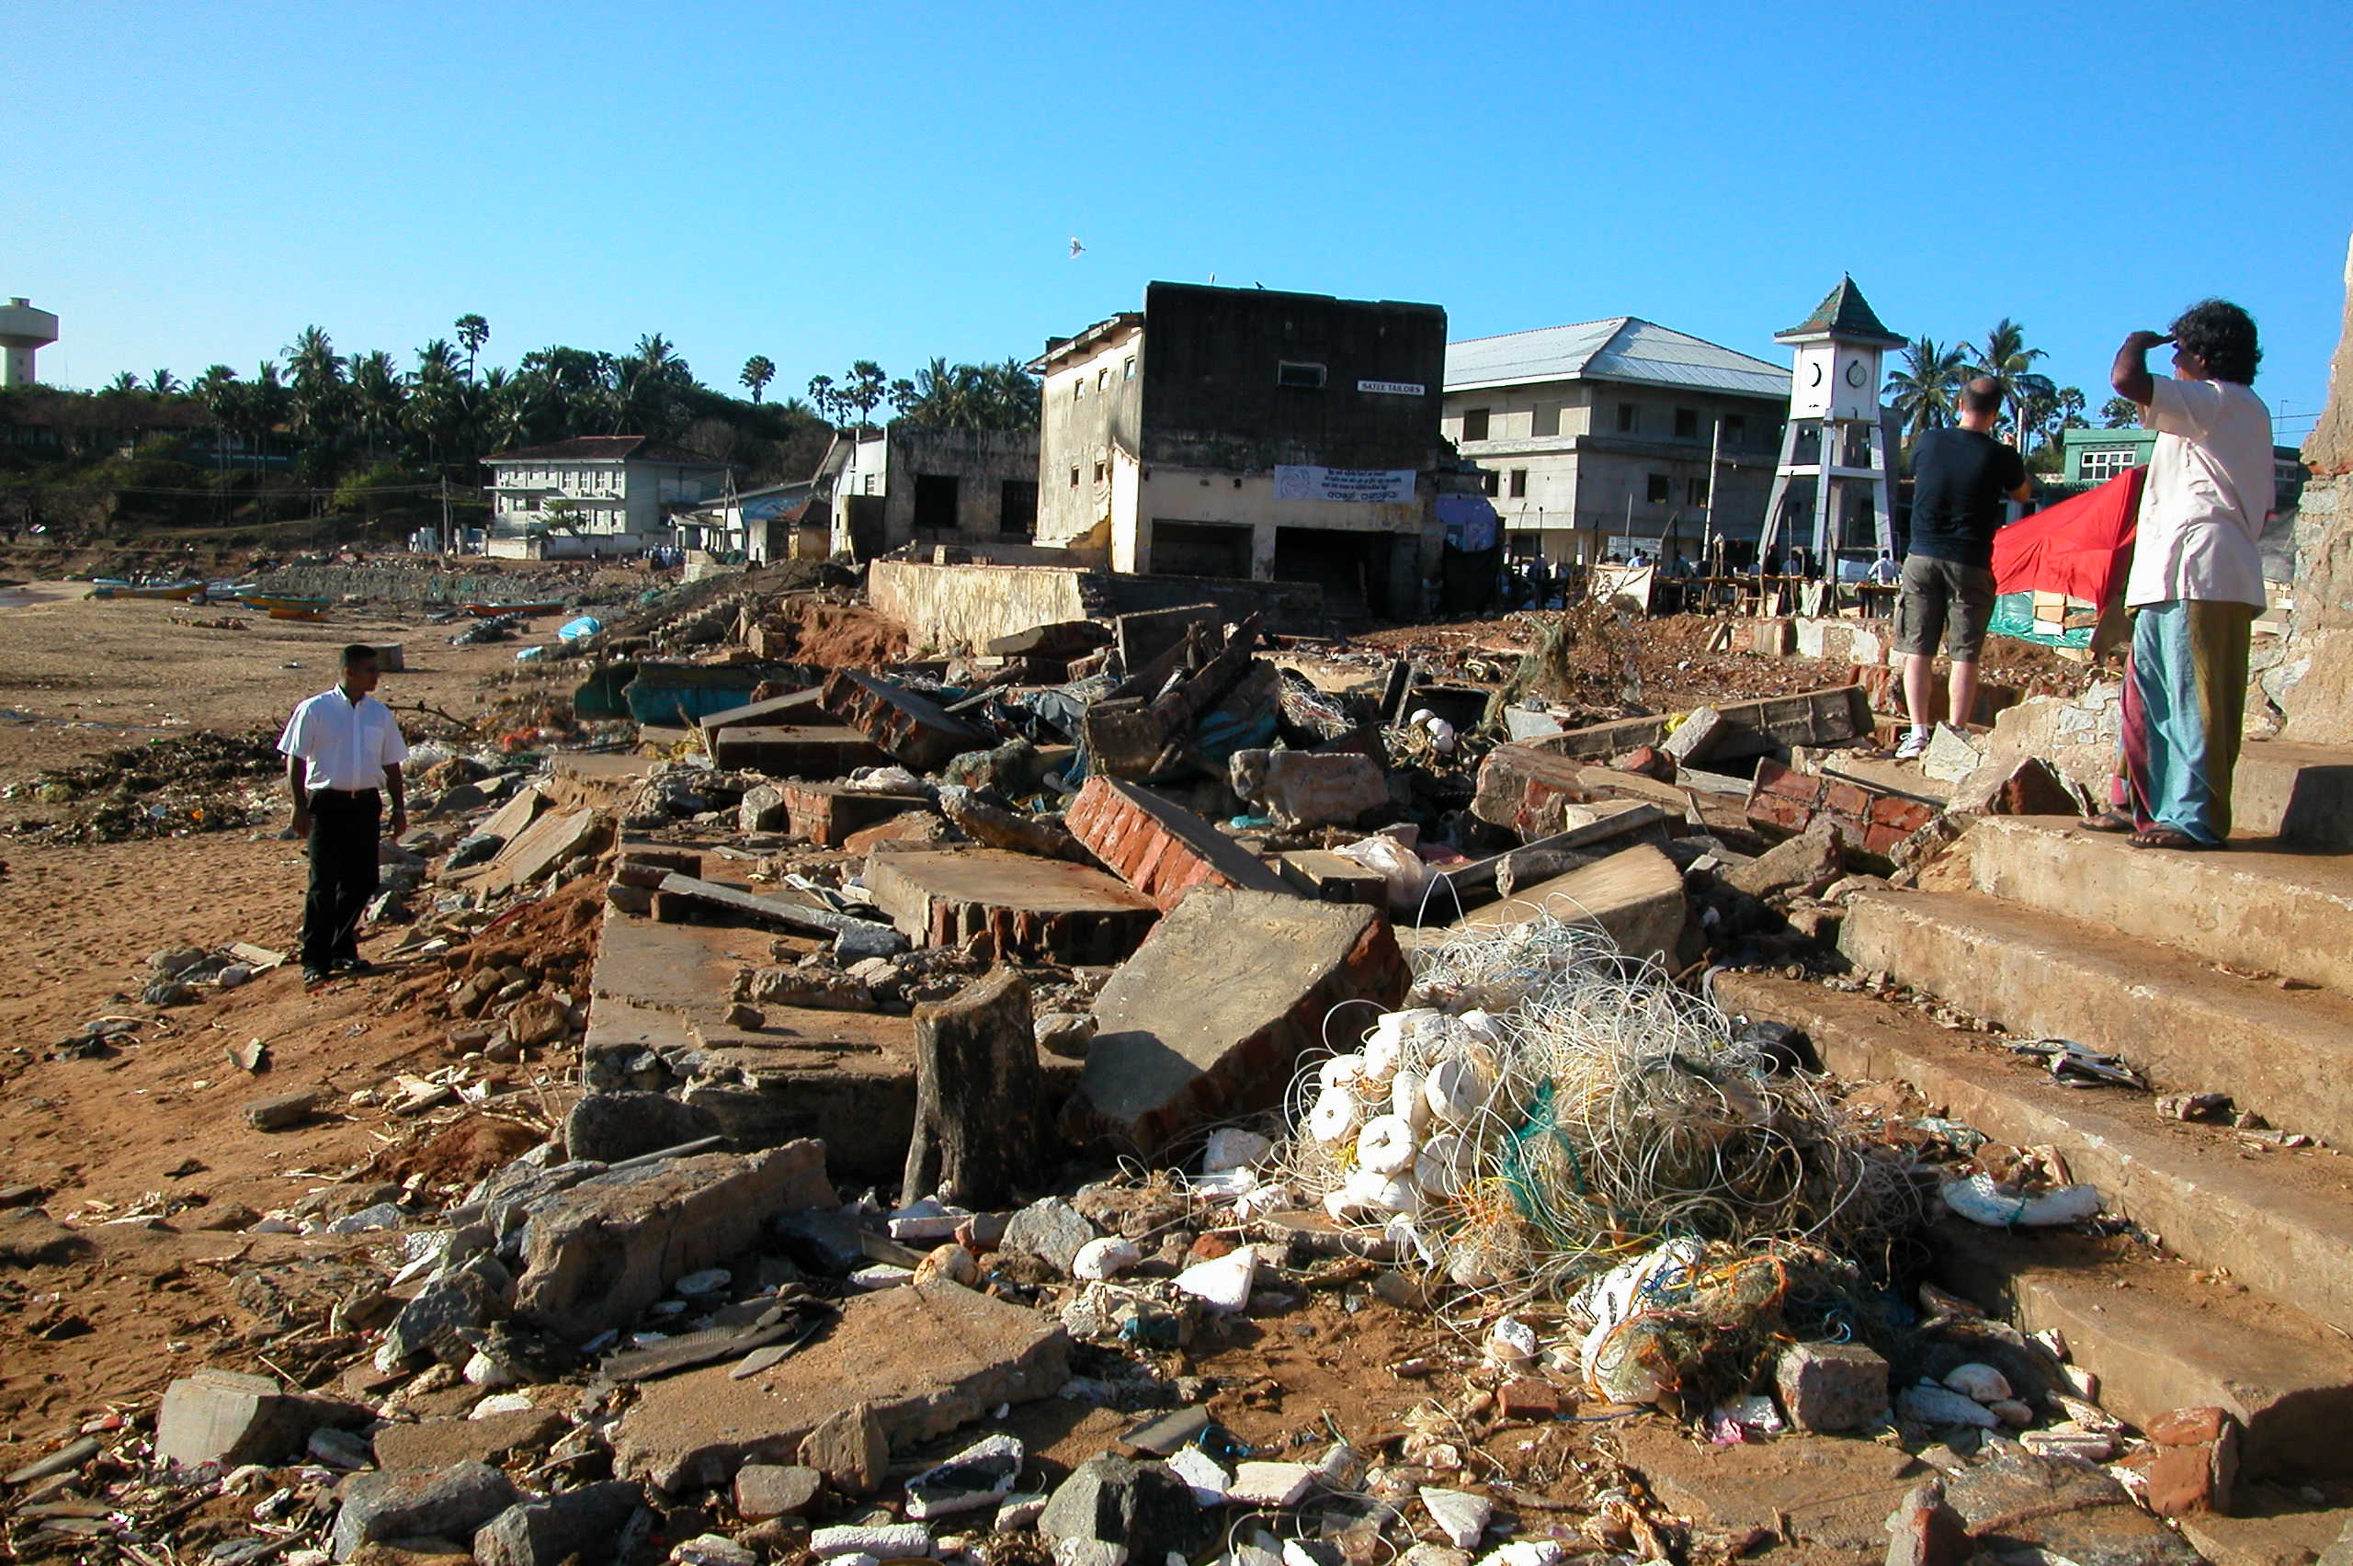
Hambantota:
4,500 people perished at this fishing town.

Slide 9
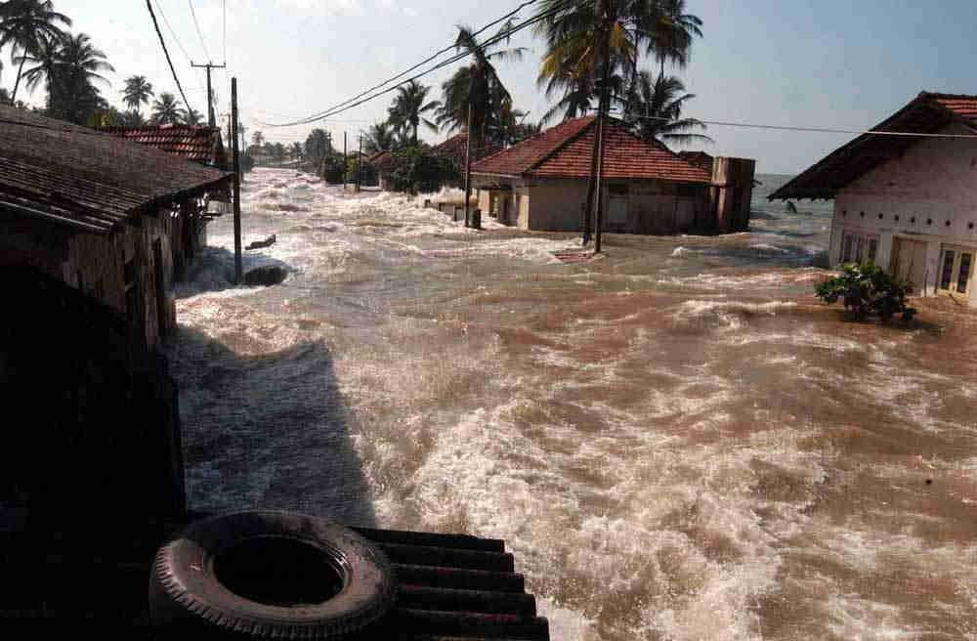
East Sri Lanka (AP Photo):
Raging water at beach front properties.

Slide 10
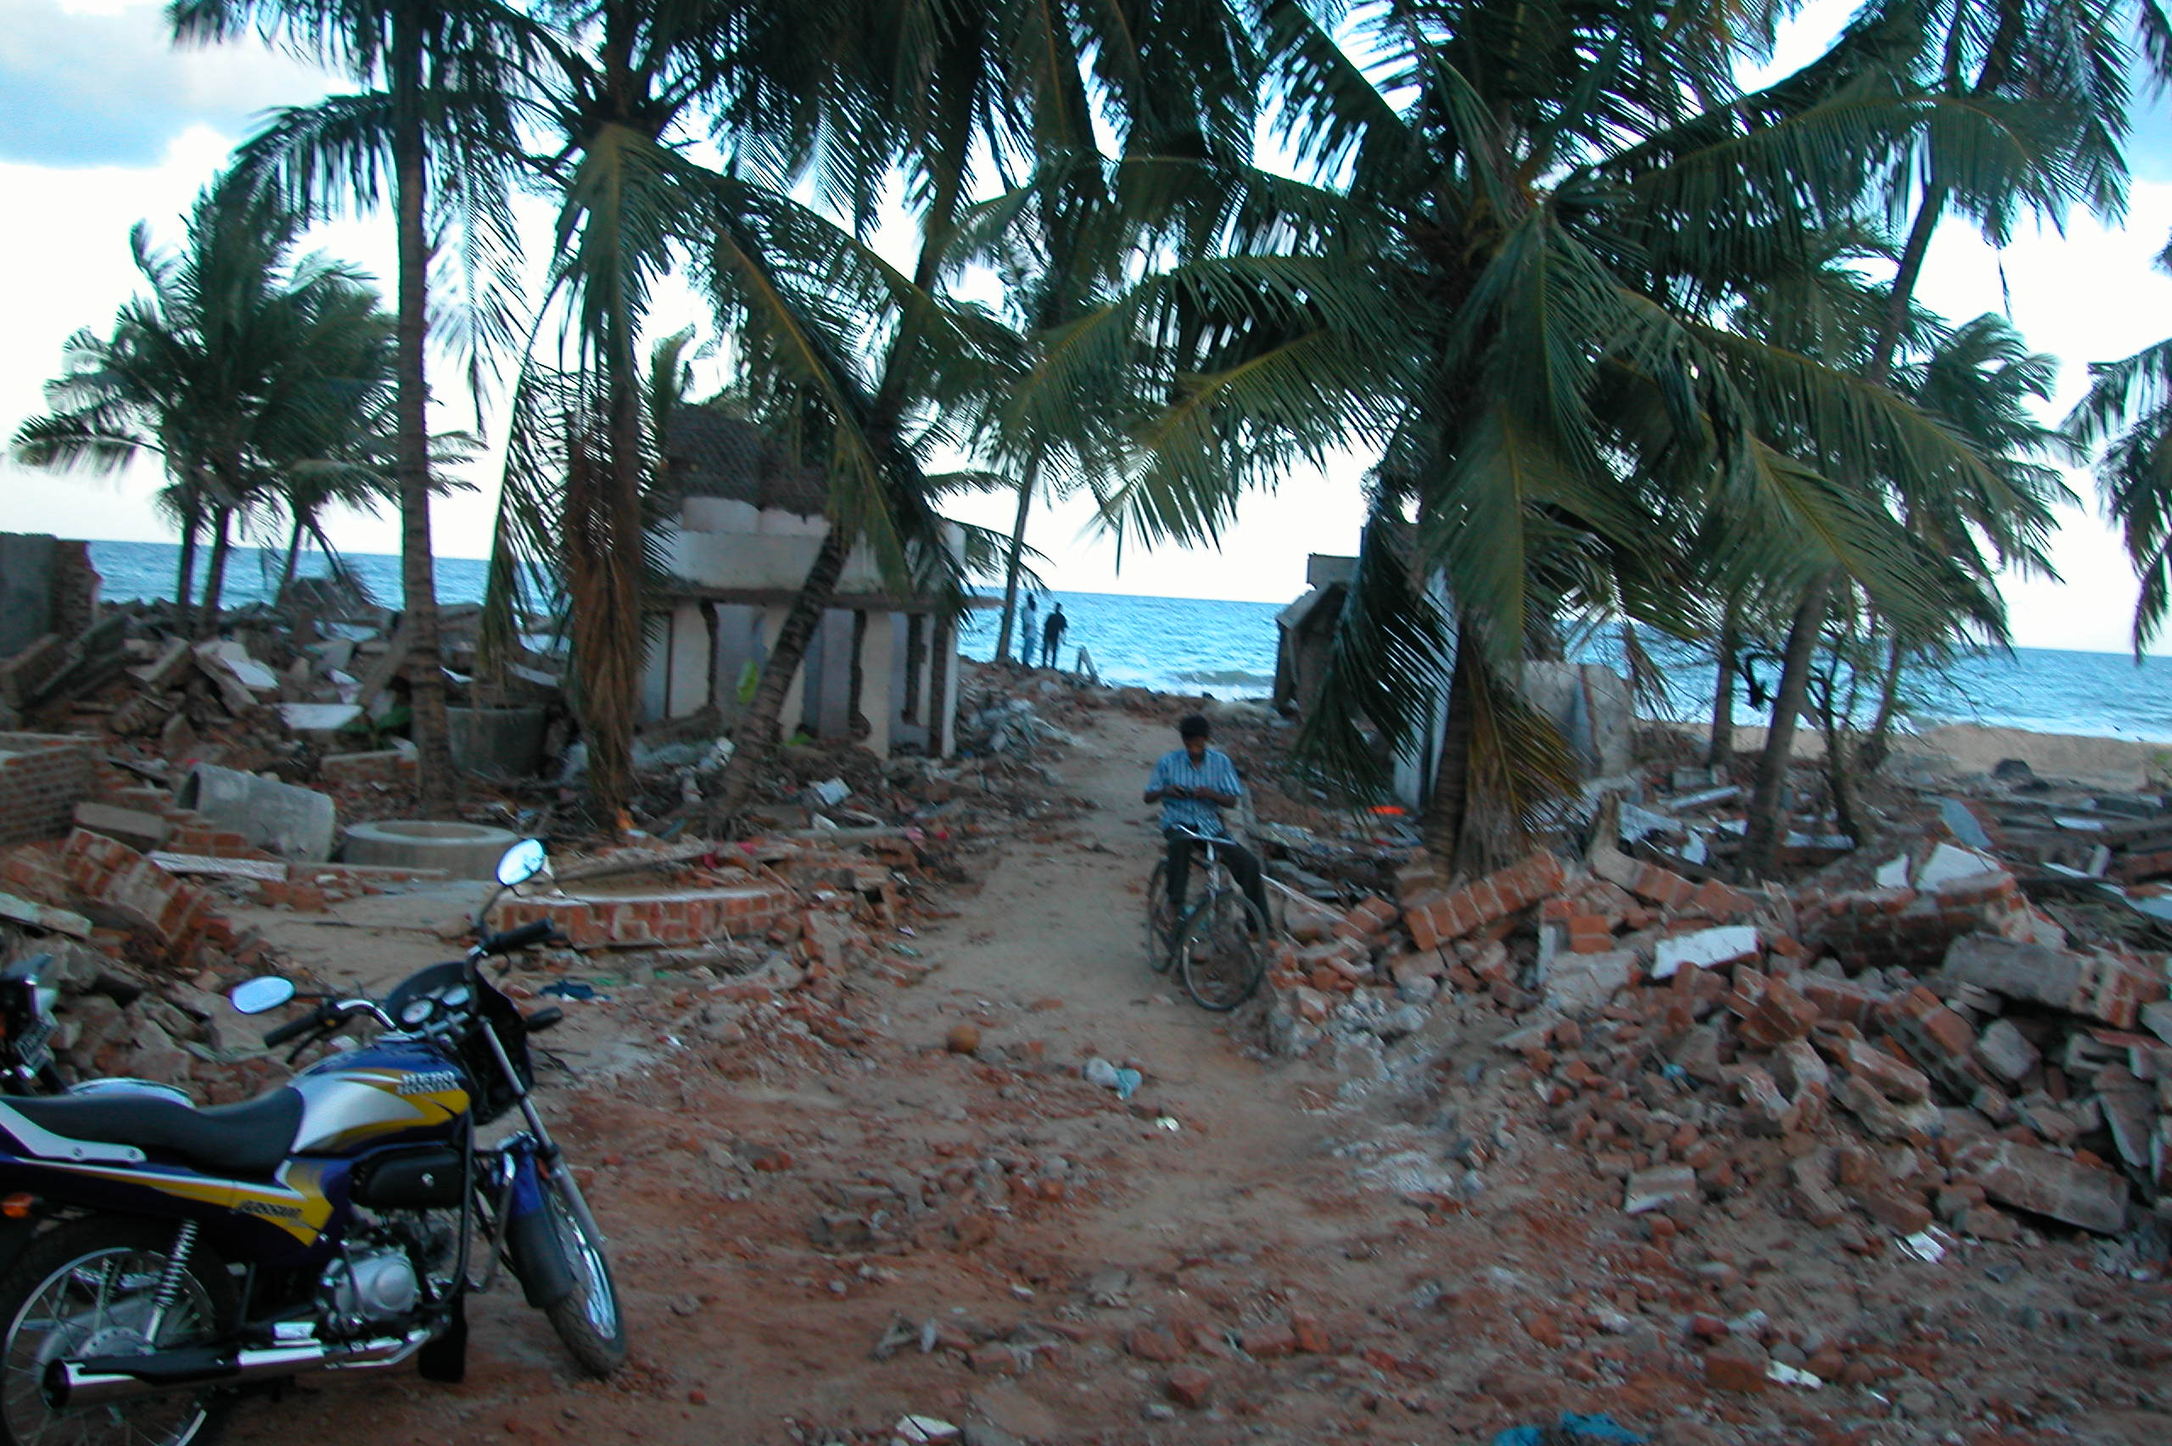
East Sri Lanka:
From Kalmunai to Batticaloa, many houses ended up like this one at the coast line.

Slide 11
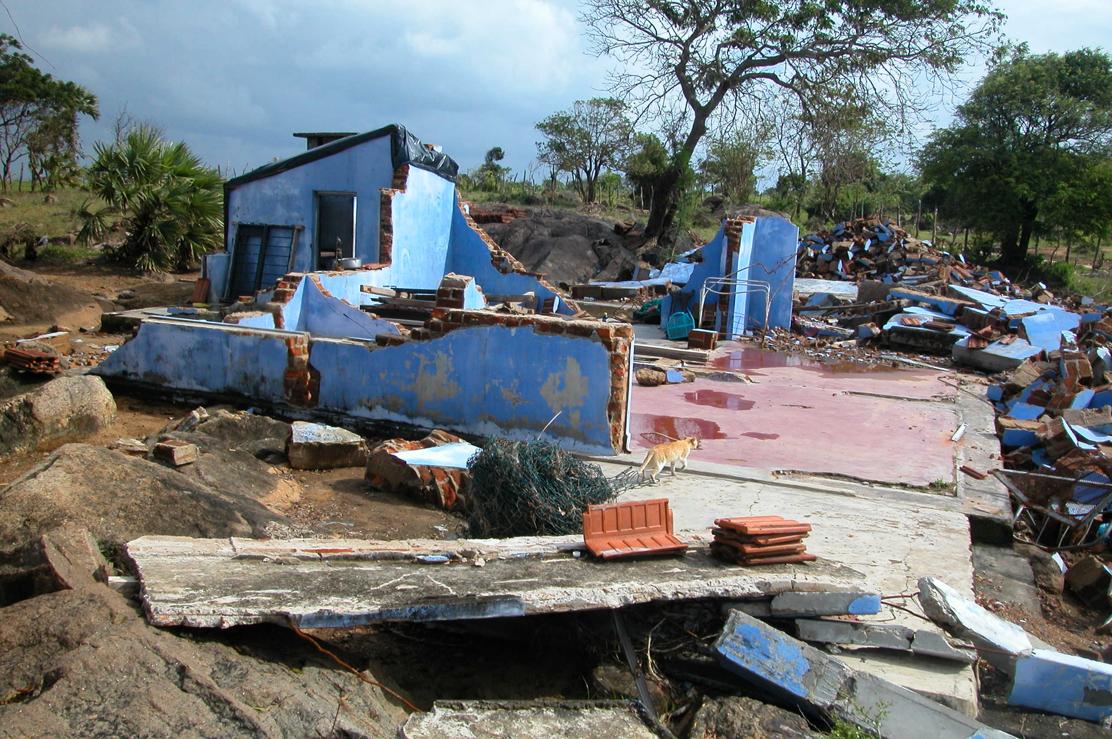
East Sri Lanka:
Another ocean front community. Un-reinforced brick and/or masonry construction were typical in the region.

Slide 12
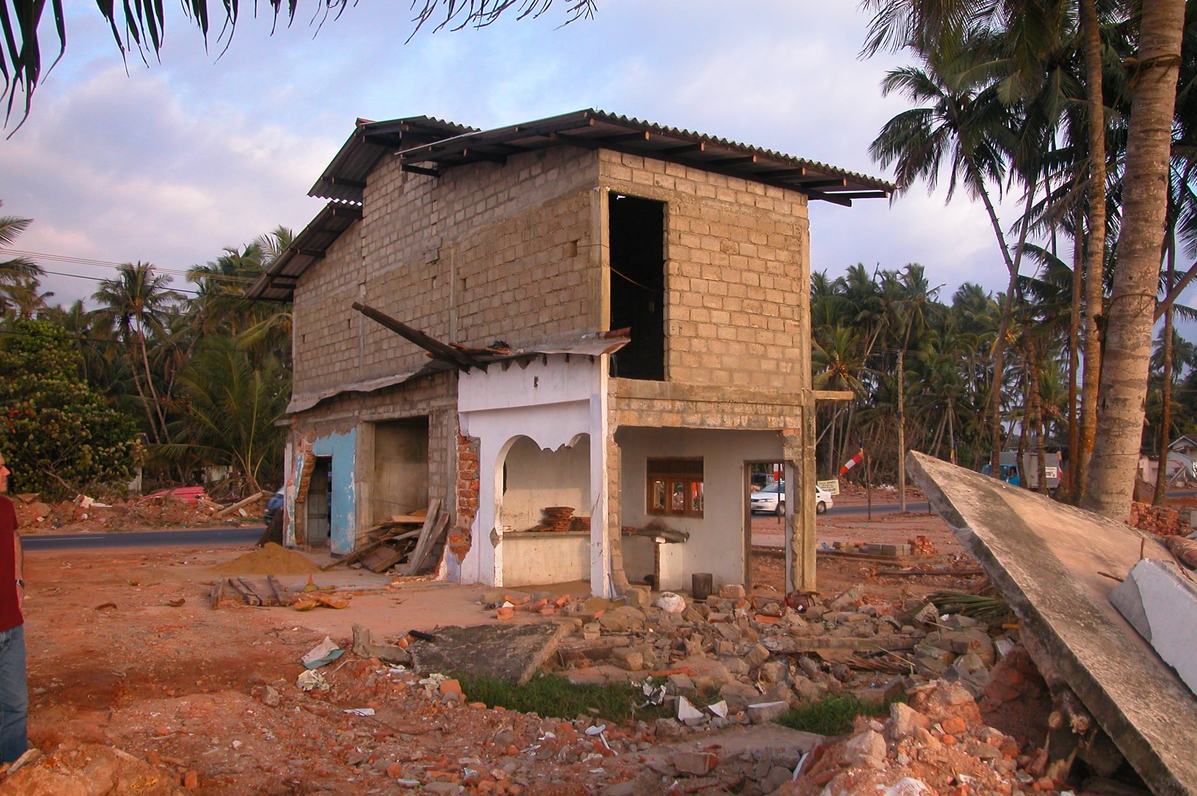
Common damages: Un-reinforced masonry structures were no match for the wave, but reinforced concrete members survived.

Slide 13
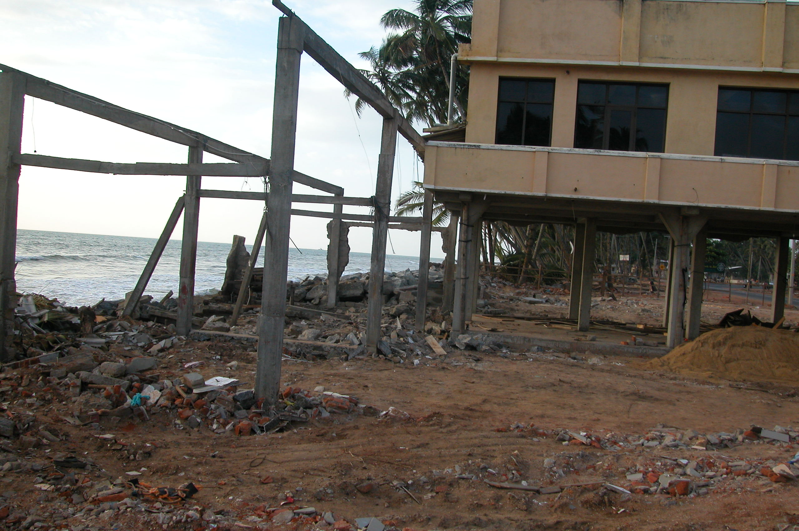
Another comparison between un-reinforced and reinforced members.

Slide 14
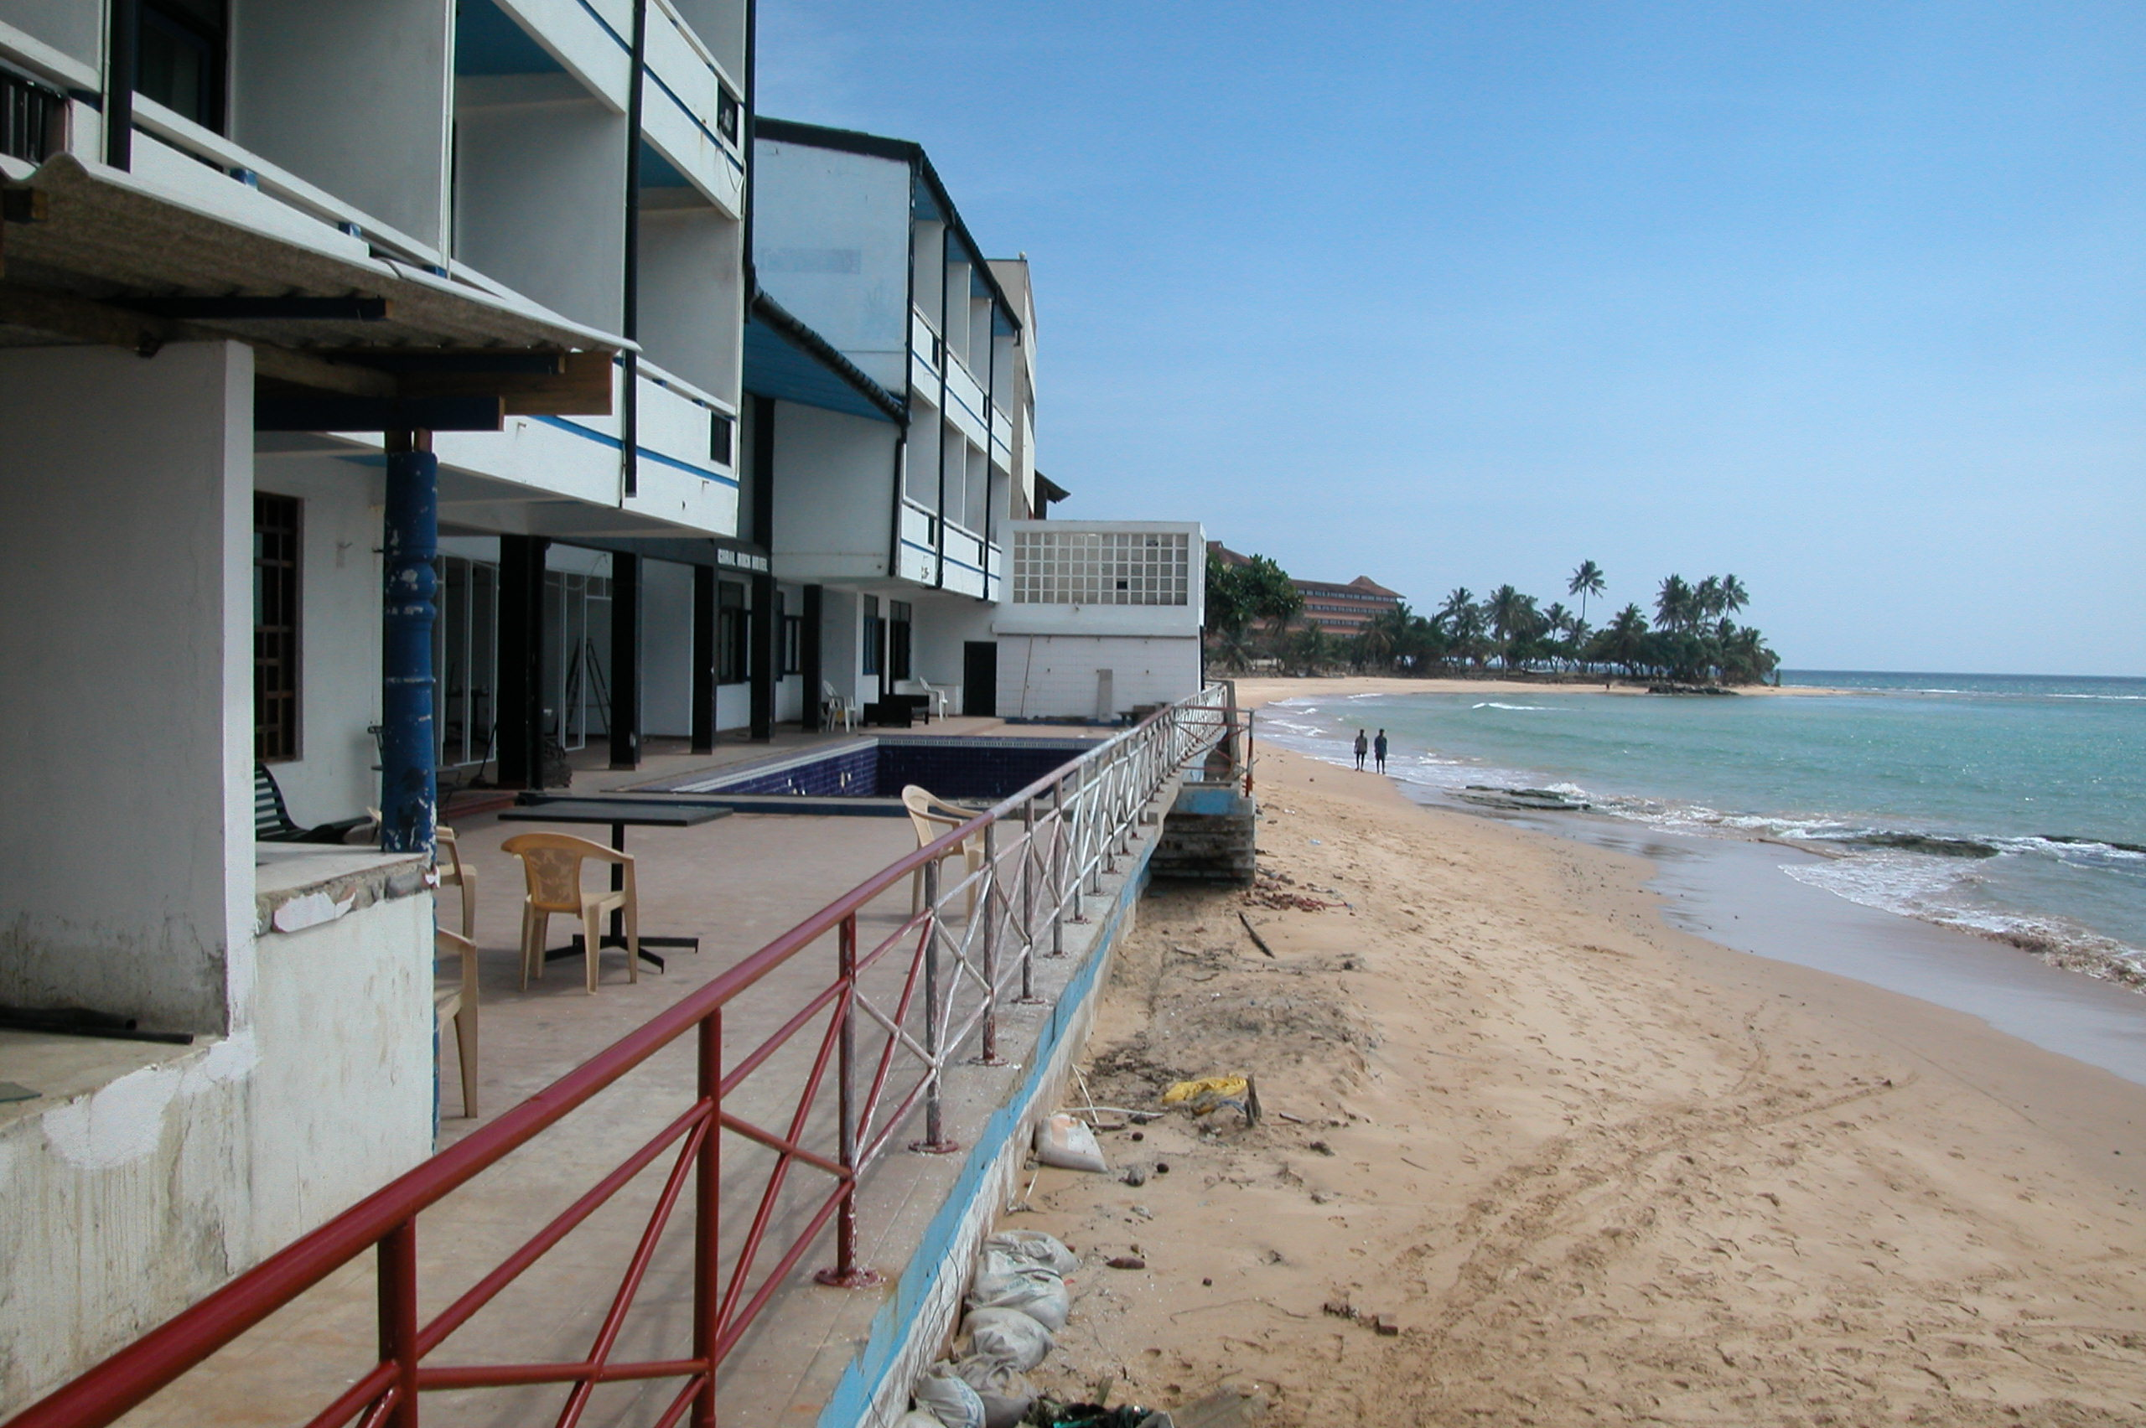
In the same region, properly designed and constructed buildings suffered minimum damages.

Slide 15
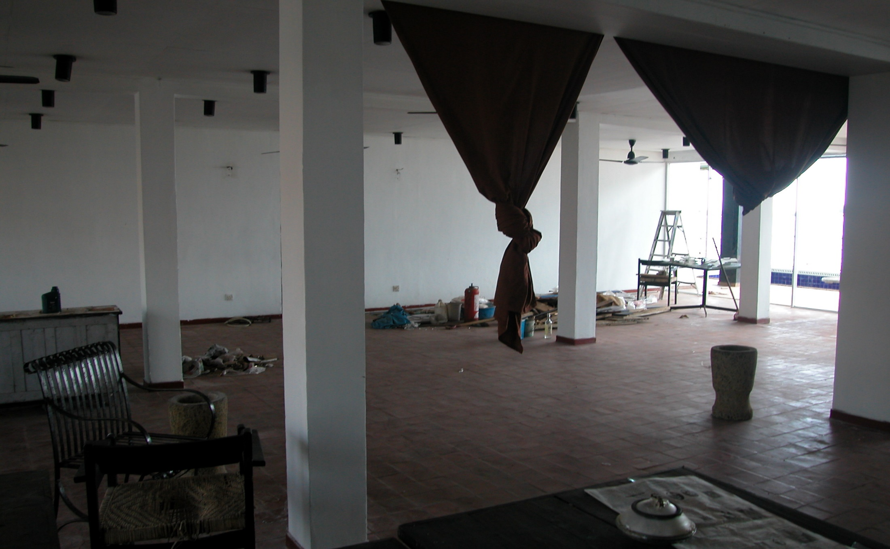
Inside the same ocean front building. Only glass windows were broken.

Slide 16
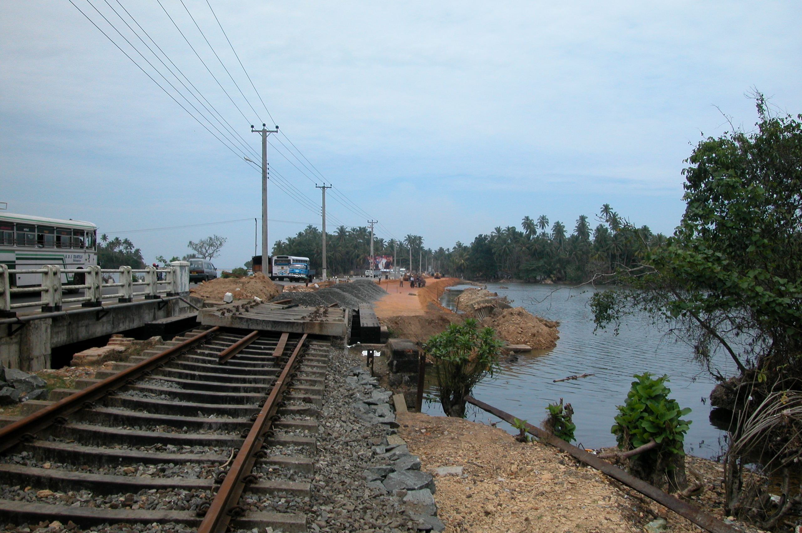
Part II: Infrastructures
South of Kalutara:
Railroad bridge was destroyed, highway bridge next to it was not.

Slide 17
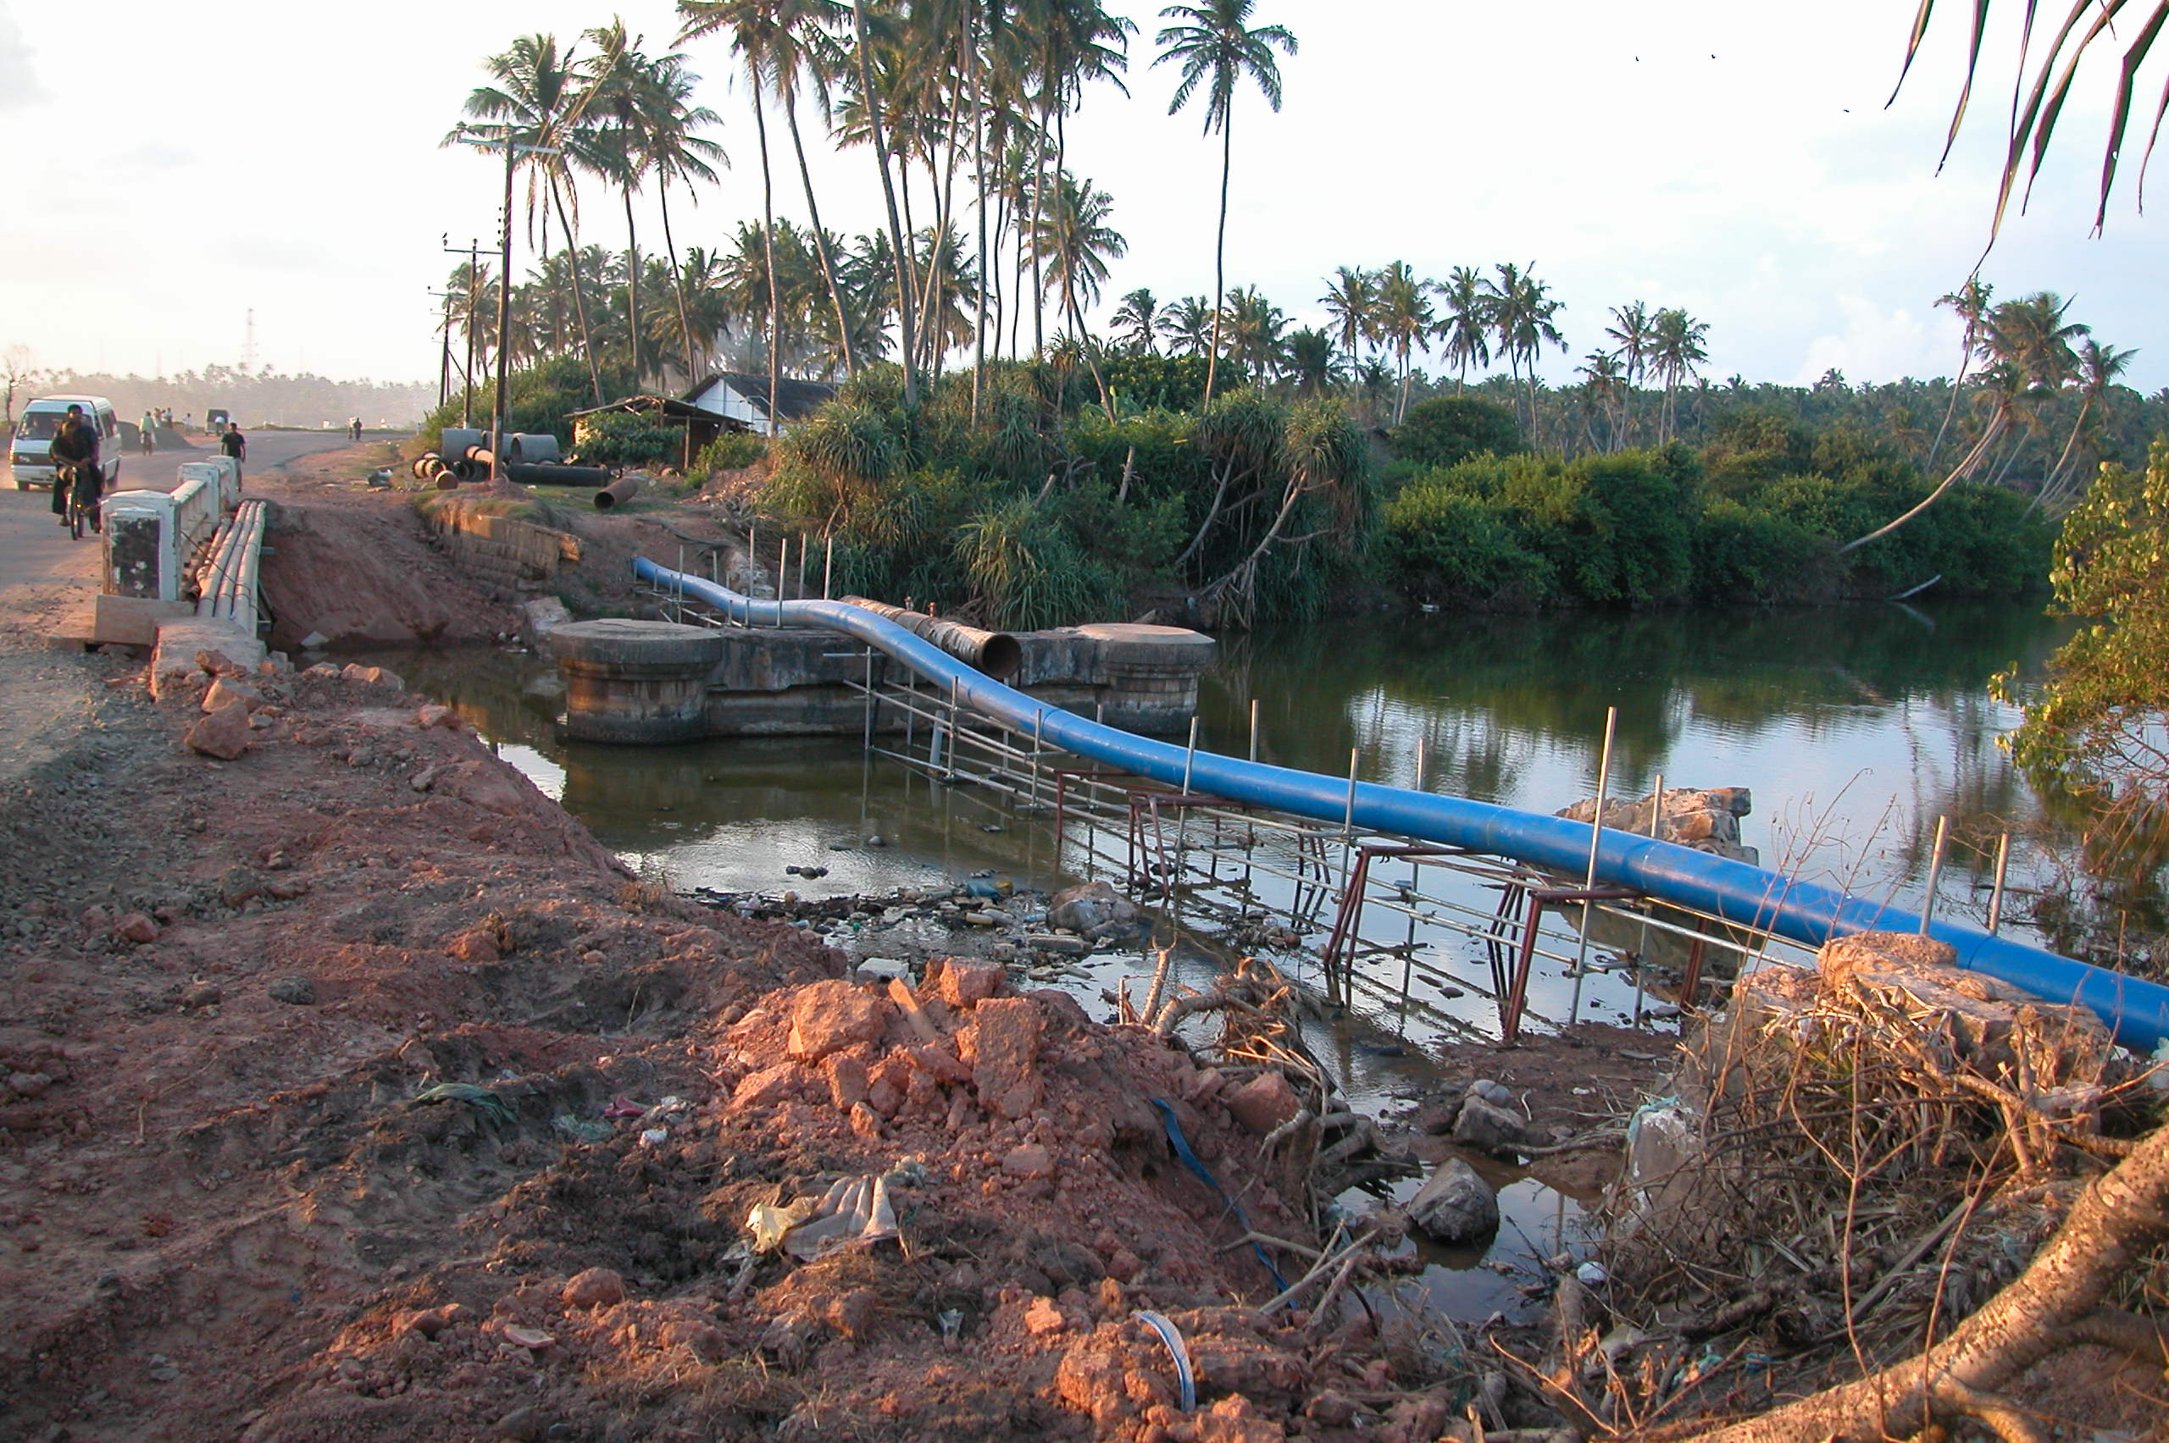
River connect to the ocean collected most of the flow. Bridge and abutment at upper stream were washed away by receding water. The highway bridge facing in-coming surge survived.

Slide 18
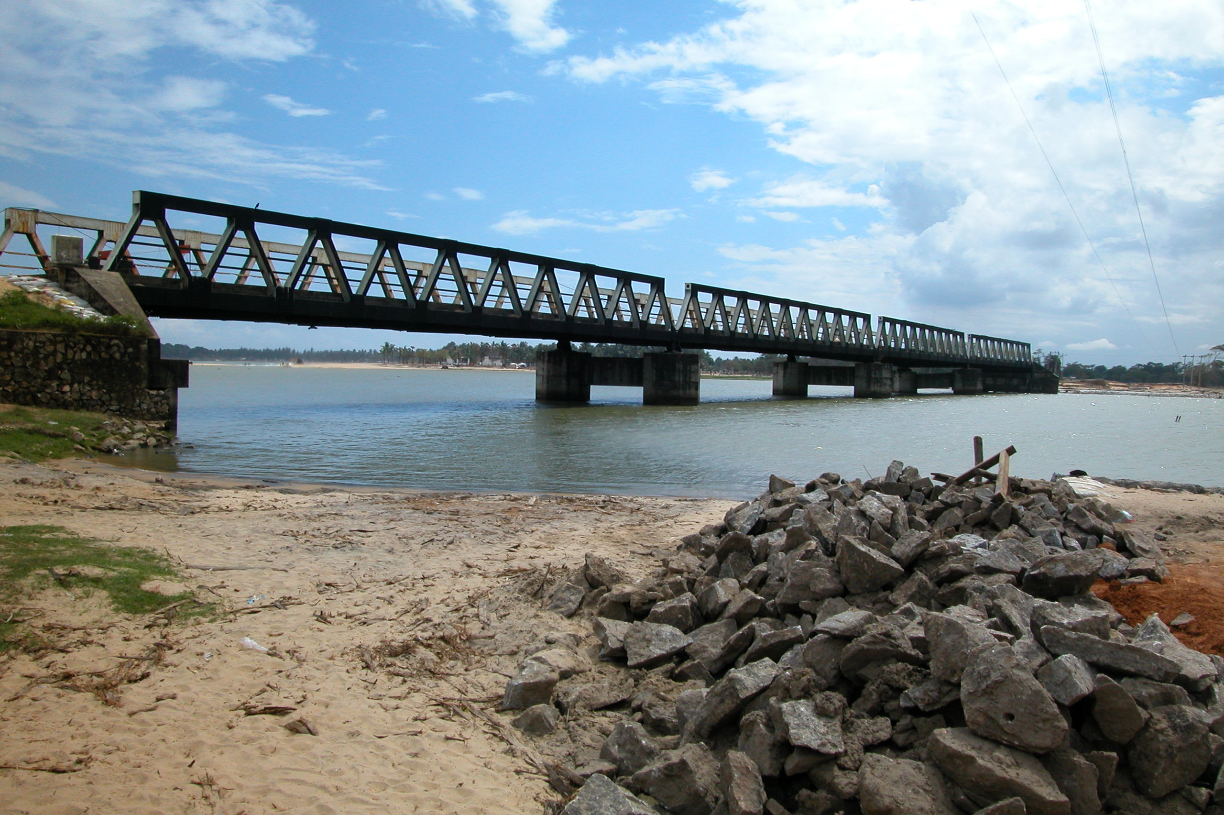
Arugam Bay:Bridge at southeast coastline
Water over-flowed the superstructure.

Slide 19
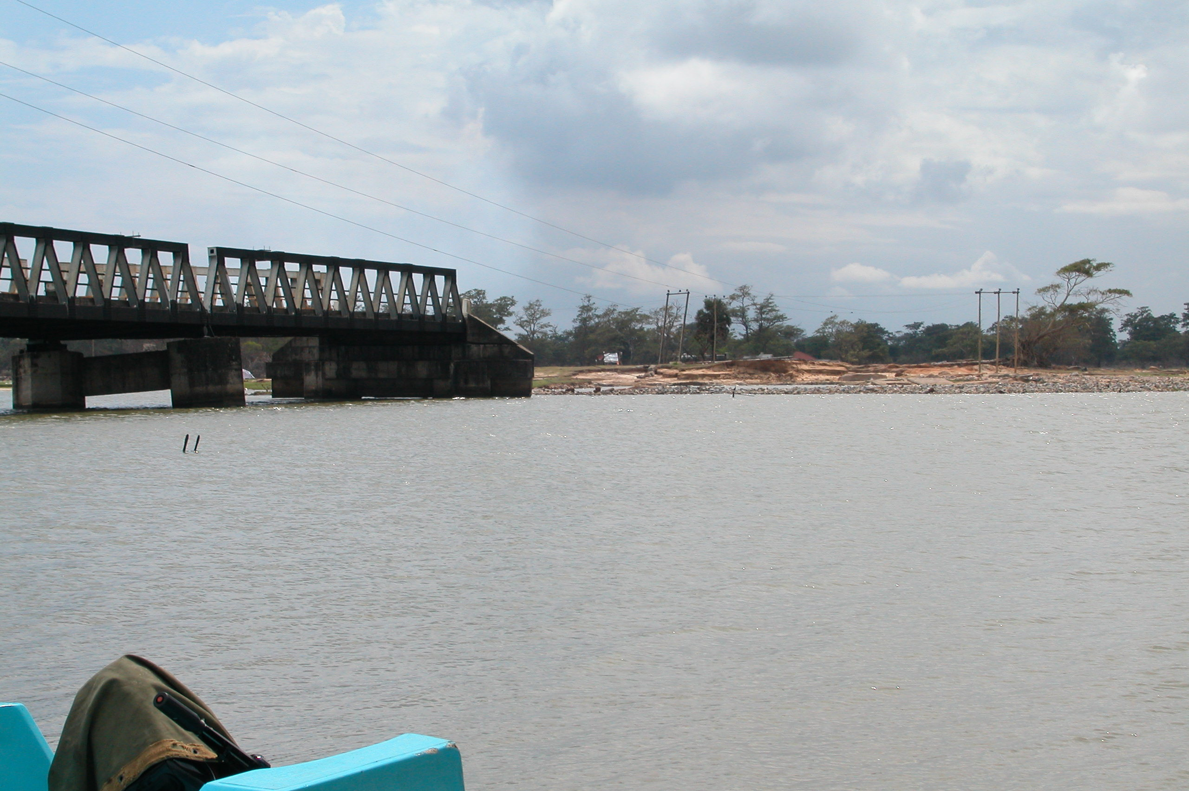
South abutment and approach road were washed away.

Slide 20
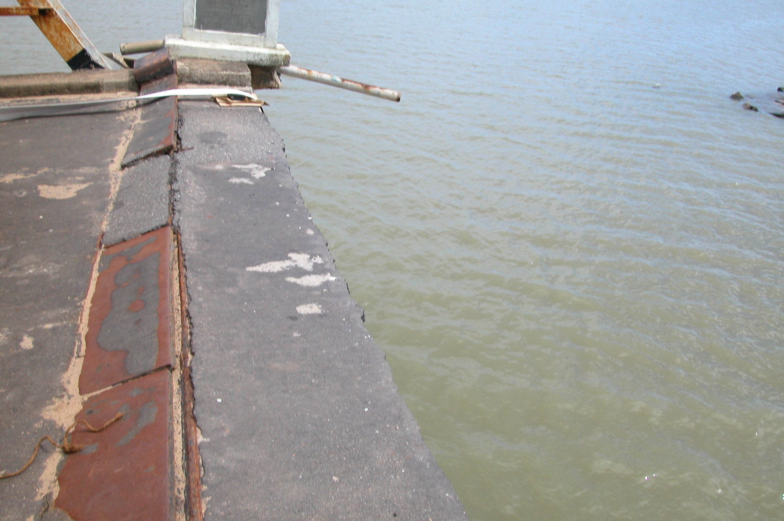
Expansion joint still there, high above the water.

Slide 21
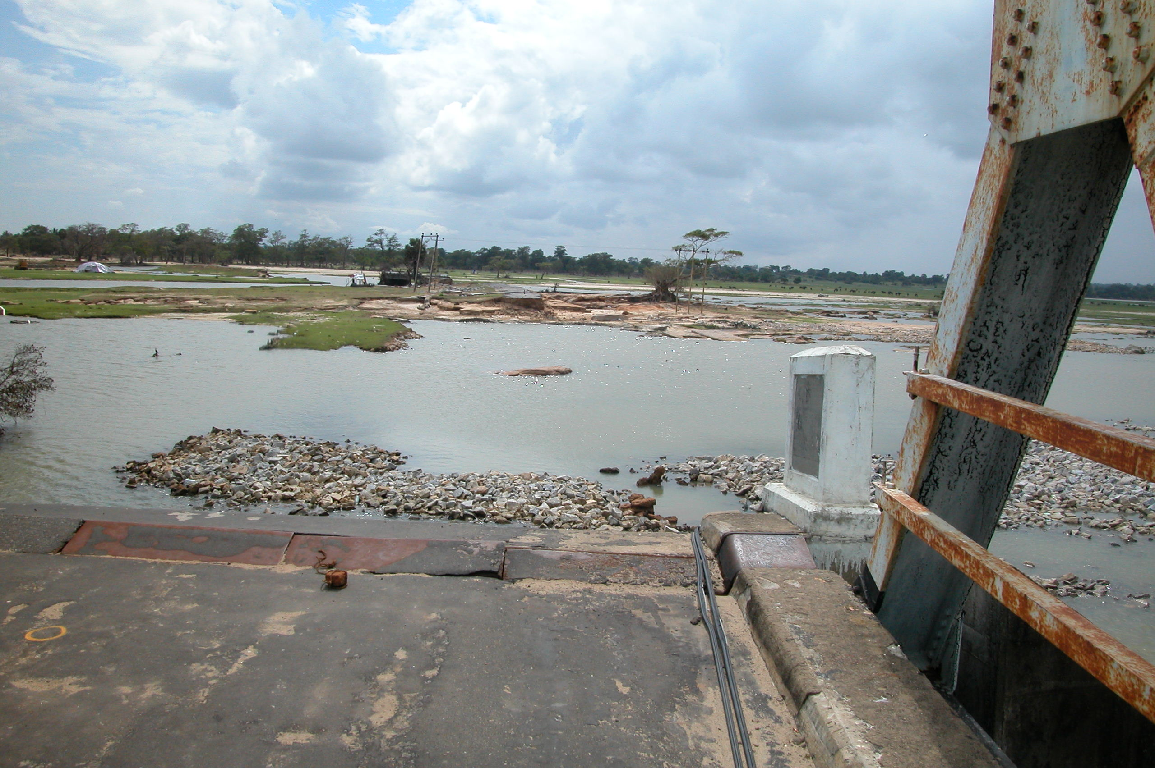
Approach road and abutments connecting the two bridges were gone.

Slide 22
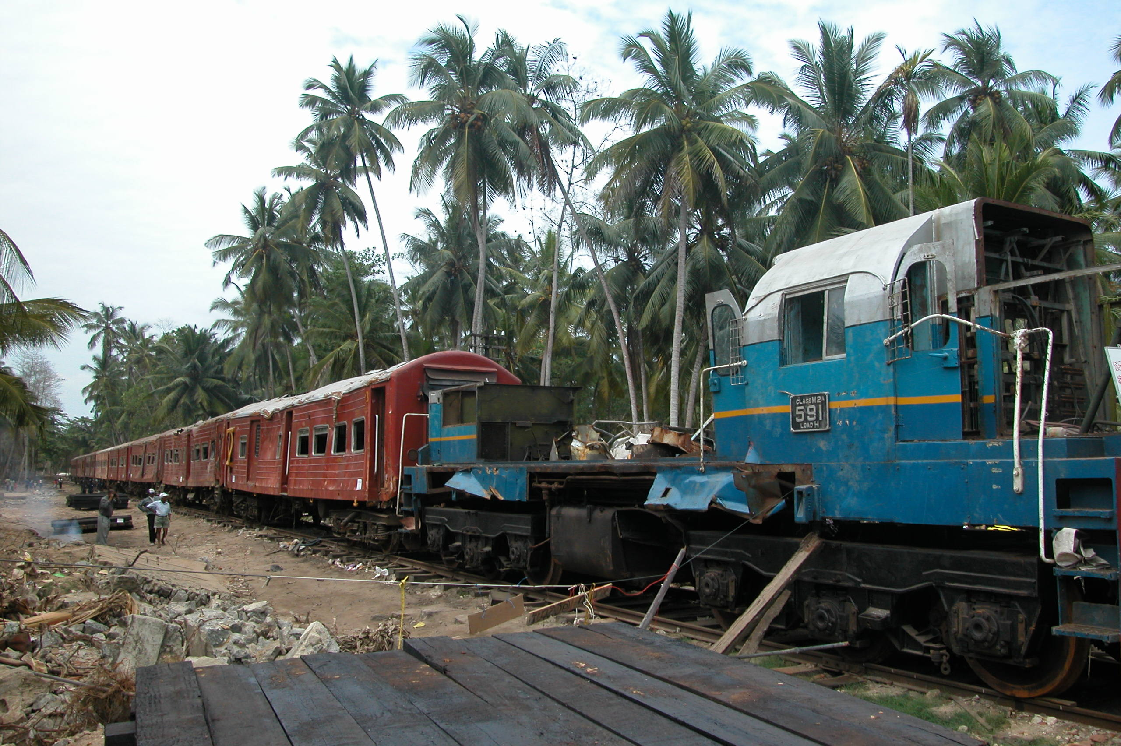
Doomed morning ride at Bentota, 60 km south of Colombo: Railroad track was several thousand feet from the ocean, but the water level reached 20 ft or more above the ground at this location.

Slide 23
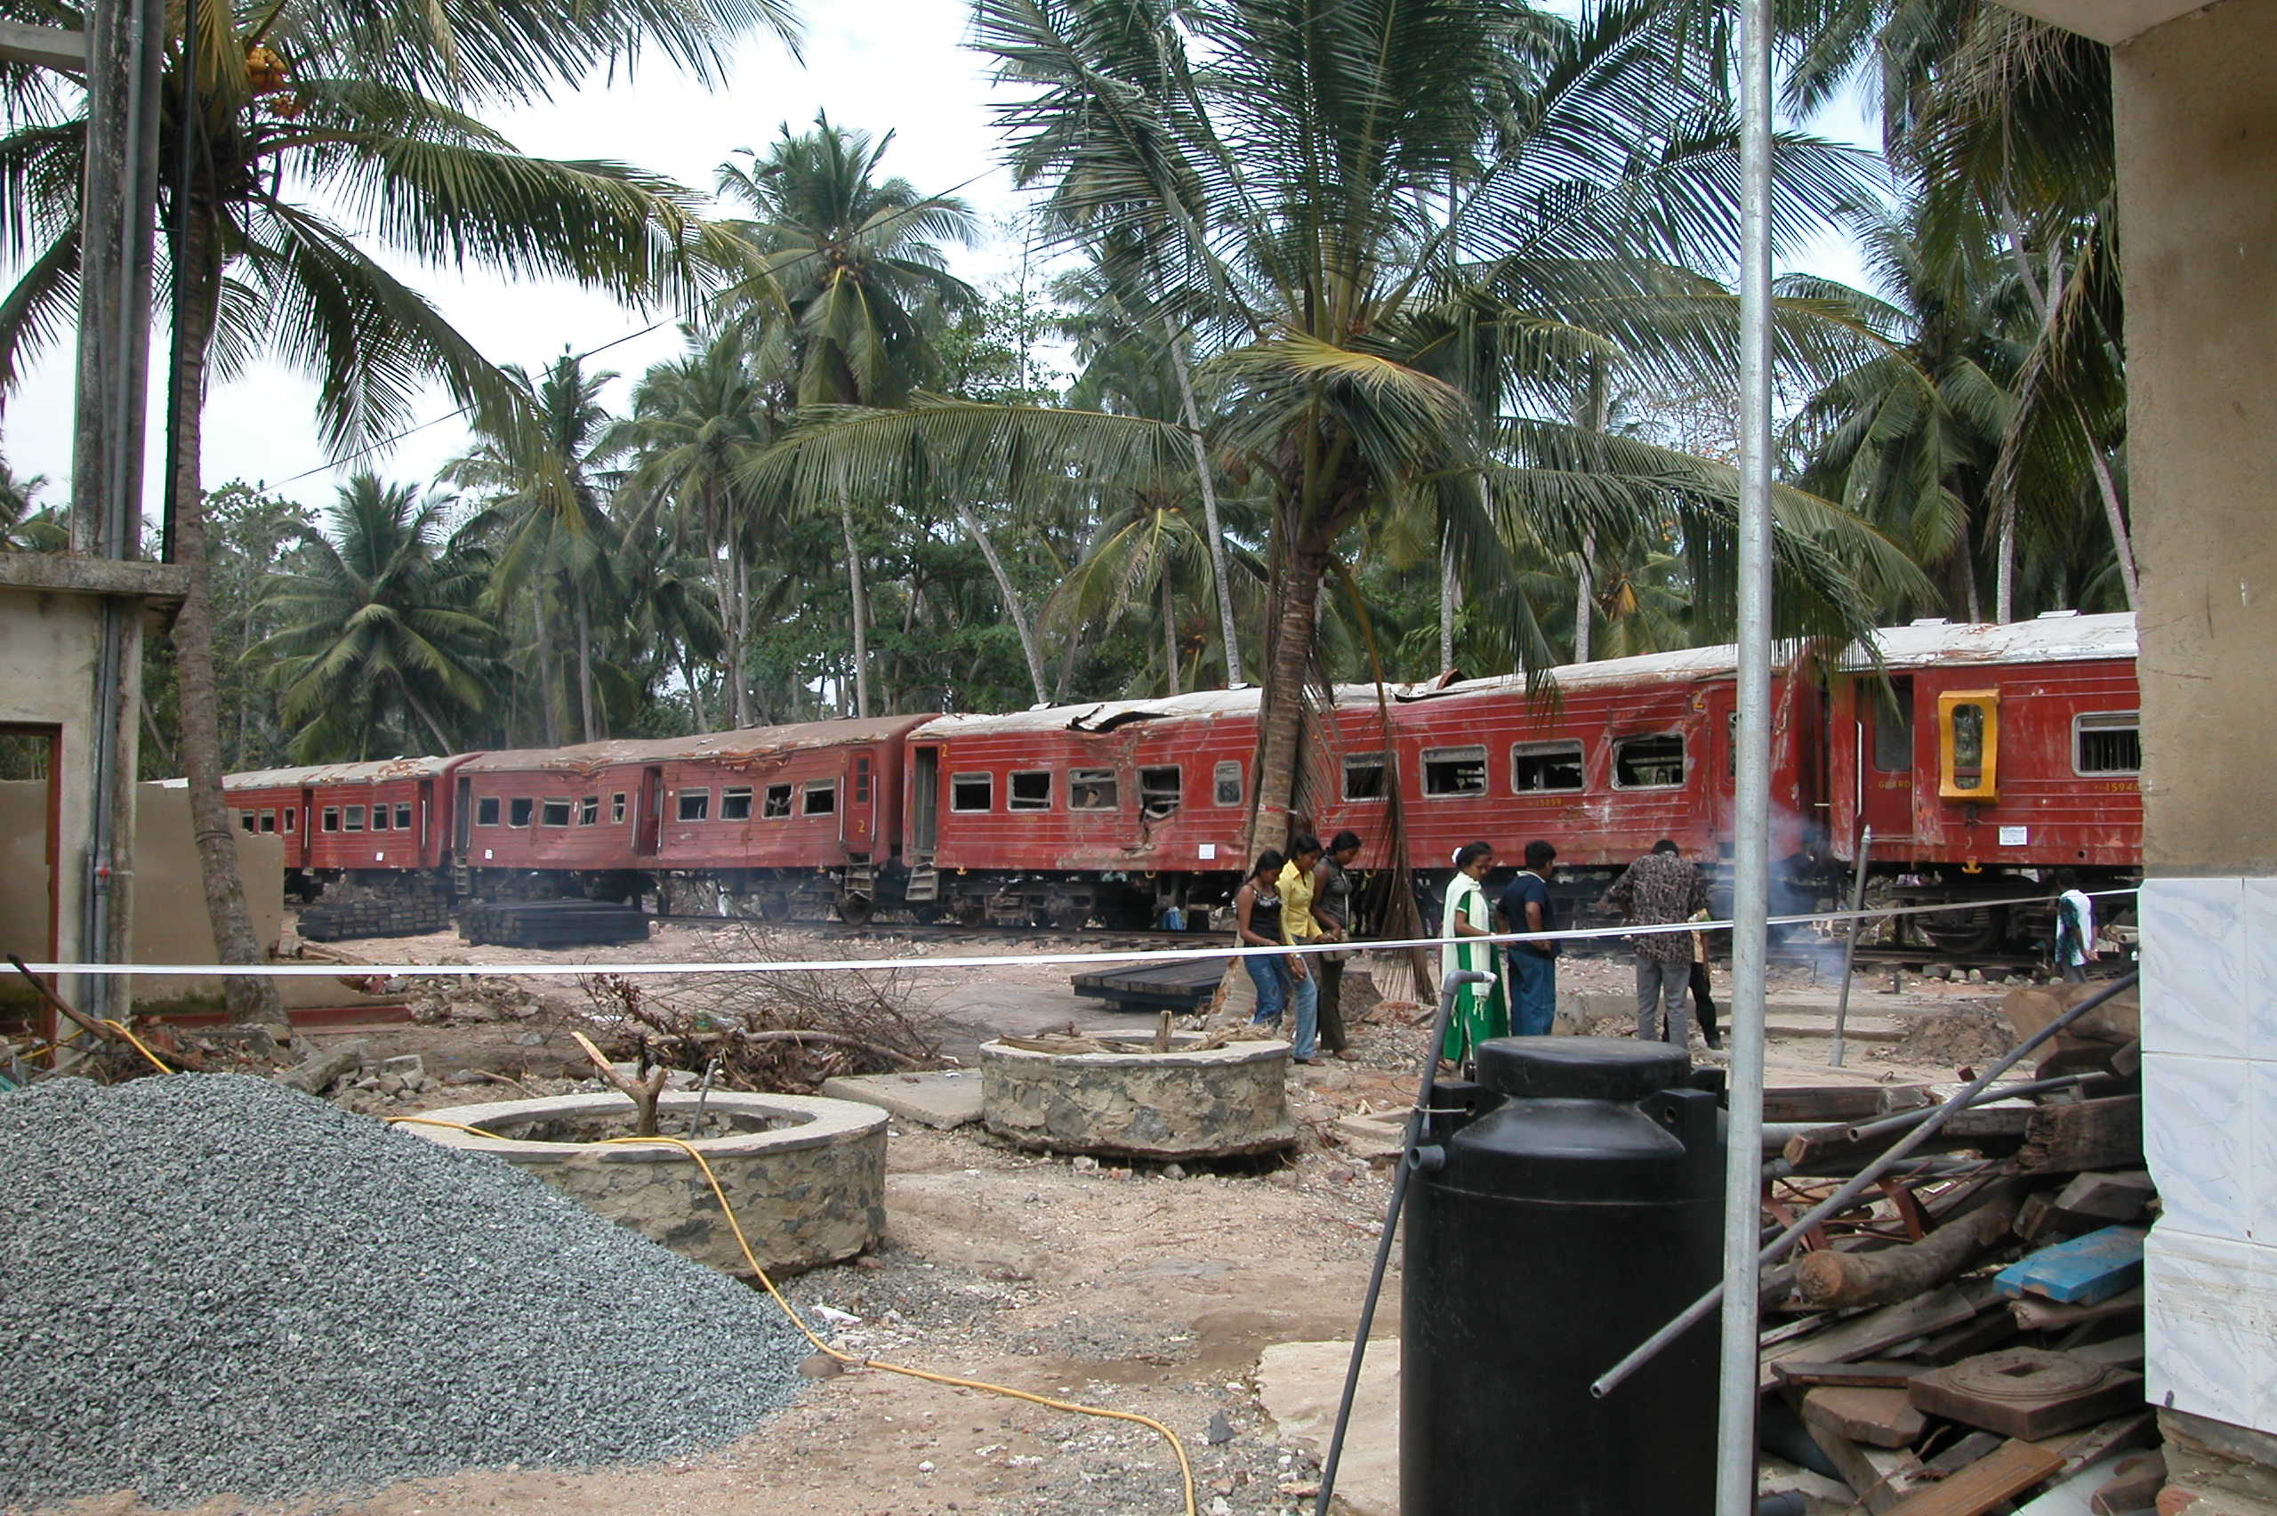
People jumped on the train in the attempt to escape, but the train was toppled and battered by the flood. 1500 lives perished.

Slide 24
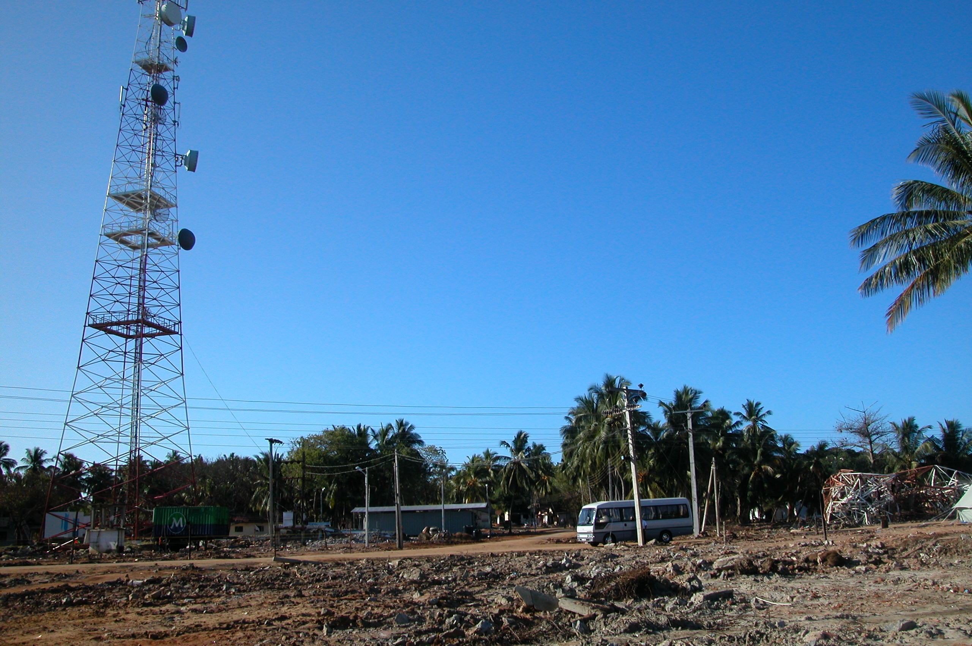
Hambantota: Thousands feet away from shoreline, this transmission tower was stuck down by the current with a floated bus. Noted all the houses nearby were destroyed.

Slide 25
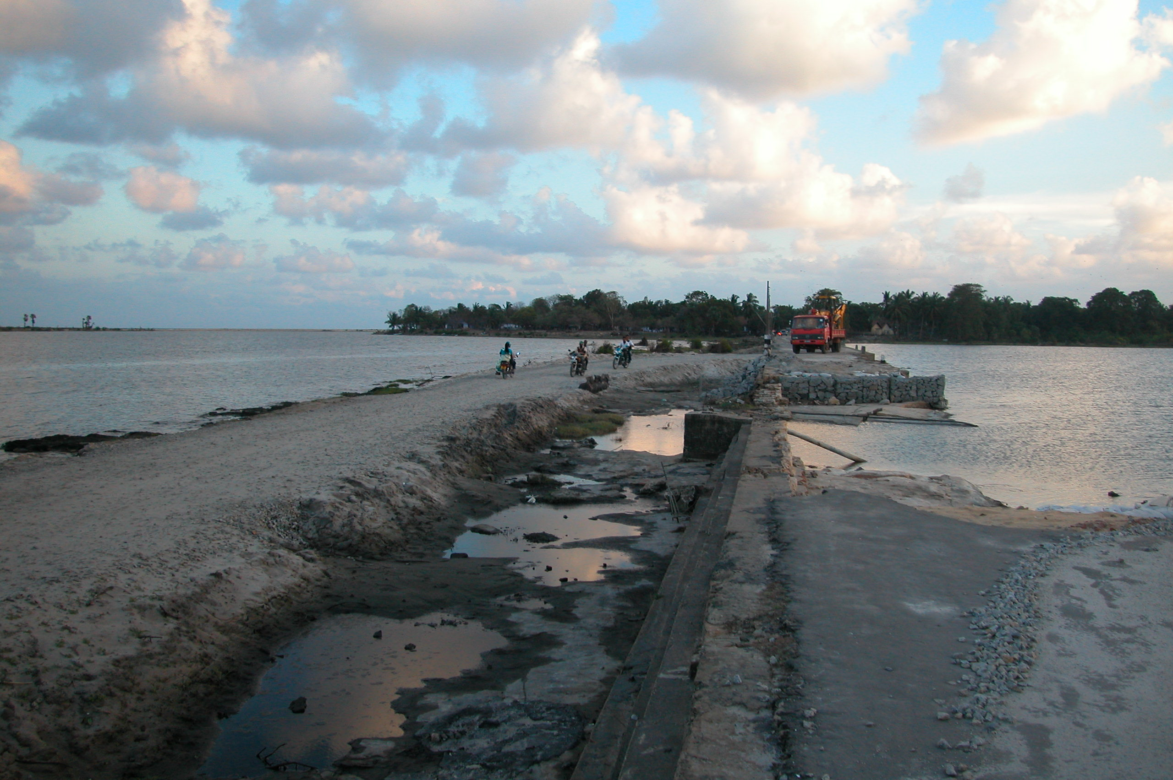
Along east coastline, from Arugam Bay to Trincomalee Bay, many roads adjacent or connect to lake or lagoon need major repair.

Slide 26
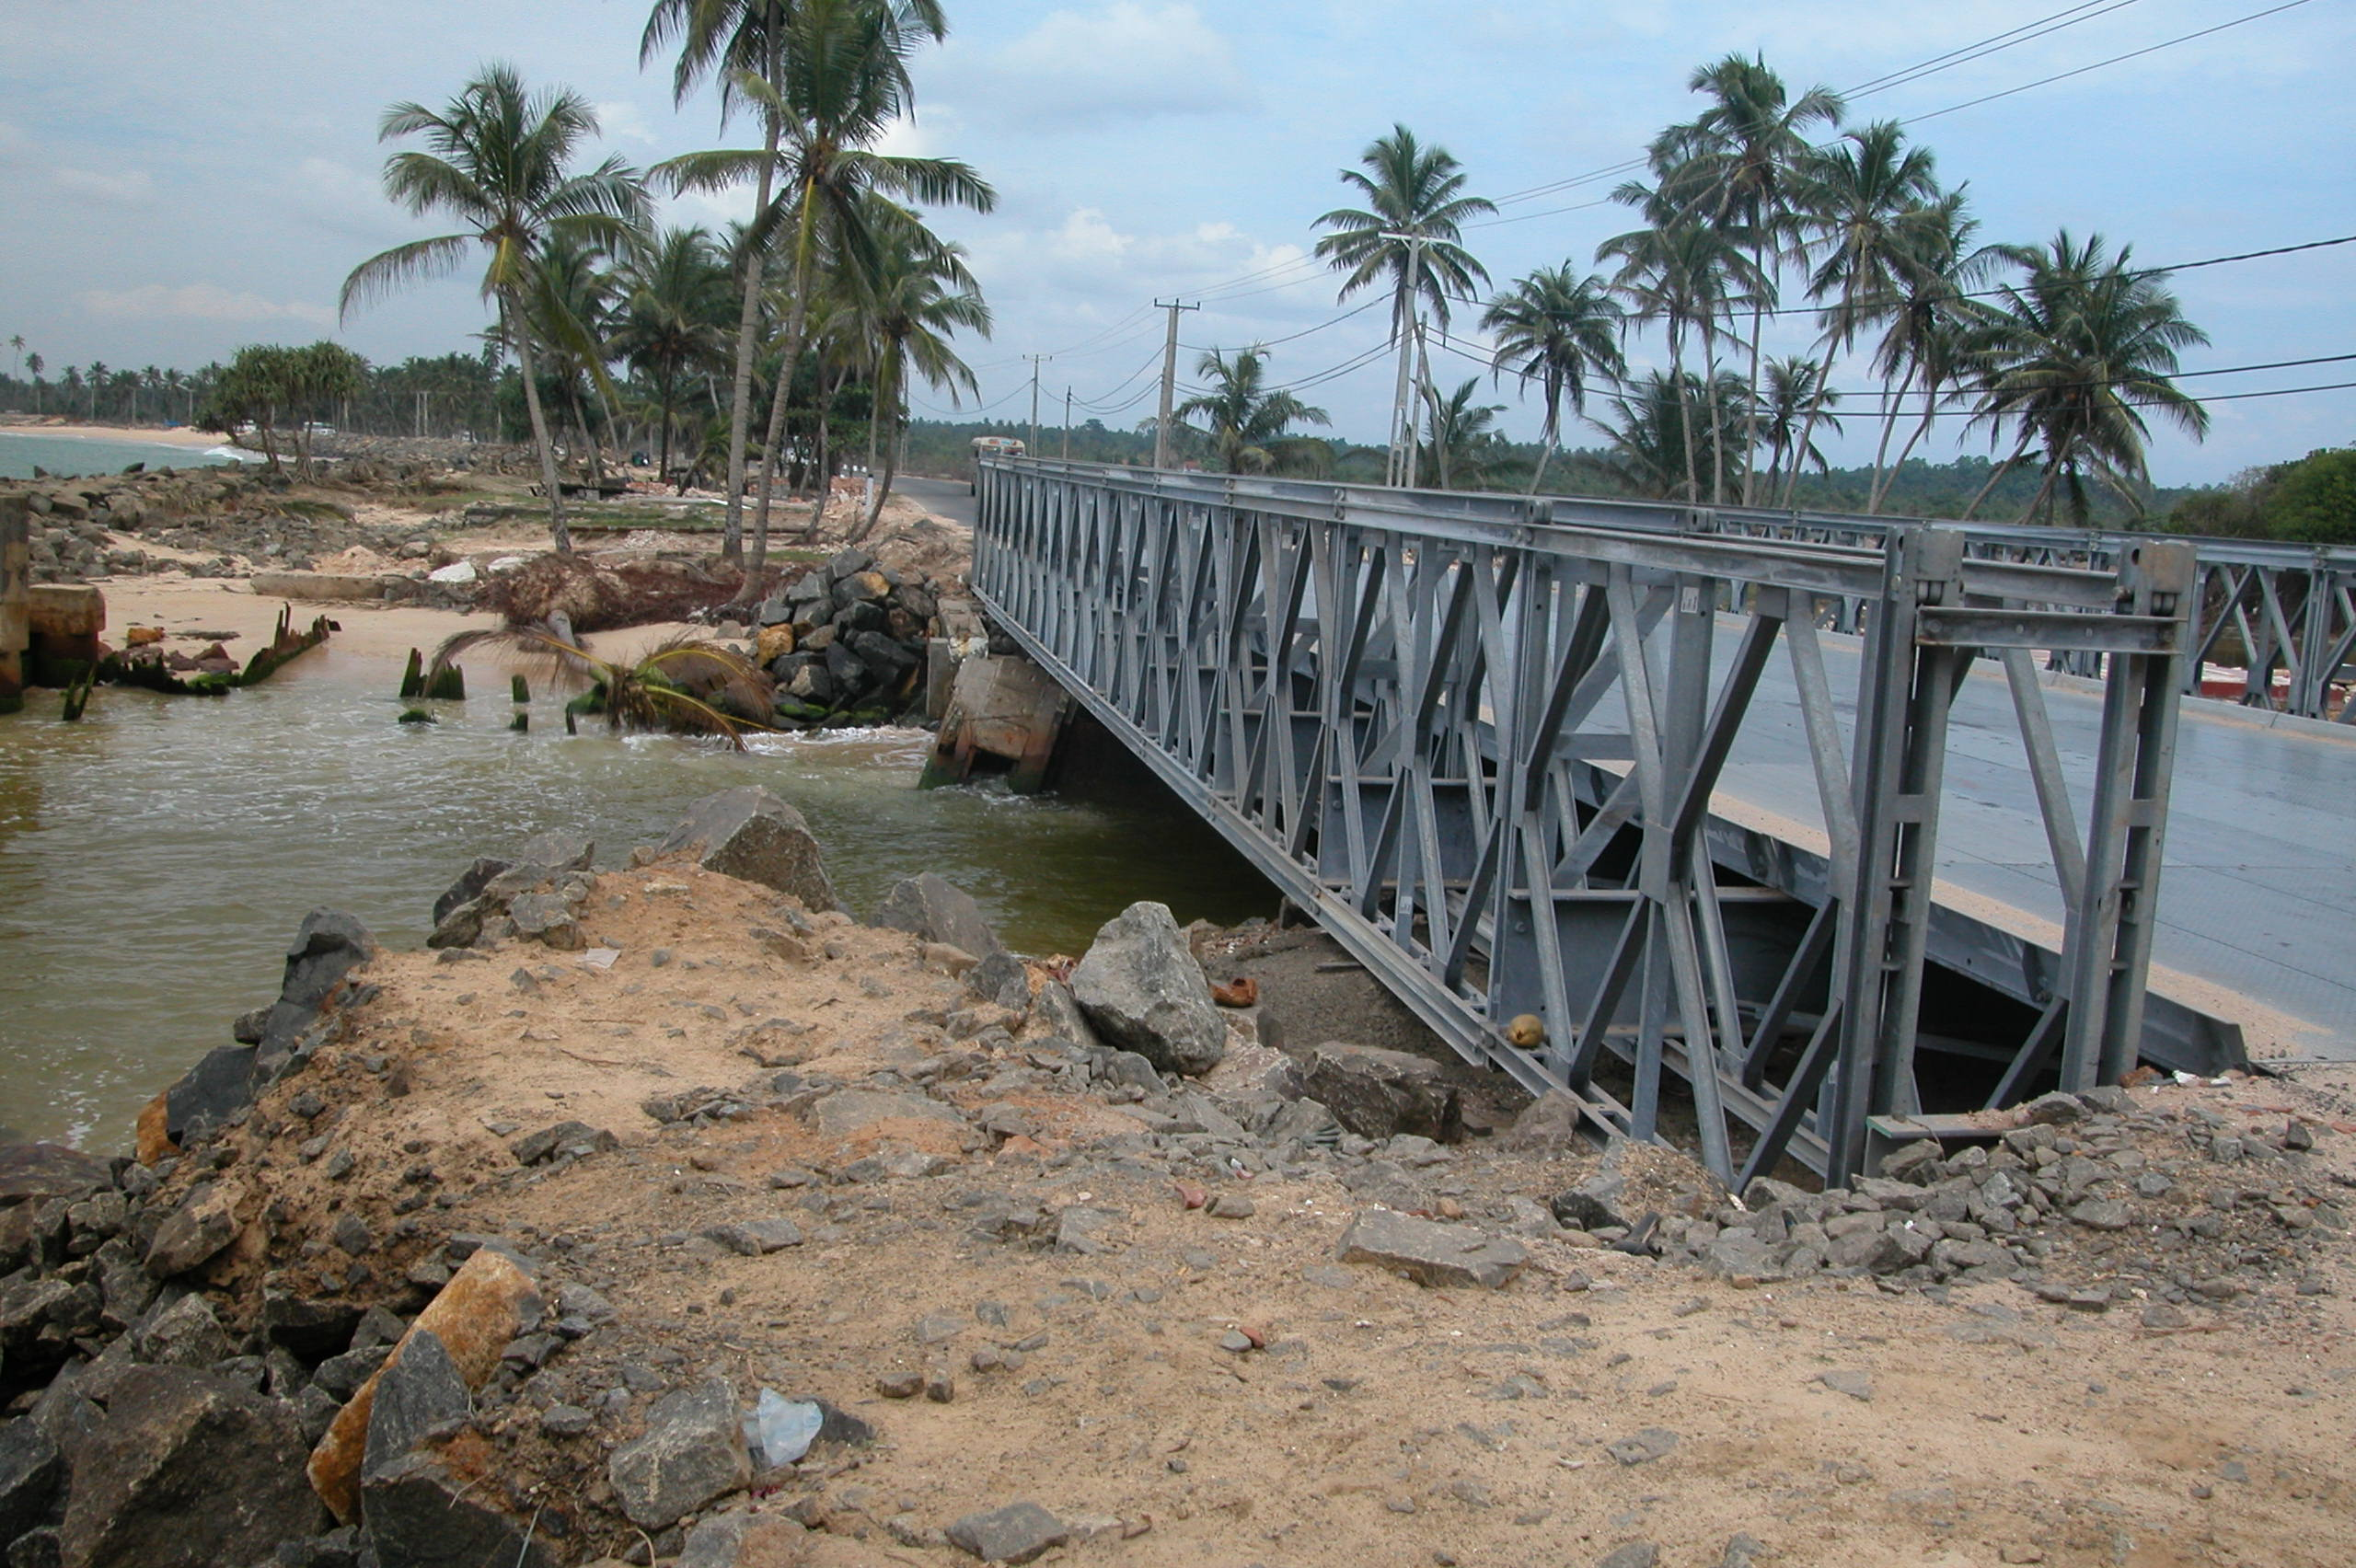
Contrary to the east coast roads, the service roads at the west region suffered minimum damages.

Slide 27
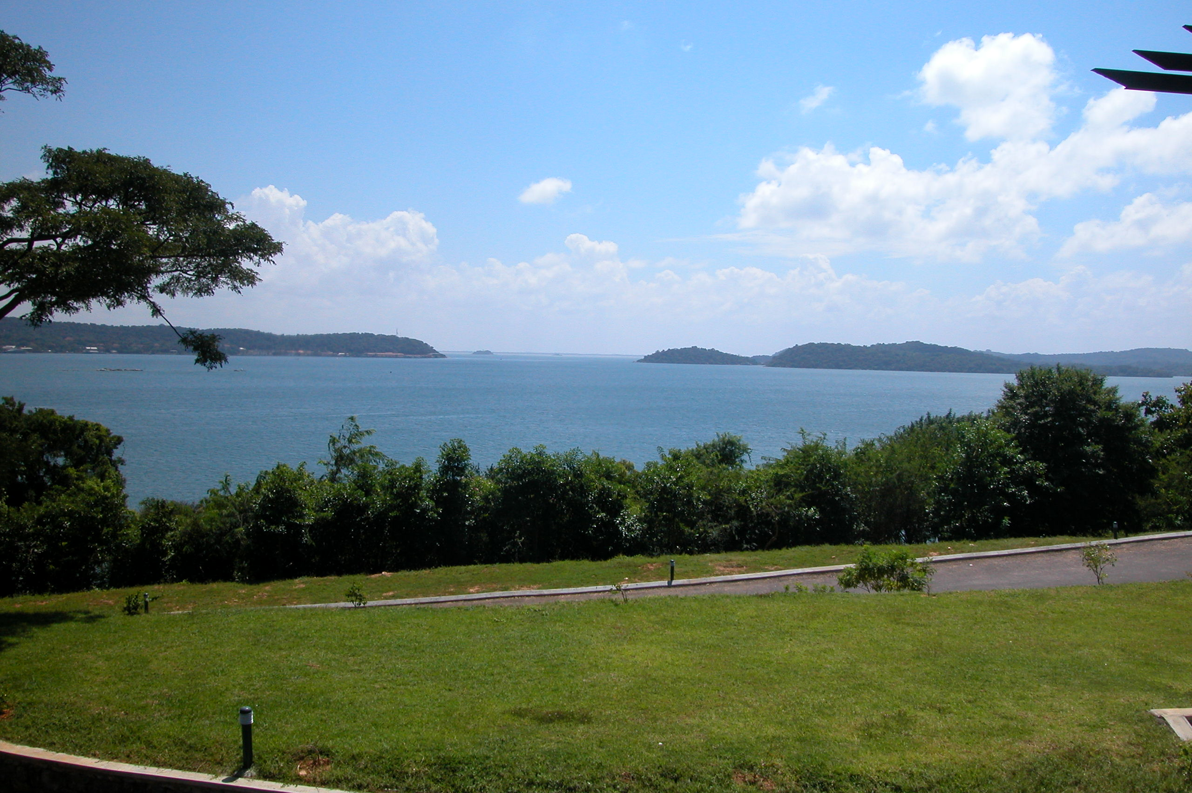
Part III: Ports and Harbors

Slide 28
ASCE Sri Lanka Reconnaissance Team visited the island from 1/31/05 to 2/4/05
Major ports visited:
Trincomalee
Colombo
Galle
Buildings, bridges, Ports, and fishing harbors were observed and evaluated

Slide 29
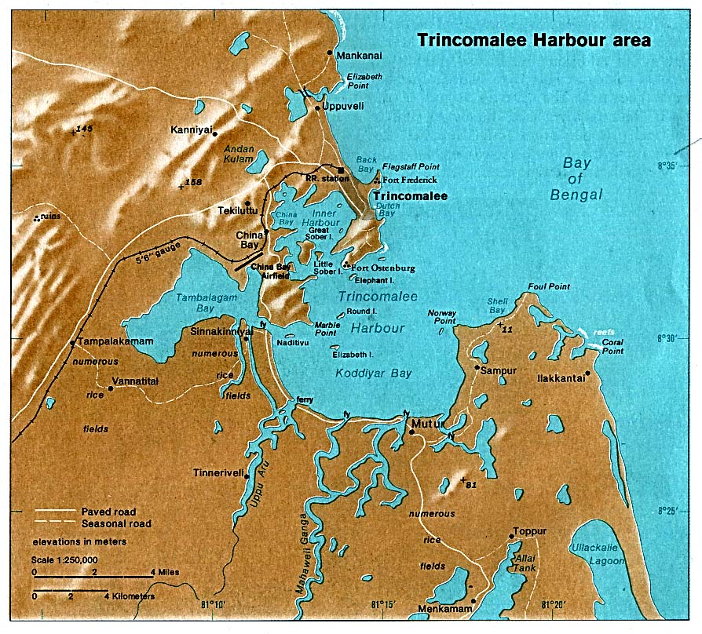
No damages to port facility
Waterfront Houses suffered heavy losses

Slide 30
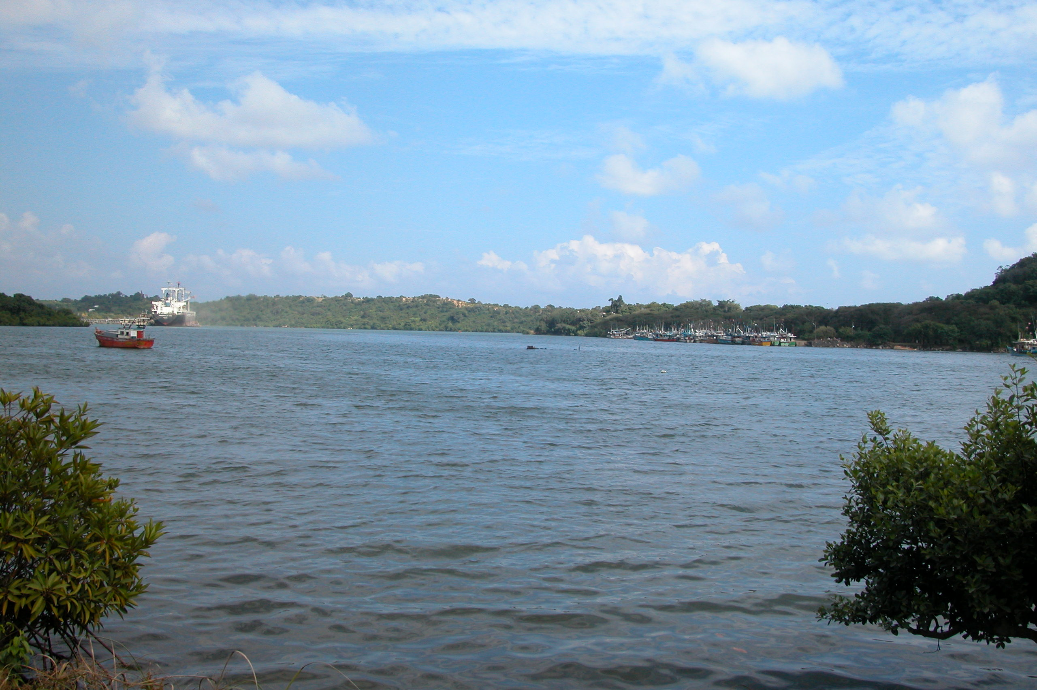
Tricomalee Inner Harbor:
Even though fierce surge attacked outer harbor, narrow entrance minimized the damages to the inner harbor facilities.

Slide 31
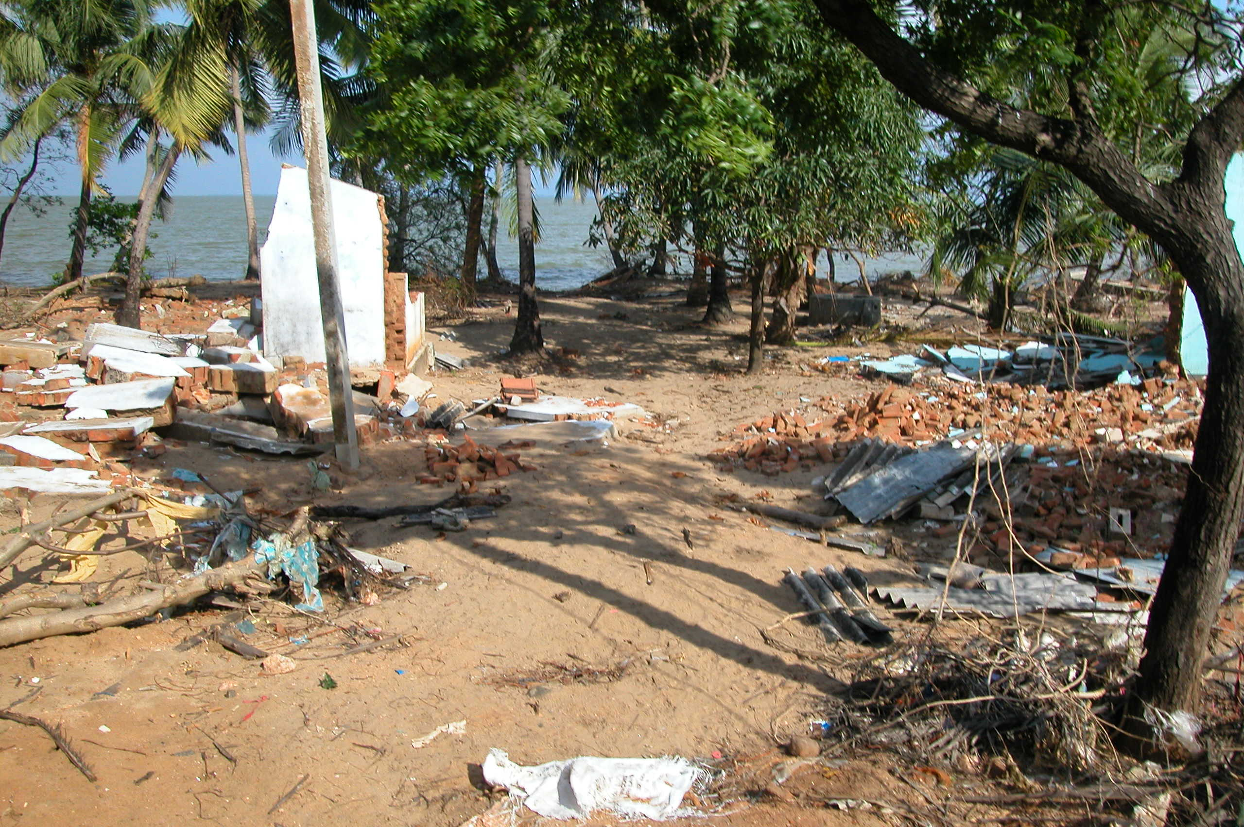
Tricomalee Outer Harbor:
Almost all the houses at coast line were destroyed.

Slide 32
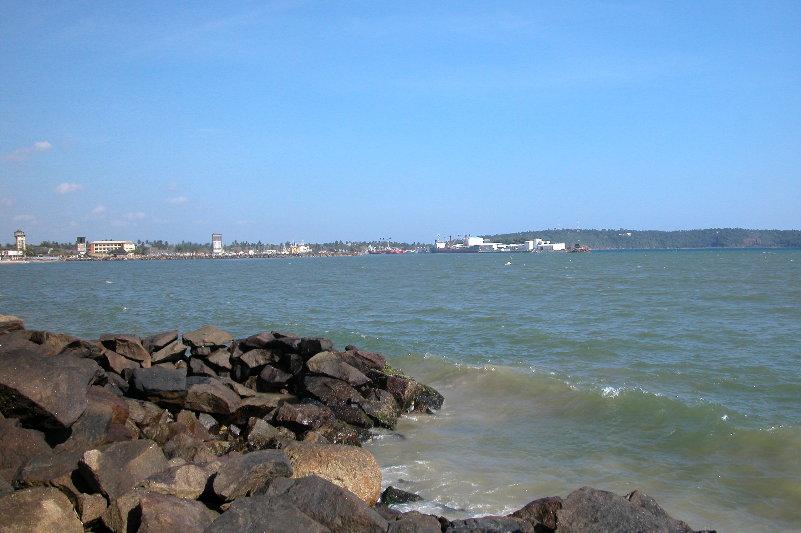
The Port of Galle, Southwest Sri Lanka:
Water was 10 ft above the deck and port buildings.

Slide 33
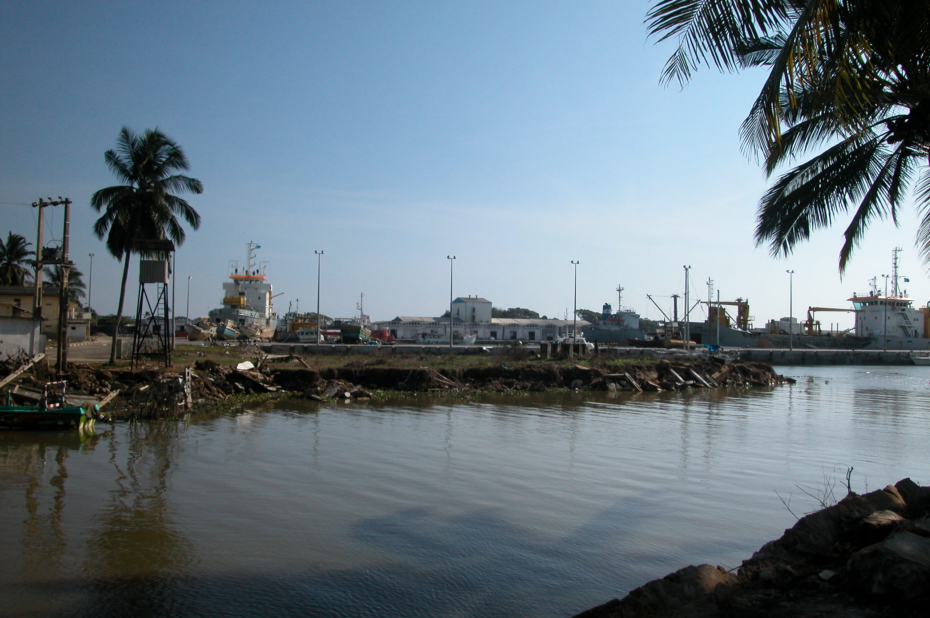
No major damage was reported, even though 2 m (6’) of silt filled the inner harbor and a 650 ton ship was tossed to on top of the deck.

Slide 34
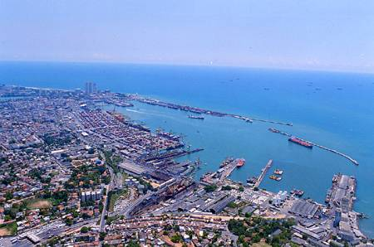
The Port of Colombo
Port of Colombo
General cargo terminal and 2 container terminals
12-15 m draft (Jaya) and 9-11 m draft (SAGT)
2 million T.E.U in 2004
Reinforced concrete deck on piles
200 Ha water area, 130 Ha land area

Slide 35
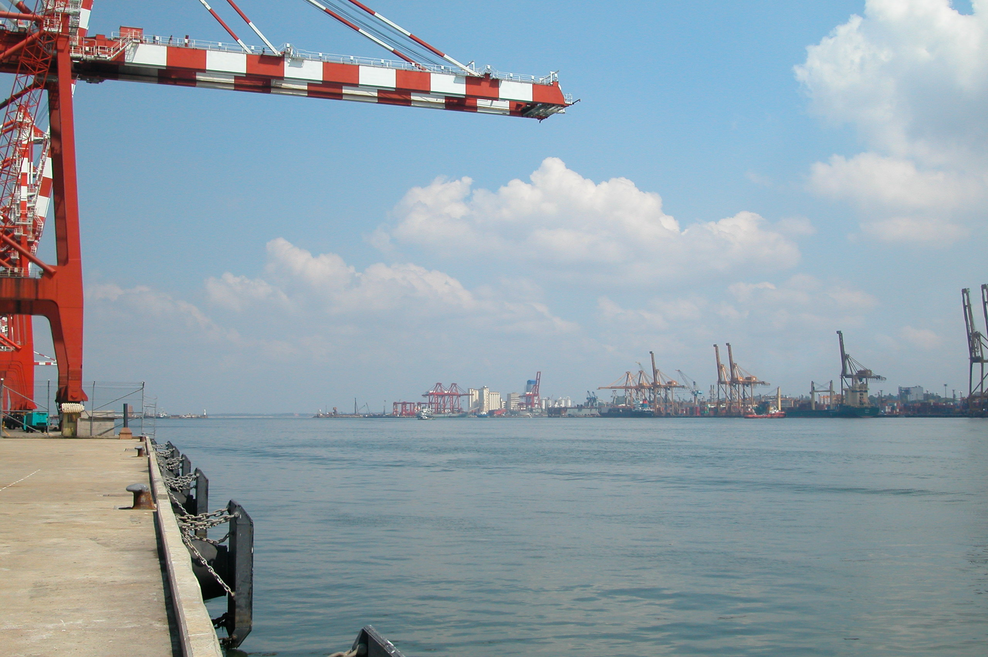
Tsunami brought no surging waves, but fast rising water.

Slide 36
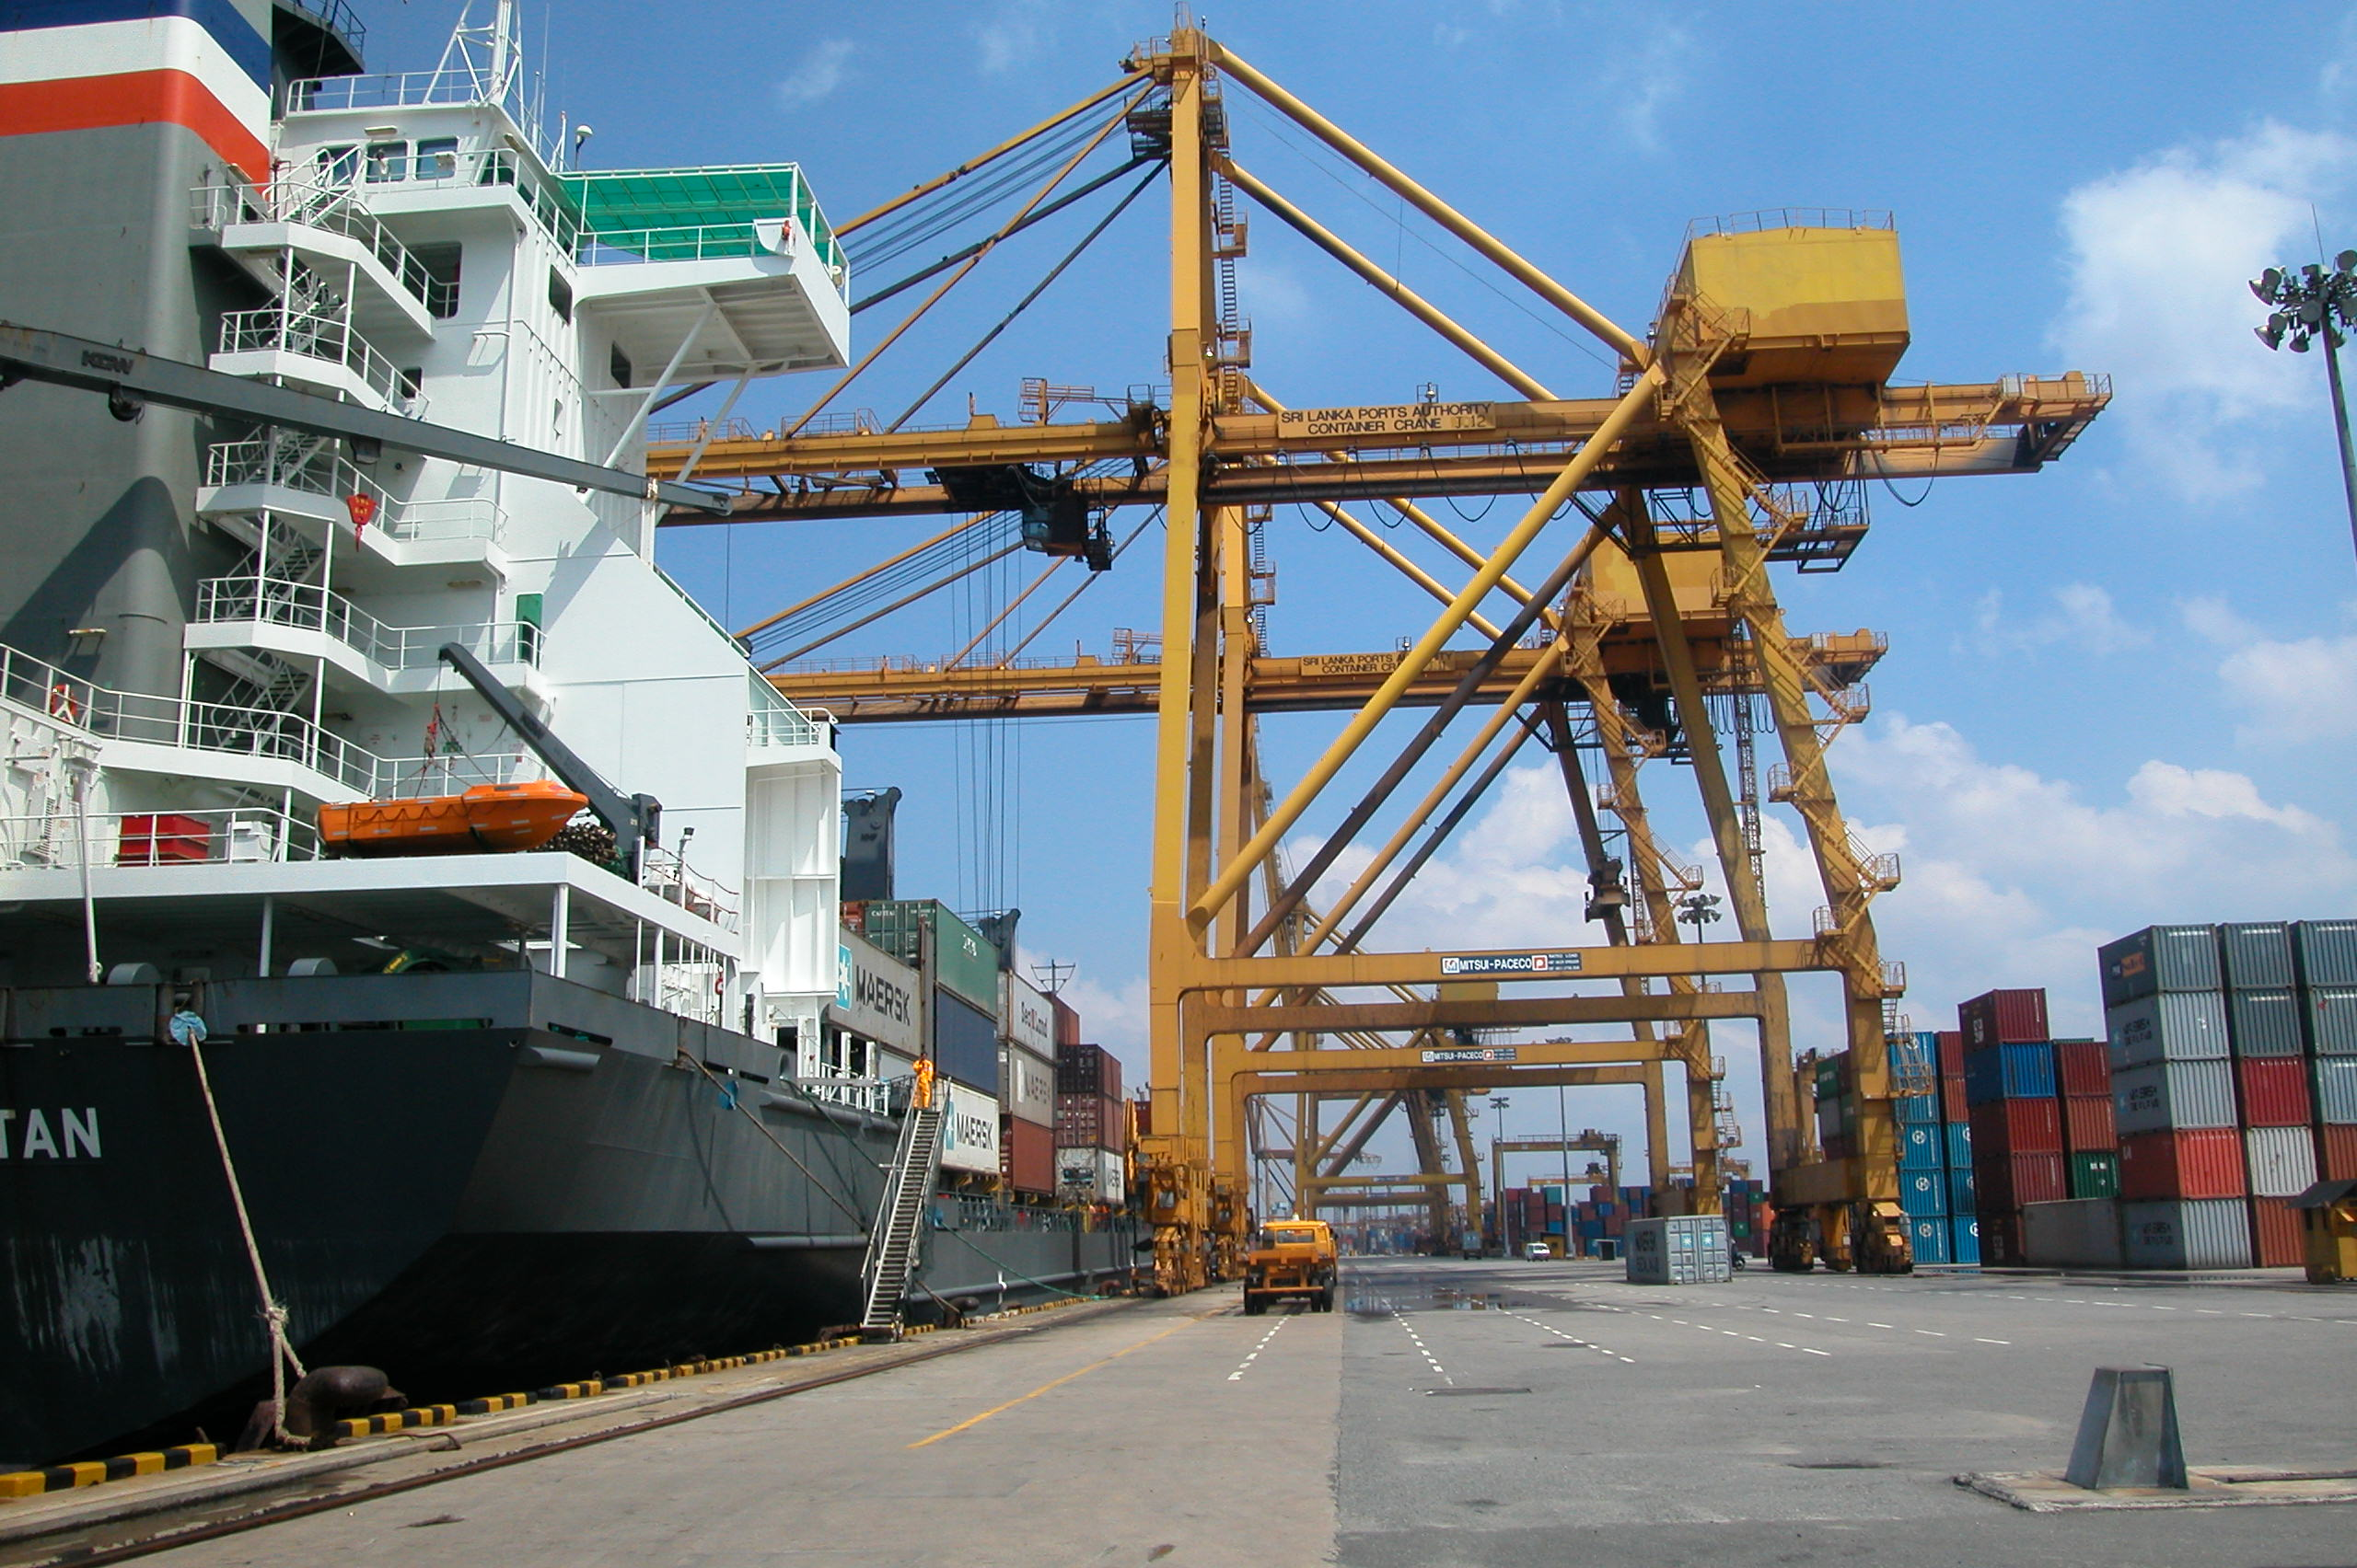
Three feet of water covered the wharfs before receding.

Slide 37
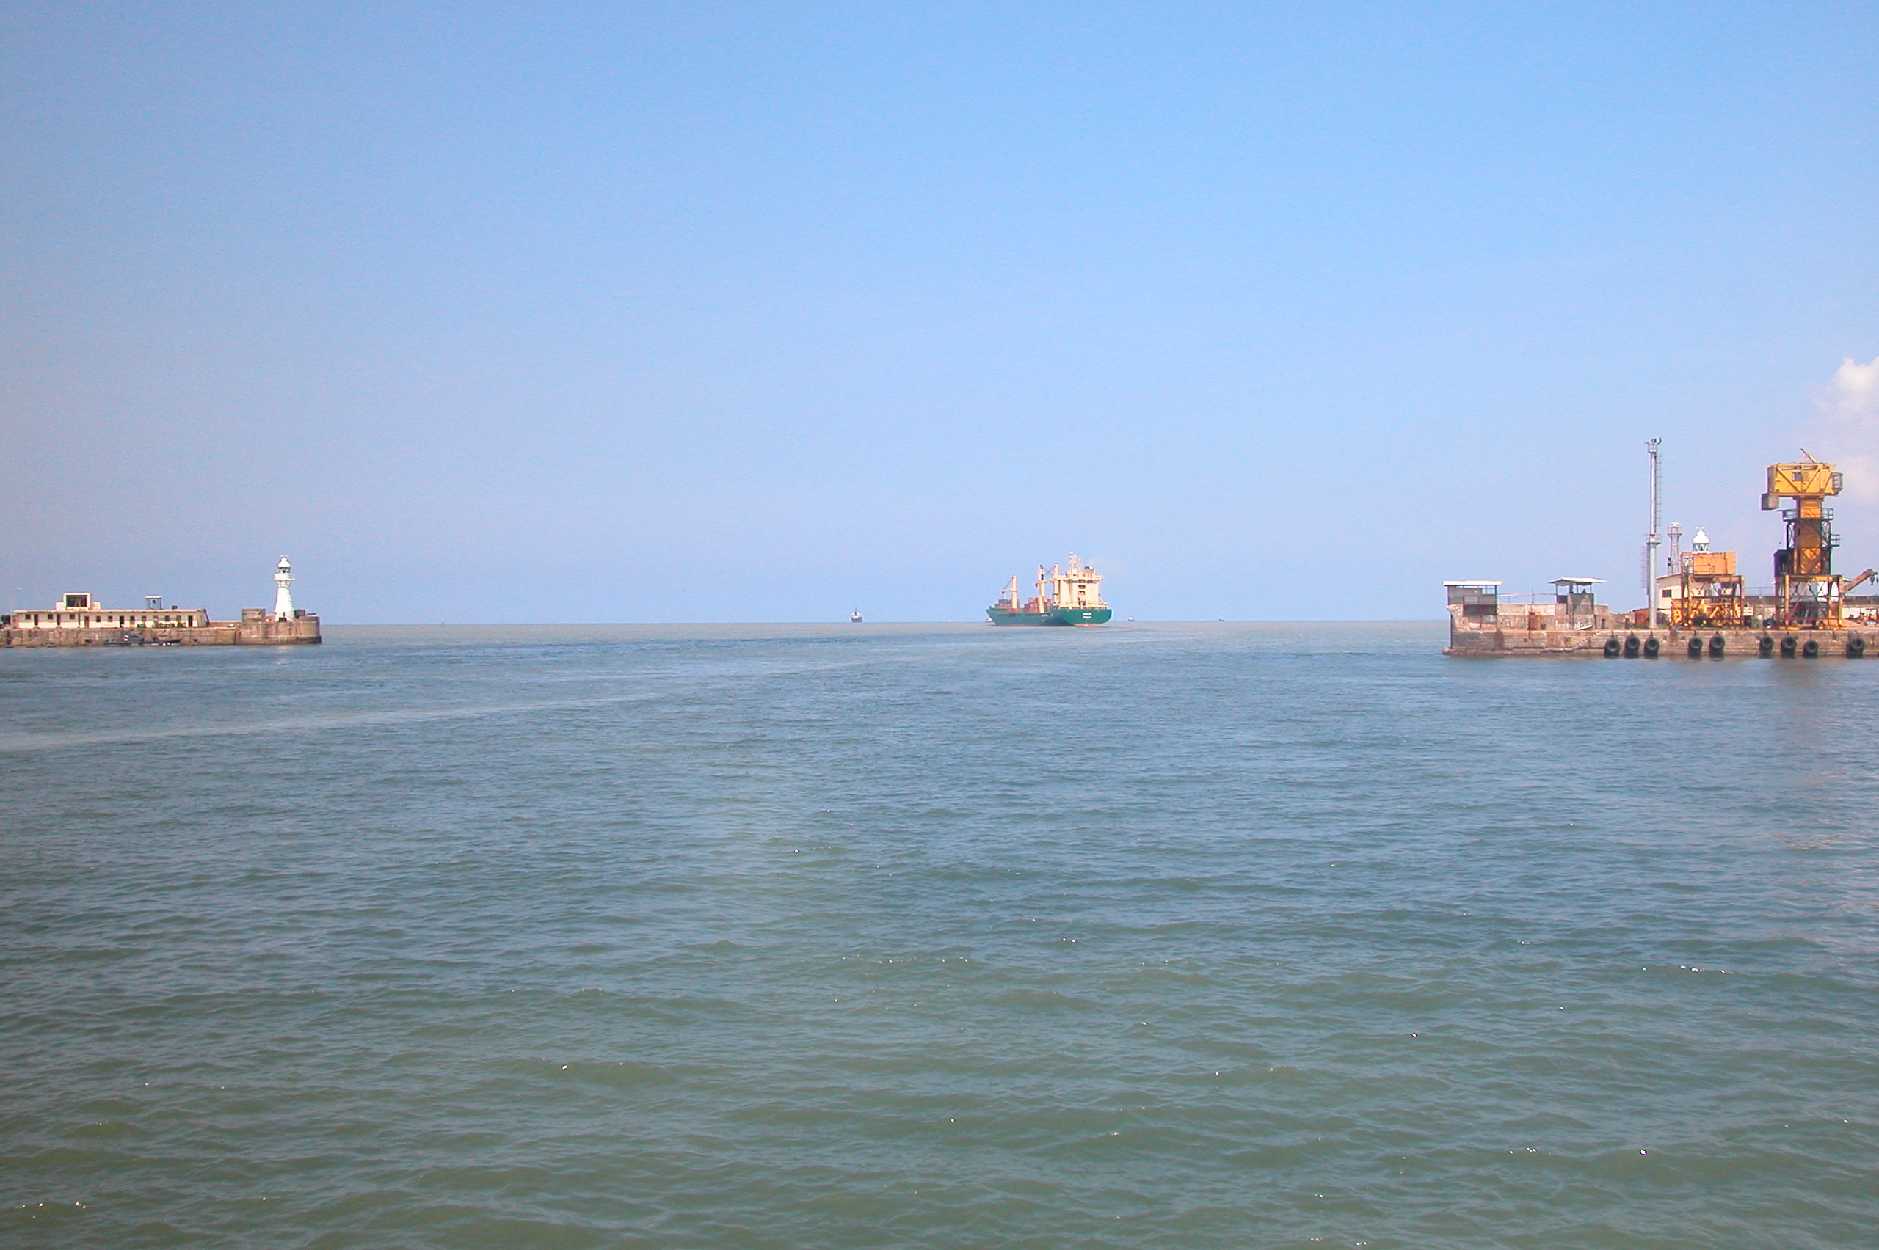
Minor damages occurred near light house when a ship hit the breakwater (slipped away from the wharf by receding water).

Slide 38
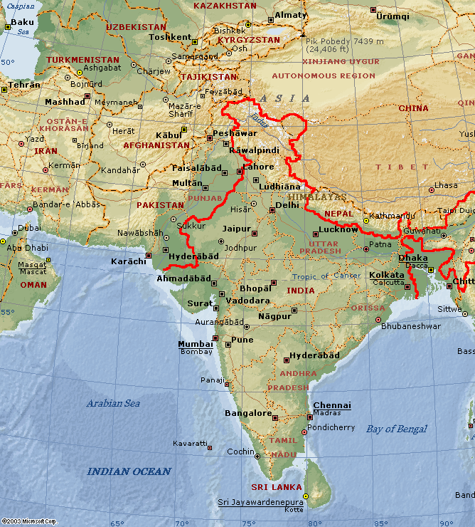
Observation in Southeast India:
2/7/05-2/11/05
Ports visited:
Chennai
Ennore
& Fishing harbors

Slide 39
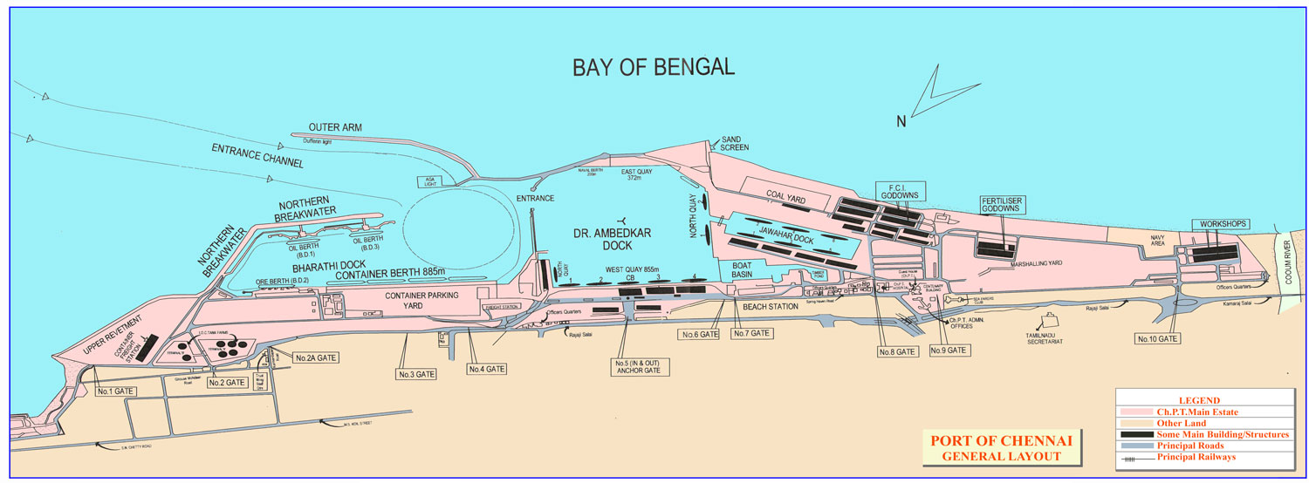
Chennai Port, India

Slide 40
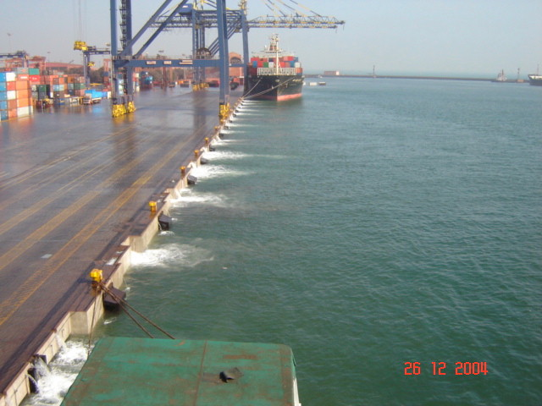
Chennai Port: 5 m (16 ft) or higher waves hit the port and fish harbor. (Deck is 4 m above MLLW level)

Slide 41
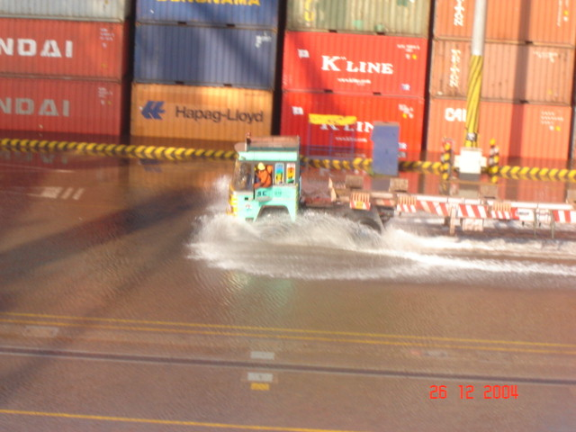
Water receded from the backland.

Slide 42
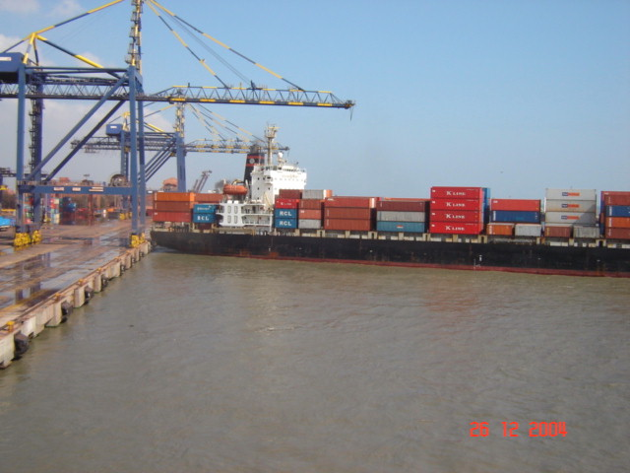
Despite the broken mooring line and high water level, wharf structures suffered no damage.

Slide 43
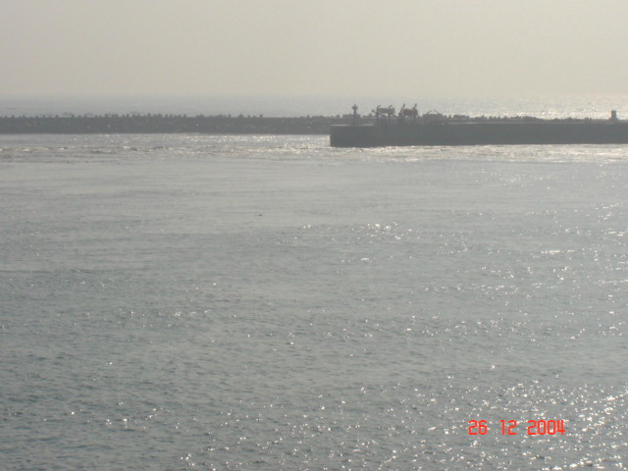
Strong current is clearly visible inside the harbor.

Slide 44
Chennai Port, India

Slide 45
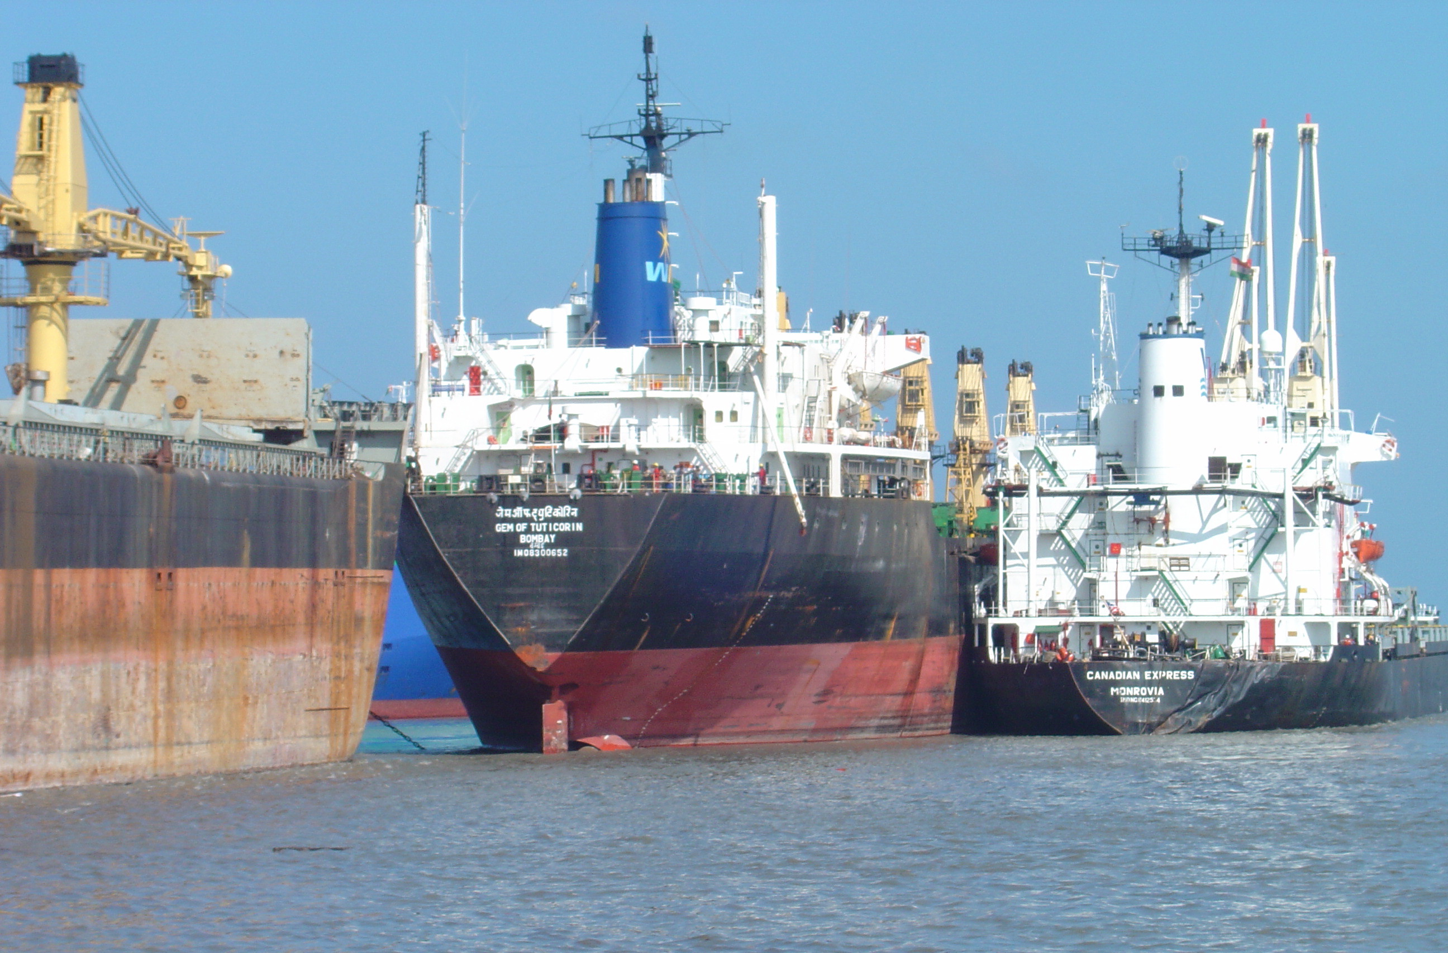
Water current circled and swirled around these vessels inside the harbor.

Slide 46
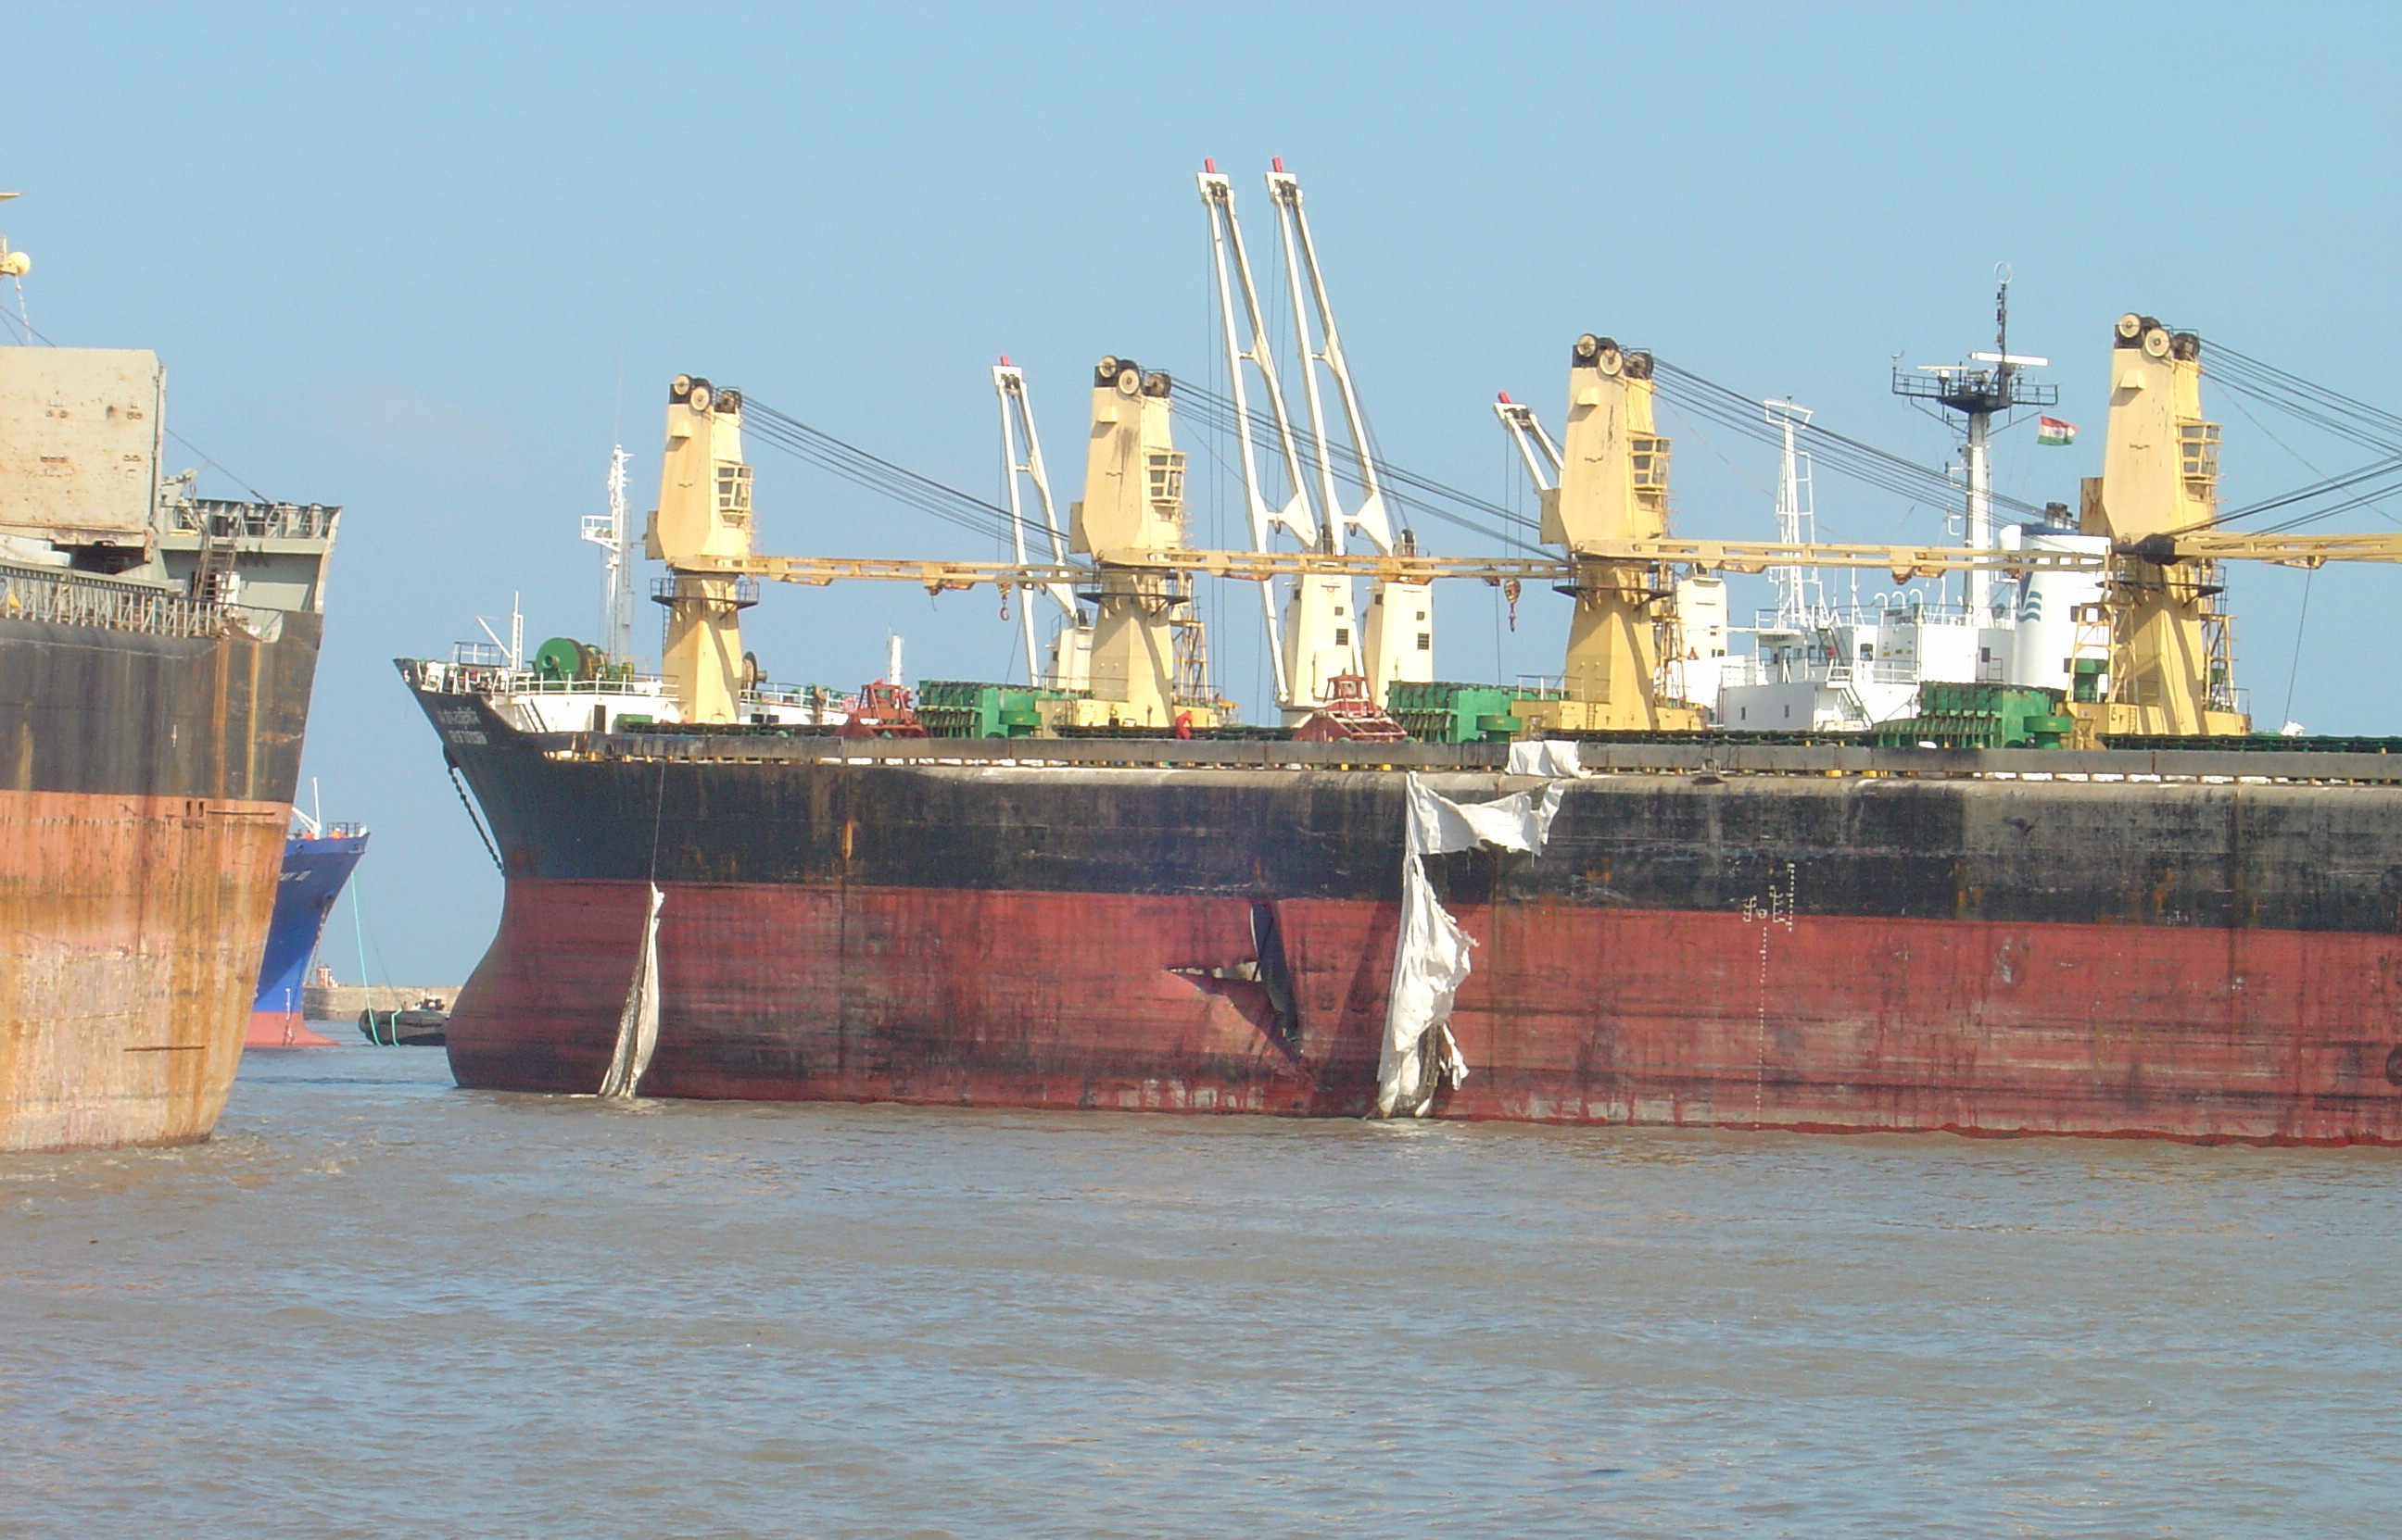
Damages caused by collision of floating ship.

Slide 47
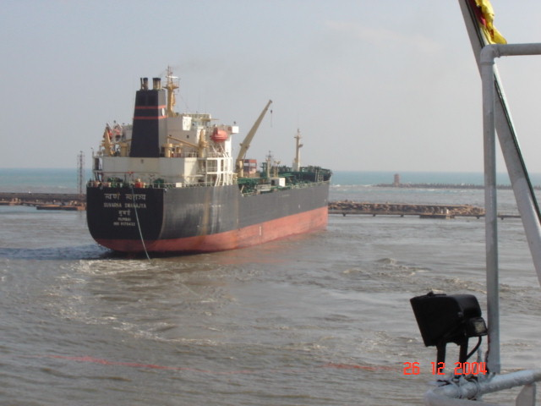
Ship floating with the receding water. Broken mooring line is visible.

Slide 48
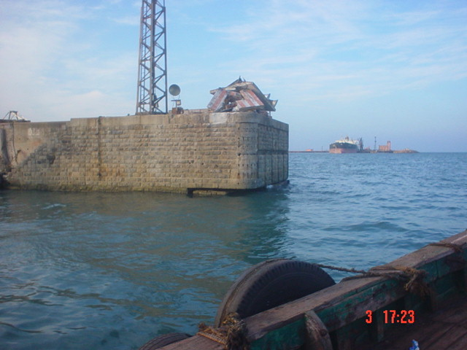
Receding water scoured the foundation, and deepened the channel by several feet.

Slide 49
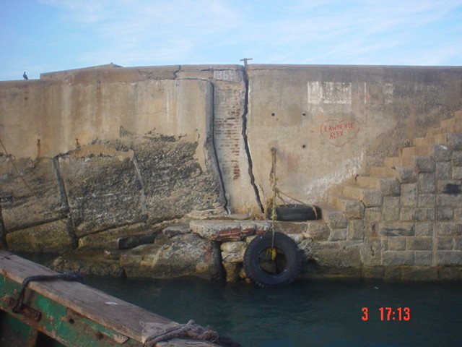
Pier settlement due to scouring.

Slide 50
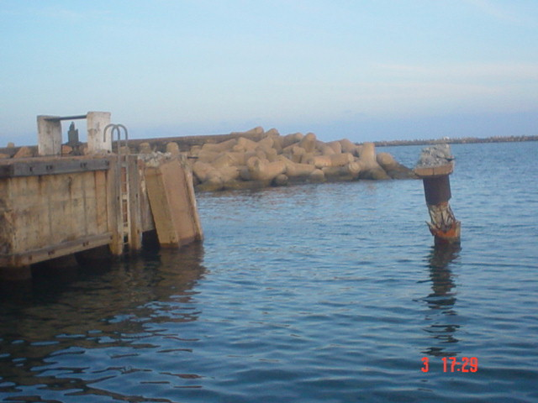
Catwalk and dolphin were knocked out by floating vessel.

Slide 51
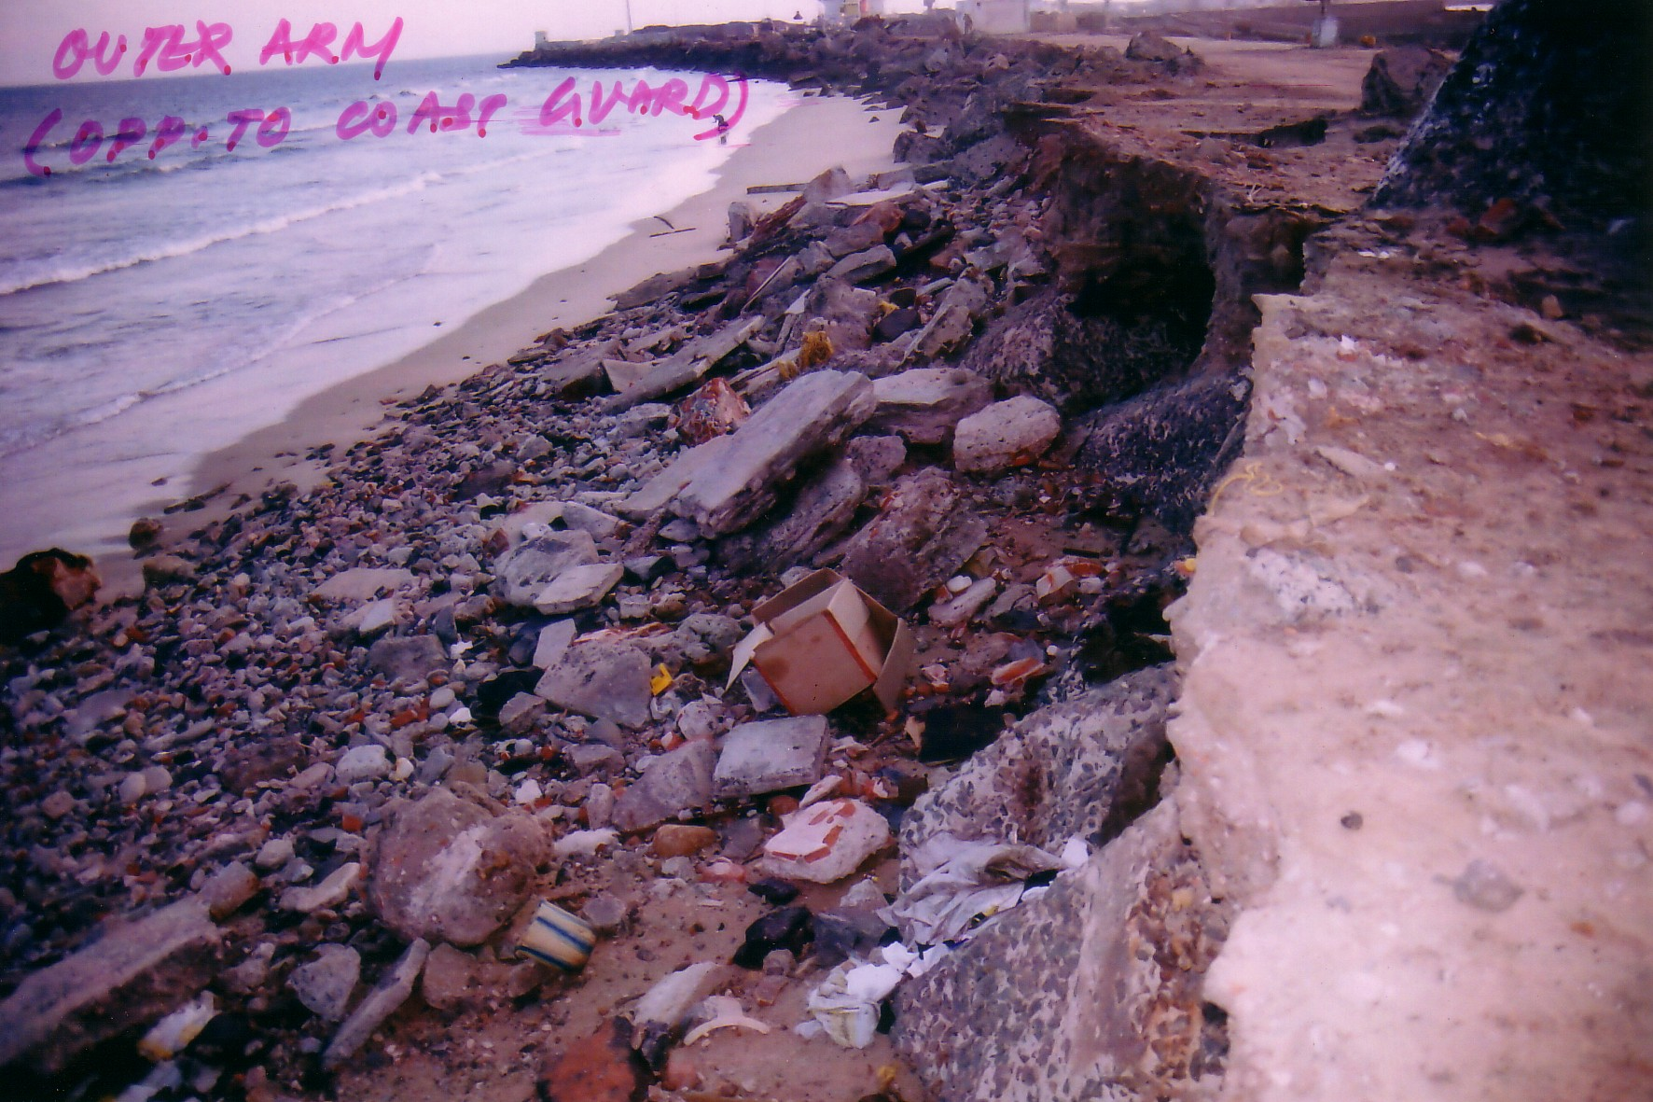
Most damages on breakwater occurred at the inner side.

Slide 52
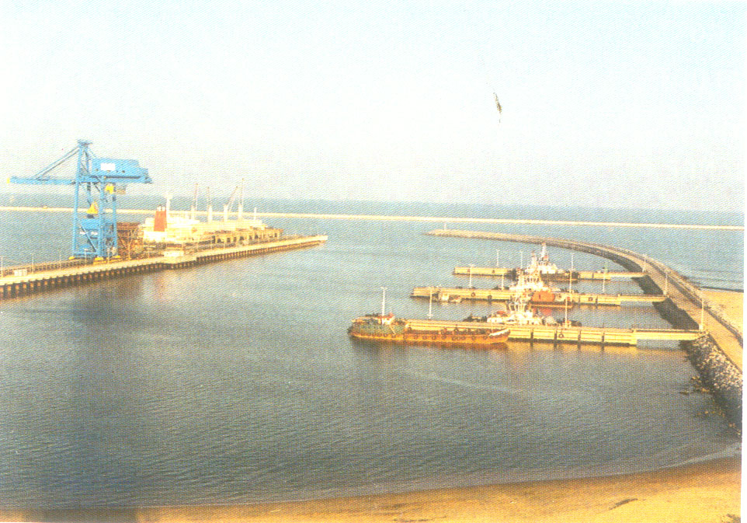
Ennore, the Port for energy, located 24 km north of Chennai.

Slide 53

Breakwater shows no damage.

Slide 54

Port staff was well prepared when Tsunami threat was noticed.

Slide 55

Tug boats were used effectively to keep the ship from floating around the harbor.

Slide 56

Sound judgment and timely response averted potential damages at this port.

Slide 57
General Findings:
Early Warning System: Many lives could have been spared had such system existed.
Education: Common sense and traditional wisdom could have reduced the loss. Education should pass through generations.
Disaster Management System: Well planned, well executed emergency response plan is essential.
Impacted Area: Reflecting waves may cause damages just as severe as direct surge.

Slide 58
Observations on Infrastructures and Buildings:
Site specific: Similar to a seismic event, the magnitude of damage is subject to many factors. Similar buildings next to each other may have different outcomes.
Receding water caused more bridge and abutment damages at the river and lake areas that drained the flooded water.
Damages were not limited to immediate costal area. High water level, strong surge and/or receding flow destroyed structures several thousand feet to the inland.
Building code enforcement is essential. Almost all property that was lost, was not properly engineered.
Planning and zoning: Low lands or coastal regions subject to monsoons and floods may need special zoning regulations and building height requirements.

Slide 59
Observations on Port Facilities
Most modern port structures are capable to resisting tsunami waves.
Depends on layout, geometry, location, water depth, and other hydraulic, structural and geotechnical features, some ports may have strong current and scouring problems, while others may be filled with silt.
Rising water may break mooring lines. In the ports that have strong current and fast receding water, floating vessels should be a concerned issue. Scouring should be investigated.
Hydraulic modeling and laboratory test could be considered at major ports.
Breakwater damages generally occurred at inner side of the structure.

Slide 60
Reported by : Peter Yin, Port of Los Angeles
ASCE-COPRI Reconnaissance Team Member
pyin@portla.org
(310) 732-3324

