Slide 1
Structural Damage and Response to Historic California Tsunamis
By Orville T. Magoon
Coastal Zone Foundation
Seismic Safety Commission Workshop May 15, 2005

Slide 2
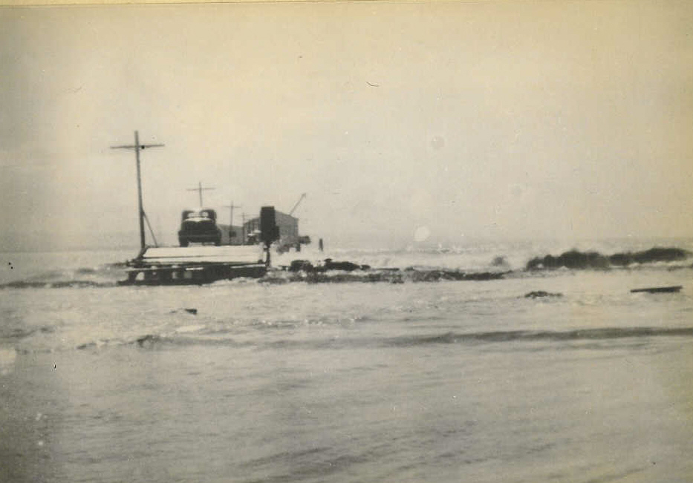
April 1, 1946 Tsunami Half Moon Bay, California

Slide 3
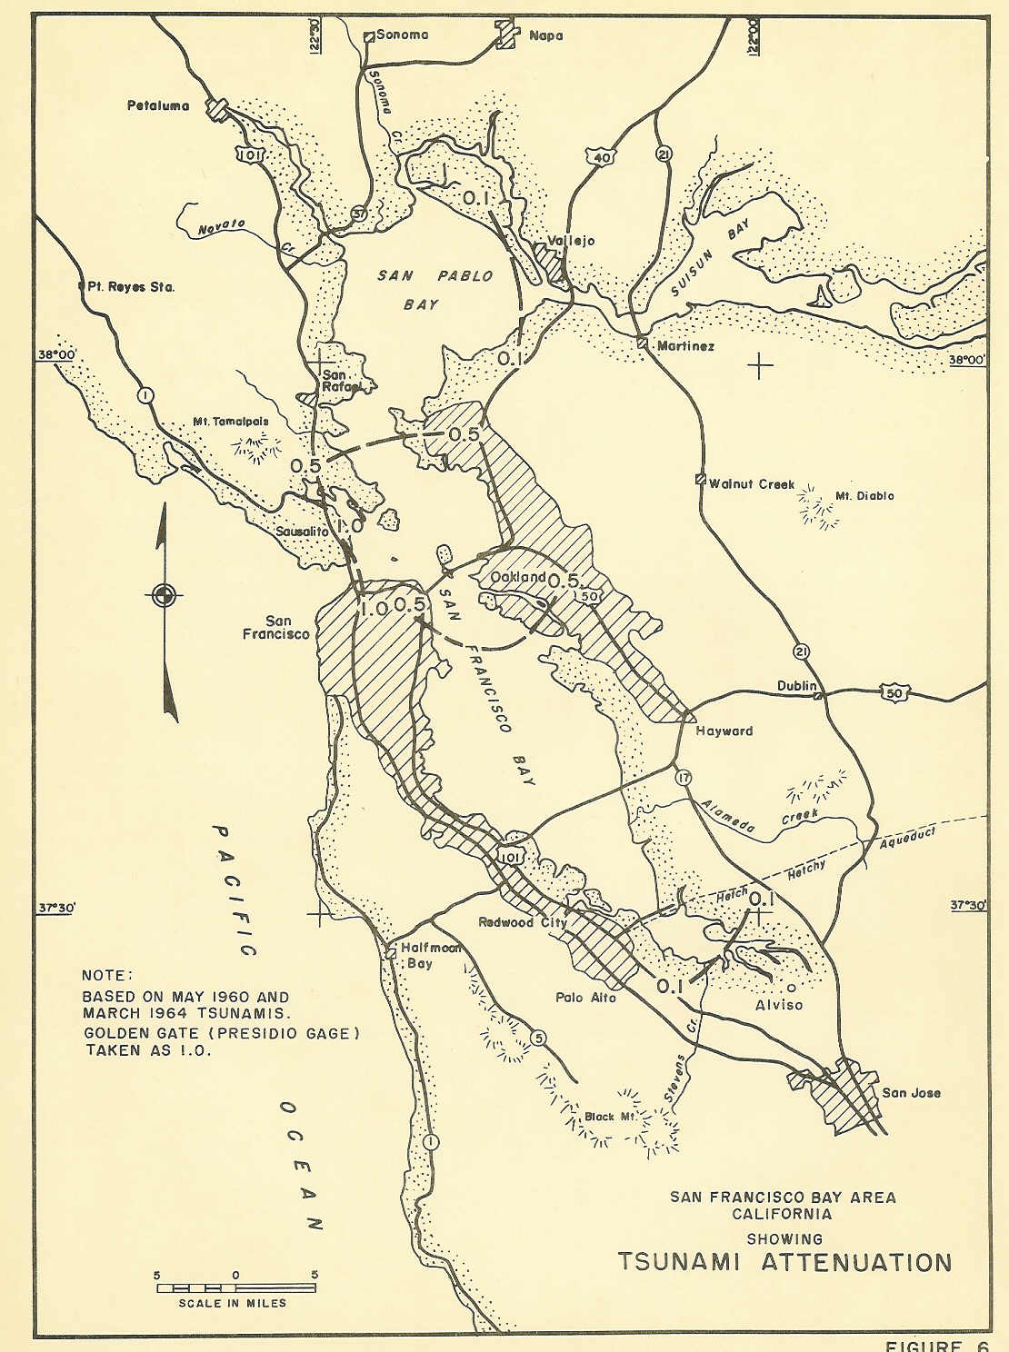

Slide 4
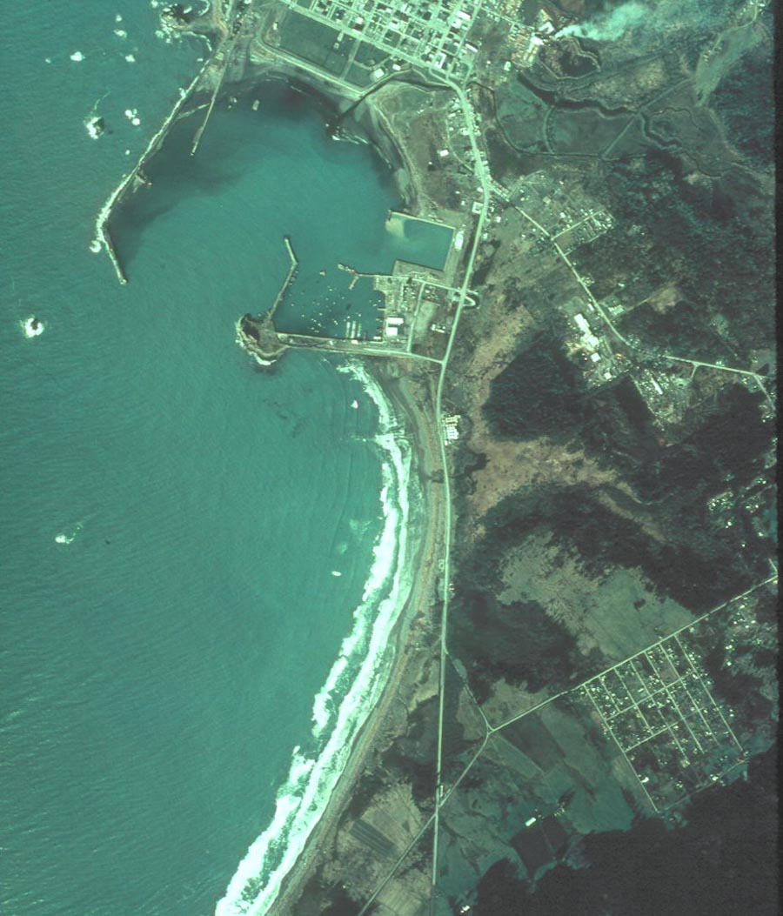
Crescent City
1974

Slide 5
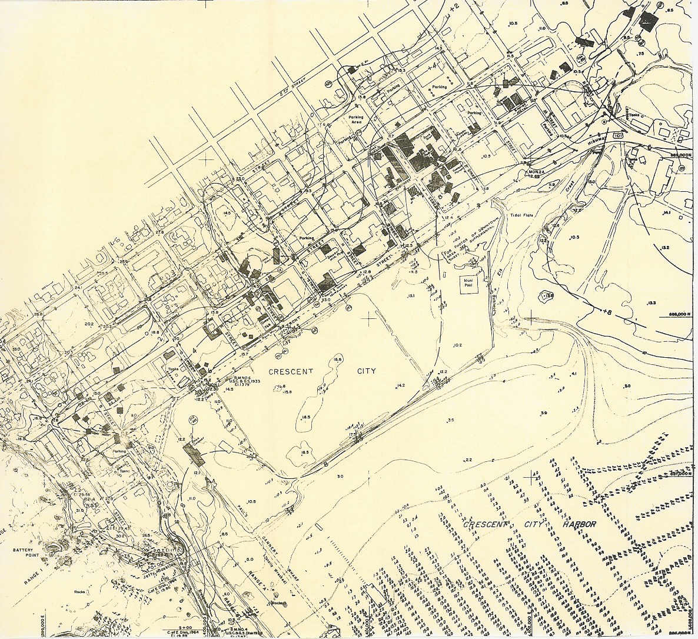

Slide 6
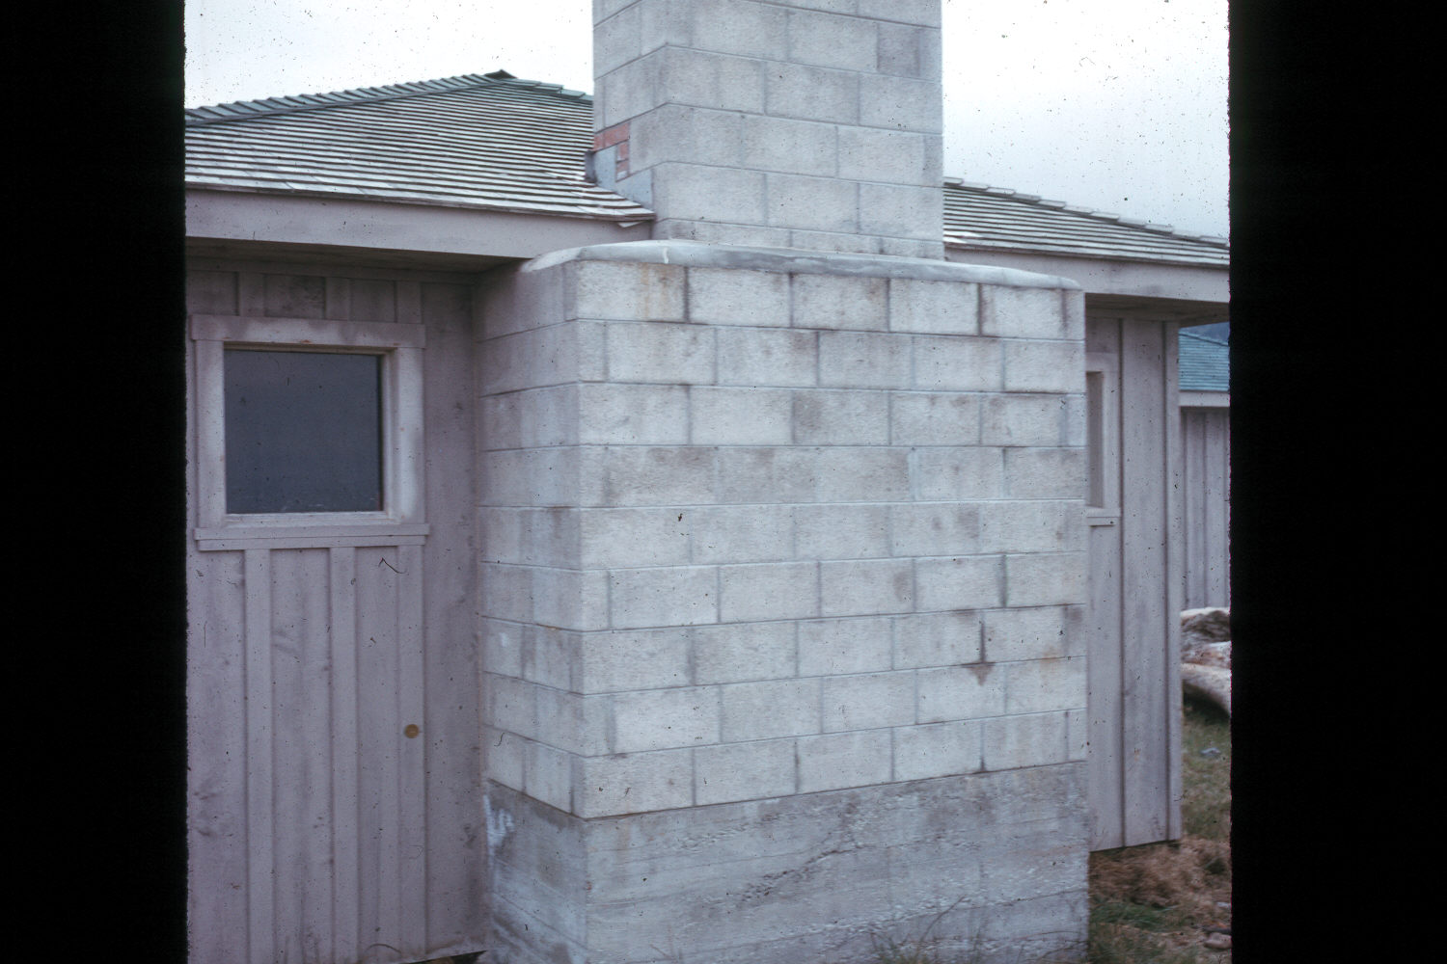
High Water Mark

Slide 7
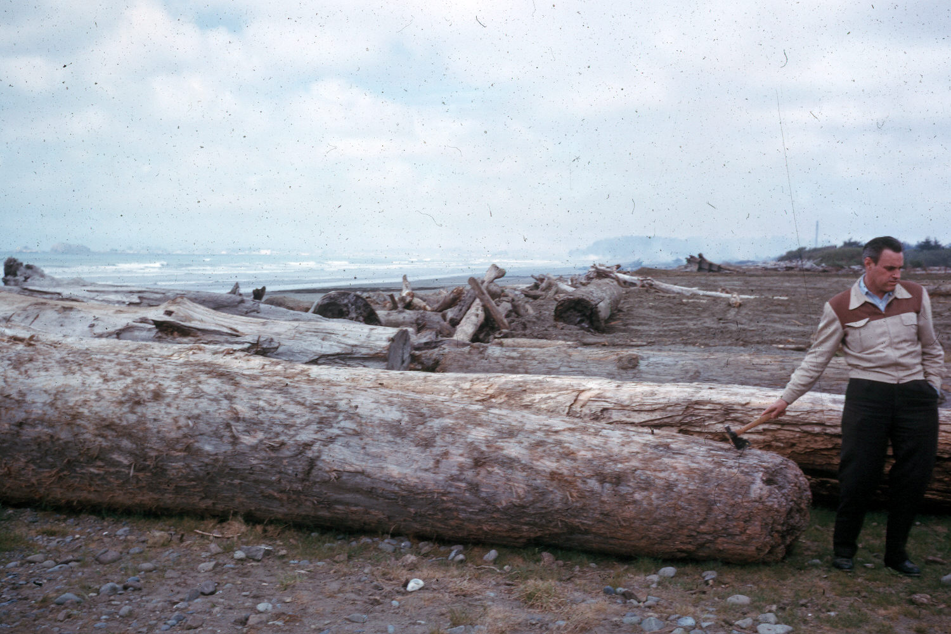

Slide 8
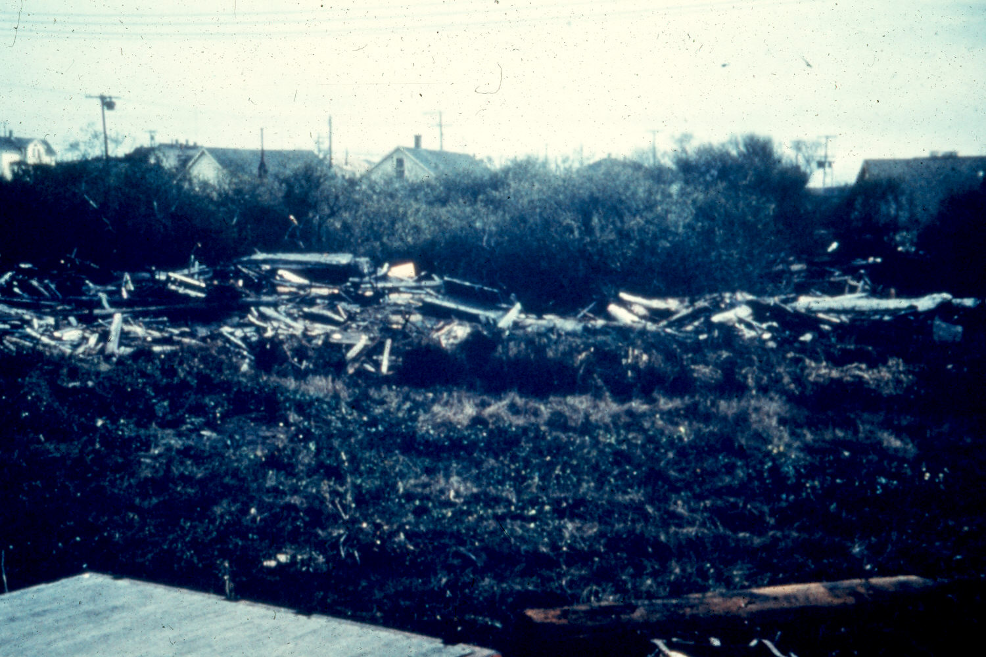

Slide 9
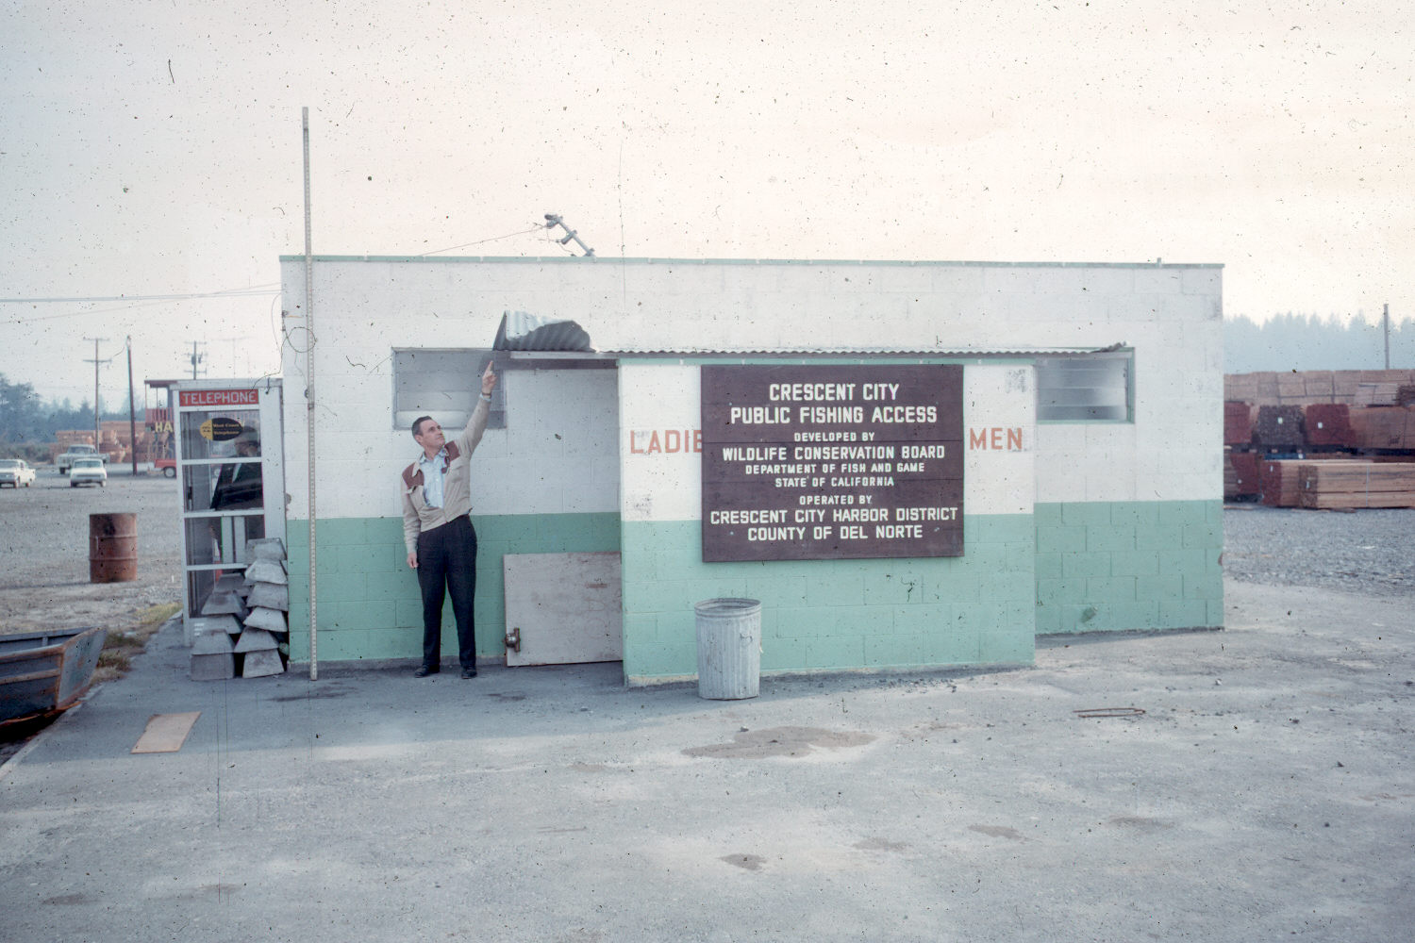
High Water Mark – 20.6’ MLLW

Slide 10
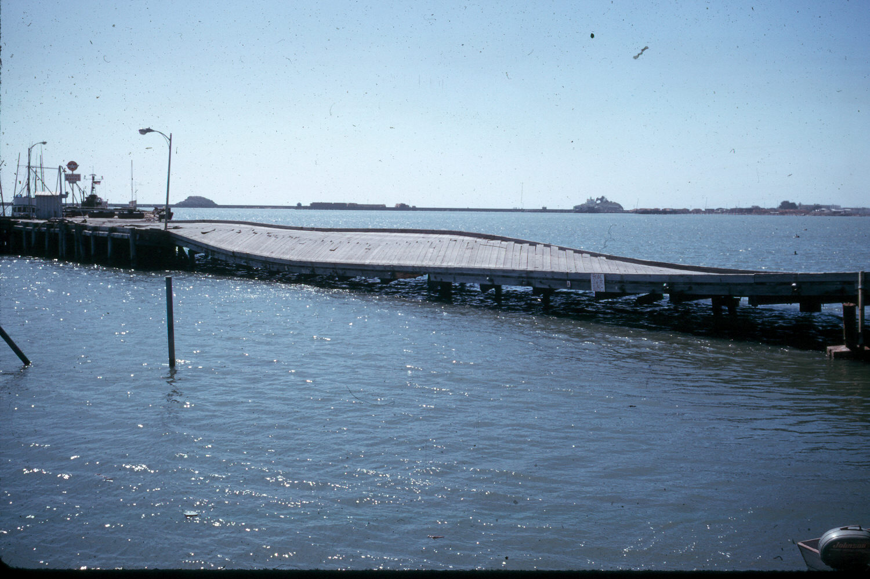

Slide 11
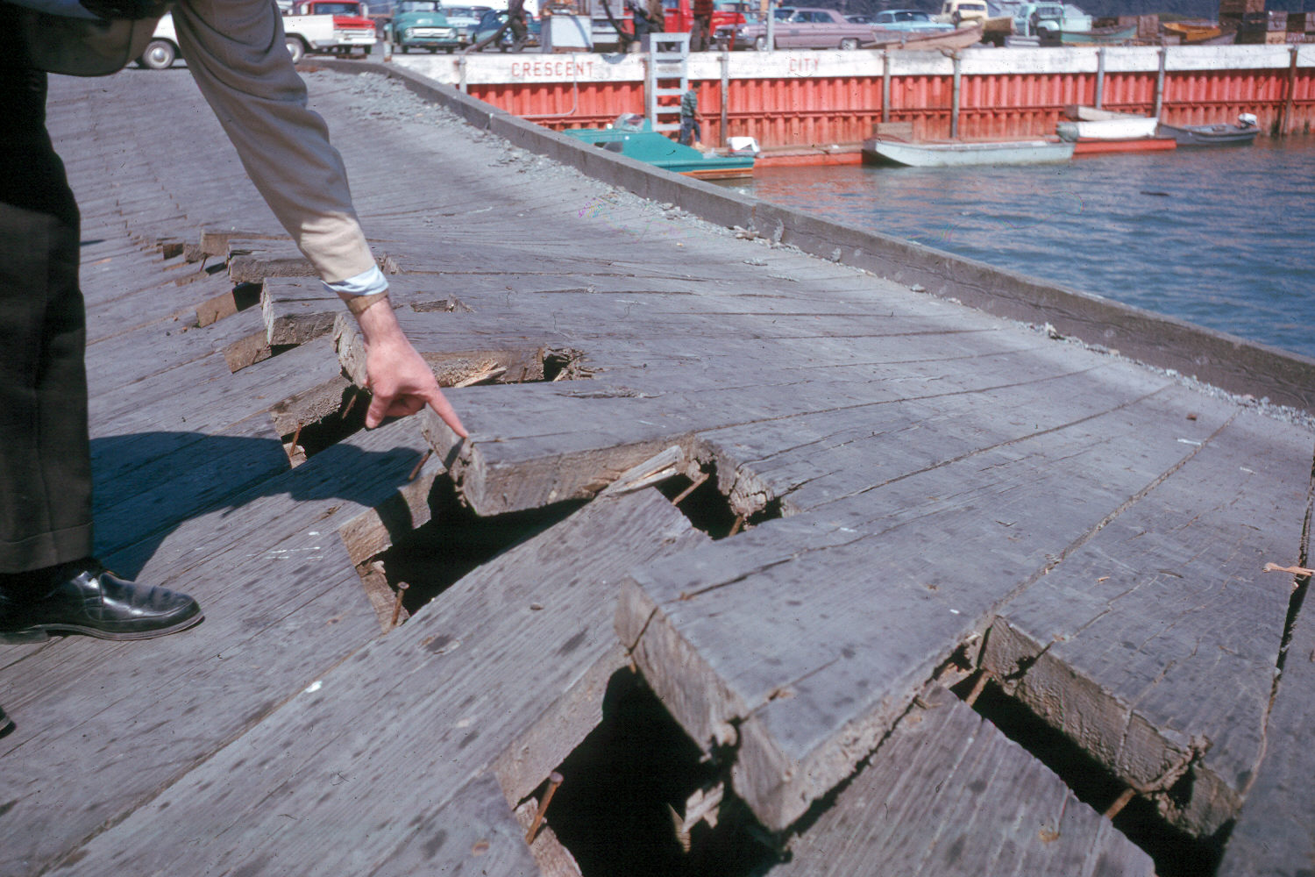

Slide 12
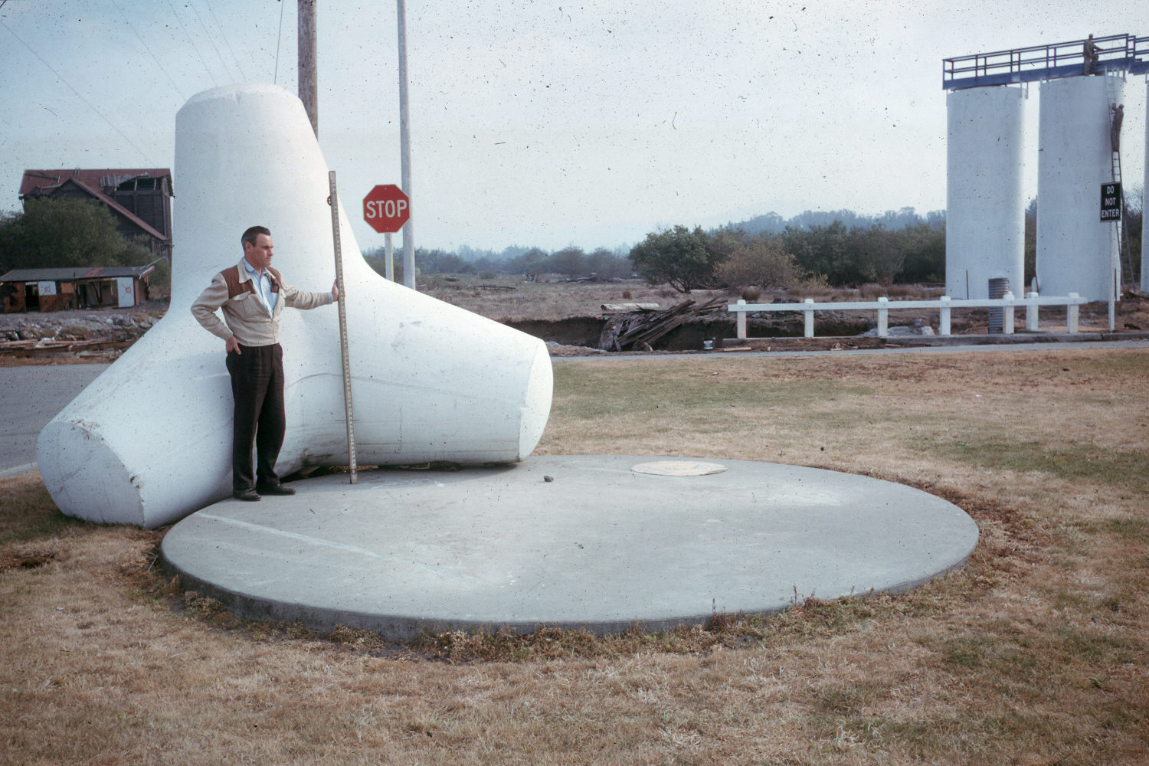

Slide 13
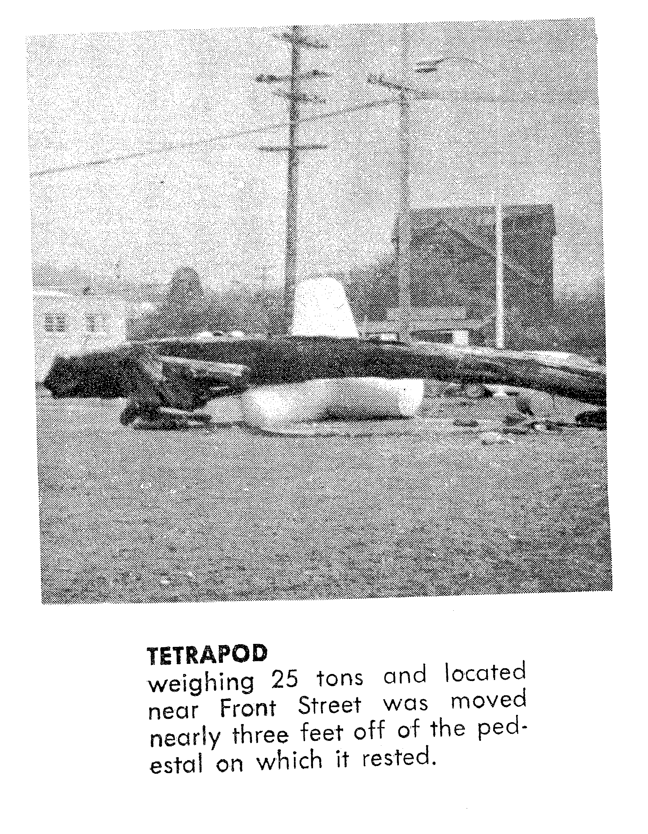

Slide 14
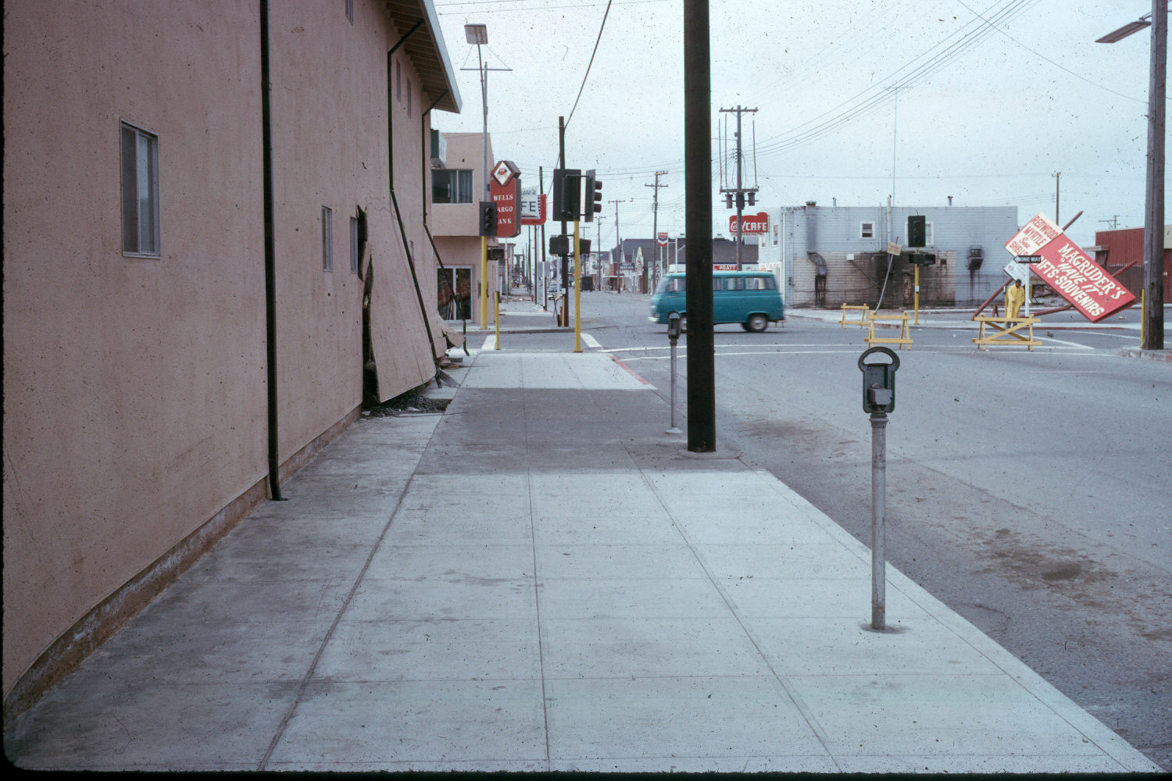

Slide 15
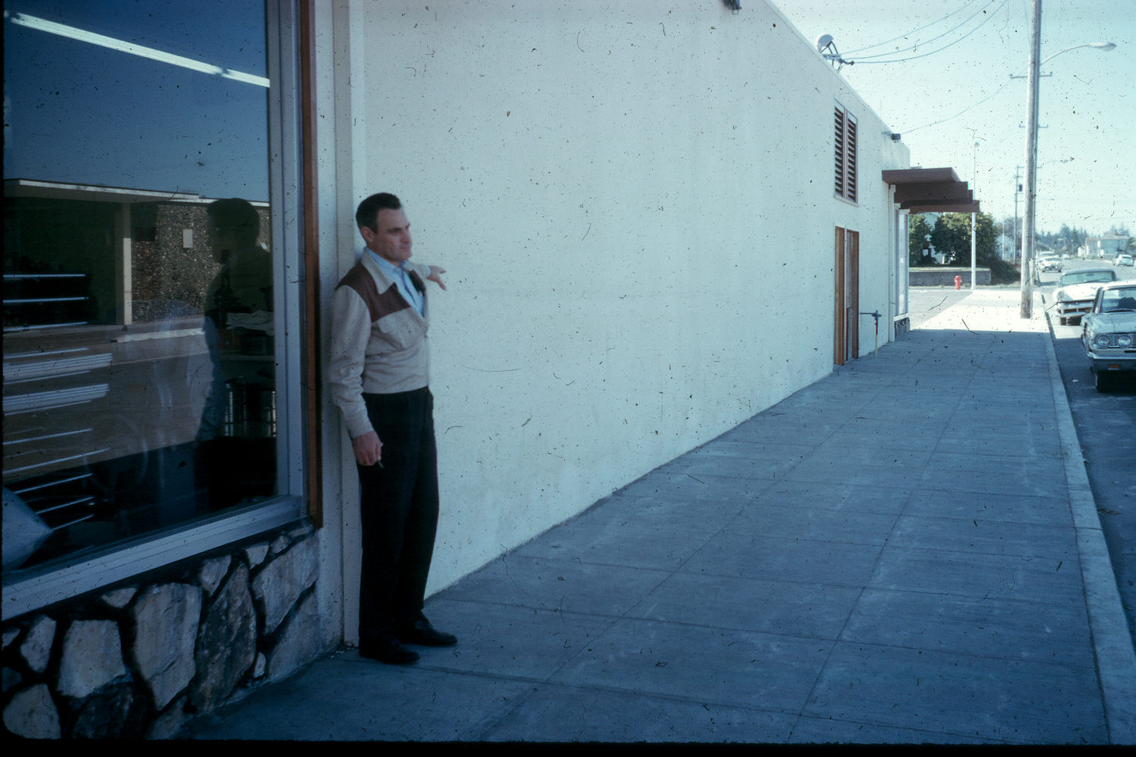

Slide 16
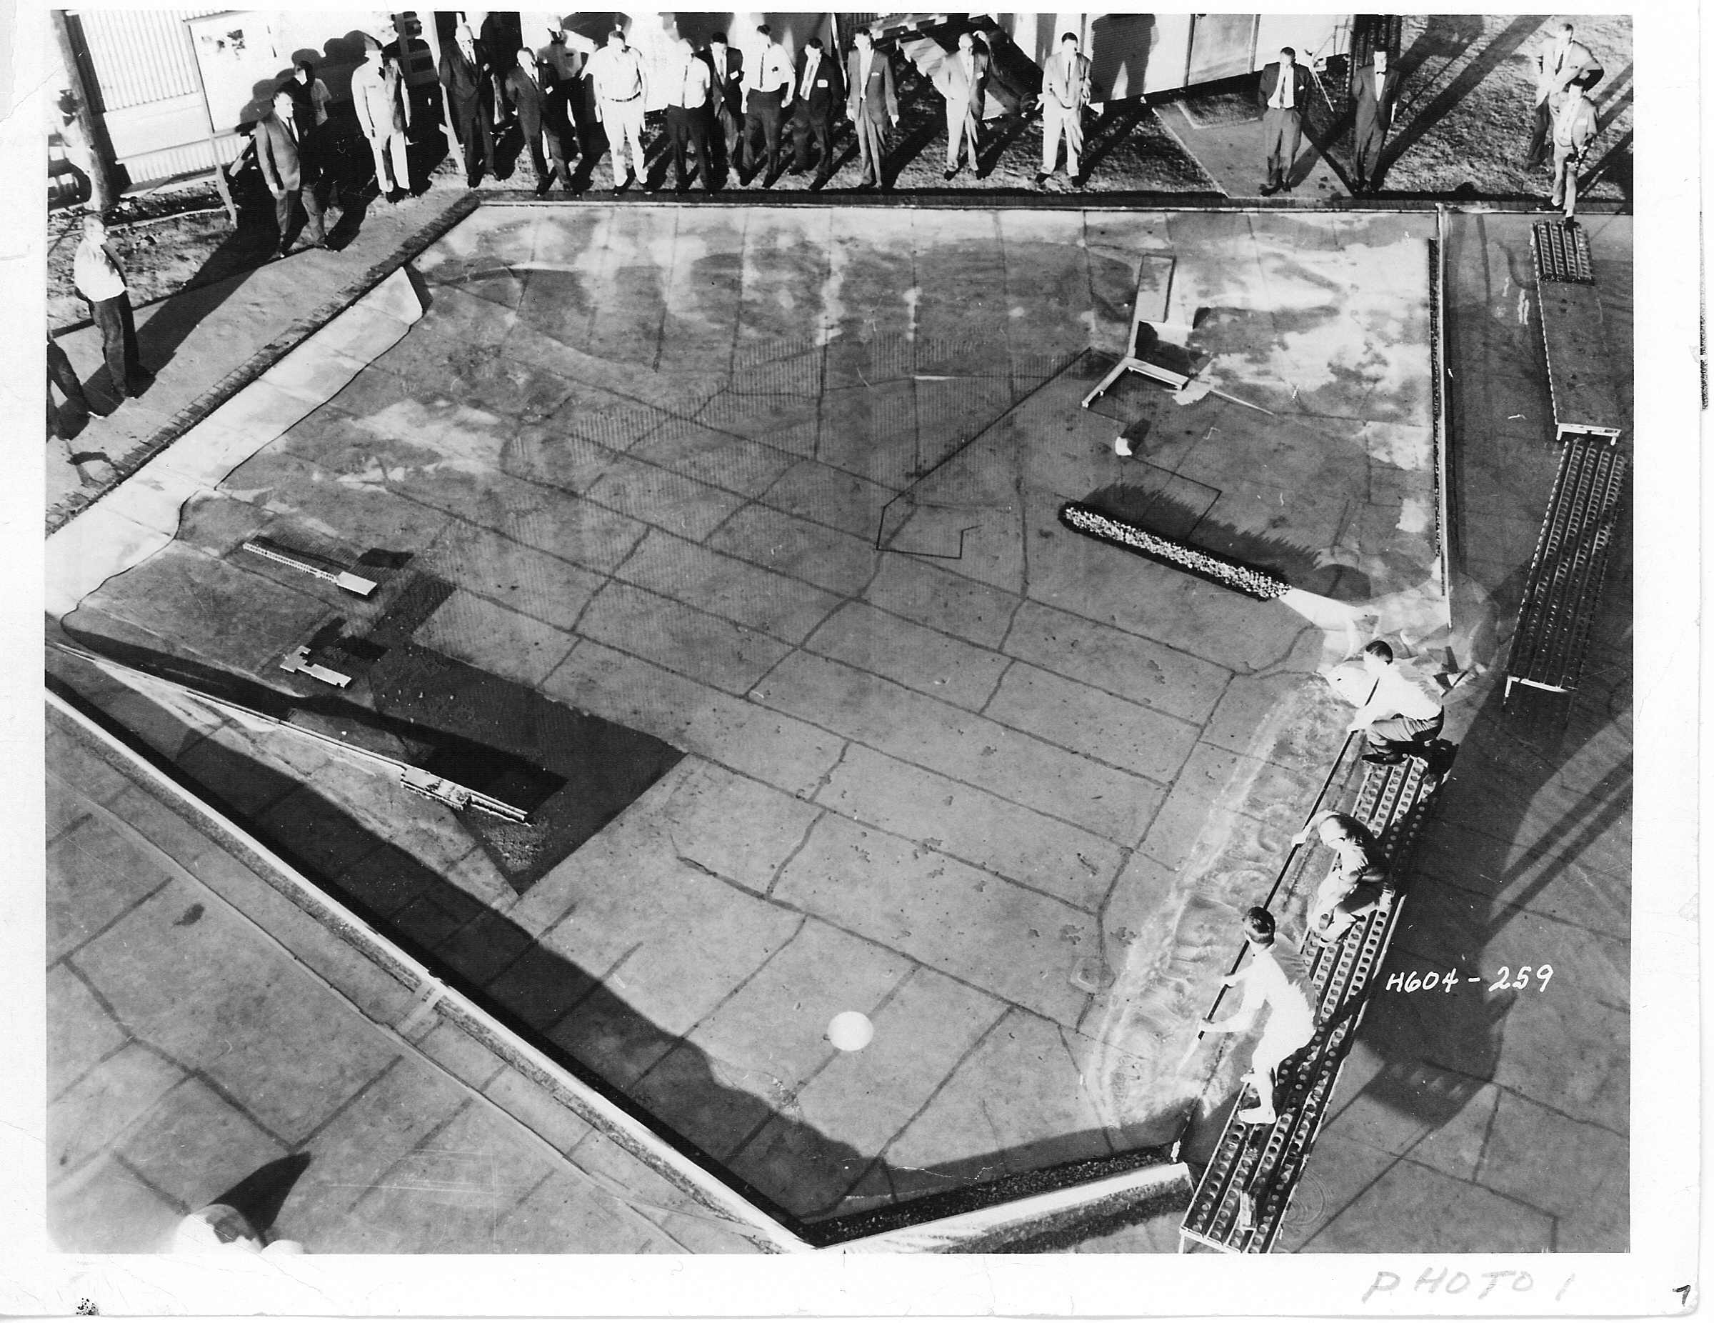

Slide 17
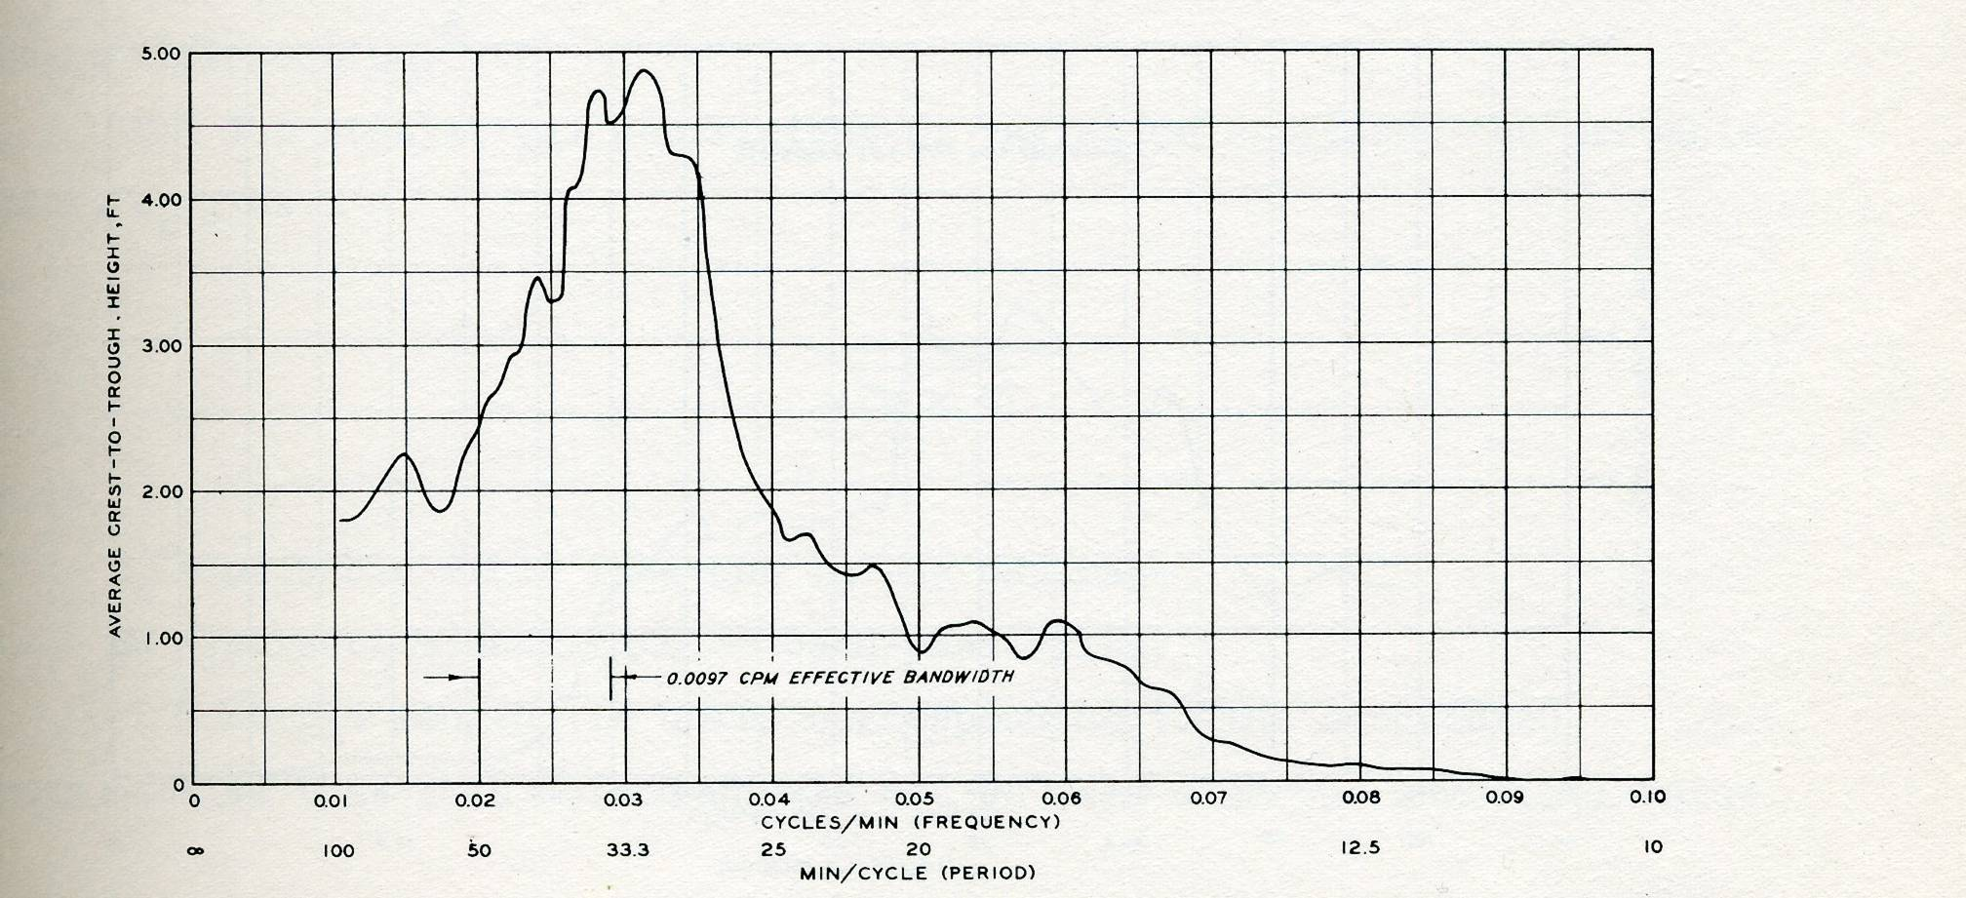
Cresent City, CA
1300-1700 Hrs
23 May 1960
0.0097 CPM Filter

Slide 18
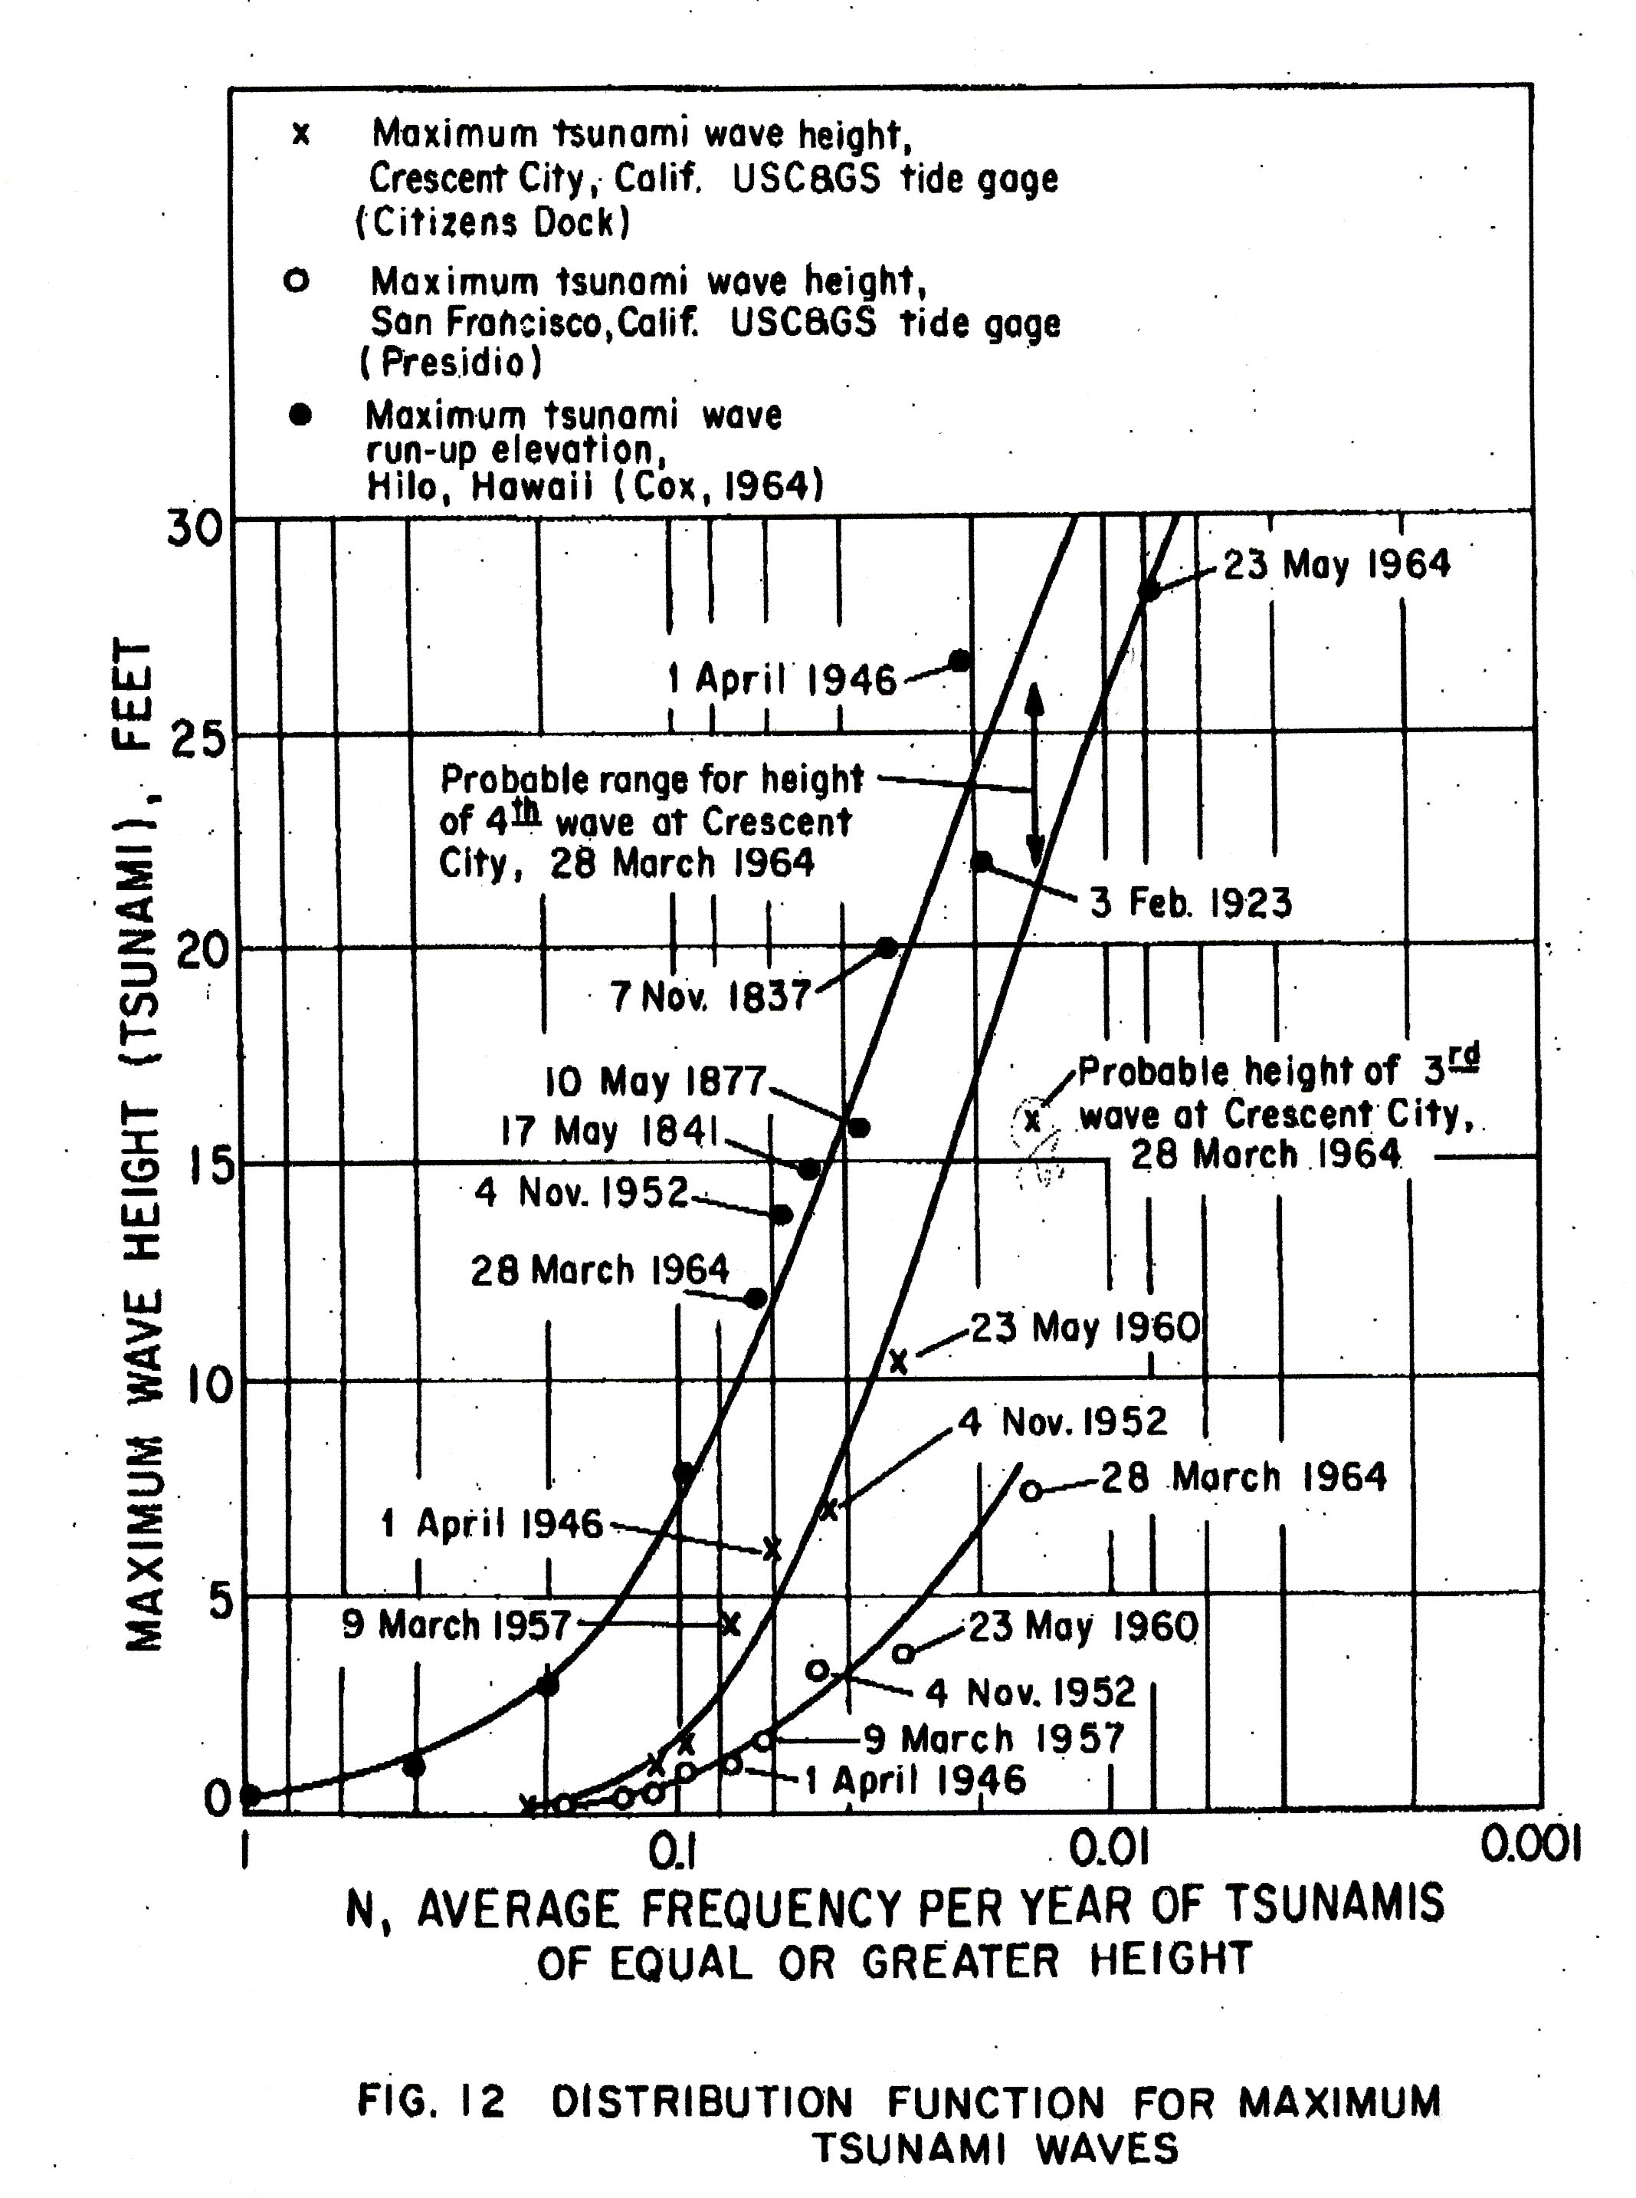

Slide 19
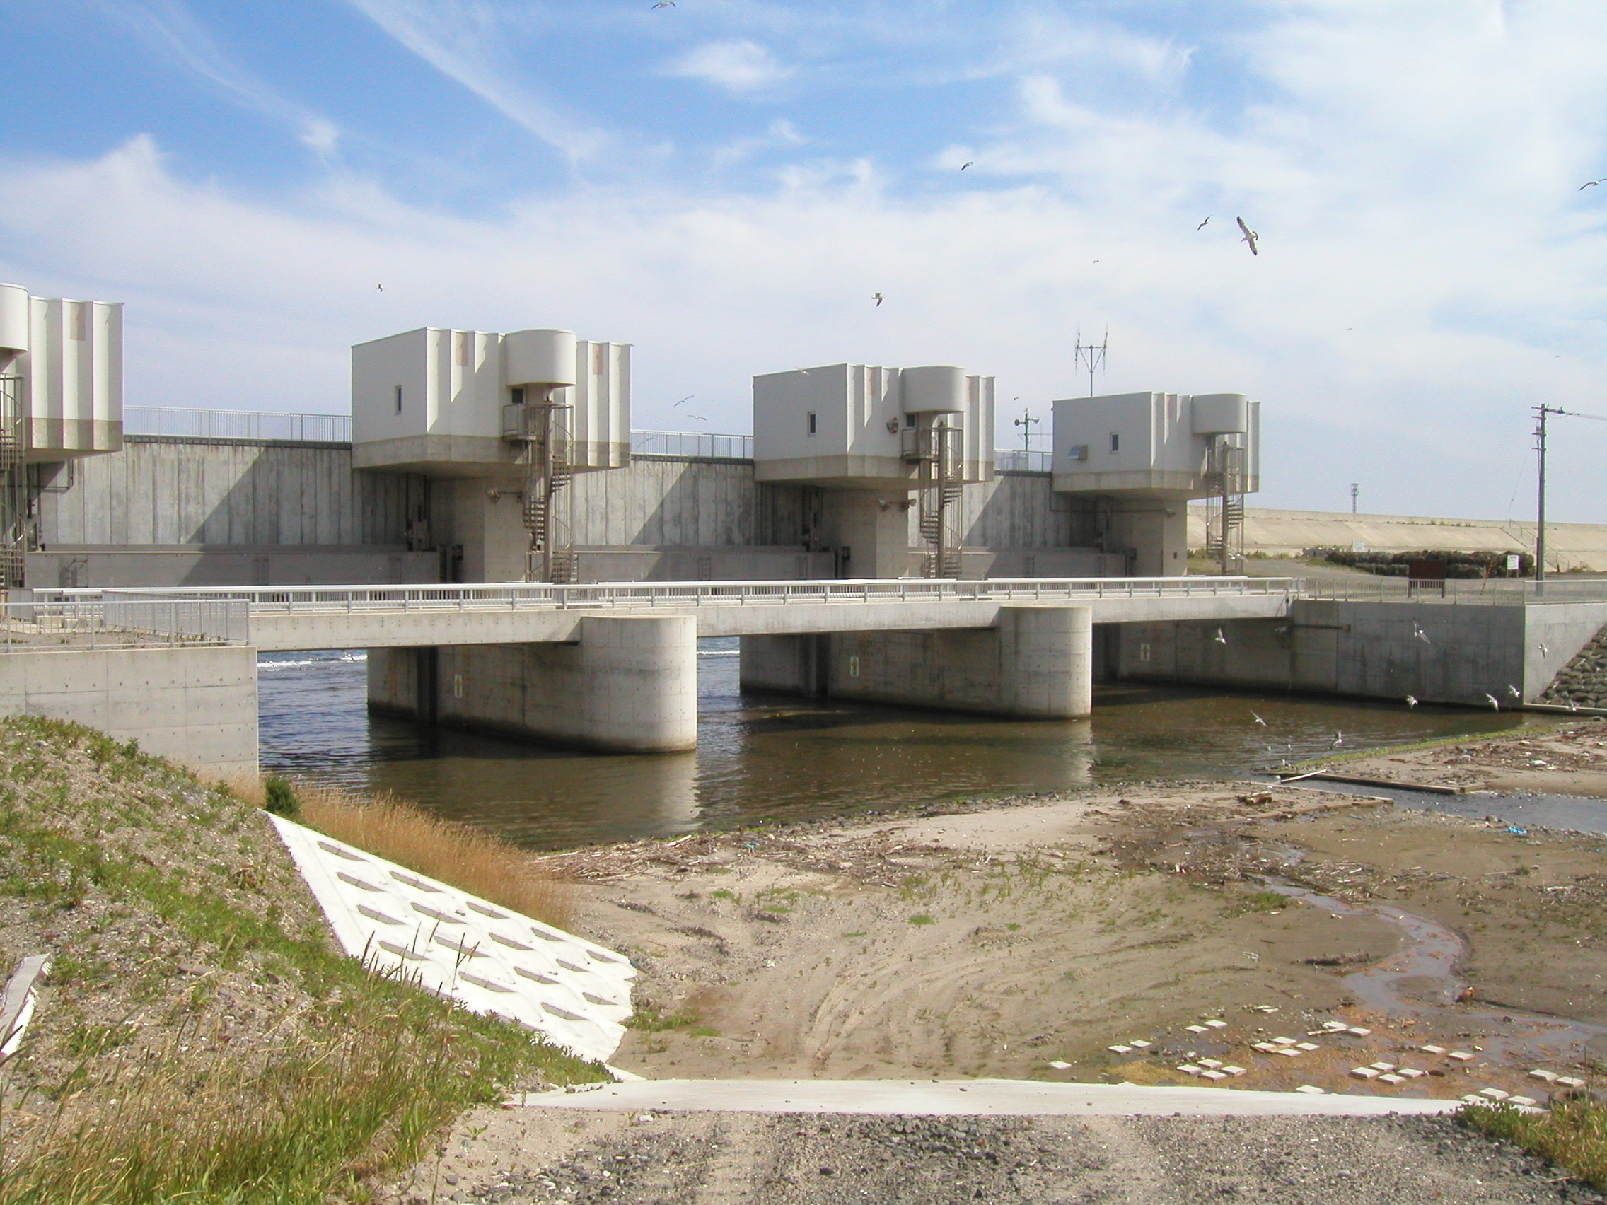
Tsunami Gate Okushiri, Japan
Top of Gate 11.7 m above low water
Gate automatically closes after 4 Mag Earthquake

Slide 20
Research Needs
Historical Review
Cascadia Subduction Zone
Near Field Events
Coastal Resonance
Existing Engineering Model Basins
Oregon State Tsunami Basin
Texas A&M Hydraulic Lab

Slide 21
Research Needs
Structural Engineering Guidance
Coastal Infrastructure
Prototype Reference Long Wave Measurement (i.e. Cresent City, CA)
Economic and Environmental Impacts
Vulnerability Maps
Vulnerability Research and Education
Risk Management Assessment and Communication

