Slide 1
Possible Local Tsunami Sources Impacting California
Michael Reichle and Don Hoirup
California Geological Survey

Slide 2
Historic Tsunamis from distant earthquakes
1946 M8.4s E. Aleutian Is. 3m 1
1952 M9.0 Kamchatka <1m
1957 M9.1 C. Aleutian Is. <1m 2?
1960 M9.5 Chile 3m
1964 M9.2 Alaska 6.3m 14

Slide 3
Some Local
Earthquake Sources

Slide 4
Historic Tsunami from local earthquakes
1812 M7 4?m
1927 M7.0 2m
1930 M5.2 .6m? 1 death
1992 M7.1 1m

Slide 5
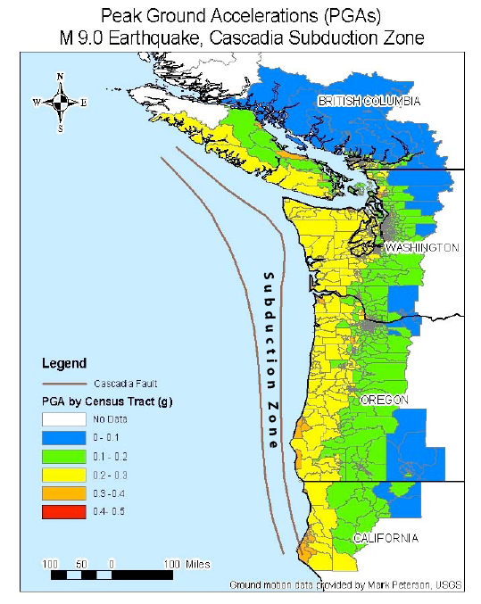
From Cascadia Region Earthquake Workshop

Slide 6
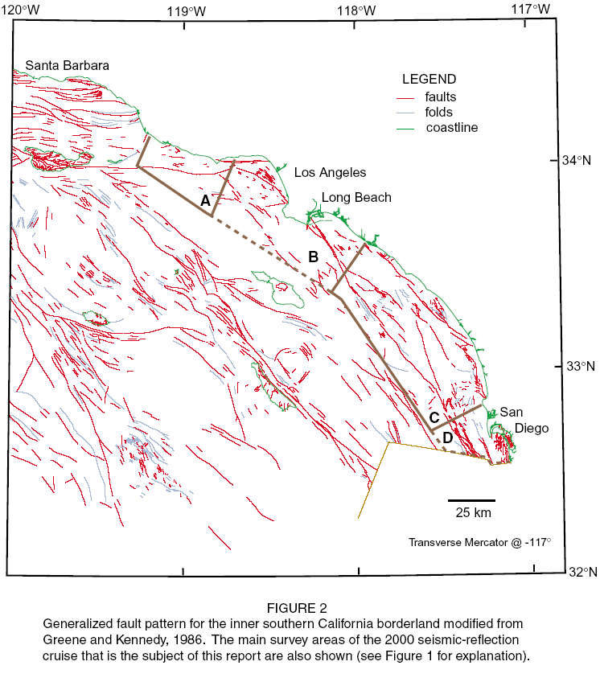

Slide 7
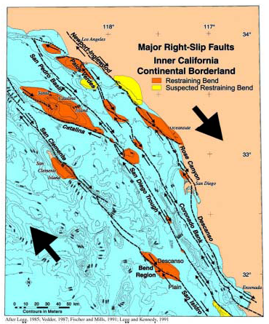

Slide 8
Some Landslide Tsunami Sources

Slide 9
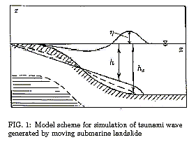
From Lobkovsky, et al. (2002)

Slide 10
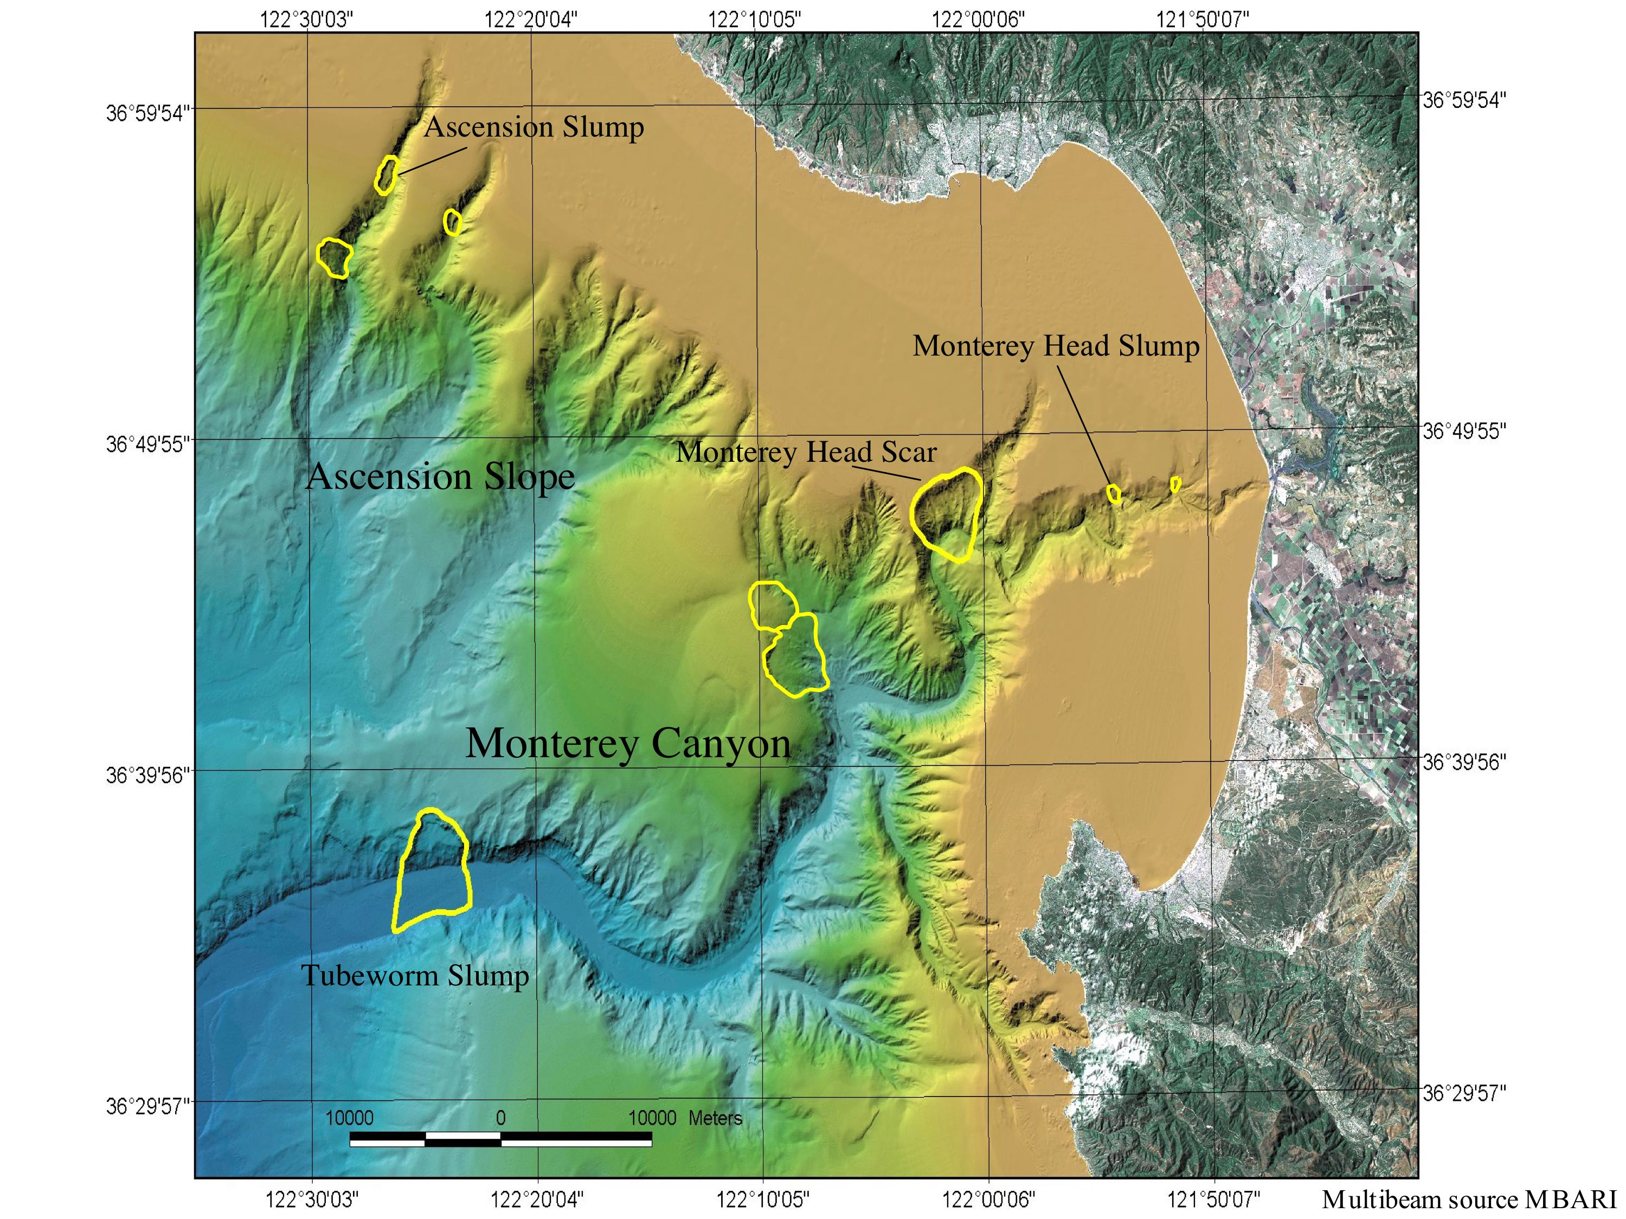

Slide 11
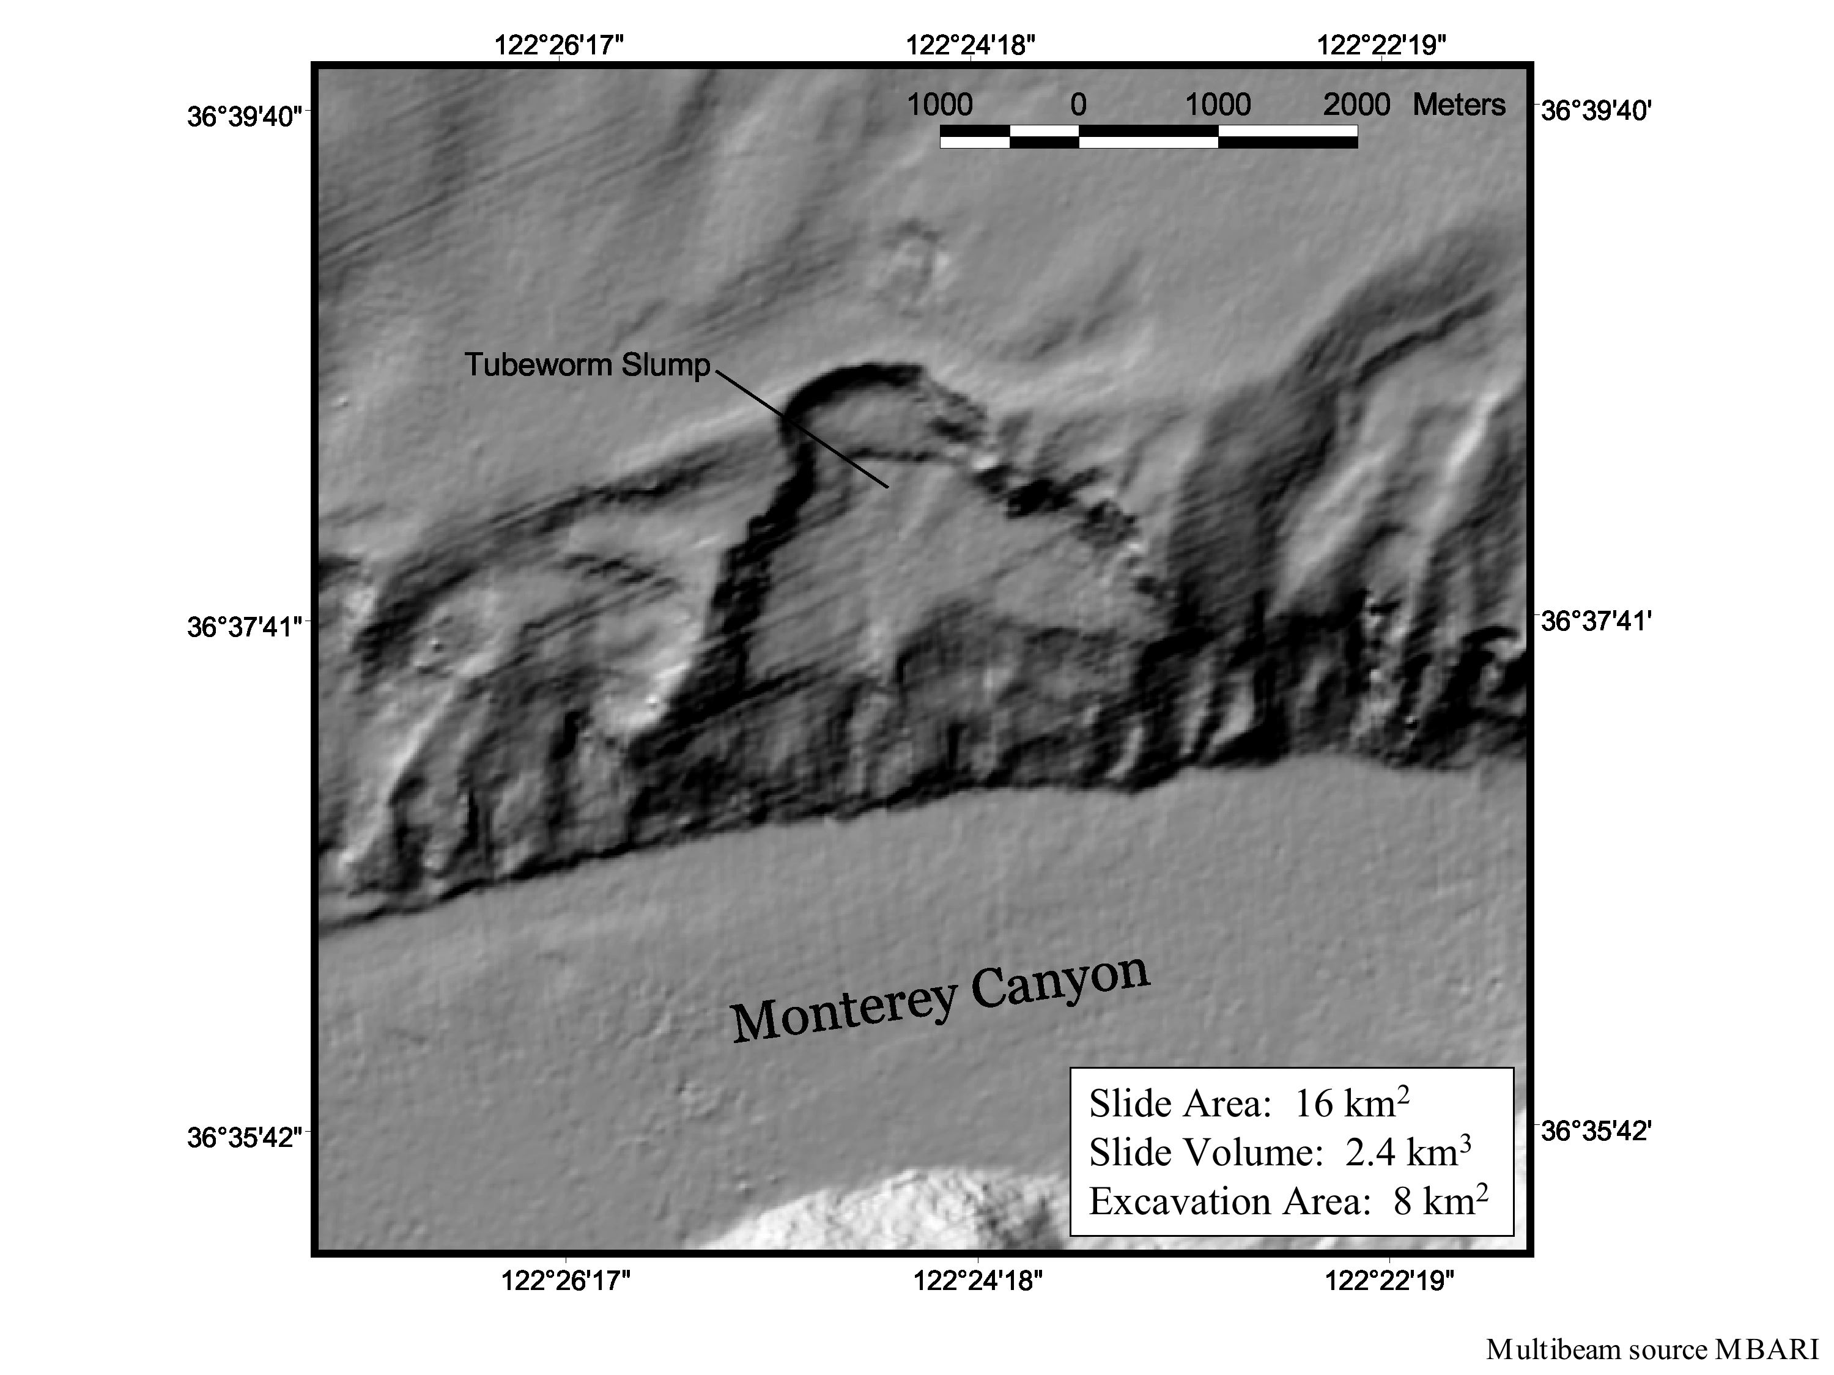

Slide 12
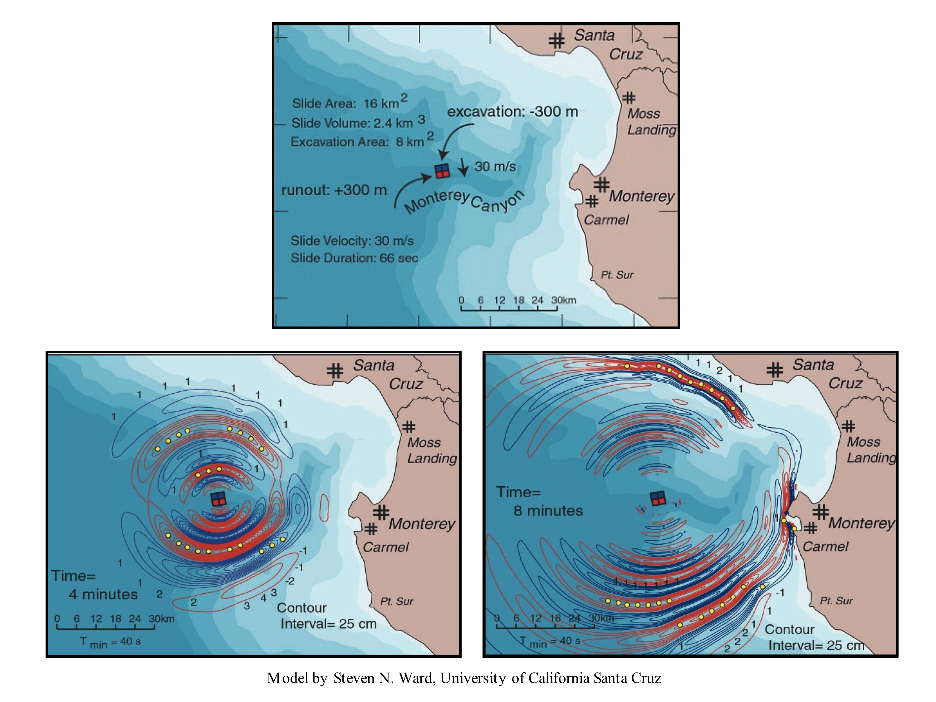

Slide 13
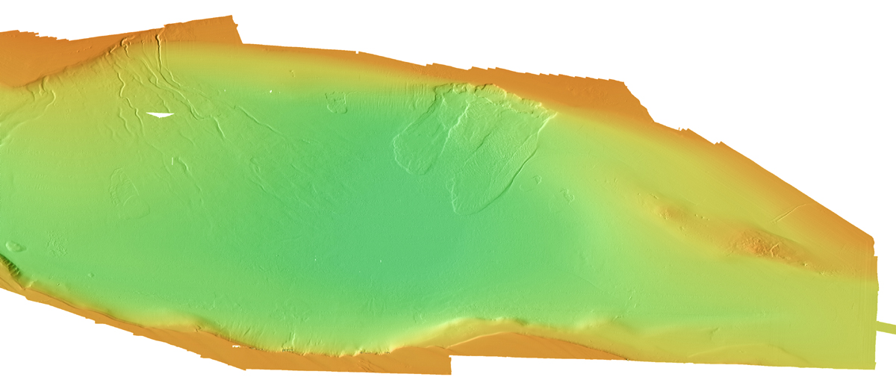

Slide 14
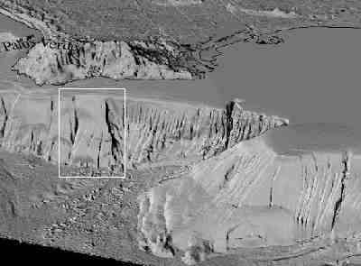

Slide 15
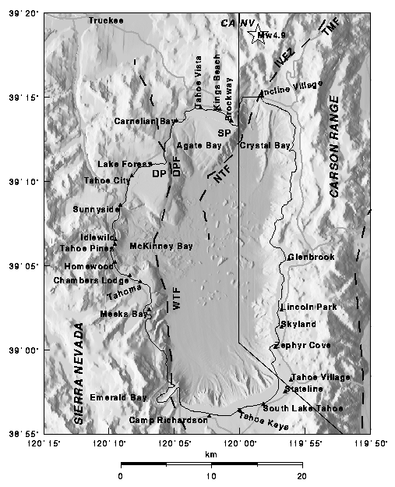

Slide 16
Seismic Hazards Mapping
The State Geologist may include in maps on the potential effects of tsunami and seiche
when information becomes available from other sources
and the State Geologist determines the information is appropriate for use by local government.
The State Geologist shall not be required to provide this information unless additional funding is provided.

