Slide 1
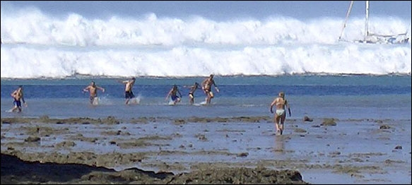
Washington State
Tsunami Program
A Comprehensive Approach
George Crawford
Washington Emergency Management Division

Slide 2
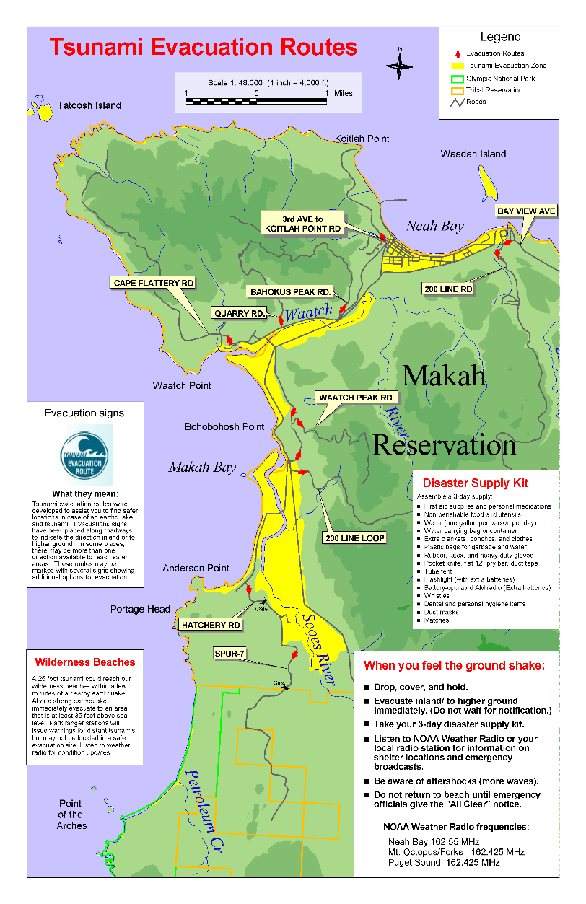

Hazard Identification and Vulnerability
=
“Local tsunami evacuation maps developed based on modeling, tsunami inundation maps and local oral history.”
Notes:
The hazard identification and risk assessment involves identifying the types of hazards, their likelihood of occurrence, location in the community that is most at risk, the impact (strength + size of area affected), and strength (Magnitude, wind velocity, etc).
Using the Hazard Assessment element we can produce hazard identification and risk assessment that can be used by local planning offices in developing various planning documents.

Slide 3
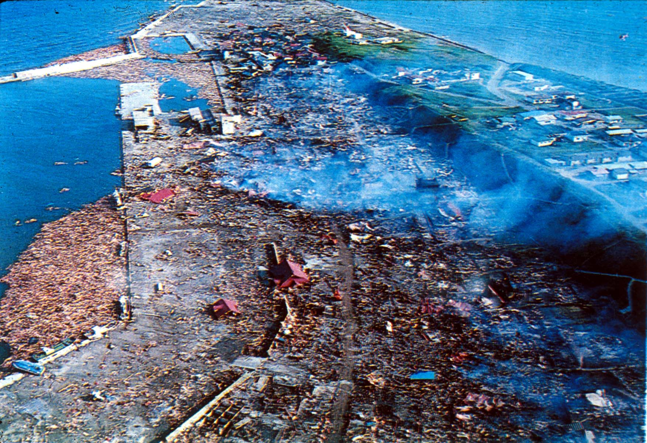
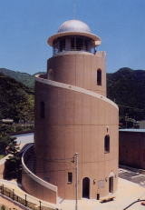
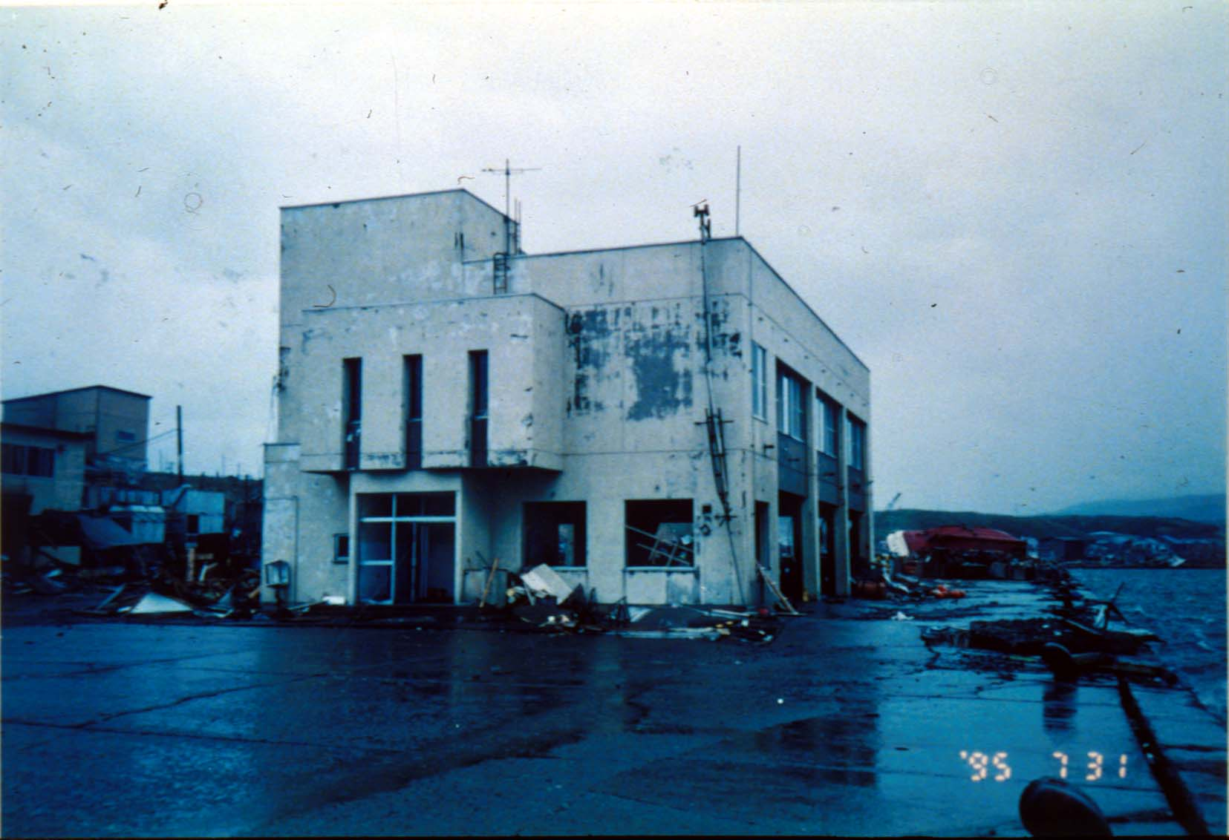
Tsunami Construction Guidance
No high ground
Vertical evacuation
Construction guidance
Nishiki Tower in Mie Prefecture, Japan

Slide 4
Program Based on Comprehensive Approach
Earthquake | Immediate (0 to 30+ minutes) | Organized Response 30 min to 12+ hours
Cascadia mag 9 | Education & Training | Education,Seismic data, Buoy data
Cascadia mag 8+ (away from rupture) | Education, Seismic data, Buoy data (rupture is like mag 9) | Education, Seismic data, Buoy data
Distant (Alaska, Japan, other) | Education, Buoy data | Education, Buoy data
Nisqually-type or crustal | Seismic data, Education | Seismic data, Education

Slide 5



Tsunami Ready Community
Public education cornerstone to success
Risk communications -- key to how people will respond
Exercise and drill response plans
Train on the use of tsunami tools
Social science must be part of the tsunami ready process

Slide 6
Challenge
Maintaining awareness and preparedness through Public Education

Slide 7
Tsunami Ready Community
Engaging business community save lives
Tourist must be aware of tsunami issues and evacuation procedures
Educate and train business on tsunami contingency planning and train staff on what to do for a tsunami

Slide 8

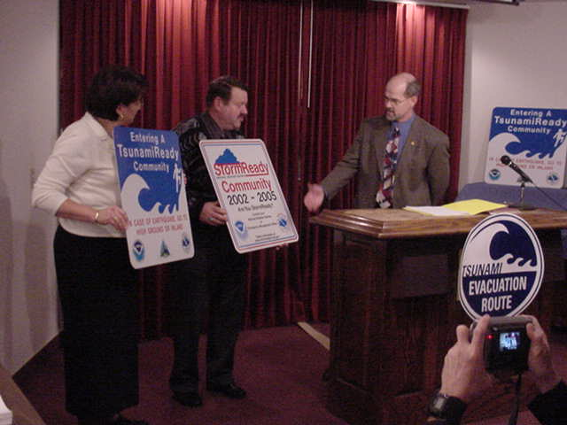
Tsunami Ready Community
Community buy-in has to take place to have a successful Tsunami Ready Program
Apply Growth Management principles to reduce impact of a Tsunami on lives and infrastructure

Slide 9
Tsunami Ready Community
Integrated on-shore communications infrastructure must be in place to get the message to the public
Communication infrastructures to support alert and notification system need to be in place to make these system effective and reliable
An indoor alert and notification system for public facilities, homes and businesses will facilitate warning and evacuation
An outdoor alert and notification system for tsunami communities to warn the public on beaches or high traffic areas

Slide 10
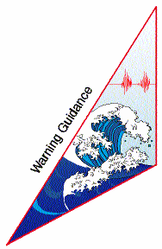
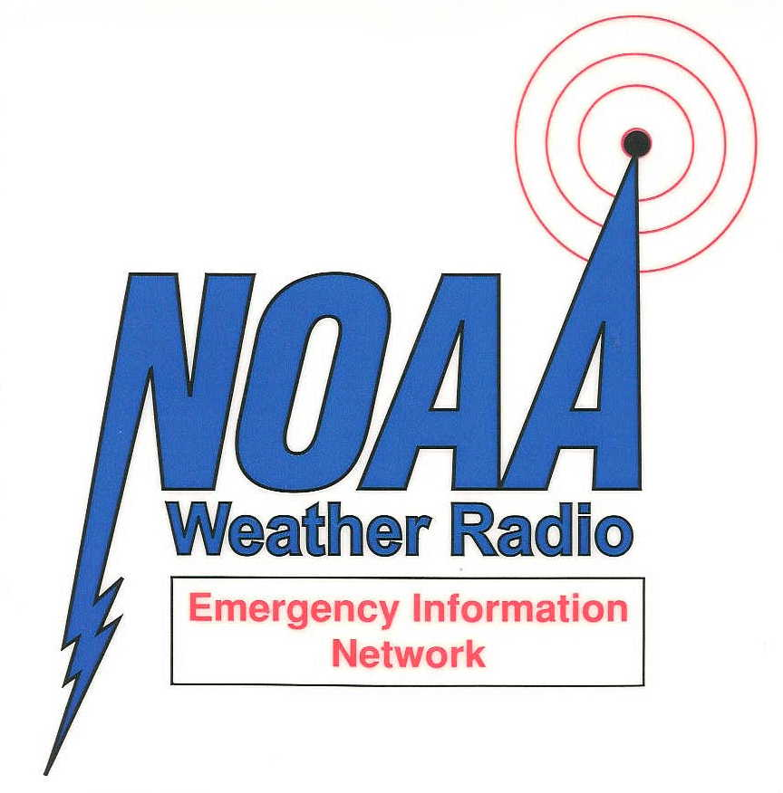
Integrated on-shore communications infrastructure
=

Slide 11
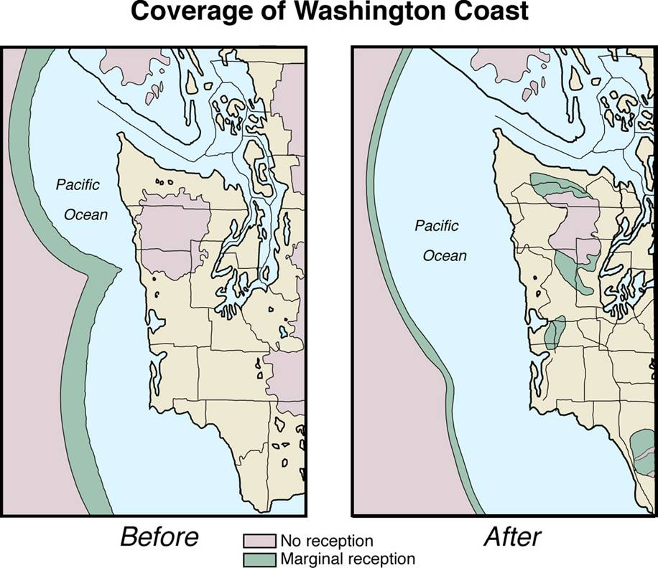
Mount Octopus NOAA Weather Radio Transmitter Site Project

Slide 12
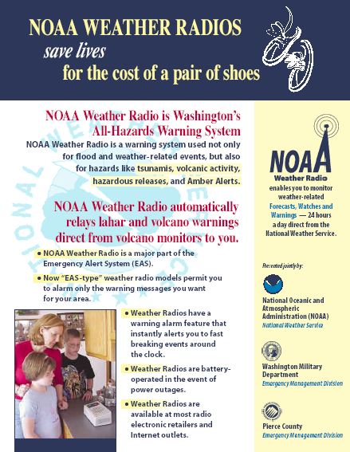
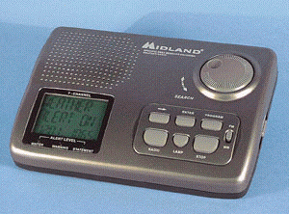
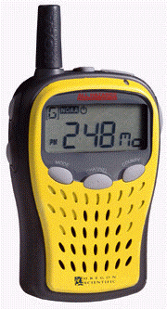
NOAA Weather Radio

Slide 13
All Hazard Alert Broadcasting (AHAB) Radio
Washington Emergency Management and Federal Signal Partnership
Withstands gale-force winds and salt corrosion with little to no maintenance
Battery operated. Charged by:
Electrical
Wind
Solar
Installed July 2, 2003
Ocean Shores
Notes:
The system was designed and developed in partnership with the EQ Program, Telecommunications Section, and Federal Signal
Prototype installed in Ocean Shores – the first TsunamiReady Community in the Nation
Prior to this system we had to depend on local response to get message out via police or fire (Many communities have volunteer fire departments which means you add time for them to respond).
During the kurl Island event we used helicopters to drop sand bags with notes to warn people to get to high ground.

Slide 14
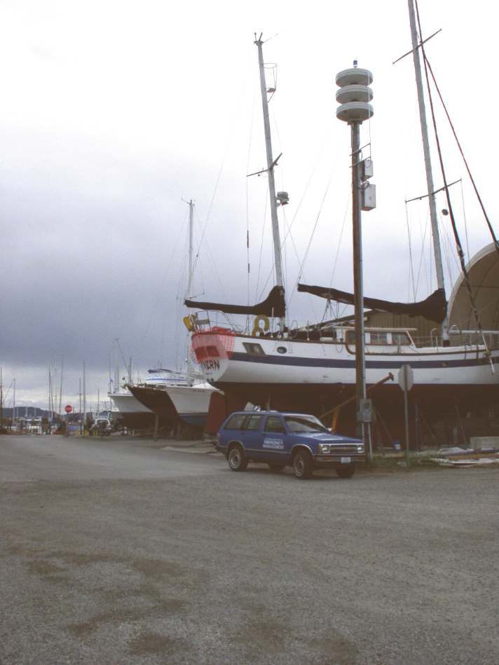
AHAB Radio
Modulator siren – 360 Degree
An intense blue light activated to further indicate that the area is under a hazardous situation
Can be activated via:
National authorities
State/local emergency management
Other communication protocols
Installed Oct 30, 2003
Port of Port Townsend
Notes:
The modulator siren produces 360° coverage and the best voice reproduction of any omni-directional siren
The light remains lit for the duration of the alert and notification (EAS messages require a defined time period for the event)
System can be activated by NWS when a NWS message has an event code (Example: NWS Tsunami Warning Message) and location code of the AHAB Radio System
Local Emergency Managers may activate the EAS system via local EAS Encoders. Each AHAB Radio Device has an EAS/SAME decoder interfaced into the speaker system and monitors the local NWR frequency for valid EAS messages. Once a valid message is received, the encoder activates the alert tone and then passes the alert audio over the speaker system. Each system has a location code – with that location code in the message, it will activate that specific system
Local emergency managers can monitor and control the AHAB Radio via a Graphic Users Interface on a local radio frequency. The system allows for direct activation for non-hazard events, or in the event local officials determine the need to provide additional alerts or messages to select locations. It can be activated for example by a police vehicle or fire engine who have the interface with the system

Slide 15
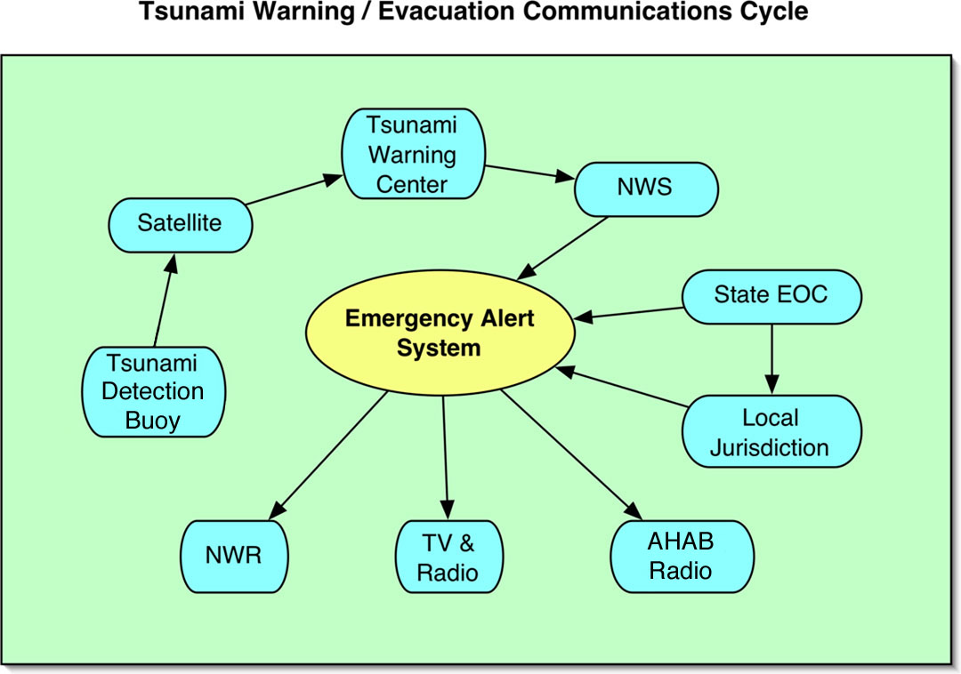
Notes:
The tsunami warning/evacuation communication cycle shows how the integration of the NWR Emergency Information Network works
Tsunami detectors send data via satellite to the Tsunami Warning Centers –In turn, a message is generated via the NOAA Weather Wire Service to NWS offices and State EOCs – Message is then sent by EAS to NWRs that are in for example: critical facilities, businesses, homes , TV and Radio and to AHAB Radio on beach heads and high traffic areas to warn of a pending hazard. Through NWR, EAS and AHAB Radio, highest dissemination of a warning can be obtained rapidly and effectively

Slide 16
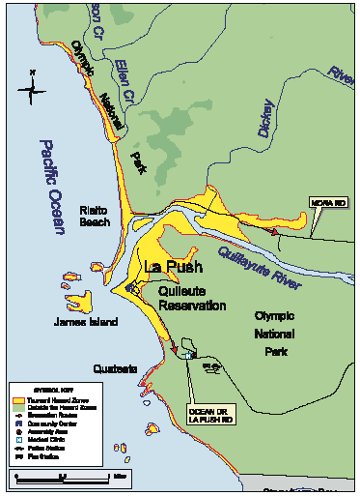
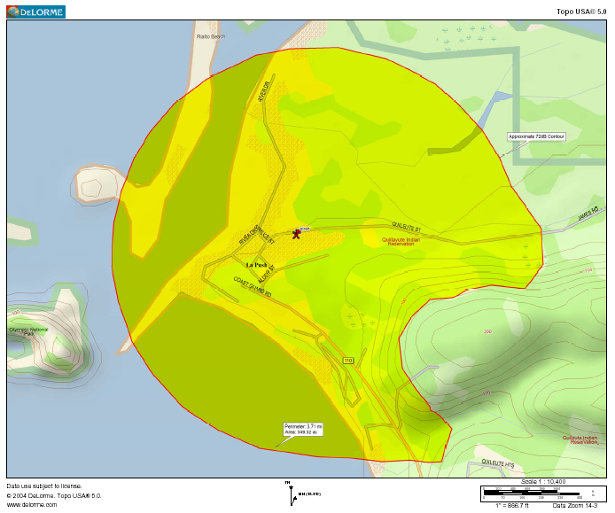
Process for Developing Coverage Area
Coverage Area Map
Evacuation Map

Slide 17
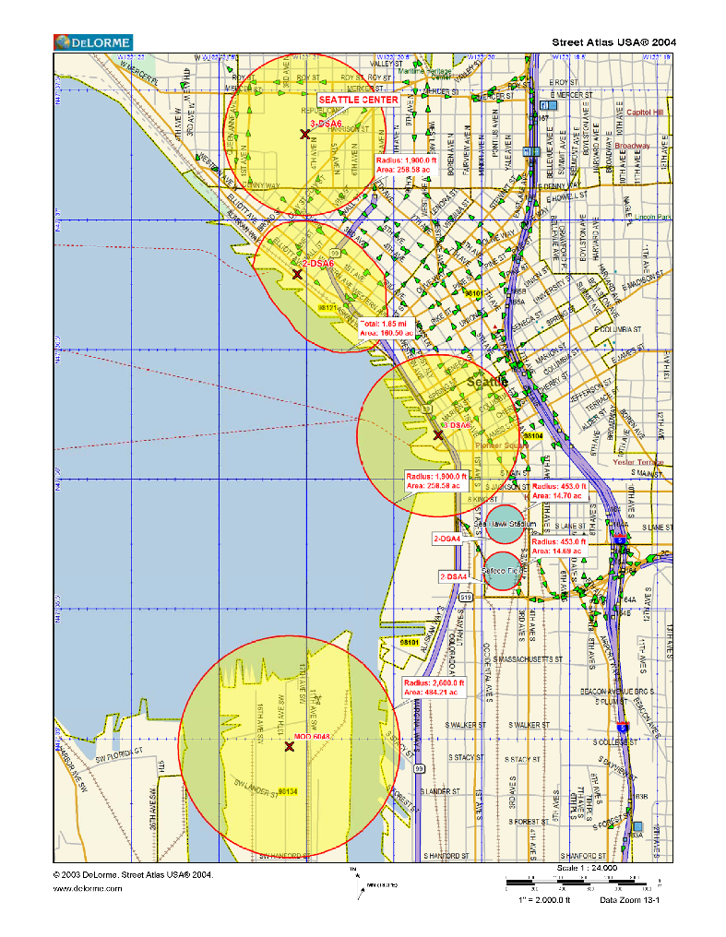
Results
Provide rapid and effective warning to areas of high risk to both man-made and natural hazards
Take advantage of several funding programs to merge several technologies
Take advantage of existing communication protocols
Take advantage of voice messaging technology and local activation of AHAB Radio
2004 National Earthquake Conference Award of Excellence – Category: Response
Seattle AHAB Radio Project uses seismic instruments, cameras, a weather station, and chemical detectors
Notes:
Seattle presently does not have an outdoor warning system – This system allows the city to make real-time guidance to those citizens and businesses in effected tsunami inundation zones. The zones include high traffic areas, a major international port facility and two stadiums
Seattle is using grant funding available under the National Tsunami Hazard Mitigation Program and those available by DHS/ODP to cover critical infrastructure in the tsunami inundation zone with the newly developed AHAB Radio System. The system will act as a platform to house potentially environmental monitors, video cameras and other associated equipment/sensors that deal with homeland security issues
AHAB Radio is very flexible on its use, it gives the emergency management and response communities capabilities on providing rapid real-time alert and notification for any hazard that they face
The system provides voice messaging versus siren modulation that allows system initiators to provide effective guidance to the at-risk areas. The system allows local activation by on-site response personnel or from a distant authorized local source – it’s an effective way to get the guidance out without putting the responder in arms way
SHOW KING 5 DVD

Slide 18



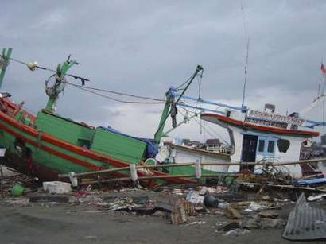

No Overnight Solutions Accept and Embrace Generational Lessons
“Become the change you want to see in the world”

