Slide 1
Near-Field Tsunamis in the POLA and the POLB
Generated from Near-Shore Faults (M. Legg)
Generated from Subaerial and Submarine Landslides (Synolakis, Borrero, Watts)
    Large scale near-shore slumps
    Failure of sediment in submarine canyons

Slide 2
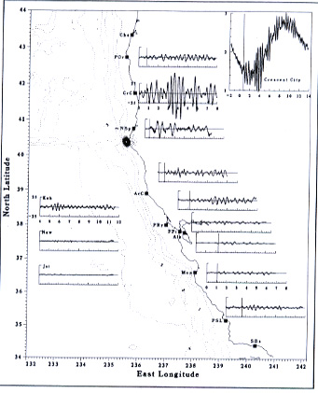
Local Tide Gage Records from the 1992 Cape Mendocino Earthquake and Tsunami

Slide 3
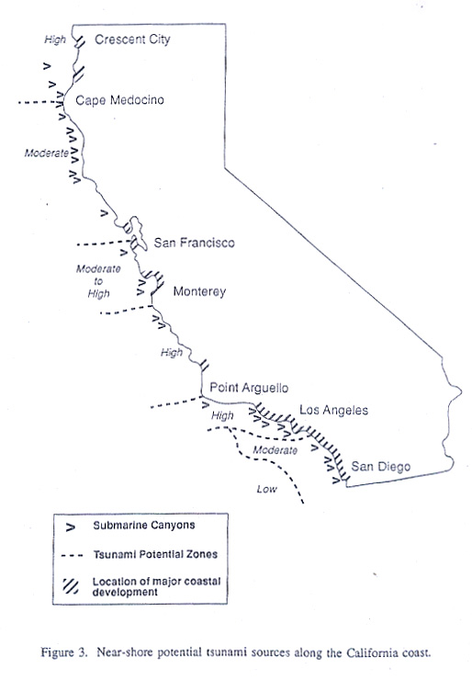
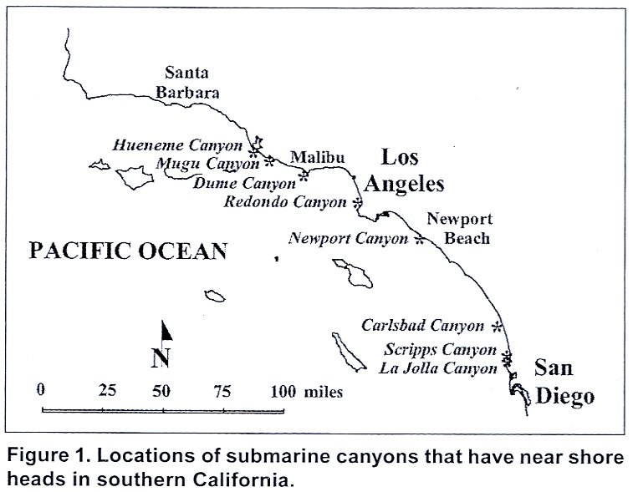
Nearshore Canyons Along the California Coast as Potential Tsunami Sources

Slide 4
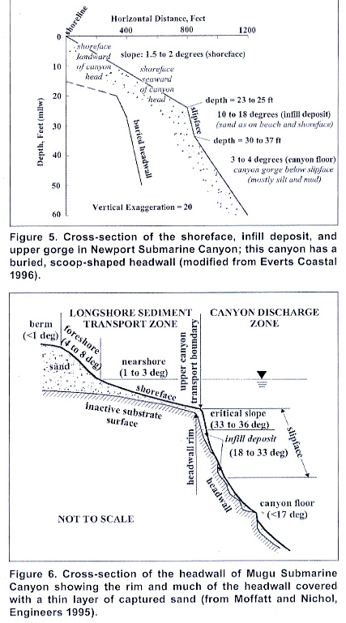
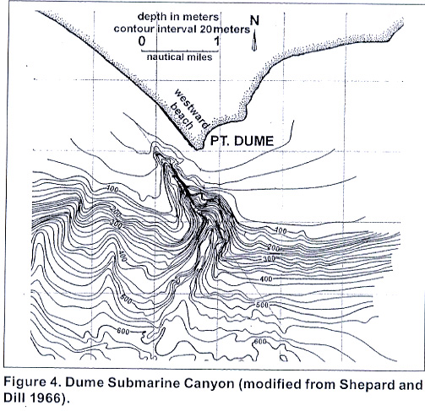
Pt. Dume Submarine Canyon and Cross-Section of Sediment Deposits in Two California Canyons

Slide 5
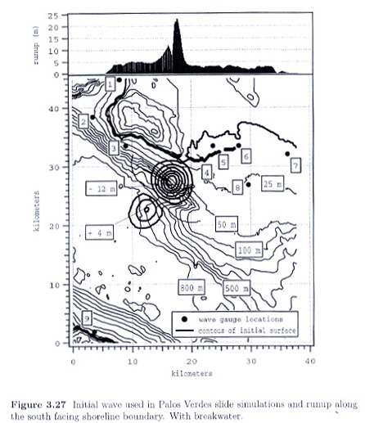
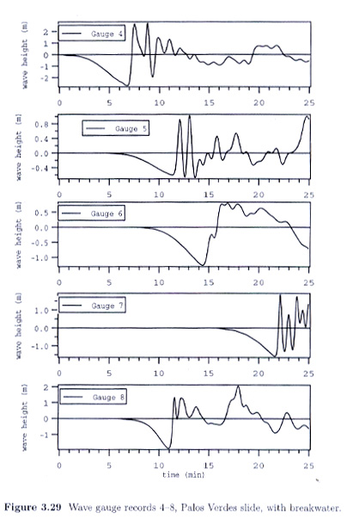
Waves Obtained in POLA/POLB from Numerical Model of Submarine Landslide (Slump)
(After Borrero, J.C. 2002)

Slide 6
Some Laboratory Studies of Landslide Generated Waves

Slide 7
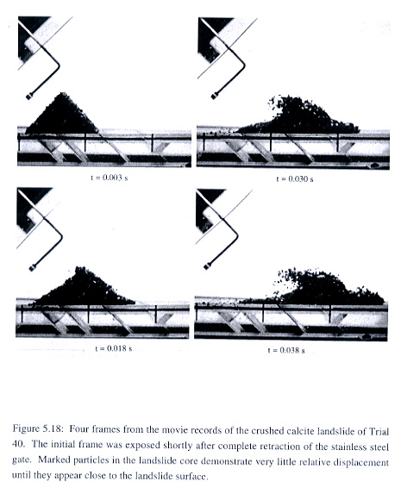
A Laboratory Experiment of Offshore Waves Generated by Submarine Landslides
Experiments conducted to investigate offshore generated waves from underwater landslides. Note: generally undeformed slide in the initial wave generating phase (after Watts, P.)

Slide 8
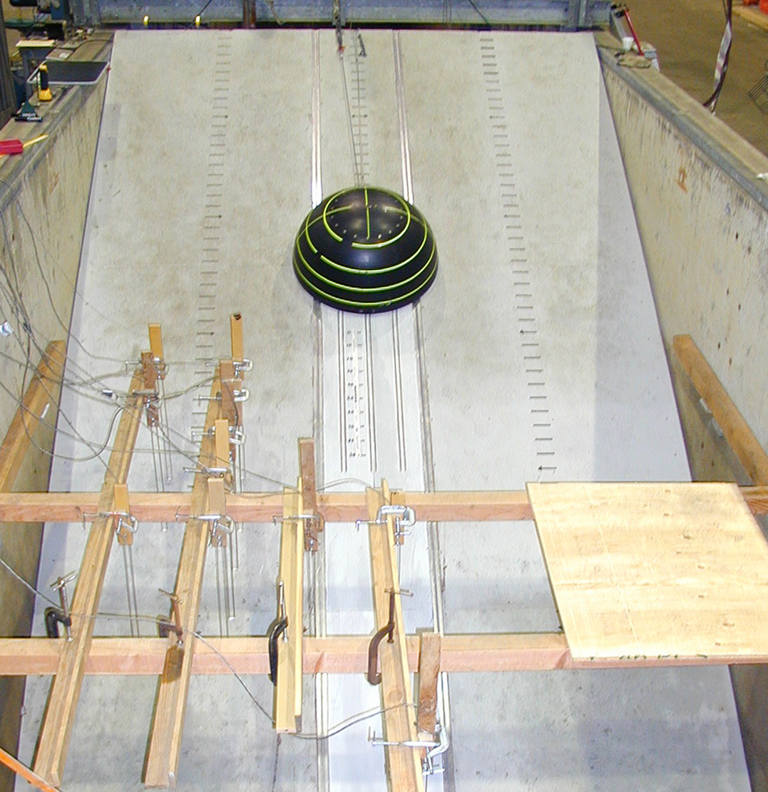
Experiment of the Run-Up Generated by Subaerial and Submarine Solid Body Slides
Shows a hemisphere (D = 3 ft) before release in a 300 ft long, 12 ft wide wave tank at Oregon State Univ. (after Raichlen, 2005)

Slide 9
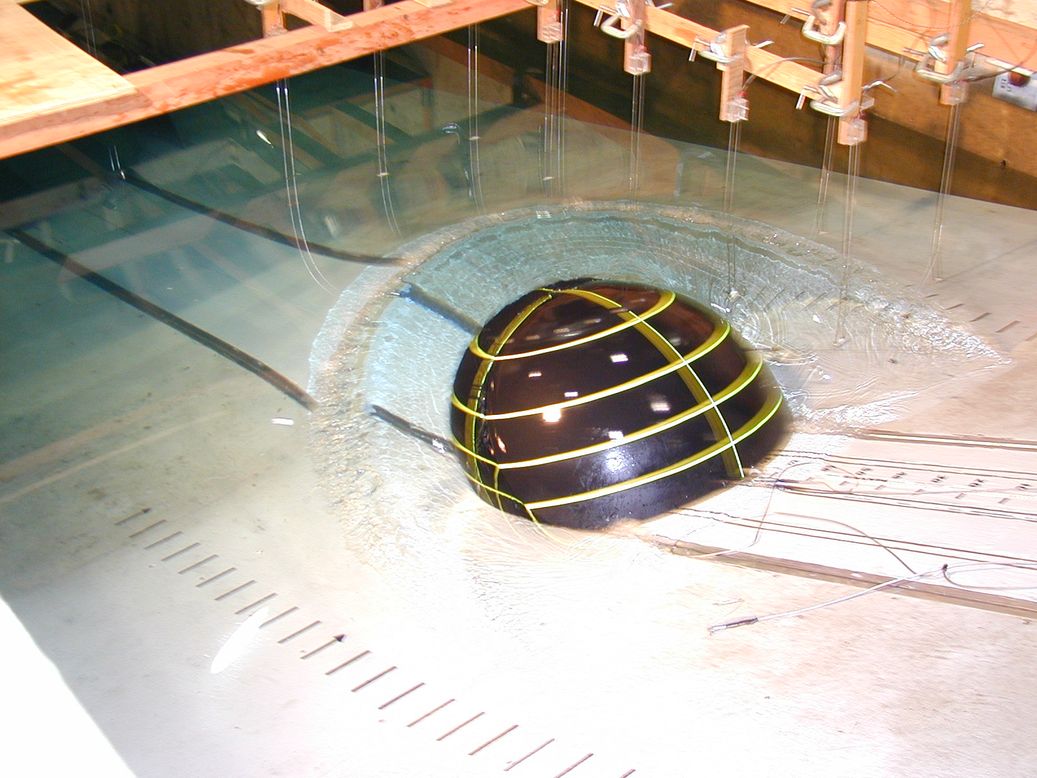
Experiment of the Run-Up Generated by Subaerial and Submarine Solid Body Slides
Waves generated in an offshore direction by the hemisphere.

Slide 10
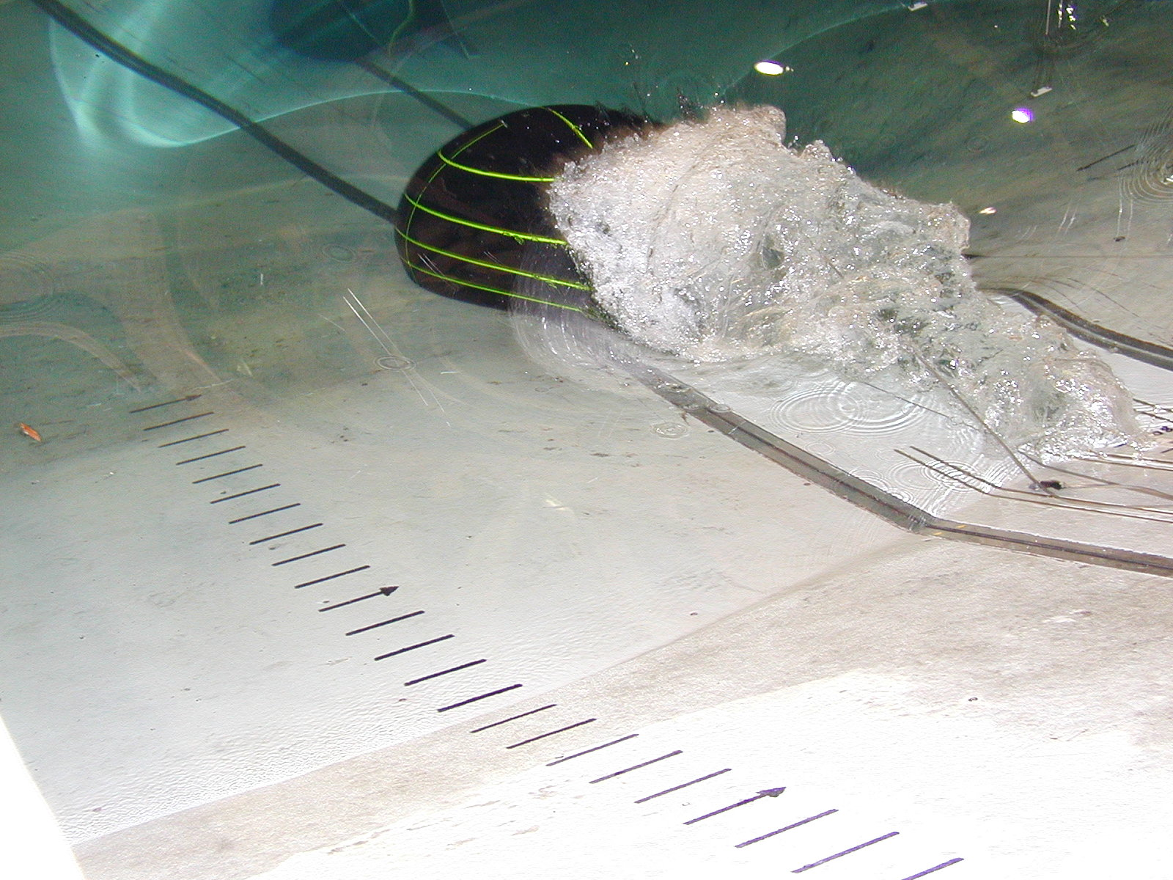
Experiment of the Run-Up Generated by Subaerial and Submarine Solid Body Slides
The “plume” in the lee of the hemisphere which generates the run-up.

Slide 11
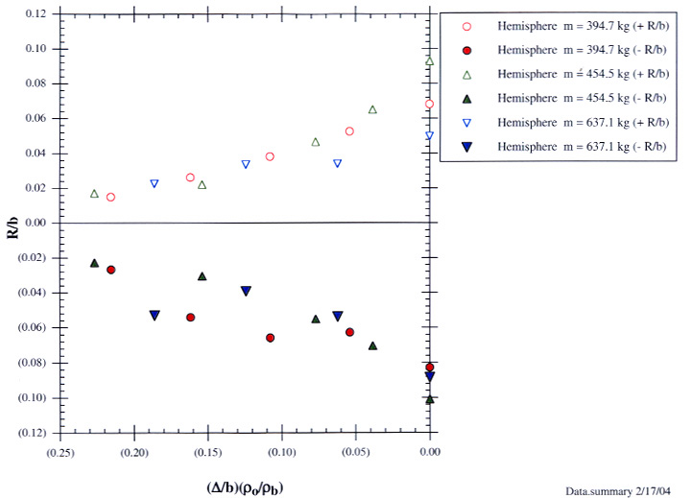

Slide 12
Some Final Thoughts for Southern California (POLA/POLB)
Tsunamis from far-field earthquakes in southern California lead to longer period oscillations compared to near-field events. This appears due to the excitation of the offshore waters and the extent of the shelf.
Forces on ships may depend on period content of excitation -- static vs. dynamic.
Velocities may be important in back channels (marina)
Local erosion problems may occur due to velocities.
Overtopping of wharfs and shoreward inundation.
Generation of debris and the impact of the waterborne debris on other structures.

