Slide 1
Tsunamis in the POLA and POLB and Some Considerations of Landslide Generated Waves
Fred Raichlen
Professor of Civil Engineering and Mechanical Engineering, Emeritus
California Institute of Technology

Slide 2
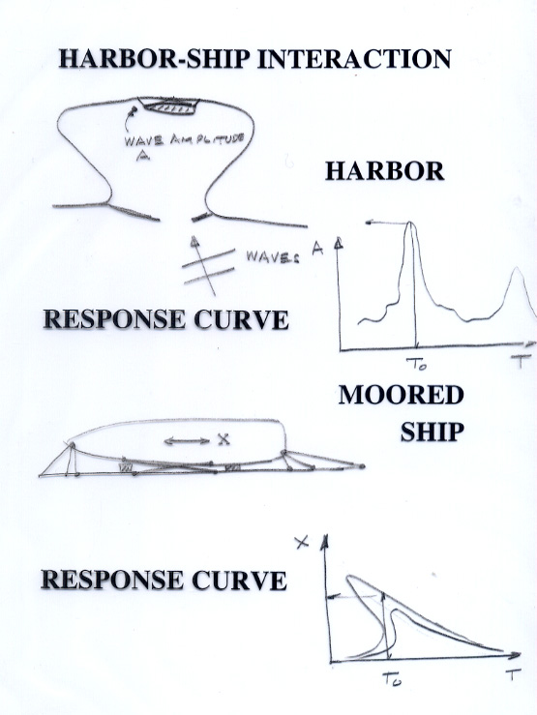
Harbor - Ship - Wave Interaction
Generally the problem is not simply the interaction of waves with the harbor, but the interaction of the moored ships with the wave induced harbor oscillations.
For tsunamis, in addition to the direct impact on moored ships there is the effect of the waves on the land-side facilities

Slide 3
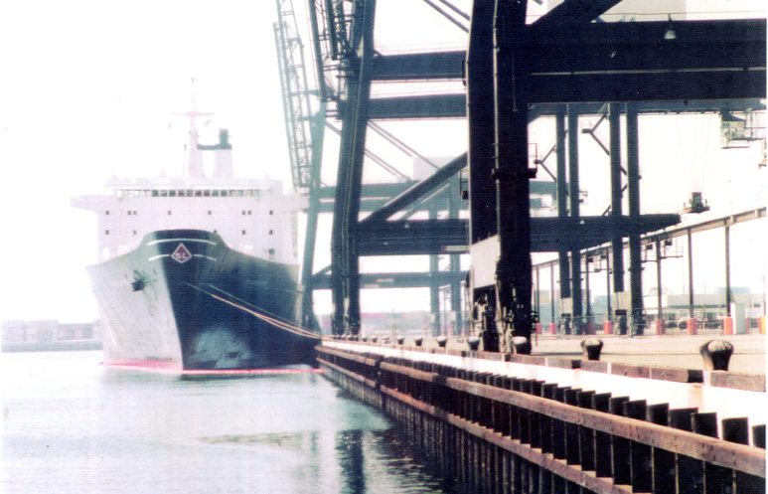
Container Ship Mooring in the POLB
Sealand Terminal 1970
Note ship size relative to mooring.
Note the massive gantry crane.

Slide 4
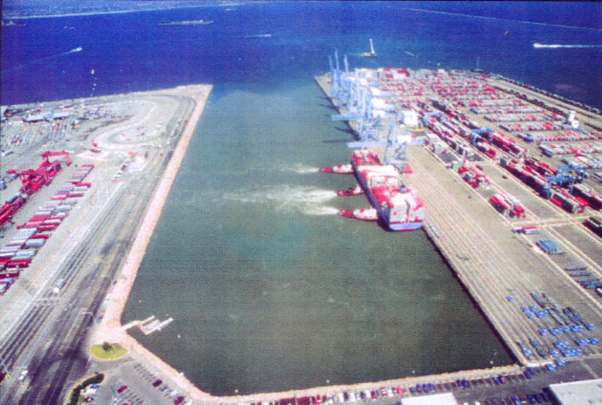
Pier J : the POLB
Note three tugs holding ship to wharf.
1995

Slide 5
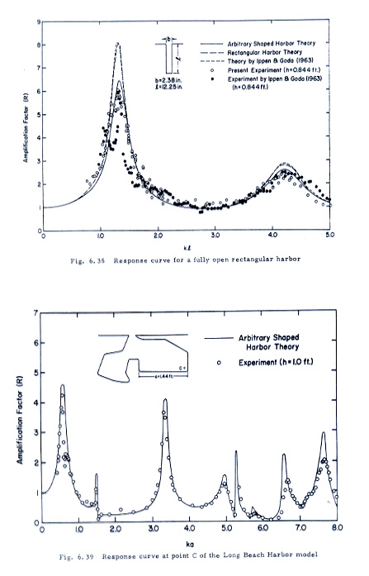
Wave Induced Oscillations in Harbors
Response of a rectangular harbor (after Ippen & Goda, Lee, J.J.)
Response of Simplified Navy Basin at the POLB (after Lee, J.J.)

Slide 6
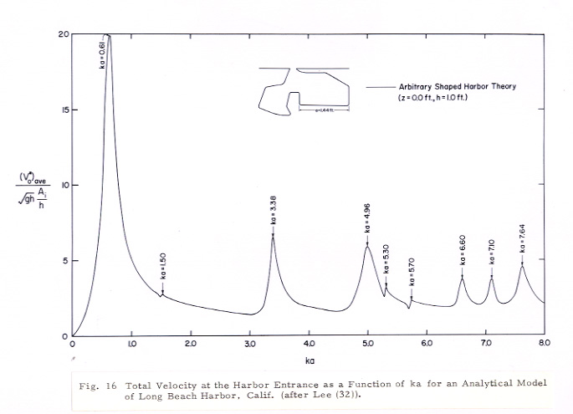
Velocity Response at the Navy Basin Harbor Entrance at the POLB
With respect to mooring considerations, to resist either far-field or near-field generated tsunamis the velocity and/or the velocity response is important.
(after J.J. Lee)

Slide 7
Tsunami Sources for the POLA and the POLB
    Tsunamis Generated in the Far-Field
    Tsunamis Generated in the Near-Field

Slide 8
Far-Field Tsunamis in the POLA and the POLB
1946 Aleutian Tsunami
1960 Chilean Tsunami
1964 Alaskan Tsunami
(after Wilson, B.W., Raichlen, F.)

Slide 9
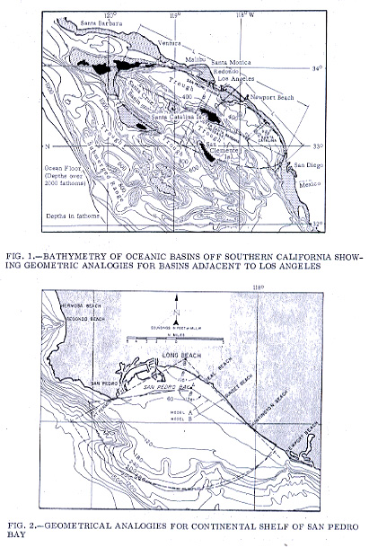
Southern California Bathymetry
California Bight
Continental Shelf of San Pedro Bay

Slide 10
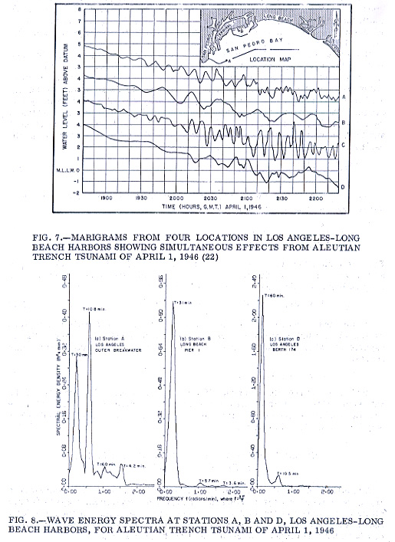
Tide Gage Records and Spectra for April 1, 1946 Tsunami

Slide 11
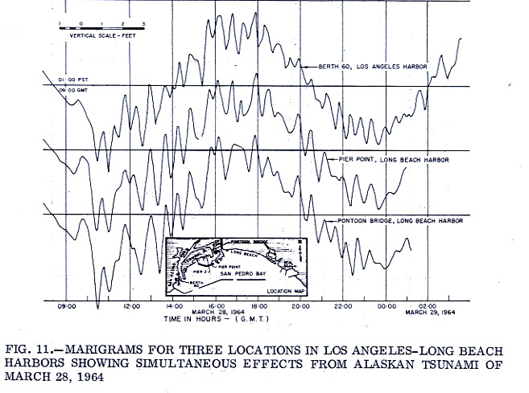
Tide Gage Record at the POLA and the POLB for the 1964 Alaskan Tsunami

Slide 12
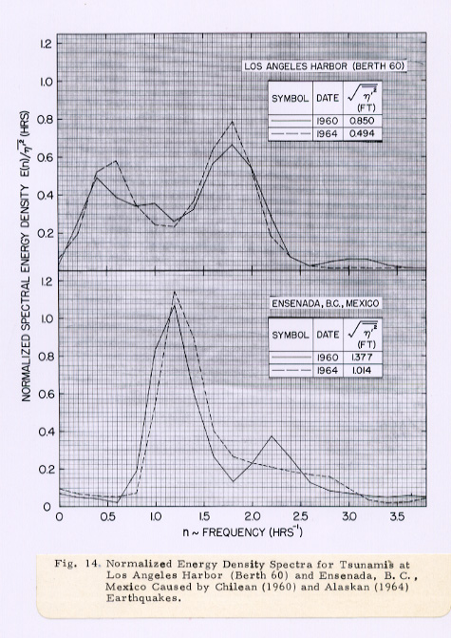
A Comparison Between the 1960 Chilean Tsunami and the 1964 Alaskan Tsunami at the POLA and at Ensenada, Mexico

Slide 13
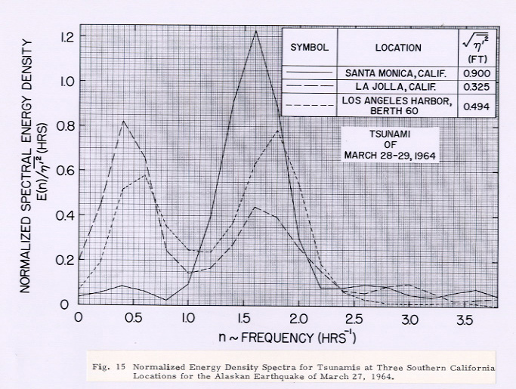
Energy Spectra for the 1964 Alaskan Tsunami at Santa Monica, La Jolla, and the POLA

