Slide 1
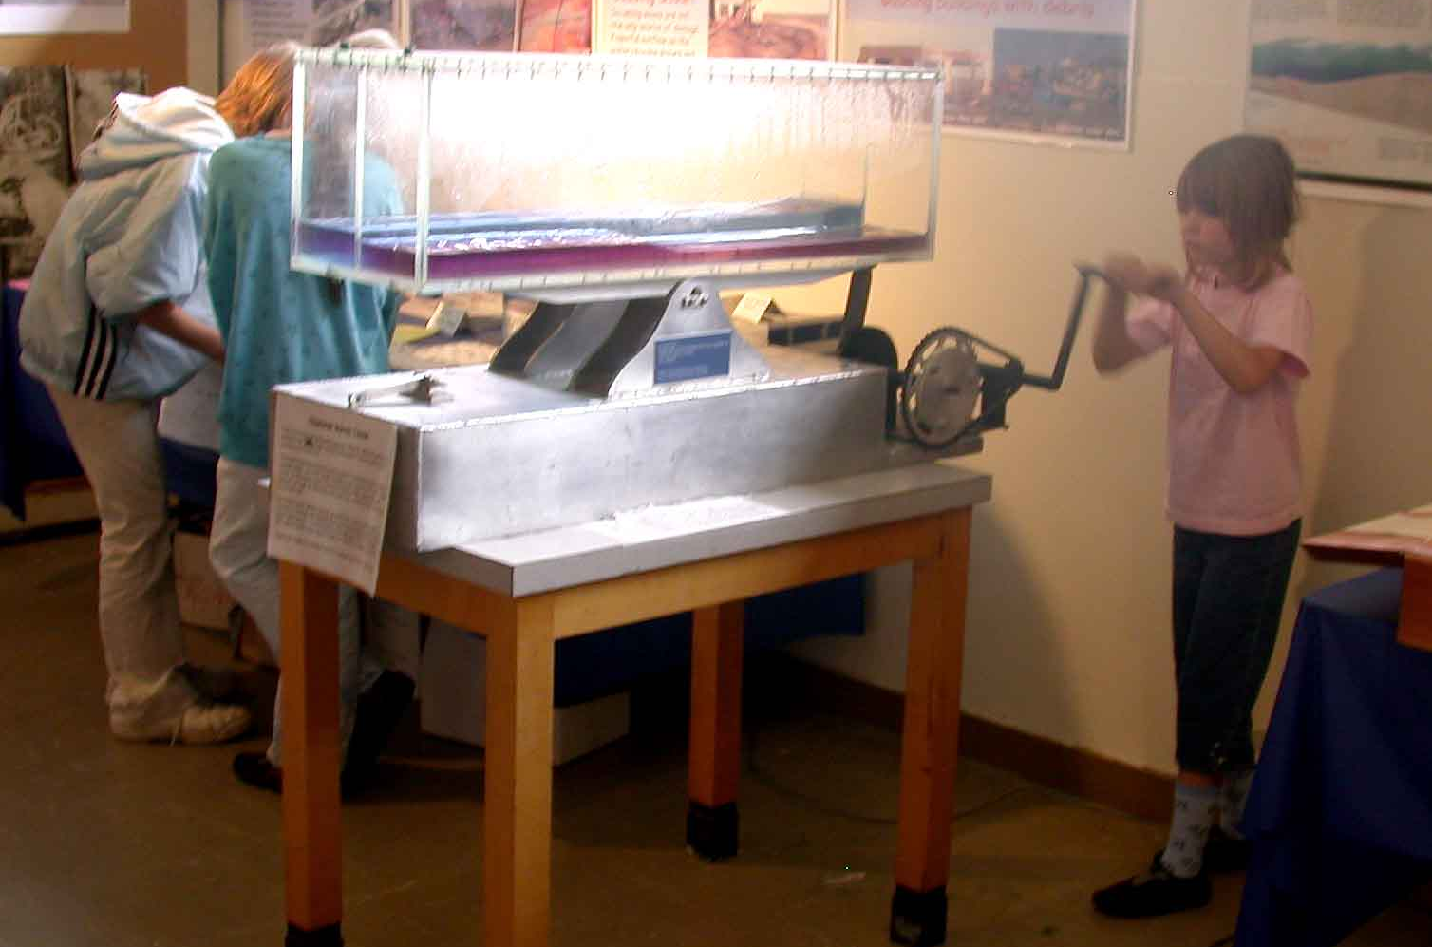
Tsunami Mitigation Efforts on
California’s North Coast

Slide 2
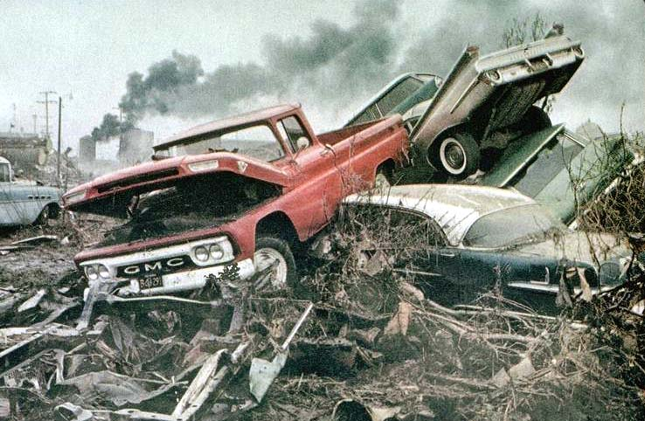
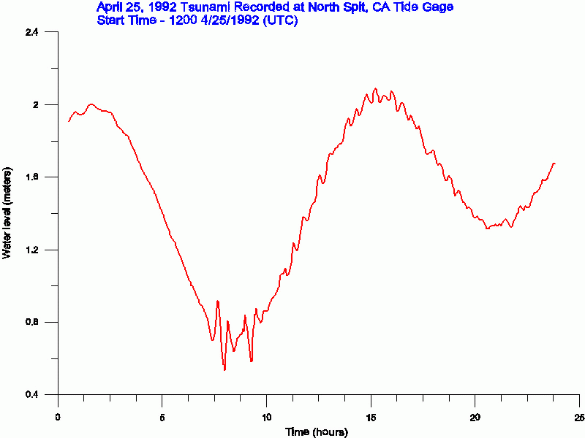
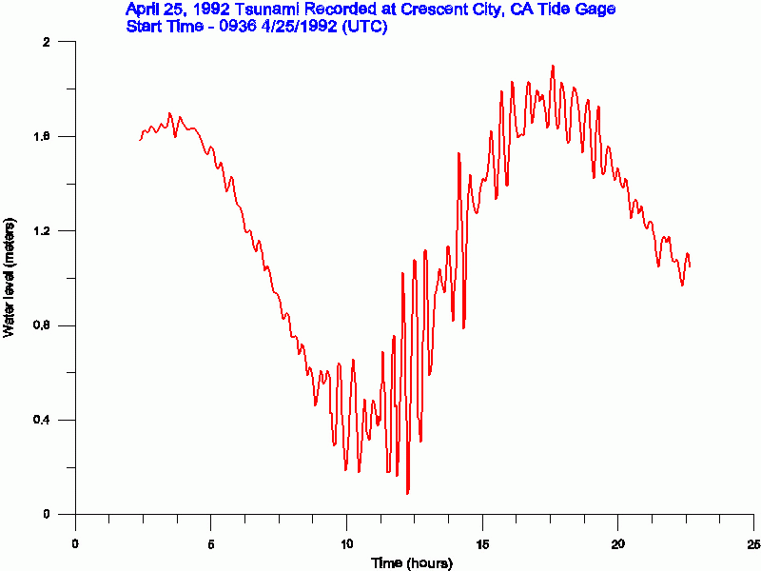
Two events:
• 1964 Tsunami
• 1992 Cape Mendocino Earthquake

Slide 3
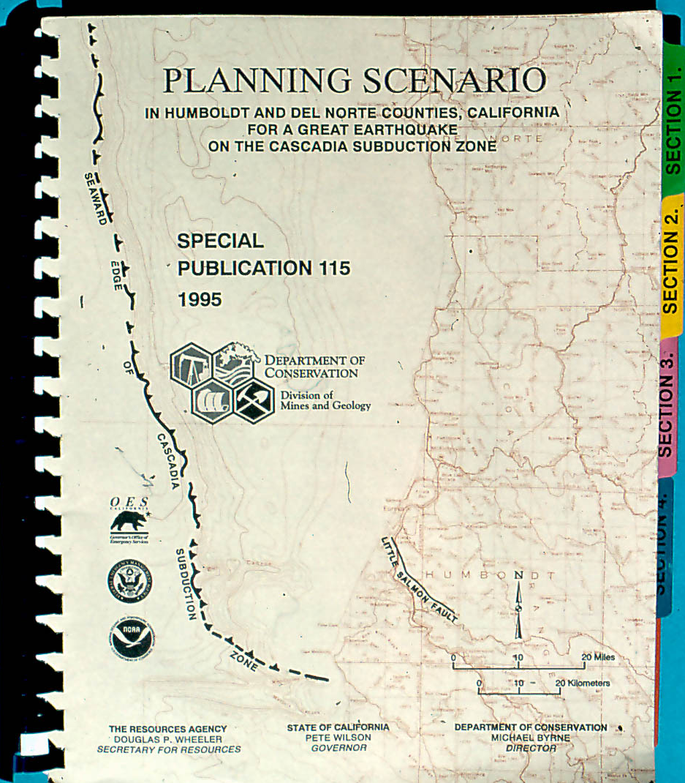
Cascadia Scenario - 1995
CDMG Publication
Magnitude 8.4
Ground shaking
Tsunami

Slide 4
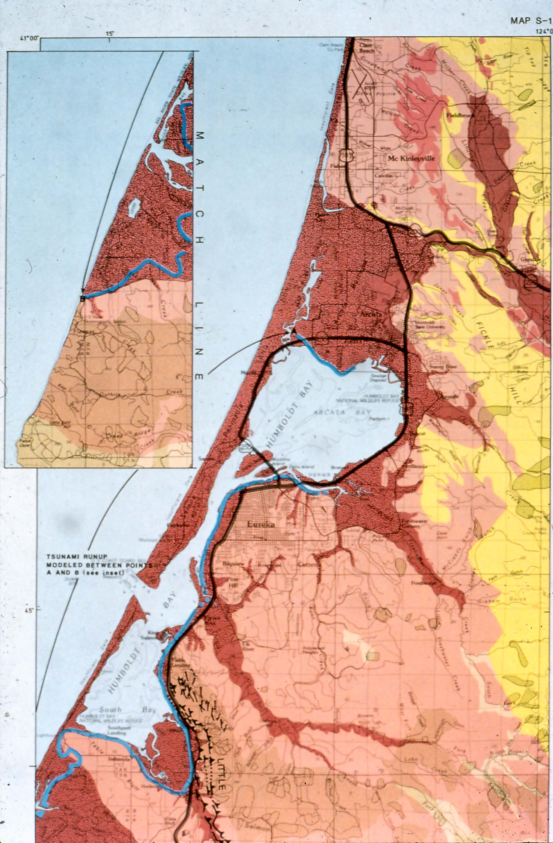

Slide 5
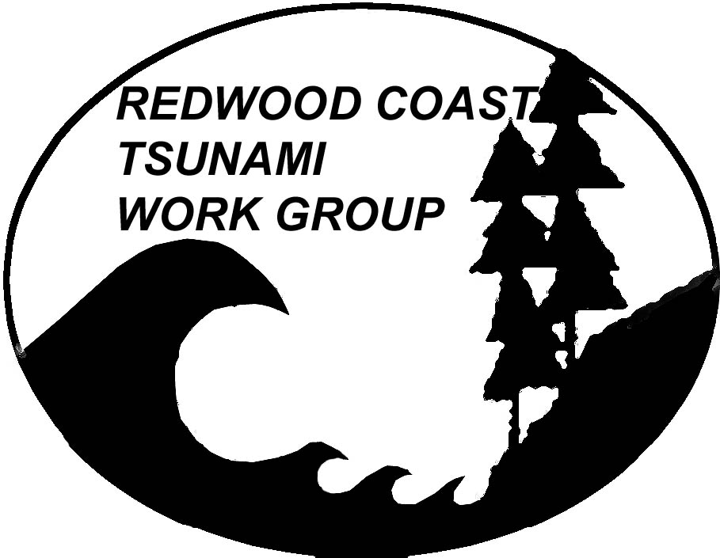
Redwood Coast Tsunami Work Group - 1996
Del Norte
Humboldt
Mendocino
• Define the needs of local jurisdictions to mitigate the North Coast earthquake and tsunami hazard
• Promote a coordinated, consistent mitigation program for all coastal areas
• Communicate technical tsunami information

Slide 6
Redwood Coast Tsunami Work Group - 1996
Public - Private Partnership
County OES
State Parks
Cal trans
American Red Cross
Humboldt State University
College of the Redwoods
National Weather Service
Redwood National & State Parks
North Coast Schools Insurance Group
Trinidad Rancheria
PG&E
Stockton Pacific
Geology Consulting Firms

Slide 7
Print Materials
Living on Shaky Ground: How to Survive Earthquakes and Tsunamis on the North Coast

Slide 8
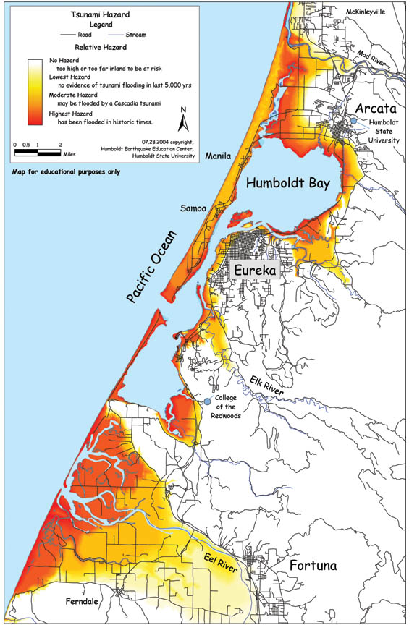
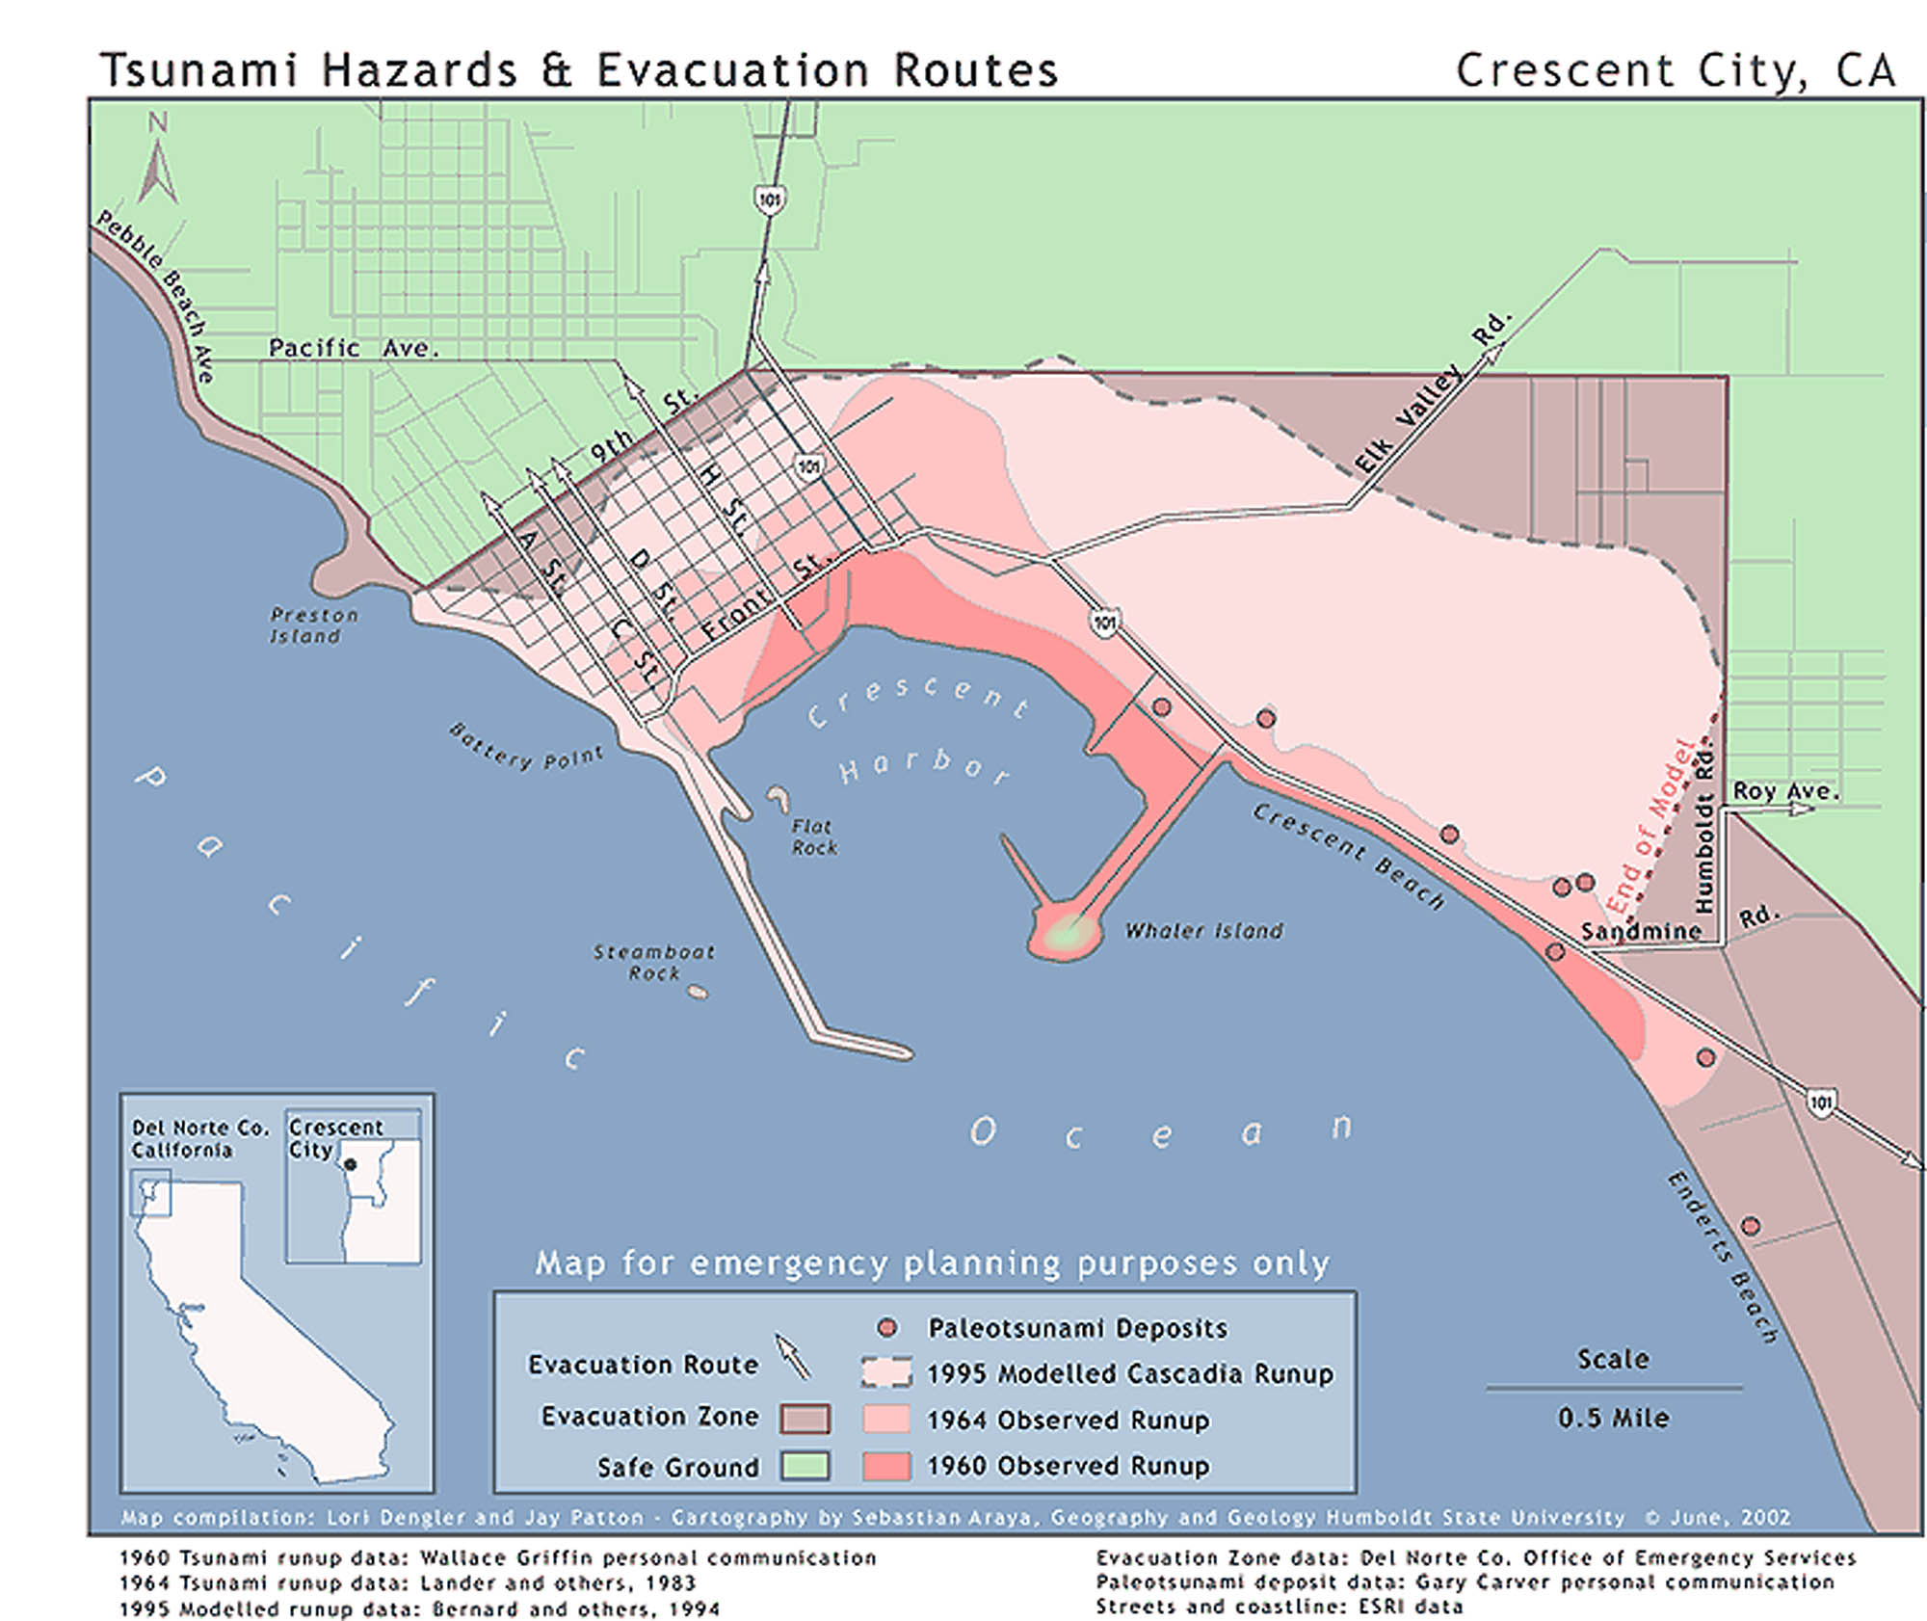
Tsunami Hazard Maps

Slide 9
Curriculum and Teacher Workshops
K - 12 curriculum
HSU - Geology 700 Professional Development Classes
Tsunami!
Tsunamis on the North Coast
Red Cross Living on the Faultline Course

Slide 10
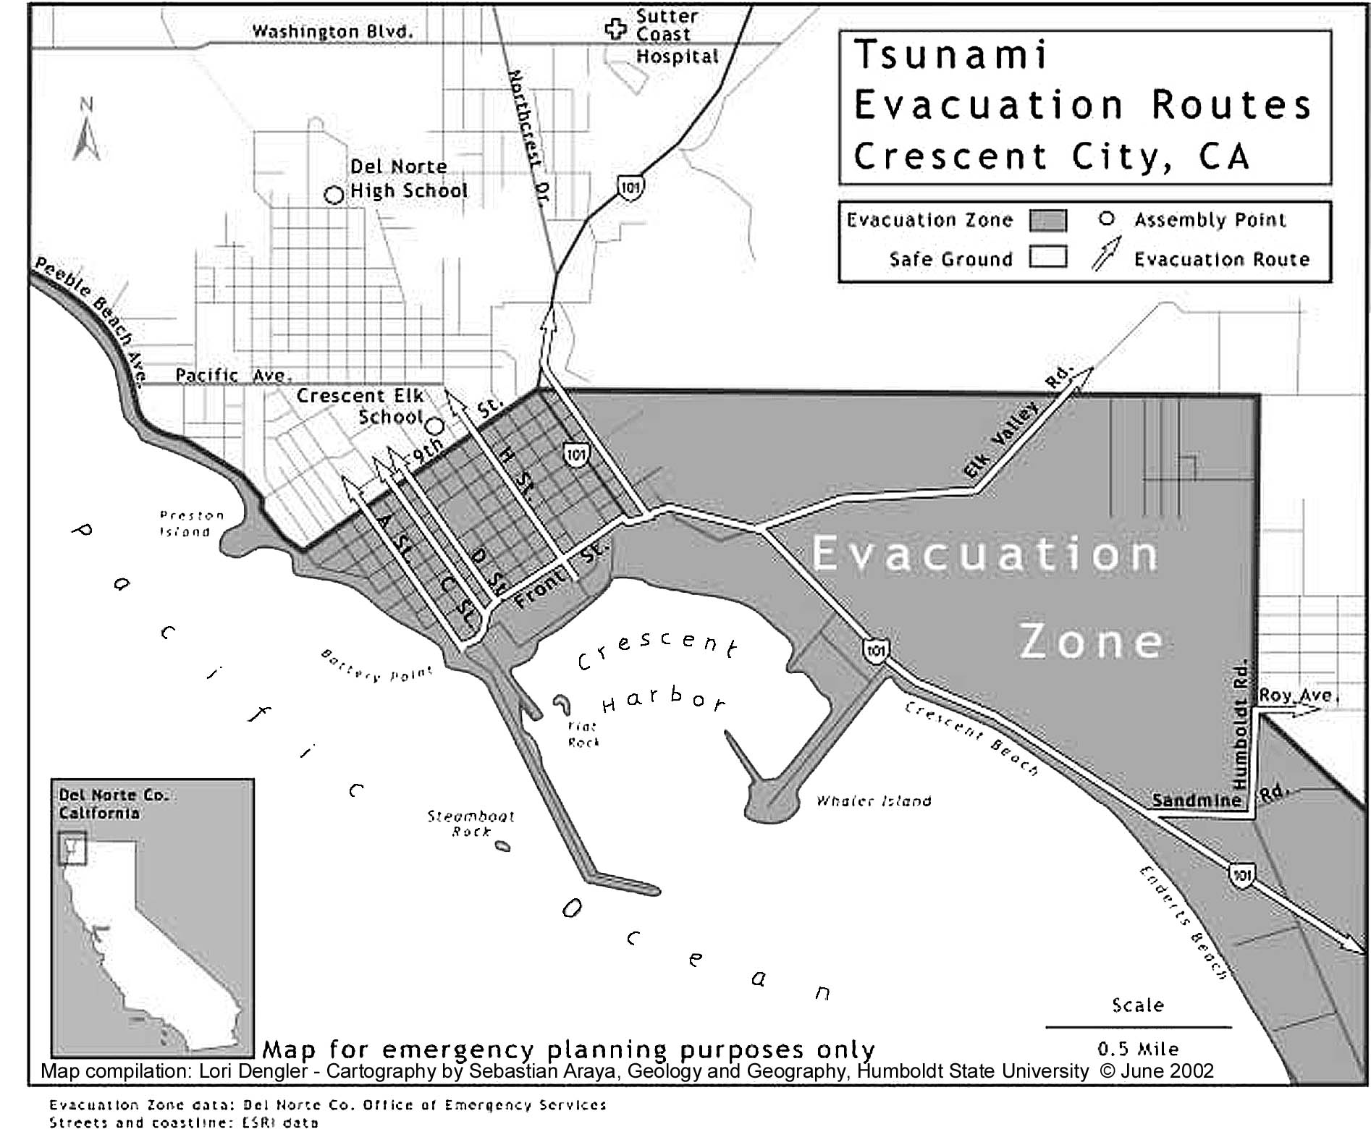
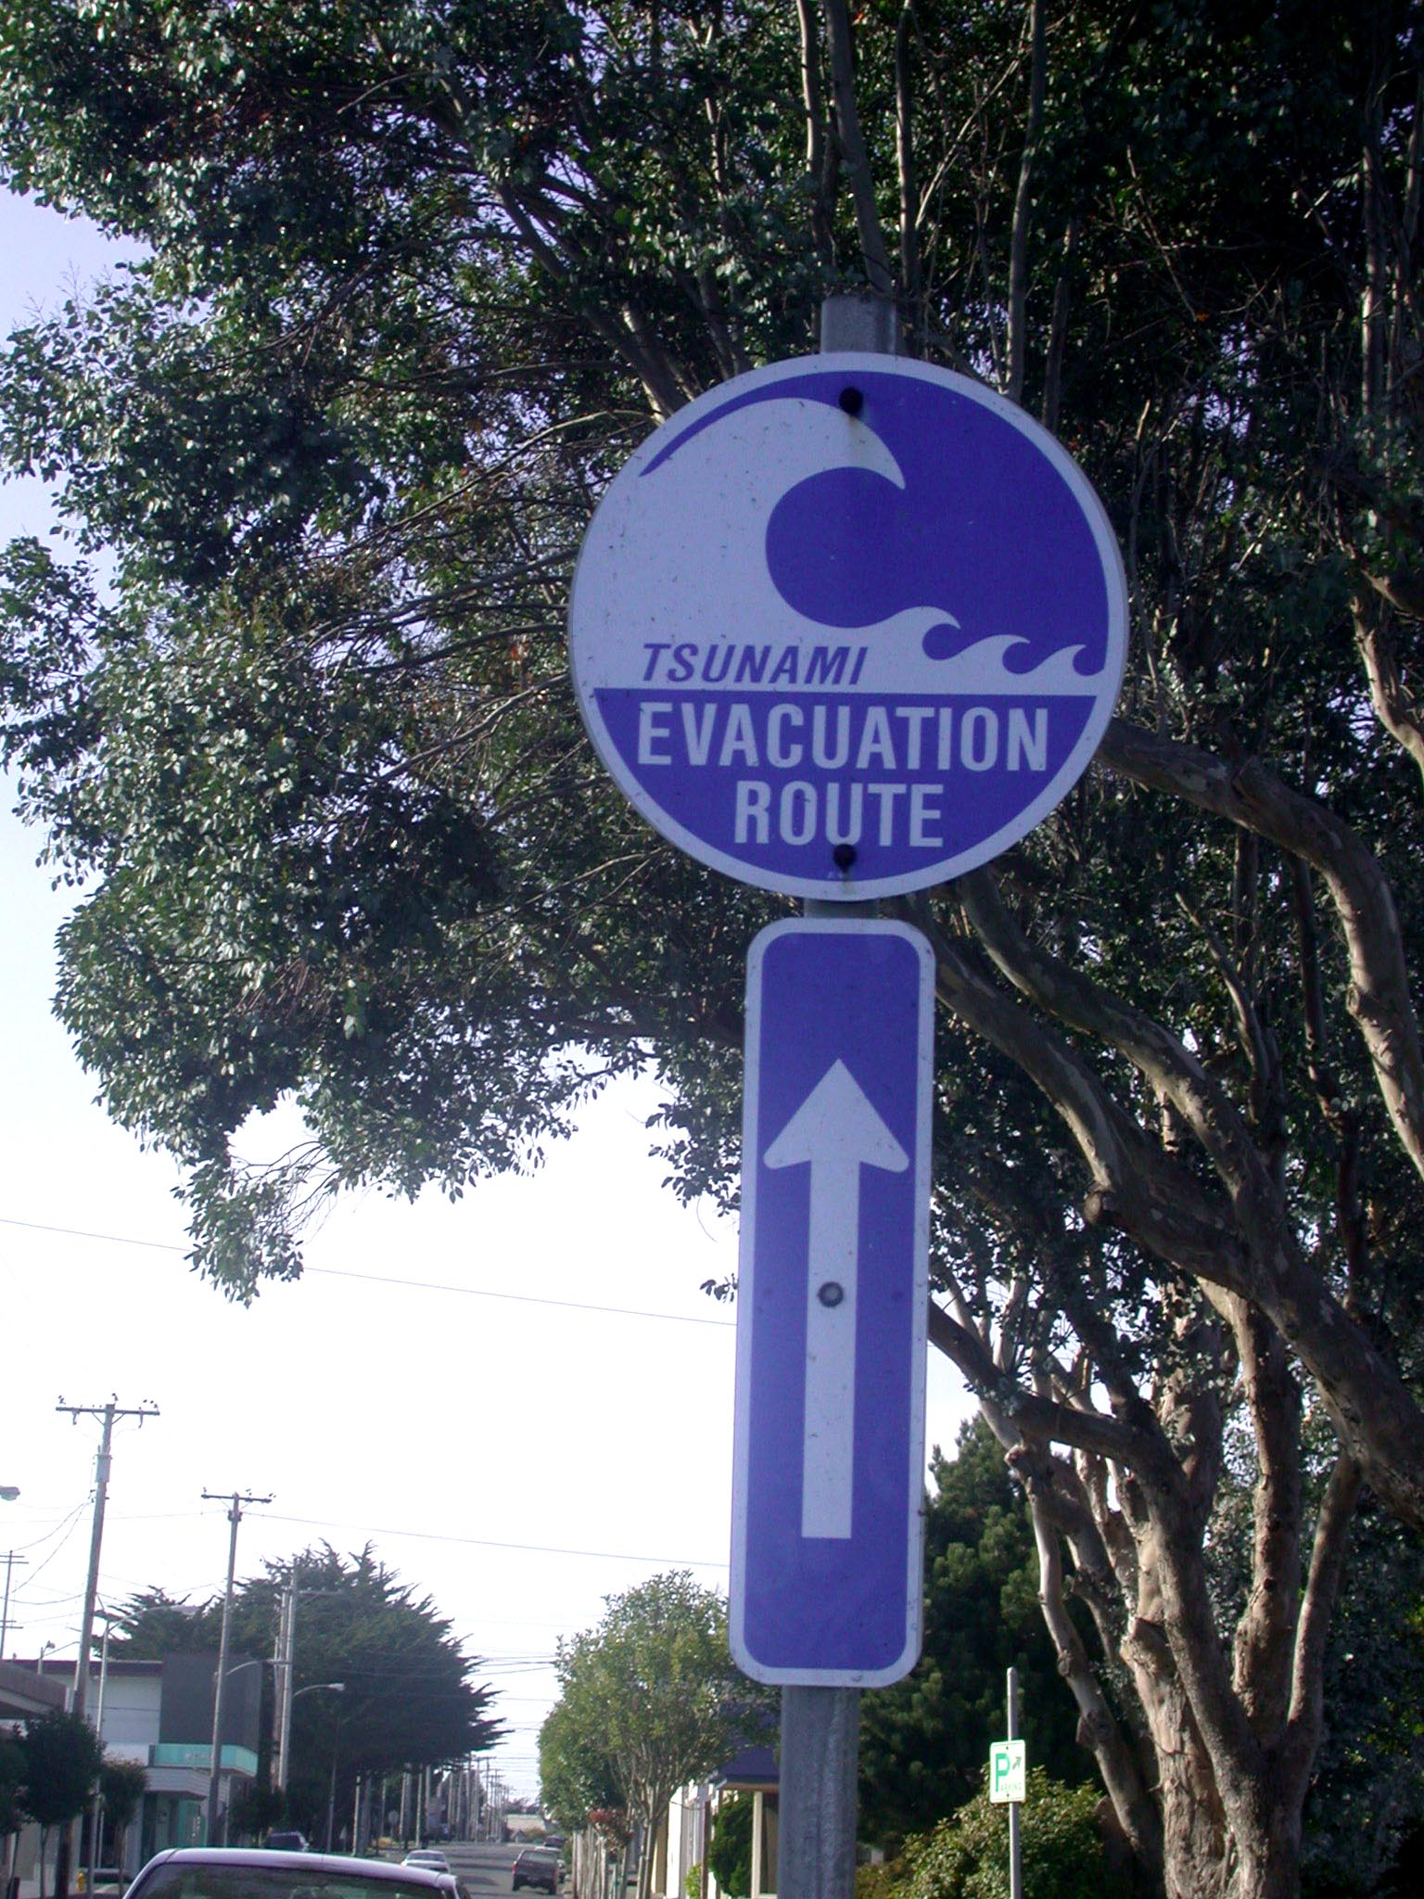
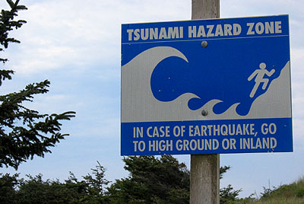
Signage & Evacuation Route Planning

Slide 11
Telephone Book/Hotel Information
TSUNAMI (TIDAL WAVE) SAFETY RESULTING FROM A LOCAL EARTHQUAKE
IF YOU FEEL A STRONG EARTHQUAKE WHICH LASTS 20 SECONDS OR MORE WHEN YOU ARE ON THE COAST:
DO NOT WAIT FOR AN OFFICIAL WARNING !!!
Protect yourself during the earthquake. Duck, cover and hold if inside and watch for falling objects until the earthquake is over.
Move to higher ground immediately AND inland away from the coastline. In Crescent City move north of 9th Street. Gather your family members and evacuate quickly. Leave everything else behind. A tsunami may be coming within minutes. Go on foot if at all possible.
Stay away from the coast. A later wave may be higher than the first! Damaging waves may continue to arrive even hours later.
Listen to radio for information. Wait until an official all clear signal has been given before returning to low-lying areas.
A Tsunami is a series of sea waves most commonly caused by earthquakes beneath the sea floor. Tsunami waves travel at speeds of up to 600 miles per hour, and can cause great damage where they come ashore.
TSUNAMI (TIDAL WAVE) SAFETY RESULTING FROM A DISTANT EARTHQUAKE
IF YOU HEAR THE WARNING SIREN OR A LOCAL EMERGENCY ALEART SYSTEM (EAS) TSUNAMI ANNCOUNCEMENT:
Never go to the coast to watch for a tsunami if you hear that a warning has been issued. Tsunamis move faster than a person can run. Incoming traffic hampers safe and timely evacuation of coastal areas.
Tsunamis are not surfable! They are not V-shaped or curling waves. Most frequently they come onshore as a rapidly-rising turbulent surge of water choked with debris.
All tsunamis, like hurricanes, are potentially dangerous and life threatening, even though they may not damage every coastline they strike.
An earthquake in your area is a natural tsunami warning. Do not stay in low-lying coastal areas after a strong earthquake has been felt. There is no time for authorities to issue a warning.
DO NOT RETURN TO THE EVACUATION ZONE UNTIL YOU ARE OFFICIALLY NOTIFIED
Damaging tsunamis are very rare. Our coastlines are vulnerable but tsunamis are infrequent. Understand the hazard and learn how to protect yourself, but don't let the threat of tsunamis ruin your enjoyment of Del Norte County/Crescent City and it’s beaches.

Slide 12
Earthquake Education Through Theatre Arts
Public Service Announcements
Video Information Skits
Plays

Slide 13
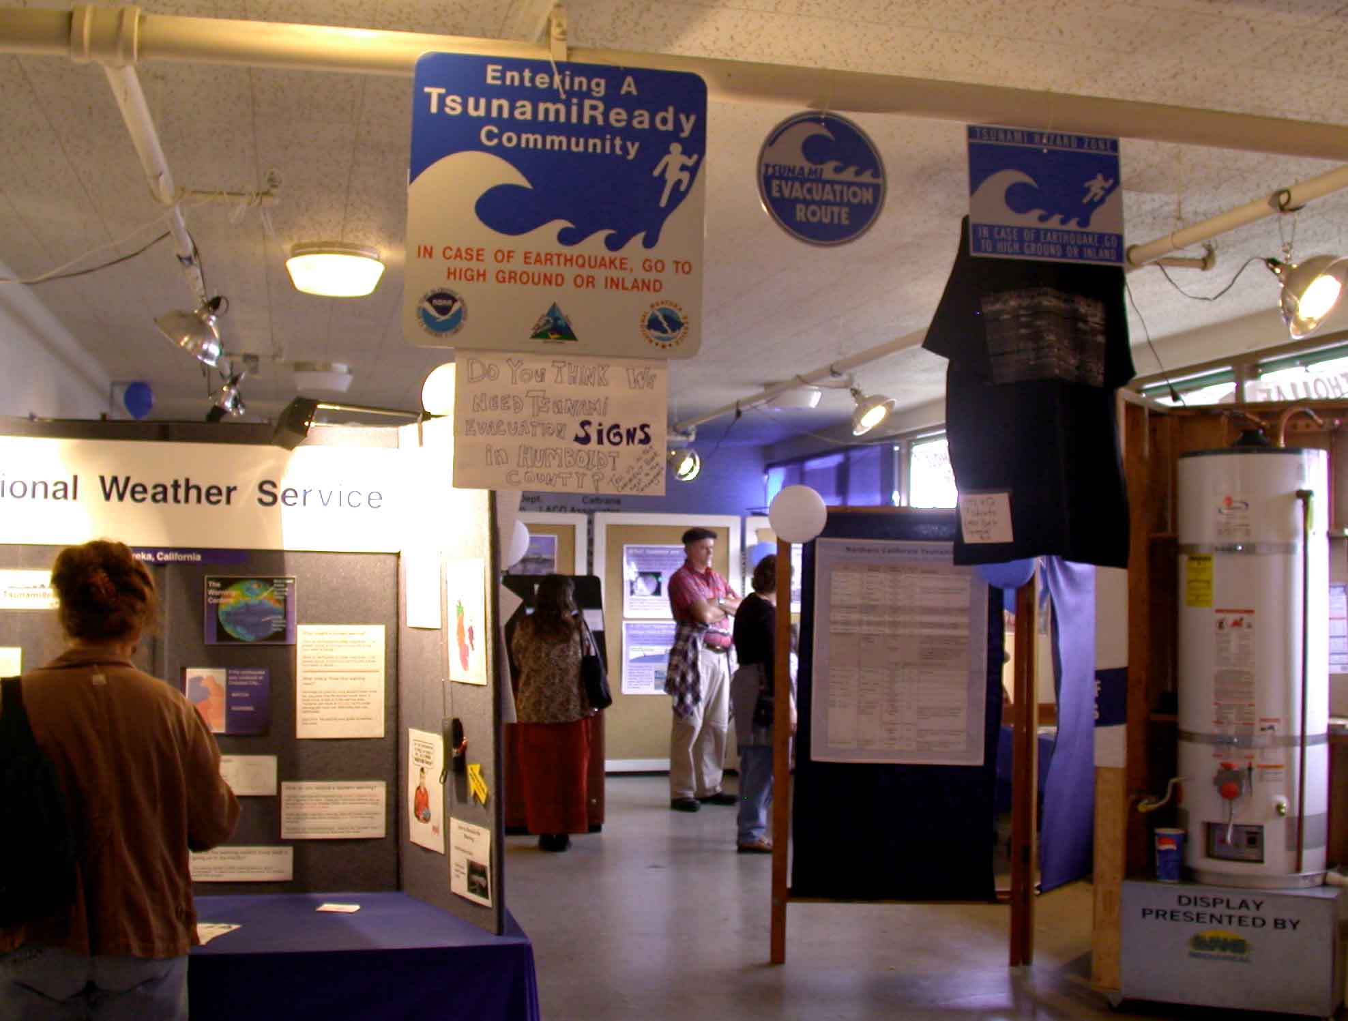
Humboldt County Fair

Slide 14
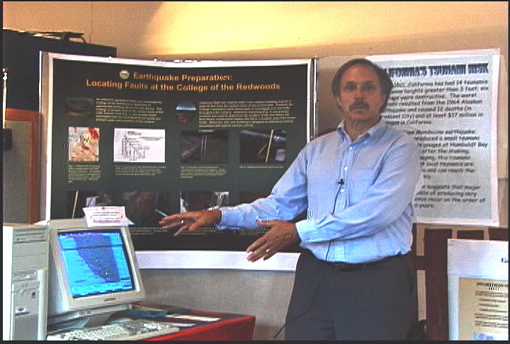
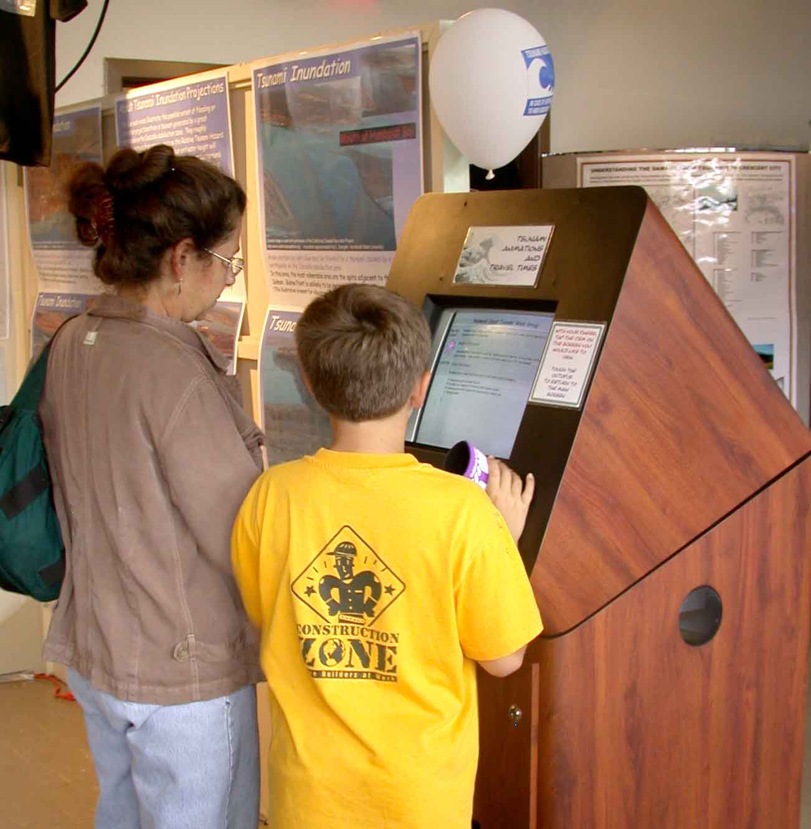
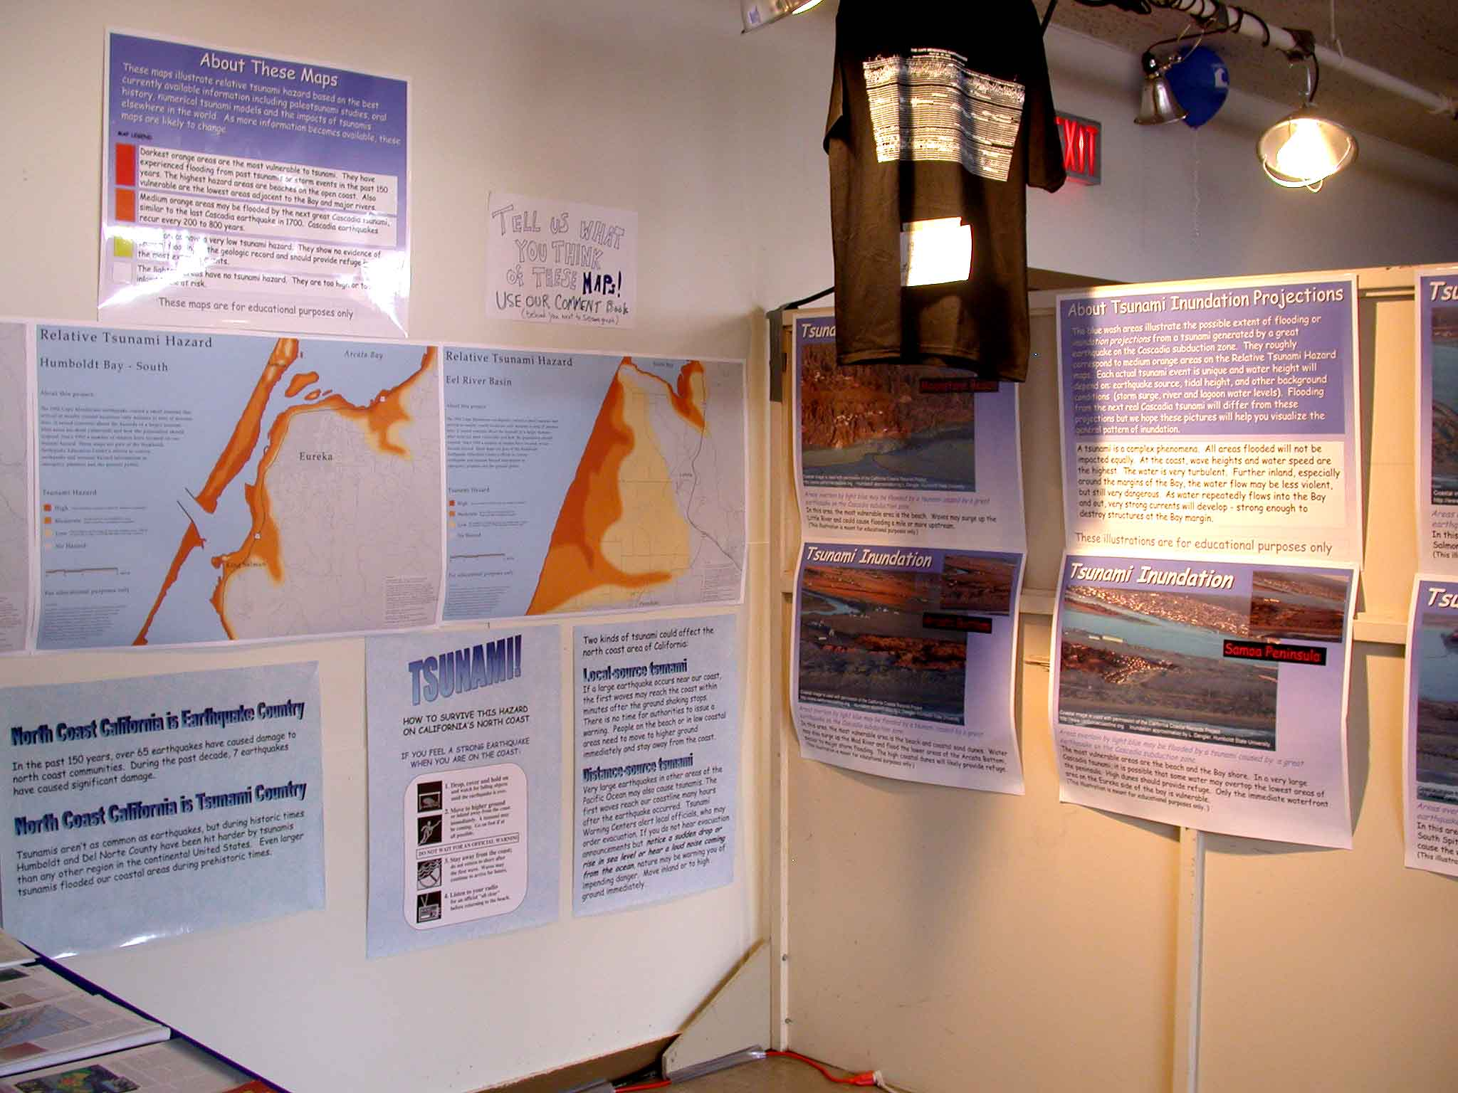

Slide 15
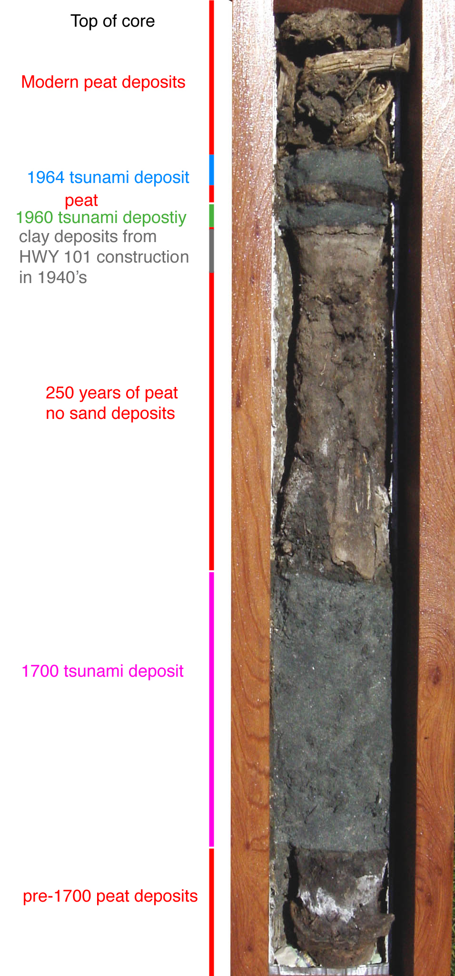

Slide 17
Nichols Pontiac, Crescent City
The 1964 Great Alaska Earthquake Lessons for the North Coast

Slide 18
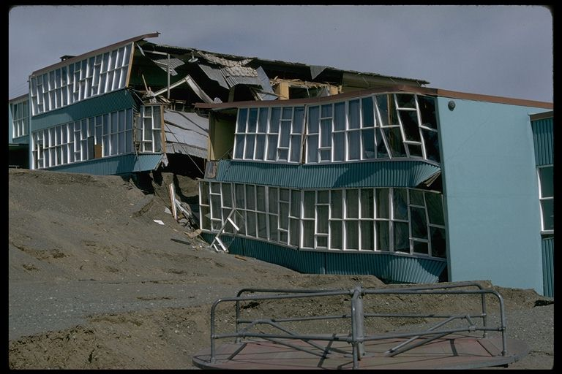
Why North Coast Residents should be interested in the 1964 Alaska earthquake
We live in the same geologic setting as Alaska - a megathrust subduction zone.
Some day the Cascadia subduction zone will produce an earthquake similar in size and effects to the 1964 Alaska earthquake.
Alaska’s experience will help us prepare for
the next Cascadia earthquake.
Government Hill Elementary School, Anchorage

Slide 19
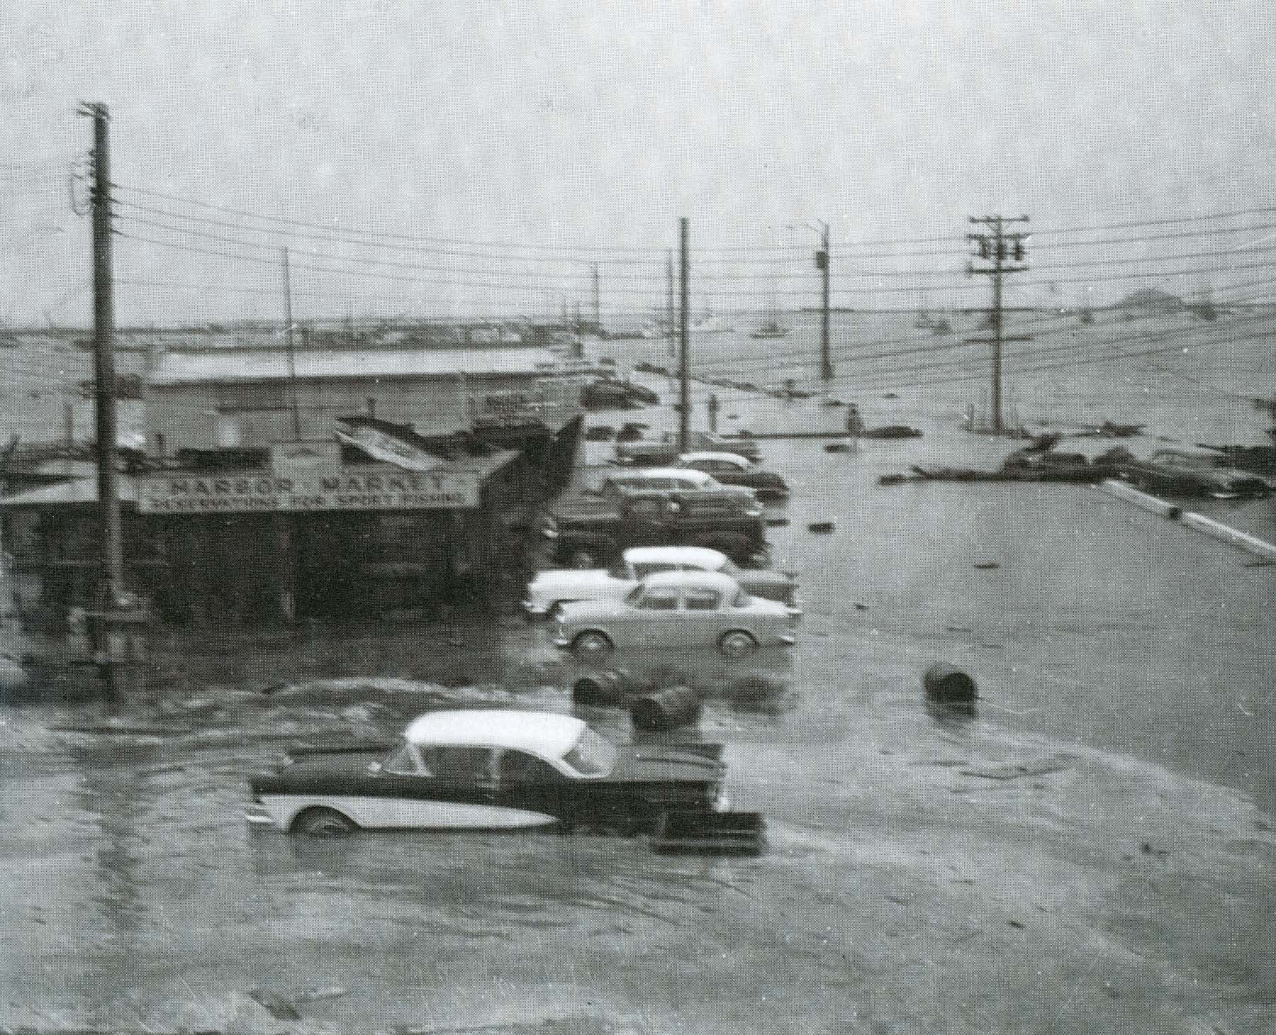
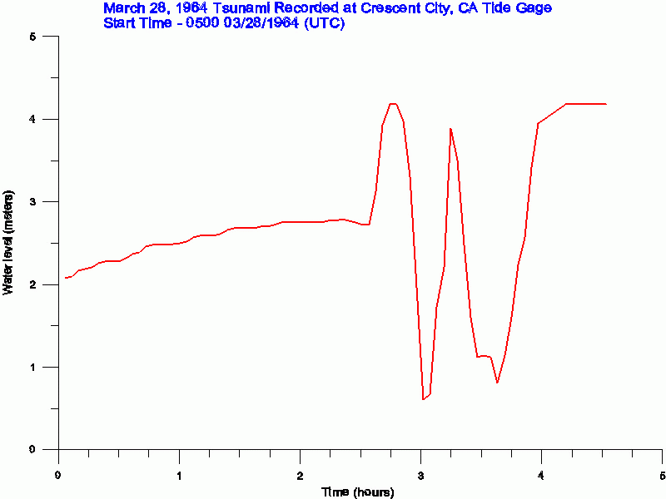
What Happened in Crescent City
Crescent City experienced tsunamis in 1946, 1952, 1957, 1960 and 1963. The 1960 tsunami caused $30,000 damage and destroyed two boats.
Fourth wave
1:45 AM?
22 feet
Third wave
1:20 AM?
Broke gage
Second wave
12:20 AM
12 feet
First wave
11:50 PM
14.5 feet
Flooding at Citizen’s Dock Road, Crescent City, from the 1960 Chilean tsunami.
In the 1964 tsunami, the first wave was about the same size as the 1960 waves. The second wave was smaller. Some people thought the worst was over
1964 tide gage showing water height in Crescent City. The instrument was destroyed as the third wave hit.
and returned to the waterfront area to clean up or to look at the damage. Unfortunately the worst was not over. The third and fourth waves were much bigger. The fourth wave reached a height of about 22 feet above the low tide level!

Slide 20
Effectiveness of Education Programs:
Surveys of Humboldt County Residents
Question 4/ 93 11/ 93 11/ 95 1/ 96 4/ 01
Knows what tsunami is 78 84 92 91 98
Tsunami can arrive minutes after EQ 51 62 75 70 73
Not safe after 1st wave retreats 65 73 75 81 87
Knows what Cascadia S.Z. is 16 20 29 32 42

Slide 21
Effectiveness of Education Programs:
Effectiveness of “Living on Shaky Ground”
Percent Responding “Yes”
1993 1995 1996
NO YES NO YES NO YES
Knows what tsunami is 80 91 87 95 85 95
Tsunami can arrive in minutes 60 66 72 77 75 78
Not safe after 1st wave retreats 69 81 69 85 72 86
Knows what Cascadia S.Z. is 14 33 23 41 19 41
NO columns: respondents who had not seen magazine
YES columns: respondents who had seen magazine

Slide 22
There is no technological solution to eliminating tsunami losses
There are many technological aids to tsunami mitigation that can be effective when used in combination with education/outreach programs
Once is never enough – effective tsunami education must be done over and over again, using different media and different perspecdtives
The media is our best friend – nurture them

Slide 23
The Tsunami Uncertainty Principle
There will always be uncertainty in hazard estimates – tides, ambient wave conditions, secondary faulting, landslides
Estimating tsunami hazards is a work in progress based on the best currently available information. It will change as more research is completed and more tsunamis occur. Let the public know this and observe the process.

Slide 24
For more information:
http://www.humboldt.edu/~geodept/earthquakes/eqk_info.html

