Slide 1
The Coastal Commission’s approach to tsunami Planning
Evaluation of hazard
  Coastal Development Permits
  Local Coastal Plans
Education
Signage
Use of inundation maps

Slide 2
Planning for Tsunamis
Know your community’s tsunami risk
Avoid new development in tsunami run-up areas
Locate and configure new development that occurs in tsunami run-up areas to minimize future tsunami losses
Design and construct new buildings to minimize tsunami damage
Protect existing development from tsunami losses
Take special precautions in locating and designing infrastructure and critical facilities
Plan for evacuation

Slide 3
Coastal Act Section 30253
New development shall:
  (1) Minimize risks to life and property in areas of high geologic, flood, and fire hazard.
  (2) Assure stability and structural integrity, and neither create nor contribute significantly to erosion, geologic instability, or destruction of the site or surrounding area or in any way require the construction of protective devices that would substantially alter natural landforms along bluffs and cliffs.

Slide 4
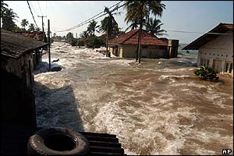
Inundation

Slide 5
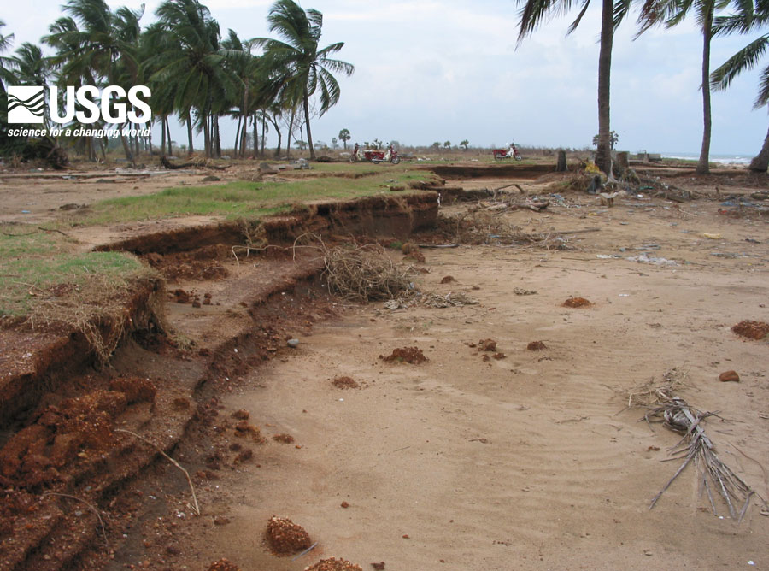
Erosion

Slide 6
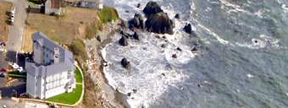
Redwood Oceanfront Resort Hotel; Crescent City

Slide 7
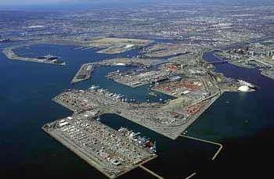
Ultramar - Valero Wilmington Refinery Alkylation Improvement Project

Slide 8
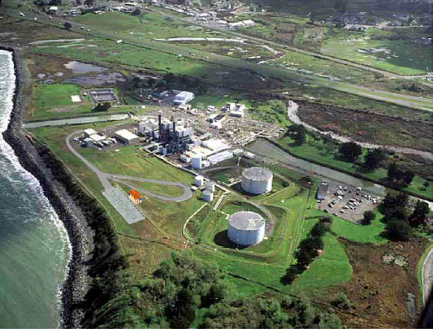
Humboldt Bay Power Plant ISFSI

Slide 9
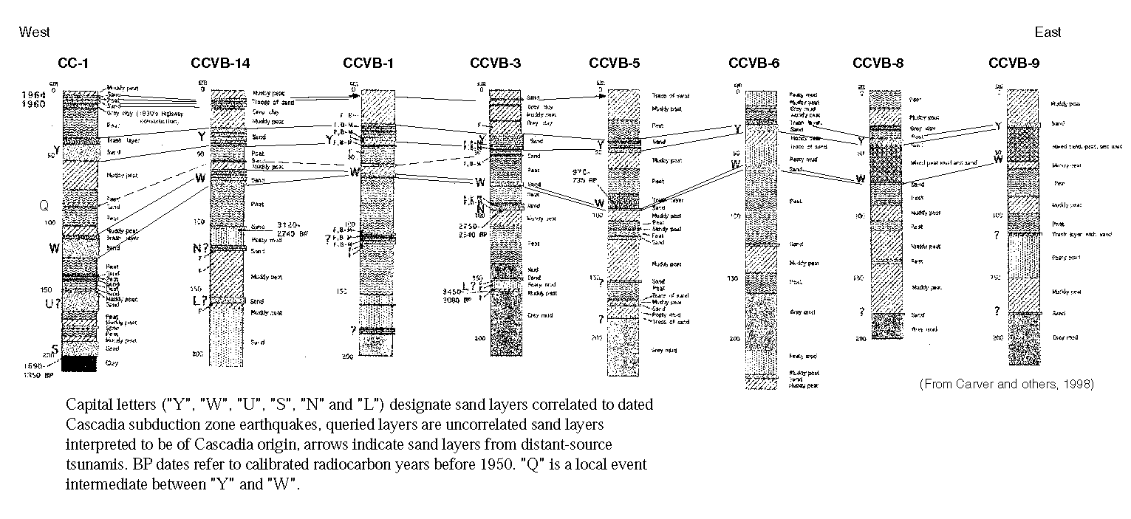
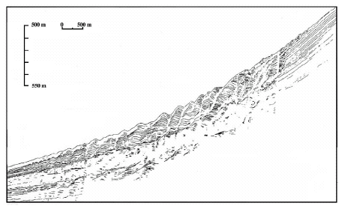

Slide 10
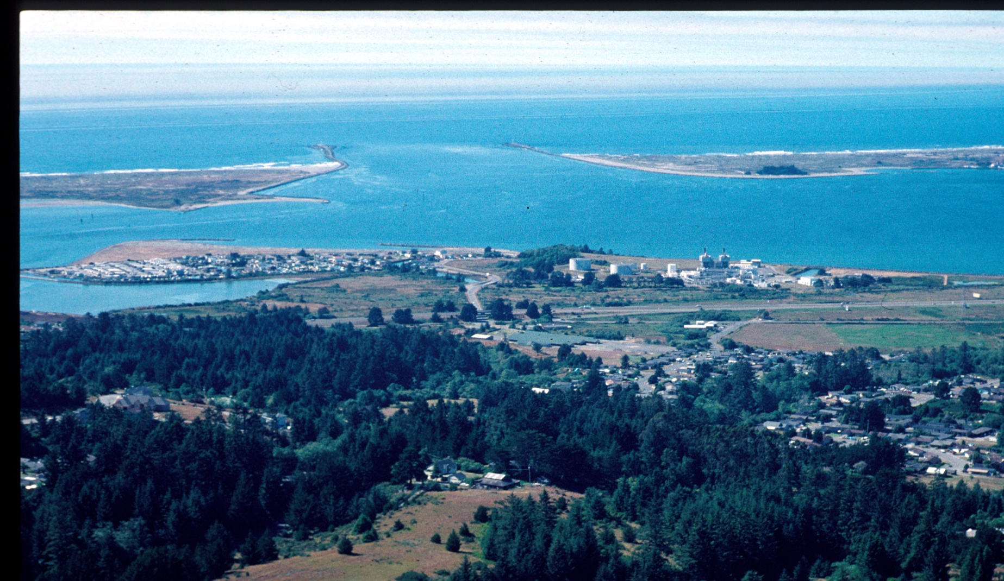

Slide 11
Local Coastal Plans
Implementation of Coastal Act at the local level
Developed by local governments
Certification by the Coastal Commission
Permit authority of certified LCP rests with local government
Some permits are appealable to the Commission
Commission’s retained jurisdiction

Slide 12
Developing tsunami LCP Policies
Develop tsunami warning systems
Restrict or prohibit development in areas susceptible to tsunami run-up
Require design mitigation
Prohibit land divisions in areas susceptible to tsunami run-up
Require new development in areas which are susceptible to tsunami hazard to investigate the probable wave impact that would occur.

Slide 13
Malibu LCP
Where feasible, development shall be sited outside of potential tsunami inundation zones. Tsunami inundation zones shall be defined as those areas identified as such on maps released by the California Office of Emergency Services, as they become available. If no such map is available, a Registered Civil Engineer with coastal experience shall make a determination, through wave run-up analysis, whether the site may reasonably be expected to be subject to inundation during a tsunami. If it is not feasible to site development outside of a tsunami inundation zone, new development shall be in conformance with all of the provisions set forth in this chapter with regard to Special Flood Hazard Zones. In addition, development shall be constructed to resist lateral movement due to the effect of water loading from the maximum expected tsunami, to the greatest extent feasible.

Slide 14

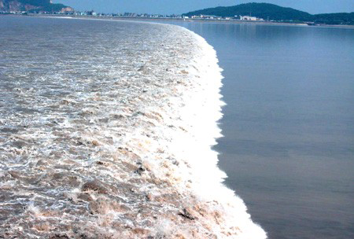
Education

Slide 15
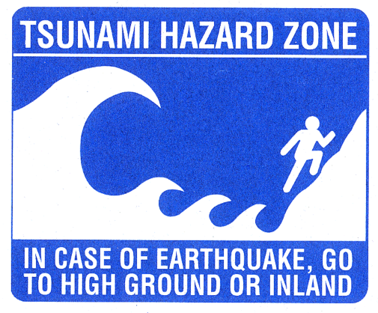

Slide 16
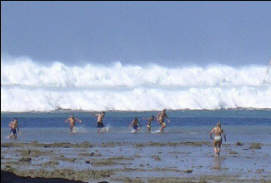

Slide 17
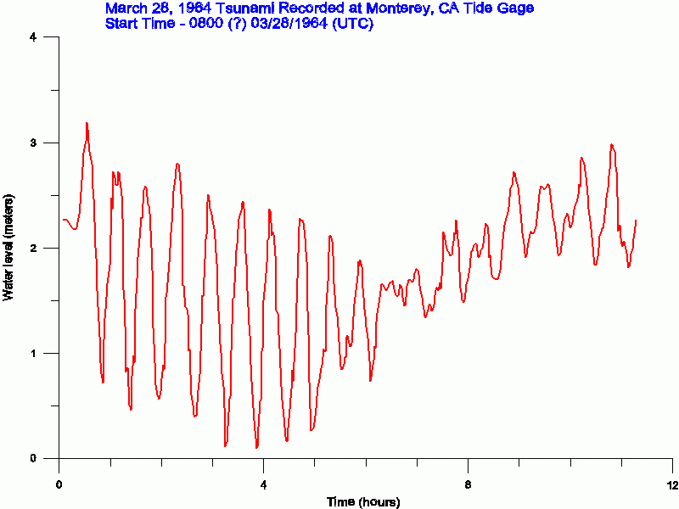

Slide 18
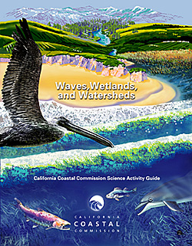
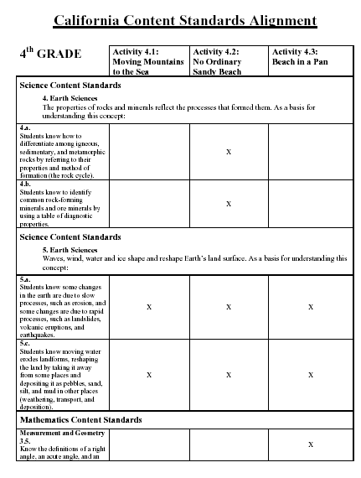
Curriculum

Slide 19
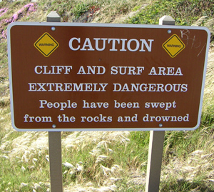
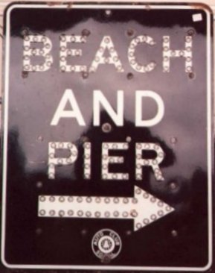
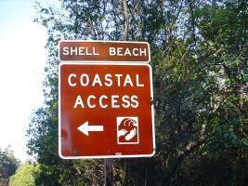
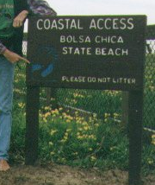
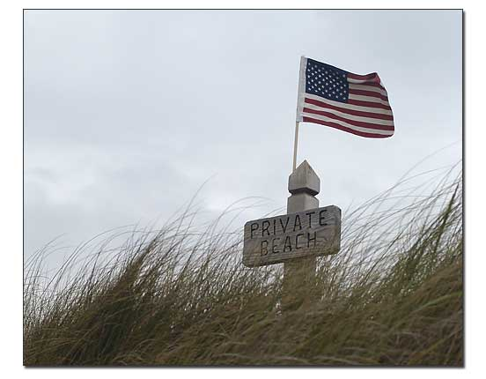

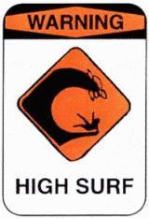
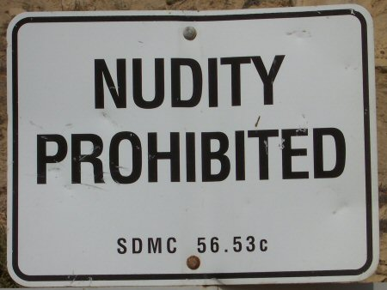
Signage

Slide 20
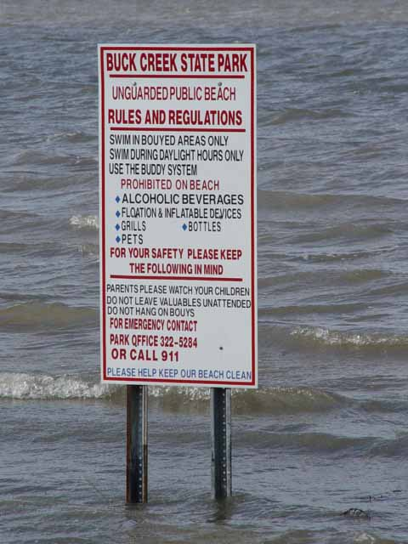
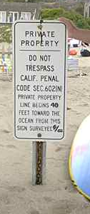
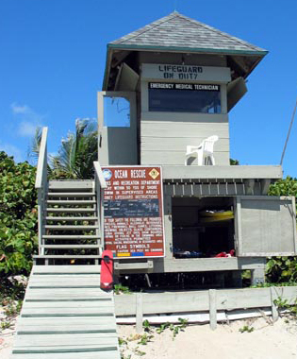
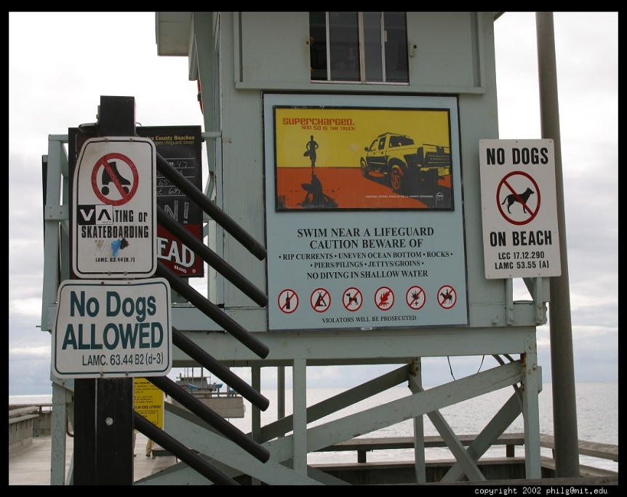
Visual impact & Placement

Slide 21
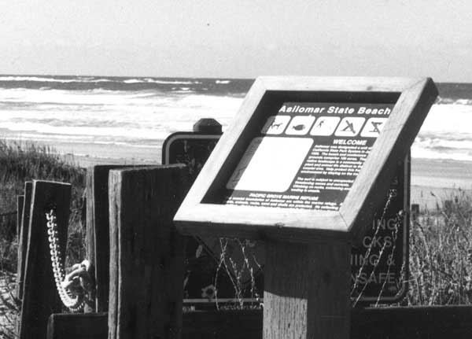
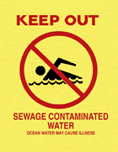
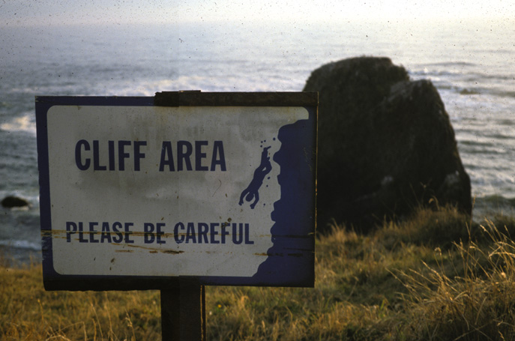
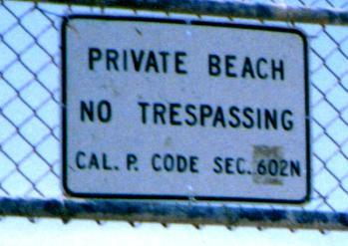
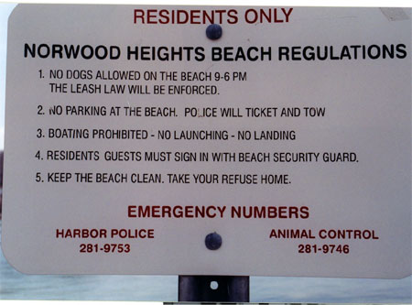
Message

Slide 22
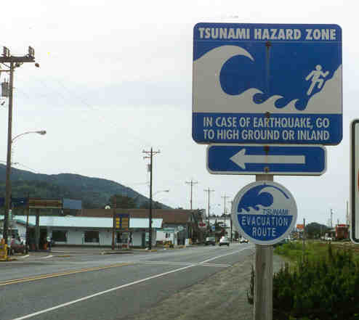
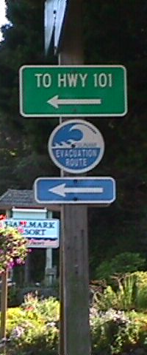
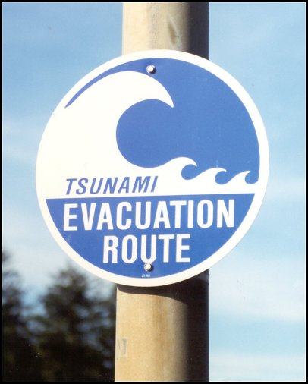
Tsunami Signage

Slide 23

Beach sirens

Slide 24
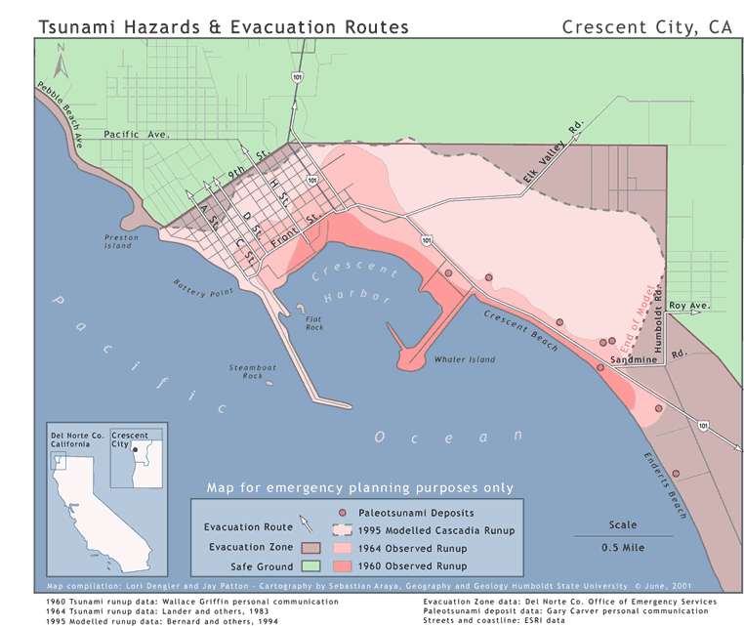
Inundation Maps

Slide 25
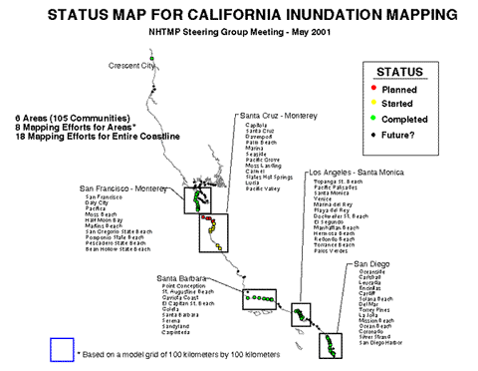
California Inundation Mapping

Slide 26
Disclaimer on California maps
Inundation projections and resulting planning maps are to be used for emergency planning purposes only. They are not based on a specific earthquake and tsunami. Areas actually inundated by a specific tsunami can vary from those predicted. The inundation maps are not a prediction of the performance, in an earthquake or tsunami, of any structure within or outside of the projected inundation area.

Slide 27
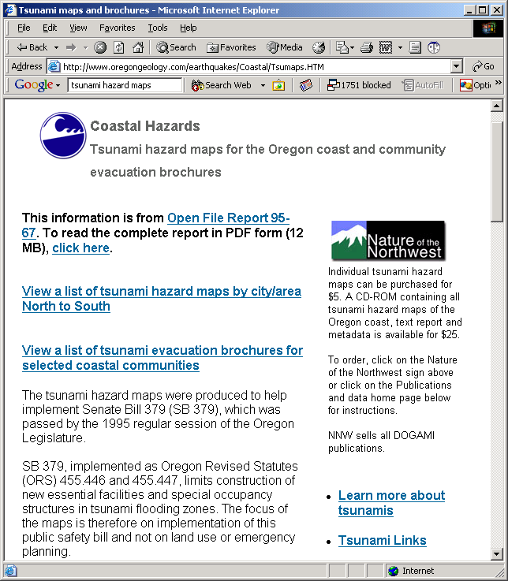
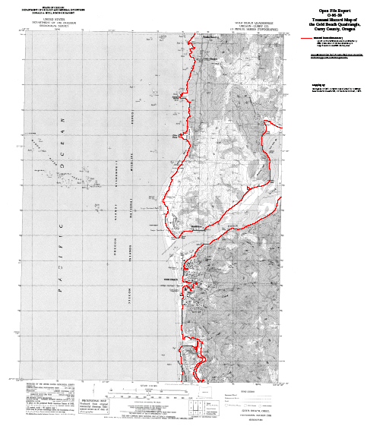
Oregon inundation maps

Slide 28
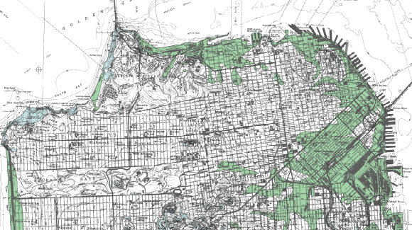
Analogous to Seismic Hazard Maps

