Slide 1
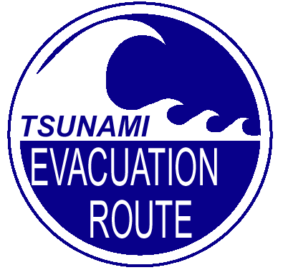
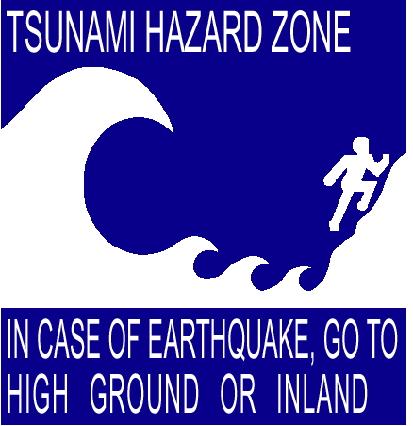

Overview of National Weather Service & the Tsunami Warning Program
Eric Boldt
Warning Coordination Meteorologist
NOAA’s National Weather Service
520 N. Elevar St.
Oxnard CA 93030
805-988-6615
March 15, 2005
Notes:
Self introduction and introduction of topic.

Slide 2
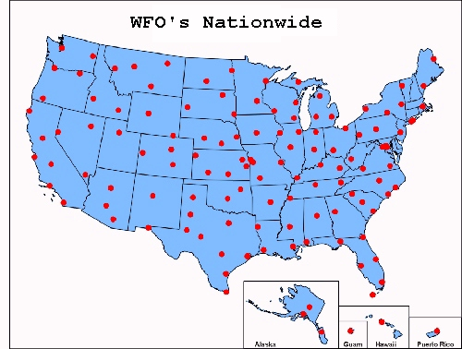
National Weather Service Mission Statement
" The National Weather Service (NWS) provides weather, hydrologic, and climate forecasts and warnings for the United States, its territories, adjacent waters and ocean areas, for the protection of life and property and the enhancement of the national economy. "
Over 120 NWS Offices

Slide 3
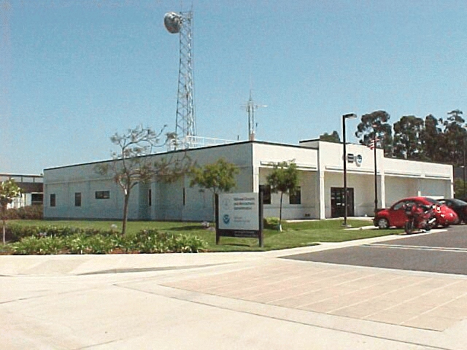
NWS Oxnard/Los Angeles
24-hour Operation
Watch/Warning Program
Forecasts
Public
Aviation
Fire
Marine
Hydrology & Precipitation
Public Service
Climate
NOAA “All Hazards” Weather Radio
EAS

Slide 4
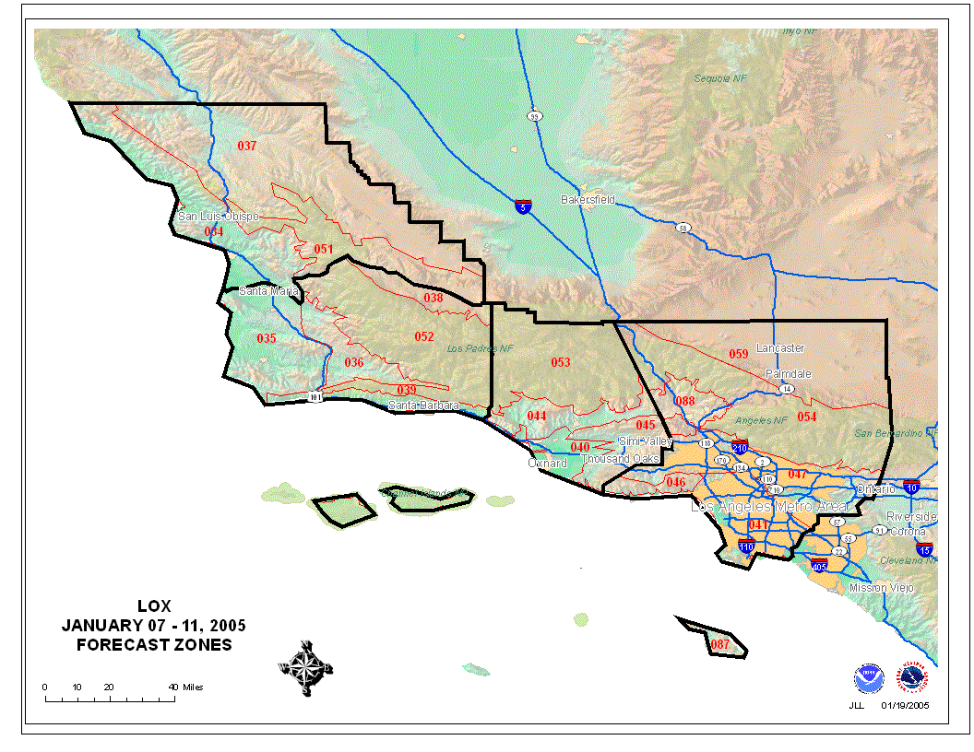
NWS Oxnard/Los Angeles County Warning Area
San Luis Obispo
Santa Barbara
Ventura
Los Angeles

Slide 5
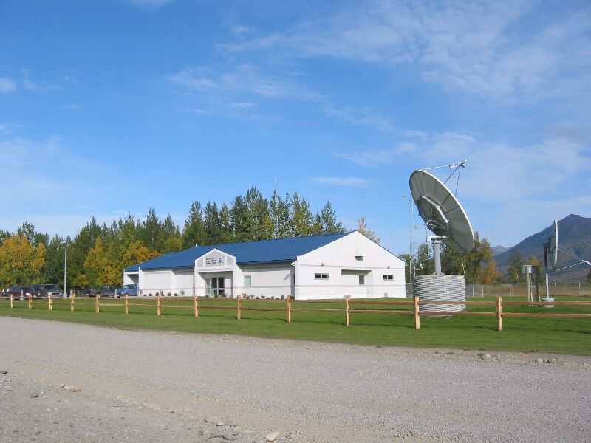
Tsunami Warning System Basics
NOAA’s National Weather Service responsible for providing tsunami warnings to West Coast
West Coast/Alaska Tsunami Warning Center
(primary for California)
Pacific Tsunami Warning Center
(backup for California)
Notes:
Weather affects the lives of all Americans and causes billions of dollars in damage each year across the nation.
From Hurricanes, to Tornadoes, to Blizzards, and Tsunamis -- people and our economy are directly affected by the ravages of severe weather.
We need some sort of program to help Americans be better prepared for severe weather to help fulfill the NWS mission of “protecting life and property and enhancing the national economy.”

Slide 6
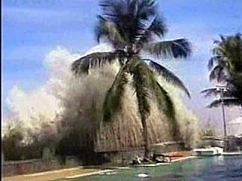
Tsunami Warning System Basics
Detect and Locate Earthquake or Causative Event
Determine if Tsunami Likely
Calculate Tsunami Arrival Times
Issue Official Warning
Confirm Tsunami
Provide Follow-on Information Bulletins
Notes:
Weather affects the lives of all Americans and causes billions of dollars in damage each year across the nation.
From Hurricanes, to Tornadoes, to Blizzards, and Tsunamis -- people and our economy are directly affected by the ravages of severe weather.
We need some sort of program to help Americans be better prepared for severe weather to help fulfill the NWS mission of “protecting life and property and enhancing the national economy.”

Slide 7
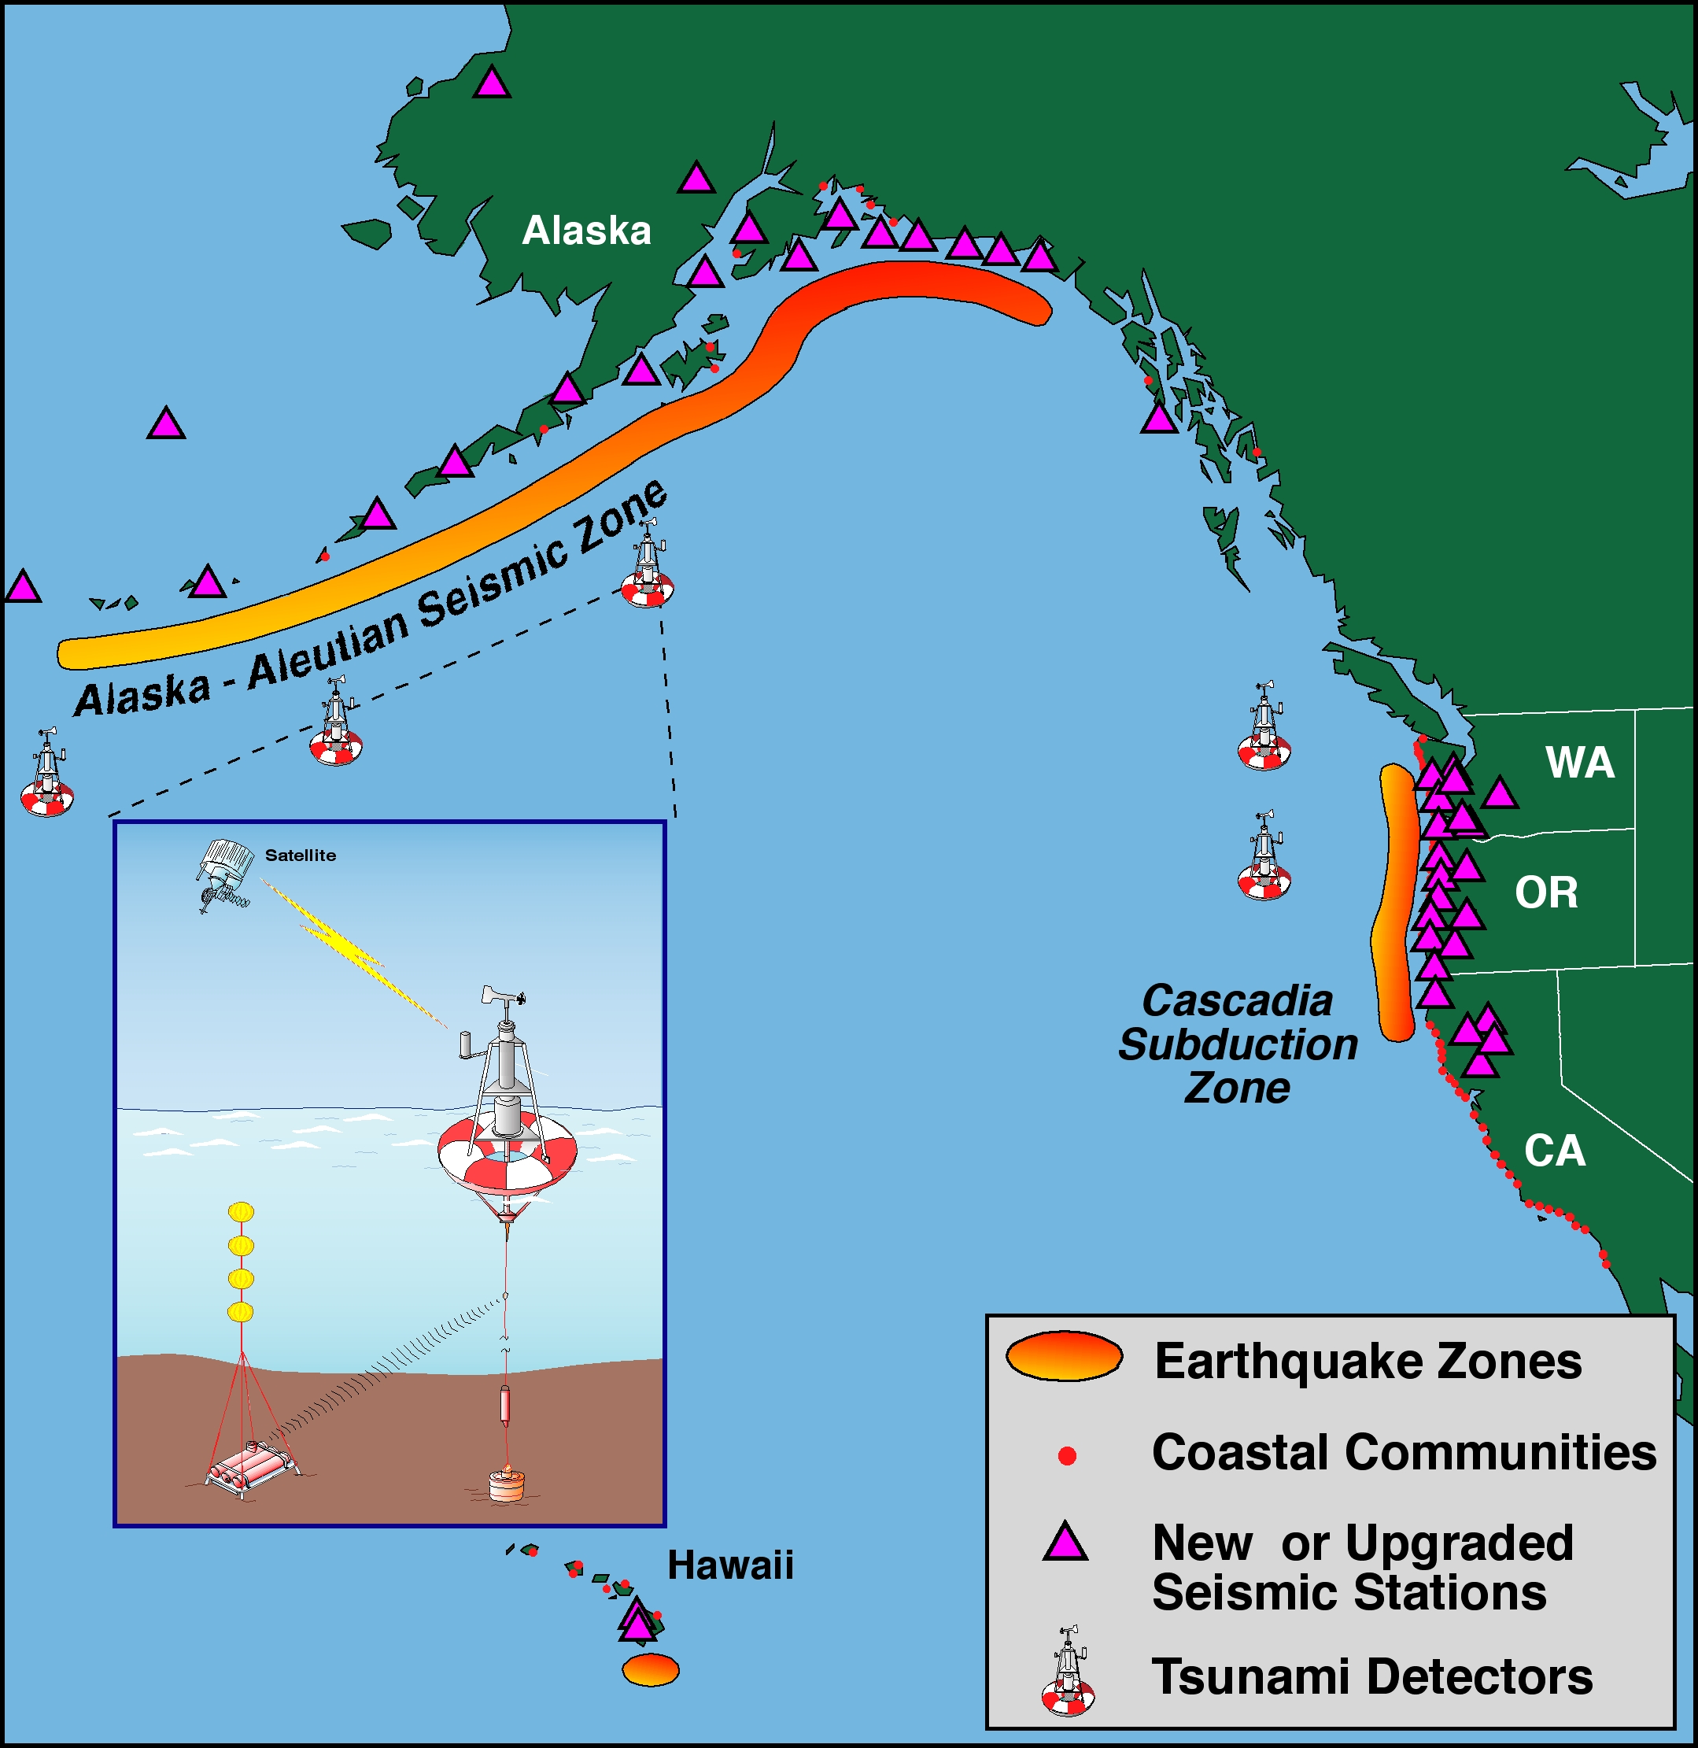
Detection and Evaluation

Slide 8
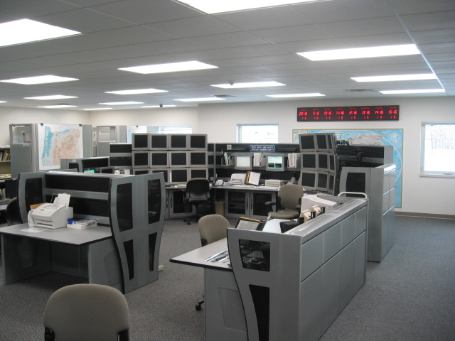
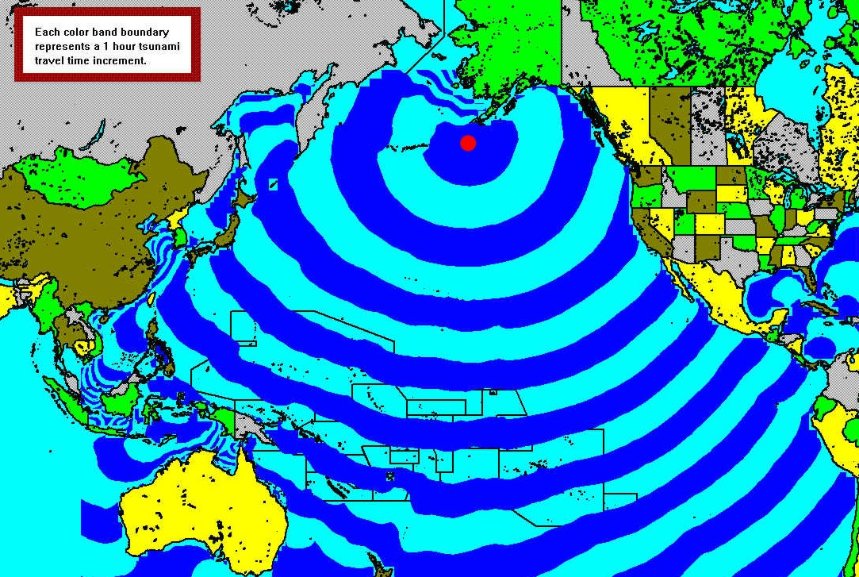
Calculate Tsunami Arrival Times
& Issue Official Warning

Slide 9
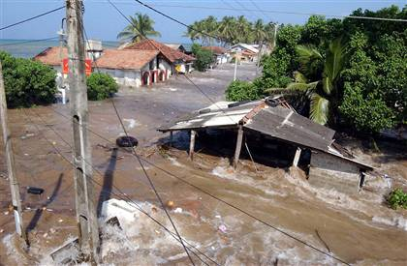
Watch & Warning Message Definitions
Tsunami Warning: means tsunami is imminent and coastal locations under warning area should prepare for flooding.
Tsunami Watch: An alert issued to areas outside the warned area.
Notes:
Weather affects the lives of all Americans and causes billions of dollars in damage each year across the nation.
From Hurricanes, to Tornadoes, to Blizzards, and Tsunamis -- people and our economy are directly affected by the ravages of severe weather.
We need some sort of program to help Americans be better prepared for severe weather to help fulfill the NWS mission of “protecting life and property and enhancing the national economy.”

Slide 10
Other Message Definitions
Tsunami Advisory: A message issued when the Pacific Tsunami Warning Center is warning for an event outside the West Coast or Alaska which poses no imminent threat to our area.
Tsunami Information Bulletin: Bulletins issued for earthquakes less than warning threshold, but greater than 6.5 which are not likely to trigger a tsunami.
Tsunami Information Message: Information messages issued when smaller earthquakes (greater than magnitude 4.0, but less than 6.5) may be felt near coastal areas.
Notes:
Weather affects the lives of all Americans and causes billions of dollars in damage each year across the nation.
From Hurricanes, to Tornadoes, to Blizzards, and Tsunamis -- people and our economy are directly affected by the ravages of severe weather.
We need some sort of program to help Americans be better prepared for severe weather to help fulfill the NWS mission of “protecting life and property and enhancing the national economy.”

Slide 11
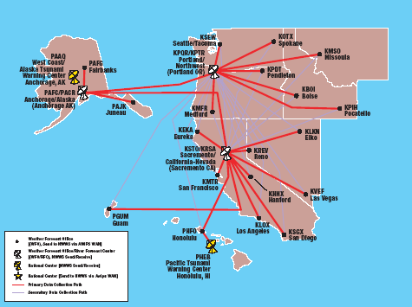
How is NWS Message Sent Out?
Notes:
Weather affects the lives of all Americans and causes billions of dollars in damage each year across the nation.
From Hurricanes, to Tornadoes, to Blizzards, and Tsunamis -- people and our economy are directly affected by the ravages of severe weather.
We need some sort of program to help Americans be better prepared for severe weather to help fulfill the NWS mission of “protecting life and property and enhancing the national economy.”

Slide 12

What is TsunamiReady?
A part of the NWS StormReady Program.
A “grass roots” program that promotes tsunami hazard readiness.
A collaborative effort between federal, state, and local emergency management, and the public.
A method to improve public safety during tsunami emergencies.
Notes:
TsunamiReady is part of the NWS StormReady Program.
Just like StormReady -- TsunamiReady communities are better prepared to save lives from severe weather.
When communities partner with the NWS, it requires hard work, time, resources, and energy.
TsunamiReady recognizes communities for their efforts.
Emergency Managers and citizens are proud of their TsunamiReady recognition.

Slide 13
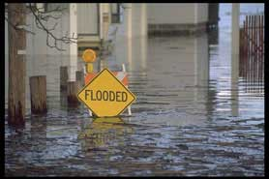
TsunamiReady Objectives
Create minimum standard community guidelines for adequate tsunami readiness.
Encourage consistency in educational materials and response.
Recognize communities that have adopted TsunamiReady guidelines.
Increase public awareness and understanding of the tsunami hazard.
Improve community pre-planning for tsunami disasters.
Notes:
This slide illustrates the 5 main objectives of the NWS TsunamiReady Program. They are…(read slide).
Notice the emphasis on standards, consistency, and advanced planning.
These attributes are key to a community successfully being recognized in the TsunamiReady program.

Slide 14
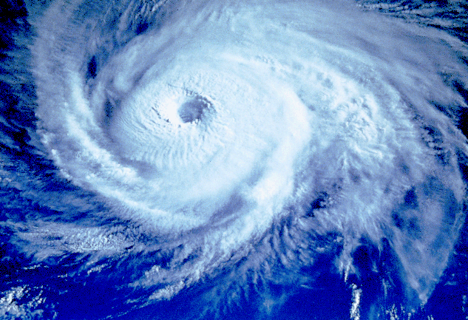
TsunamiReady Benefits
Community is more prepared for “all hazards.”
Regularly scheduled education forums.
Increase contacts with experts (emergency managers, researchers, NWS personnel).
Identify community readiness needs.
Improve position to receive State/Federal funds.
Enhance “core” infrastructure to support other community hazards.
Allow public to see how tax dollars are being spent.
Notes:
There are many benefits to a community becoming TsunamiReady.
In addition to being better prepared for the Tsunami hazard, a community will be better prepared for “all types of hazards,” whether they are natural, like Tsunamis and Hurricanes, or technological like HAZMAT spills or Terrorism.

Slide 15
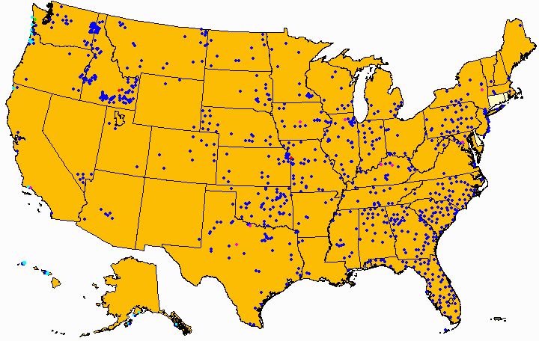
As of early March 2005 there are 877 StormReady and 16 TsunamiReady Communities in 47 States
StormReady
TsunamiReady
University/Lab
Industrial Site
Indian Nation
Notes:
There are 122 field Weather Forecast Offices (WFO) across the nation.
Each WFO has a “Warning Coordination Meteorologist” or WCM.
WCMs are our StormReady and TsunamiReady ambassadors to communities and are responsible for administering the program at the local level.
The WCM works closely with emergency managers, the media, and general public to help educate them about the threats of severe weather and to help them mitigate its affects.
Our FY2004 Goal was to recognize 100 new communities as StormReady or TsunamiReady.
We surpassed this goal and added 137 new communities during FY2004.

Slide 16
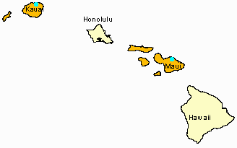
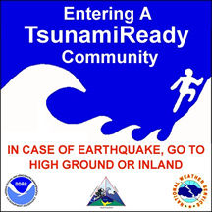
In Hawaii - Maui and Kauai Counties have been recognized as TsunamiReady

Slide 17
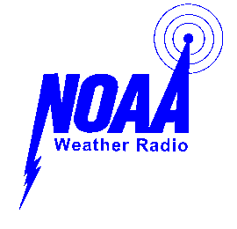
How does a Community become TsunamiReady?
Establish Communication and Coordination Plan
24 Hour Warning Point
Emergency Operations Center
Receive Critical Tsunami Warning Information
NOAA Weather Wire
NOAA Weather Radio
Emergency Managers Weather Information Network
News Media (Radio/TV)
Internet
Pagers, cell phones, etc.
Notes:
The TsunamiReady program has established guidelines that a community must meet to be officially recognized in the program.
There are five major areas that the program addresses.
The first area is: Establish Communication and Coordination Plans. The second is: Receive Critical Tsunami Warning Information.
As you can see from this slide, communication is the key to receiving critical NWS warnings.

Slide 18
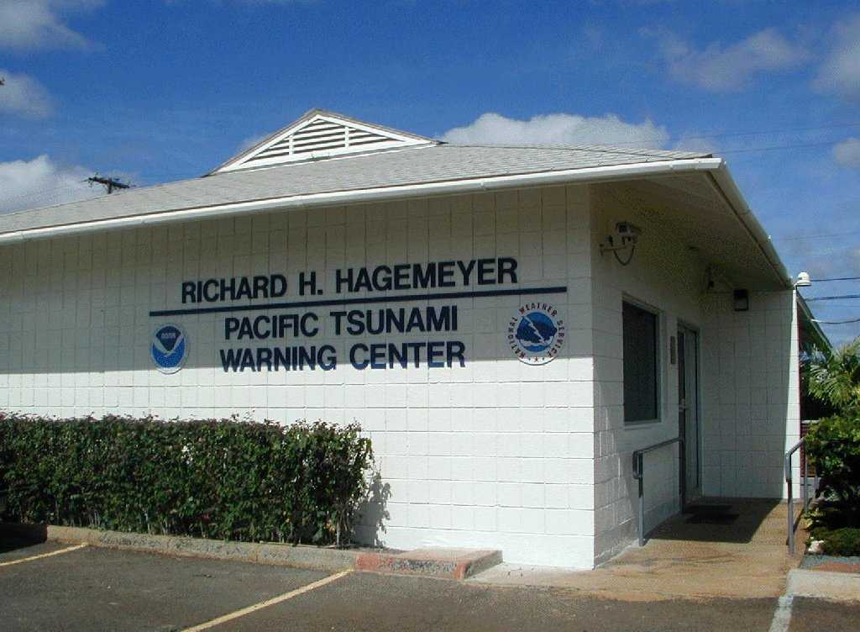
How does a Community become TsunamiReady? (cont)
Disseminate Tsunami Warnings
Emergency Alert System
Cable Override
NOAA Weather Radio in public buildings
Sirens
Other systems unique to the area
Notes:
In addition to being able to receive NWS warnings, a community must also have more than one way to disseminate the warning to the public.
Quick dissemination of NWS warnings is crucial to the success of the TsunamiReady program, because lives can be lost if the public does not receive the warning in a timely and effective manner.
This slide illustrates several ways that a community could disseminate a Tsunami Warning that was issued by the Pacific Tsunami Warning Center.

Slide 19
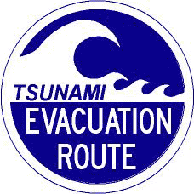
How does a Community become TsunamiReady? (cont)
Increase Community Preparedness
NWS staff provide tsunami safety presentations
Designate/establish tsunami safe zone
Designate tsunami evacuation routes and install signs
Provide written, locality specific, tsunami hazard response material to public
Schools: encourage tsunami hazard curriculum, practice evacuations, and provide safety material to staff and students
Notes:
Public education and training is also a major part of the TsunamiReady program.
NWS field WCMs visit the community and provide tsunami and weather safety presentations to both the public and emergency managers.
Local communities must also do their part and designate safe zone for Tsunamis, map out evacuation routes, install evacuation route signs, and provide this information to the public and schools.

Slide 20

How does a Community become TsunamiReady? (cont)
Administrative
Develop formal tsunami hazard operations plan
Yearly meeting/discussion by emergency manager with NWS
Visits by NWS official to community at least every other year
Notes:
Finally, the TsunamiReady program addresses what we call “administrative” preparedness.
A community must have a formal Tsunami hazard operations plan in place in order to be recognized.
Developing close partnerships between the NWS office and emergency managers – before the disaster occurs -- becomes critical during real weather emergencies.
Emergency managers are required to visit their local NWS office at least once a year.
NWS staff are required to visit emergency managers at least every other year.
However, if the local NWS office has established a close partnership with the local emergency manager, these visits can take place much more often.

Slide 21
TsunamiReady Recognition Process
Community applies to local NWS Office.
Local TsunamiReady Advisory Board reviews application.
TsunamiReady Advisory Board performs on-site verification visit.
If criteria are not met, TsunamiReady Advisory Board suggests improvements and works to implement changes.
Once criteria are met, a recognition Ceremony and Press Conference is held for community.
Notes:
This slide illustrates how a community becomes recognized in the TsunamiReady program. Let me provide you with some background…
There are Advisory Boards that implement and oversee the Storm/TsunamiReady programs. Advisory Boards are set up on a national, regional, and local basis.
The National StormReady Advisory Board is responsible for general oversight of the StormReady and TsunamiReady programs. The National Board maintains a minimum set of guidelines that is consistent across the country.
Each of the NWS’s six regional offices have Regional StormReady Advisory Boards and the Western, Alaska and Pacific regions have TsunamiReady Advisory Boards. Regional StormReady Advisory Boards monitor the activities of local boards and ensure the national guidelines are maintained.
Local StormReady Advisory Boards enhance the programs to fit local and state situations. Each local board consists of at least:
1 - NWS office Meteorologist in Charge
1 - NWS office Warning Coordination Meteorologist
1 - State emergency management agency director or designee
1 - Local emergency management association president or designee
1 – Geophysicist in Charge from the Tsunami Warning Center
The local board oversees all steps leading to the recognition of the StormReady and/or TsunamiReady community. This may include developing bylaws for the board’s activities, enhancing the national guidelines for the local area, establishing procedures for verification visits, and implementing procedures for application review.

Slide 22
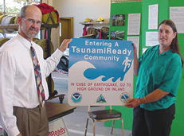
Successful Applicants Receive:
TsunamiReady recognition letter valid for 3 years.
Two official TsunamiReady signs.
Authorization to use the TsunamiReady logo.
Instructions for acquiring additional signs.
Information on how to notify the ISO for possible flood insurance rate adjustment (for StormReady).
Listing on the Natl StormReady Website.
Notes:
Here’s what successful applicants will receive.
Most importantly – the community will be better prepared to respond to a NOAA Tsunami Warning or other weather warning.
This preparedness is what will ultimately save lives if there is a real Tsunami or other weather emergency.

Slide 23
TsunamiReady Renewal Process
NWS Office sends notification letter to communities that need to re-apply with 6 months advance notice.
A copy of the original application is reviewed by community officials to certify it is still accurate.
Community provides an updated list of any new technology or information that has been added since the initial application was signed.
Once the community official signs and returns the application a 3-year renewal becomes effective.
Notes:
A jurisdictions initial Tsunami/StormReady recognition is valid for a 3 year period.
After this time, their application must once again be reviewed by the local advisory board.
If program criteria are still met, the community recognition will be renewed for an additional 3 year period.

Slide 24

NWS StormReady Website
www.stormready.noaa.gov
Communities
How to Apply
Resources/TsunamiReady
Awareness
Publications/Photos
Customer Comments
Contact Us
Notes:
This slide illustrates the information available on the NWS StormReady Website.
Jurisdictions interested in becoming StormReady can find the information they need to learn about the program and apply for recognition.

Slide 25
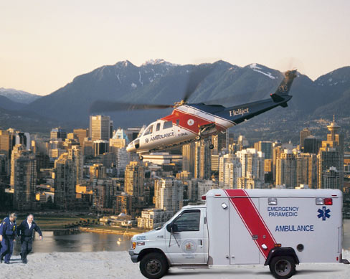
TsunamiReady Web Resources
Tsunami Information: tsunami.gov
NWS TsunamiReady Page: wcatwc.gov/tsunamiready/tready.htm
NWS West Coast/Alaska Tsunami Warning Center: wcatwc.gov/main.htm
NWS Pacific Tsunami Warning Center: www.prh.noaa.gov/pr/ptwc
Notes:
There is also a wealth of Tsunami information available on these four web sites.
Jurisdiction interested in becoming TsunamiReady can find all the information they need here.

Slide 26
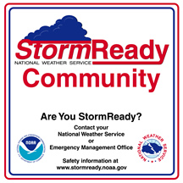
Thank You!
Notes:
Thank you!

