Slide 1
President’s Proposed Expansion of Tsunami Warning System
Eddie Bernard
Director, Pacific Marine Environmental Laboratory (PMEL)/NOAA
Member, National Tsunami Hazard Mitigation Program

Slide 3
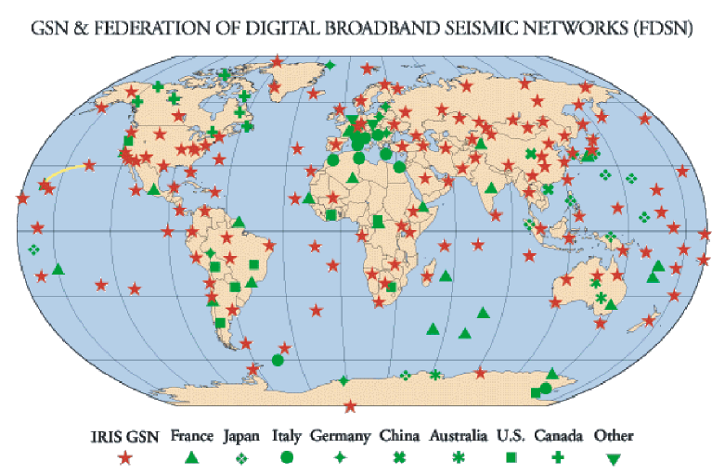

Slide 4
CPPT

Slide 5
Improving U.S. preparedness for tsunamis:
The Administration will commit $37.5 million over the next two years to expand U.S. tsunami detection and monitoring capabilities
(NOAA-$24M: USGS-$13.5M)
The National Oceanic and Atmospheric Administration (NOAA) will deploy 32 new advanced-technology Deep-ocean Assessment and Reporting of Tsunami (DART) buoys for a fully operational enhanced tsunami warning system by mid-2007.
The United States Geological Survey (USGS) will enhance its seismic monitoring and information delivery from the Global Seismic Network, a partnership with the National Science Foundation.

Slide 6
Adding deep-sea buoys and other sensors to enhance tsunami detection along the U.S. coast (Pacific, Atlantic, Caribbean, and the Gulf of Mexico).
Working internationally to build a global warning system, including in the Indian Ocean.
Improving seismic sensor data and infrastructure for better earthquake detection and warning, including in the Caribbean.
Expanding research on tsunami forecasting.
Improving response capacity with enhanced emergency warning systems community response plans, and public education.

Slide 7
U.S. PLAN FOR AN IMPROVED TSUNAMI DETECTION AND WARNING SYSTEM Improve Warnings and Forecasts

Slide 9
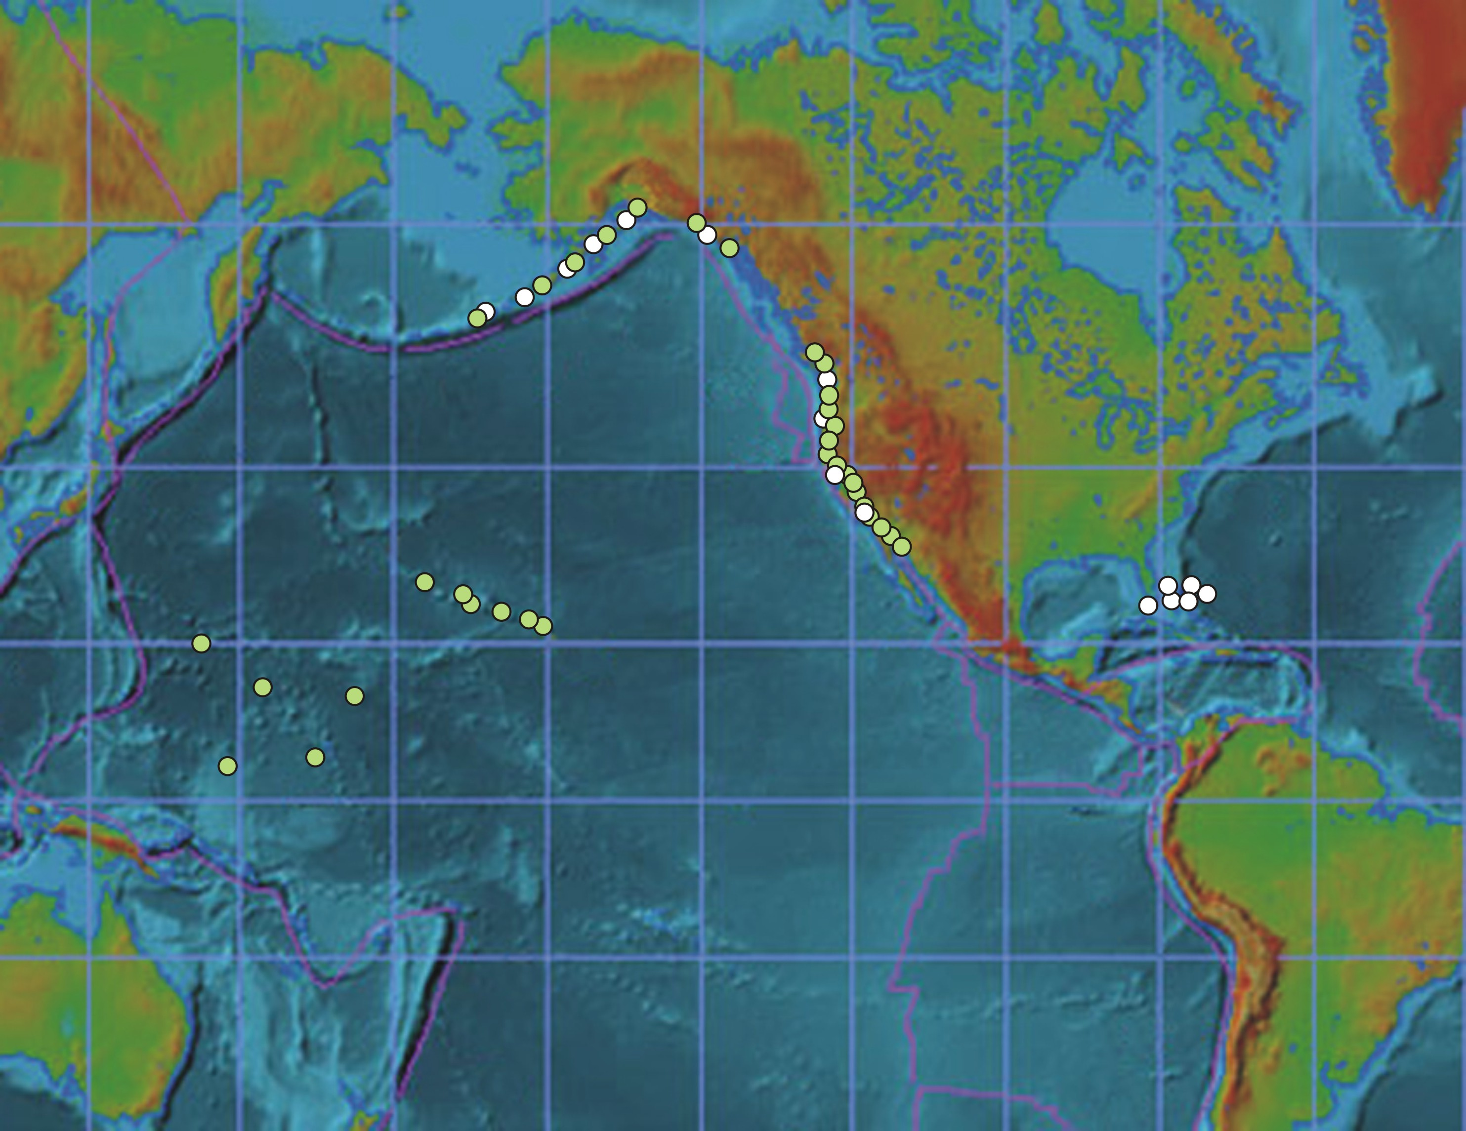
Proposed U.S. Tide Gauge Network
New Tsunami-Equipped Tide Stations (FY 05-06)
Existing Stations
New Stations

Slide 10
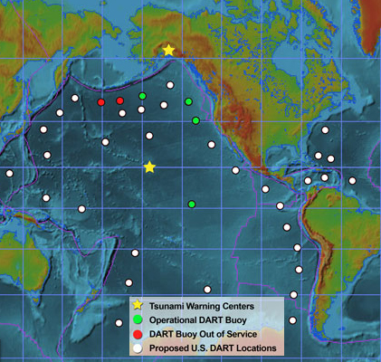
Proposed U.S. DART Network

Slide 11

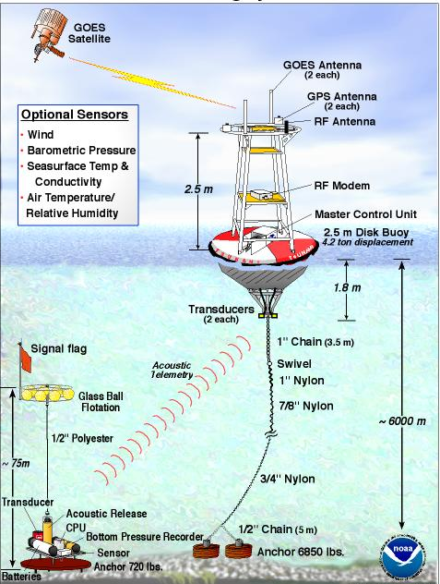
DART Concept
BPR measures small changes in pressure at the seafloor. Data sent acoustically to surface buoy, then via satellite to the Warning Centers.
Normal transmissions: Hourly reporting of 15 minute data to confirm system readiness.
Two Event Modes:
- Automatic: Triggered by seismic or tsunami wave
- Request: Warning Center triggers data stream
Animation
Notes:
FAQs – wind waves vs Tsunamis
- detection of tsunami with cubic polynomial running over 3 hour intervals to predict pressure….

Slide 12
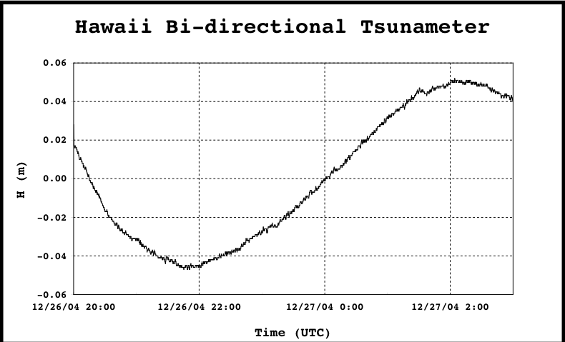
Requested DART Data: December 27,2004

Slide 13
Operational Tsunami Forecasting
• Essential to Improve Warning Speed and Reliability
• Vast Ocean Areas with No Tsunami Measurements
• Must Integrate Real-time Measurement and Modeling
- Measurement: DART Network
- Modeling: Tsunami Forecast Model

Slide 14
Tsunami Forecasting Measurement Requirements
1. Measurement type - tsunami amplitude over time for input into forecast models
2. Measurement accuracy - 0.5 cm
3. Measurement sample rate – 1 min or less
4. Measurement processing – within 2 min
5. Measurement availability – within 5 minutes to assimilate into forecast models

Slide 15
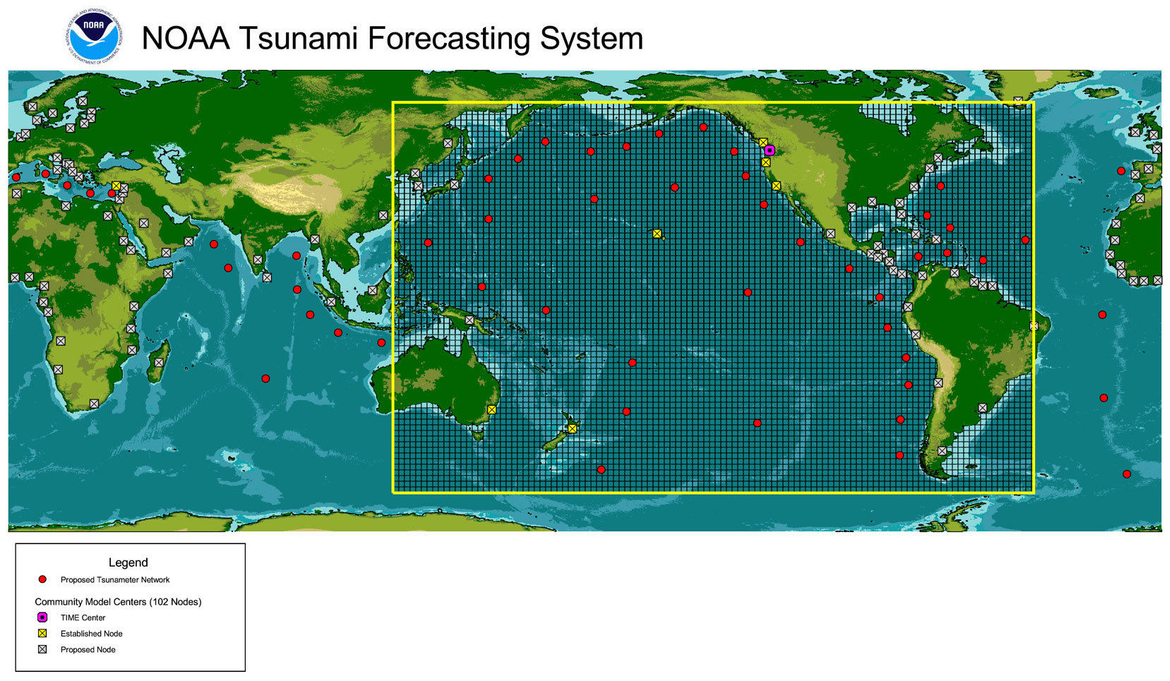

Slide 16
Elements of Tsunami Forecasting
Use propagation models to generate a simulation database
When tsunami occurs, select from database as “first estimate”
Assimilate deep ocean data to update database from “first estimate” to “offshore tsunami forecast”
Use “offshore tsunami forecast” as input for inundation model at specific site
Inundation model produces tsunami forecast at specific site

Slide 17
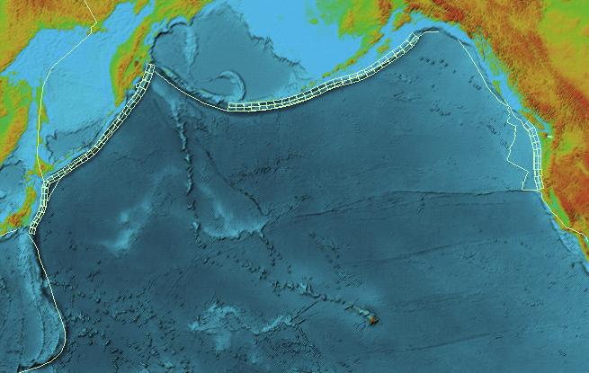
Model database
Unit sources for pre-computed tsunami propagation scenarios

Slide 18
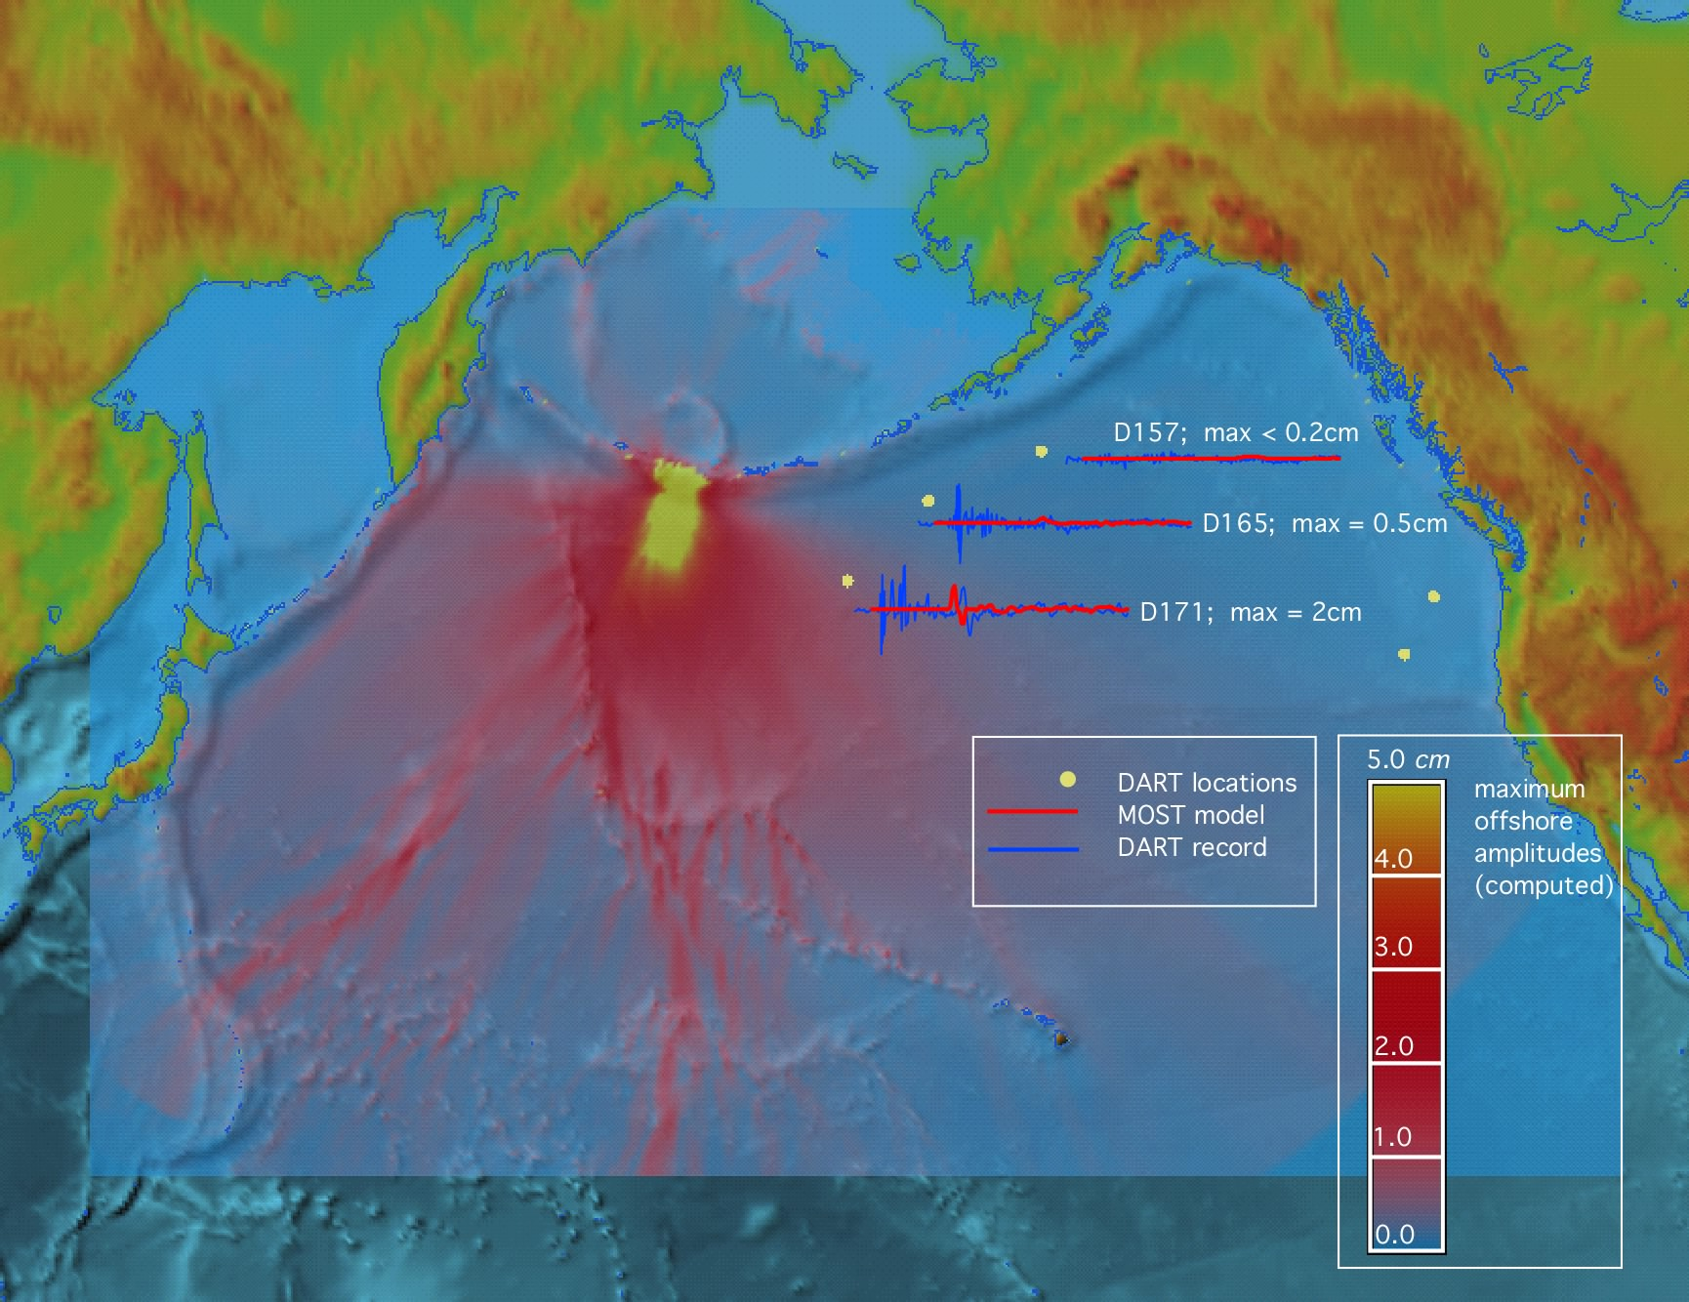
November 17, 2003 Tsunami:
DART Data Used to Update Simulation

Slide 19
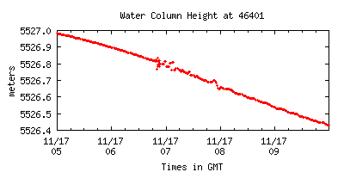
Real Time Detection of November 17, 2003 Tsunami
Tsunami
Tsunami
Seismic
Tsunami

Slide 20
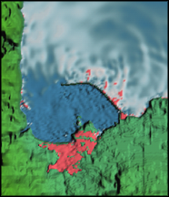
Nested Models Telescope Grid from 4000m to 25m

Slide 21
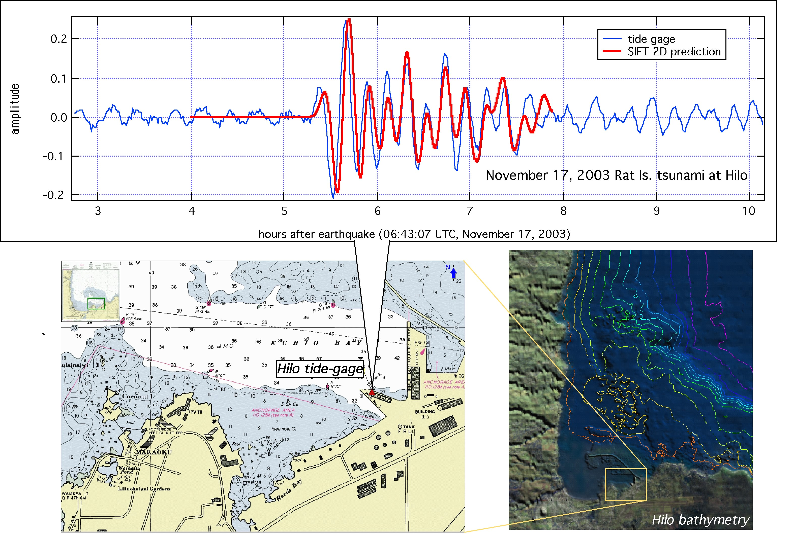
Tsunami Forecast at Hilo November 17, 2003

Slide 22
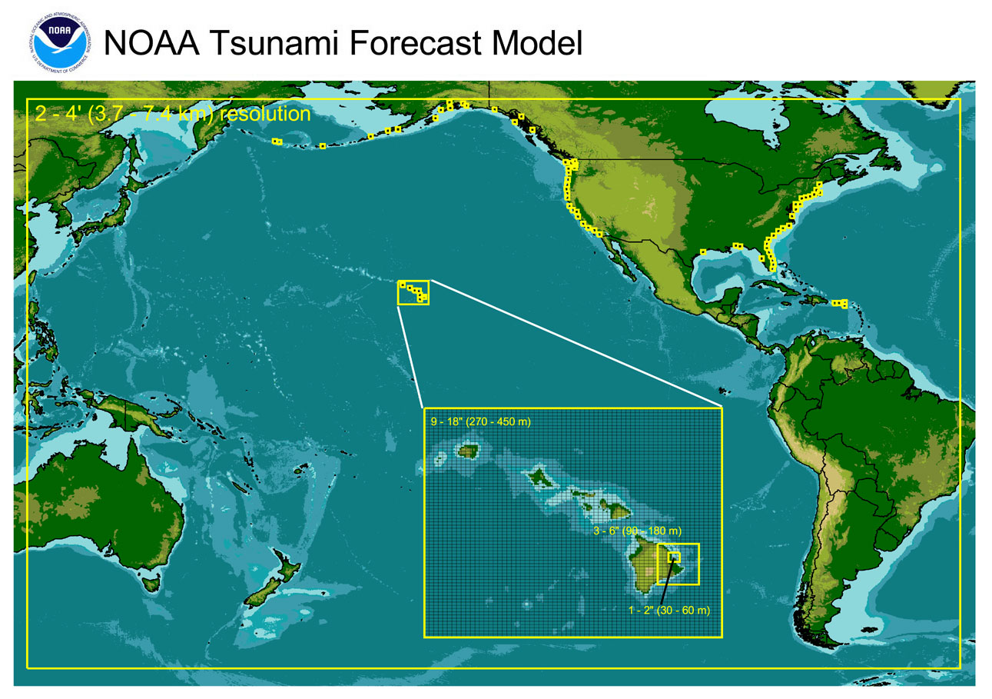

Slide 23
Model Standards Paper
Progress in National Tsunami Hazard Mitigation Program Hazard Assessment
F.I. Gonzalez, V.V. Titov, H.O. Mofjeld, A.J. Venturato, R.S. Simmons, R.Hansen, R.Combellick, R.K.Eisner, D.F. Hoirup, B.S. Yanagi, S.Young, M.Darienzo, G.R. Priest, G.L. Crawford, T. J. Walsh

Slide 24
Forecast Model to Hazard Mapping Plan
Combine real time seismic, sea level monitoring networks coupled with numerical models to produce tsunami forecast products for 74 sites
Make models available to states to produce inundation maps

Slide 25
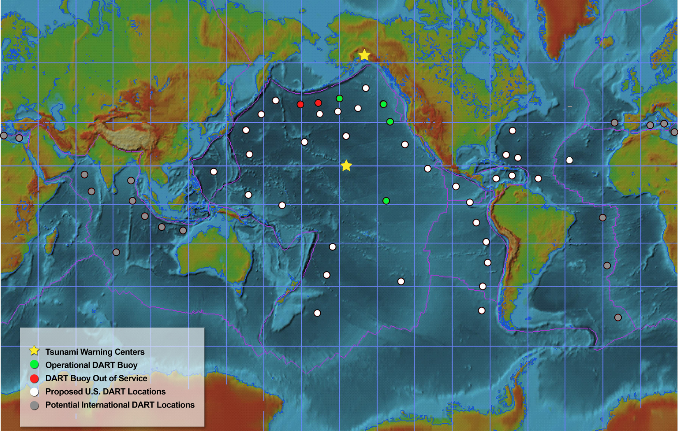
Potential GEOSS International Tsunami Warning Network

Slide 26
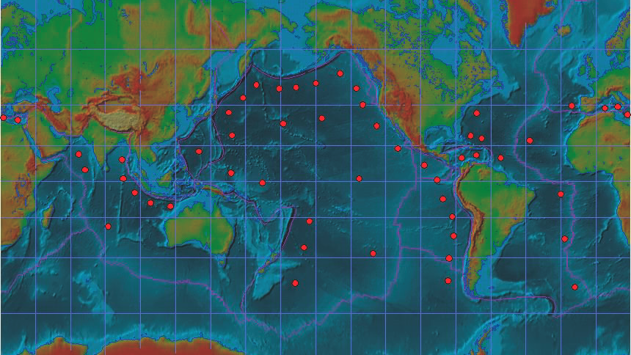
International Modeling Network Transfer, Maintain, and Improve Tsunami Forecast Models
Network Nodes Share: Models, R&D Tools, Databases, …
Under Development

Slide 27
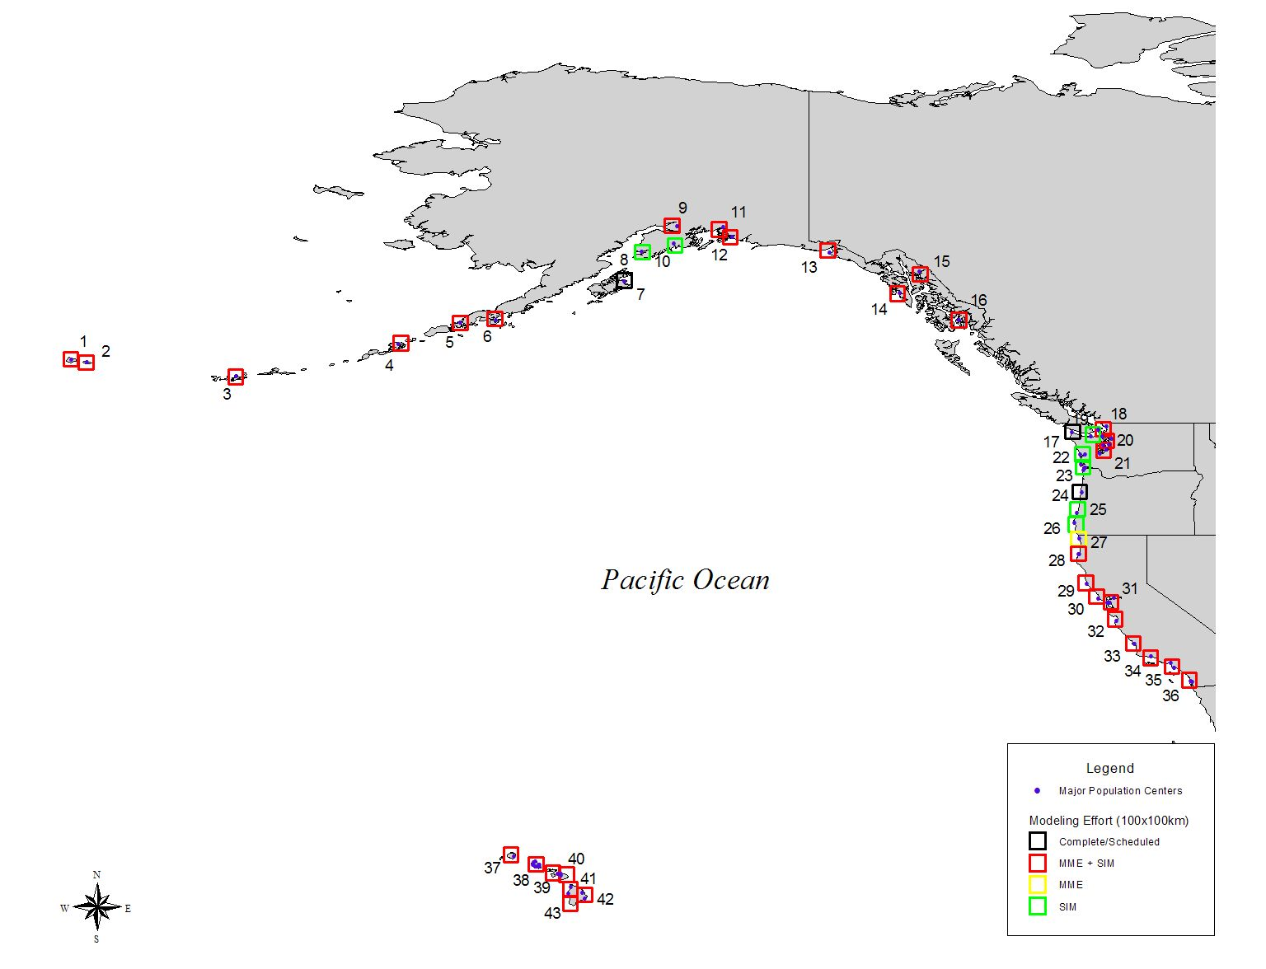

Slide 28
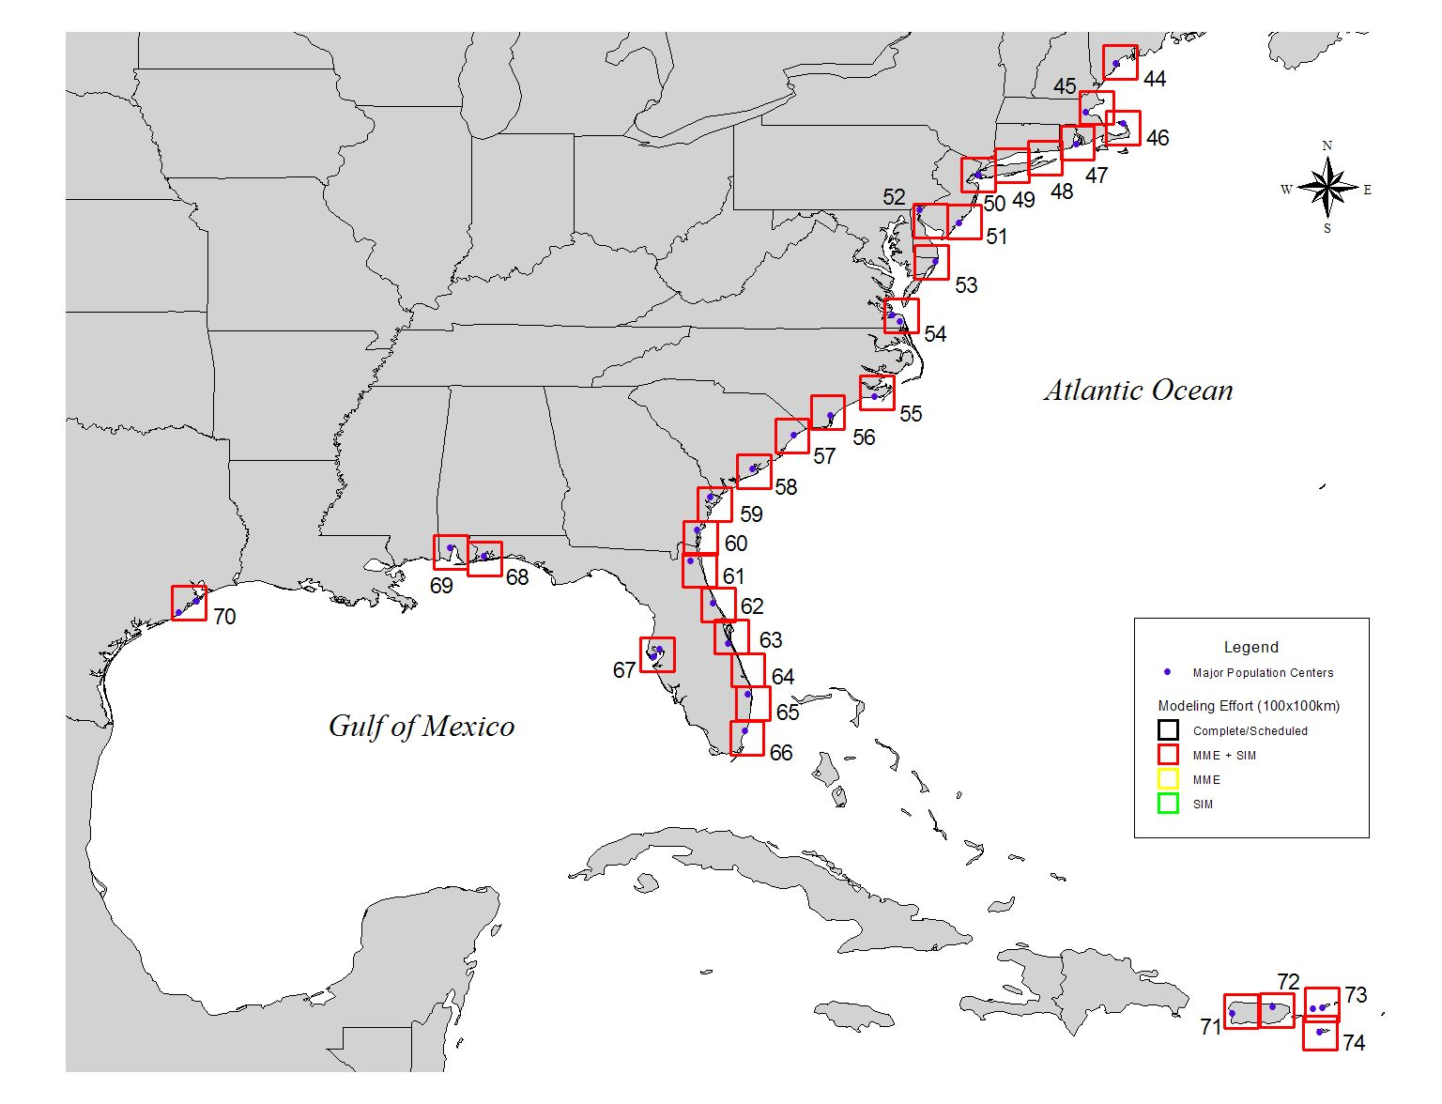

Slide 29
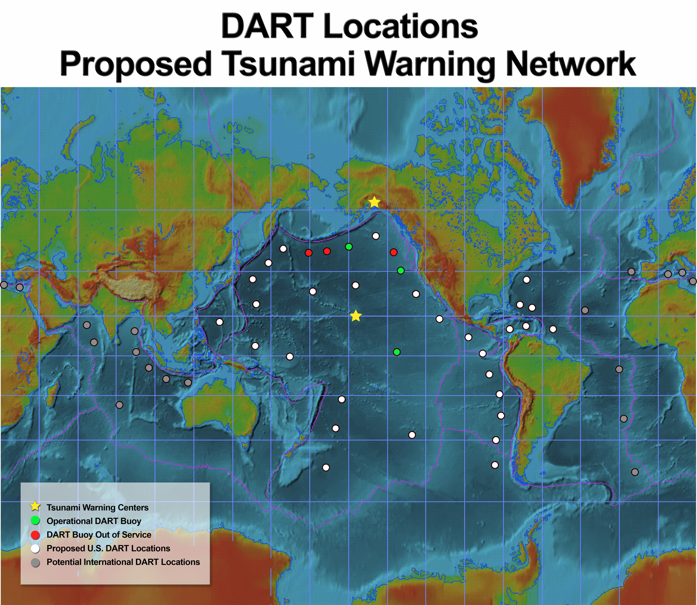
Location of DART buoys (deployed along subduction zones: 1000 km spacing)
29 - Pacific Basin (excludes 3 redundant Alaska Buoys)
6 - Atlantic/Caribbean
1 - Mid-Atlantic Ridge

Slide 30
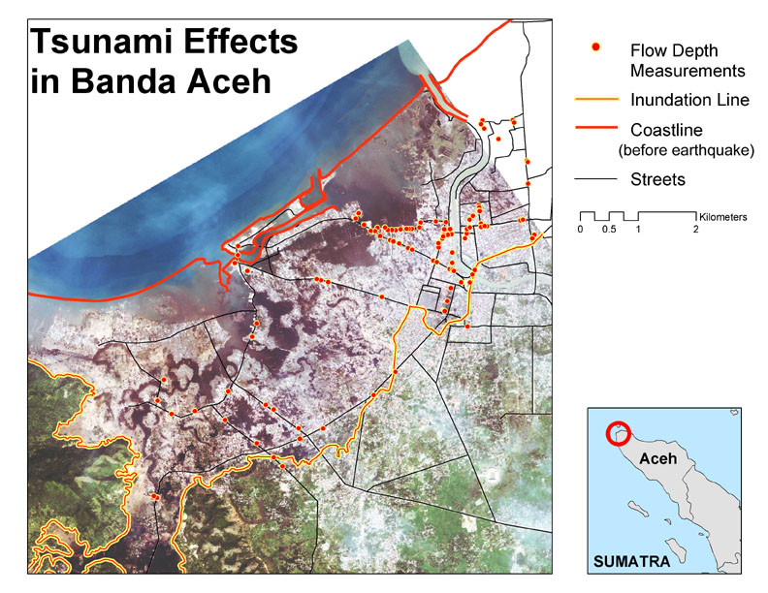
Credit:
Dr. Jose Borrero
USC,USA

Slide 31


NOAA Tsunami Warning Centers
OPERATIONAL ACTIVITIES
SEISMIC DATA COLLECTION & ANALYSES
SEA LEVEL MEASUREMENTS
DECISION-MAKING PROCESSES
MESSAGE CREATION & DISSEMINATION

Slide 33
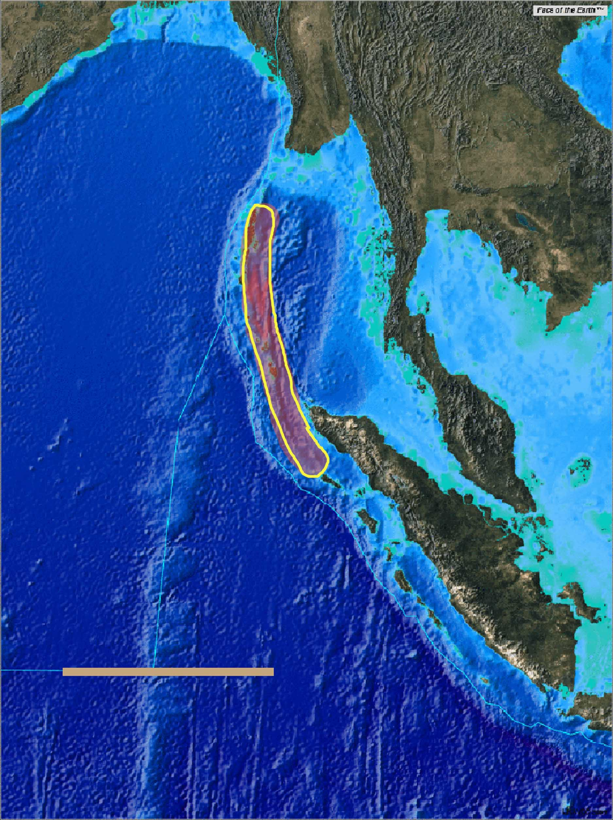
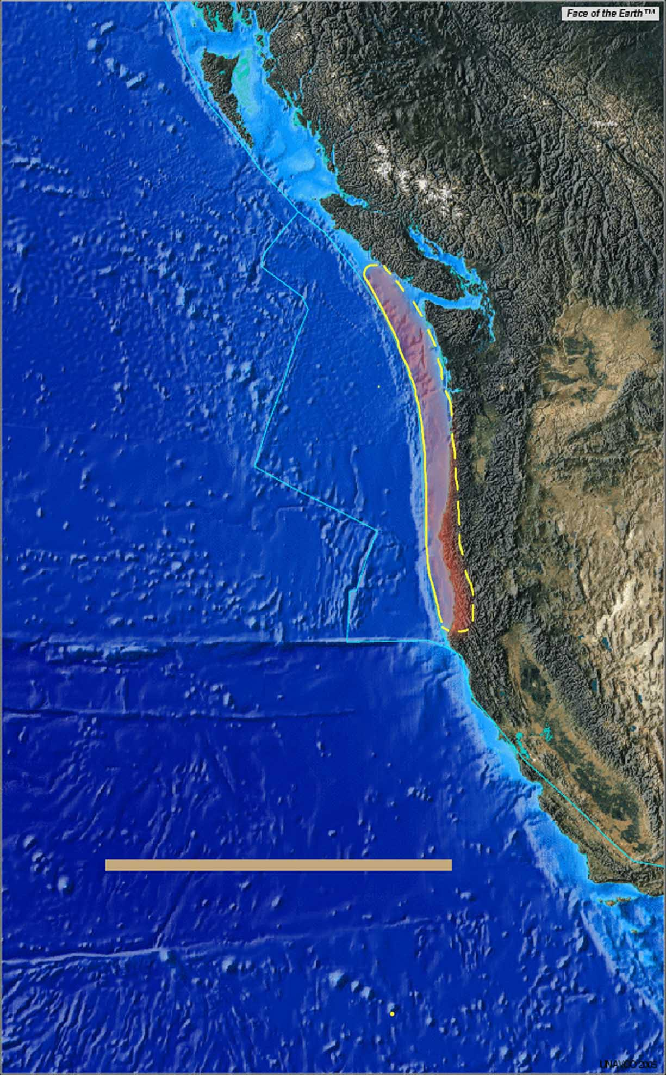
1000 km
1000 km
Cascadia
Sumatra
Credit: Lori Dengler

Slide 34
U.S. PLAN FOR AN IMPROVED TSUNAMI DETECTION AND WARNING SYSTEM

Slide 35
